Slide 1
CSCN8010
Group#4’s Final PROJECT
AI-Enhanced Self-Service Portal for Student Affairs
Aiswarya Thekkuveettil - 8993970
Rohit Krishnamurthy Iyer - 8993045
Vishnu Sivaraj - 9025320
Cemil Caglar Yapici - 9081058

Slide 2
Project Purpose and Context
As it knows that Student Success Advisors (SSAs) are overwhelmed by repetitive, low-complexity inquiries, especially after recent staff reductions. Students often ask the same FAQ-type questions, consuming advisor time.
Now our goal is: Develop a self-service AI chatbot to handle these frequently asked questions automatically, reducing SSA workload and wait times for students.
Scope: The chatbot will answer common Student Affairs queries (e.g. enrollment, fees, course changes) and escalate to a human advisor for complex or sensitive issues (a safety “off-ramp”). This ensures students still get personal help when needed.

Slide 3
Solution Overview & System Architecture
Solution: A web-based chatbot portal where students ask questions and receive instant answers. Built with a friendly UI (using Streamlit) on the front-end and an intelligent FAQ retrieval system on the back-end.
Architecture Highlights: Student questions flow from the UI to an NLP-based engine that finds answers in an FAQ knowledge base. If an inquiry triggers certain keywords or appears too complex (e.g. emotional distress), the system will prompt the student to contact an advisor (escalation).

Slide 4
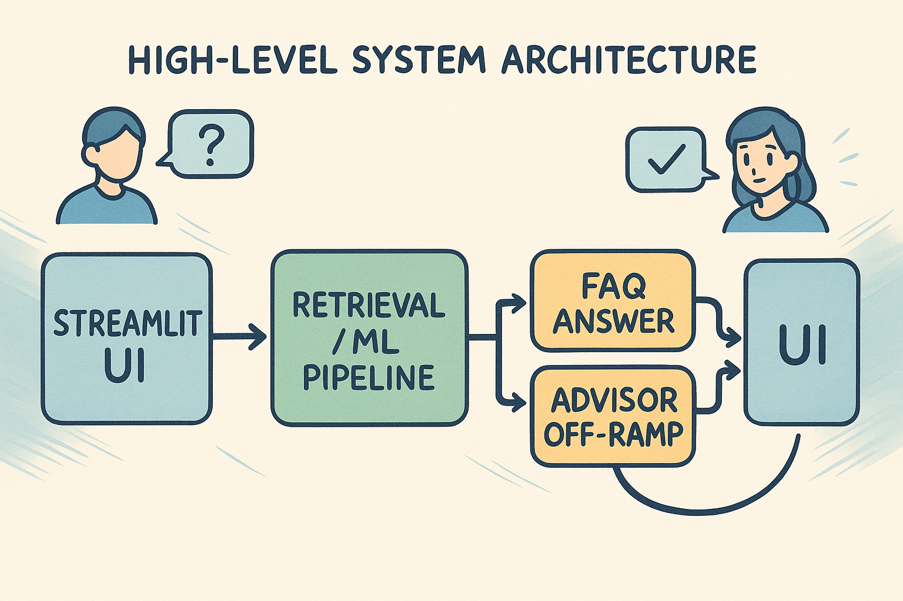
Architecture diagram
(Made by AI for AI project ☺ )

Slide 5
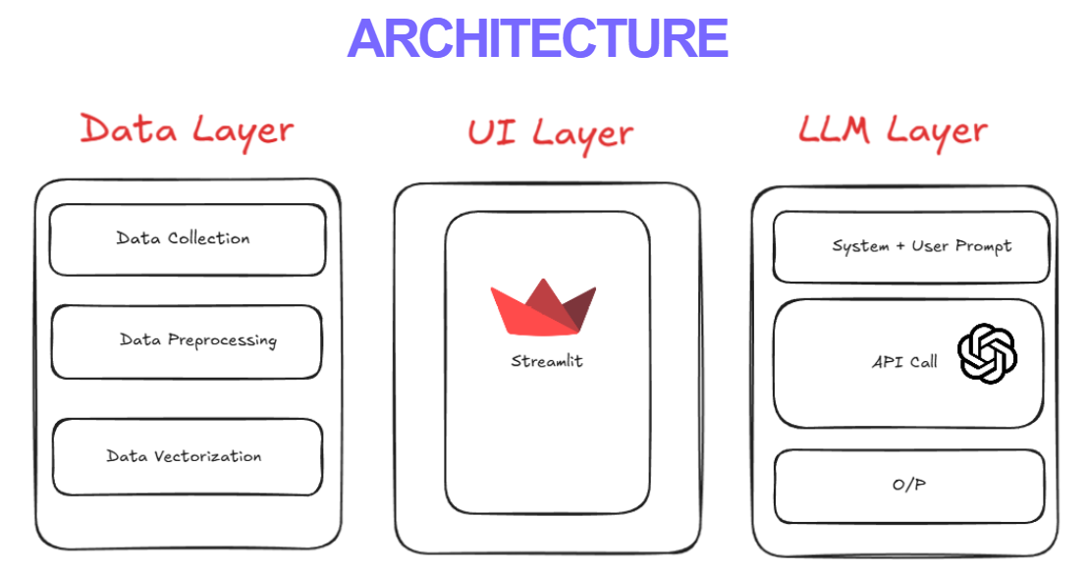
Good thing is: Streamlit is included VS Code/Python by .venv and it can be run locally also.

Slide 6
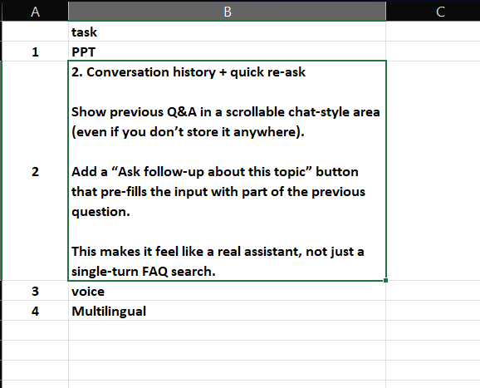
Main Tasks to Do

Slide 7
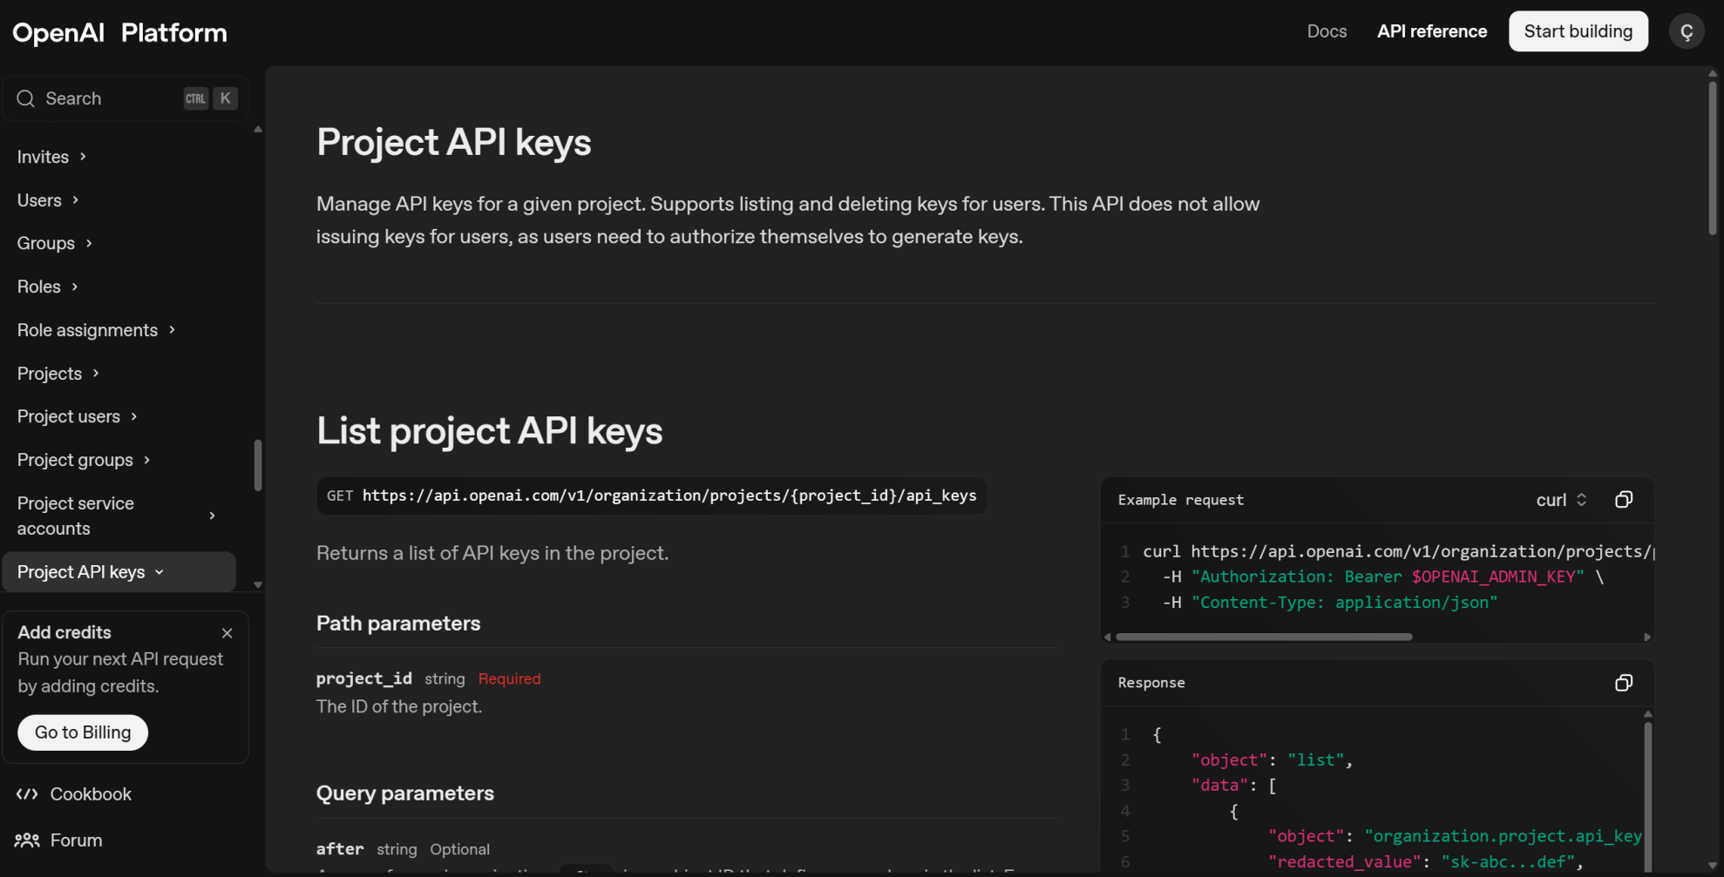
OpenAI API KEY

Slide 8
Main Components
Python:
Core language for development (backend logic, data processing, and integration of ML/NLP components).
CSV:
(for main datasets’ format, also known as excel files)
UI & Visualization:
Streamlit web app where students type questions and view answers. Used to create the interactive web application interface for the chatbot (provides a quick way to build a frontend in Python)

Slide 9
Main Components
Jupyter Notebook:
Utilized during development for prototyping and experimenting with NLP models and data (initial model training, testing queries).
Note: For Visualization Jupyter Notebook is our 2nd option like alternative if streamlit causes issues.
VS Code:
Primary code editor/IDE for the project, for implementing the application modules (helped in writing Python scripts, managing the project repository).

Slide 10
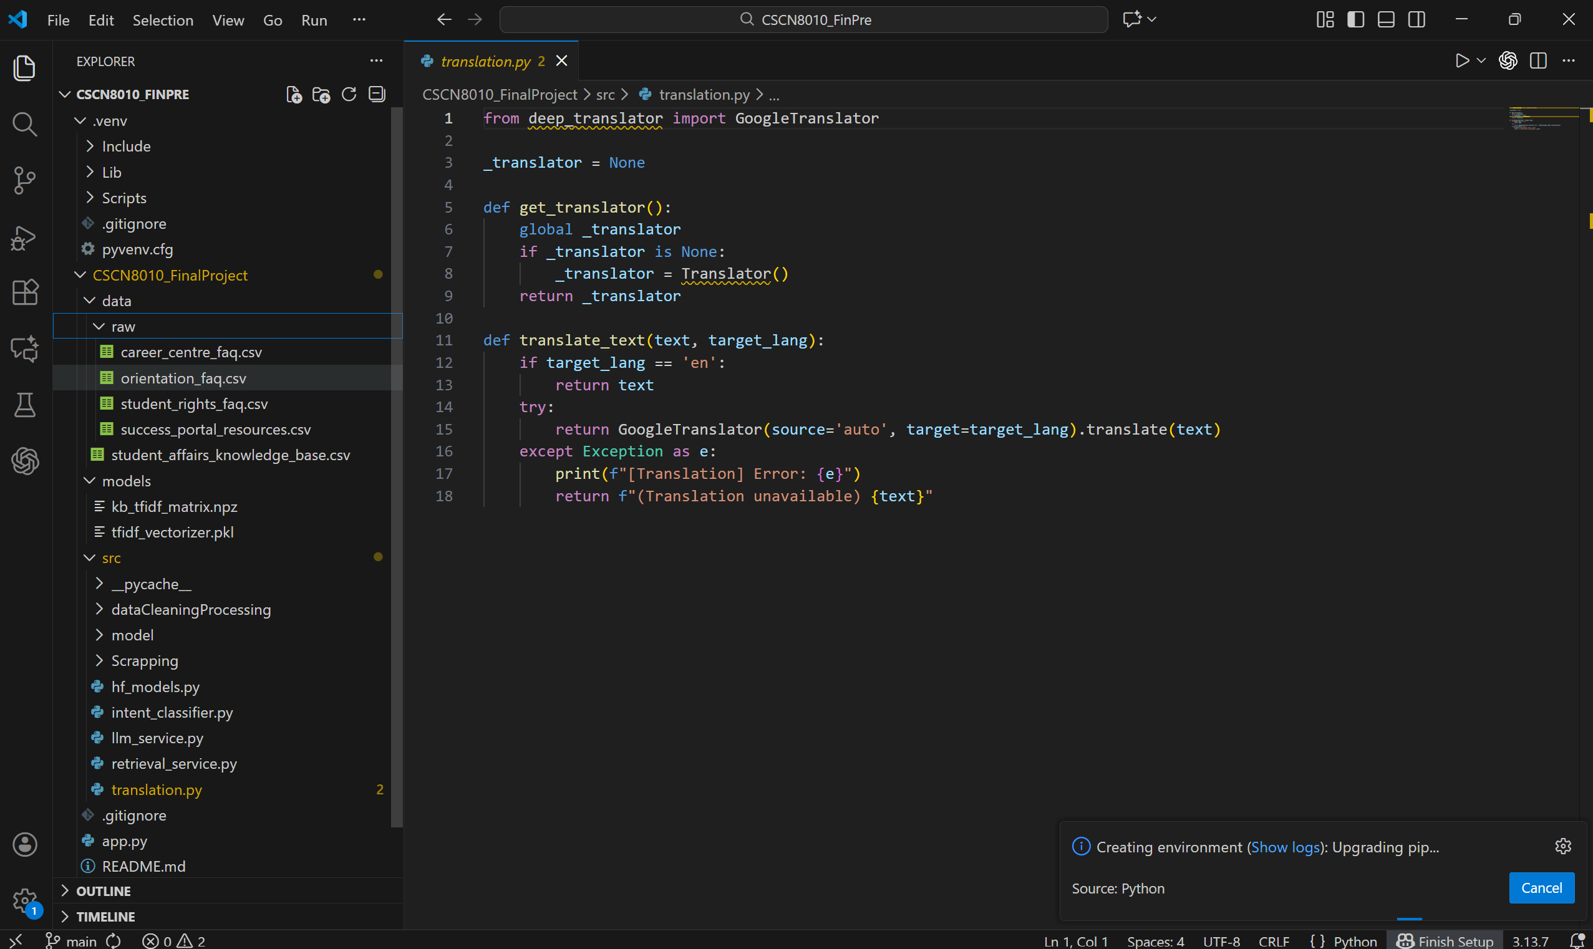
Main Screenshots from our project

Slide 11
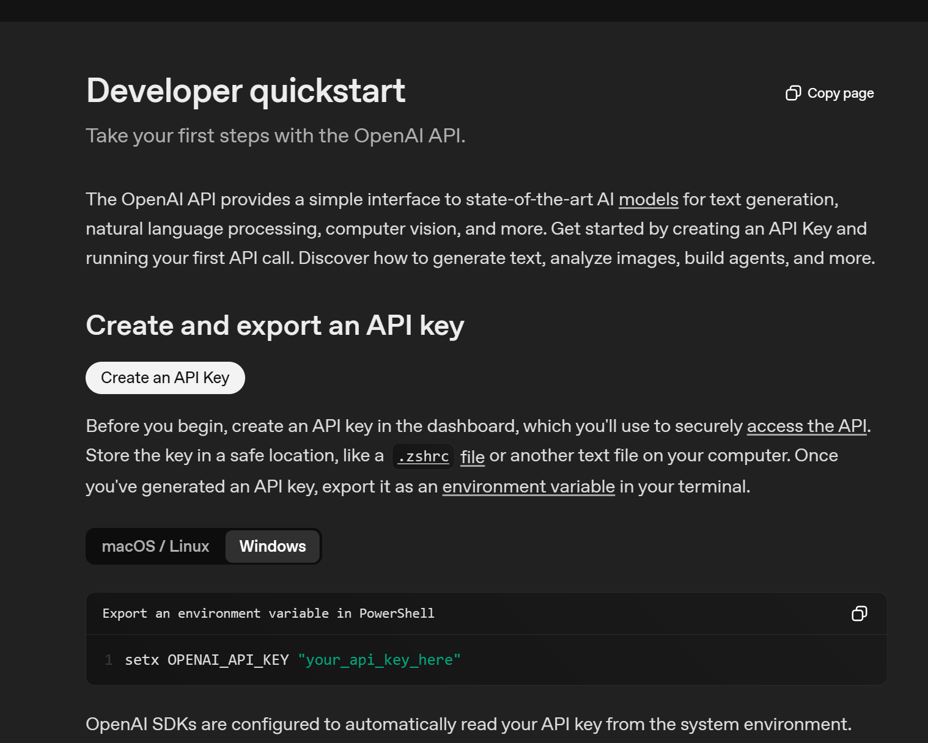

Slide 12
Knowledge Base (Data Sources)
As we mentioned on previous pages we have datasets that we had taken from different sources in different formats. Let us explain:
Student FAQ Documents (PDFs):
We gathered official FAQs from Student Affairs departments – e.g. a Registrar Office FAQ and a Student Fees FAQ – which contain common questions and answers. These PDFs cover topics like fee payments, course registration, OSAP, withdrawals, etc., forming the content the chatbot can draw from.
CSV Datasets:
The team extracted and compiled Q&A pairs from these PDFs into structured CSV files (included in the project zip). The CSV format makes it easy to load data into the chatbot and perform searches

Slide 13
Knowledge Base (Data Sources)
Data Usage:
At runtime, the chatbot indexes this content (using TF-IDF vectorization on questions). When a student asks something, the system compares the query against all known questions to retrieve the best match and its answer.
Maintenance:
The design allows updating the knowledge base by simply adding new entries to the CSV or updating the source documents, so the chatbot can stay up-to-date as policies change.

Slide 14
Sources
Openai.com
VSCode documents.
Stackoverflow
Github

