Slide 1
Data Analysis Mathematics, Algorithms & Modeling
(PROG8431)
Final Presentation of Group#5
Obesity Checker & Classifier
Mostafa Allahmoradi - 9087818
Cemil Caglar Yapici – 9081058
Jarius Bedward – 8841640

Slide 2
Definition of Problem:
(Background, Motivation, Data sets and more)
As it is known that; 21th century and post modern life –especially post modern worklife – have just changed our eating habits. People have less time than before to cook and/or prepare our meals. So this issue directs many people to order food from outside and especially we order fast food which includes alot of trans fat, high sugar, low fibers and alot more unhealthy things.
Therefore; our motivation can be explained in this part:
Analyze, Calculate and Preditc the a person is obese or non-obese with given information and dataset.
For that project our main dataset is:
detailed_meals_macros_.csv (meal macros + demographics + activity + preferences).
Our main targeted people are: Obesity label derived from BMI threshold (default BMI ≥ 30).

Slide 3
Methodology & Process
Data cleaning
  Standardized column names, removed duplicates
  Handled missing values (BMI-critical fields + numeric median fill)
Feature engineering
  Computed B(ody).M(ass).I(ndex) from height/weight
  (BMI = weight (kg) / [height (m)]²
  Created binary obesity label
  (0 is for non-obese and 1 is for obese)
Feature preparation
  One-hot encoded categorical variables
  Standardized numeric features
Modeling approach
  Baseline: Logistic Regression for interpretable classification
  Compared with other classifiers in the project (KNN, Decision Tree, Naive Bayes, Random forest etc.)

Slide 4
Experiment setup
Preparition setup:
  We are using these for our project:
  VS Code
  Python and Jupyter Notebook
  Csv (for datasets)
Experimental setup
  Train/test split (e.g., 80/20) with stratification
  StandardScaler applied to numeric features
  LogisticRegression with max_iter=1000
Evaluation metrics
  Accuracy
  Confusion matrix
  Precision/Recall/F1 (classification report)

Slide 5
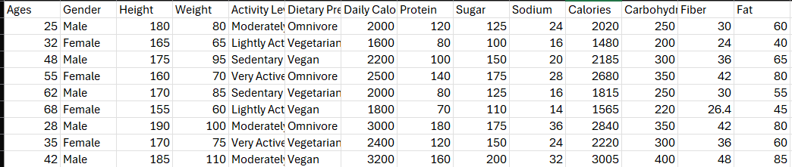
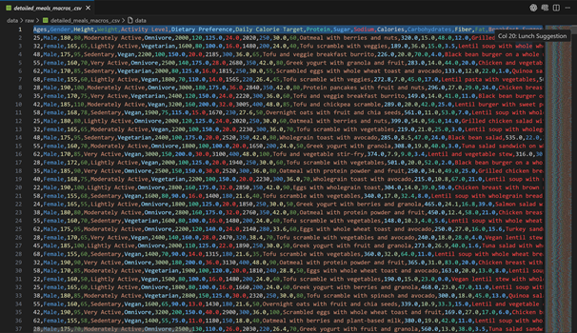
Exploratory Data Analysis and Data Snippet
Features we focused on: Ages, Gender, Height, Weight, Activity Level, Dietary Preference, Daily Calorie Target, Protein, Sugar, Sodium, Calories, Carbohydrates, Fiber, Fat, Carbohydrates, Disease

Slide 6
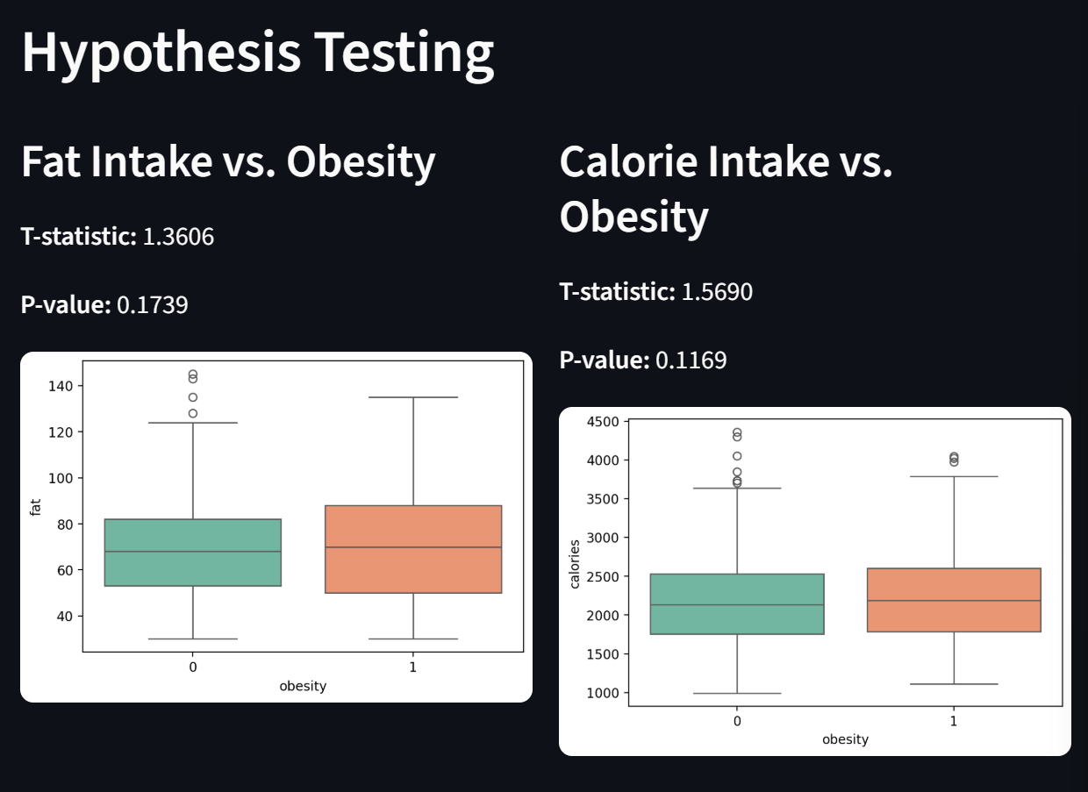
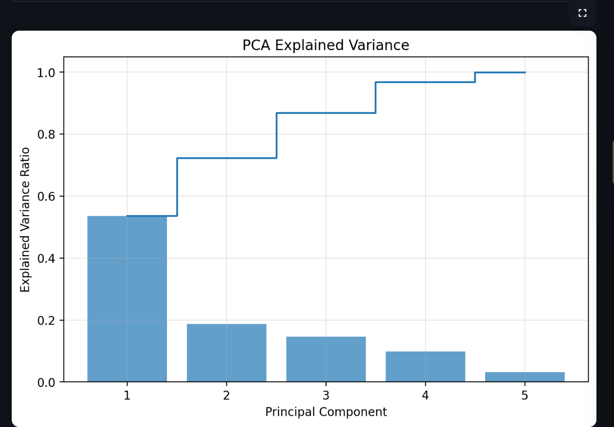
Statistical Tests & Relevance
Tests applied
–Normality checks on key numeric features
–T-test/ANOVA to compare macro averages across obesity groups
–Chi-square tests for categorical associations (activity level vs. obesity)
--PCA and Hypothesis Testing and more other test.

Slide 7
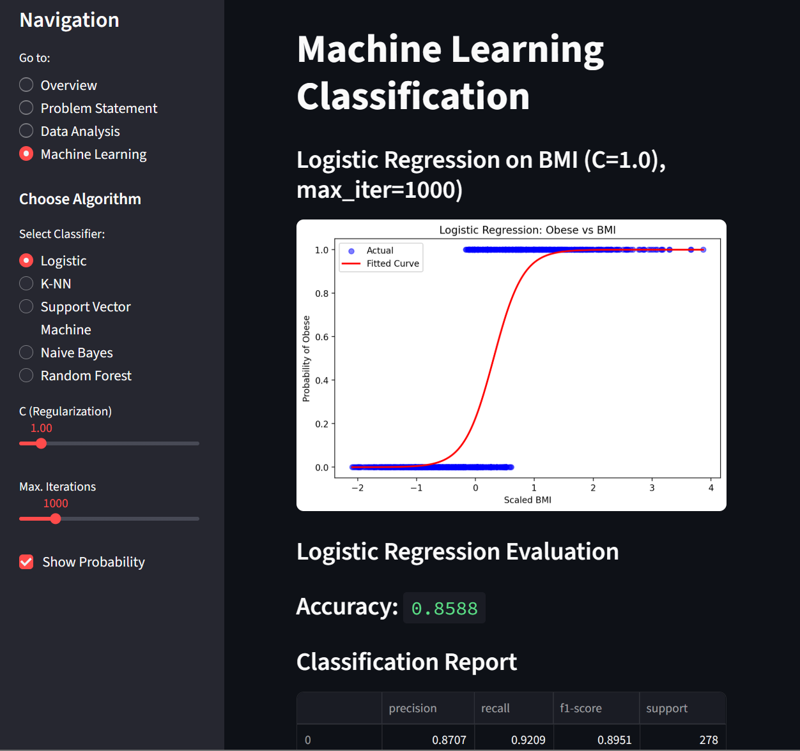
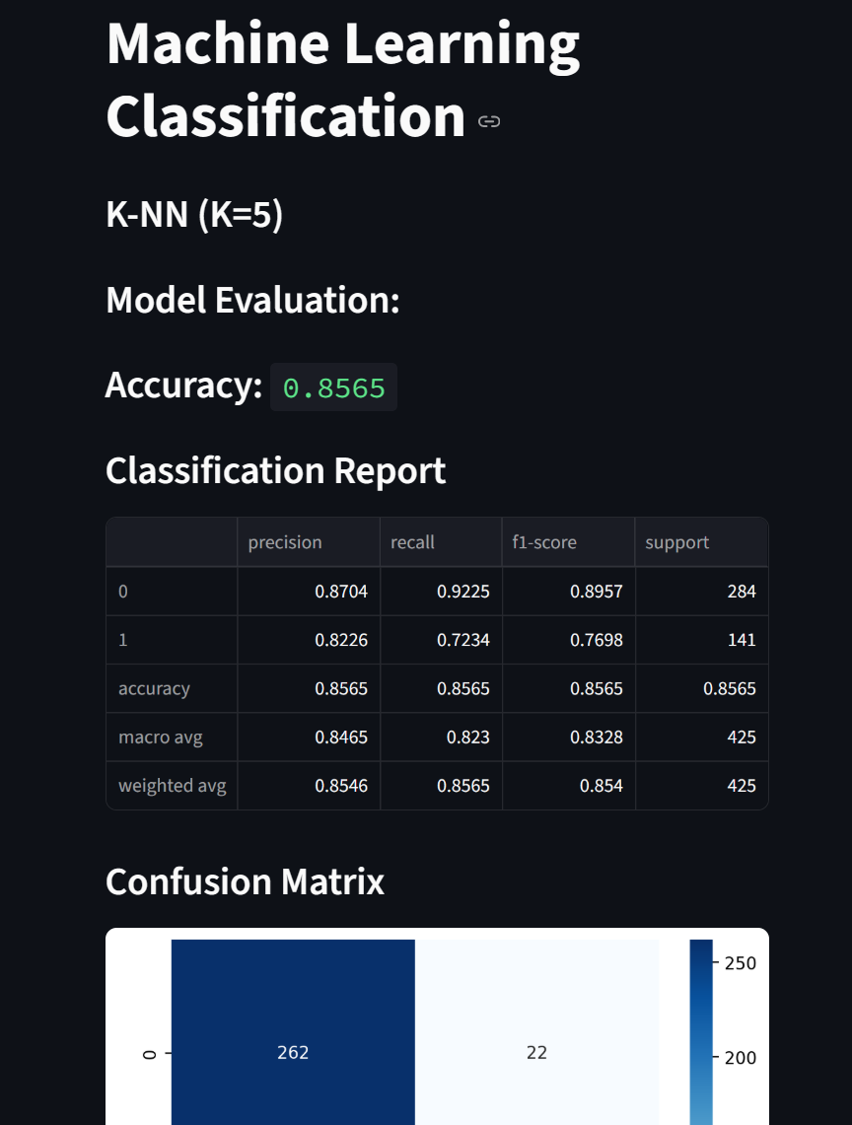
Model Comparison for Classification Algorithms
We used these models:
*KNN
*Naïve Bayes
*RandomForest
*Support Vector Machine
*Logistic Regression

Slide 8
Summary & Conclusion
We built a full obesity classification pipeline using demographic, lifestyle, and nutrition/macro variables from "detailed_meals_macros_.csv."
Obesity was defined as a binary outcome (obese vs. non-obese) using a BMI-based label derived during preprocessing.
After cleaning, encoding categorical features, and scaling numeric variables, we trained on different models.
When a model achieved certain percentage accuracy with an F1-score of [F1], showing that dietary and lifestyle variables can reasonably predict obesity status.
Compared it to with other classifiers to decide which one is the best.
Conclusion:
Our results support the hypothesis that nutrition patterns and lifestyle indicators are meaningful predictors of obesity, and an interpretable model like Logistic Regression,KNN etc can be helpful to explain which factors matter most for risk-aware dietary planning and suggest healthy lifestyle.

Slide 9
References:
Thanks A lot for our references and sources to bring this project alive:
1) VS Code Offical Docs.
https://code.visualstudio.com/docs
2) Stackoverflow
https://stackoverflow.com/questions
3) Kaggle
https://www.kaggle.com/code/guhanaein/diet-recommendation/input?select=detailed_meals_macros_.csv

