Slide 1
CEN-BOOKS
BY EMMANUEL NSUBUGA

Slide 2
TECH USED
Backend
- Nodejs
- Rest API
- Expressjs
Frontend
- Reactjs
- CSS
- javascript
- Font Awesome Icons
- React-Bootstrap

Slide 3
CEN-BOOKS
Online bookstore application developed using ReactJS.
Styling was made using
CSS
React-Bootstrap
Font Awesome Icons.

Slide 4
Cen-books has two main components:
REST API (backend)
Client App (frontend)

Slide 5
Features of Cen-books app:
Navbar and footer
Register and login forms
Validations
Administrator role for editing and adding books, delete accounts
Edit profile information
Breadcrumbs
Shopping cart
Filters
Order History

Slide 6
Interfaces
User
Admin

Slide 7
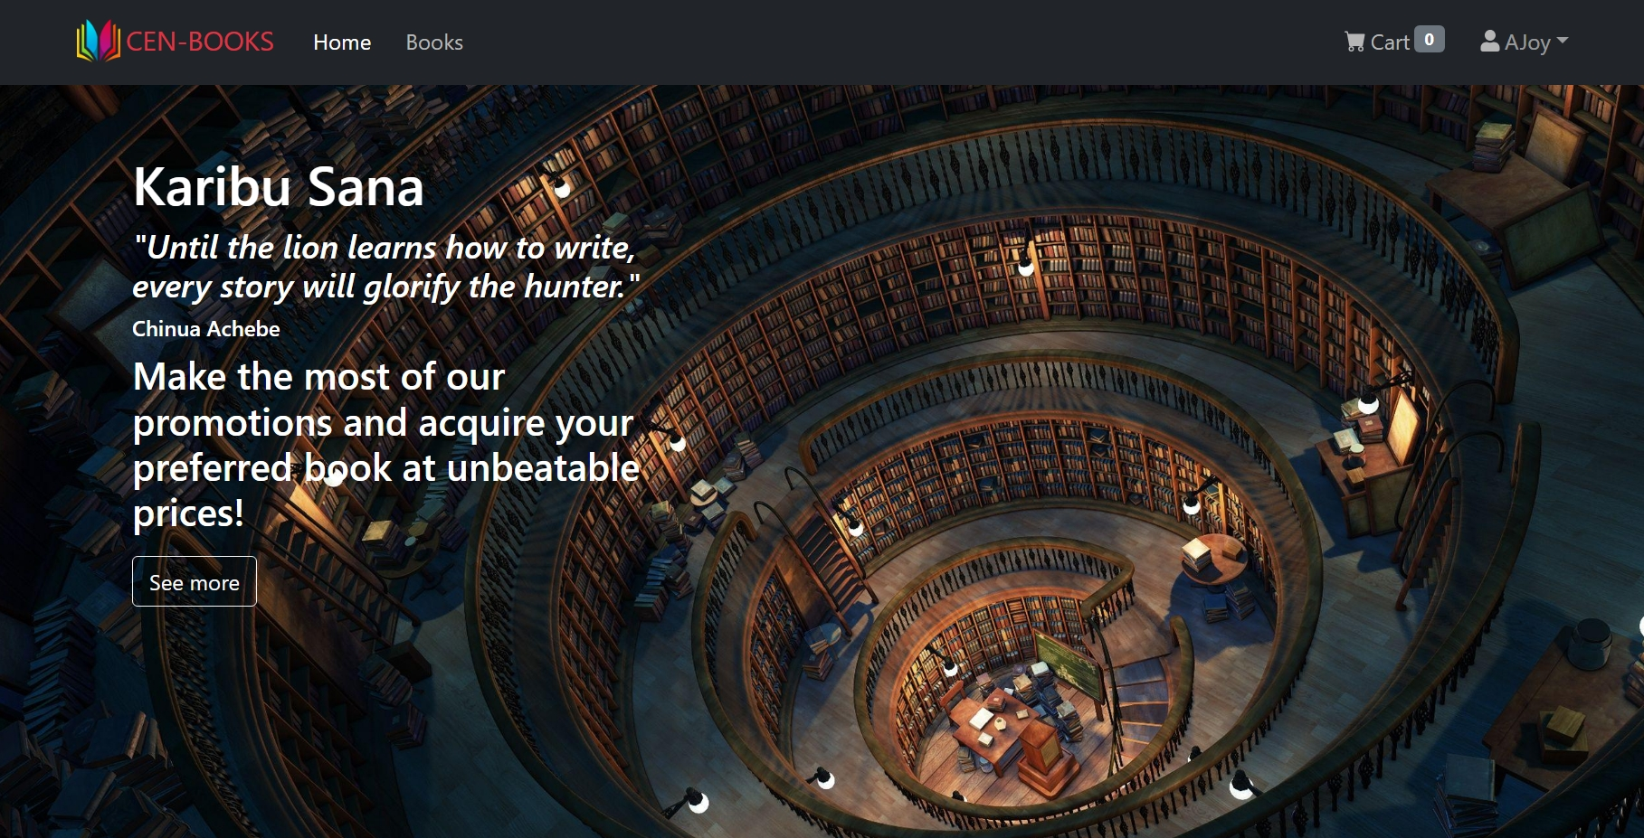
USER -homepage

Slide 8

Navbar and footer

Slide 9
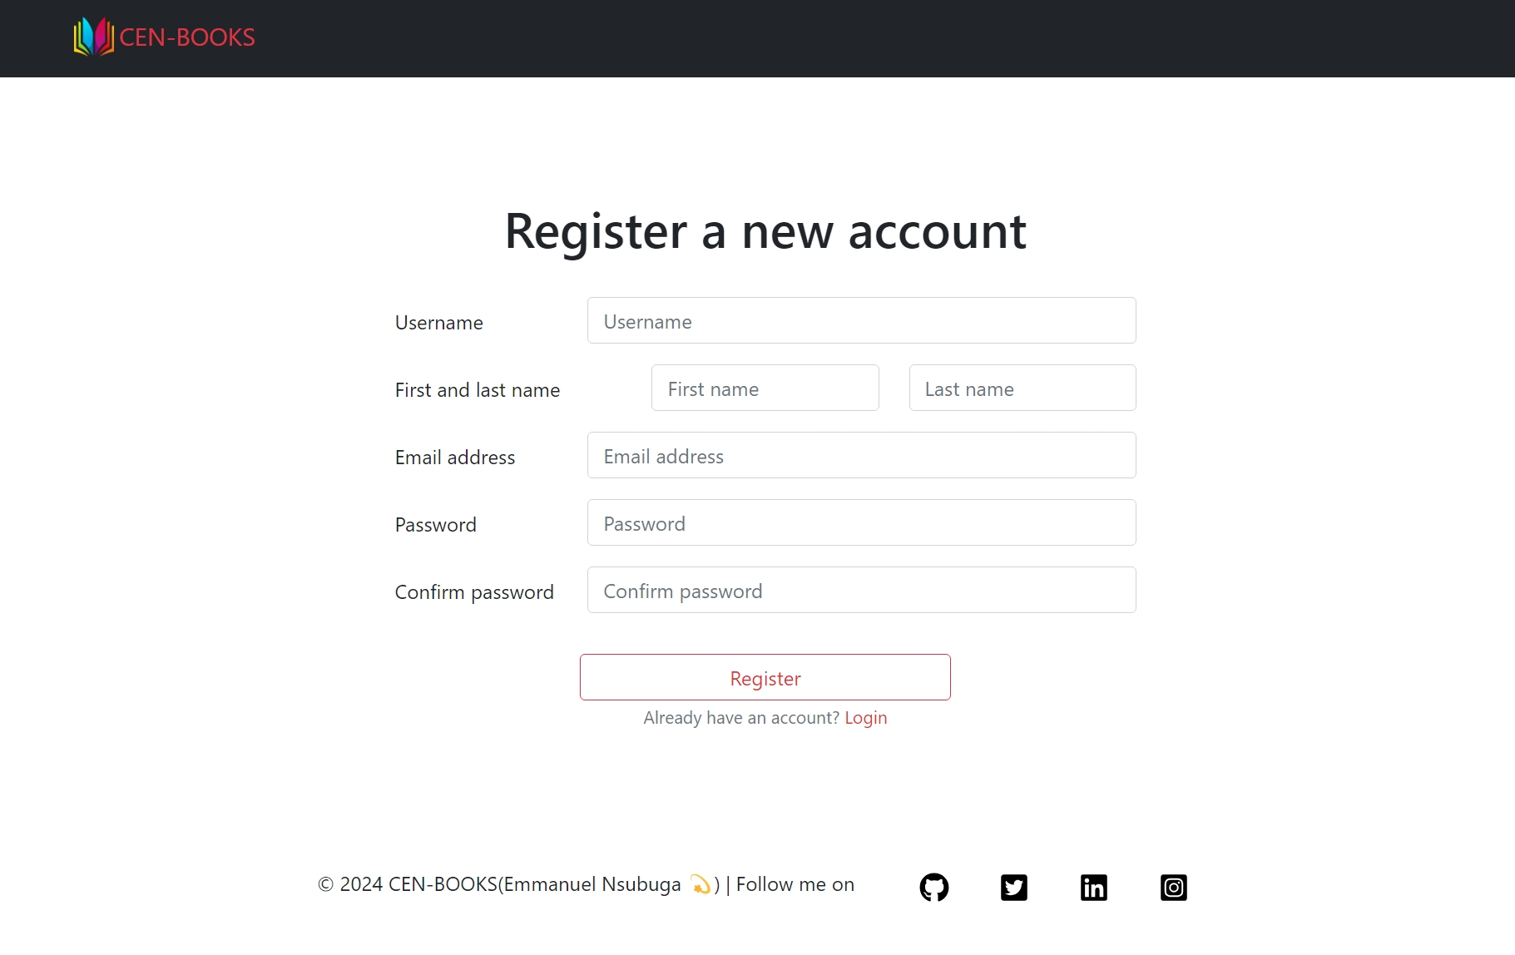
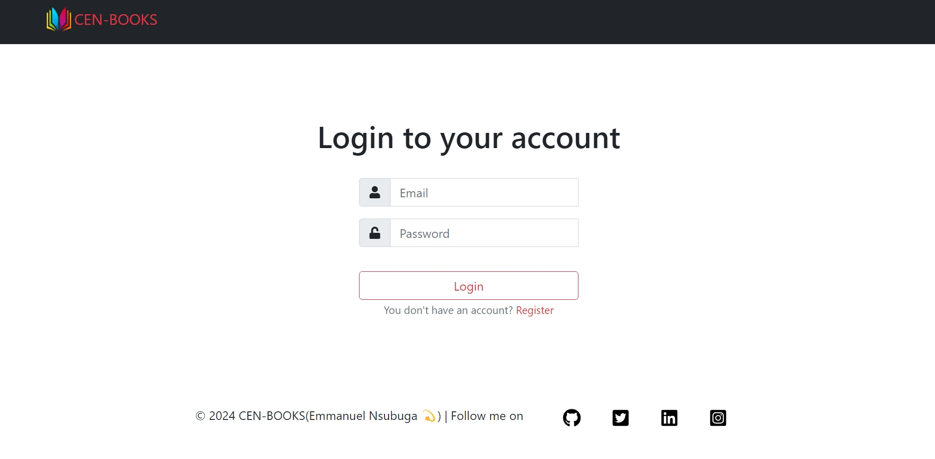
Register and login forms

Slide 10
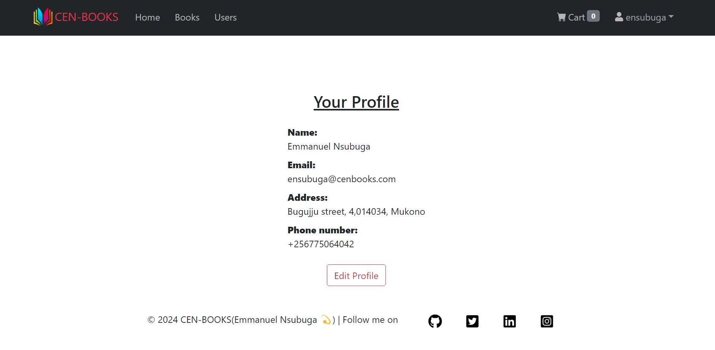
Profile details &Edit profile information

