Slide 1
Bayesian Classifier

Slide 2
A Quick Review of Probability
The Axioms of Probability
  0 <= P(A) <= 1
  P(True) = 1
  P(False) = 0
  P(A or B) = P(A) + P(B) - P(A and B)

Slide 3
Theorems from the Axioms
0 <= P(A) <= 1, P(True) = 1, P(False) = 0
P(A or B) = P(A) + P(B) - P(A and B)
    From these we can prove:
    P(not A) = P(~A) = 1-P(A)
P(A) = P(A ^ B) + P(A ^ ~B)

Slide 4
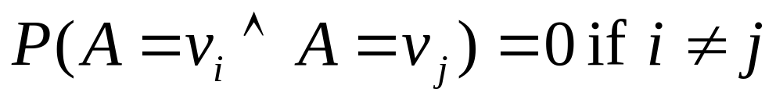
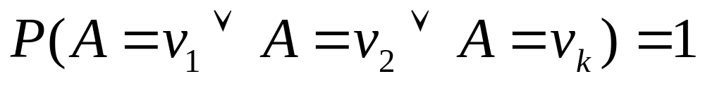
Multivalued Random Variables
Suppose A can take on more than 2 values
A is a random variable with arity k if it can take on exactly one value out of {v₁,v₂, .. v_{k}}
Thus…

Slide 5
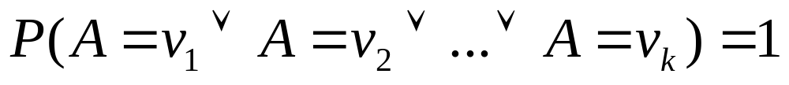
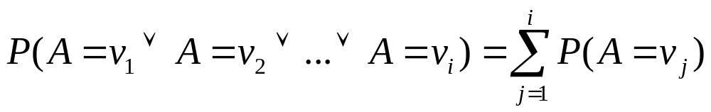
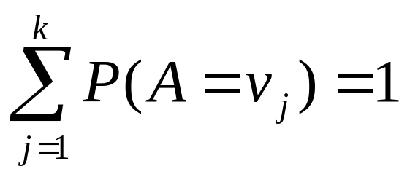
An easy fact about Multivalued Random Variables:
Using the axioms of probability…
      0 <= P(A) <= 1, P(True) = 1, P(False) = 0
      P(A or B) = P(A) + P(B) - P(A and B)
And assuming that A obeys…
It’s easy to prove that
And thus we can prove

Slide 6
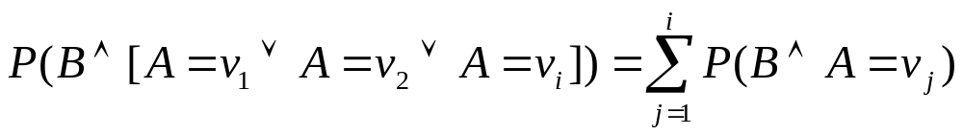
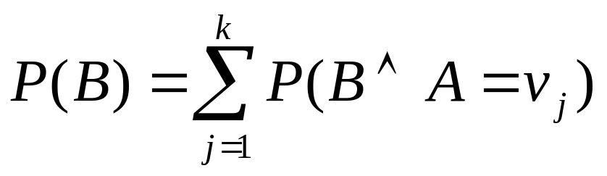
Another fact about Multivalued Random Variables:
Using the axioms of probability…
      0 <= P(A) <= 1, P(True) = 1, P(False) = 0
      P(A or B) = P(A) + P(B) - P(A and B)
And assuming that A obeys…
It’s easy to prove that
And thus we can prove

Slide 7
Conditional Probability
P(A|B) = Fraction of worlds in which B is true that also have A true
H = “Have a headache”
F = “Coming down with Flu”
P(H) = 1/10
P(F) = 1/40
P(H|F) = 1/2
“Headaches are rare and flu is rarer, but if you’re coming down with ‘flu there’s a 50-50 chance you’ll have a headache.”
F
H

Slide 8
Conditional Probability
P(H|F) = Fraction of flu-inflicted worlds in which you have a headache
= #worlds with flu and headache
------------------------------------
#worlds with flu
= Area of “H and F” region
------------------------------
Area of “F” region
= P(H ^ F)
-----------
P(F)
F
H
H = “Have a headache”
F = “Coming down with Flu”
P(H) = 1/10
P(F) = 1/40
P(H|F) = 1/2

Slide 9
Definition of Conditional Probability
P(A ^ B)
P(A|B) = -----------
P(B)
Corollary: The Chain Rule
P(A ^ B) = P(A|B) P(B)

Slide 10
Probabilistic Inference
H = “Have a headache”
F = “Coming down with Flu”
P(H) = 1/10
P(F) = 1/40
P(H|F) = 1/2
F
H
One day you wake up with a headache. You think: “Drat! 50% of flus are associated with headaches so I must have a 50-50 chance of coming down with flu”
Is this reasoning good?

Slide 11
Probabilistic Inference
H = “Have a headache”
F = “Coming down with Flu”
P(H) = 1/10
P(F) = 1/40
P(H|F) = 1/2
F
H
P(F ^ H) = …
P(F|H) = …

Slide 12
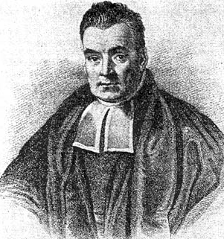
What we just did…
P(A ^ B) P(A|B) P(B)
P(B|A) = ----------- = ---------------
P(A) P(A)
This is Bayes Rule
Bayes, Thomas (1763) An essay towards solving a problem in the doctrine of chances. Philosophical Transactions of the Royal Society of London, 53:370-418

Slide 13
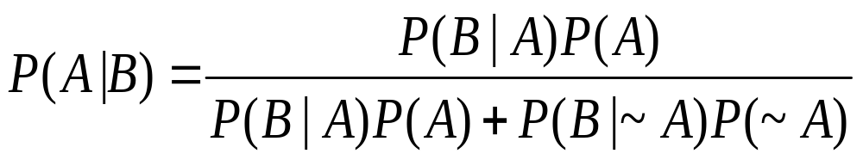
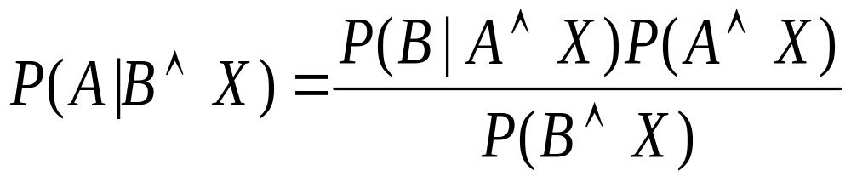
More General Forms of Bayes Rule

Slide 14
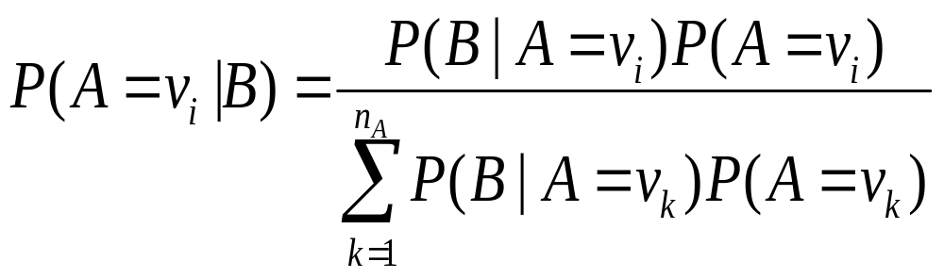
More General Forms of Bayes Rule

Slide 15
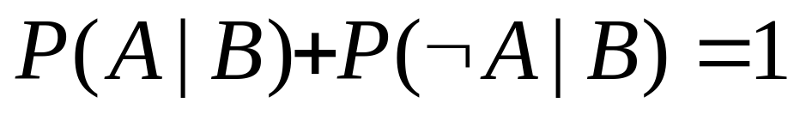
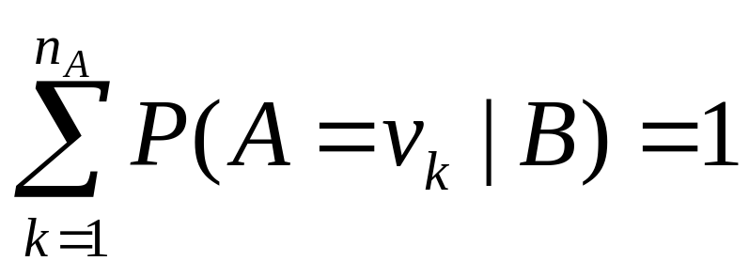
Useful Easy-to-prove facts

Slide 16
The Joint Distribution
Example: Boolean variables A, B, C
Recipe for making a joint distribution of M variables:

Slide 17
The Joint Distribution
Example: Boolean variables A, B, C
Recipe for making a joint distribution of M variables:
Make a truth table listing all combinations of values of your variables (if there are M Boolean variables then the table will have 2^{M} rows).
A | B | C
0 | 0 | 0
0 | 0 | 1
0 | 1 | 0
0 | 1 | 1
1 | 0 | 0
1 | 0 | 1
1 | 1 | 0
1 | 1 | 1

Slide 18
The Joint Distribution
Example: Boolean variables A, B, C
Recipe for making a joint distribution of M variables:
Make a truth table listing all combinations of values of your variables (if there are M Boolean variables then the table will have 2^{M} rows).
For each combination of values, say how probable it is.
A | B | C | Prob
0 | 0 | 0 | 0.30
0 | 0 | 1 | 0.05
0 | 1 | 0 | 0.10
0 | 1 | 1 | 0.05
1 | 0 | 0 | 0.05
1 | 0 | 1 | 0.10
1 | 1 | 0 | 0.25
1 | 1 | 1 | 0.10

Slide 19
The Joint Distribution
Example: Boolean variables A, B, C
Recipe for making a joint distribution of M variables:
Make a truth table listing all combinations of values of your variables (if there are M Boolean variables then the table will have 2^{M} rows).
For each combination of values, say how probable it is.
If you subscribe to the axioms of probability, those numbers must sum to 1.
A | B | C | Prob
0 | 0 | 0 | 0.30
0 | 0 | 1 | 0.05
0 | 1 | 0 | 0.10
0 | 1 | 1 | 0.05
1 | 0 | 0 | 0.05
1 | 0 | 1 | 0.10
1 | 1 | 0 | 0.25
1 | 1 | 1 | 0.10
A
0.05
0.10
0.05
0.10
0.25
0.05
C
B
0.10
0.30

Slide 20
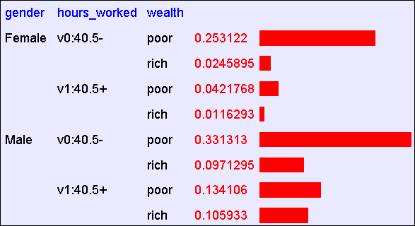
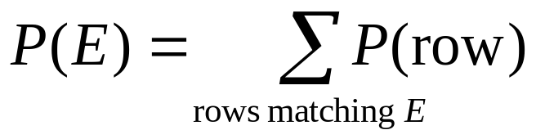
Using the Joint
One you have the JD you can ask for the probability of any logical expression involving your attribute

Slide 21
Using the Joint
P(Poor Male) = 0.4654

Slide 22
Using the Joint
P(Poor) = 0.7604

Slide 23
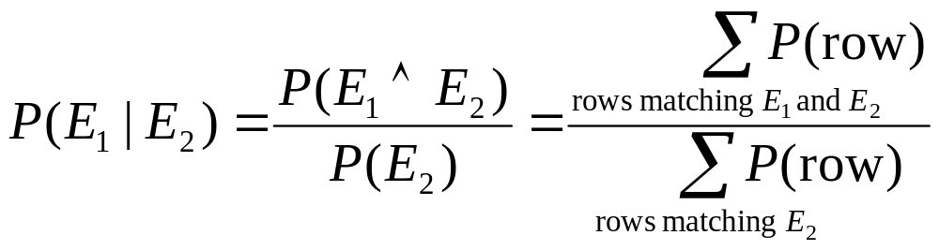
Inference with the Joint

Slide 24
Inference with the Joint
P(Male | Poor) = 0.4654 / 0.7604 = 0.612

Slide 25
Inference is a big deal
I’ve got this evidence. What’s the chance that this conclusion is true?
  I’ve got a sore neck: how likely am I to have meningitis?
  I see my lights are out and it’s 9pm. What’s the chance my spouse is already asleep?

Slide 26
Inference is a big deal
I’ve got this evidence. What’s the chance that this conclusion is true?
  I’ve got a sore neck: how likely am I to have meningitis?
  I see my lights are out and it’s 9pm. What’s the chance my spouse is already asleep?
There’s a thriving set of industries growing based around Bayesian Inference. Highlights are: Medicine, Pharma, Help Desk Support, Engine Fault Diagnosis

Slide 27
Where do Joint Distributions come from?
Idea One: Expert Humans
Idea Two: Simpler probabilistic facts and some algebra
Example: Suppose you knew
P(A) = 0.7
P(B|A) = 0.2
P(B|~A) = 0.1
P(C|A^B) = 0.1
P(C|A^~B) = 0.8
P(C|~A^B) = 0.3
P(C|~A^~B) = 0.1
Then you can automatically compute the JD using the chain rule
In another lecture: Bayes Nets, a systematic way to do this.
P(A=x ^ B=y ^ C=z) =
P(C=z|A=x^ B=y) P(B=y|A=x) P(A=x)

Slide 28
Where do Joint Distributions come from?
Idea Three: Learn them from data!
    Prepare to see one of the most impressive learning algorithms you’ll come across in the entire course….

Slide 29
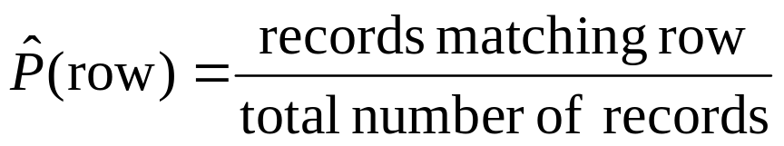
Learning a joint distribution
Build a JD table for your attributes in which the probabilities are unspecified
The fill in each row with
A | B | C | Prob
0 | 0 | 0 | ?
0 | 0 | 1 | ?
0 | 1 | 0 | ?
0 | 1 | 1 | ?
1 | 0 | 0 | ?
1 | 0 | 1 | ?
1 | 1 | 0 | ?
1 | 1 | 1 | ?
A | B | C | Prob
0 | 0 | 0 | 0.30
0 | 0 | 1 | 0.05
0 | 1 | 0 | 0.10
0 | 1 | 1 | 0.05
1 | 0 | 0 | 0.05
1 | 0 | 1 | 0.10
1 | 1 | 0 | 0.25
1 | 1 | 1 | 0.10
Fraction of all records in which
A and B are True but C is False

Slide 30
Example of Learning a Joint
This Joint was obtained by learning from three attributes in the UCI “Adult” Census Database [Kohavi 1995]

Slide 31
Where are we?
We have recalled the fundamentals of probability
We have become content with what JDs are and how to use them
We know how to learn JDs from data.

Slide 32
Density Estimation
Our Joint Distribution learner is our first example of something called Density Estimation
A Density Estimator learns a mapping from a set of attributes to a Probability
Input
Attributes
Density
Estimator
Probability

Slide 33
Density Estimation
Compare it against the two other major kinds of models:
Input
Attributes
Classifier
Prediction of
categorical output
Input
Attributes
Density
Estimator
Probability
Input
Attributes
Regressor
Prediction of
real-valued output

Slide 34
Evaluating Density Estimation
Test-set criterion for estimating performance on future data*
* See the Decision Tree or Cross Validation lecture for more detail
Input
Attributes
Test set Accuracy
Classifier
Prediction of
categorical output
Input
Attributes
Density
Estimator
?
Probability
Input
Attributes
Regressor
Prediction of
real-valued output
Test set Accuracy

Slide 35
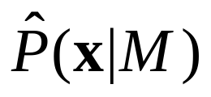
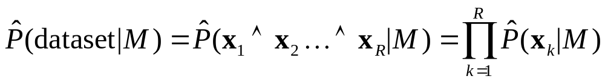
Evaluating a density estimator
Given a record x, a density estimator M can tell you how likely the record is:
Given a dataset with R records, a density estimator can tell you how likely the dataset is:
  (Under the assumption that all records were independently generated from the Density Estimator’s JD)

Slide 36
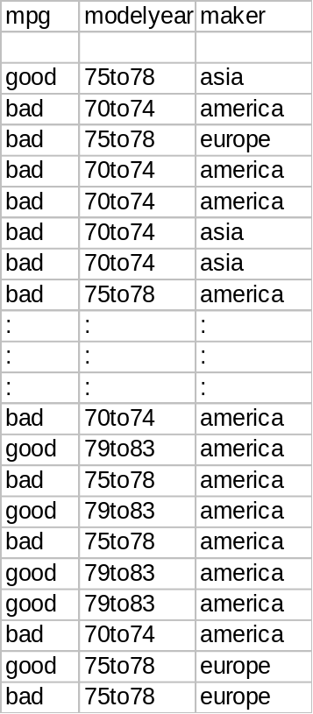
A small dataset: Miles Per Gallon
192 Training Set Records

Slide 37
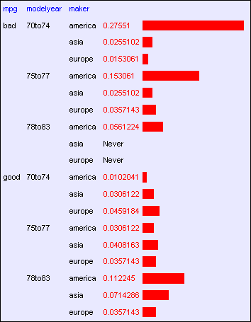
A small dataset: Miles Per Gallon
192 Training Set Records

Slide 38
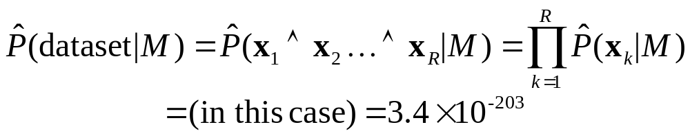
A small dataset: Miles Per Gallon
192 Training Set Records

Slide 39
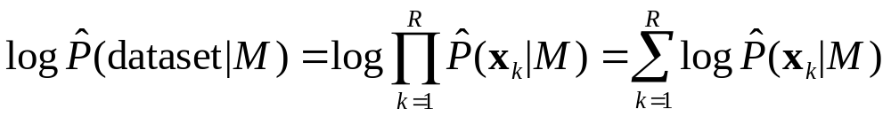
Log Probabilities
Since probabilities of datasets get so small we usually use log probabilities

Slide 40
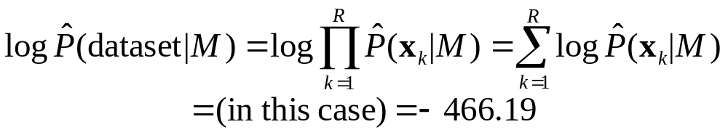
A small dataset: Miles Per Gallon
192 Training Set Records

Slide 41
Summary: The Good News
We have a way to learn a Density Estimator from data.
Density estimators can do many good things…
  Can sort the records by probability, and thus spot weird records (anomaly detection)
  Can do inference: P(E1|E2)
        Automatic Doctor / Help Desk etc
  Ingredient for Bayes Classifiers (see later)

Slide 42
Summary: The Bad News
Density estimation by directly learning the joint is trivial, mindless and dangerous

Slide 43
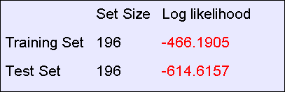
Using a test set
An independent test set with 196 cars has a worse log likelihood
(actually it’s a billion quintillion quintillion quintillion quintillion times less likely)
….Density estimators can overfit. And the full joint density estimator is the overfittiest of them all!

Slide 44
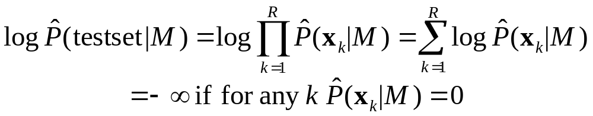
Overfitting Density Estimators
If this ever happens, it means there are certain combinations that we learn are impossible

Slide 45
Using a test set
The only reason that our test set didn’t score -infinity is that my code is hard-wired to always predict a probability of at least one in 10²⁰
We need Density Estimators that are less prone to overfitting

Slide 46
Naïve Density Estimation
The problem with the Joint Estimator is that it just mirrors the training data.
We need something which generalizes more usefully.
The naïve model generalizes strongly:
Assume that each attribute is distributed independently of any of the other attributes.

Slide 47
Independently Distributed Data
Let x[i] denote the i’th field of record x.
The independently distributed assumption says that for any i,v, u₁ u₂… u_{i-1} u_{i+1}… u_{M}
Or in other words, x[i] is independent of {x[1],x[2],..x[i-1], x[i+1],…x[M]}
This is often written as

Slide 48
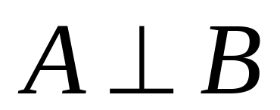
A note about independence
Assume A and B are Boolean Random Variables. Then
“A and B are independent”
if and only if
P(A|B) = P(A)
“A and B are independent” is often notated as

Slide 49
Independence Theorems
Assume P(A|B) = P(A)
Then P(A^B) =
P(A) P(B)
Assume P(A|B) =
P(A)
Then P(~A|B) =
P(~A)
Assume P(A|B) = P(A)
Then P(B|A) = P(B)
Assume P(A|B) =
P(A)
Then P(A|~B) =
P(A)

Slide 50
Multivalued Independence
For multivalued Random Variables A and B,
if and only if
from which you can then prove things like…

Slide 51
Back to Naïve Density Estimation
Let x[i] denote the i’th field of record x:
Naïve DE assumes x[i] is independent of {x[1],x[2],..x[i-1], x[i+1],…x[M]}
Example:
  Suppose that each record is generated by randomly shaking a green dice and a red dice
    Dataset 1: A = red value, B = green value
    Dataset 2: A = red value, B = sum of values
    Dataset 3: A = sum of values, B = difference of values
  Which of these datasets violates the naïve assumption?

Slide 52
Using the Naïve Distribution
Once you have a Naïve Distribution you can easily compute any row of the joint distribution.
Suppose A, B, C and D are independently distributed. What is P(A^~B^C^~D)?

Slide 53
Using the Naïve Distribution
Once you have a Naïve Distribution you can easily compute any row of the joint distribution.
Suppose A, B, C and D are independently distributed. What is P(A^~B^C^~D)?
= P(A|~B^C^~D) P(~B^C^~D)
= P(A) P(~B^C^~D)
= P(A) P(~B|C^~D) P(C^~D)
= P(A) P(~B) P(C^~D)
= P(A) P(~B) P(C|~D) P(~D)
= P(A) P(~B) P(C) P(~D)

Slide 54
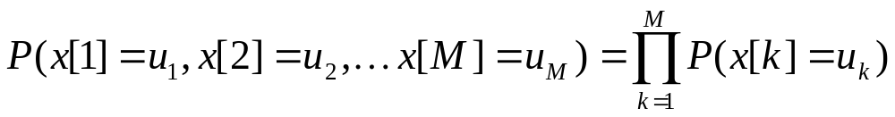
Naïve Distribution General Case
Suppose x[1], x[2], … x[M] are independently distributed.
So if we have a Naïve Distribution we can construct any row of the implied Joint Distribution on demand.
So we can do any inference
But how do we learn a Naïve Density Estimator?

Slide 55
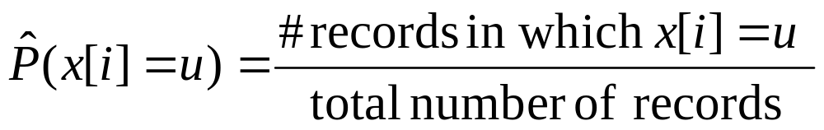
Learning a Naïve Density Estimator
Another trivial learning algorithm!

Slide 56
Contrast
Joint DE | Naïve DE
Can model anything | Can model only very boring distributions
No problem to model “C is a noisy copy of A” | Outside Naïve’s scope
Given 100 records and more than 6 Boolean attributes will screw up badly | Given 100 records and 10,000 multivalued attributes will be fine

Slide 57
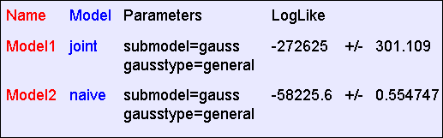
Empirical Results: “Hopeless”
The “hopeless” dataset consists of 40,000 records and 21 Boolean attributes called a,b,c, … u. Each attribute in each record is generated 50-50 randomly as 0 or 1.
Average test set log probability during 10 folds cross-validation
Despite the vast amount of data, “Joint” overfits hopelessly and does much worse

Slide 58
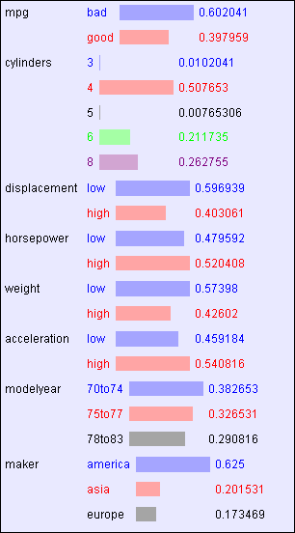
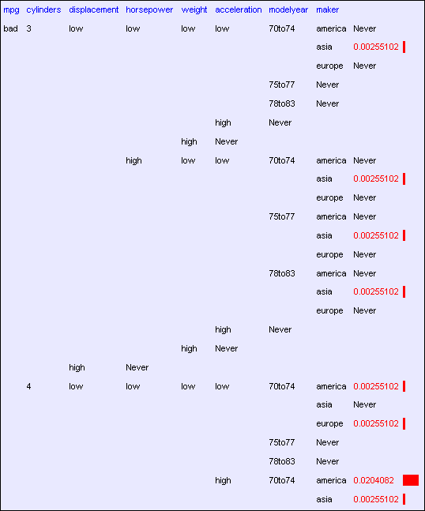
Empirical Results: “MPG”
The “MPG” dataset consists of 392 records and 8 attributes
A tiny part of the DE learned by “Joint”
The DE learned by “Naive”

Slide 59
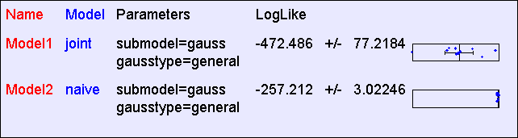
Empirical Results: “MPG”
The “MPG” dataset consists of 392 records and 8 attributes
A tiny part of the DE learned by “Joint”
The DE learned by “Naive”

Slide 60
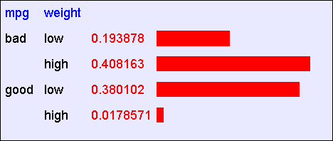
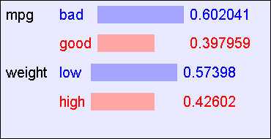
Empirical Results: “Weight vs. MPG”
Suppose we train only from the “Weight” and “MPG” attributes
The DE learned by “Joint”
The DE learned by “Naive”

Slide 61
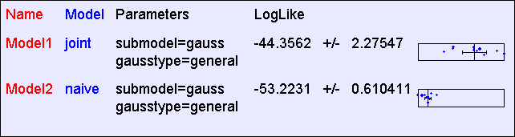
Empirical Results: “Weight vs. MPG”
Suppose we train only from the “Weight” and “MPG” attributes
The DE learned by “Joint”
The DE learned by “Naive”

Slide 62
Reminder: The Good News
We have two ways to learn a Density Estimator from data.
Other, vastly more impressive Density Estimators developed
  Mixture Models, Bayesian Networks, Density Trees, Kernel Densities and many more
Density estimators can do many good things…
  Anomaly detection
  Can do inference: P(E1|E2) Automatic Doctor / Help Desk etc
  Ingredient for Bayes Classifiers

Slide 63
Bayes Classifiers
A formidable and sworn enemy of decision trees
Input
Attributes
Classifier
Prediction of
categorical output
DT
BC

Slide 64
How to build a Bayes Classifier
Assume you want to predict output Y which has arity n_{Y} and values v₁, v₂, … v_{ny}.
Assume there are m input attributes called X₁, X₂, … X_{m}
Break dataset into n_{Y} smaller datasets called DS₁, DS₂, … DS_{ny}.
Define DS_{i} = Records in which Y=v_{i}
For each DS_{i} , learn Density Estimator M_{i} to model the input distribution among the Y=v_{i} records.

Slide 65
How to build a Bayes Classifier
Assume you want to predict output Y which has arity n_{Y} and values v₁, v₂, … v_{ny}.
Assume there are m input attributes called X₁, X₂, … X_{m}
Break dataset into n_{Y} smaller datasets called DS₁, DS₂, … DS_{ny}.
Define DS_{i} = Records in which Y=v_{i}
For each DS_{i} , learn Density Estimator M_{i} to model the input distribution among the Y=v_{i} records.
M_{i} estimates P(X₁, X₂, … X_{m} | Y=v_{i} )

Slide 66
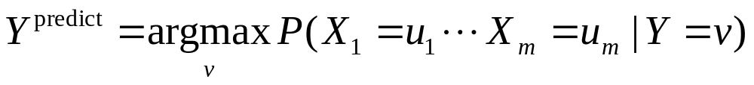
How to build a Bayes Classifier
Assume you want to predict output Y which has arity n_{Y} and values v₁, v₂, … v_{ny}.
Assume there are m input attributes called X₁, X₂, … X_{m}
Break dataset into n_{Y} smaller datasets called DS₁, DS₂, … DS_{ny}.
Define DS_{i} = Records in which Y=v_{i}
For each DS_{i} , learn Density Estimator M_{i} to model the input distribution among the Y=v_{i} records.
M_{i} estimates P(X₁, X₂, … X_{m} |Y=v_{i} )
Idea: When a new set of input values (X₁ = u₁, X₂ = u₂, …. X_{m} = u_{m}) come along to be evaluated predict the value of Y that makes P(X₁, X₂, … X_{m} | Y=v_{i} ) most likely
Is this a good idea?

Slide 67
How to build a Bayes Classifier
Assume you want to predict output Y which has arity n_{Y} and values v₁, v₂, … v_{ny}.
Assume there are m input attributes called X₁, X₂, … X_{m}
Break dataset into n_{Y} smaller datasets called DS₁, DS₂, … DS_{ny}.
Define DS_{i} = Records in which Y=v_{i}
For each DS_{i} , learn Density Estimator M_{i} to model the input distribution among the Y=v_{i} records.
M_{i} estimates P(X₁, X₂, … X_{m} | Y=v_{i} )
Idea: When a new set of input values (X₁ = u₁, X₂ = u₂, …. X_{m} = u_{m}) come along to be evaluated predict the value of Y that makes P(X₁, X₂, … X_{m} | Y=v_{i} ) most likely
This is a Maximum Likelihood classifier.
It can get silly if some Ys are very unlikely
Is this a good idea?

Slide 68
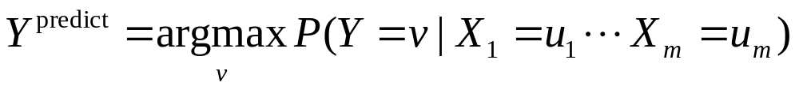
How to build a Bayes Classifier
Assume you want to predict output Y which has arity n_{Y} and values v₁, v₂, … v_{ny}.
Assume there are m input attributes called X₁, X₂, … X_{m}
Break dataset into n_{Y} smaller datasets called DS₁, DS₂, … DS_{ny}.
Define DS_{i} = Records in which Y=v_{i}
For each DS_{i} , learn Density Estimator M_{i} to model the input distribution among the Y=v_{i} records.
M_{i} estimates P(X₁, X₂, … X_{m} | Y=v_{i} )
Idea: When a new set of input values (X₁ = u₁, X₂ = u₂, …. X_{m} = u_{m}) come along to be evaluated predict the value of Y that makes P(Y=v_{i} | X₁, X₂, … X_{m}) most likely
Much Better Idea
Is this a good idea?

Slide 69
Terminology
MLE (Maximum Likelihood Estimator):
MAP (Maximum A-Posteriori Estimator):

Slide 70
Getting what we need

Slide 71
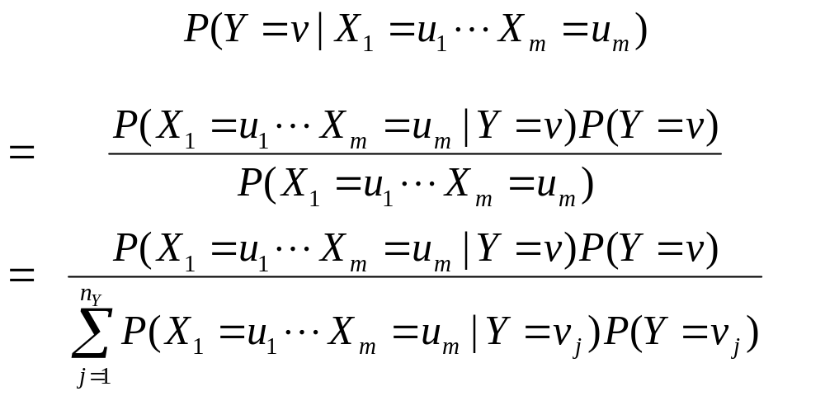
Getting a posterior probability

Slide 72
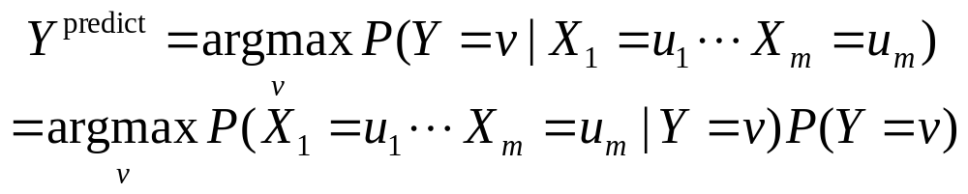
Bayes Classifiers in a nutshell
1. Learn the distribution over inputs for each value Y.
2. This gives P(X₁, X₂, … X_{m} | Y=v_{i} ).
3. Estimate P(Y=v_{i} ). as fraction of records with Y=v_{i} .
4. For a new prediction:

Slide 73
Bayes Classifiers in a nutshell
1. Learn the distribution over inputs for each value Y.
2. This gives P(X₁, X₂, … X_{m} | Y=v_{i} ).
3. Estimate P(Y=v_{i} ). as fraction of records with Y=v_{i} .
4. For a new prediction:
We can use our favorite Density Estimator here.
Right now we have two options:
Joint Density Estimator
Naïve Density Estimator

Slide 74
Joint Density Bayes Classifier
In the case of the joint Bayes Classifier this degenerates to a very simple rule:
Y^{predict} = the most common value of Y among records in which X₁ = u₁, X₂ = u₂, …. X_{m} = u_{m}.
Note that if no records have the exact set of inputs X₁ = u₁, X₂ = u₂, …. X_{m} = u_{m}, then P(X₁, X₂, … X_{m} | Y=v_{i} ) = 0 for all values of Y.
In that case we just have to guess Y’s value

Slide 75
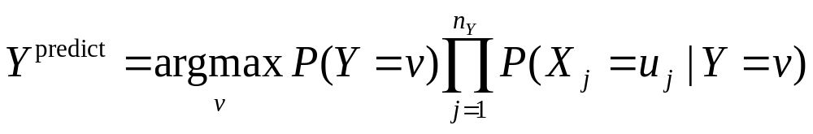
Naïve Bayes Classifier
In the case of the naive Bayes Classifier this can be simplified:

Slide 76
An Example
Day Outlook Temperature Humidity Wind PlayTennis
D1 sunny hot high weak no
D2 sunny hot high strong no
D3 overcast hot high weak yes
D4 rain mild high weak yes
D5 rain cool normal weak yes
D6 rain cool normal strong no
D7 overcast cool normal strong yes
D8 sunny mild high weak no
D9 sunny cool normal weak yes
D10 rain mild normal weak yes
D11 sunny mild normal strong yes
D12 overcast mild high strong yes
D13 overcast hot normal weak yes
D14 rain mild high strong no

Slide 77
To Learn a Naïve Bayes Classifier from this data
Two classes: y=v₁ : playtennis=no
y=v₂ : playtennis=yes
four attributes:
x₁: three values (sunny, overcast, rain)
x₂: three values (hot, mild, cool)
x₃: two values (high, normal)
x₄: two values (weak, strong)

Slide 78
What probabilities do we need to compute?
P(y=yes)= P(y=no)
P(x1=sunny|y=yes)
P(x1=overcast|y=yes)
P(x1=rain|y=yes)
P(a2=hot|y=yes)
P(a2=mild|y=yes)
P(a2=cool|y=yes)
P(a3=high|y=yes)
P(a3=normal|y=yes)
P(a4=weak|y=yes)
P(a4=strong|y=yes)
P(x1=sunny|y=no)
P(x1=overcast|y=no)
P(x1=rain|y=no)
P(a2=hot|y=no)
P(a2=mild|y=no)
P(a2=cool|y=no)
P(a3=high|y=no)
P(a3=normal|y=no)
P(a4=weak|y=no)
P(a4=strong|y=no)

Slide 79
Reorder according to class label
Day Outlook Temperature Humidity Wind PlayTennis
D1 sunny hot high weak no
D2 sunny hot high strong no
D3 overcast hot high weak yes
D4 rain mild high weak yes
D5 rain cool normal weak yes
D6 rain cool normal strong no
D7 overcast cool normal strong yes
D8 sunny mild high weak no
D9 sunny cool normal weak yes
D10 rain mild normal weak yes
D11 sunny mild normal strong yes
D12 overcast mild high strong yes
D13 overcast hot normal weak yes
D14 rain mild high strong no

Slide 80
The Classifier Learned
P(y=yes)= P(y=no)=
P(x1=sunny|y=yes) =
P(x1=overcast|y=yes) =
P(x1=rain|y=yes)=
P(a2=hot|y=yes)=
P(a2=mild|y=yes)=
P(a2=cool|y=yes)=
P(a3=high|y=yes)=
P(a3=normal|y=yes)=
P(a4=weak|y=yes)=
P(a4=strong|y=yes)=
P(x1=sunny|y=no)=
P(x1=overcast|y=no)=
P(x1=rain|y=no)=
P(a2=hot|y=no)=
P(a2=mild|y=no)=
P(a2=cool|y=no)=
P(a3=high|y=no)=
P(a3=normal|y=no)=
P(a4=weak|y=no)=
P(a4=strong|y=no)=

Slide 81
Classification Step
Given a new case/object:
outlook=sunny,
temperature=cool,
humid=high,
wind = strong
Question: whether to play or not to play tennis?

Slide 82
Classification Step
P(y=yes|x1=sunny, x2=cool, x3=high, x4=strong)
=P(yes)P(sunny|yes)P(cool|yes)
P(high|yes)P(strong|yes)
=0.64*0.22*0.33*0.33*0.33=0.005
P(y=no|x1=sunny, x2=cool, x3=high, x4=strong)
=P(no)P(sunny|no)P(cool|no)P(high|no)P(strong|no)
=0.36*0.6*0.2*0.8*0.6=0.02
The answer is No.

Slide 83
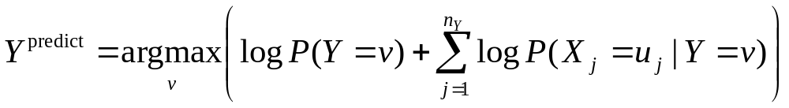
Naïve Bayes Classifier
In the case of the naive Bayes Classifier this can be simplified:
Technical Hint:
If you have 10,000 input attributes that product will underflow in floating point math. You should use logs:

Slide 84
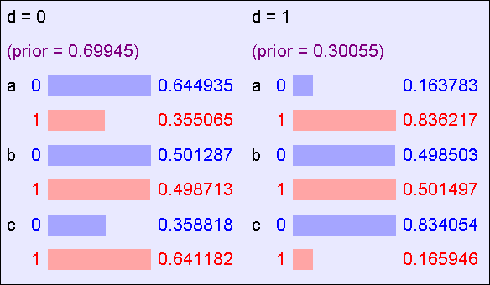
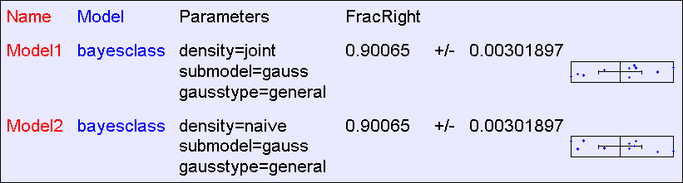
Naive BC Results: “Logical”
The “logical” dataset consists of 40,000 records and 4 Boolean attributes called a,b,c,d where a,b,c are generated 50-50 randomly as 0 or 1. D = A^~C, except that in 10% of records it is flipped
The Classifier learned by “Naive BC”

Slide 85
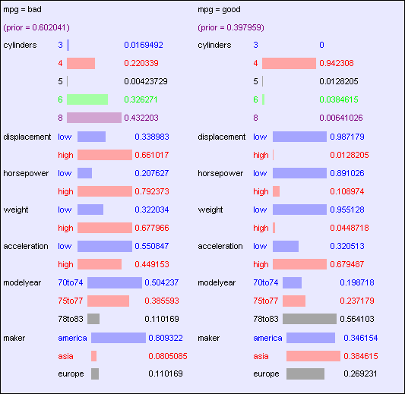
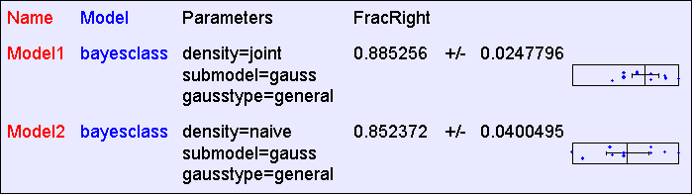
BC Results: “MPG”: 392 records
The Classifier learned by “Naive BC”

Slide 86
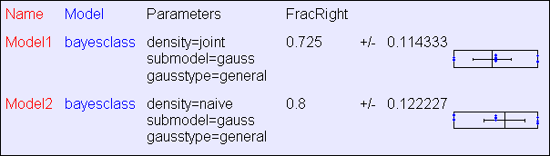
BC Results: “MPG”: 40 records

Slide 87
Classify text with naïve Bayes classifier
Why?
  Learn which news articles are of interest
  Learn to classify web pages by topic
  Spam control…
Naïve Bayes is among the most effective algorithms
What attributes shall we use to represent text documents?

Slide 88
Text Classification – data formulation
Class label:
Target concept Interesting?
Document ➔ {v1=yes, v2=no}
represent each document by vector of words (one attribute per word position in document)
    Remove stopwords, tags…
    Tokenizing
    Remove words appeared only once

Slide 89
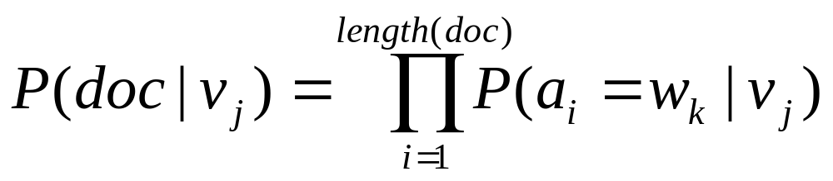
Naïve Bayes Classifier for Text Classification
Build classifier: estimate
P(v1=yes), P(v2=no),
P(doc|v1=yes), P(doc|v2=no)
conditional independence assumption:
Probability word
in position i is w_{k}
for class v_{j}

Slide 90
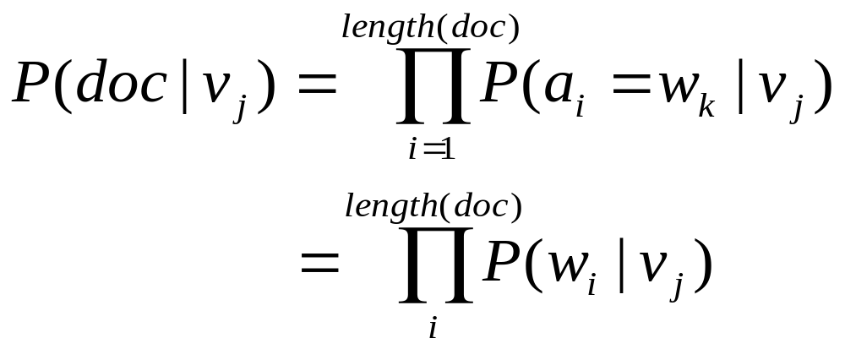
Naïve Bayes Classifier for Text Classification
Additional assumption
drop word positioning
P(a_{i}=w_{k}|v_{j}) = P(a_{m}=w_{k}|v_{j}), for all i, m
Therefore,

Slide 91
Steps in Learning Naïve Bayes Text Classifier
Collect all words and other tokens that occur in examples
Vocabulary = all distinct words and other tokens in the examples
Calculate P(v_{j}) and P(w_{k}|v_{j}) for each target value v_{j} :
  docs_{j} = subset of document examples for which the target value is v_{j}
  P(v_{j}) = |docs_{j}|/|all document examples|
  text_{j} ⬅ a single document created by concatenating all members of docs_{j}

Slide 92
Steps in Learning Naïve Bayes Text Classifier
  n = total number of words in Text_{j} (counting duplicate words multiple times)
  for each word w_{k} in Vocabulary
    n_{k} = number of times word w_{k} occurs in Text_{j}
    P(w_{k}|v_{j}) = (n_{k}+1)/(n+|Vocabulary|)

Slide 93
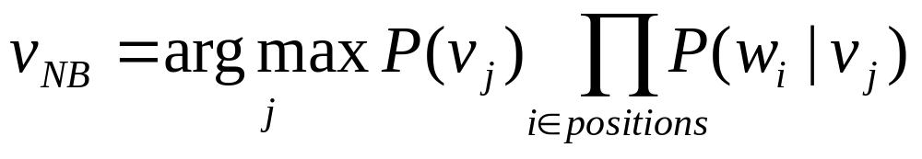
Steps in Classifying a Document using the Naïve Test Classifier
Positions = all word positions in the document that contain tokens found in Vocabulary
Return v_{NB}, where

Slide 94
Example Application: Classify newsgroup documents
Given 1000 training documents from each group,
learn to classify new documents according to
which newsgroup it came from:
comp.graphics misc.forsale
comp.os.ms-windows.misc rec.autos
comp.sys.ibm.pc.hardware rec.motorcycles
comp.sys.mac.hardware rec.sport.hockey
….
Result: Naïve Bayes obtained 89% classification
accuracy

