Slide 1
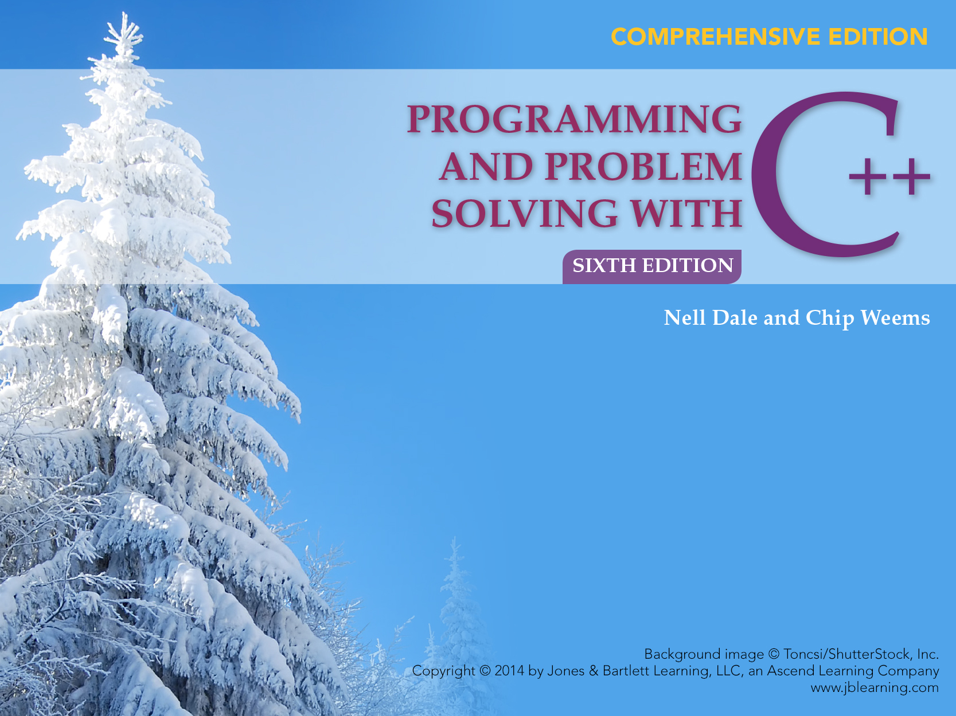
Chapter 1
Overview of Programming and Problem Solving
Slides based on work by Sylvia Sorkin, Community College of Baltimore County - Essex Campus

Slide 2
Chapter 1 Topics
Computer Programming
Programming Life-Cycle Phases
Creating an Algorithm
Machine Language vs. Assembly Language vs. High Level Languages
Compilation and Execution Processes
C++ History
Basic Control Structures
Computer Components
Computing Profession Ethics
Problem-Solving Techniques

Slide 3
What is Computer Programming?
It is the process of planning a sequence of steps(called instructions) for a computer to follow.
STEP 1
STEP 2
STEP 3
. . .

Slide 4
Programming Life Cycle Phases
Problem-Solving
Implementation
Maintenance

Slide 5
Problem-Solving Phase
Analyze the problem and specify what the solution must do
Develop a general solution(algorithm) to solve the problem
Verify that your solution really solves the problem

Slide 6
Sample Problem
Suppose a programmer needs to determine an employee’s weekly wages.
How would the calculations be done by hand?

Slide 7
One Employee’s Wages
In one week an employee works 52 hours at the hourly pay rate of $24.75. Assume a 40.0 hour normal work week and an overtime pay rate factor of 1.5.
What are the employee’s wages?
40 x $ 24.75 = $990.00
12 x 1.5 x $ 24.75= $445.50
___________
$ 1435.50

Slide 8
Weekly Wages, in General
If hours are more than 40.0
wages =
(40.0 * payRate) +
(hours - 40.0) * 1.5 *payRate
otherwise
wages = hours * payRate
RECALL EXAMPLE
(40 x $ 24.75) +(12 x 1.5 x $ 24.75) = $1435.50

Slide 9
An Algorithm
An algorithm is a step-by-step procedure for solving a problem
  with a finite amount of data
  in a finite amount of time

Slide 10
Algorithm to Determine an Employee’s Weekly Wages
1. Get the employee’s hourly payRate
2. Get the hours worked this week
3. Calculate this week’s regular wages
4. Calculate this week’s overtime wages(if any)
5. Add the regular wages to overtime wages(if any) to determine total wages for the week

Slide 11
What is a
Programming Language?
A programming language is a language with strict grammar rules, symbols, and special words used to construct a computer program

Slide 12
Implementation Phase:
Program
Translating your algorithm into a programming language is called coding
With C++, you use
  Documentation -- your written comments
  Compiler -- translates your program into machine language
  Main Program -- may call subalgorithms

Slide 13
Implementation Phase: Test
Testing your program means running(executing) your program on the computer, to see if it produces correct results
If it does not, then you must find out what is wrong with your program or algorithm and fix it--this is called debugging

Slide 14
Maintenance Phase
Use and modify the program to meet changing requirements or correct errors that show up in using it
Maintenance begins when your program is put into use and accounts for the majority of effort on most programs
Wholly rewriting program with a clear design sometimes a useful alternative to modifying the existing program to meet changing requirements

Slide 15
Software Maintenance Tips
Check the existing code works as claimed
Make changes to a copy of the existing code
After acheiving desired functionality, change related aspects of the program to leave clean, consistent code for the next programmer
Keep backup copies of current version of code to assist in developing new programs

Slide 16
Programming Life Cycle
Problem-Solving Phase
  Analysis and Specification
  General Solution(Algorithm)
  Verify
Implementation Phase
  Concrete Solution(Program)
  Test
Maintenance Phase
  Use
  Maintain

Slide 17
A Tempting Shortcut?
DEBUG
REVISE
REVISE
DEBUG
DEBUG
REVISE
Shortcut?
CODE
GOAL
TEST
THINKING
CODE

Slide 18
Memory Organization
Two circuit states correspond to 0 and 1
Bit(short for binary digit) refers to a single 0 or 1
Bit patterns represent both the computer instructions and computer data
1 byte = 8 bits
1 KB = 1024 bytes
1 MB = 1024 x 1024 = 1,048,576 bytes

Slide 19
How Many Possible Digits?
Binary(base 2) numbers use 2 digits: just 0 and 1
Decimal(base 10) numbers use 10 digits: 0 through 9

Slide 20
Machine Language
Is not portable
Runs only on a specific type of computer
Is made up of binary-coded instructions(strings of 0s and 1s)
Is the language that can be directly used by the computer

Slide 21
Assembly Language
An programming upgrade from machine language
Instructions for program are in a mnemonic
Computer cannot directly execute the instructions
An assembler program translates the assembly language instructions into machine binary code

Slide 22
High Level Languages
Portable
User writes program in language similar to natural language such as English
Many use a compiler to translate programs written in certain high-level languages
Examples -- FORTRAN, COBOL, Pascal, Ada, Modula-2, C++, Java
Most are standardized by ISO/ANSI to provide an official description of the language

Slide 23
Three C++ Program Stages
myprog.cpp
myprog.obj
myprog.exe
SOURCE
OBJECT
EXECUTABLE
written in
C++
written in
machine
language
written in
machine
language
via compiler
via linker
other code
from libraries,
etc.

Slide 24
Java Programming Language
Achieves portability by using both a compiler and an interpreter
First, a Java compiler translates a Java program into an intermediate Bytecode--not machine language
Then, an interpreter program called the Java Virtual Machine(JVM) translates a single instruction in the bytecode program to machine language and immediately runs it, one at a time

Slide 25
Basic Control Structures
A sequence is a series of statements (instructions) that execute one after another
A selection(branch) statement is used to determine which of two different statements to execute depending on certain conditions
A looping(repetition) statement is used to repeat statements while certain conditions are met
A subprogram is a smaller part of another program; a collection of subprograms solves the original problem
Each of these ways of structuring statements controls the order in which the computer executes the statements

Slide 26
SEQUENCE
Statement
Statement
Statement
. . .

Slide 27
SELECTION(branch)
IF Condition THEN Statement1 ELSE Statement2
True
Statement1
Statement
Condition
. . .
False
Statement2

Slide 28
LOOP(repetition)
WHILE Condition DO Statement1
False
. . .
Condition
True
Statement

Slide 29
SUBPROGRAM(function)
SUBPROGRAM1
. . .
SUBPROGRAM1
a meaningful collection
of SEQUENCE,
SELECTION, LOOP,
SUBPROGRAM

Slide 30
Some C++ History
1972 : Dennis Ritchie at Bell Labs designs C and 90% of UNIX is then written in C
Late 70’s : OOP becomes popular
Bjarne Stroustrup at Bell Labs adds features to C to form “C with Classes”
1983 : Name C++ first used
1998 : ISO/ANSI standardization of C++

Slide 31
Computer Components
Peripherals
Central Processing Unit(CPU)
Input Device
Control Unit
Output Device
Arithmetic Logic Unit
Auxiliary
Storage
Device
Memory Unit(RAM & Registers)

Slide 32
Memory Unit
Is an ordered sequence of storage cells, each capable of holding a piece of information
Each cell has its own unique address
The information held can be input data, computed values, or your program instructions

Slide 33
Central Processing Unit
Has two components to execute program instructions
  Arithmetic/Logic Unit performs arithmetic operations, and makes logical comparisons
  Control Unit controls the order in which your program instructions are executed

Slide 34
Peripherals
Are input, output, or auxiliary storage devices attached to a computer
  Input Devices include keyboard and mouse
  Output Devices include printers, video display, LCD screens
  Auxiliary Storage Devices include disk drives, scanners, CD-ROM and DVD-ROM drives, modems, sound cards, speakers, and digital cameras

Slide 35
Computing Profession Ethics
Copy software only with permission from the copyright holder
Give credit to another programmer by name whenever using his/her code
Use computer resources only with permission
Guard the privacy of confidential data
Protect computer resources against harmful programs, malware
Use software engineering principles to develop software free from errors

Slide 36
What are the Areas of Computer Science?
The Computing Curriculum 1991(ACM/IEEE)
Algorithms and Data Structures
Architecture
Artificial Intelligence and Robotics
Database and Information Retrieval
Human-Computer Communication
Numerical and Symbolic Computation
Operating Systems
Programming Languages
Software Engineering
Social and Professional Context

Slide 37
Problem Solving Techniques
Ask questions -- about the data, the process, the output, error conditions
Look for familiar things -- certain situations arise again and again
Solve by analogy -- it may give you a place to start
Use means-ends analysis -- determine the I/O and then work out the details

Slide 38
More Problem Solving Techniques
Divide and conquer -- break up large problems into manageable units
Building-block approach -- can you solve small pieces of the problem?
Merge solutions -- instead of joining them end to end to avoid duplicate steps
Overcome mental block -- by rewriting the problem in your own words

Slide 39
Is a year a leap year?
Problem You need to write a set of instructions that can be used to determine whether a year is a leap year. The instructions must be very clear because they are to be used by a class of fourth graders, who have just learned about multiplication and division. They plan to use the instructions as part of an assignment to determine whether any of their relatives were born in a leap year.

Slide 40
Leap Year Algorithm
Prompt the user to enter a four-digit year
Read the year
If IsLeapYear
Write “Year is a leap year”
Otherwise
Write “Year is not a leap year”

Slide 41
IsLeapYear Algorithm
Divide the year by 4
If the remainder isn't zero,
Return false(The year is not a leap year)
Otherwise divide the year by 10 and
If the remainder isn't 0,
Return true(The year is a leap year)
Otherwise, divide the year by 400 and
If the remainder isn't 0
Return false(The year is not a leap year)
Otherwise, Return true(The year is a leap year)

Slide 42
C++ Program
//******************************************************
// LeapYear program
// This program inputs a year and prints whether the year
// is a leap year or not
//******************************************************
#include <iostream> // Access output stream
using namespace std; // Access cout, endl, cin
bool IsLeapYear(int); // Prototype for subalgorithm
int main()
{
…
}

Slide 43
Body of Main
{
int year; // Year to be tested
cout << "Enter a year AD, for example, 1997."
<< endl; // Prompt for input
cin >> year; // Read year
if(IsLeapYear(year)) // Test for leap year
cout << year << " is a leap year." << endl;
else
cout << year << " is not a leap year." << endl;
return 0; // Indicates successful
// completion
}

Slide 44
IsLeapYear
bool IsLeapYear(int year)
// IsLeapYear returns true if year is a leap year and
// false otherwise
{
if(year % 4 != 0) // Is year not divisible by 4?
return false; // If so, can't be a leap year
else if(year % 100 != 0) // Is year not a multiple of 100?
return true; // If so, is a leap year
else if(year % 400 != 0) // Is year not a multiple of 400?
return false; // If so, then is not a leap year
else
return true; // Is a leap year
}

