Slide 1
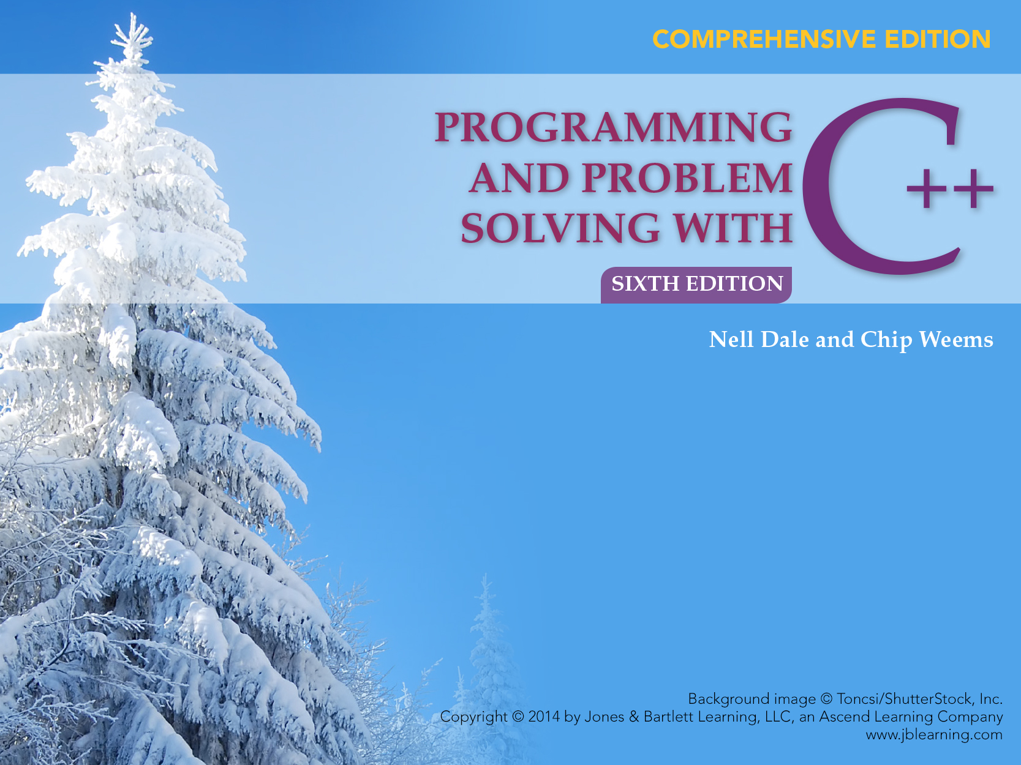
Chapter 7
Additional Control Structures

Slide 2
Chapter 7 Topics
Switch Statement for Multi-Way Branching
Do-While Statement for Looping
For Statement for Looping
Using break and continue Statements

Slide 3
Chapter 7 Topics
Additional C++ Operators
Operator Precedence
Type Coercion in Arithmetic and Relational Precedence

Slide 4
Switch Statement
The Switch statement is a selection control structure for multi-way branching
switch (IntegralExpression)
{
case Constant1 :
Statement(s); // optional
case Constant2 :
Statement(s); // optional
.
.
.
default : // optional
Statement(s); // optional
}

Slide 5
Example of Switch Statement
float weightInPounds = 165.8;
char weightUnit;
. . . // User enters letter for desired weightUnit
switch (weightUnit)
{
case ‘P’ :
case ‘p’ :
cout << weightInPounds
<< “ pounds “ << endl;
break;
case ‘O’ :
case ‘o’ :
cout << 16.0 * weightInPounds
<< “ ounces “ << endl;

Slide 6
Example of Switch Statement, continued
break;
case ‘G’ :
case ‘g’ :
cout << 454.0 * weightInPounds
<< “ grams “ << endl;
break;
default :
cout << “That unit is not handled! “
<< endl;
break;
}

Slide 7
Switch Statement
The value of IntegralExpression (of char, short, int, long or enum type) determines which branch is executed
Case labels are constant (possibly named) integral expressions
Several case labels can precede a statement

Slide 8
Control in Switch Statement
Control branches to the statement following the case label that matches the value of IntegralExpression
Control proceeds through all remaining statements, including the default, unless redirected with break

Slide 9
Control in Switch Statement
If no case label matches the value of IntegralExpression, control branches to the default label, if present
Otherwise control passes to the statement following the entire switch statement
Forgetting to use break can cause logical errors because after a branch is taken, control proceeds sequentially until either break or the end of the switch statement occurs

Slide 10
Do-While Statement
Do-While is a looping control structure in which the loop condition is tested after each iteration of the loop
SYNTAX
do
{
Statement
} while (Expression);
Loop body statement can be a single statement or a block

Slide 11
Example of Do-While
void GetYesOrNo (/* out */ char& response)
// Inputs a character from the user
// Postcondition: response has been input
// && response == ‘y’ or ‘n’
{
do
{
cin >> response; // Skips leading whitespace
if ((response != ‘y’) && (response != ‘n’))
cout << “Please type y or n : “;
} while ((response != ‘y’) && (response != ‘n’));
}

Slide 12
Do-While Loop vs. While Loop
POST-TEST loop (exit-condition)
The looping condition is tested after executing the loop body
Loop body is always executed at least once
PRE-TEST loop (entry-condition)
The looping condition is tested before executing the loop body
Loop body may not be executed at all

Slide 13
Do-While Loop
DO
Statement
WHILE
Expression
TRUE
FALSE
When the expression is tested and found to be false, the loop is exited and control passes to the statement that follows the Do-while statement

Slide 14
For Loop
SYNTAX
for (initialization; test expression; update)
{
Zero or more statements to repeat
}

Slide 15
For Loop
For loop contains
An initialization
An expression to test for continuing
An update to execute after each iteration of the body

Slide 16
Example of For Loop
int num;
for (num = 1; num <= 3; num++)
{
cout << num << “Potato”
<< endl;
}

Slide 17
Example of Repetition
num
?
int num;
for (num = 1; num <= 3; num++)
cout << num << “Potato”
<< endl;
OUTPUT

Slide 18
Example of Repetition
num
1
int num;
for (num = 1; num <= 3; num++)
cout << num << “Potato”
<< endl;
OUTPUT

Slide 19
Example of Repetition
1
num
int num;
for(num = 1; num <= 3; num++)
cout << num << “Potato”
<< endl;
true
OUTPUT

Slide 20
Example of Repetition
num
1
int num;
for (num = 1; num <= 3; num++)
cout << num << “Potato”
<< endl;
OUTPUT
1Potato

Slide 21
Example of Repetition
num
2
int num;
for (num = 1; num <= 3; num++)
cout << num << “Potato”
<< endl;
OUTPUT
1Potato

Slide 22
Example of Repetition
num
2
int num;
for (num = 1; num <= 3; num++)
cout << num << “Potato”
<< endl;
true
OUTPUT
1Potato

Slide 23
Example of Repetition
2
num
int num;
for (num = 1; num <= 3; num++)
cout << num << “Potato”
<< endl;
OUTPUT
1Potato
2Potato

Slide 24
Example of Repetition
num
3
int num;
for (num = 1; num <= 3; num++)
cout << num << “Potato”
<< endl;
OUTPUT
1Potato
2Potato

Slide 25
Example of Repetition
num
3
int num;
for (num = 1; num <= 3; num++)
cout << num << “Potato”
<< endl;
true
OUTPUT
1Potato
2Potato

Slide 26
Example of Repetition
num
3
int num;
for(num = 1; num <= 3; num++)
cout << num << “Potato”
<< endl;
OUTPUT
1Potato
2Potato
3Potato

Slide 27
Example of Repetition
num
4
int num;
for (num = 1; num <= 3; num++)
cout << num << “Potato”
<< endl;
OUTPUT
1Potato
2Potato
3Potato

Slide 28
Example of Repetition
4
num
int num;
for (num = 1; num <= 3; num++)
cout << num << “Potato”
<< endl;
false
OUTPUT
1Potato
2Potato
3Potato

Slide 29
Example of Repetition
num
4
int num;
for (num = 1; num <= 3; num++)
cout << num << “Potato”
<< endl;
false
When the loop control condition
is evaluated and has value false, the
loop is said to be “satisfied” and
control passes to the statement
following the For statement

Slide 30
Output
The output was
1Potato
2Potato
3Potato

Slide 31
Count-controlled Loop
int count;
for (count = 4; count > 0; count--)
{
cout << count << endl;
}
cout << “Done” << endl;
OUTPUT: 4
3
2
1
Done

Slide 32
What is output?
int count;
for (count = 0; count < 10; count++)
{
cout << “*”;
}

Slide 33
Answer
**********
The 10 asterisks are all on one line. Why?

Slide 34
What output from this loop?
int count;
for (count = 0; count < 10; count++);
{
cout << “*”;
}

Slide 35
Answer
No output from the for loop! Why?
The semicolon after the () means that the body statement is a null statement

Slide 36
Answer
In general, the body of the For loop is whatever statement immediately follows the ()
That statement can be a single statement, a block, or a null statement
Actually, the code outputs one * after the loop completes counting to 10

Slide 37
Several Statements in Body Block
const int MONTHS = 12;
int count;
float bill;
float sum = 0.0;
for (count = 1; count <= MONTHS; count++)
{
cout << “Enter bill: “;
cin >> bill;
sum = sum + bill;
}
cout << “Your total bill is : “ << sum << endl;

Slide 38
Break Statement
The Break statement can be used with Switch or any of the 3 looping structures
It causes an immediate exit from the Switch, While, Do-While, or For statement in which it appears
If the Break statement is inside nested structures, control exits only the innermost structure containing it

Slide 39
Guidelines for Choosing Looping Statement
For a simple count-controlled loop, use the For statement
For an event-controlled loop whose body always executes once, use of Do-While statement
For an event-controlled loop about which nothing is known, use a While statement
When in doubt, use a While statement

Slide 40
Continue Statement
The Continue statement is valid only within loops
It terminates the current loop iteration, but not the entire loop
In a For or While, Continue causes the rest of the body of the statement to be skipped; in a For statement, the update is done
In a Do-While, the exit condition is tested, and if true, the next loop iteration is begun

Slide 41
Problem
Given a character, a length, and a width, draw a box
For example, given the values ‘&’, 4, and 6, you would display
    &&&&&&
    &&&&&&
    &&&&&&
    &&&&&&

Slide 42
Additional C++ Operators
Previously discussed C++ Operators include:
  the assignment operator (=)
  the arithmetic operators (+, -, *, /, %)
  relational operators (==, !=, ,<=, >, >=)
  logical operators (!, &&, || )
C++ has many specialized other operators seldom found in other programming languages

Slide 43
Additional C++ Operators
See Table in 7.6 in Text for Additional C++ Operators for a full list of:
  Combined Assignment Operators
  Increment and Decrement Operators
  Bitwise Operators
  More Combined Assignment Operators
  Other Operators

Slide 44
Assignment Operators and Assignment Expressions
(=) is the basic assignment operator
Every assignment expression has a value and a side effect, the value that is stored into the object denoted by the left-hand side
For example, delta = 2 * 12 has the value 24 and side effect of storing 24 into delta

Slide 45
Assignment Expressions
In C ++, any expression become an expression statement when terminated by a semicolon
The following are all valid C++ statements, first 2 have no effect at run time:
23;
2 * (alpha + beta);
delta = 2 * 12;

Slide 46
Increment and Decrement Operators
The increment and decrement operators (++ and --) operate only on variables, not on constants or arbitrary expressions
1) Example of pre-incrementation
int1 = 14;
int2 = ++int1; // int1 == 15 && int2 == 15
2) Example of post-incrementation
int1 = 14;
int2 = int1++; // int1 == 15 && int2 == 14

Slide 47
Bitwise Operators
Bitwise operators (e.g., <<, >>, and |) are used for manipulating individual bits within a memory cell
<< and >> are left and right shift operators, respectively that take bits within a memory cell and shift them to the left or the right
Do not confuse relational && and || operators used in logical expressions with & and | bitwise operators

Slide 48
The Cast Operation
Explicit type cast used to show that the type conversion is intentional
In C++, the cast operation comes in three forms:
  intVar = int(floatVar); // Functional notation
  intVar = (int)floatVar; // Prefix notation
  intVar = static_cast<int>(floatVar); // Keyword notation

Slide 49
The Cast Operation
Restriction on use of functional notation: Data type name must be a single identifier
If type name consists of more than one identifier, prefix notation or keyword notation must be used
Most software engineers now recommend use of keyword cast because it is easier to find these keywords in a large program

Slide 50
The sizeof Operator
The sizeof operator --a unary operator that yields the size, in bytes, of its operand
The operand can be a variable name , as in sizeof someInt
Alternatively, the operand can be the name of a data type enclosed in parentheses: (sizeof float)

Slide 51
The ? Operator
? : operator, also called the conditional operator is a three-operand operator
Example of its use: set a variable max equal to the larger of two variables a and b.
With the ?: operator , you can use the following assignment statement:
max = (a>b) ? a : b;

Slide 52
Operator Precedence
Following Table on slide 53 and slide 54 groups discussed operators by precedence levels for C++
Horizontal line separates each precedence level from the next-lower level
Column level Associativity describes grouping order.
Within a precedence level, operators group Left to right or, Right to left

Slide 53
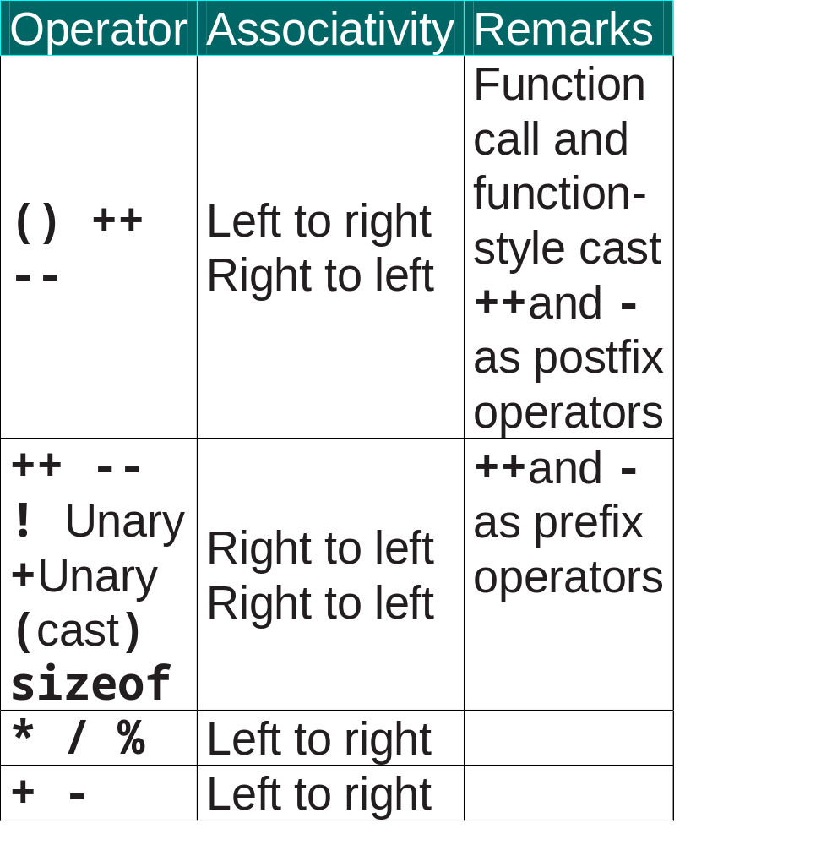

Slide 54

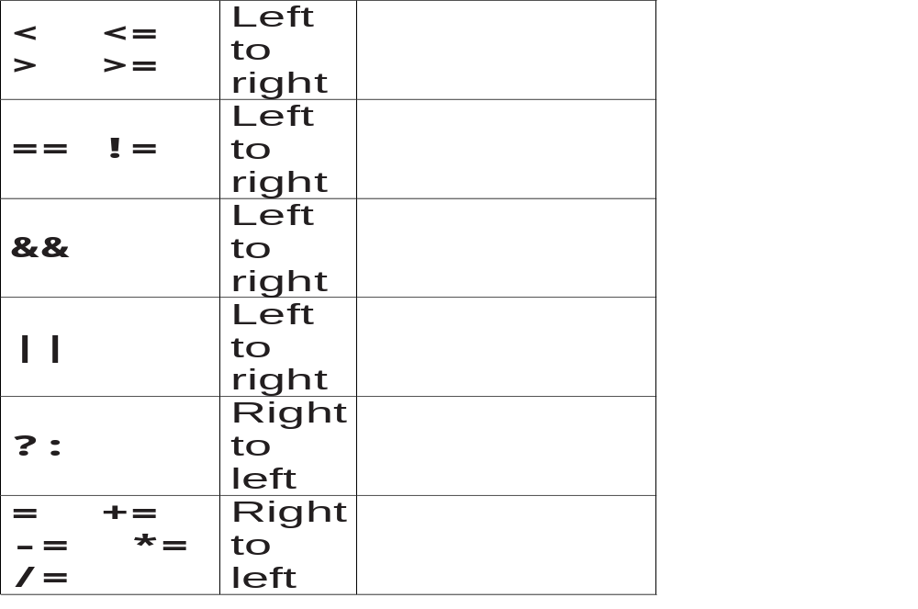

Slide 55
Type Coercion in Arithmetic and Relational Expressions
If two operands are of different types, one of them is temporarily promoted (or widened) to match the data type of the other
Rule of type coercion in an arithmetic coercion:
Step 1: Each char, short, bool, or enumeration value is promoted (widened) to int. If both operands are now int, the result is an int expression.

Slide 56
Type Coercion in Arithmetic and Relational Expressions
Step 2: If Step 1 still leaves a mixed type expression, the following precedence of types is used:
int, unsigned int, long, float, double, long double

Slide 57
Type Coercion in Arithmetic and Relational Expressions
Example: expression someFloat+2
Step 1 leaves a mixed type expression
In Step 2, int is a lower type than the float value---for example, 2.0
Then the addition takes place, and the type of the entire expression is float

Slide 58
Type Coercion in Arithmetic and Relational Expressions
This description also holds for relational expressions such as someInt <= someFloat
Value of someInt temporarily coerced to floating-point representation before the comparison occurs
Only difference between arithmetic and relational expressions:
Resulting type of relational expression is always bool---the value true or false

