Slide 1
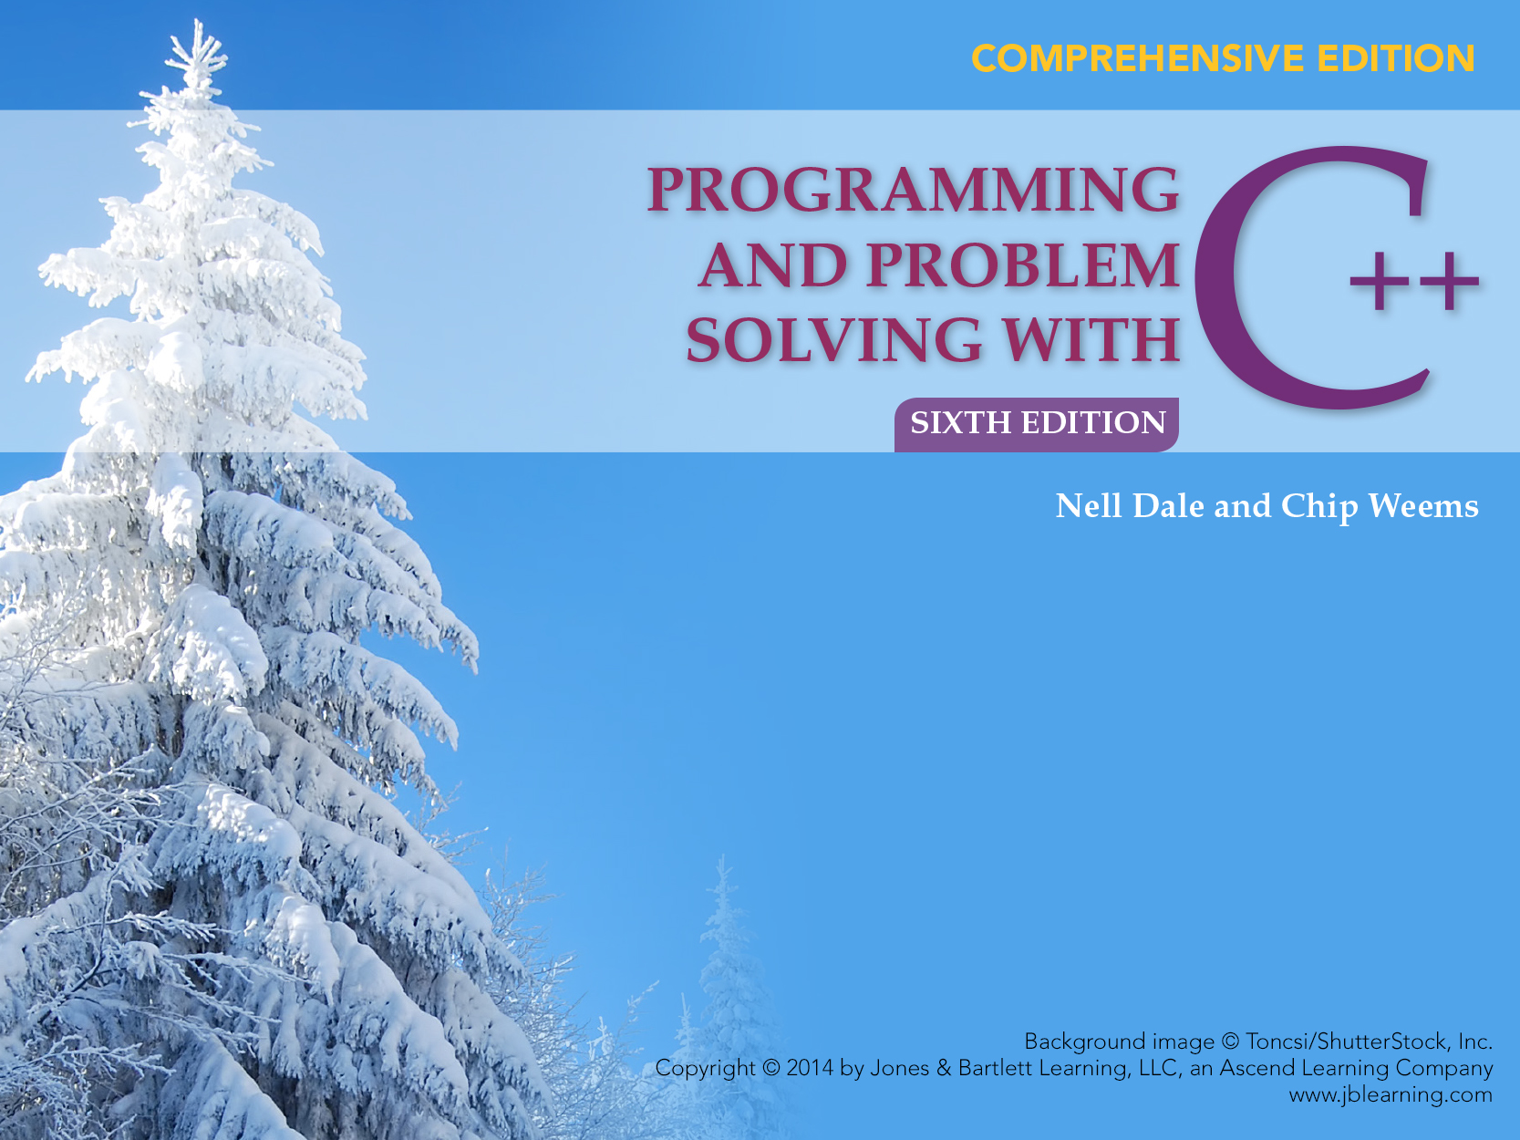
Chapter 8
Functions

Slide 2
Chapter 8 Topics
Writing a Program Using Functional Decomposition
Writing a Void Function for a Task
Using Function Arguments and Parameters

Slide 3
Chapter 8 Topics
Differences between Value Parameters and Reference Parameters
Using Local Variables in a Function
Function Preconditions and Postconditions

Slide 4
Functions
Every C++ program must have a function called main
Program execution always begins with function main
Any other functions are subprograms that must be explicitly called

Slide 5
Function Calls
One function calls another by using the name of the called function followed by ()s that enclose an argument list, which may be empty
A function call temporarily transfers control from the calling function to the called function

Slide 6
Function Call Syntax
FunctionName( Argument List )
The argument list is a way for functions to communicate with each other by passing information
The argument list can contain 0, 1, or more arguments, separated by commas, depending on the function

Slide 7
Two Parts of Function Definition
int Cube(int n) heading
{
return n * n * n; body
}

Slide 8
What is in a heading?
type of value returned
parameter list
name of function
int Cube (int n)

Slide 9
Prototypes
A prototype looks like a heading but must end with a semicolon, and its parameter list needs only to contain the type of each parameter
int Cube(int ); // Prototype

Slide 10
Function Calls
When a function is called, temporary memory is allocated for:
its value parameters;
any local variables; and
for the function’s name if the return type is not void
Flow of control then passes to the first statement in the function’s body

Slide 11
Function Calls
The called function’s statements are executed until a return statement (with or without a return value) or the closing brace of the function body is encountered
Then control goes back to where the function was called

Slide 12
#include <iostream>
int Cube(int); // prototype
using namespace std;
void main()
{
int yourNumber;
int myNumber;
yourNumber = 14;
myNumber = 9;
cout << “My Number = “ << myNumber;
cout << “its cube is “ << Cube(myNumber) << endl;
cout << “Your Number = “ << yourNumber;
cout << “its cube is “ << Cube(yourNumber)
<< endl;
}
arguments

Slide 13
Successful Function Compilation
Before a function is called in your program, the compiler must have previously processed either:
the function’s prototype or
the function’s definition (heading and body)

Slide 14
Return Values
In C++, a value-returning function returns in its identifier one value of the type specified in its heading and prototype (called the return type)
In contrast, a void-function cannot return any value in its identifier

Slide 15
Example
Write a void function called DisplayMessage(),
which you can call from main(), to describe the
pollution index value it receives as a parameter
Your city describes a pollution index
less than 35 as “Pleasant”,
35 through 60 as “Unpleasant”,
and above 60 as “Health Hazard”

Slide 16
parameter
void DisplayMessage(int index)
{
if(index < 35)
cout << “Pleasant”;
else if(index <= 60)
cout << “Unpleasant”;
else
cout << “Health Hazard”;
}

Slide 17
The Rest of the Program
#include <iostream>
void DisplayMessage(int); // Prototype
using namespace std;
int main()
{

Slide 18
The Rest of the Program, cont...
cout << “Enter air pollution index”;
cin >> pollutionIndex;
DisplayMessage(pollutionIndex); // Call
return 0;
}
argument

Slide 19
Return Statement
return; // No value to return
Is valid only in the body block of a void function
Causes control to leave the function and immediately return to the calling block, leaving any subsequent statements in the function body unexecuted

Slide 20
Header Files
Header Files contain
  Named constants like const int INT_MAX = 32767;
  Function prototypes like float sqrt(float);
  Classes like
  string, ostream, istream
  Objects like
  cin, cout

Slide 21
Program with Several Functions
function prototypes
main function
Square function
Cube function

Slide 22
Value-Returning Functions
#include <iostream>
int Square(int); // Prototypes
int Cube(int);
using namespace std;
int main()
{
cout << “The square of 27 is “
<< Square(27) << endl;
cout << “The cube of 27 is “
<< Cube(27) << endl;
return 0;
}
function calls

Slide 23
Rest of Program
int Square(int n) // Header and body
{
return n * n;
}
int Cube(int n) // Header and body
{
return n * n * n;
}

Slide 24
Void Functions Stand Alone
#include <iostream>
void DisplayMessage(int);// Prototype
using namespace std;
int main() argument
{
DisplayMessage(15); // Function call
cout << “Good Bye“ << endl;
return 0;
}

Slide 25
Parameters
parameter
void DisplayMessage(int n)
{
cout << “I have liked math for “
<< n << “ years”
<< endl;
return;
}

Slide 26
Parameter List
A parameter list is the means used for a function to share information with the block containing the call

Slide 27
Classified by Location
Arguments Parameters
Always appear in
a function call within the calling block
Always appear in
the function heading, or function prototype

Slide 28
Different Terms
Some C++ books
Use the term “actual parameters” for arguments
Those books then refer to parameters as “formal parameters”

Slide 29
Argument
in Calling Block
4000
25
age
Value Parameter Reference Parameter
The value of the
argument (25)
is passed
to the function when
it is called
The memory address (4000)
of the argument
is passed
to the function when
it is called
In this case, the
argument can be a
variable identifier,
constant,
or expression
In this case, the argument
must be a variable
identifier

Slide 30
Default Parameters
Simple types, structs, and classes are value parameters by default
Arrays are always reference parameters
Other reference parameters are marked as such by having an ampersand (&) beside their type

Slide 31
Use of Reference Parameters
Reference parameters should be used when the function is to assign a value to, or
When the function is to change the value of, a variable from the calling block without an assignment statement in the calling block

Slide 32

Using a Reference Parameter
Is like giving someone the key to your home
The key can be used by the other person to change the contents of your home!

Slide 33
Main Program Memory
4000
25
age
If you pass a copy of age to a function, it is called “pass-by-value” and the function will not be able to change the contents of age in the calling block; it is still 25 when you return

Slide 34
Main Program Memory
4000
25
age
BUT, if you pass 4000, the address of age to a function, it is called “pass-by-reference” and the function will be able to change the contents of age in the calling block; it could be 23 or 90 when you return

Slide 35
Additional Terms
Pass-by-reference
is also called . . .
  pass-by-address, or
  pass-by-location
      Can you explain why?

Slide 36
Example of Pass-by-Reference
We want to find 2 real roots for a quadratic equation with coefficients a,b,c.
Write a prototype for a void function named GetRoots() with 5 parameters. The first 3 parameters are type float. The last 2 are reference parameters of type float.

Slide 37
// Prototype
void GetRoots(float, float, float,
float&, float&);
Now write the function definition using this information :
This function uses 3 incoming values a, b, c from the calling block. It calculates 2 outgoing values root1 and root2 for the calling block. They are the 2 real roots of the quadratic equation with coefficients a, b, c.

Slide 38
void GetRoots(float a, float b, float c, float& root1, float& root2)
{ float temp; // Local variable temp = b * b - 4.0 * a * c; root1 =(-b + sqrt(temp)) /(2.0 * a); root2 =(-b - sqrt(temp)) /(2.0 * a); return;
}
Function Definition

Slide 39
#include <iostream>
#include <fstream>
#include <cmath>
// Prototype
void GetRoots(float, float, float, float&, float&);
using namespace std;
void main()
{

Slide 40
ifstream myInfile;
ofstream myOutfile;
float a, b, c, first, second;
int count = 0;
...... // Open files
while(count < 5)
{ myInfile >> a >> b >> c;
// Call
GetRoots(a, b, c, first, second);
myOutfile << a << b << c
<< first << second << endl;
count++;
}
...... // Close files
}

Slide 41
Pass-by-value
“incoming”
value of
argument
CALLING
BLOCK
FUNCTION
CALLED

Slide 42
Pass-by-reference
“incoming”
original value of
argument
CALLING
BLOCK
FUNCTION
CALLED
“outgoing”
changed value of
argument
OR,

Slide 43
Pass-by-reference
OR argument
has no value yet
when call occurs
CALLING
BLOCK
FUNCTION
CALLED
“outgoing”
new value of
argument

Slide 44
Data Flow Determines
Passing-Mechanism
Parameter Data Flow Passing-Mechanism
Incoming /* in */ Pass-by-value
Outgoing /* out */ Pass-by-reference
Incoming/outgoing Pass-by-reference
/* inout */

Slide 45
Questions
Why is a function used for a task?
To cut down on the amount of detail in your main program (encapsulation)
Can one function call another function?
Yes
Can a function even call itself?
Yes, that is called recursion; it is very useful and requires special care in writing

Slide 46
More Questions
Does it make any difference what names you use for parameters?
No; just use them in function body
Do parameter names and argument names have to be the same?
No

Slide 47
Functions are written to specifications
The specifications state:
the return type;
the parameter types;
whether any parameters are “outgoing” and
what task the function is to perform with its parameters
The advantage is that teamwork can occur without knowing what the argument identifiers (names) will be

Slide 48
Write prototype and function definition for
A void function called GetRating() with one reference parameter of type char
The function repeatedly prompts the user to enter a character at the keyboard until one of these has been entered: E, G, A, P to represent Excellent, Good, Average, Poor

Slide 49
void GetRating(char&); // Prototype
void GetRating(char& letter)
{
cout << “Enter employee rating.” << endl;
cout << “Use E, G, A, or P : ”;
cin >> letter;
while((letter != ‘E’) &&
(letter != ‘G’) &&
(letter != ‘A’) &&
(letter != ‘P’))
{
cout << “Rating invalid. Enter again: ”;
cin >> letter;
}
}

Slide 50
An Assertion
An assertion is a truth-valued statement--one that is either true or false (not necessarily in C++ code)
Examples
studentCount > 0
sum is assigned && count > 0
response == ‘y’ or ‘n’
0.0 <= deptSales <= 25000.0
beta == beta @ entry * 2

Slide 51
Preconditions and Postconditions
A precondition is an assertion describing everything that the function requires to be true at the moment the function is invoked
A postcondition describes the state at the moment the function finishes executing, providing the precondition is true
The caller is responsible for ensuring the precondition, and the function code must ensure the postcondition
For example . . .

Slide 52
Function with Postconditions
void GetRating(/* out */ char& letter)
// Precondition: None
// Postcondition: User has been
// prompted to enter a letter
// && letter == one of these
// input values: E,G,A, or P

Slide 53
Function with Postconditions, continued
{
cout << “Enter employee rating.” << endl;
cout << “Use E, G, A, or P : ”;
cin >> letter;
while((letter != ‘E’) &&
(letter != ‘G’) &&
(letter != ‘A’) && (letter != ‘P’))
{
cout << “Rating invalid. Enter again: ”;
cin >> letter;
}
}

Slide 54
Function with Preconditions and Postconditions
void GetRoots( /* in */ float a, /* in */ float b,
/* in */ float c,
/* out */ float& root1,
/* out */ float& root2)
// Precondition: a, b, and c are assigned
// && a != 0 && b*b - 4*a*c != 0
// Postcondition: root1 and root2 are assigned
// && root1 and root2 are roots of quadratic with
// coefficients a, b, c

Slide 55
Function with Preconditions and Postconditions, continued...
{
float temp;
temp = b * b - 4.0 * a * c;
root1 =(-b + sqrt(temp)) /(2.0 * a);
root2 =(-b - sqrt(temp)) /(2.0 * a);
return;
}

Slide 56
Another Function with Preconditions and Postconditions
void Swap( /* inout */ int& firstInt,
/* inout */ int& secondInt)
// Precondition: firstInt and secondInt
// are assigned
// Postcondition: firstInt == secondInt@entry
// && secondInt == firstInt@entry

Slide 57
Another Function with Preconditions and Postconditions, cont...
{
int temporaryInt;
temporaryInt = firstInt;
firstInt = secondInt;
secondInt = temporaryInt;
}

