Slide 1
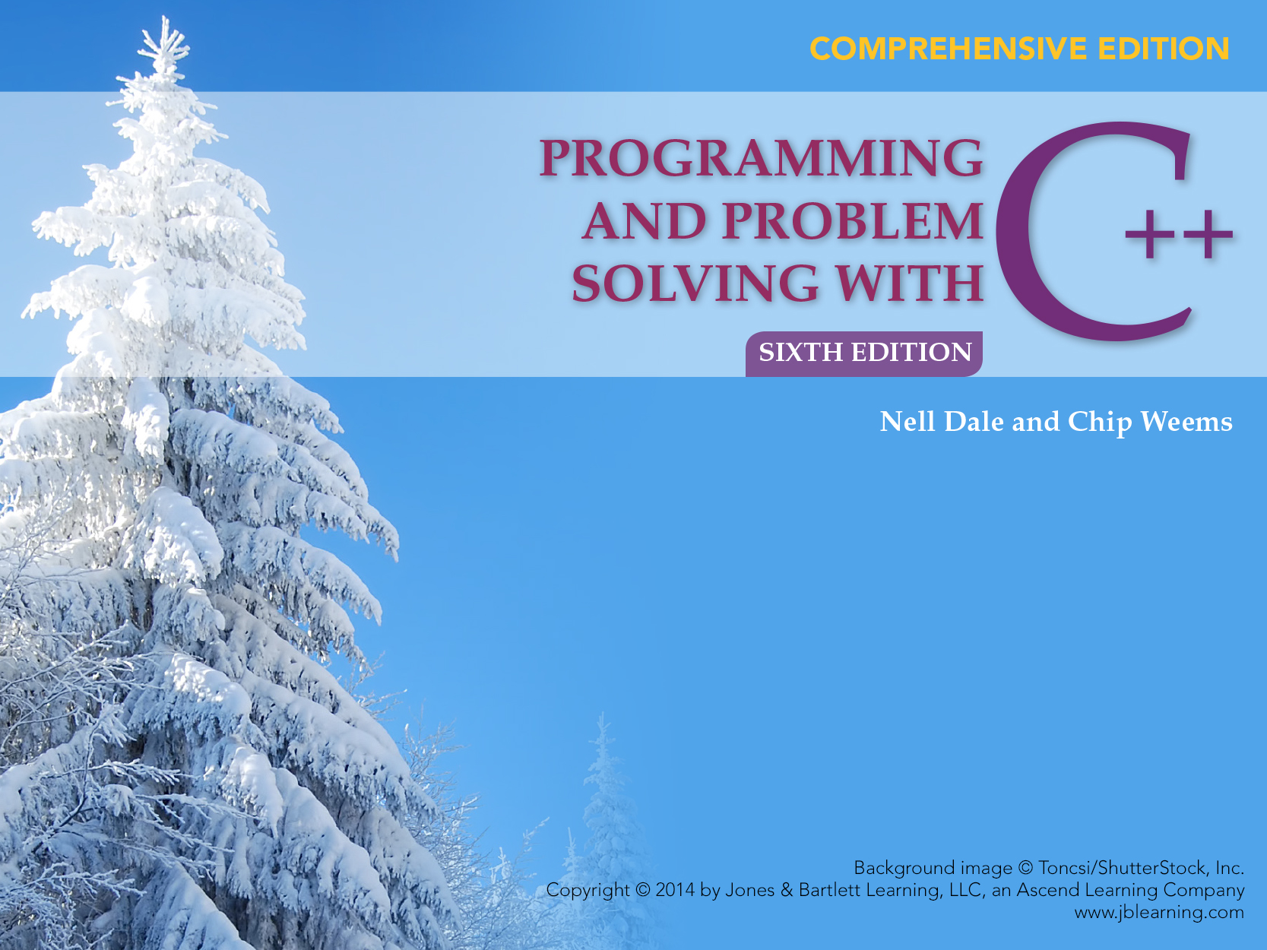
Chapter 9
Scope, Lifetime, and More on Functions

Slide 2
Chapter 8 Topics
Local Scope vs. Global Scope of an Identifier
Detailed Scope Rules to Determine which Variables are Accessible in a Block
Determining the Lifetime of a Variable
Writing a Value-Returning Function for a Task
Some Value-Returning Functions with Prototypes in Header Files cctype and cmath
Creating and Using a Module Structure Chart
Stub Testing a Program

Slide 3
Scope of Identifier
The scope of an identifier (or named constant) is the region of program code in which it is legal to use that identifier for any purpose

Slide 4
Local Scope vs. Global Scope
The scope of an identifier that is declared inside a block (this includes function parameters) extends from the point of declaration to the end of the block
The scope of an identifier that is declared outside of all namespaces, functions, and classes extends from point of declaration to the end of the entire file containing the program code

Slide 5
const float TAX_RATE = 0.05; // Global constant
float tipRate; // Global variable
void handle (int, float); // Function prototype
using namespace std;
int main ()
{
int age; // age and bill local to this block
float bill;
. // a, b, and tax cannot be used here
. // TAX_RATE and tipRate can be used
handle (age, bill);
return 0;
}
void handle (int a, float b)
{
float tax; // a, b, and tax local to this block
. // age and bill cannot be used here
. // TAX_RATE and tipRate can be used
}

Slide 6
Detailed Scope Rules
Function names have global scope
A function parameter’s scope is identical to the scope of a local variable declared in the outermost block of the function body
A global variable’s (or constant’s) scope extends from its declaration to the end of the file, except as noted in rule 5
A local variable’s (or constant’s) scope extends from its declaration to the end of the block in which it is declared, including any nested blocks, except as noted in rule 5
An identifier’s scope does not include any nested block that contains a locally declared identifier with the same name (local identifiers have name precedence)

Slide 7
Name Precedence Implemented by Compiler Determines Scope
When an expression refers to an identifier,
  The compiler first checks the local declarations
  If the identifier isn’t local, the compiler works outward through each level of nesting until it finds an identifier with same name where it stops
Any identifier with the same name declared at a level further out is never reached
If compiler reaches global declarations and still can’t find the identifier, an error message results

Slide 8
Namespace Scope
The scope of an identifier declared in a namespace definition extends from the point of declaration to the end of the namespace body, and its scope includes the scope of a using directive specifying that namespace

Slide 9
3 Ways to Use Namespace Identifiers
  Use a qualified name consisting of the namespace, the scope resolution operator :: and the desired the identifier
  alpha = std::abs(beta);
  Write a using declaration
using std::abs;
alpha = abs(beta);
  Write a using directive locally or globally
using namespace std;
alpha = abs_x0008_(beta);

Slide 10
Name Precedence
(or Name Hiding)
When a function declares a local identifier with the same name as a global identifier, the local identifier takes precedence within that function

Slide 11
Memory Allocation
int someInt; // For the global variable
int Square (int n) // For instructions in body
{
int result; // For the local variable
result = n * n;
return result;
}

Slide 12
No Memory Allocation
int Square (int n);
// Function prototype
extern int someInt;
// someInt is defined in another file
// and is thus global to everything in
// this file

Slide 13
Lifetime of a Variable
The lifetime of a variable is the time during program execution in which an identifier actually has memory allocated to it

Slide 14
Lifetime of Local Automatic Variables
Their storage is created (allocated) when control enters the function
Local variables are “alive” while function is executing
Their storage is destroyed (deallocated) when function exits

Slide 15
Lifetime of Global Variables
Their lifetime is the lifetime of the entire program
Their memory is allocated when program begins execution
Their memory is deallocated when the entire program terminates

Slide 16
Automatic vs. Static Variable
Storage for automatic variable is allocated at block entry and deallocated at block exit
Storage for static variable remains allocated throughout execution of the entire program

Slide 17
Default Allocation
Local variables are automatic
To obtain a static local variable, you must use the reserved word static in its declaration

Slide 18
Static and Automatic
Local Variables
int popularSquare(int n)
{
static int timesCalled = 0;
// Initialized only once
int result = n * n;
// Initialized each time
timesCalled = timesCalled + 1;
cout << “Call # “ << timesCalled << endl;
return result;
}

Slide 19
Data Flow Determines
Passing-Mechanism
Parameter Data Flow Passing-Mechanism
Incoming /* in */ Pass-by-value
Outgoing /* out */ Pass-by-reference
Incoming/outgoing Pass-by-reference
/* inout */

Slide 20
Prototype for float Function
AmountDue() is a function with 2 parameters
The first is type char, the other is type int
float AmountDue (char, int);
This function calculates and returns the amount due for local phone calls
The char parameter contains either a ‘U’ or an ‘L’ indicating Unlimited or Limited service; the int variable contains the number of calls made
Assume Unlimited service is $40.50 per month and limited service is $19.38 for up to 30 calls, and $.09 per additional call

Slide 21
float AmountDue (char kind, int calls)
// Two parameters
{
float result; // One local variable
const float UNLIM_RATE = 40.50,
LIM_RATE = 19.38,
EXTRA = .09;
if (kind ==‘U’)
result = UNLIM_RATE;
else if ((kind == ‘L’) && (calls <= 30))
result = LIM_RATE;
else
result = LIM_RATE + (calls - 30) * EXTRA;
return result;
}

Slide 22
#include <iostream>
#include <fstream>
float AmountDue (char, int); // Prototype
using namespace std;
void main ()
{
ifstream myInfile;
ofstream myOutfile;
int areaCode, phoneNumber, calls;
int count = 0;
float bill;
char service;
. . . . . . // Open files
while (count < 100)
{
myInfile >> service >> phoneNumber >> calls;
bill = AmountDue (service, calls); // Function call
myOutfile << phoneNumber << bill << endl;
count++;
}
. . . . . . // Close files
}

Slide 23
To handle the call
AmountDue(service, calls)
MAIN PROGRAM MEMORY
4000 4002 4006
Locations:
200
?
‘U’
calls bill service
TEMPORARY MEMORY for function to use
7000 7002 7006
Locations:
calls result kind

Slide 24
Handling Function Call bill = AmountDue(service, calls);
Begins by evaluating each argument
A copy of the value of each is sent to temporary memory which is created and waiting for it
The function body determines result
Result is returned and assigned to bill

Slide 25
int Power (/* in */ int x, // Base number
/* in */ int n) // Power
// This function computes x to the n power
// Precondition:
// x is assigned && n >= 0 && (x to the n) <= INT_MAX
// Postcondition:
// Return value == x to the n power
{
int result; // Holds intermediate powers of x
result = 1;
while (n > 0)
{
result = result * x;
n--;
}
return result;
}

Slide 26
Syntax Template for
Function Definition
DataType FunctionName ( Parameter List )
{
Statement
.
.
.
}

Slide 27
Using bool Type with a Loop
. . .
bool dataOK; // Declare Boolean variable
float temperature;
. . .
dataOK = true; // Initialize the Boolean variable
while (dataOK)
{
. . .
if (temperature > 5000)
dataOK = false;
}

Slide 28
A Boolean Function
bool IsTriangle ( /* in */ float angle1,
/* in */ float angle2,
/* in */ float angle3)
// Function checks if 3 incoming values add up to
// 180 degrees, forming a valid triangle
// Precondition:
// angle1, angle2, angle3 are assigned
// Postcondition:
// Return == true, f sum is within 0.000001 of
// 180.0 degrees
// == false, otherwise
{
return (fabs(angle1 + angle2 + angle3 - 180.0)
< 0.000001);
}

Slide 29
Some Prototypes in Header File < cctype >
int isalpha (char ch);
// If ch is an alphabet character,
// Return value == nonzero
// == zero, otherwise
int isdigit (char ch);
// If ch is a digit (‘0’ - ‘9’),
// Return value == nonzero
// == zero, otherwise
int islower (char ch);
// If ch is a lowercase letter (‘a’ - ‘z’),
// Return value == nonzero
// == zero, otherwise
int isupper (char ch);
// If ch is an uppercase letter (‘A’ - ‘Z’),
// Return value == nonzero
// == zero, otherwise

Slide 30
Some Prototypes in Header File < cmath >
double cos (double x);
// Return value == trigonometric cosine of angle x
// in radians
double exp (double x);
// Return value == the value e (2.718 . . .) raised to
// the power x
double log (double x);
// Return value == natural (base e) logarithm of x
double log10 (double x);
// Return value == common (base 10) logarithm of x
double pow (double x, double y);
// Return value == x raised to the power y

Slide 31
What will the function do with your argument(s)?
The answer to this question determines
whether your function parameter
should be value or reference
as follows . . .

Slide 32
Value vs Reference
If the function--
Function parameter should be--
only uses its value
assigns it a value
changes its value
/* in */ value parameter
/* out */ reference parameter
using &
/* inout */ reference parameter
using &
NOTE: I/O stream variables and arrays are exceptions

Slide 33
Use Void or Value-Returning Functions?
If it must return more than one value or modify any of the caller’s arguments, do not use a value-returning function
If it must perform I/O, do not use a value-returning function
If there is only one value returned, and it is Boolean, a value-returning function is appropriate
If there is only one value returned, and that value will be used immediately in an expression, a value-returning function is appropriate
When in doubt, use a void function; you can recode any value-returning function as a void function by adding an extra outgoing parameter
If both void and value-returning are acceptable, use the one you prefer

Slide 34
Use Stubs in Testing a Program
A stub is a dummy function with a very simple body, often just an output statement that this function was reached, and a return value (if any is required) of the correct type
Its name and parameter list is the same as the function that will actually be called by the program being tested

