Slide 1
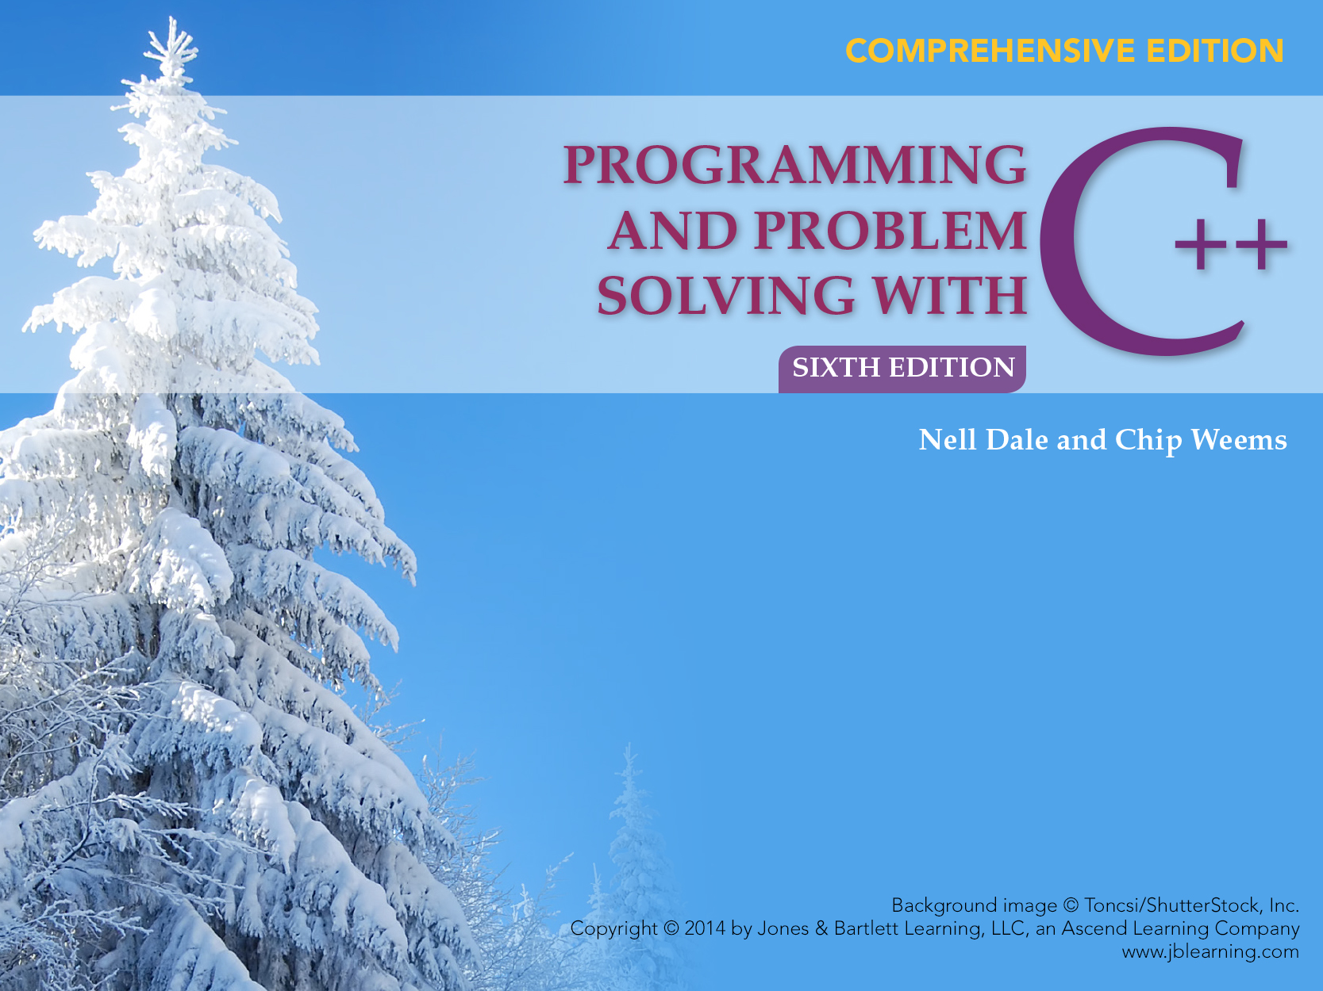
Chapter 10 Simple Data Types: Built-In and User-Defined

Slide 2
Chapter 10 Topics
External and Internal Representations of Data
Integral and Floating Point Data Types
Using Combined Assignment Operators
Using an Enumeration Type

Slide 3
Chapter 10 Topics
Creating and Including User-Written Header Files
Meaning of a Structured Data Type
Declaring and Using a struct Data Type
C++ union Data Type

Slide 4
C++ Simple Data Types
simple types
integral
floating
char short int long bool enum float double long double
unsigned

Slide 5
By definition,
The size of a C++ char value is always 1 byte
exactly one byte of memory space
Sizes of other data type values in C++ are machine-dependent
‘A’

Slide 6
Using one byte (= 8 bits)
0 1 1 0 0 0 1 1
How many different numbers can be represented using 0’s and 1’s?
Each bit can hold either a 0 or a 1. So there are just two choices for each bit, and there are 8 bits.
2 x 2 x 2 x 2 x 2 x 2 x 2 x 2 = 2⁸ = 256

Slide 7
Using two bytes (= 16 bits)
0 1 1 0 0 0 1 1
0 1 0 0 1 0 1 0
2¹⁶ = 65,536
So 65, 636 different numbers can be represented
If we wish to have only one number representing the integer zero, and half of the remaining numbers positive, and half negative, we can obtain the 65,536 numbers in the range -32,768 . . . . 0 . . . . 32,767

Slide 8
Some Integral Types
Type Size in Bytes Minimum Value Maximum Value
char 1 -128 127
short 2 -32,768 32,767
int 2 -32,768 32,767
long 4 -2,147,483,648 2,147,483,647
NOTE: Values given for one machine; actual sizes are machine-dependent

Slide 9
Data Type bool
Domain contains only 2 values, true and false
Allowable operation are the logical (!, &&, ||) and relational operations

Slide 10
Operator sizeof
sizeof A C++ unary operator that yields the size on your machine, in bytes, of its single operand. The operand can be a variable name, or it can be the name of a data type enclosed in parentheses.
int age;
cout << “Size in bytes of variable age is “
<< sizeof age << end;
cout << “Size in bytes of type float is “
<< sizeof (float) << endl;

Slide 11
The only guarantees made by C++ are . . .
1 = sizeof(char) <= sizeof(short) <= sizeof(int) <= sizeof(long)
1 <= sizeof (bool) <= sizeof (long)
sizeof (float) <= sizeof (double) <= sizeof (long double)

Slide 12
. . . and the following three other C++ guarantees
char is at least 8 bits
short is at least 16 bits
long is at least 32 bits

Slide 13
Exponential (Scientific) Notation
2.7E4 means 2.7 x 10 ⁴ =
2.7000 =
27000.0
2.7E-4 means 2.7 x 10 ⁻ ⁴ =
0002.7 =
0.00027

Slide 14
Floating Point Types
Type Size in Bytes Minimum Maximum
Positive Value Positive Value
float 4 3.4E-38 3.4E+38
double 8 1.7E-308 1.7E+308
long double 10 3.4E-4932 1.1E+4932
NOTE: Values given for one machine; actual sizes are machine-dependent

Slide 15
More about Floating Point Types
Floating point constants in C++ like 94.6 without a suffix are of type double by default
To obtain another floating point type constant a suffix must be used
The suffix F or f denotes float type, as in 94.6F
The suffix L or l denotes long double, as in 94.6L

Slide 16
Header Files climits and cfloat
Contain constants whose values are the maximum and minimum for your machine
Such constants are FLT_MAX, FLT_MIN, LONG_MAX, LONG_MIN

Slide 17
Header Files climits and cfloat
#include <climits>
using namespace std;
cout << “Maximum long is “ << LONG_MAX
<< endl;
cout << “Minimum long is “ << LONG_MIN
<< endl;

Slide 18
C++ Data Types
simple
structured
integral enum
floating
array struct union class
char short int long bool
address
float double long double
pointer reference

Slide 19
ASCII and EBCDIC
ASCII (pronounced ask-key) and EBCDIC are two character sets commonly used to represent characters internally as one-byte integers
ASCII is used on most personal computers; EBCDIC is used mainly on IBM mainframes
The character ‘A’ is internally stored as integer 65 in ASCII and 193 in EBCDIC
In both sets, uppercase and lowercase letters are in alphabetical order, allowing character comparisons such as ‘A’ < ‘B’, ‘a’ < ‘b’...
ASCII is a subset of Unicode, a character set that uses two bytes to represent each character and has a wider international following than ASCII

Slide 20
ASCII (Printable) Character Set 0 1 2 3 4 5 6 7 8 9
Right
Digit
Left
Digit(s)
3 ” ! “ # $ % & ‘
4 ( ) * + , - . / 0 1
5 2 3 4 5 6 7 8 9 : ;
6 < = > ? @ A B C D E
7 F G H I J K L M N O
8 P Q R S T U V W X Y
9 Z [ \ ] ^ _ ` a b c
10 d e f g h I j k l m
11 n o p q r s t u v w
12 x y z { | } ~

Slide 21
C++ Data Types
simple
structured
integral enum
floating
array struct union class
char short int long bool
address
float double long double
pointer reference

Slide 22
typedef statement
typedef creates an additional name for an already existing data type
Before bool type became part of ISO-ANSI C++, a Boolean type was simulated this way on the following slide

Slide 23
typedef statement
typedef int Boolean;
const Boolean true = 1;
const Boolean false = 0;
:
Boolean dataOK;
:
dataOK = true;

Slide 24
Combined Assignment Operators
int age;
cin >> age;
A statement to add 3 to age
age = age + 3;
OR
age += 3;

Slide 25
A statement to subtract 10 from weight
int weight;
cin >> weight;
weight = weight - 10;
OR
weight -= 10;

Slide 26
A statement to divide money by 5.0
float money;
cin >> money;
money = money / 5.0;
OR
money /= 5.0;

Slide 27
A statement to double profits
float profits;
cin >> profits;
profits = profits * 2.0;
OR
profits *= 2.0;

Slide 28
A statement to raise cost 15%
float cost;
cin >> cost;
cost = cost + cost * 0.15;
OR
cost = 1.15 * cost;
OR
cost *= 1.15;

Slide 29
Enumeration Types
C++ allows creation of a new simple type by listing (enumerating) all the ordered values in the domain of the type
EXAMPLE
enum MonthType { JAN, FEB, MAR, APR, MAY, JUN,
JUL, AUG, SEP, OCT, NOV, DEC };
name of new type
list of all possible values of this new type

Slide 30
enum Type Declaration
enum MonthType { JAN, FEB, MAR, APR, MAY, JUN,
JUL, AUG, SEP, OCT, NOV, DEC};
The enum declaration creates a new programmer-defined type and lists all the possible values of that type--any valid C++ identifiers can be used as values
The listed values are ordered as listed; that is,
JAN < FEB < MAR < APR , and so on
You must still declare variables of this type

Slide 31
Declaring enum Type Variables
enum MonthType { JAN, FEB, MAR, APR, MAY, JUN,
JUL, AUG, SEP, OCT, NOV, DEC };
MonthType thisMonth; // Declares 2 variables
MonthType lastMonth; // of type MonthType
lastMonth = OCT; // Assigns values
thisMonth = NOV; // to these variables
lastMonth = thisMonth;
thisMonth = DEC;

Slide 32
Storage of enum Type Variables
stored as 0 stored as 1 stored as 2 stored as 3 etc.
enum MonthType { JAN, FEB, MAR, APR, MAY, JUN,
JUL, AUG, SEP, OCT, NOV, DEC};
stored as 11

Slide 33
Use Type Cast to Increment enum Type Variables
enum MonthType { JAN, FEB, MAR, APR, MAY, JUN,
JUL, AUG, SEP, OCT, NOV, DEC};
MonthType thisMonth;
MonthType lastMonth;
lastMonth = OCT;
thisMonth = NOV;
lastMonth = thisMonth;

Slide 34
Use Type Cast to Increment enum Type Variable, cont...
thisMonth = thisMonth++; // COMPILE ERROR !
thisMonth = MonthType(thisMonth + 1);
// Uses type cast

Slide 35
More about enum Type
Enumeration type can be used in a Switch statement for the switch expression and the case labels
Stream I/O (using the insertion << and extraction >> operators) is not defined for enumeration types; functions can be written for this purpose

Slide 36
More about enum Type
Comparison of enum type values is defined using the 6 relational operators (< , <= , > , >= , == , !=)
An enum type can be the return type of a value-returning function in C++

Slide 37
MonthType thisMonth;
switch (thisMonth) // Using enum type switch expression
{
case JAN :
case FEB :
case MAR : cout << “Winter quarter”;
break;
case APR :
case MAY :
case JUN : cout << “Spring quarter”;
break;

Slide 38
case JUL :
case AUG :
case SEP : cout << “Summer quarter”;
break;
case OCT :
case NOV :
case DEC : cout << “Fall quarter”;
}

Slide 39
Using enum type Control Variable with for Loop
enum MonthType { JAN, FEB, MAR, APR, MAY, JUN, JUL, AUG, SEP, OCT, NOV, DEC };
void WriteOutName (/* in */ MonthType); // Prototype
.
.
.

Slide 40
Using enum type Control Variable with for Loop
MonthType month;
for (month = JAN; month <= DEC;
month = MonthType (month + 1))
// Requires use of type cast to increment
{
WriteOutName (month);
// Function call to perform output
.
.
.
}

Slide 41
void WriteOutName ( /* in */ MonthType month)
// Prints out month name
// Precondition: month is assigned
// Postcondition: month name has been
// written out

Slide 42
{ switch (month)
{
case JAN : cout << “ January ”; break;
case FEB : cout << “ February: break;
case MAR : cout << “ March ”; break;
case APR : cout << “ April ”; break;
case MAY : cout << “ May ”; break;
case JUN : cout << “ June ”; break;
case JUL : cout << “ July ”; break;
case AUG : cout << “ August ”; break;
case SEP : cout << “ September ”; break;
case OCT : cout << “ October ”; break;
case NOV : cout << “ November ”; break;
case DEC : cout << “ December ”; break;
}
}

Slide 43
Function with enum Type Return Value
enum SchoolType {PRE_SCHOOL, ELEM_SCHOOL, MIDDLE_SCHOOL, HIGH_SCHOOL, COLLEGE };

Slide 44
SchoolType GetSchoolData (void)
// Obtains information from keyboard to
// determine level
// Postcondition: Return value ==
// personal school level
{
SchoolType schoolLevel;
int age;
int lastGrade;
// Prompt for information
cout << “Enter age : “;
cin >> age;

Slide 45
if (age < 6)
schoolLevel = PRE_SCHOOL;
else
{
cout << “Enter last grade completed in “
<< “ school: “;
cin >> lastGrade;

Slide 46
if (lastGrade < 5)
schoolLevel = ELEM_SCHOOL;
else if (lastGrade < 8)
schoolLevel = MIDDLE_SCHOOL;
else if (lastGrade < 12)
schoolLevel = HIGH_SCHOOL;
else
schoolLevel = COLLEGE;
}
// Return enum type value
return schoolLevel;
}

Slide 47
Multifile C++ Programs
C++ programs often consist of several different files with extensions such as .h and .cpp
Related typedef statements, const values, enum type declarations, and similar items are often placed in user-written header files
By using the #include preprocessor directive, the contents of these header files are inserted into any program file that uses them

Slide 48
Inserting Header Files
#include <iostream>
// iostream
#include “school.h”
int main ()
{ enum SchoolType
{ PRE_SCHOOL,
. ELEM_SCHOOL, . MIDDLE_SCHOOL,
. HIGH_SCHOOL, COLLEGE };
}

Slide 49
Structured Data Type
A structured data type is a type in which each value is a collection of component items
The entire collection has a single name
Each component can be accessed individually
Used to bundle together related data of various types for convenient access under the same identifier
For example . . .

Slide 50
struct AnimalType
enum HealthType { Poor, Fair, Good, Excellent };
struct AnimalType // Declares a struct data type
{ // does not allocate memory
long id;
string name;
string genus;
struct members
string species;
string country;
int age;
float weight;
HealthType health;
};
50

Slide 51
struct AnimalType
// Declare variables of AnimalType
AnimalType thisAnimal;
AnimalType anotherAnimal

Slide 52
struct type Declaration
SYNTAX
struct TypeName // Does not allocate memory
{
MemberList
};

Slide 53
struct type Declaration
The struct declaration names a type and names the members of the struct
It does not allocate memory for any variables of that type!
You still need to declare your struct variables

Slide 54
More about struct type declarations
Scope of a struct
If the struct type declaration precedes all functions, it will be visible throughout the rest of the file
If it is placed within a function, only that function can use it

Slide 55
More about struct type declarations
It is common to place struct type declarations in a (.h) header file and #include that file
It is possible for members of different struct types to have the same identifiers;
Also a non-struct variable may have the same identifier as a structure member

Slide 56
Accessing struct Members
Dot (period) is the member selection operator
After the struct type declaration, the various members can be used in your program only when they are preceded by a struct variable name and a dot
EXAMPLES
thisAnimal.weight
anotherAnimal.country

Slide 57
Operations on struct Members
The type of the member determines the
allowable operations
thisAnimal.age = 18;
thisAnimal.id = 2037581;
cin >> thisAnimal.weight;
getline (cin, thisAnimal.species);
thisAnimal.name = “giant panda”;
thisAnimal.genus[0] = toupper(thisAnimal.genus[0]);
thisAnimal.age++;

Slide 58
Aggregate Operation
An aggregation operation is an operation on a data structure as a whole, as opposed to an operation on an individual component of the data structure

Slide 59
Aggregate struct Operations
Operations valid on struct type variables are
Assignment to another struct variable of the same type
Pass as an argument (by value or by reference)
Return as value of a function
I/O, arithmetic, and comparisons of entire struct variables are NOT ALLOWED!

Slide 60
Aggregate struct Operations
// Assignment
anotherAnimal = thisAnimal;
// Value parameter
WriteOut(thisAnimal);
// Reference parameter
ChangeWeightAndAge(thisAnimal);
// Function return value
thisAnimal = GetAnimalData();

Slide 61
void WriteOut( /* in */ AnimalType thisAnimal)
// Prints out values of all members of thisAnimal
// Precondition: all members of thisAnimal
// are assigned
// Postcondition:all members have been written out

Slide 62
{
cout << “ID # “ << thisAnimal.id
<< thisAnimal.name << endl;
cout << thisAnimal.genus
<< thisAnimal.species
<< endl;

Slide 63
cout << thisAnimal.country << endl;
cout << thisAnimal.age << “ years “ << endl;
cout << thisAnimal.weight << “ lbs. “
<< endl;
cout << “General health : “;
WriteWord (thisAnimal.health);
}

Slide 64
Passing a struct Type by Reference
void ChangeAge(/* inout */ AnimalType& thisAnimal)
// Adds 1 to age
// Precondition: thisAnimal.age is assigned
// Postcondition:thisAnimal.age ==
// thisAnimal.age@entry + 1
{
thisAnimal.age++;
}

Slide 65
AnimalType GetAnimalData ()
// Obtains all information about an animal from
// keyboard
// Postcondition:
// Return value == AnimalType members entered at
// kbd
{
65

Slide 66
{
AnimalType thisAnimal;
char response;
do
{
// Have user enter members until they are
// correct
.
.
.
} while (response != ‘Y’);
return thisAnimal;
}

Slide 67
Hierarchical Structures
The type of a struct member can be another struct type
This is called nested or hierarchical structures
Hierarchical structures are very useful when there is much detailed information in each record
For example . . .

Slide 68
struct MachineRec
Information about each machine in a shop contains:
an idNumber;
a written description;

Slide 69
struct MachineRec
the purchase date;
the cost;
and a history (including failure rate, number of days down;
and date of last service);

Slide 70
struct DateType
{
int month; // Assume 1 . . 12
int day; // Assume 1 . . 31
int year; // Assume 1900 . . 2050
};
struct StatisticsType
{
float failRate;
// DateType is a struct type
DateType lastServiced;
int downDays;
};

Slide 71
struct MachineRec
{
int idNumber;
string description;
// StatisticsType is a struct
StatisticsType history;
DateType purchaseDate;
float cost;
};
MachineRec machine;

Slide 72
Unions in C++
DEFINITION
A union is a struct that holds only one of its members at a time during program execution.
EXAMPLE
union WeightType
{
long wtInOunces; Only one at at time
int wtInPounds;
float wtInTons;
};

Slide 73
Using Unions
// Declares a union type
union WeightType
{
long wtInOunces;
int wtInPounds;
float wtInTons;
};

Slide 74
Using Unions
// Declares a union variable
WeightType weight;
weight.wtInTons = 4.83;
// Weight in tons is no longer
// needed
// Reuse the memory space
weight.wtInPounds = 35;

Slide 75
Pointer Variables in C++
A pointer variable is a variable whose value is the address of a location in memory
To declare a pointer variable, you specify the type of value that the pointer will point to, for example:
int* ptr; // ptr will hold the address of an int
char* q; // q will hold the address of a char

Slide 76
Using a Pointer Variable
int x;
x = 12;
int* ptr;
ptr = &x;
NOTE: Because ptr holds the address of x,
we say that ptr “points to” x
12
x
2000
2000
ptr
3000

Slide 77
Unary operator * is the indirection (deference) operator
int x;
x = 12;
int* ptr;
ptr = &x;
cout << *ptr;
NOTE: The value pointed to by ptr is denoted by *ptr
12
x
2000
2000
ptr
3000

Slide 78
Using the Dereference Operator
int x;
x = 12;
int* ptr;
ptr = &x;
*ptr = 5; // Changes the value // at address ptr to 5
12 5
x
2000
2000
ptr
3000

Slide 79
Another Example
A Z
ch
char ch;
ch = ‘A’;
char* q;
q = &ch;
*q = ‘Z’;
char* p;
p = q; // The rhs has value 4000
// Now p and q both point
// to ch.
4000
4000
4000
q
p
5000
6000

Slide 80
Pointer Expressions
Arithmetic expressions are made up of variables, constants, operators, and parenthesis.
Pointer expressions are composed of pointer variables, pointer constants, pointer operators, and parenthesis.

Slide 81
Pointer Constants
In C++, there is only one literal pointer:
The value 0 (the NULL pointer)
Programmers prefer to use the named constant NULL defined in cstddef:
char* charPtr = 0;
#include <cstddef>
char* charPtr = NULL;

Slide 82
Pointers to Structs
Pointers can point to any type of variable, including structs:
struct PatientRec
{
int idNum;
int height;
int weight;
};
PatientRec patient;
PatientRec* patientPtr = &patient;

Slide 83
Pointers to Structs
Pointers can point to any type of variable, including structs:
struct PatientRec
{
int idNum;
int height;
int weight;
};
PatientRec patient;
PatientRec* patientPtr = &patient;
A pointer variable of
Type “pointer to PatientRec”

Slide 84
Pointers, Structs, & Expressions
How can I access a struct member variable using a pointer to a struct?

Slide 85
Pointers, Structs, & Expressions
How can I access a struct member variable using a pointer to a struct?
Approach #1:
(*patientPtr).weight = 160;

Slide 86
Pointers, Structs, & Expressions
How can I access a struct member variable using a pointer to a struct?
Approach #1:
(*patientPtr).weight = 160;
First, dereference. We need
to use parenthesis because
the ‘.’ operator has higher
precedence.

Slide 87
Pointers, Structs, & Expressions
How can I access a struct member variable using a pointer to a struct?
Approach #1:
(*patientPtr).weight = 160;
Then, we access the
member variable.

Slide 88
Pointers, Structs, & Expressions
How can I access a struct member variable using a pointer to a struct?
Approach #1:
Approach #2:
(*patientPtr).weight = 160;
patientPtr->weight = 160;

Slide 89
Pointers, Structs, & Expressions
How can I access a struct member variable using a pointer to a struct?
Approach #1:
Approach #2:
(*patientPtr).weight = 160;
Because member access is so common we use the ‘->’ operator as a shorthand for * and ().
patientPtr->weight = 160;
Approach #1 and #2 “do the same thing”!

Slide 90
Reference Types
Like pointer variables, reference variables contain the addresses of other variables:
This declares a variable that contains the address of a PatientRec variable.
PatientRec& patientRef;

Slide 91
Reference versus Pointers
Similarities
Both contain addresses of data objects.
Differences
Pointers require * for dereference and & to get the address of a data object.
References do this automatically

Slide 92
Reference/Pointer Comparison
Using a Pointer Variable
Using a Reference Variable
int gamma = 26;
int* intPtr = gamma;
// intPtr is a pointer
// variable that points
// to gamma.
*intRef = 35;
// gamma == 35
*intRef = *intRef + 3;
// gamma == 38
int gamma = 26;
int& intRef = gamma;
// intRef is a reference
// variable that points
// to gamma.
intRef = 35;
// gamma == 35
intRef = intRef + 3;
// gamma == 38

Slide 93
C++ Data Types
simple
structured
integral enum
floating
struct union
char short int long bool
address
float double long double
pointer reference

