Slide 1
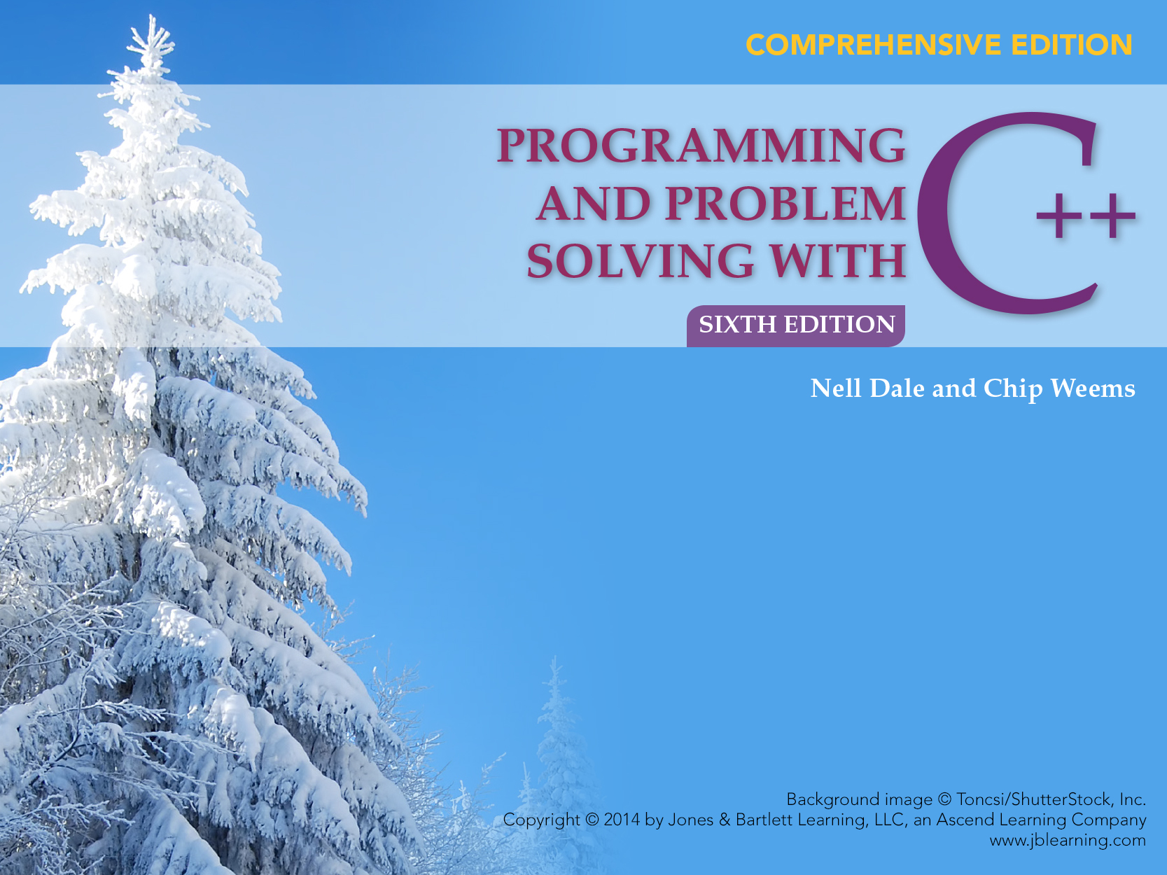
Chapter 15
Inheritance, Polymorphism and Object-Oriented Design

Slide 2
Chapter 15 Topics
Structured Programming vs. Object-Oriented Programming
Using Inheritance to Create a New C++ class Type
Using Composition (Containment) to Create a New C++ class Type

Slide 3
Chapter 15 Topics
Static vs. Dynamic Binding of Operations to Objects
Virtual Member Functions

Slide 4
Two Programming Paradigms
Structural (Procedural) Object-Oriented
PROGRAM PROGRAM
FUNCTION
OBJECT
Operations
Data
FUNCTION
OBJECT
OBJECT
Operations
Data
FUNCTION
Operations
Data

Slide 5
Object-Oriented Programming Language Features
1. Data abstraction
2. Inheritance of properties
3. Dynamic binding of operations to objects

Slide 6
OOP Terms C++ Equivalents
Object Class object or class instance
Instance variable Private data member
Method Public member function
Message passing Function call ( to a public member function)

Slide 7
What is an object?
OBJECT
set of methods
(public member functions)
internal state
(values of private data members)
Operations
Data

Slide 8
Inheritance Hierarchy Among Vehicles
vehicle
wheeled vehicle
boat
car
bicycle
two-door
four-door
Every car is a wheeled vehicle.

Slide 9
Inheritance
Inheritance is a mechanism by which one class acquires (inherits) the properties (both data and operations) of another class
The class being inherited from is the Base Class (Superclass)

Slide 10
Inheritance, cont...
The class that inherits is the Derived Class (Subclass)
The derived class is specialized by adding properties specific to it

Slide 11
class Time Specification
// Specification file (“time.h”)
class Time
{
public:
void Set ( int hours, int minutes, int seconds);
void Increment ();
void Write () const;
Time ( int initHrs, int initMins, int initSecs);
// Constructor
Time (); // Default constructor

Slide 12
class Time Specification
private:
int hrs;
int mins;
int secs;
};

Slide 13
Class Interface Diagram
Time class
Set
Private data:
hrs
mins
secs
Increment
Write
Time
Time

Slide 14
Using Inheritance to Add Features
// Specification file (“exttime.h”)
#include “time.h”
enum ZoneType{EST, CST, MST, PST, EDT, CDT, MDT, PDT};
class ExtTime : public Time // Time is the base class

Slide 15
Using Inheritance to Add Features
{
public:
void Set(int hours, int minutes, int seconds,
ZoneType timeZone);
void Write () const;
ExtTime ( int initHrs, int initMins,
int initSecs, ZoneType initZone);
ExtTime ();
private:
ZoneType zone; // Additional data member
};

Slide 16
class ExtTime:public Time
Says class Time is a public base class of the derived class ExtTime
As a result, all public members of Time (except constructors) are also public members of ExtTime
In this example, new constructors are provided, new data member zone added, and member functions Set and Write overridden

Slide 17
Class Interface Diagram
ExtTime class
Set
Set
Increment
Increment
Private data:
hrs
mins
secs
Write
Write
ExtTime
Time
ExtTime
Time
Private data:
zone

Slide 18
Client Code Using ExtTime
#include “exttime.h”
.
.
.
ExtTime thisTime ( 8, 35, 0, PST);
ExtTime thatTime; // Default constructor called
thatTime.Write(); // Outputs 00:00:00 EST
cout << endl;

Slide 19
Client Code Using ExtTime
thatTime.Set (16, 49, 23, CDT);
thatTime.Write(); // Outputs 16:49:23 CDT
cout << endl;
thisTime.Increment ();
thisTime.Increment ();
thisTime.Write (); // Outputs 08:35:02 PST
cout << endl;

Slide 20
Constructor Rules for Derived Classes
At run time, the base class constructor is implicitly called first, before the body of the derived class’s constructor executes
If the base class constructor requires parameters, they must be passed by the derived class’s constructor

Slide 21
Implementation of ExtTime Default Constructor
ExtTime::ExtTime ( )
// Default Constructor
// Postcondition:
// hrs == 0 && mins == 0 && secs == 0
// (via an implicit call to base class default
// constructor)
// && zone == EST

Slide 22
Implementation of ExtTime Default Constructor
{
zone = EST;
}

Slide 23
Implementation of Another ExtTime Class Constructor
ExtTime::ExtTime ( /* in */ int initHrs,
/* in */ int initMins,
/* in */ int initSecs,
/* in */ ZoneType initZone)
: Time (initHrs, initMins, initSecs)

Slide 24
Implementation of Another ExtTime Class Constructor
// Constructor initializer
// Pre: 0 <= initHrs <= 23 && 0 <= initMins <= 59
// 0 <= initSecs <= 59 && initZone is
// assigned
// Post: zone == initZone && Time set by base
// class constructor
{
zone = initZone;
}

Slide 25
Implementation of
ExtTime::Set function
void ExtTime::Set ( /* in */ int initHrs,
/* in */ int initMins,
/* in */ int initSecs,
/* in */ ZoneType initZone)
// Pre: 0 <= initHrs <= 23 && 0 <= initMins <= 59
// 0 <= initSecs <= 59 && initZone is assigned
// Post: zone == timeZone && Time set by base
// class function

Slide 26
Implementation of
ExtTime::Set function
{
Time::Set (hours, minutes, seconds);
zone = timeZone;
}

Slide 27
Implementation of
ExtTime::Write Function
void ExtTime::Write ( ) const
// Postcondition:
// Time has been output in form HH:MM:SS ZZZ
// where ZZZ is the time zone abbreviation

Slide 28
Implementation of
ExtTime::Write Function
{
static string zoneString[8] = { “EST”, CST”,
MST”, “PST”, “EDT”, “CDT”, “MDT”, “PDT” };
Time::Write ();
cout << ‘ ‘ << zoneString[zone];
}

Slide 29
Responsibilities
Responsibilities are operations implemented as C++ functions
Action responsibilities are operations that perform an action
Knowledge responsibilities are operations that return the state of private data variables

Slide 30
What responsibilities are Missing?
The Time class needs
int Hours()
int Minutes()
int Seconds()
The ExtTime class needs
ZoneType zone()

Slide 31
Composition (or Containment)
Composition (containment) is a mechanism by which the internal data (the state) of one class includes an object of another class

Slide 32
An Entry Object
#include "Time.h"
#include "Name.h"
#include <string>
class Entry
{
public:
string NameStr() const;
// Returns a string made up of first
// name and last name
string TimeStr() const;
// Returns a string made up of hour,
// colon, minutes

Slide 33
An Entry Object
Entry();
// Default constructor
Entry(……)
// Parameterized constructor
private:
Name name;
Time time;
}

Slide 34
Implementation of
ExtTime::Write Function
void ExtTime::Write ( ) const
// Postcondition:
// Time has been output in form HH:MM:SS ZZZ
// where ZZZ is the time zone abbreviation

Slide 35
Implementation of
ExtTime::Write Function
{
static string zoneString[8] = { “EST”, CST”,
MST”, “PST”, “EDT”, “CDT”, “MDT”, “PDT” };
Time::Write ();
cout << ‘ ‘ << zoneString[zone];
}

Slide 36
Order in Which Constructors are Executed
Given a class X:
If X is a derived class its base class constructor is executed first
Next, constructors for member objects, if any, are executed (using their own default constructors if none is specified)
Finally, the body of X’s constructor is executed

Slide 37
In C++ . . .
When the type of a formal parameter is a
parent class, the argument used can be
the same type as the formal parameter
or,
any descendant class type

Slide 38
Static Binding
Static binding is the compile-time determination of which function to call for a particular object based on the type of the formal parameter(s)
When pass-by-value is used, static binding occurs

Slide 39
Static Binding Is Based on Formal Parameter Type
void Print ( /* in */ Time someTime)
{
cout << “Time is “;
someTime.Write ( );
cout << endl;
}
CLIENT CODE OUTPUT
Time startTime(8, 30, 0);
ExtTime endTime(10,45,0,CST);
Print ( startTime); Time is 08:30:00
Print ( endTime); Time is 10:45:00

Slide 40
Dynamic Binding
Dynamic binding is the run-time determination of which function to call for a particular object of a descendant class based on the type of the argument
Declaring a member function to be virtual instructs the compiler to generate code that guarantees dynamic binding

Slide 41
Virtual Member Function
// Specification file ( “time.h”)
class Time
{
public:
. . .
virtual void Write () const;
// Forces dynamic binding
. . .

Slide 42
Virtual Member Function
private:
int hrs;
int mins;
int secs;
};

Slide 43
Dynamic binding requires pass-by-reference
void Print ( /* in */ Time& someTime)
{
cout << “Time is “;
someTime.Write ( );
cout << endl;
}
CLIENT CODE OUTPUT
Time startTime ( 8, 30, 0);
ExtTime endTime (10,45,0,CST);
Print ( startTime); Time is 08:30:00
Print ( endTime); Time is 10:45:00 CST

Slide 44
Using virtual functions in C++
Dynamic binding requires pass-by-reference when passing a class object to a function
In the declaration for a virtual function, the word virtual appears only in the base class

Slide 45
Using virtual functions in C++
If a base class declares a virtual function, it must implement that function, even if the body is empty
A derived class is not required to re-implement a virtual function; if it does not, the base class version is used

Slide 46
Object-Oriented Design
Identify the Objects and Operations
Determine the relationship among objects
Design and Implement the driver

Slide 47
Implementation of the Design
Choose a suitable data representation
  Built-in data type
  Existing ADT
  Create a new ADT
Create algorithms for the abstract operations
  Top-down design is often the best technique to create algorithms for the function tasks

Slide 48
Case Study
Beginning of the Appointment Calendar Program
Class Entry composed of a Name class and a Time class
Current Time class represents active time (seconds with Increment)
Need a static Time class for time in the appointment calendar
  Is inheritance appropriate?

