Slide 1
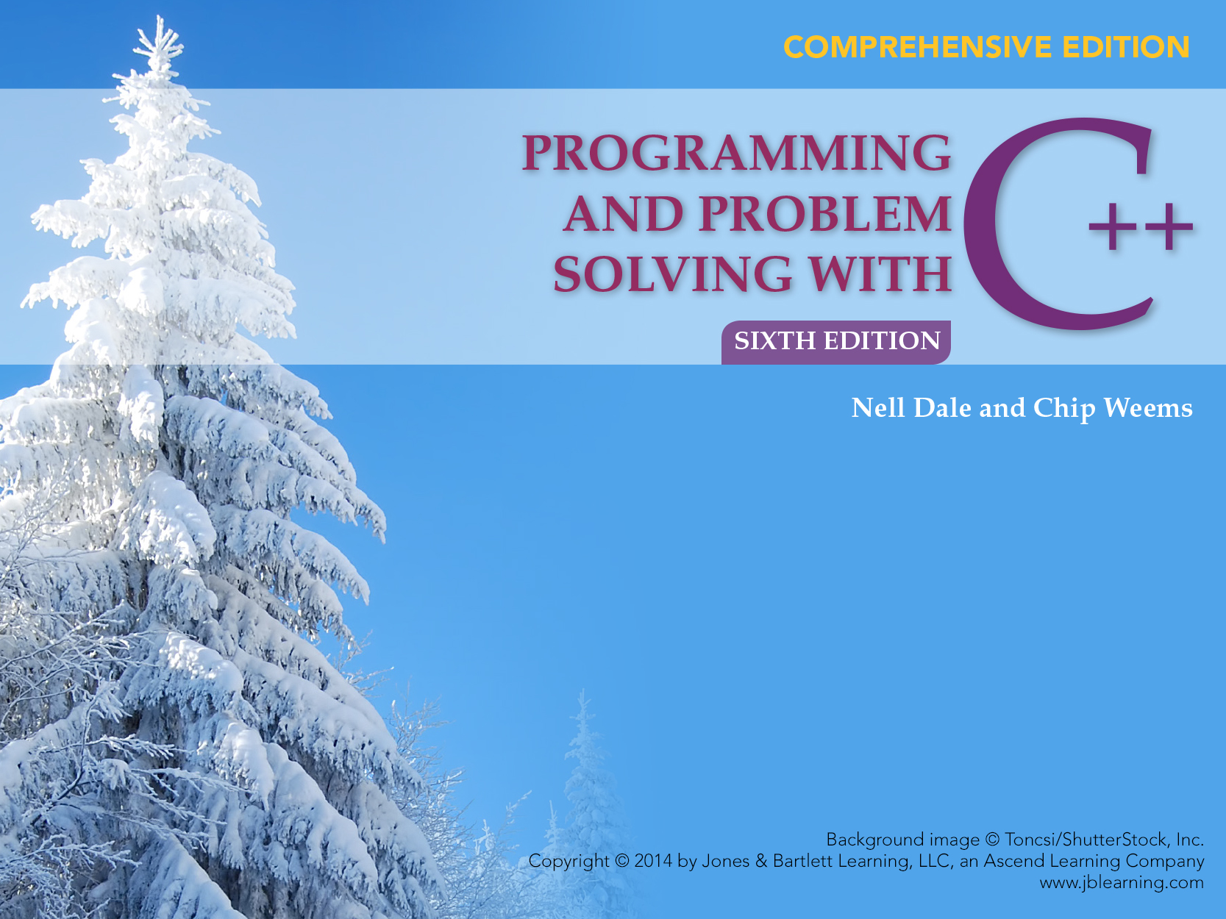
Chapter 16
Templates and Exceptions

Slide 2
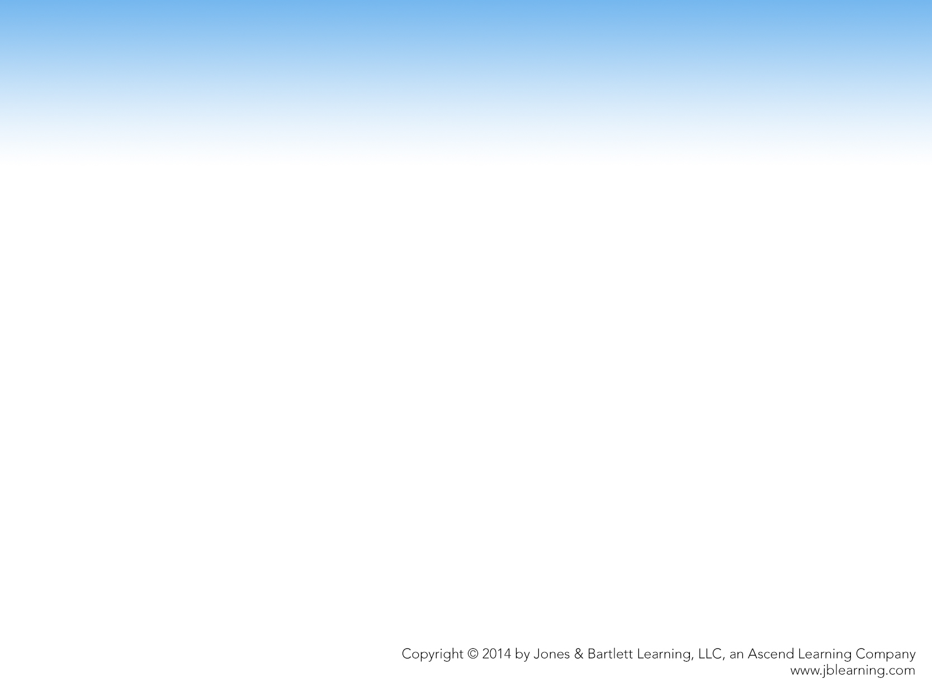
Chapter 16 Topics
C++ Function Templates
Instantiating a Function Templates
C++ Class Templates
Instantiating Class Templates
Function Definitions for Members of a Template Class

Slide 3
Generic Algorithms
Generic algorithms are algorithms in which the actions or steps are defined, but the data types of the items being manipulated are not

Slide 4
Example of a Generic Algorithm
void PrintInt(int n)
{
cout << "***Debug" << endl;
cout << "Value is " << n << endl;
}
void PrintChar(char ch)
{
cout << "***Debug" << endl;
cout << "Value is " << ch << endl;
}
void PrintFloat(float x)
{
cout << "***Debug" << endl;
cout << "Value is " << x << endl;
}
void PrintDouble(double d)
{
cout << "***Debug" << endl;
cout << "Value is " << d << endl;
}
sum = alpha + beta + gamma;
PrintInt(sum);
PrintChar(initial);
PrintFloat(angle);
To output the traced values,we insert:

Slide 5
Function Overloading
  Function overloading is the use of the same name for different functions, distinguished by their parameter lists
  Eliminates need to come up with many different names for identical tasks
  Reduces the chance of unexpected results caused by using the wrong function name

Slide 6
Example of Function Overloading
void Print(int n)
{
cout << "***Debug" << endl;
cout << "Value is " << n << endl;
}
void Print(char ch)
{
cout << "***Debug" << endl;
cout << "Value is " << ch << endl;
}
void Print(float x)
{
}
To output the traced values, we insert:
Print(someInt);
Print(someChar);
Print(someFloat);

Slide 7
Function Template
A C++ language construct that allows the compiler to generate multiple versions of a function by allowing parameterized data types
FunctionTemplate
Template < TemplateParamList >
FunctionDefinition
TemplateParamDeclaration
class
Identifier
typename

Slide 8
Example of a Function Template
template<class SomeType>
void Print(SomeType val)
{
cout << "***Debug" << endl;
cout << "Value is " << val << endl;
}
Template parameter
Print<int>(sum);
Print<char>(initial);
Print<float>(angle);
To output the traced values, we insert:
Template argument

Slide 9
Instantiating a Function Template
When the compiler instantiates a template, it substitutes the template argument for the template parameter throughout the function template
TemplateFunction Call
Function < TemplateArgList > (FunctionArgList)

Slide 10
Generic Functions, Function Overloading, Template Functions
Generic Function
Different Function Definitions
Different Function Names
Function Overloading
Different Function Definitions
Same Function Name
Template Functions
One Function Definition (a function template)
Compiler Generates Individual Functions

Slide 11
User-Defined Specializations
Example that demonstrates use of template < >
template<>
void Print(string vName, // Name of the variable
StatusType val ) // Value of the variable
{
cout << "***Debug" << endl;
cout << "Value of " << vName << " = ";

Slide 12
Example, continued.
switch (val)
{
case OK : cout << "OK";
break;
case OUT_OF_STOCK : cout << "OUT_OF_STOCK";
break;
case BACK_ORDERED : cout << "BACK_ORDERED";
break;
default : cout << "Invalid value";
}
cout << endl;
}

Slide 13
Organization of Program Code
Three possibilities:
Template definitions at the beginning of program file, prior to main function
Function prototypes first, then the main function, then the template definitions
Template definition in the header file, use #include to insert that file into the program

Slide 14
What is a Generic Data Type?
It is a type for which the operations are defined but the data types of the items being manipulated are not

Slide 15
What is a Class Template?
It is a C++ language construct that allows the compiler to generate multiple versions of a class by allowing parameterized data types

Slide 16
Example of a Class Template
template<class ItemType>
class GList
{
public:
bool IsEmpty() const;
bool IsFull() const;
int Length() const;
void Insert(/* in */ ItemType item);
void Delete(/* in */ ItemType item);
bool IsPresent(/* in */ ItemType item) const;
void SelSort();
void Reset() const;
ItemType GetNextItem();
GList(); // Constructor
Template parameter

Slide 17
Example of a Class Template, cont. . .
private:
int length;
ItemType data[MAX_LENGTH];
};

Slide 18
Instantiating a Class Template
To create lists of different data types
// Client code
GList<int> list1;
GList<float> list2;
GList<string> list3;
list1.Insert(356);
list2.Insert(84.375);
list3.Insert("Muffler bolt");
template argument
Compiler generates 3 distinct class types
GList_int list1;
GList_float list2;
GList_string list3;

Slide 19
Instantiating a Class Template
Class template arguments must be explicit
The compiler generates distinct class types called template classes or generated classes
When instantiating a template, a compiler substitutes the template argument for the template parameter throughout the class template

Slide 20
Substitution Example
class GList_int
{
public:
void Insert(/* in */ ItemType item);
void Delete(/* in */ ItemType item);
bool IsPresent(/* in */ ItemType item) const;
private:
int length;
ItemType data[MAX_LENGTH];
};
int
int
int
int

Slide 21
Writing Function Templates
template<class ItemType>
void GList<ItemType>::Insert(/* in */ ItemType item)
{
data[length] = item;
length++;
}

Slide 22
Writing Function Templates
void GList<float>::Insert(/* in */ float item)
{
data[length] = item;
length++;
}

Slide 23
Organization of Program Code
A compiler must know the argument to the template in order to generate a function template, and this argument is located in the client code
Solutions
  Have specification file include implementation file
  Combine specification file and implementation file into one file

Slide 24
Warning!
Are you using an IDE (integrated development environment) where the editor, compiler, and linker are bundled into one application?
Remember The compiler must know the template argument
How you organize the code in a project may differ depending on the IDE you are using

Slide 25
An Exception is…
An exception is:
an unusual, often unpredictable event,
detectable by software or hardware,
requires special processing;
also, in C++, a variable or class object that represents an exceptional event
An exception handler is a section of program code that is executed when a particular exception occurs

Slide 26
The throw Statement
Throw: to signal the fact that an exception has occurred; also called raise
ThrowStatement
throw Expression

Slide 27
The try-catch Statement
How one part of the program catches and processes the exception that another part of the program throws.
TryCatchStatement
try
Block
catch (FormalParameter)
Block
catch (FormalParameter)
FormalParameter
DataType VariableName
…

Slide 28
Example of a try-catch Statement
try
{
// Statements that process personnel data and may throw
// exceptions of type int, string, and SalaryError
}
catch (int)
{
// Statements to handle an int exception
}

Slide 29
try-catch Continued
catch (string s)
{
cout << s << endl; // Prints "Invalid customer age"
// More statements to handle an age error
}
catch (SalaryError)
{
// Statements to handle a salary error
}

Slide 30
Execution of try-catch
A
statement throws
an exception
No
statements throw
an exception
Exception
Handler
Control moves directly to exception handler
Statements to deal with exception are executed
Statement
following entire try-catch
statement

Slide 31
Selecting an Exception Handler
The computer:
Examines data types of the formal parameters in exception handlers
Searches in a “north-to-south” order
Selects first formal parameter whose data type matches that of the thrown exception
Ellipse parameters are a “wild card” and catch all (Place the “catch all” handler last)

Slide 32
More on Selecting Exception Handlers
The parameter’s name is needed only if statements in the body of the exception handler use that variable
It is a good idea to use only:
  user-defined classes (and structs) as exception types
  one type per exception
  descriptive identifiers

Slide 33
Nonlocal Exception Handlers
It is more common for the throw to occur inside a function that is called from within a try-clause than for the throw to be located within the try-catch statement

Slide 34
Throwing an Exception to be Caught by the Calling Code
void Func3()
{
try
{
Func4();
}
catch (ErrType)
{
}
}
Function
call
void Func4()
{
if (error)
throw ErrType();
}
Normal
return
Return from
thrown exception

Slide 35
Passing an Exception up the Chain of Function Calls
Program
terminates
immediately
main
main
No ErrType handler
NoErrType handler
Call
Func1
No ErrType handler
Immediate
return
Func1
Call
ErrType handler
Call
Func2
No ErrType handler
Immediate return
Call
Func2
Immediate
return
NoErrTypehandler
Call
Func3
No ErrType handler
Immediate
return
Call
Func3
Immediate
return
NoErrTypehandler
Call
Func4
No ErrType handler
throw ErrType();
Call
Func4
Immediate
return
Immediate
return
No ErrType handler
throw ErrType();
No function has a handler for ErrType
Function Func1 has a handler for ErrType

Slide 36
Re-Throwing an Exception
The throw expression is optional
      throw;
Re-throwing an exception in C++ allows partial exception handling

Slide 37
Standard Exceptions
Exceptions Thrown by the Language
      new, dynamic_cast, typeid, exception specification
Exceptions Thrown by Standard Library Routines
      Facilities inherited from the C language
      Facilities designed specifically for C++

Slide 38
Dividing by ZERO
Apply what you know:
int Quotient(/* in */ int numer, // The numerator
/* in */ int denom) // The denominator
{
if (denom != 0)
return numer / denom;
else
// What to do??
}

Slide 39
A Solution
// “quotient.cpp” -- Quotient program
#include<iostream>
#include <string>
using namespace std;
int Quotient(int, int);
class DivByZero // Exception class
{};
int main()
{
int numer; // Numerator
int denom; // Denominator
cout << "Enter numerator and denominator: ";

Slide 40
cin >> numer >> denom;
while (cin)
{
try
{
cout << "Their quotient: "
<< Quotient(numer, denom) << endl;
}
catch (DivByZero)
{
cout << "*** Denominator can't be 0"
<< endl;
}

Slide 41
cout << "Enter numerator and denominator: ";
cin >> numer >> denom;
}
return 0;
}
int Quotient(/* in */ int numer, // The numerator
/* in */ int denom) // The denominator
{
if (denom == 0)
throw DivByZero();
return numer / denom;
}

Slide 42
Appointment Calendar
Replace array-based list with linked list to demonstrate that changing implementation doesn’t change client code
Add exceptions to Appointment Calendar Program

