Slide 1
Rendering Faces for Visual Realism

Slide 2
Visual Realism Requirements
Light Sources
Materials (e.g., plastic, metal)
Shading Models
Depth Buffer Hidden Surface Removal
Textures
Reflections
Shadows

Slide 3
Rendering Objects
We know how to model mesh objects, manipulate a jib camera, view objects, and make pictures.
Now we want to make these objects look visually interesting, realistic, or both.
We want to develop methods of rendering a picture of the objects of interest: computing how each pixel of a picture should look.

Slide 4
Rendering Objects (2)
Much of rendering is based on different shading models, which describe how light from light sources interacts with objects in a scene.
  It is impractical to simulate all of the physical principles of light scattering and reflection.
  A number of approximate models have been invented that do a good job and produce various levels of realism.

Slide 5
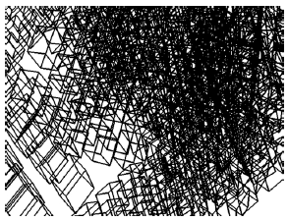
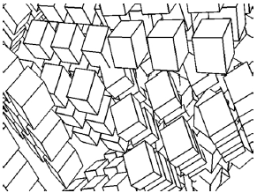
Rendering
Rendering: deciding how a pixel should look
Example: compare wireframe (left) to wire-frame with hidden surface removal (right)

Slide 6
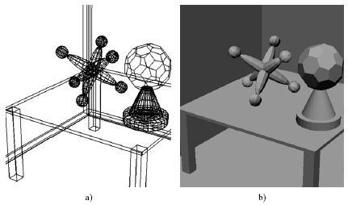
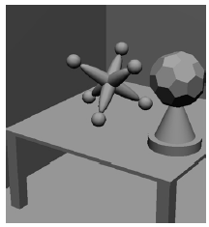
Rendering (2)
Example: Compare mesh objects drawn using wire-frame, flat shading, smooth (Gouraud) shading

Slide 7
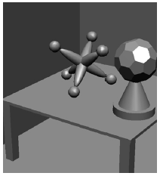
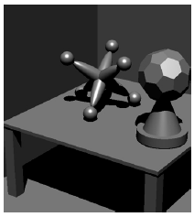
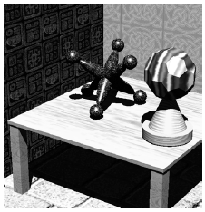
Rendering (3)
Compare to images with specular highlights, shadows, textures

Slide 8
Visual Realism Requirements
Light Sources
Materials (e.g., plastic, metal)
Shading Models
Depth Buffer Hidden Surface Removal
Textures
Reflections
Shadows

Slide 9
Hidden Surface
Hidden Surface Removal is very important in 3D scenes
Only surfaces closest to the eye should be seen and objects that are hidden by others should be eliminated.
The use of a depth buffer facilitates hidden surface removal.

Slide 10
Hidden Surface Removal
To use depth-buffering, you need to enable it:
glutInitDisplayMode (GLUT_DEPTH| ..);
glEnable (GL_DEPTH_TEST);
Initialize the depth buffer and color buffer by using:
glClear(GL_DEPTH_BUFFER_BIT | GL_COLOR_BUFFER_BIT);

Slide 11
Hidden Surface Removal
Put them together:
glutInitDisplayMode(GLUT_DEPTH|..);
glEnable(GL_DEPTH_TEST);
…
// in display function
glClear(GL_COLOR_BUFFER_BIT|GL_DEPTH_BUFFER_BIT);
draw3DObjectA();
draw3DObjectB();

Slide 12
Visual Realism Requirements
Light Sources
Materials (e.g., plastic, metal)
Shading Models
Depth Buffer Hidden Surface Removal
Textures
Reflections
Shadows

Slide 13
What is light?
Light is the most important idea behind visual representation of anything a human can visually perceive.
What you see isn’t based on the objects that you are viewing but on the rays of light reflected from those objects.
Your eyes don’t directly see objects.
There is no physical correlation between your eyes and those objects.

Slide 14
What is light?
Light rays originate from an energy source (sun or lamp)
Theoretically, a ray of light travels in a straight line.
Your perception of an object comes from the light reflected or scattered off of an object that your eyes absorb.

Slide 15
What is light?
Two rules:
  Your eyes are mechanisms that perceive or absorb photons of light and not objects. You as a programmer, must simulate this functionality on the computer screen.
  A ray of light travels in a straight line (not exactly true but we can think of it this way).

Slide 16
What is light?
Albert Einstein in 1905 developed the theory of light:
  He described the “photoelectric effect”.
  Described the activity of the ultraviolet light hitting a surface and emitting electrons off that surface.
  This behavior was supported by an explanation that light was made up of a stream of energy packets called photons.

Slide 17
Color of light
Light seen by human eye is a mixture of lights scattered and reflected against the surroundings of different material property.
All physical matter is made up of atoms.
Reflection of photons off of physical matter depends on
  Kind of atoms
  Amount of each kind
  Arrangement of atoms in the object

Slide 18
Color of light
Some photons are absorbed
Some photons are reflected
Color that the material reflects is observed as that material’s color
The more light the material reflects, the more shiny it will appear to the viewer.
Each color is simply energy that can be represented by a wavelength.

Slide 19
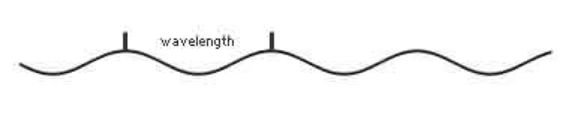
Color of light
Color is only a wavelength visible to the eye.
A wavelength is measured by the distance between the peaks of the energy wave:
Visible light is contained within the wavelengths ranging from 390 nanometers to 720 nanometers in length.

Slide 20
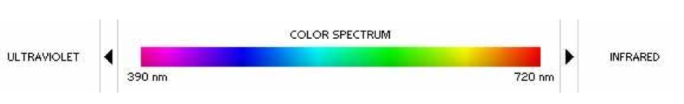
Color of light
390 nanometers is the color violet
720 nanometers is the color red
Everything in between is visible light and the range from 390 to 720 is called the color spectrum.

Slide 21
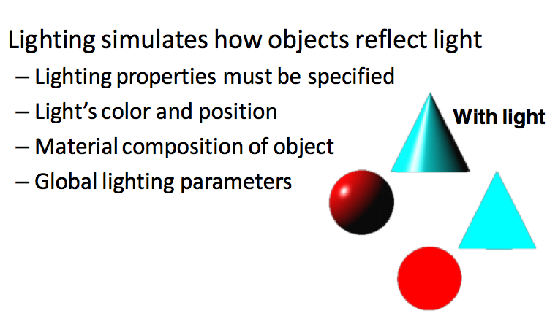
Lighting Principles
With no light

Slide 22





Steps in Adding Lighting in OpenGL
Ambient
Light comp
Diffuse
Light comp
Ambient
Light reflecting
Specular
Light comp
Diffuse
Light reflecting
Specular
Light reflecting

Slide 23
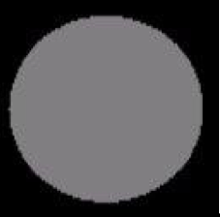
Lighting Properties:
Light comes from light sources that can be turned on/off
Ambient lighting comes from light that is so scattered there is no way to tell its original location
Ambient light is the average volume of light created from all light sources surrounding the lit area.
Example: Backlighting in a room
3D sphere looks 2D

Slide 24
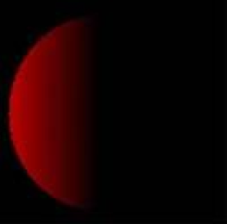
Lighting Properties:
The diffuse component of lighting is light that comes from one direction.
Diffuse light has a position in space and comes from a single direction.
Once it hits a surface, it is scattered equally in all directions.
Example: A flashlight
A diffuse red light cast
onto a black object

Slide 25
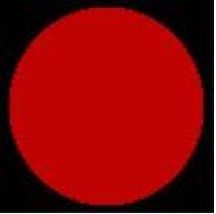
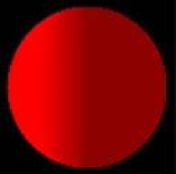
Lighting Properties:
To demonstrate how Ambient& Diffuse light
works together:
Dark red ambient light only
Add diffuse light on the
right side
Note sphere now looks3D

Slide 26
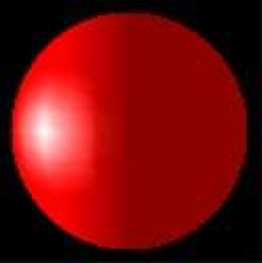
Lighting Properties:
Specular light comes from a particular direction like a diffuse light.
It bounces off the surface in a particular direction
It relies on the angle between the viewer and the light source.
Creates a highlighted area

Slide 27
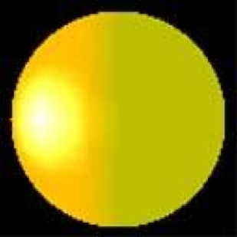
Lighting Properties:
Emissive light is responsible for the object’s material’s property to reflect or absorb light.
When applied to an object’s material, emissive light simulates the light reflected off the object.

Slide 28
RGB Values for Lights
A light source is characterized by the amount of red, green, & blue light it emits.
Examples: If R=G=B=1.0, the light is the brightest possible white.
If R=G=B=.5, the color is still white, but only at half intensity, so it appears gray
If R=G=1.0 and B=0.0, the light appears yellow.

Slide 29
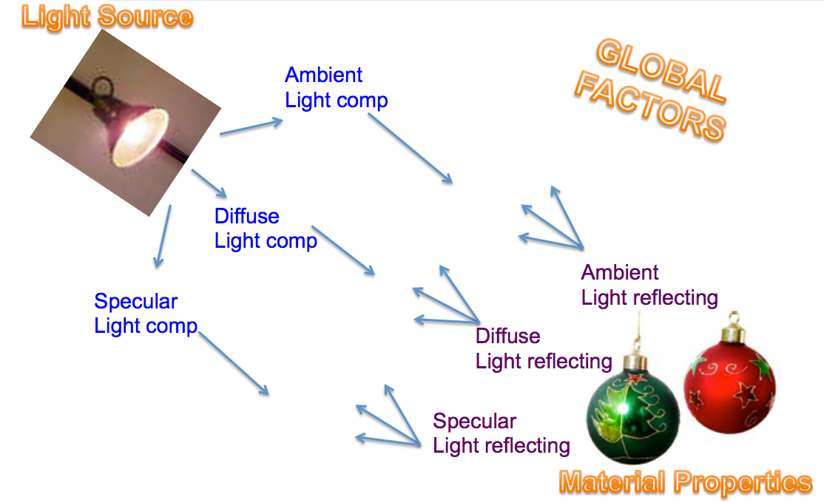
How OpenGL Simulates Lights
Lighting contributors
  Lighting properties
  Lighting model properties
  Surface material properties

Slide 30
Setting Lighting Properties
glLightfv( light, property, value );
light specifies which light
  multiple lights (at least 8), starting with GL_LIGHT0
Properties
  Colors for ambient, diffuse, & specular component
  position and type
  attenuation

Slide 31
Types of Lights
OpenGL supports two types of Lights
  Local (Point) light sourcess of Light
    Local light positioned at (x, y, z, 1)
  Infinite (Directional) light sources
    Infinite light directed along (x, y, z, 0)

Slide 32
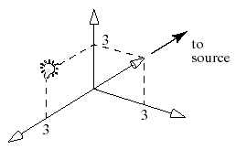
Point and Vector Light Locations
The figure shows a local source at (0, 3, 3, 1) and a remote source “located” along vector (3, 3, 0, 0).
Infinitely remote light sources are often called “directional”. There are computational advantages to using directional light sources, since direction s in the calculations of diffuse and specular reflections is constant for all vertices in the scene.
But directional light sources are not always the correct choice: some visual effects are properly achieved only when a light source is close to an object.

Slide 33
Creating and Using Light Sources in Open-GL
Each light has a position specified in homogeneous coordinates using a GLfloat array named, for example, litePos.
Glfloat litePos[4]={3, 3, 1, 1};
The light is created using
glLightfv (GL_LIGHT0, GL_POSITION, litePos);
If the position is a vector (4th component = 0), the source is infinitely remote (like the sun).

Slide 34
Creating and Using Light Sources in OpenGL (2)
The light color is specified by a 4-component array [R, G, B, A] of GLfloat, named (e.g.) amb0. The A value can be set to 1.0 for now:
Glfloat amb0={0.2, 0.8, 0.0, 1.0};
The light color is specified by
glLightfv (GL_LIGHT_0, GL_AMBIENT, amb0);
Similar statements specify GL_DIFFUSE and GL_SPECULAR.

Slide 35
Creating and Using Light Sources in OpenGL (3)
Lights do not work unless you turn them on.
  In your main program, add the statements
  glEnable (GL_LIGHTING);
  glEnable (GL_LIGHT0);
  If you are using other lights, you will need to enable them also.
To turn off a light
glDisable (GL_LIGHT0);
To turn them all off,
glDisable (GL_LIGHTING);

Slide 36
Creating an Entire Light
// define some colors
GLfloat amb0[ ] = {0.2, 0.4, 0.6, 1.0};
GLfloat diff0[ ] = {0.8, 0.9, 0.5, 1.0};
GLfloat spec0[ ] = { 1.0, 0.8, 1.0, 1.0};
// attach them to LIGHT0
glLightfv(GL_LIGHT0, GL_AMBIENT, amb0);
glLightfv(GL_LIGHT0, GL_DIFFUSE, diff0);
glLightfv(GL_LIGHT0, GL_SPECULAR, spec0);

Slide 37
How OpenGL Simulates Lights
Lighting contributors
  Lighting properties
  Lighting model properties
  Surface material properties

Slide 38
Creating and Using Light Sources in OpenGL (4)
Global ambient light is present even if no lights are created. Its default color is {0.2, 0.2, 0.2, 1.0}.
To change this value, create a GLfloat array of values newambient and use the statement
glLightModelfv (GL_LIGHT_MODEL_AMBIENT, newambient);
Default light values are:
  {0, 0, 0, 1} for ambient for all lights,
  {1, 1, 1, 1} for diffuse and specular light for LIGHT_0, and
  {0, 0, 0, 1} for diffuse and specular light for lights LIGHT_1 to LIGHT_7

Slide 39

Spotlights in Open-GL
A spotlight emits light only in a cone of directions; there is no light outside the cone. Inside the cone, I = I_{s}(cos β)^{ε}, where cos β uses the angle between d and a line from the source to P.

Slide 40
Spotlights in OpenGL (2)
To create the spotlight, create a GLfloat array for d. Default values are d = {0, 0, 0, 1}, α = 180º, ε = 0: a point source.
Then add the statements:
Glfloat d={2, 2, 2, 1};
  glLightf (GL_LIGHT0, GL_SPOT_CUTOFF, 45.0); //45.0 is α in degrees)
  glLightf (GL_LIGHT0, GL_SPOT_EXPONENT, 4.0); //4.0 is ε)
  glLightfv (GL_LIGHT0, GL_SPOT_DIRECTION, d);

Slide 41
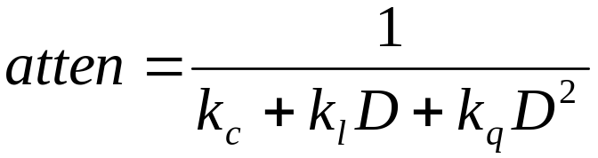
Attenuation of Light with Distance
OpenGL also allows you to specify how rapidly light diminishes with distance from a source.
OpenGL attenuates the strength of a positional light source by the following attenuation factor:
where k_{c}, k_{l}, and k_{q} are coefficients and D is the distance between the light’s position and the vertex in question.

Slide 42
Attenuation of Light with Distance (2)
These parameters are controlled by calling:
glLightf(GL_LIGHT0, GL_CONSTANT_ATTENUATION, 2.0);
glLightf(GL_LIGHT0, GL_LINEAR_ATTENUATION, 2.0);
glLightf(GL_LIGHT0, GL_QUADRATIC_ATTENUATION, 2.0);
The default values are k_{c} = 1, k_{l} = 0, and k_{q} = 0 (no attenuation).

Slide 43
Moving Light Sources in OpenGL
To move a light source independently of the camera:
  set its position array,
  clear the color and depth buffers,
  set up the ModelView matrix to use for everything except the light source and push the matrix
  move the light source and set its position
  pop the matrix
  set up the camera, and draw the objects.

Slide 44
Changing the OpenGL Light Model
The color of global ambient light: specify its color using:
GLfloat amb[ ] = {0.2, 0.3, 0.1, 1.0};
glLightModelfv(GL_LIGHT_MODEL_AMBIENT, amb);
Is the viewpoint local or remote?
  OpenGL computes specular reflections using the “halfway vector” h = s + v . The true directions s and v are normally different at each vertex in a mesh.
  OpenGL uses v = (0, 0, 1), along the positive z-axis, to increase rendering speed. To use the true value of v for each vertex, execute
glLightModeli(GL_LIGHT_MODEL_LOCAL_VIEWER, GL_TRUE);

Slide 45
Changing the OpenGL Light Model (2)
Are both sides of a polygon shaded properly?
Each polygonal face in a model has two sides. When modeling, we tend to think of them as the “inside” and “outside” surfaces. The convention is to list the vertices of a face in counter-clockwise (CCW) order as seen from outside the object.
OpenGL has no notion of inside and outside. It can only distinguish between “front faces” and “back faces”. A face is a front face if its vertices are listed in counter-clockwise (CCW) order as seen by the eye.

Slide 46
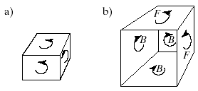
Changing the OpenGL Light Model (3)
For a space-enclosing object (a) all visible faces are front faces; OpenGL draws them properly with the correct shading.
If a box has a face removed (b), OpenGL does not shade back faces properly. To force OpenGL to shade back faces, use:
glLightModeli(GL_LIGHT_MODEL_TWO_SIDE, GL_TRUE);
OpenGL reverses the normal vectors of any back-face and performs shading properly.
Replace GL_TRUE with
GL_FALSE (the default) to
turn off this facility.

Slide 47
Steps in Adding Lighting in OpenGL
Ambient
Light comp
Diffuse
Light comp
Ambient
Light reflecting
Specular
Light comp
Diffuse
Light reflecting
Specular
Light reflecting

Slide 48
Steps in Adding Lighting in OpenGL (1)
Step 1: Establish vertex normal
  Make sure the normal for each vertex has been defined
  Draw with :
    glNormal3f(0.0, 0.0, 1.0);
    glVertex3f(-50.0, 50.0, 10.0);
  One normal for one vertex, or one normal for a group of vertices

Slide 49
Steps in Adding Lighting in OpenGL (2)
Step 2: Enable/Define the necessaries:
  glEnable(GL_LIGHTING);
  glEnable(GL_DEPTH_TEST); // perform hidden depth removal
  glEnable(GL_NORMALIZE); // !!! important to get the right shading !!!
  glShadeModel (GL_SMOOTH);
  Optional:
    glFrontFace(GL_CCW);

Slide 50
Steps in Adding Lighting in OpenGL (3)
Step 3. Setup the Light source
GLfloat sourceLight[] = { 0.25, 0.25, 0.25, 1.0 };
Glfloat specularLight[] = {0.8, 0.8, 0.8, 1.0};
GLfloat lightPos[] = { -50.0, 25.0, 250.0, 0.0 };
Glfloat shininess[] = {50.0};
  glLightfv(GL_LIGHT0,GL_AMBIENT,sourceLight);
  glLightfv(GL_LIGHT0,GL_DIFFUSE,sourceLight);
  glLightfv(GL_LIGHT0,GL_DIFFUSE,specularLight);
  glLightfv(GL_LIGHT0,GL_POSITION,lightPos);
  glEnable(GL_LIGHT0);

Slide 51
Steps in Adding Lighting in OpenGL (4)
Step 3. Setup the Light source continued …
Optional:
  Setup multiple light sources (at different locations)
  Specify certain light source as spot light (α and ε )

Slide 52
Steps in Adding Lighting in OpenGL (5)
Step 4. Setup the material properties of each object
  GLfloat mat_color[] = {0.23, 0.23, 0.23, 1.0 };
  GLfloat mat_specular[] = {0.5, 0.5, 0.5, 1.0 };
  GLfloat mat_shininess[] = {100.0 };
  glMaterialfv(GL_FRONT, GL_SPECULAR, mat_specular);
  glMaterialfv(GL_FRONT, GL_SHININESS, mat_shininess);
  glMaterialfv(GL_FRONT, GL_AMBIENT, mat_color);
  glMaterialfv(GL_FRONT, GL_DIFFUSE, mat_color);

Slide 53
Steps in Adding Lighting in OpenGL (6)
Step 5. Define various options in the global shading model
GLfloat amb[ ] = {0.2, 0.3, 0.1, 1.0};
glLightModelfv(GL_LIGHT_MODEL_AMBIENT, amb);
glLightModeli(GL_LIGHT_MODEL_TWO_SIDE, GL_TRUE);
glLightf(GL_LIGHT0, GL_CONSTANT_ATTENUATION, 2.0);
glLightf(GL_LIGHT0, GL_LINEAR_ATTENUATION, 2.0);
glLightf(GL_LIGHT0, GL_QUADRATIC_ATTENUATION, 2.0);
…

Slide 54
Steps in Adding Lighting in OpenGL (7)
Useful Optional Step for setting up Color Tracking
// Enable color tracking
glEnable(GL_COLOR_MATERIAL);
// Set Material properties to follow glColor values
glColorMaterial(GL_FRONT, GL_AMBIENT_AND_DIFFUSE);
// use glColor to specify color directly
glColor3f(1.0, 0.0, 0.0);
glNormal3f(0.0, 0.0, 1.0);
glVertex3f(-50.0, 50.0, 20.0);

Slide 55
Code: Independent Motion of Light
void display()
{
GLfloat position[ ] = {2, 1, 3, 1}; //initial light position
// clear color and depth buffers
glMatrixMode(GL_MODELVIEW);
glLoadIdentity();
glPushMatrix();
glTranslated(...); // move the light
glLightfv(GL_LIGHT0, GL_POSITION, position);
glPopMatrix();
gluLookAt(...); // set the camera position
<.. draw the object ..>
glutSwapBuffers();
}

Slide 56
Code: Light Moves with Camera
GLfloat pos[ ] = {0,0,0,1};
glMatrixMode(GL_MODELVIEW);
glLoadIdentity();
glLightfv(GL_LIGHT0, GL_POSITION, position); // light at (0,0,0)
gluLookAt(...); // move light and camera
// draw the object
<.. draw the object ..>

Slide 57
Visual Realism Requirements
Light Sources
Materials (e.g., plastic, metal)
Shading Models
Depth Buffer Hidden Surface Removal
Textures
Reflections
Shadows

Slide 58
Shading Models: Introduction
Assume to start with that light has no color, only brightness: R = G = B
Assume we also have a point source of light (sun or lamp) and general ambient light

Slide 59
Shading Models: Introduction (2)
When light hits an object, some light is absorbed (and turns into heat), some is reflected, and some may penetrate the interior (e.g., of a clear glass object).
If all the light is absorbed, the object appears black and is called a blackbody.
If all the light is transmitted, the object is visible only through refraction.

Slide 60
Shading Models: Introduction (3)
When light is reflected from an object, some of the reflected light reaches our eyes, and we see the object.
  Diffuse reflection: some of the light slightly penetrates the surface and is re-radiated uniformly in all directions. The light takes on some fraction of the color of the surface.
  Specular reflection: more mirror-like. Light is reflected directly from the object’s outer surface, giving rise to highlights of approximately the same color as the source. The surface looks shiny.

Slide 61
Shading Models: Introduction (4)
In the simplest model, specular reflected light has the same color as the incident light. This tends to make the material look like plastic.
In a more complex model, the color of the specular light varies over the highlight, providing a better approximation to the shininess of metal surfaces.

Slide 62
Shading Models: Introduction (5)
Most surfaces produce some combination of diffuse and specular reflection, depending on surface characteristics such as roughness and type of material.
The total light reflected from the surface in a certain direction is the sum of the diffuse component and the specular component.
  For each surface point of interest, we compute the size of each component that reaches the eye.

Slide 63
Reflected Light Model
Finding Reflected Light: a model
  Model is not completely physically correct, but it provides fast and relatively good results on the screen.
  Intensity of a light is related to its brightness. We will use I_{s} for intensity, where s is R or G or B.

Slide 64
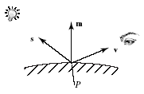
Calculating Reflected Light
To compute reflected light at point P, we need 3 vectors: normal m to the surface at P and vectors s from P to the source and v from P to the eye. We use world coordinates.

Slide 65
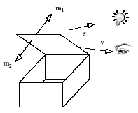
Calculating Reflected Light (2)
Each face of a mesh object has an inside and an outside.
Normally the eye sees only the outside (front, in Open-GL), and we calculate only light reflected from the outside.

Slide 66
Calculating Reflected Light (3)
If the eye can see inside, we must also compute reflections from the inside (back, in OpenGL).
  If v ∙ m > 0, the eye can see the face and lighting must be calculated.

Slide 67
Calculating Diffuse Light
Diffuse scattering is assumed to be independent of the direction from the point, P, to the location of the viewer’s eye.
Because the scattering is uniform in all directions, the orientation of the facet F relative to the eye is not significant, and I_{d} is independent of the angle between m and v (unless v ∙ m < 0, making I_{d} =0.)
The amount of light that illuminates the facet does depend on the orientation of the facet relative to the point source: the amount of light is proportional to the area of the facet that it sees: the area subtended by a facet.

Slide 68
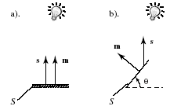
Calculating Diffuse Light (2)
The intensity depends on the projection of the face perpendicular to s (Lambert's law): I_{d} cosθ

Slide 69
Calculating Diffuse Light (3)
For θ near 0º, brightness varies only slightly with angle, because the cosine changes slowly there. As θ approaches 90º, the brightness falls rapidly to 0.
We know cos θ = (s∙m)/(|s||m|).
I_{d} = I_{d}ρ_{d} (s∙m)/(|s||m|).
  I_{d} is the intensity of the source.
  ρ_{d} is the diffuse reflection coefficient and depends on the material the object is made of.
s∙m < 0 implies I_{d} = 0.
So to take all cases into account, we use
I_{d} = I_{d}ρ_{d} max [(s∙m)/(|s||m|), 0].

Slide 70
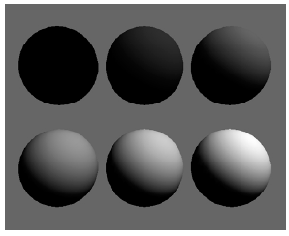
Example: Spheres Illuminated with Diffuse Light.
Spheres with reflection coefficients from 0 to 1 by 0.2.
The source intensity is 1.0. Background intensity is 0.4.
The sphere is totally black when ρ_{d} = 0.0, and the shadow in its bottom half (where (s∙m)/(|s||m|) < 0) is also black.
I_{d}=1.0,
I_{a}=0.4
Ρ_{d}=0, 0.2, 0.4,
0.6, 0.8, 1.0

Slide 71
Calculating Diffuse Light (4)
The light intensity falling on facet S from the point source is known to decrease as the inverse square of the distance between S and the source. We could try to incorporate this in our model.
Experiments show that using this law yields pictures with exaggerated depth effects.
Also, we sometimes model light sources as if they lie “at infinity”. Using an inverse square law in such a case would quench the light entirely.
So we ignore distance effects in calculating light intensity.

Slide 72
Calculating the Specular Component
Real objects do not scatter light uniformly in all directions; a specular component is added to the shading model.
Specular reflection causes highlights, which can add significantly to realism of a picture when objects are shiny.

Slide 73
Calculating the Specular Component (2)
A simple model for specular light was developed by Phong. It is easy to apply.
  The highlights generated by the Phong model give an object a plastic-like or glass-like appearance.
  The Phong model is less successful with objects that are supposed to have a shiny metallic surface, although you can roughly approximate them with OpenGL by careful choices of certain color parameters.

Slide 74
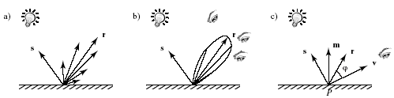
Calculating the Specular Component (3)
Most of the light reflects at equal angles from the (smooth and/or shiny) surface, along direction r, the reflected direction.

Slide 75
Calculating the Specular Component (2)
In Ch. 4, we found that r = -s + 2 m (s∙m)/(|m|²) (mirror reflection direction).
For surfaces that are not mirrors, the amount of reflected light decreases as the angle φ between r and v (vector from reflection point to eye) increases.
For a simplified model, we say the intensity decreases as cos^{f} φ, where f is chosen experimentally between 1 and 200.

Slide 76
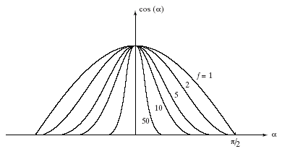
Calculating the Specular Component (3)
The effect of f : large f values give concentrated highlights; smaller ones give larger dimmer highlights.

Slide 77
Calculating the Specular Component (4)
cos φ = r∙v/(|r||v|)
I_{sp} = I_{s} ρ_{s} (r∙v/(|r||v|))^{f}.
  ρ_{s} is the specular reflection coefficient, which depends on the material.
If r∙v < 0, there is no reflected specular light.
I_{sp} = I_{s} ρ_{s} max[(r∙v/(|r||v|))^{f}, 0].

Slide 78
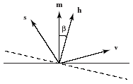
Speeding up Calculations for Specular Light
Find the halfway vector h = s + v.
Then the angle β between h and m approximately measures the falloff of intensity. To take care
of errors, we use a
different f value, and
write
I_{sp} = I_{s} ρ_{s} max[(h∙m/(|h||m|))^{f}, 0]

Slide 79
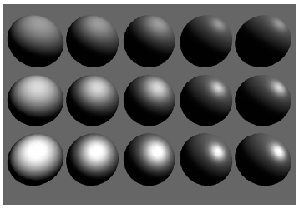
Calculating the Specular Component (5)
From bottom to top, ρ_{s} = 0.75, 0.5, 0.25. From left to right, f = 3, 6, 9, 25, 200.
ρ_{a}= 0.1
ρ_{d}= 0.4

Slide 80
Ambient Light
Our desire for a simple reflection model leaves us with far from perfect renderings of a scene.
  E.g., shadows appear to be unrealistically deep and harsh.
To soften these shadows, we can add a third light component called ambient light.

Slide 81
Ambient Light (2)
The scenes we observe around us always seem to be bathed in some soft non-directional light.
This light arrives by multiple reflections from various objects in the surroundings and from light sources that populate the environment, such as light coming through a window, fluorescent lamps, and the like.
We assume a uniform background glow called ambient light exists in the environment.
This ambient light source is not situated at any particular place, and it spreads in all directions uniformly.

Slide 82
Calculating Ambient Light
The source is assigned an intensity, I_{a}.
Each face in the model is assigned a value for its ambient reflection coefficient, ρ_{a} (often this is the same as the diffuse reflection coefficient, ρ_{d}), and the term I_{a} ρ_{a} is simply added to whatever diffuse and specular light is reaching the eye from each point P on that face.
I_{a} and ρ_{a} are usually arrived at experimentally, by trying various values and seeing what looks best.

Slide 83
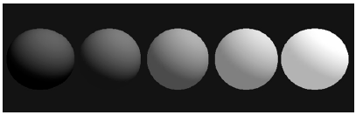
Adding Ambient Light to Diffuse Reflection
The diffuse and ambient sources have intensity 1.0, and ρ_{d} = 0.4. ρ_{a} = 0, 0.1, 0.3, 0.5, 0.7 (left to right).
Modest ambient light softens shadows; too much ambient light washes out shadows.

Slide 84
Combining Light Contributions and Adding Color
I = I_{a} ρ_{a} + I_{s} ρ_{d} lambert + I_{sp} ρ_{s} x phong^{f}
where Lambert = max[(s∙m)/(|s||m|), 0] and Phong = max[(h∙m/(|h||m|), 0]
To add color, we use 3 separate total intensities like that above, one each for Red, Green, and Blue, which combine to give any desired color of light.
We say the light sources have three types of color: ambient = (I_{ar}, I_{ag}, I_{ab}), diffuse = (I_{dr}, I_{dg}, I_{db}), and specular = (I_{spr}, I_{spg}, I_{spb} ).

Slide 85
Combining Light Contributions and Adding Color (2)
Generally the diffuse light and the specular light have the same intensity.
ρ_{s} is the same for R, G, and B, so specular light is the color of the light source.
An object’s color (in white light) is specified by 9 coefficients (ambient and diffuse are color of object):
ambient reflection coefficients: ρ_{ar}, ρ_{ag}, and ρ_{ab;}
diffuse reflection coefficients: ρ_{dr}, ρ_{dg}, and ρ_{db}
specular reflection coefficients: ρ_{sr}, ρ_{sg}, and ρ_{sb}

Slide 86
Example
If the color of a sphere is 30% red, 45% green, and 25% blue, it makes sense to set its ambient and diffuse reflection coefficients to (0.3K, 0.45K, 0.25K) respectively, where K is some scaling value that determines the overall fraction of incident light that is reflected from the sphere.
Now if it is bathed in white light having equal amounts of red, green, and blue (I_{sr} = I_{sg} = I_{sb} = I) the individual diffuse components have intensities I_{r} = 0.3 K I, I_{g} = 0.45 K I, I_{b} = 0.25 K I, so as expected we see a color that is 30% red, 45% green, and 25% blue.

Slide 87
Example (2)
Suppose a sphere has ambient and diffuse reflection coefficients (0.8, 0.2, 0.1), so it appears mostly red when bathed in white light.
We illuminate it with a greenish light I_{s} = (0.15, 0.7, 0.15).
The reflected light is then given by (0.12, 0.14, 0.015), which is a fairly even mix of red and green, and would appear yellowish.
  0.12 = 0.8 x 0.15, 0.14 = 0.2 x 0.7, 0.015 = 0.1 x 0.15

Slide 88
Example
Because specular light is mirror-like, the color of the specular component is often the same as that of the light source.
  E.g., the specular highlight seen on a glossy red apple when illuminated by a yellow light is yellow rather than red.
To create specular highlights for a plastic-like surface, set the specular reflection coefficients ρ_{sr} = ρ_{sg} = ρ_{sb}= ρ_{s}, so that the reflection coefficients are ‘gray’ in nature and do not alter the color of the incident light.
The designer might choose ρ_{s} = 0.5 for a slightly shiny plastic surface, or ρ_{s} = 0.9 for a highly shiny surface.

Slide 89
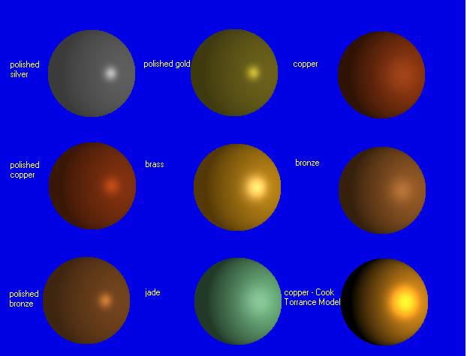
Combining Light Contributions and Adding Color (3)
A list of ρ and f values for various materials for ambient, diffuse, and specular light is given in Fig. 8.17.
Spheres of different materials (mostly metallic, but one jade at bottom center) are shown at right (Fig. 8.18).

Slide 90
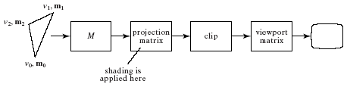
Shading and the Graphics Pipeline
Shading is applied to a vertex at the point in the pipeline where the projection matrix is applied. We specify a normal and a position for each vertex.

Slide 91
Shading and the Graphics Pipeline (2)
glNormal3f (norm[i].x, norm[i].y, norm[i].z) specifies a normal for each vertex that follows it.
The modelview matrix transforms both vertices and normals (m), the latter by M^{-T}m. M^{-T} is the transpose of the inverse matrix M⁻¹.
The positions of lights are also transformed.

Slide 92
Shading and the Graphics Pipeline (3)
Then a color is applied to each vertex, the perspective transformation is applied, and clipping is done.
Clipping may create new vertices which need to have colors attached, usually by linear interpolation of initial vertex colors.
If the new point a is 40% of the way from v₀ to v₁, the color associated with a is a blend of 60% of (r₀, g₀, b₀) and 40% of (r₁, g₁, b₁):
color at point a = (lerp(r₀, r₁, 0.4), lerp(g₀, g₁, 0.4), lerp(b₀, b₁, 0.4))

Slide 93
Shading and the Graphics Pipeline (4)
The vertices are finally passed through the viewport transformation where they are mapped into screen coordinates (along with pseudodepth, which now varies between 0 and 1).
The quadrilateral is then rendered (with hidden surface removal).

