Slide 1
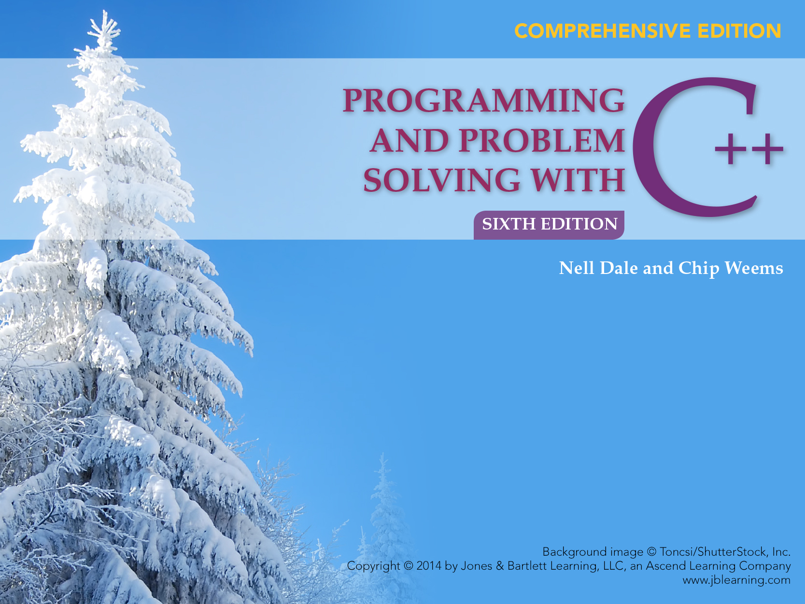
Chapter 2
C++ Syntax and Semantics, and the Program Development Process

Slide 2
Chapter 2 Topics
Programs Composed of Several Functions
Syntax Templates
Legal C++ Identifiers
Assigning Values to Variables
Declaring Named Constants
String Concatenation
Output Statements
C++ Program Comments

Slide 3
A C++ program is a collection of one or more functions
There must be a function called main()
Execution always begins with the first statement in function main()
Any other functions in your program are subprograms and are not executed until they are called

Slide 4
Program With Several Functions
main function
square function
cube function

Slide 5
Program With Three Functions
#include <iostream>
int Square(int); // Declares these two
int Cube(int); // value-returning functions
using namespace std;
int main()
{
cout << “The square of 27 is “
<< Square(27)<< endl; // Function call
cout << “The cube of 27 is “
<< Cube(27)<< endl; // Function call
return 0;
}

Slide 6
Rest of Program
int Square(int n)
{
return n * n;
}
int Cube(int n)
{
return n * n * n;
}

Slide 7
Output of program
The square of 27 is 729
The cube of 27 is 19683

Slide 8
Shortest C++ Program
type of returned value
int main()
{
return 0;
}
name of function

Slide 9
What is in a heading?
type of returned value
says no parameters
name of function
int main( )

Slide 10
Block(Compound Statement)
A block is a sequence of zero or more statements enclosed by a pair of curly braces { }
SYNTAX
{
Statement (optional)
.
.
.
}

Slide 11
Every C++ function has 2 parts
int main() heading
{
body block
return 0;
}

Slide 12
What is an Identifier?
An identifier is the name used for a data object(a variable or a constant), or for a function, in a C++ program
Beware: C++ is a case-sensitive language
Using meaningful identifiers is a good programming practice

Slide 13
Identifiers
An identifier must start with a letter or underscore, and be followed by zero or more letters
(A-Z, a-z), digits(0-9), or underscores _
VALID
age_of_dog taxRateY2K
PrintHeading ageOfHorse
NOT VALID (Why?)
age# 2000TaxRate Age-Of-Cat

Slide 14
More About Identifiers
Some C++ compilers recognize only the first 32 characters of an identifier as significant
Then these identifiers are considered the same:
  age_Of_This_Old_Rhinoceros_At_My_Zoo
  age_Of_This_Old_Rhinoceros_At_My_Safari
Consider these:
  Age_Of_This_Old_Rhinoceros_At_My_Zoo
  age_Of_This_Old_Rhinoceros_At_My_Zoo

Slide 15
C++ Data Types
simple
structured
integral enum
floating
array struct union class
char short int long bool
address
float double long double
pointer reference

Slide 16
C++ Simple Data Types
simple types
integral
floating
char short int long bool enum float double long double
unsigned

Slide 17
Standard Data Types in C++
Integral Types
  represent positive and negative integers
  declared as int, short, or long
Floating Types
  represent real numbers with a decimal point
  declared as float, or double
Character Types
  represent single alphanumerical character---a letter, digit, or a special symbol
  declared as char

Slide 18
Samples of C++ Data Values
int sample values
  4578 -4578 0
float sample values
  95.274 95. .265
char sample values
‘B’ ‘d’ ‘4’ ‘?’ ‘*’

Slide 19
What is a Variable?
A variable is a location in memory that can be referred to by an identifier and in which a data value that can be changed is stored
Declaring a variable means specifying both its name and its data type

Slide 20
What Does a Variable Declaration Do?
int ageOfDog;
float taxRate;
char middleInitial;
A declaration tells the compiler to allocate enough
memory to hold a value of this data type and to associate the identifier with this location
1 byte for middleInitial
4 bytes for taxRateY2K

Slide 21
C++ Data Type String
A string is a sequence of characters enclosed in double quotes
Sample string values
“Hello” “Year 2000” “1234”
The empty string (null string)contains no characters and is written as ""

Slide 22
More About Type String
A string is not a built-in(standard)type
  It is a programmer-defined data type
  It is provided in the C++ standard library
String operations include
  Comparing 2 string values
  Searching a string for a particular character
  Joining one string to another

Slide 23
What is a Named Constant?
A named constant is a location in memory that can be referred to by an identifier and in which a data value that cannot be changed is stored
Valid constant declarations
const string STARS = “****”;
const float NORMAL_TEMP = 98.6;
const char BLANK = ‘ ’;
const int VOTING_AGE = 18;
const float MAX_HOURS = 40.0;

Slide 24
Giving a Value to a Variable
Assign(give)a value to a variable by using the assignment operator =
Variable declarations
string firstName;
char middleInitial;
char letter;
int ageOfDog;
Valid assignment statements
firstName = “Fido”;
middleInitial = ‘X’;
letter = middleInitial;
ageOfDog = 12;

Slide 25
What is an Expression in C++?
An expression is a valid arrangement of variables, constants, and operators
In C++ each expression can be evaluated to compute a value of a given type
The value of the expression
9 + 5 is 14

Slide 26
Assignment Operator Syntax
Variable = Expression
Done second
Done first
Result is
stored in
variable
Expression
is
evaluated

Slide 27
String Concatenation(+)
Concatenation is a binary operation that uses the + operator
At least one of the operands of the + operator must be a string variable or named string constant--the other operand can be a string literal or a char variable, literal, or constant

Slide 28
Concatenation Example
const string WHEN = “Tomorrow”;
const char EXCLAMATION = ‘!’;
string message1;
string message2;
message1 = “Yesterday “;
message2 = “and “;
message1 = message1 + message2 +
WHEN + EXCLAMATION;

Slide 29
Insertion Operator(<<)
Variable cout is predefined to denote an output stream that goes to the standard output device(display screen)
The insertion operator << called “put to” takes two operands
The left operand is a stream expression, such as cout
The right operand is an expression of a simple type or a string constant

Slide 30
Output Statements
SYNTAX
These examples yield the same output:
cout << “The answer is “;
cout << 3 * 4;
cout << “The answer is “ << 3 * 4;
cout << Expression << Expression . . .;

Slide 31
Is compilation the first step?
No; before your source program is compiled, it is first examined by the C++ Preprocessor that:
  removes all comments from source code
  handles all preprocessor directives--they begin with the # character such as
  #include <iostream>
  This include tells the preprocessor to look in the standard include directory for the header file called iostream and insert its contents into your source code

Slide 32
No I/O is built into C++
Instead, a library provides an output stream
executing
program
Screen
ostream

Slide 33
Using Libraries
A library has two parts
  Interface (stored in a header file) tells what items are in the library and how to use them
  Implementation (stored in another file) contains the definitions of the items in the library
#include <iostream>
  Refers to the header file for the iostream library needed for use of cout and endl.

Slide 34
Function Concept in Math
Function definition
f(x) = 5 x - 3
When x = 1, f(x)= 2 is the returned value
When x = 4, f(x)= 17 is the returned value
Returned value is determined by the function definition and by the values of any parameters
Parameter of function
Name of function

Slide 35
C++ Program
// ******************************************************
// PrintName program
// This program prints a name in two different formats
// ******************************************************
#include <iostream> // for cout and endl
#include <string> // for data type string
using namespace std;
const string FIRST = “Herman”; // Person’s first name
const string LAST = “Smith”; // Person’s last name
const char MIDDLE = ‘G’; // Person’s middle initial

Slide 36
C++ Code Continued
int main()
{
string firstLast; // Name in first-last format
string lastFirst; // Name in last-first format
firstLast = FIRST + “ “ + LAST;
cout << “Name in first-last format is “ << endl
<< firstLast << endl;
lastFirst = LAST + “, “ + FIRST + ’ ’;
cout << “Name in first-last format is “ << endl
<< lastFirst << MIDDLE << ’.’ << endl;
return 0;
}

Slide 37
Output of Program
Name in first-last format is Herman Smith
Name in last-first-initial format is Smith, Herman G.

Slide 38
Software Maintenance Tips When Modifying Complex Code
Break a long block of code into smaller chunks that have distinct purposes
Identify portions of the code that you know you can ignore
Focus on those code sections that are clearly related to the maintenance task
Make sure you understand which changes are required including asking questions about unclear matters

Slide 39
Software Maintenance Tips When Modifying Complex Code
Consider the major steps (e.g., an application whose steps are input, process, and output) you have identified in the existing code
Then establish how you would solve the maintenance task within the overall approach of the existing code
Examine and evaluate how your changes affect other parts of the application
Document your changes to the code

Slide 40
Creating a Chessboard
Problem Your college is hosting a chess tournament, and the people running the tournament want to record the final positions of the pieces in each game on a sheet of paper with a chessboard preprinted on it. Your job is to write a program to preprint these pieces of paper. The chessboard is an eight-by-eight pattern of squares that alternate between black and white, with the upper left square being white. You need to print out squares of light characters (spaces) and dark characters( such as *) in this pattern to form the chessboard.

Slide 41
Chessboard
Constants
Name Value Function
  BLACK '********' Characters forming one line of a black square
  WHITE ' ' Characters forming one line of a white square
  Variables
Name Data Type Description
  whiteRow string A row beginning with a white square
  blackRow string A row beginning with a black square

Slide 42
Algorithm
Repeat four times
Output five whiteRows
Output five blackRows

Slide 43
C++ Program
//*****************************************************
// Chessboard program
// This program prints a chessboard pattern that is
// built up from basic strings of white and black
// characters.
//*****************************************************
#include <iostream>
#include <string>
using namespace std;
const string BLACK = "********"; // Define black square line
const string WHITE = " "; // Define white square line

Slide 44
C++ Program
int main()
{
string whiteRow; // White square beginning row
string blackRow; // Black square beginning row
// Create a white-black row
whiteRow = WHITE + BLACK + WHITE + BLACK +
WHITE + BLACK + WHITE + BLACK;
// Create a black-white row
blackRow = BLACK + WHITE + BLACK + WHITE +
BLACK + WHITE + BLACK + WHITE;

Slide 45
C++ Program
// Print five white-black rows
cout << whiteRow << endl;
cout << whiteRow << endl;
cout << whiteRow << endl;
cout << whiteRow << endl;
cout << whiteRow << endl;
// Print five black-white rows
cout << blackRow << endl;
cout << blackRow << endl;
cout << blackRow << endl;
cout << blackRow << endl;
cout << blackRow << endl;
// Print rest of the rows
...
return 0;
}

