Slide 1
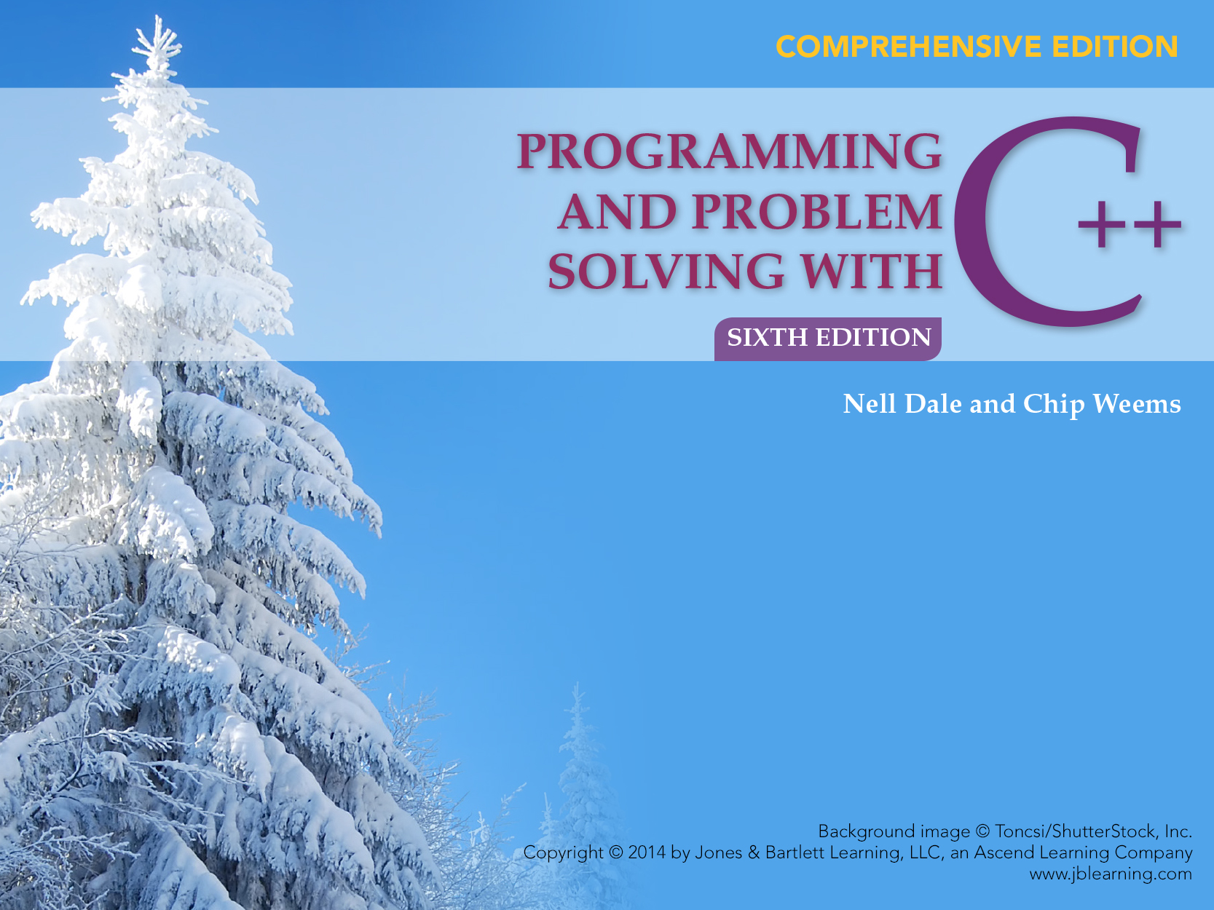
Chapter 3
Numeric Types, Expressions, and Output

Slide 2
Chapter 3 Topics
Constants of Type int and float
Evaluating Arithmetic Expressions
Implicit Type Coercion and Explicit Type Conversion
Calling a Value-Returning Function
Using Function Arguments

Slide 3
Chapter 3 Topics
Using C++ Library Functions in Expressions
Calling a Void Function
C++ Manipulators to Format Output
String Operations length, find, and substr

Slide 4
C++ Data Types
simple
structured
integral enum
floating
array struct union class
char short int long bool
address
float double long double
pointer reference

Slide 5
C++ Simple Data Types
simple types
integral
floating
char short int long bool enum float double long double
unsigned

Slide 6
Standard Data Types in C++
Integral Types (or Integer Types)
  represent whole numbers and their negatives
  declared as int, short, long, or char
Floating Types
  represent real numbers with a decimal point
  declared as float or double

Slide 7
Standard Data Types in C++
Character Type
  represents single characters such as 'B'
  declared as char
  classified as an integral type because C++ allows char to be used for storing integer values with a limited range

Slide 8
Samples of C++ Data Values
int sample values
  4578 -4578 0
float sample values
  95.274 95. .265
  9521E-3 -95E-1 95.213E2
char sample values
  ‘B’ ‘d’ ‘4’ ‘?’ ‘*’

Slide 9
Scientific Notation
2.7E4 means 2.7 x 10 ⁴ =
2.7000 =
27000.0
2.7E-4 means 2.7 x 10 ⁻ ⁴ =
0002.7 =
0.00027

Slide 10
More About Floating Point Values
Floating point numbers have an integer part and a fractional part, with a decimal point in between.
Either the integer part or the fractional part, but not both, may be missing
Examples 18.4 500. .8
- 127.358

Slide 11
More About Floating Point Values
Alternatively, floating point values can have an exponent, as in scientific notation
The number preceding the letter E doesn’t need to include a decimal point
Examples 1.84E1 5E2 8E-1
-.127358E3

Slide 12
Division Operator
The result of the division operator depends on the type of its operands
If one or both operands has a floating point type, the result is a floating point type.
Otherwise, the result is an integer type
Examples 11 / 4 has value 2 11.0 / 4.0 has value 2.75 11 / 4.0 has value 2.75

Slide 13
Main returns an int value
to the operating system
//*******************************************************
// FreezeBoil program
// This program computes the midpoint between
// the freezing and boiling points of water
//*******************************************************
#include < iostream >
using namespace std;
const float FREEZE_PT = 32.0; // Freezing point of water
const float BOIL_PT = 212.0; // Boiling point of water
int main()
{
float avgTemp; // Holds the result of averaging
// FREEZE_PT and BOIL_PT

Slide 14
Function main Continued
cout << “Water freezes at “ << FREEZE_PT << endl;
cout << “ and boils at “ << BOIL_PT
<< “ degrees.” << endl;
avgTemp = FREEZE_PT + BOIL_PT;
avgTemp = avgTemp / 2.0;
cout << “Halfway between is “;
cout << avgTemp << “ degrees.” << endl;
return 0;
}

Slide 15
Modulus Operator
The modulus operator % can only be used with integer type operands and always has an integer type result
Its result is the integer type remainder of an integer division
Example 11 % 4 has value 3 because
R = ?
4
)
11

Slide 16
More C++ Operators
int age;
age = 8;
age = age + 1;
8
age
9
age

Slide 17
Prefix Form
Increment Operator
int age;
age = 8;
++age;
8
age
9
age

Slide 18
Postfix Form
Increment Operator
int age;
age = 8;
age++;
8
age
9
age

Slide 19
Decrement Operator
int dogs;
dogs = 100;
dogs--;
100
dogs
99
dogs

Slide 20
Which Form to Use
When the increment(or decrement) operator is used in a “stand alone” statement solely to add one(or subtract one) from a variable’s value, it can be used in either prefix or postfix form
USE EITHER
dogs--; --dogs;

Slide 21
BUT...
When the increment (or decrement) operator is used in a statement with other operators, the prefix and postfix forms can yield different results
We’ll see how later . . .

Slide 22
What is an Expression in C++?
An expression is a valid arrangement of variables, constants, and operators
In C++ each expression can be evaluated to compute a value of a given type
The value of the expression
9.3 * 4.5 is 41.85

Slide 23
Operators can be
binary involving 2 operands 2 + 3
unary involving 1 operand - 3
ternary involving 3 operands later

Slide 24
Some C++ Operators
Precedence Operator Description
Higher ( ) Function call
+ Positive
- Negative
* Multiplication
/ Division
% Modulus(remainder)
+ Addition
- Subtraction
Lower = Assignment

Slide 25
Precedence
Higher Precedence determines which operator is applied first in an expression having several operators

Slide 26
Associativity
Left to right associativity–in an expression having two operators with the same priority, the left operator is applied first
Grouping order –synonmous w/ associativity
In C++ the binary operators
*, /, %, +, - are all left associative
Expression 9 - 5 - 1 means (9 - 5) - 1
4 - 1
3

Slide 27
Evaluate the Expression
7 * 10 - 5 % 3 * 4 + 9
(7 * 10) - 5 % 3 * 4 + 9
70 - 5 % 3 * 4 + 9
70 -(5 % 3) * 4 + 9
70 - 2 * 4 + 9
70 -( 2 * 4) + 9
70 - 8 + 9
(70 - 8 ) + 9
62 + 9
71

Slide 28
Parentheses
Parentheses can be used to change the usual order
Parts in() are evaluated first
Evaluate (7 *(10 - 5) % 3) * 4 + 9
(7 * 5 % 3 ) * 4 + 9
( 35 % 3) * 4 + 9
2 * 4 + 9
8 + 9
17

Slide 29
Recall Assignment Operator Syntax
Variable = Expression
First, expression on right is evaluated
Then the resulting value is stored in the memory location of variable on left

Slide 30
Automatic Type Conversion
Implict conversion by the compiler of a value from one data type to another is known as automatic type coercion
An automatic type coercion occurs after evaluation but before the value is stored if the types differ for expression and variable
See examples on Slides 31, 32, and 33

Slide 31
What value is stored?
float a;
float b;
a = 8.5;
b = 9.37;
a = b;
a
8.5
a
?
b
9.37
b
?

Slide 32
What is stored?
float someFloat;
someFloat
someFloat = 12; // Causes implicit type conversion
?
12.0
someFloat

Slide 33
What is stored?
int someInt;
someInt
someInt = 4.8; // Causes implicit type conversion
?
4
someInt

Slide 34
Type Casting is Explicit Conversion of Type
Explicit type casting (or type conversion) used to clarify that the mixing of types is intentional, not an oversight
Explicit type casting helps make programs clear and error free as possible

Slide 35
Examples of Explicit Typecasting
int(4.8) has value 4
float(5) has value 5.0
float(7/4) has value 1.0
float(7) / float(4) has value 1.75

Slide 36
Some Expressions
int age;
Example Value
age = 8 8
- age - 8
5 + 8 13
5 / 8 0
6.0 / 5.0 1.2
float(4 / 8) 0.0
float(4) / 8 0.5
cout << “How old are you?” cout
cin >> age cin
cout << age cout

Slide 37
What values are stored?
float loCost;
float hiCost;
loCost = 12.342;
hiCost = 12.348;
loCost =
float(int(loCost * 100.0 + 0.5)) / 100.0;
hiCost =
float(int(hiCost * 100.0 + 0.5)) / 100.0;

Slide 38
Values were rounded to 2 decimal places
loCost
12.34
12.35
hiCost

Slide 39
Functions
Every C++ program must have a function called main
Program execution always begins with function main
Any other functions are subprograms and must be called by the main function

Slide 40
Function Calls
One function calls another by using the name of the called function together with() containing an argument list
A function call temporarily transfers control from the calling function to the called function

Slide 41
More About Functions
It is not considered good practice for the body block of function main to be long
Function calls are used to do subtasks
Every C++ function has a return type
If the return type is not void, the function returns a value to the calling block

Slide 42
Where are functions?
Functions are subprograms
  located in libraries, or
  written by programmers for their use in a particular program

Slide 43
HEADER FILE FUNCTION EXAMPLE VALUE
OF CALL
<cstdlib> abs(i) abs(-6) 6
<cmath> pow(x,y) pow(2.0,3.0) 8.0
fabs(x) fabs(-6.4) 6.4
<cmath> sqrt(x) sqrt(100.0) 10.0
sqrt(x) sqrt(2.0) 1.41421
<cmath> log(x) log(2.0) .693147
<iomanip> setprecision(n) setprecision(3)

Slide 44
Write C++ Expressions for
The square root of b² - 4ac
sqrt(b * b - 4.0 * a * c)
The square root of the average of myAge and yourAge
sqrt((myAge + yourAge) / 2)

Slide 45
Function Call
A function call temporarily transfers control to the called function’s code
When the function’s code has finished executing, control is transferred back to the calling block

Slide 46
Function Call Syntax
Function Name = (Argument List)
The argument list is a way for functions to communicate with each other by passing information
The argument list can contain zero, one, or more arguments, separated by commas, depending on the function

Slide 47
A void function call stands alone
#include <iostream>
void DisplayMessage(int n);
// Declares function
int main()
{
DisplayMessage(15);
// Function call
cout << “Good Bye“ << endl;
return 0;
}

Slide 48
A void function does NOT return a value
// Header and body here
void DisplayMessage(int n)
{
cout << “I have liked math for “
<< n << “ years” << endl;
}

Slide 49
Two Kinds of Functions
Value-Returning Void
Always returns
a single value to its caller and is called from within an expression
Never returns a value to its caller and is called as a separate statement

Slide 50
<< is a binary operator
<< is called the output or insertion operator
<< is left associative
Expression Has value
cout << age cout
Statement
cout << “You are “ << age << “ years old\n”;

Slide 51
<iostream> is header file
For a library that defines 3 objects
An istream object named cin (keyboard)
An ostream object named cout (screen)
An ostream object named cerr (screen)

Slide 52
No I/O is built into C++
Instead, a library provides input stream and output stream
Keyboard
executing
program
Screen
istream
ostream

Slide 53
Manipulators
Manipulators are used only in input and output statements
endl, fixed, showpoint, setw, and setprecision are manipulators that can be used to control output format
endl is use to terminate the current output line and create blank lines in output

Slide 54
Insertion Operator(<<)
The insertion operator << takes 2 operands
The left operand is a stream expression, such as cout
The right operand is an expression of simple type, a string, or a manipulator

Slide 55
Output Statements
SYNTAX(revised)
cout << ExpressionOrManipulator
<< ExpressionOrManipulator . . .;

Slide 56
Output Statements
SYNTAX
These examples yield the same output
cout << “The answer is “;
cout << 3 * 4;
cout << “The answer is “ << 3 * 4;
cout << Expression << Expression . . .;

Slide 57
Using Manipulators
Fixed and Showpoint
Use the following statement to specify that (for output sent to the cout stream) decimal format (not scientific notation) be used,
and that a decimal point be included (even for floating values with 0 as fractional part)
cout << fixed << showpoint;

Slide 58
setprecision(n)
Requires #include <iomanip> and appears in an expression using insertion operator(<<)
If fixed has already been specified, argument n determines the number of places displayed after the decimal point for floating point values
Remains in effect until explicitly changed by another call to setprecision

Slide 59
What is exact output?
#include <iomanip> // For setw() and setprecision()
#include <iostream>
using namespace std;
int main()
{
float myNumber = 123.4587;
cout << fixed << showpoint;
// Use decimal format
// Print decimal points
cout << “Number is ” << setprecision(3)
<< myNumber << endl;
return 0;
}

Slide 60
OUTPUT
Number is 123.459
Value is rounded if necessary to be displayed
with exactly 3 places after the decimal point

Slide 61
Manipulator setw
“Set width” lets us control how many character positions the next data item should occupy when it is output
setw is only for formatting numbers and strings, not char type data

Slide 62
setw(n)
Requires #include <iomanip> and appears in an expression using insertion operator(<<)
Argument n is called the fieldwidth specification
Argument n determines the number of character positions in which to display a right-justified number or string (not char data)

Slide 63
setw(n)
The number of character positions used is expanded if n is too narrow
“Set width” affects only the very next item displayed and is useful to align columns of output

Slide 64
A) What is exact output?
#include <iomanip> // For setw()
#include <iostream>
#include <string>
using namespace std;

Slide 65
A) What is exact output?, cont...
int main()
{
int myNumber = 123;
int yourNumber = 5;
cout << setw(10) << “Mine”
<< setw(10) << “Yours” << endl
<< setw(10) << myNumber
<< setw(10) << yourNumber << endl;
return 0;
}

Slide 66
Output
position
12345678901234567890
Mine Yours
123 5
Each is displayed right-justified and
each is located in a total of 10 positions

Slide 67
B) What is exact output?
#include <iomanip> // For setw() and setprecision()
#include <iostream>
using namespace std;
int main()
{
float myNumber = 123.4;
float yourNumber = 3.14159;

Slide 68
B) What is exact output, continued?
cout << fixed << showpoint;
// Use decimal format; print decimal points
cout << “Numbers are: ” << setprecision(4)
<< endl << setw(10) << myNumber
<< endl << setw(10) << yourNumber
<< endl;
return 0;
}

Slide 69
OUTPUT
12345678901234567890
Numbers are:
123.4000
3.1416
Each is displayed right-justified and
rounded if necessary and each is
located in a total of 10 positions with
4 places after the decimal point

Slide 70
More Examples
312.0
x
4.827
y
float x = 312.0;
float y = 4.827;
OUTPUT
cout << fixed << showpoint;
cout << setprecision(2)
<< setw(10) << x << endl ’’’’ 3 1 2.00
<< setw(10) << y << endl; ’’’’’’ 4.83
cout << setprecision(1)
<< setw(10) << x << endl ’’’’’ 3 1 2.0
<< setw(10) << y << endl; ’’’’’’’ 4.8
cout << setprecision(5)
<< setw(7) << x << endl 3 1 2.00000
<< setw(7) << y << endl;                                   4.82700

Slide 71
HEADER MANIPULATOR ARGUMENT EFFECT
FILE TYPE
<iostream> endl none terminates
output line
<iostream> showpoint none displays
decimal point
<iostream> fixed none activates
scientific notation
<iomanip> setw(n) int sets fieldwidth
to n positions
<iomanip> setprecision(n) int sets precision
to n digits

Slide 72
length Function
Function length returns an unsigned integer value that equals the number of characters currently in the string
Function size returns the same value as function length
You must use dot notation in the call to function length or size

Slide 73
find Function
Function find returns an unsigned integer value that is the beginning position for the first occurrence of a particular substring within the string
The substring argument can be a string constant, a string expression, or a char value
If the substring was not found, function find returns the special value string::npos

Slide 74
substr Function
Function substr returns a particular substring of a string
The first argument is an unsigned integer that specifies a starting position within the string
The second argument is an unsigned integer that specifies the length of the desired substring
Positions of characters within a string are numbered starting from 0, not from 1

Slide 75
Mortgage Payments
Problem Your parents are thinking about refinancing
their mortgage, and have asked you to help them with
the calculations. Now that you're learning C++, you
realize that you can save yourself a lot of calculator
button-pressing by writing a program to do
the calculations automatically.

Slide 76
Algorithm
Define Constants
Set LOAN_AMOUNT = 50000.00
Set NUMBER_OF_YEARS = 7
Set YEARLY_INTEREST = 0.0524
Calculate Values
Set monthlyInterest to YEARLY_INTEREST divided by 12
Set numberOfPayments to NUMBER_OF_YEARS times 12
Set payment to(LOAN_AMOUNT *
pow(monthlyInterest+1,numberrOfPayments)
* monthlyInterest))
/(pow(monthlyInterest+1, numberOfPayments) - 1)
Output Results
Print "For a loan amount of " LOAN_AMOUNT "with an interest rate of "
YEARLY_INTEREST " and a " NUMBER_OF_YEARS "
year mortgage, "
Print "your monthly payments are $" payment "."

Slide 77
C++ Program
//***************************************************
// Mortgage Payment Calculator program
// This program determines the monthly payments on a
// mortgage given the loan amount, the yearly interest,
// and the number of years.
//***************************************************
#include <iostream> // Access cout
#include <cmath> // Access power function
#include <iomanip> // Access manipulators
using namespace std;
const float LOAN_AMOUNT = 50000.00; // Amount of loan
const float YEARLY_INTEREST = 0.0524;// Yearly interest
const int NUMBER_OF_YEARS = 7; // Number of years

Slide 78
C++ Program
int main()
{
// Local variables
float monthlyInterest; // Monthly interest rate
int numberOfPayments; // Total number of payments
float payment; // Monthly payment
// Calculate values
monthlyInterest = YEARLY_INTEREST / 12;
numberOfPayments = NUMBER_OF_YEARS * 12;
payment =(LOAN_AMOUNT *
pow(monthlyInterest + 1, numberOfPayments)
* monthlyInterest)/(pow(monthlyInterest + 1,
numberOfPayments) - 1);

Slide 79
C++ Program
// Output results
cout << fixed << setprecision(2)
<< "For a loan amount of "
<< LOAN_AMOUNT << " with an interest rate of "
<< YEARLY_INTEREST << " and a "
<< NUMBER_OF_YEARS
<< " year mortgage, " << endl;
cout << " your monthly payments are $" << payment
<< "." << endl;
return 0;
}

