Slide 1
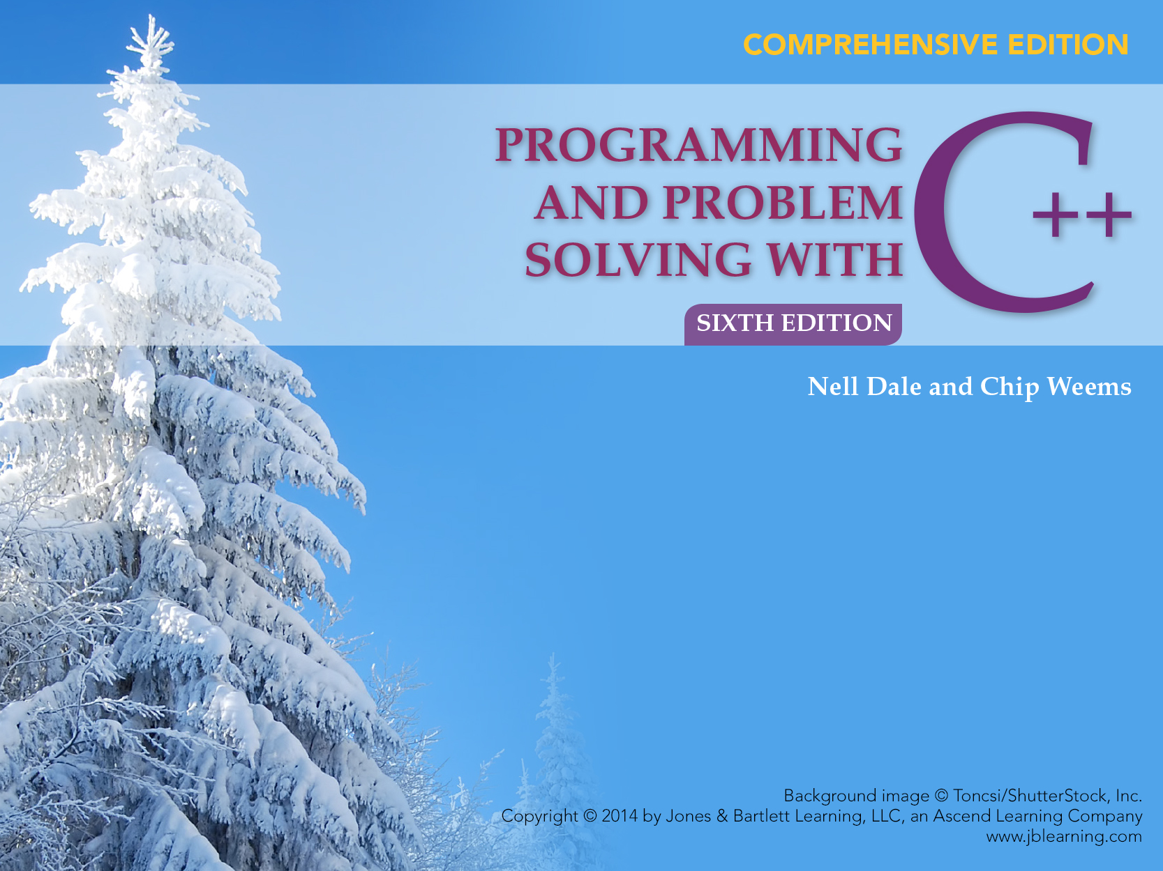
Chapter 4
Program Input and the Software Design Process

Slide 2
Chapter 4 Topics
Input Statements to Read Values into a Program using >>, and functions get, ignore, getline
Prompting for Interactive Input/Output
(I/O)
Using Data Files for Input and Output

Slide 3
Chapter 4 Topics
Object-Oriented Design Principles
Functional Decomposition Methodology
Software Engineering Tip Documentation

Slide 4
C++ Input/Output
No built-in I/O in C++
A library provides input stream and output stream
Keyboard
executing
program
Screen
istream
ostream

Slide 5
<iostream> Header File
Access to a library that defines 3 objects
  An istream object named cin (keyboard)
  An ostream object named cout (screen)
  An ostream object named cerr (screen)

Slide 6
Giving a Value to a Variable
In your program you can assign (give) a value to the variable by using the assignment operator =
ageOfDog = 12;
or by another method, such as
cout << “How old is your dog?”;
cin >> ageOfDog;

Slide 7
>> Operator
>> is called the input or extraction operator
>> is a binary operator
>> is left associative
Expression Has value
cin >> age cin
Statement
cin >> age >> weight;

Slide 8
Extraction Operator (>>)
Variable cin is predefined to denote an input stream from the standard input device((the keyboard)
The extraction operator >> called “get from” takes 2 operands; the left operand is a stream expression, such as cin--the right operand is a variable of simple type

Slide 9
Extraction Operator (>>)
Operator >> attempts to extract (inputs) the next item from the input stream and to store its value in the right operand variable
>> “skips over” (actually reads but does not store anywhere) leading white space characters as it reads your data from the input stream(either keyboard or disk file)

Slide 10
Input Statements
SYNTAX
These examples yield the same result.
cin >> length;
cin >> width;
cin >> length >> width;
cin >> Variable >> Variable . . .;

Slide 11
Whitespace Characters Include . . .
blanks
tabs
end-of-line (newline) characters
newline character created by:
  hitting Enter or Return at the keyboard or
  by using the manipulator endl or by using the symbols "\n" in the program

Slide 12
At keyboard you type:
A[space]B[space]C[Enter]
char first;
char middle;
char last;
cin >> first ;
cin >> middle ;
cin >> last ;
NOTE: A file reading marker is left pointing to the newline character after the ‘C’ in the input stream
first
middle
last
‘A’
‘B’
‘C’
first
middle
last

Slide 13
At keyboard you type:
[space]25[space]J[space]2[Enter]
int age;
char initial;
float bill;
cin >> age;
cin >> initial;
cin >> bill;
NOTE: A file reading marker is left pointing to the newline character after the 2 in the input stream
age
initial
bill
25
‘J’
2.0
age
initial
bill

Slide 14
Keyboard and Screen I/O
#include <iostream>
input data
output data
executing
program
Keyboard
Screen
cin
(of type istream)
cout
(of type ostream)

Slide 15
Another example using >>
NOTE: shows the location of the file reading marker
STATEMENTS CONTENTS MARKER
POSITION
int i; 25 A\n
char ch; 16.9\n
float x;
cin >> i; 25 A\n
16.9\n
cin >> ch; 25 A\n
16.9\n
cin >> x; 25 A\n
16.9\n
i
ch
x
25
i
ch
x
25
‘A’
i
ch
x
25
‘A’
16.9
i
ch
x

Slide 16
Another Way to Read char Data
The get() function can be used to read a single character.
get() obtains the very next character from the input stream without skipping any leading whitespace characters

Slide 17
At keyboard you type:
A[space]B[space]C[Enter]
char first;
char middle;
char last;
cin.get(first);
cin.get(middle);
cin.get(last);
NOTE: The file reading marker is left pointing to the space after the ‘B’ in the input stream
first
middle
last
‘A’
‘ ’
‘B’
first
middle
last

Slide 18
Use function ignore()
to skip characters
The ignore() function is used to skip (read and discard) characters in the input stream
The call:
cin.ignore(howMany, whatChar);
will skip over up to howMany characters or until whatChar has been read, whichever comes first

Slide 19
An Example Using cin.ignore()
NOTE: shows the location of the file reading marker
STATEMENTS CONTENTS MARKER
POSITION
int a; 957 34 1235\n
int b; 128 96\n
int c;
cin >> a >> b; 957 34 1235\n
128 96\n
cin.ignore(100, ‘\n’); 957 34 1235\n
128 96\n
cin >> c; 957 34 1235\n
128 96\n
a
b
c
957
34
a
b
c
957
34
a
b
c
957
34
128
a
b
c

Slide 20
Another Example Using cin.ignore()
NOTE: shows the location of the file reading marker
STATEMENTS CONTENTS MARKER
POSITION
int i; A 22 B 16 C 19\n
char ch;
cin >> ch; A 22 B 16 C 19\n
cin.ignore(100, ‘B’); A 22 B 16 C 19\n
cin >> i; A 22 B 16 C 19\n
i
ch
‘A’
957
34
i
ch
‘A’
957
34
i
ch
16
‘A’
957
34
i
ch

Slide 21
String Input in C++
Input of a string is possible using the extraction operator >>
Example
string message;
cin >> message;
Cout << message;
However . . .

Slide 22
>> Operator with Strings
Using the extraction operator(>>) to read input characters into a string variable
The >> operator skips any leading whitespace characters such as blanks and newlines
It then reads successive characters into the string
>> operator then stops at the first trailing whitespace character (which is not consumed, but remains waiting in the input stream)

Slide 23
String Input Using >>
string firstName;
string lastName;
cin >> firstName >> lastName;
Suppose input stream looks like this:
Joe Hernandez 23
What are the string values?

Slide 24
Results Using >>
string firstName;
string lastName;
cin >> firstName >> lastName;
Result
“Joe” “Hernandez”
firstName lastName

Slide 25
getline() Function
Because the extraction operator stops reading at the first trailing whitespace, >> cannot be used to input a string with blanks in it
Use the getline function with 2 arguments to overcome this obstacle
First argument is an input stream variable, and second argument is a string variable
Example
string message;
getline(cin, message);

Slide 26
getline(inFileStream, str)
getline does not skip leading whitespace characters such as blanks and newlines
getline reads successive characters(including blanks) into the string, and stops when it reaches the newline character ‘\n’
The newline is consumed by getline, but is not stored into the string variable

Slide 27
String Input Using getline
string firstName;
string lastName;
getline(cin, firstName);
getline(cin, lastName);
Suppose input stream looks like this:
Joe Hernandez 23
What are the string values?

Slide 28
Results Using getline
“ Joe Hernandez 23” ?
firstName lastName
string firstName;
string lastName;
getline(cin, firstName);
getline(cin, lastName);

Slide 29
Interactive I/O
In an interactive program the user enters information while the program is executing
Before the user enters data, a prompt should be provided to explain what type of information should be entered
The amount of information needed in the prompt depends on
  the complexity of the data being entered, and
  the sophistication of the person entering the data

Slide 30
Prompting for Interactive I/O
// Pattern: cout(prompt) cin(read value)
cout << “Enter part number : “ << endl;
cin >> partNumber;
cout << “Enter quantity ordered : “ << endl;
cin >> quantity;
cout << “Enter unit price : “ << endl;
cin >> unitPrice;
// Calculate and print results

Slide 31
Prompting for Interactive I/O, cont...
totalPrice = quantity * unitPrice;
cout << “Part # “ << partNumber << endl;
cout << “Quantity: “ << quantity
<< endl;
cout << “Unit Cost: $ “ << setprecision(2)
<< unitPrice << endl;
cout << “Total Cost: $ “ << totalPrice
<< endl;

Slide 32
Disk Files for I/O
#include <fstream>
input data
output data
disk file
“myInfile.dat”
executing
program
disk file
“myOut.dat”
your variable
(of type ifstream)
your variable
(of type ofstream)

Slide 33
Disk I/O
To use disk I/O
  Access #include <fstream>
  Choose valid identifiers for your file streams and declare them
  Open the files and associate them with disk names

Slide 34
Disk I/O, cont...
  Use your file stream identifiers in your I/O statements(using >> and << , manipulators, get, ignore)
  Close the files

Slide 35
Disk I/O Statements
#include <fstream>
ifstream myInfile; // Declarations
ofstream myOutfile;
myInfile.open(“myIn.dat”); // Open files
myOutfile.open(“myOut.dat”);
myInfile.close(); // Close files
myOutfile.close();

Slide 36
Opening a File
Opening a file
  Associates the C++ identifier for your file with the physical(disk) name for the file
    If the input file does not exist on disk, open is not successful
    If the output file does not exist on disk, a new file with that name is created
    If the output file already exists, it is erased

Slide 37
Opening a File
Opening a file
  Places a file reading marker at the very beginning of the file, pointing to the first character in the file

Slide 38
Stream Fail State
When a stream enters the fail state,
  Further I/O operations using that stream have no effect at all
  The computer does not automatically halt the program or give any error message

Slide 39
Stream Fail State
Possible reasons for entering fail state include:
  Invalid input data (often the wrong type)
  Opening an input file that doesn’t exist
  Opening an output file on a disk that is already full or is write-protected

Slide 40
Run Time File Name Entry
#include <string>
// Contains conversion function c_str
ifstream inFile;
string fileName;
// Prompt:
cout << “Enter input file name: “ << endl;
cin >> fileName;
// Convert string fileName to a C string type
inFile.open(fileName.c_str());

Slide 41
Functional Decomposition
A technique for developing a program in which the problem is divided into more easily handled subproblems
The solutions of these subproblems create a solution to the overall problem

Slide 42
Functional Decomposition
In functional decomposition, we work from the abstract (a list of the major steps in our solution) to the particular (algorithmic steps that can be translated directly into code in C++ or another language)

Slide 43
Functional Decomposition
Focus is on actions and algorithms
Begins by breaking the solution into a series of major steps; process continues until each subproblem cannot be divided further or has an obvious solution

Slide 44
Functional Decomposition
Units are modules representing algorithms
  A module is a collection of concrete and abstract steps that solves a subproblem
  A module structure chart (hierarchical solution tree) is often created
Data plays a secondary role in support of actions to be performed

Slide 45
Module Structure Chart
Main
Initialize
Total Miles
Compute
Mileages
Write
Total Miles
Open Files
Get Data
Round To
Nearest Tenth

Slide 46
Object-Oriented Design
A technique for developing a program in which the solution is expressed in terms of objects -- self-contained entities composed of data and operations on that data
cin
cout
>>
<<
get
Private data
setf
Private data
.
.
.
.
.
.
ignore
setw

Slide 47
More about OOD
Languages supporting OOD include: C++, Java, Smalltalk, Eiffel, CLOS, and Object-Pascal
A class is a programmer-defined data type and objects are variables of that type

Slide 48
More about OOD
In C++, cin is an object of a data type (class) named istream, and cout is an object of a class ostream.
Header files iostream and fstream contain definitions of stream classes
A class generally contains private data and public operations (called member functions)

Slide 49
Object-Oriented Design (OOD)
Focus is on entities called objects and operations on those objects, all bundled together
Begins by identifying the major objects in the problem, and choosing appropriate operations on those objects

Slide 50
Object-Oriented Design (OOD)
Units are objects; programs are collections of objects that communicate with each other
Data plays a leading role; algorithms are used to implement operations on the objects and to enable object interaction

Slide 51
Two Programming
Methodologies
Functional Object-Oriented
Decomposition Design
FUNCTION
OBJECT
Operations
Data
FUNCTION
OBJECT
OBJECT
Operations
Data
FUNCTION
Operations
Data

Slide 52
What is an object?
OBJECT
set of functions
internal state
Operations
Data

Slide 53
An object contains data and operations
checkingAccount
OpenAccount
Private data:
accoutNumber
balance
WriteCheck
MakeDeposit
IsOverdrawn
GetBalance

Slide 54
OOD Used with Large Software Projects
Objects within a program often model real-life objects in the problem to be solved
Many libraries of pre-written classes and objects are available as-is for re-use in various programs

Slide 55
OOD Used with Large Software Projects
The OOD concept of inheritance allows the customization of an existing class to meet particular needs without having to inspect and modify the source code for that class
This can reduce the time and effort needed to design, implement, and maintain large systems

Slide 56
Software Engineering Tip Documentation
Documentation includes the written problem specification, design, development history, and actual code of a problem
Good documentation helps other programmers read and understand a program
Good documentation invaluable when software is being debugged and modified (maintained)

Slide 57
Software Engineering Tip Documentation
Documentation is both external and internal to the program
External documentation includes the specifications, development history, and the design documents
Internal documents includes the program format and self-documenting code--meaningful identifiers and comments

Slide 58
Software Engineering Tip Documentation
Comments in your programs may be sufficient for someone reading or maintaining your programs
However, if the program is to be used by non-programmers, then you must also provide a user's manual
Keep documentation up-to-date and indicate any changes you made in pertinent documentation

Slide 59
Names in Multiple Formats
Problem
You are beginning to work on a problem that needs to output names in several formats along with the corresponding social security number.
As a start, you decide to write a short C++ program that inputs a social security number and a single name and displays it in the different formats, so you can be certain that all of your string expressions are correct.

Slide 60
Algorithm
Main Module Level 0
  Open files
  Get social security number
  Get name
  Write data in proper formats
  Close files
Open Files Level 1
  inData.open("name.dat")
  outData.open("name.out")

Slide 61
Get Name
Get first name
Get middle name or initial
Get last name

Slide 62
Write Data in Proper Formats
Write first name, blank, middle name, blank,
last name, blank, social security number
Write last name, comma, first name, blank,
middle name, blank, social security number
Write last name, comma, blank, first name,
blank, middle initial, period, blank,
social security number
Write first name, blank, middle initial, period,
blank, last name

Slide 63
Middle initial Level 2
  Set initial to middleName.substr(0, 1) + period
Close files
  inData.close()
  outData.close()

Slide 64
C++ Program
//*************************************************************
// Format Names program
// This program reads in a social security number, a first name
// a middle name or initial, and a last name from file inData.
// The name is written to file outData in three formats:
// 1. First name, middle name, last name, and social security
// number.
// 2. last name, first name, middle name, and social
// security number
// 3. last name, first name, middle initial, and social
// security number
// 4. First name, middle initial, last name
//*************************************************************

Slide 65
#include <fstream> // Access ofstream
#include <string> // Access string
using namespace std;
int main()
{
// Declare and open files
ifstream inData;
ofstream outData;
inData.open("name.dat");
outData.open("name.out");

Slide 66
// Declare variables
string socialNum; // Social security number
string firstName; // First name
string lastName; // Last name
string middleName; // Middle name
string initial; // Middle initial

Slide 67
// Read in data from file inData
inData >> socialNum >> firstName >> middleName
>> lastName;
// Access middle initial and append a period
initial = middleName.substr(0, 1) + '.';

Slide 68
// Output information in required formats
outData << firstName << ' ' << middleName << ' '
<< lastName << ' ' << socialNum << endl;
outData << lastName << ", " << firstName << ' '
<< middleName << ' ' << socialNum << endl;
outData << lastName << ", " << firstName << ' '
<< initial << ' ' << socialNum << endl;
outData << firstName << ' ' << initial << ' '
<< lastName;

Slide 69
// Close files
inData.close();
outData.close();
return 0;
}

