Slide 1
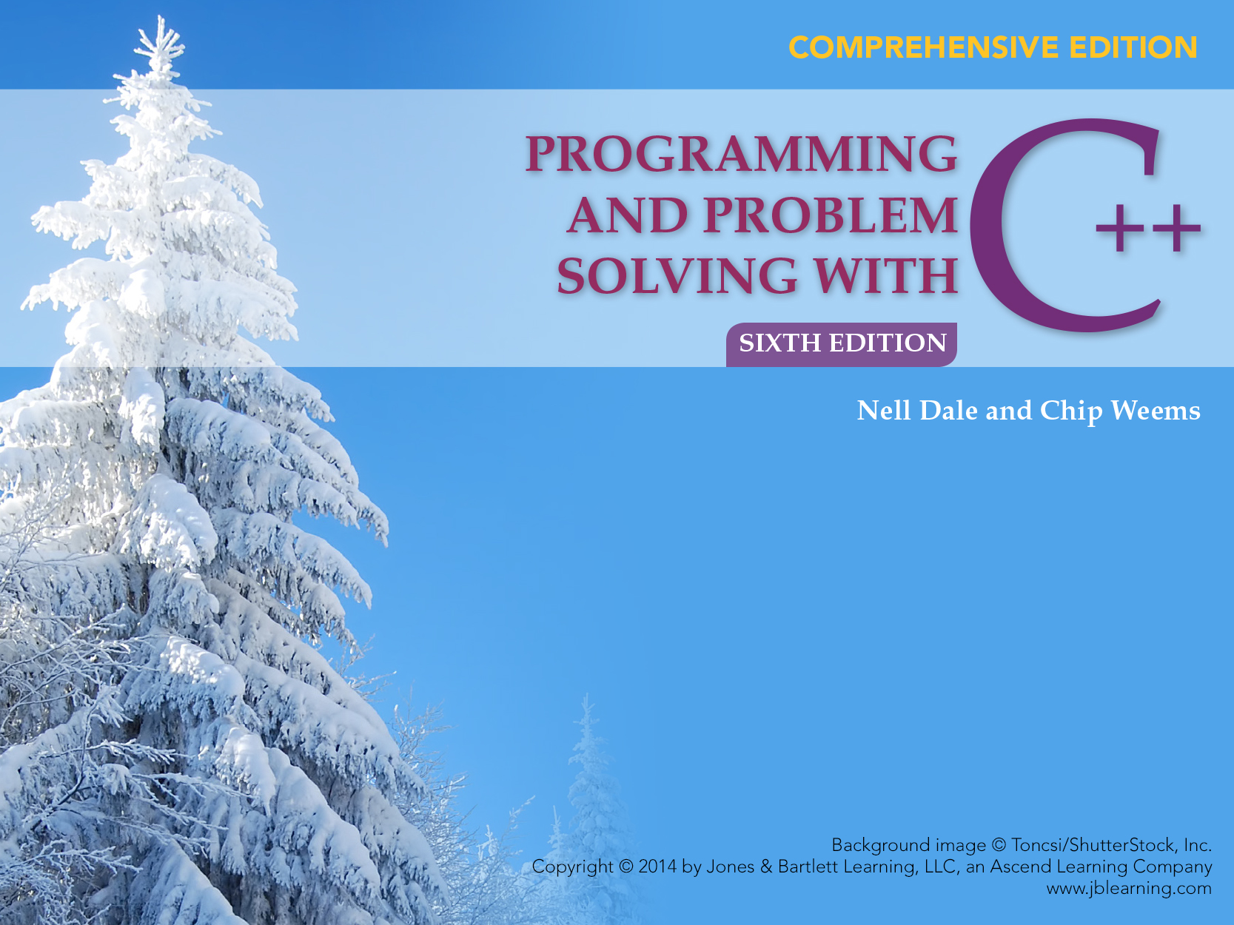
Chapter 5
Conditions, Logical Expressions, and Selection Control Structures

Slide 2

Chapter 5 Topics
Data Type bool
Using Relational and Logical Operators to Construct and Evaluate Logical Expressions
If-Then-Else Statements

Slide 3
Chapter 5 Topics
If-Then Statements
Nested If Statements for Multi-way Branching
Testing the State of an I/O Stream
Testing a C++ Program

Slide 4
Flow of Control
Flow of Control is the order in which program statements are executed
What are the possibilities?

Slide 5
Flow of Control
Sequential unless a “control structure” is used to change the order
Two general types of control structures
  Selection (also called branching)
  Repetition (also called looping)

Slide 6
bool Data Type
Type bool is a built-in type consisting of just two values, the constants true and false
We can declare variables of type bool
bool hasFever; // true if has high temperature
bool isSenior; // true if age is at least 55

Slide 7
C++ Control Structures
Selection
  if
  if . . . else
  switch
Repetition
  for loop
  while loop
  do . . . while loop

Slide 8
Expressions
Control structures use logical expressions to make choices, which may include:
6 Relational Operators
< <= > >= == !=
3 Logical Operators
! && ||

Slide 9
6 Relational Operators
are used in expressions of form:
ExpressionA Operator ExpressionB
  temperature > humidity
  rain >= average
  B * B - 4.0 * A * C < 0.0
  hours <= 40
  abs (number) == 35
  initial != ‘Q’

Slide 10
Given
int x, y;
x = 4;
y = 6;
Expression Value
x < y true
x + 2 < y false
x != y true
x + 3 >= y true
y == x false
y == x+2 true
y = x + 3 7 (true)

Slide 11
Comparing Strings
Two objects of type string (or a string object and a C string) can be compared using the relational operators
A character-by-character comparison is made using the ASCII character set values
If all the characters are equal, then the 2 strings are equal. Otherwise, the string with the character with smaller ASCII value is the “lesser” string

Slide 12
string myState;
string yourState;
myState = “Texas”;
yourState = “Maryland”;
Expression Value
myState == yourState false
myState > yourState true
myState == “Texas” true
myState < “texas” true

Slide 13
Operator Meaning Associativity
! NOT Right
*, / , % Multiplication, Division, Modulus Left
+ , - Addition, Subtraction Left
< Less than Left
<= Less than or equal to Left
> Greater than Left
>= Greater than or equal to Left
== Is equal to Left
!= Is not equal to Left
&& AND Left
|| OR Left
= Assignment Right

Slide 14
Logical
Expression Meaning Description
! p NOT p ! p is false if p is true
! p is true if p is false
p && q p AND q p && q is true if
both p and q are true.
It is false otherwise.
p || q p OR q p || q is true if either
p or q or both are true. It is false otherwise.

Slide 15
int age;
bool isSenior, hasFever;
float temperature;
age = 20;
temperature = 102.0;
isSenior = (age >= 55); // isSenior is false
hasFever = (temperature > 98.6);
// hasFever is true
Expression Value
isSenior && hasFever false
isSenior || hasFever true
! isSenior true
! hasFever false

Slide 16
What is the value?
int age, height;
age = 25;
height = 70;
Expression Value
!(age < 10) ?
!(height > 60) ?

Slide 17
“Short-Circuit” Evaluation
C++ uses short circuit evaluation of logical expressions
This means logical expressions are evaluated left to right and evaluation stops as soon as the final truth value can be determined

Slide 18
Short-Circuit Example
int age, height;
age = 25;
height = 70;
Expression
(age > 50) && (height > 60)
false
Evaluation can stop now because result of && is only true when both sides are true; thus it is already determined the expression will be false

Slide 19
More Short-Circuiting
int age, height;
age = 25;
height = 70;
Expression
(height > 60) || (age > 40)
true
Evaluation can stop now because result of || is true if either side is true; thus it is already determined that the expression will be true

Slide 20
What happens?
int age, weight;
age = 25;
weight = 145;
Expression
(weight < 180) && (age >= 20)
true
Must still be evaluated because truth
value of entire expression is not yet known (Why?)

Slide 21
What happens?
int age, height;
age = 25;
height = 70;
Expression
! (height > 60) || (age > 50)
true
false
Does this part need to be evaluated?

Slide 22
Write an expression for each
taxRate is over 25% and income is less than $20,000
temperature is less than or equal to 75° or humidity is less than 70%
age is over 21 and age is less than 60
age is 21 or 22

Slide 23
Some Answers
(taxRate > .25) && (income < 20000)
(temperature <= 75) || (humidity < .70)
(age > 21) && (age < 60)
(age == 21) || (age == 22)

Slide 24
Use Precedence Chart
int number;
float x;
number != 0 && x < 1 / number
/ has highest priority
< next priority
!= next priority
&& next priority
What happens if Number has value 0?
Run Time Error (Division by zero) occurs

Slide 25
Short-Circuit Benefits
One Boolean expression can be placed first to “guard” a potentially unsafe operation in a second Boolean expression
Time is saved in evaluation of complex expressions using operators || and &&

Slide 26
Our Example Revisited
int number;
float x;
(number != 0) && (x < 1 / number)
is evaluated first and has value false
Because operator is &&, the entire expression will have value false; because of short-circuiting, the right side is not evaluated in C++

Slide 27
Warning About Expression in C++
“Boolean expression” means an expression whose value is true or false
An expression is any valid combination of operators and operands

Slide 28
Warning About Expression in C++
Each expression has a value, which can lead to unexpected results
Construct your expressions carefully
  use precedence chart to determine order
  use parentheses for clarification (and safety)

Slide 29
What went wrong?
This is only supposed to display “HEALTHY AIR” if the air quality index is between 50 and 80.
But when you tested it, it displayed “HEALTHY AIR” when the index was 35.
int AQIndex;
AQIndex = 35;
if (50 < AQIndex < 80)
cout << “HEALTHY AIR“;

Slide 30
Analysis of Situation
AQIndex = 35;
According to the precedence chart, the expression
(50 < AQIndex < 80) means
(50 < AQIndex) < 80 because < is Left Associative
(50 < AQIndex) is false (has value 0)
(0 < 80) is true.

Slide 31
Corrected Version
int AQIndex;
AQIndex = 35;
if ((50 < AQIndex) && (AQIndex < 80))
cout << “HEALTHY AIR“;

Slide 32
Comparing Real Values
Do not compare floating point values for equality, compare them for near-equality.
float myNumber;
float yourNumber;
cin >> myNumber;
cin >> yourNumber;
if (fabs (myNumber - yourNumber) < 0.00001)
cout << “They are close enough!”
<< endl;

Slide 33
Flow of Control
Flow of control is the order in which program statements are executed
THE 3 POSSIBILITIES ARE:
Sequential
Selection Control Structure
Loop Control Structure

Slide 34
Selection Statements
Selection statements are statements used to choose an action, depending on the current status of your program as it is running

Slide 35
Expressions
Control structure use logical expressions which may include
6 Relational Operators
< <= > >= == !=
3 Logical Operators
! && ||

Slide 36
What can go wrong here?
float average;
float total;
int howMany;
.
.
.
average = total / howMany;

Slide 37
Improved Version
float average,
float total;
int howMany;
if (howMany > 0)
{
average = total / howMany;
cout << average;
}
else
cout << “No prices were entered”;

Slide 38
If-Then-Else Syntax
if (Expression)
StatementA
else
StatementB
NOTE: StatementA and StatementB each can be a single statement, a null statement, or a block

Slide 39
if .. else provides two-way selection
between executing one of 2 clauses (the if clause or the else clause)
TRUE
FALSE
expression
if clause
else clause

Slide 40
Blocks Recommended
if (Expression)
{
}
else
{
}
“if clause”
“else clause”

Slide 41
int carDoors, driverAge;
float premium, monthlyPayment;
. . .
if ((carDoors == 4) && (driverAge > 24))
{
premium = 650.00;
cout << “ LOW RISK “;
}
else
{
premium = 1200.00;
cout << “ HIGH RISK ”;
}
monthlyPayment = premium / 12.0 + 5.00;

Slide 42
What happens if you omit braces?
if ((carDoors == 4) && (driverAge >24))
premium = 650.00;
cout << “ LOW RISK “;
else
premium = 1200.00;
cout << “ HIGH RISK ”;
monthlyPayment = premium / 12.0 + 5.00;
Compile error occurs: The “if clause” is the single statement following the if

Slide 43
Omitting Braces
Braces can be omitted only when a clause is a single statement
if (lastInitial <= ‘K’)
volume = 1;
else
volume = 2;
cout << “Look it up in volume # “
<< volume << “ of NYC phone book”;

Slide 44
Example
// Where is first ‘A’ found in a string?
string myString;
string::size_type pos;
. . .
pos = myString.find(‘A’);
if (pos == string::npos)
cout << “No ‘A’ was found“ << endl;
else
cout << “An ‘A’ was found in position “
<< pos << endl;

Slide 45
Example
Assign value .25 to discountRate and assign value 10.00 to shipCost if purchase is over 100.00
Otherwise, assign value .15 to discountRate and assign value 5.00 to shipCost
Either way, calculate totalBill

Slide 46
Example
Braces cannot be omitted!
if (purchase > 100.00)
{
discountRate = .25;
shipCost = 10.00;
}
else
{
discountRate = .15;
shipCost = 5.00;
}
totalBill = purchase * (1.0 - discountRate) + shipCost;

Slide 47
If-Then Statement
Determine whether or not to execute a statement (which can be a single statement or an entire block)
TRUE
expression
FALSE
statement

Slide 48
If-Else Syntax
if (Expression)
Statement
NOTE: Statement can be a single statement, a null statement, or a block

Slide 49
Example
// Stop processing if bad data
int number;
cout << “Enter a non-zero number ”;
cin >> number;
if (number == 0)
{
cout << “Bad input. Program terminated ”;
return 1;
}
// Otherwise continue processing

Slide 50
These are equivalent. Why?
if (number == 0) if (! number )
{ {
. .
. .
. .
} }
Each expression is only true when number has value 0

Slide 51
Examples
If taxCode is ‘T’, increase price by adding taxRate times price to it
If code has value 1, read values for income and taxRate from myInfile, and calculate and display taxDue as their product
If A is strictly between 0 and 5, set B equal to 1/A, otherwise set B equal to A

Slide 52
Some Answers
if (taxCode == ‘T’)
price = price + taxRate * price;
if (code == 1)
{
myInfile >> income >> taxRate;
taxDue = income * taxRate;
cout << taxDue;
}

Slide 53
Remaining Answer
if ((A > 0) && (A < 5))
B = 1/A;
else
B = A;

Slide 54
Example
What is output? Why?
int age;
age = 20;
if (age = 16)
{
cout << “Did you get driver’s license?”;
}

Slide 55
Example
What is output? Why?
int age;
age = 30;
if (age < 18)
cout << “Do you drive?”;
cout << “Too young to vote”;

Slide 56
Example
What is output? Why?
int code;
code = 0;
if (! code)
cout << “Yesterday”;
else
cout << “Tomorrow”;

Slide 57
Example
What is output? Why?
int number;
number = 0;
if (number = 0)
cout << “Zero value”;
else
cout << “Non-zero value”;

Slide 58
Nested If Statements
if (Expression1 )
Statement1
else if (Expression2 )
Statement2
.
.
.
else if (ExpressionN )
StatementN
else
Statement N+1
Exactly 1 of these statements will be executed

Slide 59
Nested If Statements
Each Expression is evaluated in sequence, until some Expression is found that is true
Only the specific Statement following that particular true Expression is executed

Slide 60
Nested If Statements
If no Expression is true, the Statement following the final else is executed
Actually, the final else and final Statement are optional, and if omitted and no Expression is true, then no Statement is executed
An example . . .

Slide 61
Multi-way Branching
if (creditsEarned >= 90 )
cout << “SENIOR STATUS “;
else if (creditsEarned >= 60 )
cout << “JUNIOR STATUS “;
else if (creditsEarned >= 30 )
cout << “SOPHOMORE STATUS “;
else
cout << “FRESHMAN STATUS “;

Slide 62
Example
Display one word to describe the int value of number as “Positive”, “Negative”, or “Zero”
Your city classifies a pollution index
  less than 35 as “Pleasant”,
  35 through 60 as “Unpleasant”,
  above 60 as “Health Hazard”
  Display the correct description of the
  pollution index value

Slide 63
One Answer
if (number > 0)
cout << “Positive”;
else if (number < 0)
cout << “Negative”;
else
cout << “Zero”;

Slide 64
Other Answer
if (index < 35)
cout << “Pleasant”;
else if (index <= 60)
cout << “Unpleasant”;
else
cout << “Health Hazard”;

Slide 65
Example
Write a void function DisplayMessage that you can call from main to describe the pollution index value it receives as an argument
Your city describes a pollution index
less than 35 as “Pleasant”,
35 through 60 as “Unpleasant”,
above 60 as “Health Hazard.”

Slide 66
void DisplayMessage(int index)
{
if (index < 35)
cout << “Pleasant”;
else if (index <= 60)
cout << “Unpleasant”;
else
cout << “Health Hazard”;
}

Slide 67
A Driver Program
#include <iostream>
using namespace std;
void DisplayMessage (int); // Declare function
int main (void)
{
int pollutionIndex; // Declare variable

Slide 68
A Driver Program, cont...
cout << “Enter air pollution index”;
cin >> pollutionIndex;
DisplayMessage(pollutionIndex); // Call
return 0;
}

Slide 69
Example
Every Monday thru Friday you go to class
When it is raining you take an umbrella
But on the weekend, what you do depends on the weather
If it is raining you read in bed
Otherwise, you have fun outdoors

Slide 70
Solution
// Program tells how to spend your day
#include < iostream >
using namespace std;
void main (void)
{
int day;
char raining;
cout << “Enter day (use 1 for Sunday)”;
cin >> day;
cout << “Is it raining? (Y/N)”;
cin >> raining;
if ((day == 1) || (day == 7))

Slide 71
Solution, cont...
{ // Sat or Sun
if (raining == ‘Y’)
cout << “Read in bed”;
else
cout << “Have fun outdoors”;
}
else
{
cout << “Go to class ”;
if (raining == ‘Y’)
cout << “Take an umbrella”;
}
}

Slide 72
In the absence of braces,
an else is always paired with the closest preceding if that doesn’t already have an else paired with it

Slide 73
Example
float average;
average = 100.0;
if (average >= 60.0)
if (average < 70.0)
cout << “Marginal PASS”;
else
cout << “FAIL”;
FAIL is printed; WHY? The compiler ignores indentation and pairs the else with the second if
100.0
average

Slide 74
Use Braces to Correct Problem
float average;
average = 100.0;
if (average >= 60.0)
{
if (average < 70.0)
cout << “Marginal PASS”;
}
else
cout << “FAIL”;
100.0
average

Slide 75
Each I/O stream has a state (condition)
An input stream enters fail state when you
  try to read invalid input data
  try to open a file which does not exist
  try to read beyond the end of the file
An output stream enters fail state when you
  try to create a file with an invalid name
  try to create a file on a write-protected disk
  try to create a file on a full disk

Slide 76
Determining the Stream State
The stream identifier can be used as if it were a Boolean variable that has value false when the last I/O operation on that stream failed and has value true when it did not fail
After you use a file stream, you should check on its state

Slide 77
Checking the State
ofstream myOutfile;
myOutfile.open (“myOut.dat”);
if (! myOutfile)
{
cout << “File opening error. ”
<< “Program terminated.” << endl;
return 1;
}
// Otherwise send output to myOutfile

Slide 78
Testing Selection Control Structures
To test a program with branches, use enough data sets to ensure that every branch is executed at least once
This strategy is called minimum complete coverage

Slide 79
Testing Often Combines Two Approaches
WHITE BOX BLACK BOX
TESTING TESTING
Code Coverage
Allows us to see the
program code while
designing the tests,
so that data values at
the boundaries, and
possibly middle values,
can be tested.
Data Coverage
Tries to test as many
allowable data values as
possible without regard
to program code.

Slide 80
Testing
Design and implement a test plan
A test plan is a document that specifies the test cases to try, the reason for each, and the expected output
Implement the test plan by verifying that the program outputs the predicted results

Slide 81
PHASE RESULT TESTING TECHNIQUE
Problem solving Algorithm Algorithm walk-through
Implementation Coded program Code walk-through,
Trace
Compilation Object program Compiler messages
Execution Output Implement test plan

Slide 82
Body Mass Index Problem
Problem
Implement a measure called the Body Mass Index (BMI)
BMI computes a ratio of your weight and height, which has become a popular tool to determine an appropriate weight.
The formula for non-metric values is
BMI = weight * 703 / height²

Slide 83
What is the BMI?
BMI correlates with body fat, which can be used to determine if a weight is unhealthy for a certain height.
Do a search of the Internet for "body mass index" and you will find more than a million hits.

Slide 84
What is the BMI?, continued
In these references, the formula remains the same but the interpretation varies somewhat, depending on age and sex.
Here is a the most commonly used generic interpretation.
BMI Interpretation
< 20 Underweight
20-25 Normal
26-30 Overweight
over 30 Obese

Slide 85
Algorithm
Get Data Level 1
  Prompt for weight
  Read weight
  Prompt for height
  Read height
Test Data
  IF weight < 0 OR height < 0
  Set dataAreOK to false
  ELSE
  Set dataAreOK to true
Calculate BMI
  Set bodyMassIndex to weight * 703 / height ²

Slide 86
Algorithm Continued
Print
Print "Your BMI is ", bodyMassIndex, '.'
Print "Interpretation and instructions."
IF bodyMassIndex <20
Print "Underweight: Have a milk shake."
ELSE IF bodyMassIndex < 26
Print "Normal: Have a glass of milk."
ELSE IF bodyMassIndex < 30
Print "Overweight: Have a glass of iced tea."
ELSE
Print "Obese: See your doctor."

Slide 87
C++ Program
//**************************************************
// BMI Program
// This program calculates the body mass index (BMI)
// given a weight in pounds and a height in inches and
// prints a health message based on the BMI.
//***************************************************
#include <iostream>
using namespace std;

Slide 88
C++ BMI Program, continued
int main()
{
const int BMI_CONSTANT = 703;// Non-metric constant
float weight; // Weight in pounds
float height; // Height in inches
float bodyMassIndex; // Appropriate BMI
bool dataAreOK; // True if data OK

Slide 89
C++ BMI Program, cont...
// Calculate body mass index
bodyMassIndex = weight * BMI_CONSTANT
/ (height * height);
// Print message indicating status
cout << "Your BMI is "
<< bodyMassIndex << ". " << endl;
cout << "Interpretation and instructions."
<< endl;

Slide 90
C++ BMI Program, cont...
if (bodyMassIndex < 20)
cout << "Underweight: ...." << endl;
else if (bodyMassIndex <= 25)
cout << "Normal: ...." << endl;
else if (bodyMassIndex <= 30)
cout << "Overweight:...." << endl;
else
cout << "Obese: ...." << endl;
return 0;
}

Slide 91
Testing the BMI Program
There is no testing in this program, but there should be!!
Should you use white box or black box testing?
What test should be included?
Where should the tests(s) be inserted?

