Slide 1
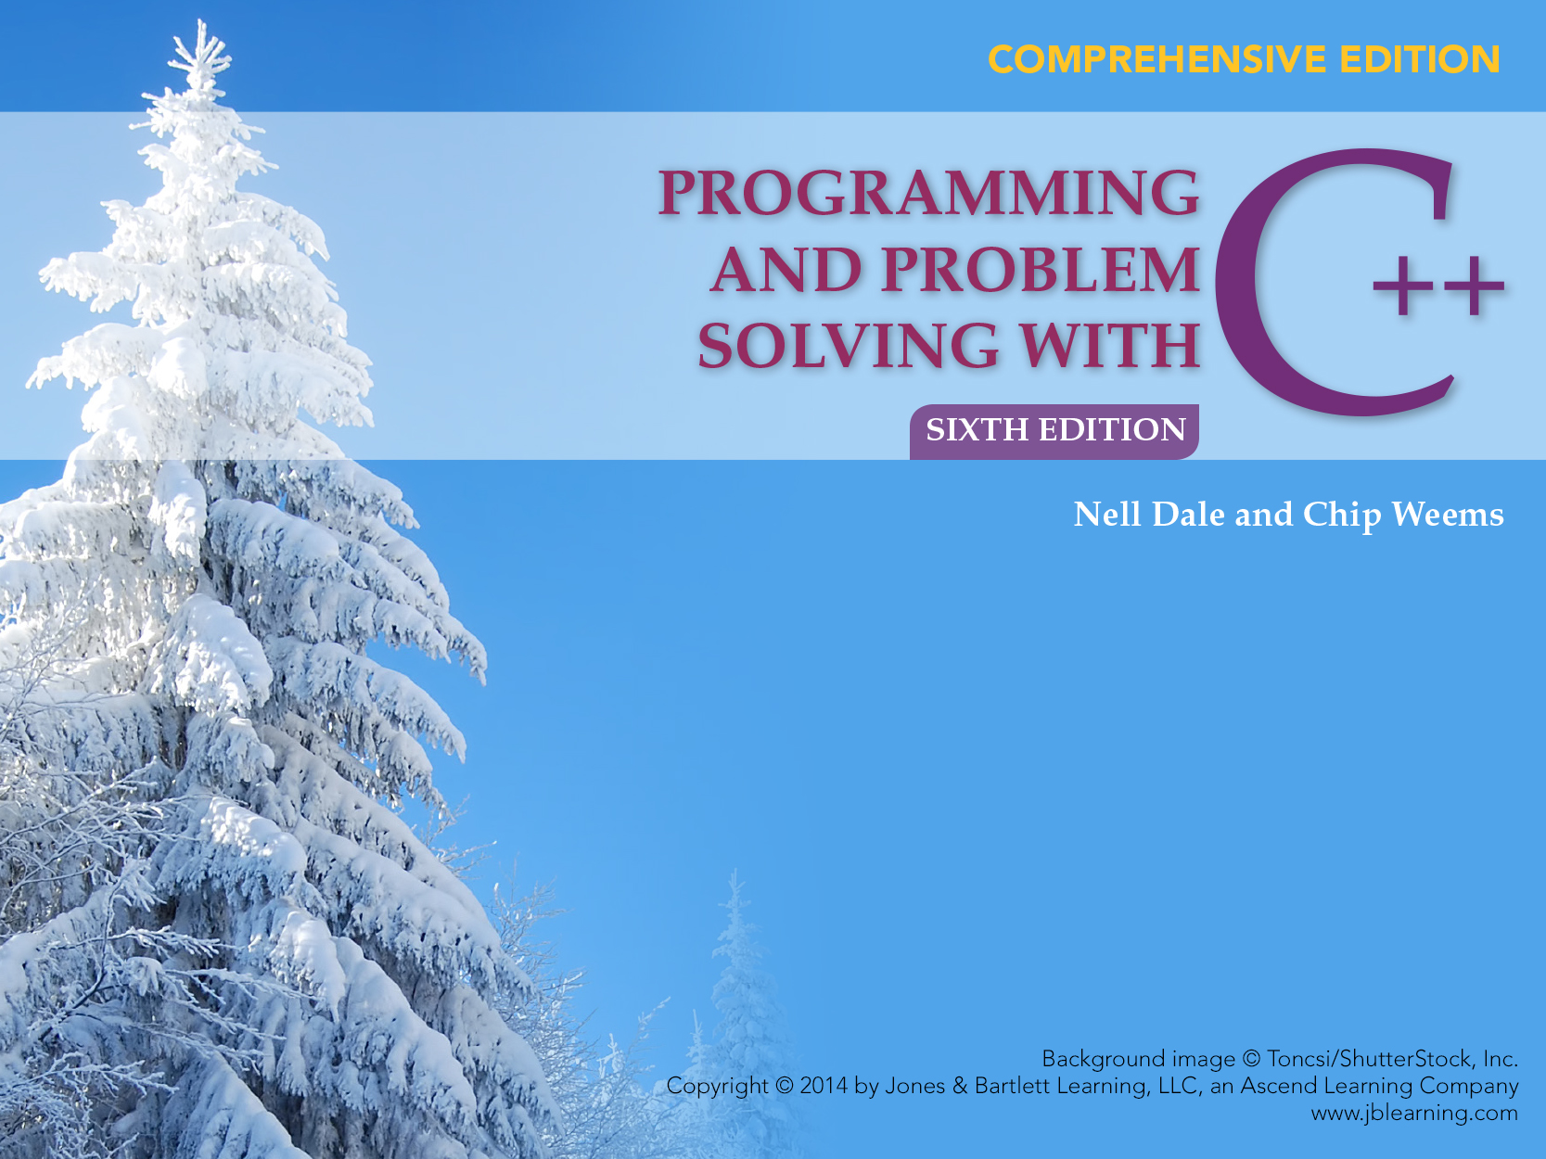
Chapter 6
Looping

Slide 2
Chapter 6 Topics
While Statement Syntax
Count-Controlled Loops
Event-Controlled Loops
Using the End-of-File Condition to Control Input Data

Slide 3
Chapter 6 Topics
Using a While Statement for Summing and Counting
Nested While Loops
Loop Testing and Debugging

Slide 4
Loops
What is a loop?
A loop is a repetition control structure that causes a single statement or block to be executed repeatedly

Slide 5
Two Types of Loops
Count controlled loops
Repeat a statement or block a specified number of times
Event-controlled loops
Repeat a statement or block until a condition within the loop body changes that causes the repetition to stop

Slide 6
While Statement
SYNTAX
while (Expression)
{ .
. // loop body
.
}
Loop body can be a single statement, a null statement, or a block

Slide 7
When the expression is tested and found to be false, the loop is exited and control passes to the statement that follows the loop body
WHILE LOOP
FALSE
Expression
TRUE
body
statement

Slide 8
Count-Controlled Loops
Count-controlled loops contain:
  An initialization of the loop control variable
  An expression to test if the proper number of repetitions has been completed
  An update of the loop control variable to be executed with each iteration of the body

Slide 9
Count-Controlled Loop Example
int count; // Loop-control variable
count = 4; // Initialize loop variable
while(count > 0) // Test expression
{
cout << count << endl; // Repeated action
count --; // Update loop variable
}
cout << “Done” << endl;

Slide 10
Count-controlled Loop
int count;
count = 4;
while(count > 0)
{
cout << count << endl;
count --;
}
cout << “Done” << endl;
count
OUTPUT

Slide 11
Count-controlled Loop
count
4
int count;
count = 4;
while(count > 0)
{
cout << count << endl;
count --;
}
cout << “Done” << endl;
OUTPUT

Slide 12
Count-controlled Loop
count
4
int count;
count = 4;
while(count > 0) TRUE
{
cout << count << endl;
count --;
}
cout << “Done” << endl;
OUTPUT

Slide 13
Count-controlled Loop
int count;
count = 4;
while(count > 0)
{
cout << count << endl;
count --;
}
cout << “Done” << endl;
count
4
OUTPUT
4

Slide 14
Count-controlled Loop
int count;
count = 4;
while(count > 0)
{
cout << count << endl;
count --;
}
cout << “Done” << endl;
count
3
OUTPUT
4

Slide 15
Count-controlled Loop
count
3
int count;
count = 4;
while(count > 0) TRUE
{
cout << count << endl;
count --;
}
cout << “Done” << endl;
OUTPUT
4

Slide 16
Count-controlled Loop
count
3
int count;
count = 4;
while(count > 0)
{
cout << count << endl;
count --;
}
cout << “Done” << endl;
OUTPUT
4
3

Slide 17
Count-controlled Loop
count
2
int count;
count = 4;
while(count > 0)
{
cout << count << endl;
count --;
}
cout << “Done” << endl;
OUTPUT
4
3

Slide 18
Count-controlled Loop
count
2
int count;
count = 4;
while(count > 0) TRUE
{
cout << count << endl;
count --;
}
cout << “Done” << endl;
OUTPUT
4
3

Slide 19
Count-controlled Loop
count
2
int count;
count = 4;
while(count > 0)
{
cout << count << endl;
count --;
}
cout << “Done” << endl;
OUTPUT
4
3
2

Slide 20
Count-controlled Loop
int count;
count = 4;
while(count > 0)
{
cout << count << endl;
count --;
}
cout << “Done” << endl;
count
1
OUTPUT
4
3
2

Slide 21
Count-controlled Loop
count
1
int count;
count = 4;
while(count > 0) TRUE
{
cout << count << endl;
count --;
}
cout << “Done” << endl;
OUTPUT
4
3
2

Slide 22
Count-controlled Loop
count
1
int count;
count = 4;
while(count > 0)
{
cout << count << endl;
count --;
}
cout << “Done” << endl;
OUTPUT
4
3
2
1

Slide 23
Count-controlled Loop
count
0
int count;
count = 4;
while(count > 0)
{
cout << count << endl;
count --;
}
cout << “Done” << endl;
OUTPUT
4
3
2
1

Slide 24
Count-controlled Loop
count
0
int count;
count = 4;
while(count > 0) FALSE
{
cout << count << endl
count --;
}
cout << “Done” << endl;
OUTPUT
4
3
2
1

Slide 25
Count-controlled Loop
int count;
count = 4;
while(count > 0)
{
cout << count << endl;
count --;
}
cout << “Done” << endl;
count
0
OUTPUT
4
3
2
1
Done

Slide 26
Example
myInfile contains 100 blood pressures
Use a while loop to read the 100 blood pressures and find their total

Slide 27
ifstream myInfile;
int thisBP;
int total;
int count;
count = 0; // Initialize
while (count < 100) // Test expression
{
myInfile >> thisBP;
total = total + thisBP;
count++; // Update
}
cout << “The total = “ << total << endl;

Slide 28
Types of Event-Controlled Loops
Sentinel controlled
  Keep processing data until a special value that is not a possible data value is entered to indicate that processing should stop
End-of-file controlled
  Keep processing data as long as there is more data in the file
Flag controlled
  Keep processing data until the value of a flag changes in the loop body

Slide 29
Examples of Kinds of Loops
Count controlled loop
Read exactly 100 blood pressures from a file
End-of-file controlled
loop
Read all the blood pressures from a file no matter how many are there

Slide 30
Examples of Kinds of Loops
Sentinel controlled
loop
Read blood pressures until a special value
selected by you(like -1) is read
Flag controlled
loop
Read blood pressures until a dangerously high BP(200 or more) is read

Slide 31
A Sentinel-controlled Loop
Requires a “priming read”
A priming read is the reading of one set of data before the loop to initialize the variables in the expression

Slide 32
// Sentinel controlled loop
total = 0;
cout << “Enter a blood pressure(-1 to stop) ”;
cin >> thisBP;

Slide 33
// Sentinel controlled loop, cont...
while(thisBP != -1) // While not sentinel
{
total = total + thisBP;
cout << “Enter a blood pressure(-1 to stop)”;
cin >> thisBP;
}
cout << total;

Slide 34
End-of-File Controlled Loop
Uses the fact that a file goes into the fail state when you try to read a data value beyond the end of the file to control the loop

Slide 35
// End-of-file controlled loop
total = 0;
myInfile >> thisBP; // Priming read

Slide 36
// End-of-file controlled loop, cont...
while(cin) // While last read successful
{
total = total + thisBP;
cout << “Enter blood pressure”;
cin >> thisBP; // Read another
}
cout << total;

Slide 37
// End-of-file at keyboard
total = 0;
cout << “Enter blood pressure “
<< “(Ctrl-Z to stop)”;
cin >> thisBP; // Priming read

Slide 38
// End-of-file at keyboard, cont...
while(cin) // While last read successful
{
total = total + thisBP;
cout << “Enter blood pressure”;
cin >> thisBP; // Read another
}
cout << total;

Slide 39
Flag-controlled Loops
Initialize a flag (to true or false)
Use meaningful name for the flag
A condition in the loop body changes the value of the flag
Test for the flag in the loop test expression

Slide 40
Example of Flag-controlled Loop
countGoodReadings = 0;
isSafe = true; // Initialize Boolean flag
while(isSafe)
{
cin >> thisBP;
if (thisBP >= 200)
isSafe = false; // Change flag value

Slide 41
Example, continued
else
countGoodReadings++;
}
cout << countGoodReadings << endl;

Slide 42
Common Loop Uses
Count all data values
Count special data values
Sum data values
Keep track of current and previous values

Slide 43
Current and Previous Values
Write a program that counts the number of != operators in a program file
Read one character in the file at a time
Keep track of current and previous characters

Slide 44
Keeping Track of Values
(x != 3)
{
cout << endl;
}
previous current count
( x 0
x ‘ ‘ 0
‘ ‘ ! 0
FILE CONTENTS
! = 1
= ‘ ‘ 1
‘ ‘ 3 1
3 ) 1

Slide 45
Loop Program Keeping Track of Current and Previous Values
int count;
char previous;
char current;
count = 0;
inFile.get(previous); // Priming reads
inFile.get(current);

Slide 46
Keeping Track of Current and Previous Values , continued
while(inFile)
{
if((current == ‘=‘) && (previous == ‘!’))
count++;
previous = current; // Update
inFile.get(current); // Read another
}

Slide 47
Nested Loops
initialize outer loop
while (outer loop condition)
{ . . .
initialize inner loop
while(inner loop condition)
{
inner loop processing and update
}
. . .
}

Slide 48
Patient Data
A file contains blood pressure data for different people. Each line has a patient ID, the number of readings for that patient, followed by the actual readings.
ID howMany Readings
4567 5 180 140 150 170 120
2318 2 170 210
5232 3 150 151 151

Slide 49
Read the data and display a chart
Patient ID BP Average
4567 152
2318 190
5232 151
. .
. .
. .
There were 432 patients in file.

Slide 50
Algorithm
Initialize patientCount to 0
Read first ID and howMany from file

Slide 51
Algorithim, cont...
While not end-of-file
  Increment patientCount
  Display ID
  Read and sum this patient’s BP’s
  Calculate and display average for patient
  Read next ID and howMany from file
Display patientCount

Slide 52
Designing Nested Loops
Begin with outer loop
When you get to where the inner loop appears, make it a separate module and come back to its design later

Slide 53
Designed Nested Loop Example
#include <iostream>
#include <fstream>
using namespace std;

Slide 54
Designed Nested Loop Example
int main()
{
int patientCount; // Declarations
int thisID;
int howMany;
int thisBP;
int totalForPatient;
int count;
float average;
ifstream myInfile;

Slide 55
Designed Nested Loop Example, cont....
myInfile.open(“BP.dat”);
if (!myInfile) // Opening failed
{
cout <<
“File opening error. Program terminated.”;
return 1;
}
cout << “ID Number Average BP” << endl;
patientCount = 0;
// Priming read
myInfile >> thisID >> howMany;

Slide 56
Designed Nested Loop Example, cont....
while(myInfile)// Last read successful
{
patientCount++;
cout << thisID;
// Initialize inner loop
totalForPatient = 0;
count = 0;
while(count < howMany)
{
myInfile >> thisBP;
count ++;
totalForPatient =
totalForPatient + thisBP;
}

Slide 57
Designed Nested Loop Example, cont....
average = totalForPatient / float(howMany);
cout << int(average + .5) << endl;
// Another read
myInfile >> thisID >> howMany;
}
cout << “There were “ << patientCount
<< “patients on file.” << endl;
cout << “Program terminated.” << endl;
return 0;
}

Slide 58
Information About 20 Books in Diskfile
“myIn.dat”
Hardback or
Paperback?
Price of book
3.98 P <eoln>
7.41 H <eoln>
8.79 P <eoln>
.
.
.
Write a program to find total value of all books

Slide 59
C++ Program
#include <iostream> // Access cout
#include <fstream> // Access file I/O
using namespace std;
int main(void)
{
float price; // Declarations
char kind;
ifstream myInfile;
float total = 0.0;
int count = 1;

Slide 60
C++ Program, cont...
myInfile.open(“myIn.dat”);
// count-controlled processing loop
while( count <= 20)
{
myInfile >> price >> kind;
total = total + price;
count ++;
}
cout << “Total is: “ << total << endl;
myInfile.close();
return 0;
}

Slide 61
Trace of Program Variables
count price kind total
0.0
1 3.98 ‘P’ 3.98
2 7.41 ‘H’ 11.39
3 8.79 ‘P’ 20.18
4 etc.
20
21 so loop terminates

Slide 62
Complexity
Complexity is a measure of the amount of work involved in executing an algorithm relative to the size of the problem

Slide 63
Polynomial Times
N N⁰ N¹ N² N³
constant linear quadratic cubic
1 1 1 1 1
10 1 10 100 1,000
100 1 100 10,000 1,000,000
1,000 1 1,000 1,000,000 1,000,000,000
10,000 1 10,000 100,000,000 1,000,000,000,000

Slide 64
Loop Testing and Debugging
Test data should test all sections of program
Beware of infinite loops -- program doesn’t stop
Check loop termination condition, and watch for “off-by-1” bugs(OBOBs)
Use get function for loops controlled by detection of ‘\n’ character

Slide 65
Loop Testing and Debugging
Use algorithm walk-through to verify pre- and post conditions
Trace execution of loop by hand with code walk-through
Use a debugger to run program in “slow motion” or use debug output statements

