Slide 1
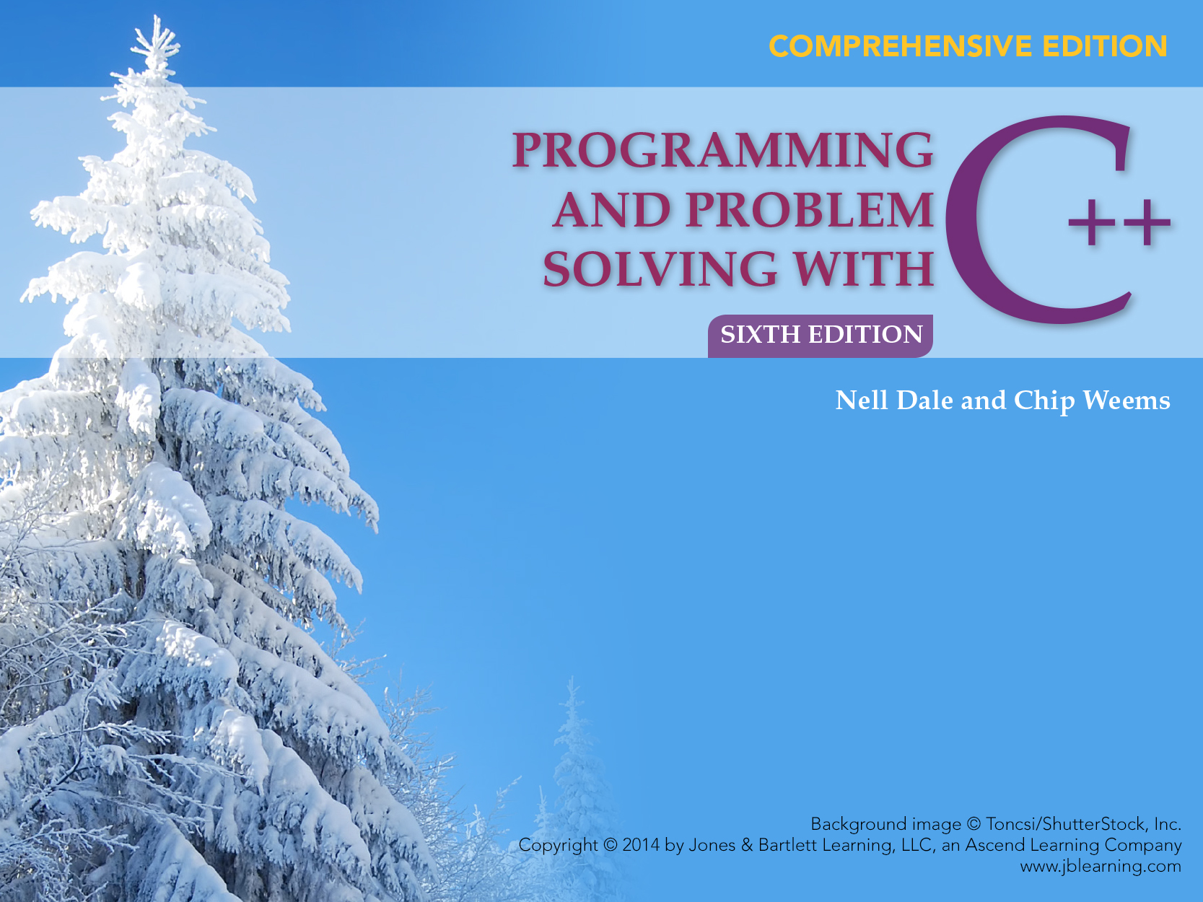
Chapter 11 Arrays

Slide 2
Chapter 11 Topics
Declaring and Using a One-Dimensional Array
Passing an Array as a Function Argument
Using const in Function Prototypes
Using an Array of struct or class Objects

Slide 3
Chapter 11 Topics
Using an enum Index Type for an Array
Declaring and Using a Two-Dimensional Array
Two-Dimensional Arrays as Function Parameters
Declaring a Multidimensional Array

Slide 4
C++ Data Types
simple
structured
integral enum
floating
array struct union class
char short int long bool
address
float double long double
pointer reference

Slide 5
Structured Data Type
A structured data type is a type that
Stores a collection of individual components with one variable name
And allows individual components to be stored and retrieved by their position within the collection

Slide 6
Declare variables to store and total 3 blood pressures
int bp1, bp2, bp3;
int total;
4000
4002
4004
bp1
bp2
bp3
cin >> bp1 >> bp2 >> bp3;
total = bp1 + bp2 + bp3;

Slide 7
What if you wanted to store and total 1000 blood pressures?
int bp[1000];
// Declares an array of 1000 int values
5000 5002 5004 5006
. . . .
bp[0] bp[1] bp[2] . . . . bp[999]

Slide 8
One-Dimensional Array Definition
An array is a structured collection of components (called array elements):
Arrays are all of the same data type, given a single name, and stored in adjacent memory locations

Slide 9
One Dimensional Array Definiton, cont...
The individual components are accessed by using the array name together with an integral valued index in square brackets
The index indicates the position of the component within the collection

Slide 10
Another Example
Declare an array called temps which will hold up to 5 individual float values
float temps[5]; // Declaration allocates memory
number of elements in the array
Base Address
7000 7004 7008 7012 7016
temps[0] temps[1] temps[2] temps[3] temps[4]
indexes or subscripts

Slide 11
Declaration of an Array
The index is also called the subscript
In C++, the first array element always has subscript 0, the second array element has subscript 1, etc.
The base address of an array is its beginning address in memory
SYNTAX
DataType ArrayName[ConstIntExpression];

Slide 12
Yet Another Example
Declare an array called name which will hold up to 10 individual char values
char name[10]; // Declaration allocates memory
number of elements in the array
Base Address
6000 6001 6002 6003 6004 6005 6006 6007 6008 6009
name[0] name[1] name[2] name[3] name[4] . . . . . name[9]

Slide 13
Assigning Values to Individual Array Elements
float temps[5]; int m = 4; // Allocates memory
temps[2] = 98.6;
temps[3] = 101.2;
temps[0] = 99.4;
temps[m] = temps[3] / 2.0;
temps[1] = temps[3] - 1.2;
// What value is assigned?
7000 7004 7008 7012 7016
99.4 ? 98.6 101.2 50.6
temps[0] temps[1] temps[2] temps[3] temps[4]

Slide 14
What values are assigned?
float temps[5]; // Allocates memory
int m;
for (m = 0; m < 5; m++)
{
temps[m] = 100.0 + m * 0.2 ;
}
7000 7004 7008 7012 7016
? ? ? ? ?
temps[0] temps[1] temps[2] temps[3] temps[4]

Slide 15
Now what values are printed?
float temps[5]; // Allocates memory
Int m;
. . . . .
for (m = 4; m >= 0; m--)
{
cout << temps[m] << endl;
}
7000 7004 7008 7012 7016
100.0 100.2 100.4 100.6 100.8
temps[0] temps[1] temps[2] temps[3] temps[4]

Slide 16
Variable Subscripts
float temps[5]; // Allocates memory
int m = 3;
. . . . . .
What is temps[m + 1] ?
What is temps[m] + 1 ?
7000 7004 7008 7012 7016
100.0 100.2 100.4 100.6 100.8
temps[0] temps[1] temps[2] temps[3] temps[4]

Slide 17
A Closer Look at the Compiler
float temps[5]; // Allocates memory
To the compiler, the value of the identifier temps is the base address of the array
We say temps is a pointer (because its value is an address); it “points” to a memory location
7000 7004 7008 7012 7016
100.0 100.2 100.4 100.6 100.8
temps[0] temps[1] temps[2] temps[3] temps[4]

Slide 18
Initializing in a Declaration
int ages[5] ={ 40, 13, 20, 19, 36 };
for (int m = 0; m < 5; m++)
{
cout << ages[m];
}
6000 6002 6004 6006 6008
40 13 20 19 36
ages[0] ages[1] ages[2] ages[3] ages[4]

Slide 19
Passing Arrays as Arguments
In C++, arrays are always passed by reference
Whenever an array is passed as an argument, its base address is sent to the called function

Slide 20
In C++, No Aggregate Array Operations
The only thing you can do with an entire array as a whole (aggregate) is to pass it as an argument to a function
Exception: aggregate I/O is permitted for C strings (special kinds of char arrays)

Slide 21
Using Arrays as Arguments to Functions
Generally, functions that work with arrays require two items of information:
The beginning memory address of the array (base address) and
The number of elements to process in the array

Slide 22
Example with Array Parameters
#include <iomanip>
#include <iostream>
void Obtain (int[], int); // Prototypes here
void FindWarmest (const int[], int , int&);
void FindAverage (const int[], int , int&);
void Print (const int[], int);
using namespace std;

Slide 23
Example continued...
int main ( )
{
// Array to hold up to 31 temperatures
int temp[31
int numDays;
int average;
int hottest;
int m;

Slide 24
Example continued
cout << “How many daily temperatures? ”;
cin >> numDays;
Obtain(temp, numDays);
// Call passes value of numDays
// and address temp
cout << numDays << “ temperatures“
<< endl;
Print (temp, numDays);

Slide 25
Example continued...
FindAverage (temp, numDays, average);
FindWarmest (temp, numDays, hottest);
cout << endl << “Average was: “
<< average << endl;
cout << “Highest was: “
<< hottest << endl;
return 0;
}

Slide 26
Memory Allocated for Array
// Array to hold up to 31 temperatures
int temp[31];
Base Address
6000
50 65 70 62 68 . . . . . .
temp[0] temp[1] temp[2] temp[3] temp[4] . . . . . temp[30]

Slide 27
void Obtain ( /* out */ int temp[] ,
/* in */ int number )
// User enters number temperatures at keyboard
// Precondition:
// number is assigned && number > 0
// Postcondition:
// temp[0 . . number -1] are assigned

Slide 28
{
int m;
for (m = 0; m < number; m++)
{
cout << “Enter a temperature : “;
cin >> temp[m];
}
}

Slide 29
void Print ( /* in */ const int temp[],
/* in */ int number )
// Prints number temperature values to screen
// Precondition:
// number is assigned && number > 0
// temp[0 . . number -1] are assigned
// Postcondition:
// temp[0 . . number -1] printed 5 per line

Slide 30
{
int m;
cout << “You entered: “;
for (m = 0; m < number; m++)
{
if (m % 5 == 0)
cout << endl;
cout << setw(7) << temp[m];
}
}

Slide 31
Use of const
Because the identifier of an array holds the base address of the array, & is never needed for an array in the parameter list :
Arrays are always passed by reference
To prevent elements of an array used as an argument from being unintentionally changed by the function:
You place const in the function prototype and heading

Slide 32
Use of const in prototypes
Do not use const with outgoing array because
function is supposed to change array values
void Obtain (int[], int);
void FindWarmest (const int[], int , int &);
void FindAverage (const int[], int , int &);
void Print (const int[], int);
use const with incoming array values to
prevent unintentional changes by function

Slide 33
Example, cont...
void FindAverage( /* in */ const int temp[],
/* in */ int number,
/* out */ int & avg)
// Determines average of temp[0 . . number-1]
// Precondition:
// number is assigned && number > 0
// temp[0 . . number -1] are assigned
// Postcondition:
// avg == average of temp[0 . . number-1]
{
int m;
int total = 0;
for (m = 0; m < number; m++)
{
total = total + temp[m];
}
avg =
int (float(total) / float(number) + .5);
}
void FindAverage( /* in */ const int temp[],
/* in */ int number,
/* out */ int & avg)
// Determines average of temp[0 . . number-1]
// Precondition:
// number is assigned && number > 0
// temp[0 . . number -1] are assigned
// Postcondition:
// avg == average of temp[0 . . number-1]

Slide 34
Example, cont...
{
int m;
int total = 0;
for (m = 0; m < number; m++)
{
total = total + temp[m];
}
avg =
int (float(total) / float(number) + .5);
}

Slide 35
Another Example
void FindWarmest ( /* in */ const int temp[],
/* in */ int number,
/* out */ int& largest)
// Determines largest of temp[0 . . number-1]
// Precondition:
// number is assigned && number > 0
// temp[0 . . number -1] are assigned
// Postcondition:
// largest== largest value in
// temp[0 . . number-1]

Slide 36
Another Example, cont...
{
int m;
// Initialize to first element
largest = temp[0];
for (m = 0; m < number; m++)
{
if (temp[m] > largest)
largest = temp[m];
}
}

Slide 37
Using Arrays for Counters
Write a program to count the number of each alphabetic letter in a text file
letter ASCII
‘A’ 65
‘B’ 66
‘C’ 67
‘D’ 68
. .
. .
. .
‘Z’ 90
A:\my.dat
This is my text file.
It contains many
things!
5 + 8 is not 14.
Is it?

Slide 38
const int SIZE 91; int freqCount[SIZE];
freqCount[0] 0
freqCount[1] 0
. .
. .
. .
freqCount[65] 2
freqCount[66] 0
. .
. .
freqCount[89] 1
freqCount[90] 0
unused
counts ‘A’ and ‘a’
counts ‘B’ and ‘b’
.
.
.
counts ‘ Y’ and ‘y’
counts ‘Z’ and ‘z’

Slide 39
Main Module Pseudocode
Level 0
Open dataFile (and verify success)
Zero out freqCount
Read ch from dataFile
WHILE NOT EOF on dataFile
If ch is alphabetic character
If ch is lowercase alphabetic
Change ch to uppercase
Increment freqCount[ch] by 1
Read ch from dataFile
Print characters and frequencies

Slide 40
Counting Frequency of Alphabetic Characters
// Program counts frequency of each alphabetic
// character in text file.
#include < fstream >
#include < iostream >
#include < cctype >
const int SIZE=91;
void PrintOccurrences(const int[]); // Prototype

Slide 41
Counting Frequency of Alphabetic Characters
int main ()
{
ifstream dataFile;
int freqCount[SIZE];
char ch;
char index;

Slide 42
Counting Frequency of Alphabetic Characters
dataFile.open (“my.dat”); // Open
if (! dataFile) // Verify success
{
cout << “ CAN’T OPEN INPUT FILE ! “
<< endl;
return 1;
}
for ( int m = 0; m < SIZE; m++) // Zero array
freqCount[m] = 0;

Slide 43
Counting Frequency of Alphabetic Characters
// Read file one character at a time
dataFile.get (ch); // Priming read
while (dataFile) // While read successful
{
if (isalpha (ch))
{
if (islower (ch))
ch = toupper (ch);
freqCount[ch] = freqCount[ch] + 1;

Slide 44
Counting Frequency of Alphabetic Characters
}
dataFile. get (ch); // Get next character
}
PrintOccurrences (freqCount);
return 0;
}

Slide 45
Counting Frequency of Alphabetic Characters
void PrintOccurrences (
/* in */ const int freqCount [])
// Prints each alphabet character and its frequency
// Precondition:
// freqCount[‘A’ . . ‘Z’] are assigned
// Postcondition:
// freqCount[‘A’ . . ‘Z’] have been printed

Slide 46
Counting Frequency of Alphabetic Characters
{
char index;
cout << “File contained “ << endl;
cout << “LETTER OCCURRENCES” << endl;
for ( index = ‘A’ ; index < = ‘Z’; index ++)
{
cout << setw(4) << index << setw(10)
<< freqCount[index] << endl;
}
}

Slide 47
More about Array Indexes
Array indexes can be any integral type including char and enum types
The index must be within the range 0 through the declared array size minus one
It is the programmer’s responsibility to make sure that an array index does not go out of bounds

Slide 48
More About Array Indexes
The index value determines which memory location is accessed
Using an index value outside this range causes the program to access memory locations outside the array

Slide 49
Array with enum Index Type
DECLARATION
enum Department { WOMENS, MENS, CHILDRENS, LINENS, HOUSEWARES, ELECTRONICS };
float salesAmt[6];
Department which;
USE
for (which = WOMENS; which <= ELECTRONICS; which = Department(which + 1))
cout << salesAmt[which] << endl;

Slide 50
float salesAmt[6];
salesAmt[WOMENS] (i. e. salesAmt[0])
salesAmt[MENS] (i. e. salesAmt[1])
salesAmt[CHILDRENS] (i. e. salesAmt[2])
salesAmt[LINENS] (i. e. salesAmt[3])
salesAmt[HOUSEWARES] (i. e. salesAmt[4])
salesAmt[ELECTRONICS] (i. e. salesAmt[5])

Slide 51
Parallel Arrays
Parallel arrays are two or more arrays that have the same index range and whose elements contain related information, possibly of different data types
EXAMPLE
const int SIZE 50;
int idNumber[SIZE];
float hourlyWage[SIZE]; parallel arrays

Slide 52
const int SIZE 50; int idNumber[SIZE]; // Parallel arrays hold float hourlyWage[SIZE]; // Related information
idNumber[0] 4562 hourlyWage[0] 9.68
idNumber[1] 1235 hourlyWage[1] 45.75
6278
idNumber[2] hourlyWage[2] 12.71
. . . .
. . . .
. . . .
idNumber[48] 8754 hourlyWage[48] 67.96
idNumber[49] 2460 hourlyWage[49] 8.97

Slide 53
Array of Structures
const int MAX_SIZE = 500;
enum HealthType { POOR, FAIR, GOOD, EXCELLENT };
struct AnimalType // Declares struct type

Slide 54
Array of Structures, cont...
{
long id;
string name;
string genus;
string species;
string country;
int age;
float weight;
HealthType health;
};
// Declares array
AnimalType bronxZoo[MAX_SIZE];

Slide 55
AnimalType bronxZoo[MAX_SIZE];
bronxZoo
[0]
[1]
. .
. .
. .
[498]
[499]
bronxZoo[0].id 3456219
bronxZoo[0].name “camel”
bronxZoo[0].genus “Camelus”
bronxZoo[0].species “dromedarius”
bronxZoo[0].country “India”
bronxZoo[0].age 10
bronxZoo[0].weight 992.8
bronxZoo[0].health Fair

Slide 56
AnimalType bronxZoo[MAX_SIZE];
.id .name .genus .species .country .age .weight .health
bronxZoo[0] 3456219 “camel” “Camelus”“dromedarius” “India” 10 992.8 Fair
bronxZoo[1]
bronxZoo[2]
bronxZoo[3]
. .
. .
. .
bronxZoo[498]
bronxZoo[499]

Slide 57
Add 1 year to the age member of each element of the bronxZoo array
for (j = 0; j < MAX_SIZE; j++)
bronxZoo[j].age = bronxZoo[j].age + 1;
OR,
for (j = 0; j < MAX_SIZE; j++)
bronxZoo[j].age++;

Slide 58
Find total weight of all elements of the bronxZoo array
float total = 0.0;
for (j = 0; j < MAX_SIZE; j++)
total += bronxZoo[j].weight;

Slide 59
Specification of Time
class Time // “Time.h”
{
public : // 7 function members
void Set (int hours, int minutes, int seconds);
void Increment ();
void Write () const;
bool Equal (Time otherTime) const;
bool LessThan (Time otherTime) const;

Slide 60
Specification of Time
Time (int initHrs, int initMins, int initSecs);
// Constructor
Time ();
// Default constructor
private : // Three data members
int hrs;
int mins;
int secs;
};

Slide 61
Time Class Instance Diagram
class Time
Set
Increment
Private data:
hrs
mins
secs
18
30
0
Write
Equal
LessThan
Time
Time

Slide 62
Array of Class Objects
const int MAX_SIZE = 50;
// Declare array of class objects
Time trainSchedule[MAX_SIZE];
The default constructor, if there is any constructor,
is invoked for each element of the array

Slide 63
Two-Dimensional Array
A two-dimensional array is a collection of components, all of the same type, structured in two dimensions, (referred to as rows and columns)
Individual components are accessed by a pair of indexes representing the component’s position in each dimension
DataType ArrayName[ConstIntExpr][ConstIntExpr]...;

Slide 64
EXAMPLE -- Array for monthly high temperatures for
all 50 states
const int NUM_STATES = 50;
const int NUM_MONTHS = 12;
int stateHighs[NUM_STATES][NUM_MONTHS];
[0]
[1]
[2]
.
. stateHighs[2][7]
.
[48]
[49]
[0] [1] [2] [3] [4] [5] [6] [7] [8] [9][10][11]
row 2,
col 7
might be
Arizona’s
high for
August
66 64 72 78 85 90 99 105 98 90 88 80

Slide 65
enum Month { JAN, FEB, MAR, APR, MAY, JUN,
JUL, AUG, SEP, OCT, NOV, DEC };
const int NUM_MONTHS = 12;
const int NUM_STATES = 50;
int stateHighs[NUM_STATES][NUM_MONTHS];
[0]
[1]
[2]
.
. stateHighs[2][AUG]
.
[48]
[49]
[JAN] . . . [AUG] . . [DEC]
row 2,
col AUG
could be
Arizona’s
high for
August
66 64 72 78 85 90 99 105 98 90 88 80

Slide 66
Array for Monthly High Temperatures for all 50 states, cont...
enum State { AL, AK, AZ, AR, CA, CO, CT, DE, FL, GA, HI, ID, IL, IN, IA, KS, KY, LA, ME, MD, MA, MI, MN, MS, MO, MT, NE, NV, NH, NJ, NM, NY, NC, ND, OH, OK, OR, PA, RI, SC, SD, TN, TX, UT, VT, VA, WA, WV, WI, WY };
enum Month { JAN, FEB, MAR, APR, MAY, JUN, JUL,
AUG, SEP, OCT, NOV, DEC };
const int NUM_MONTHS = 12;
const int NUM_STATES = 50;
int stateHighs[NUM_STATES][NUM_MONTHS];

Slide 67
[AL]
[AK]
[AZ]
.
.
.
[WI]
[WY]
row AZ, col. AUG holds stateHighs[AZ][AUG]
Arizona’s high for August
[JAN] . . . [AUG] . . [DEC]
66 64 72 78 85 90 99 105 98 90 88 80

Slide 68
Finding the Average High Temperature for Arizona
int total = 0;
int month; // Without enum types
int average;
for (month = 0; month < NUM_MONTHS; month ++)
total = total + stateHighs[2][month];
average = int (total / 12.0 + 0.5);
average
85

Slide 69
Finding the Average High Temperature for Arizona, cont...
int total = 0;
Month month; // With enum types defined
int average;
for (month = JAN; month <= DEC; month = Month(month+1))
total = total + stateHighs[AZ][month];
average = int (total / 12.0 + 0.5);
average
85

Slide 70
const int NUM_STATES = 50; const int NUM_MONTHS = 12; int stateHighs[NUM_STATES][NUM_MONTHS];
STORAGE
rows columns
In memory, C++ stores arrays in row order; the first row is followed by the second row, etc.
Base Address
8000
8024
8048
. . .
12 highs for state 0 12 highs for state 1 etc.
Alabama Alaska
first row second row

Slide 71
Viewed another way . . .
stateHighs[0][0]
stateHighs[0][1]
stateHighs[0][2]
stateHighs[0][3]
stateHighs[0][4]
stateHighs[0][5]
stateHighs[0][6]
stateHighs[0][7]
stateHighs[0][8]
stateHighs[0][9]
stateHighs[0][10]
stateHighs[0][11]
stateHighs[1][0]
stateHighs[1][1]
stateHighs[1][2]
stateHighs[1][3]
.
.
.
Base Address 8000
To locate an element such as
stateHighs[2][7]
the compiler needs to know
that there are 12 columns
in this two-dimensional array.
At what address will
stateHighs[2][7] be found?
Assume 2 bytes for type int.

Slide 72
Arrays as Parameters
As with a one-dimensional array, when a two- (or higher) dimensional array is passed as an argument, the base address of the caller’s array is sent to the function
The size of all dimensions except the first must be included in the function heading & prototype
The sizes of those dimensions in the function’s parameter list must be exactly the same as those declared for the caller’s array

Slide 73
Write a function using the two-dimensional stateHighs array to fill a one-dimensional stateAverages array
const int NUM_STATES = 50;
const int NUM_MONTHS = 12;
int stateHighs[NUM_STATES][NUM_MONTHS];
int stateAverages[NUM_STATES];
[0]
62 [1]
85 [2]
.
.
.
[48]
[49]
[0] [1] [2] [3] [4] [5] [6] [7] [8] [9][10][11]
Alaska
Arizona
43 42 50 55 60 78 80 85 81 72 63 40
66 64 72 78 85 90 99 105 98 90 88 80

Slide 74
void FindAverages( /* in */ const int stateHighs[][NUM_MONTHS], /* out */ int stateAverages[])
//PRE:stateHighs[0..NUM_STATES][0..NUM_MONTHS]
// assigned
// POST:stateAverages[0..NUM_STATES] contains
// rounded high temperature for each state

Slide 75
{
int state;
int month;
int total;
for (state = 0; state < NUM_STATES; state++)
{
total = 0;
for (month = 0; month < NUM_MONTHS; month++)
total += stateHighs[state][month];
stateAverages[state] = int(total/12.0 + 0.5);
}
}

Slide 76
Using typedef with Arrays
The typedef statement helps eliminate the chances of size mismatches between function arguments and parameters. FOR EXAMPLE,
typedef int StateHighs [NUM_STATES][NUM_MONTHS];
typedef int StateAverages [NUM_STATES];
void FindAverages(
/* in */ const StateHighs stateHighs,
/* out */ StateAverages stateAverages)
{
}

Slide 77
Declaring Multidimensional Arrays
Example of three-dimensional array
const NUM_DEPTS = 5;
// mens, womens, childrens, electronics, furniture
const NUM_MONTHS = 12;
const NUM_STORES = 3; // White Marsh, Owings Mills, Towson
int monthlySales[NUM_DEPTS][NUM_MONTHS][NUM_STORES];
rows columns sheets
OR USING TYPEDEF
typedef int MonthlySales [NUM_DEPTS][NUM_MONTHS][NUM_STORES];
MonthlySales monthlySales;

Slide 78
const NUM_DEPTS = 5;
// mens, womens, childrens, electronics, furniture
const NUM_MONTHS = 12;
const NUM_STORES = 3; // White Marsh, Owings Mills, Towson
int monthlySales[NUM_DEPTS][NUM_MONTHS][NUM_STORES];
monthlySales[3][7][0]
sales for electronics in August at White Marsh
3 STORES
sheets
5 DEPTS
rows
12 MONTHS columns

Slide 79
Print Sales for Dec. by Department
COMBINED SALES FOR December
DEPT # DEPT NAME SALES $
0 Mens 12345
1 Womens 13200
2 Childrens 11176
3 Electronics 22567
4 Furniture 11230

Slide 80
Print sales for Jan. by department
COMBINED SALES FOR January
DEPT # DEPT NAME SALES $
0 Mens 8345
1 Womens 9298
2 Childrens 7645
3 Electronics 14567
4 Furniture 21016

Slide 81
// mens, womens, childrens, electronics,
// furniture
const NUM_DEPTS = 5;
const NUM_MONTHS = 12;
// White Marsh, Owings Mills, Towson
const NUM_STORES = 3;
int monthlySales[NUM_DEPTS][NUM_MONTHS][NUM_STORES];
. . . .

Slide 82
for (month = 0; month < NUM_MONTHS; month++)
{
cout << “COMBINED SALES FOR ” ;
// Function call to write the name of month
WriteOut(month);
cout << “DEPT # DEPT NAME SALES $” << endl;

Slide 83
for (dept = 0; dept < NUM_DEPTS; dept++)
{
totalSales = 0;
for (store = 0; store < NUM_STORES; store++)
totalSales = totalSales +
monthlySales[dept][month][store];
WriteDeptNameAndSales(dept, totalSales);
}
}

Slide 84
Adding a Fourth Dimension . . .
const NUM_DEPT = 5; // mens, womens, childrens …
const NUM_MONTHS = 12;
const NUM_STORES = 3; // White Marsh, Owings Mills, Towson
const NUM_YEARS = 2;
int moreSales[NUM_DEPTS][NUM_MONTHS][NUM_STORES][NUM_YEARS];
year 0 year 1
moreSales[3][7][0][1]
for electronics, August, White Marsh, one year after starting year

Slide 85
C-Style Strings
We have already been introduced to the C++ string data type.
Because C++ is a superset of C it inherited C’s primitive mechanism for representing strings.

Slide 86
Strings as Arrays
C represents strings as arrays of char:
char mystring[4];
mystring[0] = ‘d’;
mystring[1] = ‘o’;
mystring[2] = ‘g’;
mystring[3] = ‘s’;

Slide 87
C-String Literal Initialization
A character array can also be initialized with a string literal:
The compiler will automatically create an array of the proper length and generate the assignments we saw on the previous slide.
char mystring[] = “dogs”;

Slide 88
C-String Literal Initialization
A character array can also be initialized with a string literal:
The compiler will automatically create an array of the proper length and generate the assignments we saw on the previous slide.
char mystring[] = “dogs”;
However, the resulting array contents are
not exactly the same…

Slide 89
C-String Initialization Differences
This construction creates an array of characters as you would expect.
char mystring[4];
mystring[0] = ‘d’;
mystring[1] = ‘o’;
mystring[2] = ‘g’;
mystring[3] = ‘s’;
‘d’
‘o’
‘g’
‘s’
‘\0’

Slide 90
C-String Initialization Differences
This construction creates an array of characters as you would expect.
char mystring[4];
mystring[0] = ‘d’;
mystring[1] = ‘o’;
mystring[2] = ‘g’;
mystring[3] = ‘s’;
‘d’
‘o’
‘g’
‘s’
‘\0’
The string literal initialization automatically adds the null character ‘\0’ to the end of the array.
char mystring[] = “dogs”;
This array has length 5.

Slide 91
C-String Initialization Differences
We can achieve the same effect manually
This construction creates an array of characters as you would expect.
char mystring[5];
mystring[0] = ‘d’;
mystring[1] = ‘o’;
mystring[2] = ‘g’;
mystring[3] = ‘s’;
mystring[4] = ‘\0’;
‘d’
‘o’
‘g’
‘s’
‘\0’
The string literal initialization automatically adds the null character ‘\0’ to the end of the array.
char mystring[] = “dogs”;
This array has length 5.

Slide 92
Pointers to C-Strings
Because an array variable is just a pointer to the first element of an array, we can declare a string as a pointer to char:
char *mystring = “dogs”;
These are the same!
char mystring[] = “dogs”;

Slide 93
String Termination & Length
The ‘\0’ sentinel character is used to indicate the end of a C-style string.
We can use this to determine the length:
int length(char* str) {
int len = 0;
char* ch = str;
while (*ch != ‘\0’) {
len++;
}
return len;
}

Slide 94
String Termination & Length
The ‘\0’ sentinel character is used to indicate the end of a C-style string.
We can use this to determine the length:
int length(char* str) {
int len = 0;
char* ch = str;
while (*ch != ‘\0’) {
len++;
}
return len;
}
Loop until you reach the ‘\0’ character
(end of string)

Slide 95
C-Strings Mutability
C-Strings are mutable.
The contents of a string can be modified.
Assigning a character to any location in the C-string will overwrite the existing character with the one specified.
char ch[] = “hello”;
ch[2] = ‘Z’;
This changes the first ‘l’ character in “hello” to a ‘Z’.

Slide 96
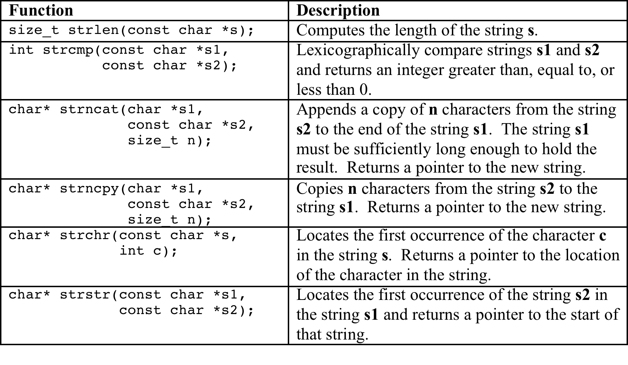
Useful C-String Functions
Include the string.h header file.

Slide 97
Converting to C++ Strings
Converting To C++ String
Converter From C++ String
char *cdog = “dogs”;
string cppdog(cdog);
char *cdog = cppdog.c_str();

