Slide 1
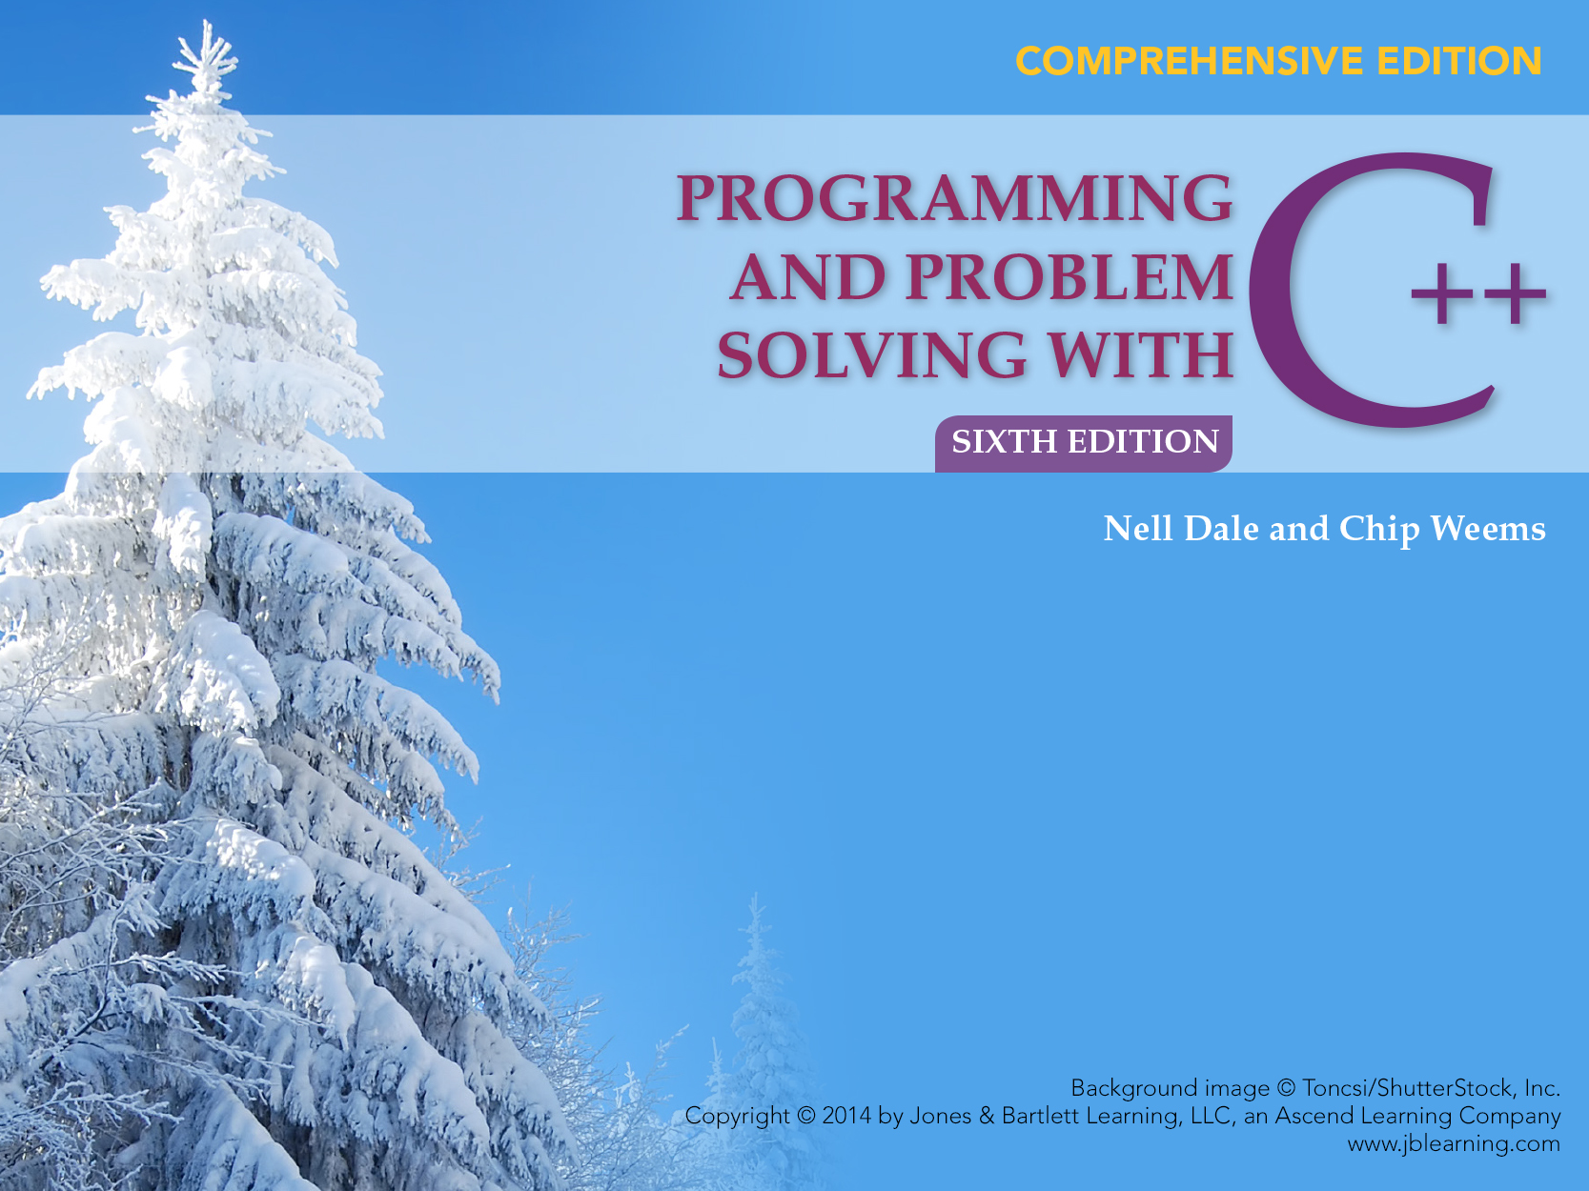
Chapter 17
Introduction to the Data Structures Using the Standard Template Library

Slide 2
Chapter Topics
The distinction between Standard Template Library (STL) and data structures in the abstract sense
Containers and Algorithms of the Standard Template Library
Working with STL iterators
Operation of stacks, queues, and deques

Slide 3
Chapter Topics
Using the basic STL sequence containers: vector, list, and deque
The structure and operations associated with tree and hash table abstract types
Using the STL associative containers set and map as abstract data types

Slide 4
Abstract Data Structures vs. Implementations
Every data structure has two aspects:
  its abstract (conceptual) form and
  its implementation
  Advantage of being able to use data and control abstraction to divorce these two aspects in object-oriented programming:
  Client code can use an comprehensible natural representation that saves computer memory space through an efficient underlying implementation

Slide 5
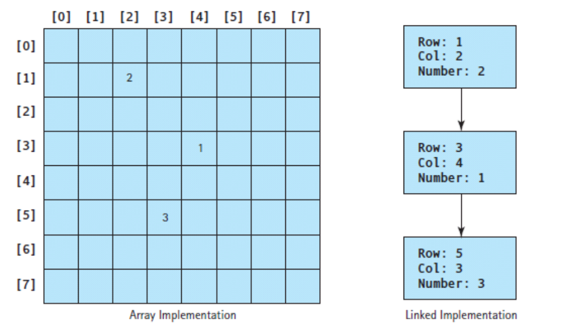
A Linked Implementation of a Sparsely Filled Array Conserves Space
[Insert Figure 17.2]

Slide 6
Additional Linear Structures
Differences in linear data structures are based on how they are accessed
Arrays and lists support very general access
If access is restricted in some way, we can define a data structure with a simpler interface, e.g., stacks and cues
Also, in some cases the restrictions permit the programmer to create a more efficient implementation

Slide 7
Containers of the Standard Template Library (STL)
STL composed primarily of templates
Two main sections of the library: containers and algorithms
C++ 's templates for 8 generic structured data types of the containers portion are summarized on p. 879 of Ch. 14
We will describe these 8 template classes:
stack, list, queue, priority_queue, vector, set, and map

Slide 8
Declaring and Specializing STL Template Classes
To declare and specialize any of these above template classes, use its name, followed by the type in angle brackets
Example:
list<string> strList; // Create an empty list of strings
vector<int> intVec; // Create an empty vector of ints

Slide 9
Containers Portion of STL
Type of container's elements can either be built-in type or a class
STL requires that element objects support at least a minimal subset of the overloaded relational operators
For most compilers, overloading < and == is sufficient, but a few require more of the operators to be overloaded

Slide 10
Algorithms Portion of STL
Algorithms portion of the STL has a large number of function templates used in many different contexts
Table on pp. 880 of Ch. 17 summarizes the more commonly used functions: copy, copy_backward, equal, find, max, min, random_shuffle, replace, search, set_difference, and set_intersection, set_union, sort, and transform
Not all of these above functions can be applied to every container

Slide 11
Iterators in the STL
In the STL, the iterator is an object that points to some place in a container
An iterator has extra functionality including operations that cause it to move in a step-by-step fashion through an STL container
Two categories of iterators in the STL: forward and reverse

Slide 12
Iterators in the STL
Use the ++ operator to advance a forward iterator and -- to shift the iterator backward
Iterators returned by rbegin and rend point to the end and the beginning of a container, respectively
Using ++ with a reverse iterator moves it from the back to the front and applying -- causes a move to the back

Slide 13
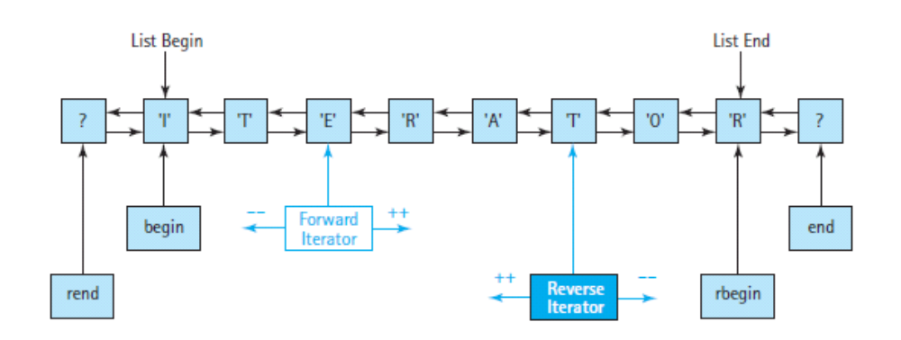
Forward and Reverse Iterators Associated with a List

Slide 14
Iterators in the STL
Design of these iterators meant to facilitate traversing a container with a For loop
With random-access containers (such as deque and vector), + and - can be applied to iterators compute the location of another element
Iterators remain valid only as long as the contents of the container do not change
When an element is inserted into or deleted from a container, its iterators become invalid

Slide 15
Stacks
A stack is a data structure that can be accessed from only one end
With a stack, one has the ability to insert an element at the top (as the first element) and remove the top (first) element
Accountants call this property, LIFO, "last in, first out"
Real-life examples include plate holder stacked in a cafeteria or cars in a noncircular driveway

Slide 16
Stacks
Term push is used for insertion operation and the term pop is used for the deletion operation
In some implementations of a stack, pop also returns the top element
In other implementations, a separate operation, top, retrieves the top value and pop simply deletes it

Slide 17
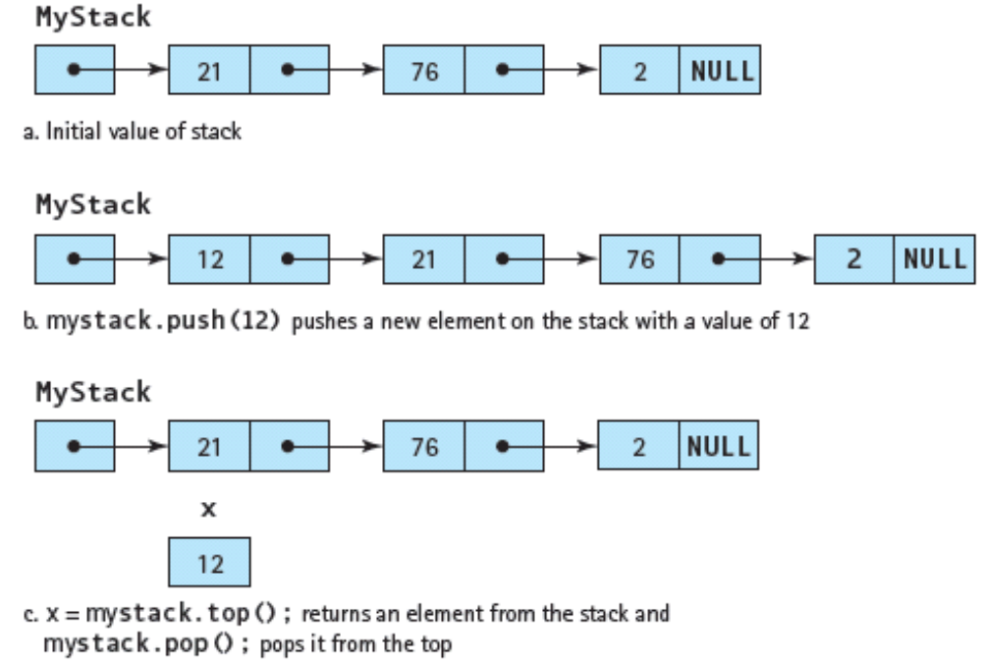
A Stack Showing Push, Top, and Pop Operations

Slide 18
Uses of Stacks in Systems Software
C++ uses stacks to keep track of nested method calls
Compiler uses a stack to translate arithmetic expressions
Stacks used whenever programmer wants to remember a sequence of objects or actions in the reverse order from their original occurrence

Slide 19
Example of Use of a Stack
An algorithm to read in a file containing a series of lines and printing out the lines in reverse order using a stack of strings shown below:
Create stack
Create file in
while in
stack.push(in.getline)
while not stack. empty
print stack.top
stack.pop

Slide 20
Algorithm Example
Algorithm on previous slide illustrates, one needs a way to test whether the stack is empty
Also, one may desire to find the size of a stack
Even with these additions, the stack interface has only five responsibilities making it a simple abstract type

Slide 21
Queues
A queue–a data structure in which elements are entered at one end and removed from the other end
Accountants call this property, FIFO, "first in, first out"
Examples include a waiting line in a bank or supermarket and a line of cars on a one-way street

Slide 22
C++ Terminology for Queues
C++ mostly uses stack terminology for queues: push, pop, empty, and size
Consequently, one must be careful in naming stack and priority objects to distinguish what kind of object each one is
Operation named, back, returns the element at the rear of the queue

Slide 23
Priority Queues
A priority queue behaves like a queue in that data is removed only from its front
Instead of inserting elements at the rear, however, elements are inserted so that they are in some prescribed order
Example: Passengers boarding an airplane who are called to line up in order of their seat assignments

Slide 24
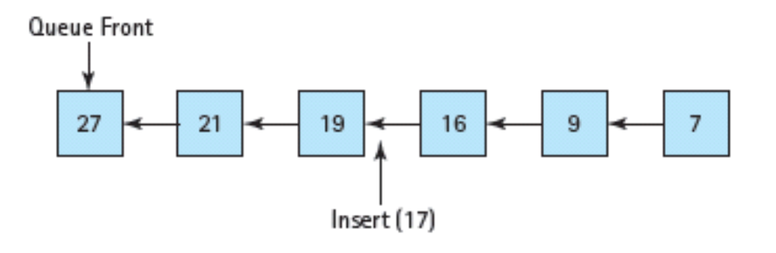
A Priority Queue, ADT Showing Insertion and Deletion Points

Slide 25
Bidirectional lists
Bidirectional lists appropriate to use when:
one wants to make insertions and deletions in the middle of the data structures;
random access is not as important as in array;
the array is inappropriate either as an ADT or as an implementation;

Slide 26
Bidirectional lists, cont...
Bidirectional lists appropriate to use when:
a programmer wants a list structure that provides for bidirectional traversal;
only in cases when a programmer needs these extra features because of its space inefficiency

Slide 27
Linked Implementation of the Bidirectional lists
In a linked implementation of the bidirectional list:
List nodes augmented with a second link that points in the opposite directions
External references kept to the front & the back of the list
One has the ability to step through the nodes by going either forward or backward, See Figure 17.7

Slide 28
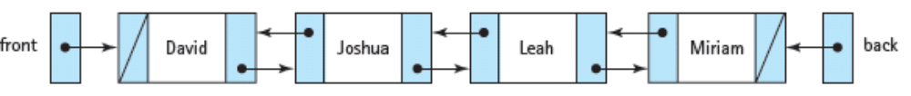
A Bidirectional Linked list

Slide 29
deque Operations
C++ deque uses :
push_front and push_back for insertion,
pop_front and pop_back for deletion
front and back for accessing the head an tail operations
C++ deque is one huge class that combines a combination of the interfaces for the abstract directional list, the deque, and the array

Slide 30
deques
A deque is the bidirectional equivalent of a queue
With deques, a programmer can insert and delete items at either end
Example: it could represent a train of railroad cars in a switchyard, where cars can be added and removed at either end of the train

Slide 31

Example of a deque

Slide 32
The vector Template
The vector class implements or defines an array, and vector doesn't have to be fixed in size
As a result, subarray processing becomes unnecessary as does the need to decide how big to make the array when one declares it
Vector must be instantiated with a constructor at run time
Thus, one cannot declare a vector using an initialization list as one can do with an array

Slide 33
Simple Calls to Vector Constructors
Examples:
vector<int> intVec(20); // A vector holding 20 integers
// all initialized to 0,
vector<string> noSizeVec; // A vector holding 0 strings
The first statement makes sense–similar to writing this code: int intVec[20]
But why declare a vector with no space in it, as in the second statement?

Slide 34
vector Constructors, cont. . .
The reason is that a vector automatically expands to hold as much data as one puts into it
In the second statement , the programmer did not know how many strings he or she would put into noSizeVec
Consequently, the programmer declares the vector with no elements and lets the structure grow as one inserts value

Slide 35
vector Constructors
When one knows a maximum size in advance, one should indicate that value in the constructor
Table on p. 886 of Ch. 17 summarizes operations of operators commonly used with vector
These operators include: at, back, begin, capacity, clear, empty, end, erase, front, insert, push_back, rbegin, rend, reserve, and size

Slide 36
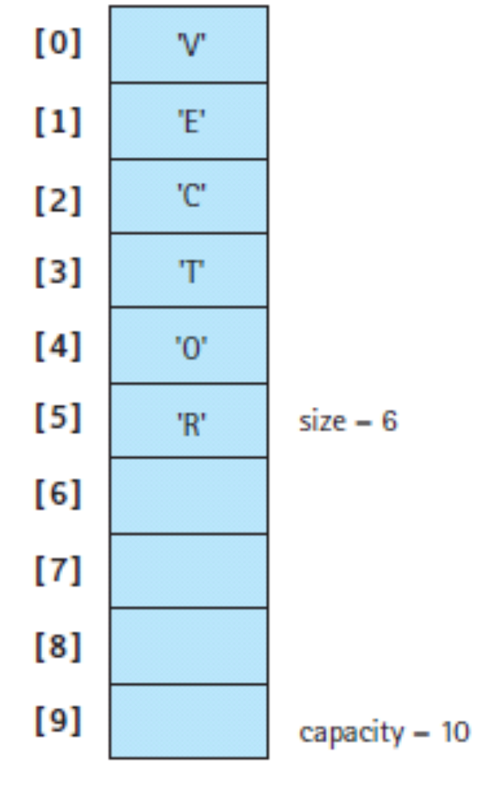
A vector <char> for which 10 Spaces Reserved and 6 Elements Inserted

Slide 37
Initializing a vector from an Array of Values
While unable to use an initializer list with a vector; however, one can initialize it from an array of values
Example from program in Ch. 17 looking up number of occupants in a given apartment:
int occData[] = {3,4,0,3,4,1,1,2,3,2,1,4,2,3,0,5,2,3};
vector<int> occupants(occData, occData+sizeof(occData)/sizeof(int));

Slide 38
Initializing a vector from an Array of Values, cont. . .
First argument, occData, is the base address of the already initialized array
Second argument, occData+sizeof(occData)/sizeof(int), is the address that is one greater than the location of the last element of the array
C++ automatically casts these addresses into iterators of the appropriate type as they are passed to the constructor
Constructor designed so that the address just beyond the array doesn't copy that location into the vector

Slide 39
list Template
list defines:
back, begin, clear, empty, end, erase, front, insert, push_back, rbegin, rend, and size with similar meanings as for vector
Table on p.888 of ch.17 describes additional operators that list supports
Because it is a linked implementation, list does not define a capacity or reserve

Slide 40
list Template
Because it doesn't support random access, the [] operator is not overloaded nor is the at operation supported
A list can be created:
  with zero elements
  with a specific number of elements initialized to a default value
  by initializing from an array or another container
  by using a copy constructor

Slide 41
Example: How a List Works
Following nonsense example program creates a list from user input and:
displays it contents in different ways
applies various mutator operations and
merges it with another list

Slide 42
//************************************* // This program demonstrates various list methods //******************************************************
#include <iostream> #include <list> using namespace std;
int main ()
{ list<string> demo; // Create an empty list string word;
cout << "Enter a line with six words:" << endl;
for (int i = 1; i <= 6; i++) {
cin >> word;
demo.push_back(word); // Insert elements at back
}
//*******************************************// This program demonstrates various list methods //******************************************************
#include <iostream>
#include <list> using namespace std;
int main ()
{
list<string> demo; // Create an empty list
string word;
cout << "Enter a line with six words:" << endl;
for (int i = 1; i <= 6; i++) {
cin >> word;
demo.push_back(word); // Insert elements at back
}

Slide 43
// Access front, back, and size
cout << "Front element: " << demo.front() << endl
<< "Back element: " << demo.back() << endl
<< "Size of list: " << demo.size() << endl;
// Create a forward iterator
list<string>::iterator place;
cout << "List contents from beginning to end: " << endl;
// Traverse list in forward direction
for (place = demo.begin(); place != demo.end();
place++)

Slide 44
cout << *rplace << " ";
cout << endl << "Enter a word to insert after the first word: ";
cin >> word;
place = demo.begin(); // Point forward iterator to front ++place; // Advance one place
demo.insert(place, word); // Insert an element
place = demo.end(); // Point forward iterator past end
--place; // Move back to last element
--place; // Move back one more place
demo.erase(place); // Delete element
cout << "Next to last word has been erased." << endl;
cout << "Enter a word to add at the front: ";
cin >> word;
demo.push_front(word); // Insert at front
cout << "List contents from beginning to end: " << endl;

Slide 45
The stack Template
The goal of the stack type is to model a LIFO push-down stack as simply as possible
Stack type has only five operators associated with it: empty, top, push, pop, and size
See Table on p. 891 of Ch. 17 for detailed description of these operators' actions

Slide 46
Creating a stack
Two ways to create a stack, either as an empty container or as copy of a vector, list, or deque
Examples:
1) stack<float> fltStack; // Create an empty stack of floats stack<string>
2) strStack(demo); // Create string stack from list demo

Slide 47
The queue Template
Simple design philosophy of queue very similar to stack except in a couple of respects:
In queue, push inserts elements at one end of data structure and pop removes them from the other end.
In addition to the observer, front, for the element that is about to be popped, queue provides back to allow one to look at element most recently pushed
Table providing summary of queue's operations on p. 892 of Ch. 17

Slide 48
The queue Template
Two forms of constructors for queue:
1) default creates an empty queue;
2) other form allows one to initialize the queue with a copy of the contents of vector, list, or deque

Slide 49
The priority_queue Template
Major difference of priority_queue with queue: elements in the structure kept in sorted order with priority_queue
Thus, push inserts elements using an insertion sort so that they go directly to their appropriate places in the ordering
At one end, top observes the element with the greatest value and application of pop removes it
Example of priority_queue : triage of patients in an emergency room of a hospital
Table on p. 894 of ch.17 has a summary of its operations

Slide 50
The deque Template
deque replicates most operations of list including: back, begin, clear, empty, end, erase, front, insert, push_back, rbegin, rend, and size with similar meanings
As with vector, deque overloads [ ] and at to provide random access
Being linked, it lacks a need to support capacity or reserve operations
See Problem-Solving Case Study at end of Ch. 17 for example of use of deque

Slide 51
The deque Template
deque does not directly support merge, remove, reverse, sort, or unique
However, equivalent function templates with the same names, all applicable to deque, are defined in the algorithms section of the STL
Increase in capability gained by using deque is offset by the costs in efficiency in running deque
Thus, do not use deque unless you actually need the combined features of list and vector

Slide 52
Nonlinear Structures: Binary Trees
A binary tree is a nonlinear structure in which elements have links that branch out in just two different directions
A binary tree is referenced by an external pointer to a specific node, called the root of the tree
The root has two pointers: one to its left child and one to its right child
The left and right children of a node are called siblings

Slide 53
Nonlinear Structures: Binary Trees
For any node in a tree, the left child of the node is the root of the left subtree of the node
Similarly, the right child is the root of the right subtree
Nodes whose left and right children are both NULL are called leaf nodes
No theoretical limit on the number of nodes in a tree

Slide 54
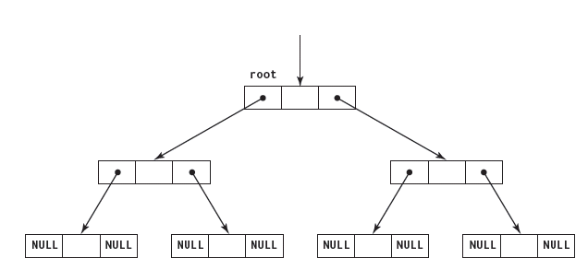
A Binary Tree

Slide 55
A Binary Search Tree
A binary search tree– a special type of binary tree where the values are arranged in a particular order
Component in any node is > component of its left child or any of its children (left subtree) and < the component of its right child or any of it children (right subtree)
This above definition assumes no duplicates

Slide 56
Binary Search Tree
Binary search trees useful in looking for a certain item because:
one is able to identify which half of the tree is in with just one comparison and
one is able then to tell which half of that half the item is in with one more comparison
Process continues until either we find the item or we determine that the item is not there

Slide 57
Searching for # 50 in a Binary Search Tree
[Insert Illustration of Searching for # 50 on Binary Search Tree on Bottom of p. 909 in .pdf version ]

Slide 58
Searching for #18, a Number not in Binary Search Tree
[Insert Binary Search Tree Diagram of for #18 on top of p.990 of .pdf version]

Slide 59
Traversing the Binary Search Tree
Three commonly used traversal patterns for a tree: 1) in-order traversal
2) pre-order traversal
3) post-order traversal
1) In-order traversal: 2) Pre-order traversal:
Visit the left subtree Visit the root
Then, the visit root Then, visit left subtree
Then, visit right subtree Then, visit right subtree

Slide 60
Traversing the Binary Search Tree
3) Post-order traversal:
Visit the left sub-tree
Then, visit the right sub-tree
Then, Visit the root
Depending on the data stored in a binary tree, each order of traversal may have a particular use

Slide 61
Example of In-order Traversal
[Copy and Paste Binary Child Binary Search Tree on Bottom of p. 910 of .pdf Ch.17]

Slide 62
Hash Functions
A hash function is an algorithmic function that converts (hashes) large, usually different-sized amount of data into small datum
This datum (hash value) is usually a single integer that may serve as an index into an array
Hash functions mostly used to expedite table lookup or data comparison assignments such as locating items in a database or detecting duplicated or similar records in a data set

Slide 63
Hash Functions and Collisions
A hash function may sort and store multiple values into the same place in the array, known as a collision
Desirable to minimize collisions through different approaches such as rehashing
Efficiency of hashing depends on having an array or table that is large enough to hold the data set
Figure 17.12 shows a chained hash table, a well designed hash function with lists remaining fairly short and having few collisions

Slide 64
A Chained Hash Table
[Insert Figure 17.12 from top of p. 913 of pdf. version of text]

Slide 65
Associative Containers
Associative containers permit one to locate values not by their positions, but by their associated values
Associative lookup or content addressable access used for many kinds of data processing
Value used for searching is called the key, and collectively these values must be ordered so that it allows two keys to be compared
In many cases, the keys must also be unique, and set and map are two of STL's associative containers

Slide 66
The set Template
The STL set template stored only unique values
If one tries to insert a value already in a set, the set will be unchanged
Internally, the values in a set are sorted from least to greatest to traverse the set as if it was a sorted list
However, this is less efficient than traversing a sequence container such as list

Slide 67
set Operations
set excels at finding elements by their values
After find operator provides an iterator pointing to value in a set, one can use it to erase the element or retrieve adjacent elements
Table on p. 915 of Ch. 17 contains description of set operations:
begin, clear, count empty, end, erase, find, insert, lower_bound , rbegin, rend, size, and upper_bound

Slide 68
set Algorithms
set_difference, set_intersection, and set_ union are the three set algorithms
They are called like traditional functions and must include <algorithm> to use them
All of the set algorithms use same arrangement of five parameters, (iterators): set_difference(start1, end1, start2, end2, and output);

Slide 69
Example of call to set_difference
Inserter must be used to force the set algorithms to generate their output in a way that enables a set to insert the output into itself
Example of a call to set_difference:
set_difference(set1.begin(), set1.end(), // First set set2.begin(), set2.end(), // Second set inserter(set3, set3.end())); // Result set
In this example, set3 contains all of the elements of set1 that are not found in set2

Slide 70
The map Template
An STL map is like a set with a major difference:
set stores only key values; map associates second value with each key
map permits one to implement the kind of name-index array, such as a phone book illustrated in Figure 17.14
Although conceptually an array, a map may be implemented internally with a linked structure such as binary search tree or a chained hash table

Slide 71
map Operations
Elements of operations are sorted
map supports operations begin, clear, cout, empty, end, erase, find, insert, lower_bound, rbegin, rend, size, and upper_bound
Insert operation expects a value of the template type pair

Slide 72
A Conceptual Illustration of a map for a phone book
[Insert Figure 17.14 Top of p. 916]

Slide 73
Example of Using a map for a Phone Book
Here is an example definition of a map that could be used for a phone book, and an insert operation that places an entry into it:
map<string, int> phonebook;
phonebook.insert(pair<string, int>("Eben Johnson", 5550001));

Slide 74
Another Difference Between set and map
With map, the [ ] operator is overloaded, enabling one to write code using concise syntax
For example, the following intricate code statements:
map<string, int>::iterator place; place = phonebook.find("Eben Johnson"); cout << *place.first << ": " << *place.second << endl; phonebook.erase(place);
can instead be written concisely as the following:
map<string, int> phonebook;
string name = "Eben Johnson";
phonebook[name] = 5550001;
cout << name << ": " << phonebook[name] << endl;
phonebook.erase(name);

