Slide 1
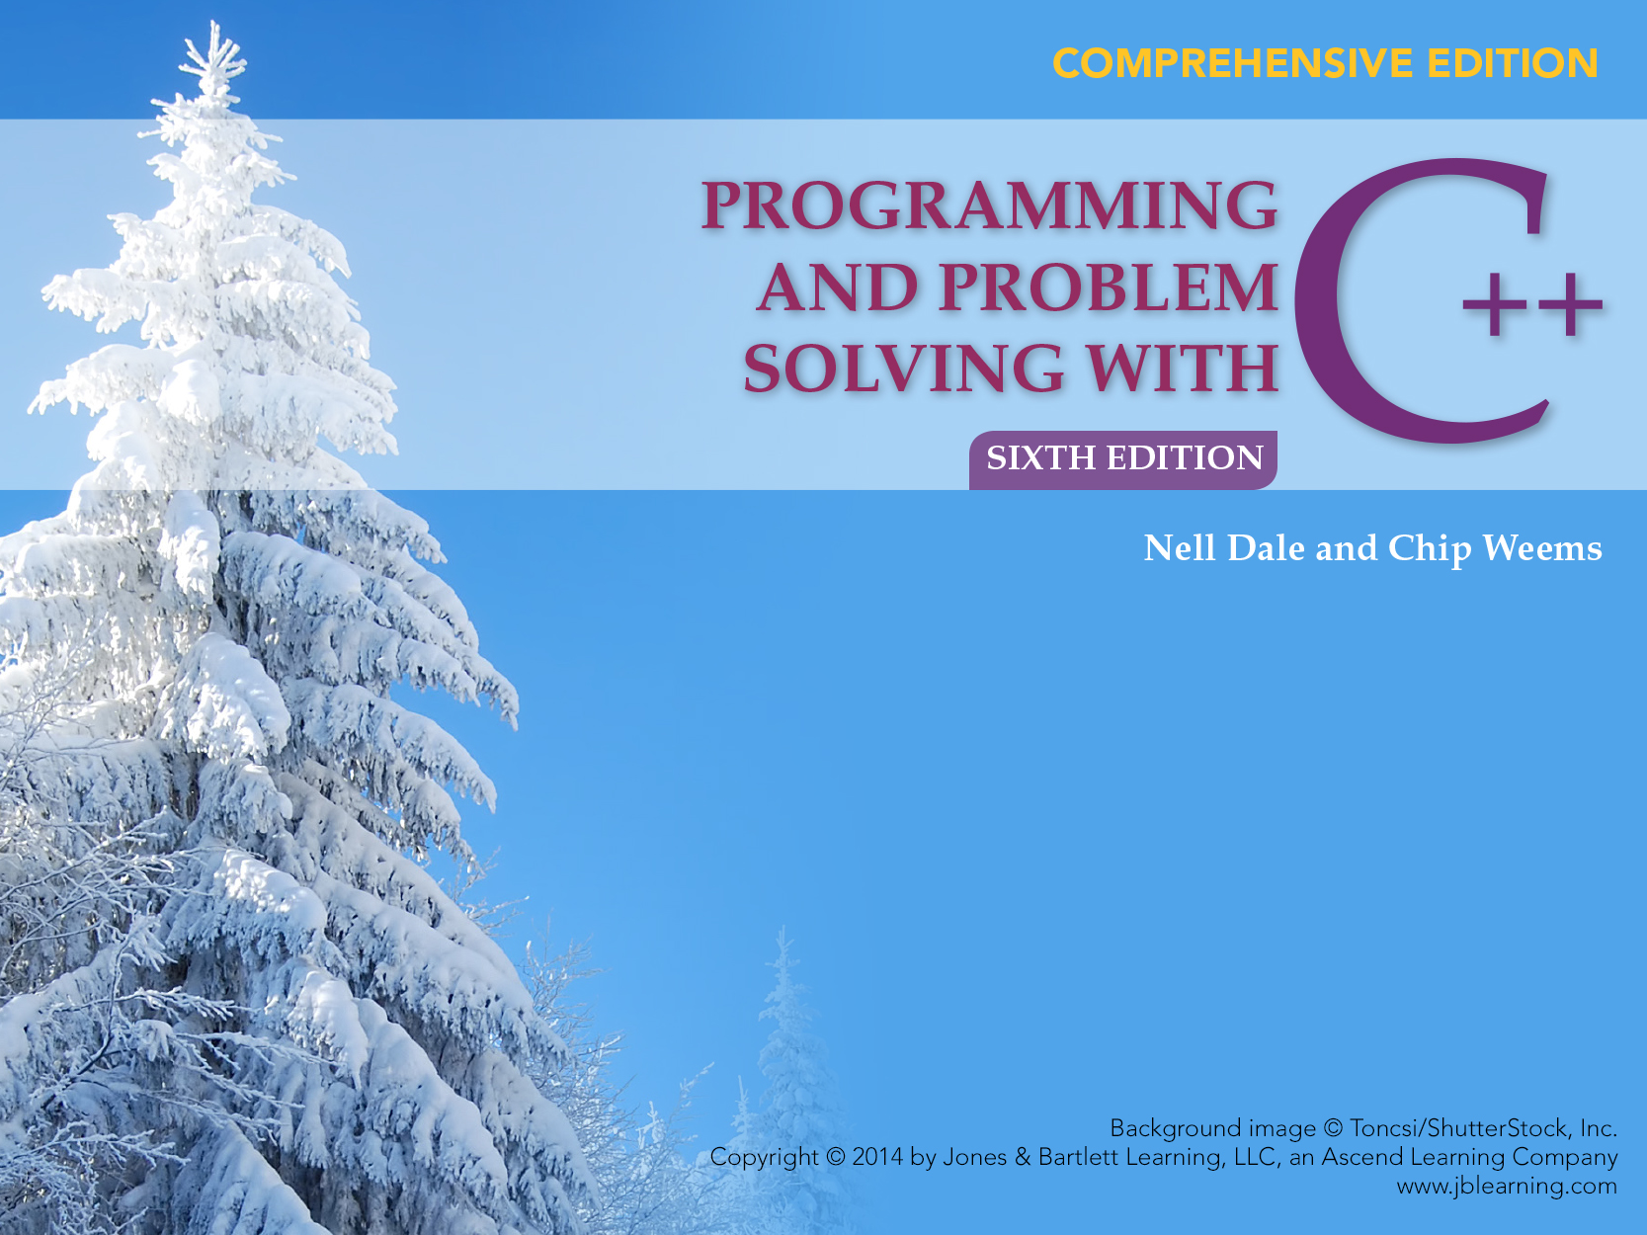
Chapter 18
Recursion

Slide 2
Chapter 18 Topics
Meaning of Recursion
Base Case and General Case in Recursive Function Definitions
Writing Recursive Functions with Simple Type Parameters

Slide 3
Chapter 18 Topics
Writing Recursive Functions with Array Parameters
Writing Recursive Functions with Pointer Parameters
Understanding How Recursion Works

Slide 4
Recursive Function Call
A recursive call is a function call in which the called function is the same as the one making the call
In other words, recursion occurs when a function calls itself!
But we need to avoid making an infinite sequence of function calls (infinite recursion)

Slide 5
Finding a Recursive Solution
A recursive solution to a problem must be written carefully
The idea is for each successive recursive call to bring you one step closer to a situation in which the problem can easily be solved
This easily solved situation is called the base case
Each recursive algorithm must have at least one base case, as well as a general (recursive) case

Slide 6
General Format for
Many Recursive Functions
if (some easily-solved condition) // Base case
solution statement
else // General case
recursive function call
Some examples . . .

Slide 7
Writing a Recursive Function to Find the Sum of the Numbers from 1 to n
DISCUSSION
The function call Summation(4) should have value 10, because that is 1 + 2 + 3 + 4
For an easily-solved situation, the sum of the numbers from 1 to 1 is certainly just 1
So our base case could be along the lines of
if (n == 1)
return 1;

Slide 8
Writing a Recursive Function to Find the Sum of the Numbers from 1 to n
Now for the general case. . .
The sum of the numbers from 1 to n, that is,
1 + 2 + . . . + n can be written as
n + the sum of the numbers from 1 to (n - 1),
that is, n + 1 + 2 + . . . + (n - 1)
or, n + Summation(n - 1)
And notice that the recursive call Summation(n - 1) gets us “closer” to the base case of Summation(1)

Slide 9
Finding the Sum of the Numbers from 1 to n
int Summation (/* in */ int n)
// Computes the sum of the numbers from 1 to
// n by adding n to the sum of the numbers
// from 1 to (n-1)
// Precondition: n is assigned && n > 0
// Postcondition: Return value == sum of
// numbers from 1 to n
{
if (n == 1) // Base case
return 1;
else // General case
return (n + Summation (n - 1));
}

Slide 10
Summation(4) Trace of Call
Returns 4 + Summation(3) = 4 + 6 = 10
Call 1:
Summation(4)
Returns 3 + Summation(2) = 3 + 3 = 6
Call 2:
Summation(3)
Returns 2 + Summation(1)
= 2 + 1 = 3 Call 3:
Summation(2)
n==1
Returns 1
Call 4:
Summation(1)
n
4
n
3
n
2
n
1

Slide 11
Writing a Recursive Function to Find n Factorial
DISCUSSION
The function call Factorial(4) should have value 24, because that is 4 * 3 * 2 * 1
For a situation in which the answer is known, the value of 0! is 1
So our base case could be along the lines of
if (number == 0)
return 1;

Slide 12
Writing a Recursive Function to Find
Factorial(n)
Now for the general case . . .
The value of Factorial(n) can be written as
n * the product of the numbers from (n - 1) to 1,
that is,
n * (n - 1) * . . . * 1
or, n * Factorial(n - 1)
And notice that the recursive call Factorial(n - 1) gets us “closer” to the base case of Factorial(0)

Slide 13
Recursive Solution
int Factorial ( int number)
// Pre: number is assigned and number >= 0
{
if (number == 0) // Base case
return 1;
else // General case
return
number + Factorial (number - 1);
}

Slide 14
Another Example Where Recursion Comes Naturally
From mathematics, we know that
2⁰ = 1 and 2⁵ = 2 * 2⁴
In general,
x⁰ = 1 and x^{n} = x * x^{n-1}
for integer x, and integer n > 0
Here we are defining x^{n} recursively, in terms of x^{n-1}

Slide 15
// Recursive definition of power function
int Power ( int x, int n)
// Pre: n >= 0; x, n are not both zero
// Post: Return value == x raised to the
// power n.
{
if (n == 0)
return 1; // Base case
else // General case
return ( x * Power (x, n-1))
}
Of course, an alternative would have been to use an iterative solution instead of recursion

Slide 16
Extending the Definition
What is the value of 2 ⁻³ ?
Again from mathematics, we know that it is
2 ⁻³ = 1 / 2³ = 1 / 8
In general,
x^{n} = 1/ x ^{-n}
for non-zero x, and integer n < 0
Here we again defining x^{n} recursively, in terms of x^{-n} when n < 0

Slide 17
// Recursive definition of power function
float Power ( /* in */ float x,
/* in */ int n)
// Pre: x != 0 && Assigned(n)
// Post: Return value == x raised to the power n
{
if (n == 0) // Base case
return 1;
else if (n > 0) // First general case
return ( x * Power (x, n - 1));
else // Second general case
return ( 1.0 / Power (x, - n));
}

Slide 18
The Base Case Can Be “Do Nothing”
void PrintStars (/* in */ int n)
// Prints n asterisks, one to a line
// Precondition: n is assigned
// Postcondition:
// IF n <= 0, n stars have been written
// ELSE call PrintStars
{
if (n <= 0) // Base case: do nothing
else
{
cout << ‘*’ << endl;
PrintStars (n - 1);
}
}
// Can rewrite as . . .

Slide 19
Recursive Void Function
void PrintStars (/* in */ int n)
// Prints n asterisks, one to a line
// Precondition: n is assigned
// Postcondition:
// IF n > 0, call PrintStars
// ELSE n stars have been written
{
if (n > 0) // General case
{
cout << ‘*’ << endl;
PrintStars (n - 1);
}
// Base case is empty else-clause
}

Slide 20
PrintStars(3) Trace of Call
Call 1:
PrintStars(3)
* is printed
Call 2:
PrintStars(2)
* is printed
Call 3:
PrintStars(1)
* is printed
Call 4:
PrintStars(0)
Do nothing
n
3
n
2
n
1
n
0

Slide 21
Recursive Mystery Function
int Find(/* in */ int b, /* in */ int a)
// Simulates a familiar integer operator
// Precondition: a is assigned && a > 0
// && b is assigned && b >= 0
// Postcondition: Return value == ???
{
if (b < a) // Base case
return 0;
else // General case
return (1 + Find (b - a, a));
}

Slide 22
Find(10, 4) Trace of Call
Returns 1 + Find(6, 4) = 1 + 1 = 2
Call 1:
Find(10, 4)
Returns 1 + Find(2, 4) = 1 + 0 = 1
Call 2:
Find(6, 4)
b < a
Returns 0
Call 3:
Find(2, 4)
b a
10 4
b a
6 4
b a
2 4

Slide 23
Writing a Recursive Function to Print Array Elements in Reverse Order
DISCUSSION
For this task, we will use the prototype:
void PrintRev(const int data[ ], int first, int last);
6000
The call
PrintRev (data, 0, 3);
should produce this output: 95 87 36 74
74 36 87 95
data[0] data[1] data[2] data[3]

Slide 24
Base Case and General Case
A base case may be a solution in terms of a “smaller” array
Certainly for an array with 0 elements, there is no more processing to do
The general case needs to bring us closer to the base case situation
If the length of the array to be processed decreases by 1 with each recursive call, we eventually reach the situation where 0 array elements are left to be processed

Slide 25
Base Case and General Case, cont. . .
In the general case, we could print either the first element, that is, data[first] or we could print the last element, that is, data[last]
Let’s print data[last]: After we print data[last], we still need to print the remaining elements in reverse order

Slide 26
Using Recursion with Arrays
int PrintRev (
/* in */ const int data [ ],// Array to be printed
/* in */ int first, // Index of first element
/* in */ int last ) // Index of last element
// Prints items in data [first..last] in reverse order
// Precondition: first assigned && last assigned
// && if first <= last, data [first..last] assigned

Slide 27
Using Recursion with Arrays
{
if (first <= last) // General case
{
cout << data[last] << “ “; // Print last
PrintRev(data, first, last - 1); //Print rest
}
// Base case is empty else-clause
}

Slide 28
PrintRev(data, 0, 2) Trace
Call 1:
PrintRev(data, 0, 2)
data[2] printed
Call 2:
PrintRev(data, 0, 1)
data[1] printed
Call 3:
PrintRev(data, 0, 0)
data[0] printed
Call 4:
PrintRev(data, 0, -1)
NOTE: data address 6000 is also passed Do nothing
first 0
last 2
first 0
last 1
first 0
last 0
first 0
last -1

Slide 29
Why use recursion?
These examples could all have been written more easily using iteration
However, for certain problems the recursive solution is the most natural solution
This often occurs when structured variables are used

Slide 30
Why use recursion?
Remember The iterative solution uses a loop, and the recursive solution uses a selection statement

Slide 31
Recursion with Linked Lists
For certain problems the recursive solution is the most natural solution
This often occurs when pointer variables are used

Slide 32
struct NodeType
typedef char ComponentType;
struct NodeType
{
ComponentType component;
NodeType* link;
}
NodeType* head;

Slide 33
RevPrint(head);
head
‘A’ ‘B’ ‘C’ ‘D’ ‘E’
FIRST, print out this section of list, backwards
THEN, print
this element

Slide 34
Base Case and General Case
A base case may be a solution in terms of a “smaller” list
Certainly for a list with 0 elements, there is no more processing to do
Our general case needs to bring us closer to the base case situation
If the number of list elements to be processed decreases by 1 with each recursive call, the smaller remaining list will eventually reach the situation where 0 list elements are left to be processed

Slide 35
Base Case and General Case
In the general case, we print the elements of the (smaller) remaining list in reverse order and then print the current element

Slide 36
Using Recursion with a Linked List
void RevPrint (NodeType* head)
// Pre: head points to an element of a list
// Post: All elements of list pointed to by head have
// been printed in reverse order.

Slide 37
Using Recursion with a Linked List
{
if (head != NULL) // General case
{
RevPrint (head-> link); // Process the rest
// Print current
cout << head->component << endl;
}
// Base case : if the list is empty, do nothing
}

Slide 38
Recall that . . .
Recursion occurs when a function calls itself (directly or indirectly)
Recursion can be used in place of iteration (looping)
Some functions can be written more easily using recursion

Slide 39
Recursion or Iteration?
CLARITY
EFFICIENCY

Slide 40
What is the value of Rose(25)?
int Rose (int n)
{
if (n == 1) // Base case
return 0;
else // General case
return (1 + Rose(n / 2));
}

Slide 41
Finding the Value of Rose(25)
Rose(25) the original call
= 1 + Rose(12) first recursive call
= 1 + (1 + Rose(6)) second recursive call
= 1 + (1 + (1 + Rose(3))) third recursive call
= 1 + (1 + (1 + (1 + Rose(1)))) fourth recursive call
= 1 + 1 + 1 + 1 + 0
= 4

Slide 42
Writing Recursive Functions
There must be at least one base case and at least one general (recursive) case--the general case should bring you “closer” to the base case
The arguments(s) in the recursive call cannot all be the same as the formal parameters in the heading
Otherwise, infinite recursion would occur

Slide 43
Writing Recursive Functions
In function Rose(), the base case occurred when (n == 1) was true
The general case brought us a step closer to the base case, because in the general case the call was to Rose(n/2),
And the argument n/2 was closer to 1 (than n was)

Slide 44
When a function is called...
A transfer of control occurs from the calling block to the code of the function
It is necessary that there be a return to the correct place in the calling block after the function code is executed
This correct place is called the return address
When any function is called, the run-time stack is used--activation record for the function call is placed on the stack

Slide 45
Stack Activation Record
The activation record (stack frame) contains:
the return address for this function call;
the parameters;
local variables;
and space for the function’s return value (if non-void)

Slide 46
Stack Activation Record
The activation record for a particular function call is popped off the run-time stack when final closing brace in the function code is reached,
Or when a return statement is reached in the function code
At this time the function’s return value, if non-void, is brought back to the calling block return address for use there

Slide 47
// Another recursive function
int Func (/* in */ int a, /* in */ int b)
// Pre: Assigned(a) && Assigned(b)
// Post: Return value == ??

Slide 48
{
int result;
if (b == 0) // Base case
result = 0;
else if (b > 0) // First general case
result = a + Func (a, b - 1));
// Say location 50
else // Second general case
result = Func (- a, - b);
// Say location 70
return result;
}

Slide 49
Run-Time Stack Activation Records x = Func(5, 2); // original call at instruction 100
FCTVAL ?
result ?
b 2
a 5
Return Address 100
original call
at instruction 100
pushes on this record
for Func(5,2)

Slide 50
Run-Time Stack Activation Records x = Func(5, 2); // original call at instruction 100
FCTVAL ?
result ?
b 1
a 5
Return Address 50
FCTVAL ?
result 5+Func(5,1) = ?
b 2
a 5
Return Address 100
call in Func(5,2) code
at instruction 50
pushes on this record
for Func(5,1)
record for Func(5,2)

Slide 51
Run-Time Stack Activation Records x = Func(5, 2); // original call at instruction 100
FCTVAL ?
result ?
b 0
a 5
Return Address 50
FCTVAL ?
result 5+Func(5,0) = ?
b 1
a 5
Return Address 50
FCTVAL ?
result 5+Func(5,1) = ?
b 2
a 5
Return Address 100
call in Func(5,1) code
at instruction 50
pushes on this record
for Func(5,0)
record for Func(5,1)
record for Func(5,2)

Slide 52
Run-Time Stack Activation Records x = Func(5, 2); // original call at instruction 100
FCTVAL 0
result 0
b 0
a 5
Return Address 50
FCTVAL ?
result 5+Func(5,0) = ?
b 1
a 5
Return Address 50
FCTVAL ?
result 5+Func(5,1) = ?
b 2
a 5
Return Address 100
record for Func(5,0)
is popped first
with its FCTVAL
record for Func(5,1)
record for Func(5,2)

Slide 53
Run-Time Stack Activation Records x = Func(5, 2); // original call at instruction 100
FCTVAL 5
result 5+Func(5,0) = 5+ 0 b 1
a 5
Return Address 50
FCTVAL ?
result 5+Func(5,1) = ?
b 2
a 5
Return Address 100
record for Func(5,1)
is popped next
with its FCTVAL
record for Func(5,2)

Slide 54
Run-Time Stack Activation Records x = Func(5, 2); // original call at instruction 100
FCTVAL 10
result 5+Func(5,1) = 5+5
b 2
a 5
Return Address 100
record for Func(5,2)
is popped last
with its FCTVAL

Slide 55
Show Activation Records for these calls
x = Func(- 5, - 3);
x = Func(5, - 3);
What operation does Func(a, b) simulate?

Slide 56
Write a function . . .
Write a function that takes an array a and two subscripts, low and high as arguments, and returns the sum of the elements
a[low]+..+ a[high]
Write the function two ways - - one using iteration and one using recursion
For your recursive definition’s base case, for what kind of array do you know the value of Sum(a, low, high) right away?

Slide 57
// Recursive definition
int Sum ( /* in */ const int a[ ],
/* in */ int low,
/* in */ int high)
// Pre: Assigned(a[low..high]) && low <= high
// Post: Return value == sum of items a[low..high]
{
if (low == high) // Base case
return a [low];
else // General case
return a [low] + Sum(a, low + 1, high);
}

Slide 58
// Iterative definition
int Sum ( /* in */ const int a[ ],
/* in */ int high)
// Pre: Assigned(a[0..high])
// Post: Return value == sum of items a[0..high]
{
int sum = 0;
for (int index= 0; index <= high; index++)
sum = sum + a[index];
return sum;
}

Slide 59
Write a function . . .
Write a LinearSearch that takes an array a and two subscripts, low and high, and a key as arguments R
It returns true if key is found in the elements a[low...high]; otherwise, it returns false

Slide 60
Write a function . . .
Write the function two ways - - using iteration and using recursion
For your recursive definition’s base case(s), for what kinds of arrays do you know the value of LinearSearch(a, low, high, key) right away?

Slide 61
// Recursive definition
bool LinearSearch
(/* in */ const int a[ ],
/* in */ int low,
/* in */ int high,
/* in */ int key)
// Pre: Assigned(a[low..high])
// Post: IF (key in a[low..high])
// Return value is true,
// else return value is false

Slide 62
{
if (a [ low ] == key) // Base case
return true;
else if (low == high) // Second base case
return false;
else // General case
return
LinearSearch(a, low + 1, high, key);
}

Slide 63
Function BinarySearch()
BinarySearch that takes sorted array a, and two subscripts, low and high, and a key as arguments
It returns true if key is found in the elements a[low...high], otherwise, it returns false
BinarySearch can also be written using iteration or recursion, but it is an inherently recursive algorithm

Slide 64
x = BinarySearch(a, 0, 14, 25);
low high key
subscripts
0 1 2 3 4 5 6 7 8 9 10 11 12 13 14
array
0 2 4 6 8 10 12 14 16 18 20 22 24 26 28
16 18 20 22 24 26 28
24 26 28
24
NOTE: denotes element examined

Slide 65
// Recursive definition
bool BinarySearch (/* in */ const int a[ ],
/* in */ int low,
/* in */ int high,
/* in */ int key)
// Pre: a[low .. high] in ascending order && Assigned (key)
// Post: IF (key in a[low . . high]), return value is true
// otherwise return value is false

Slide 66
{
int mid;
if (low > high)
return false;
else
{
mid = (low + high) / 2;
if (a [ mid ] == key)
return true;
else if (key < a[mid]) // Look in lower half
return BinarySearch(a, low, mid-1, key);
else // Look in upper half
return BinarySearch(a, mid+1, high, key);
}
}

