Slide 1
A 1990s keyword baseline beat the embedding
model this system ships - at 1/8 the latency
Agentic RAG Research Assistant · 4 retrieval arms, 191 questions, paired tests · Cena Shabani
Notes:
Open on the finding, not the topic. Almost every public RAG write-up wires an embedding model to a vector store and shows one impressive answer. None of them build a baseline. I built one, and it won - nDCG 0.978 against 0.751, at two milliseconds against seventeen. And because every arm answered the same questions, I could test whether that gap is real rather than asking you to eyeball two error bars. That is the talk.

Slide 2
The decision: which retrieval strategy is worth its latency?
A RAG demo is a commodity. A defensible evaluation of
one is not.
Retrieval is the half nobody measures - no baseline to
beat, no confidence interval, no significance test, no
latency, no per-question look.
So: four retrieval strategies, each one idea apart from
the last, holding the corpus, questions and metrics
constant - and price each one.
dense · bm25 · hybrid RRF · cross-encoder rerank
Notes:
Frame it as a spending decision, because that is what it is. Every millisecond of retrieval is latency on every query in production, and every extra component is something to operate. I wanted the answer to be a number rather than a preference - and I was expecting the expensive options to win. Each arm adds exactly one idea to the previous one, so a difference has a cause; an arm that changed two things at once would be unattributable. The dense arm delegates to the shipped retriever rather than reimplementing it, and a test asserts they return identical hits - otherwise every number would describe a retriever the system does not actually use.

Slide 3
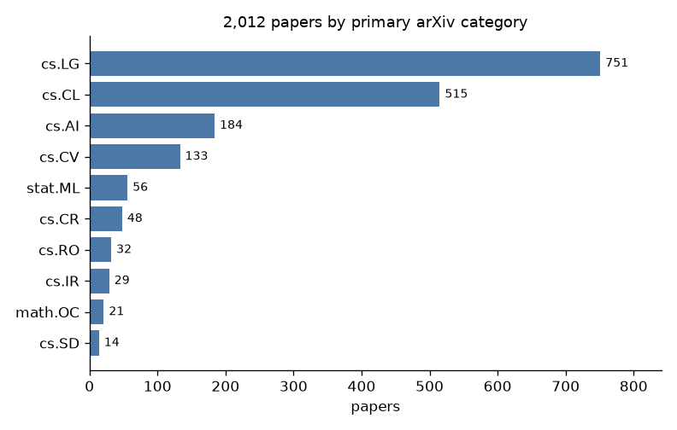
2,012 arXiv papers, with the ground truth deliberately seeded
· cs.CL and cs.LG from the arXiv API, plus 12 seminal
papers fetched by id
· Title + abstract only - licence-safe for every paper,
and each paper's licence is recorded anyway
· 4,298 chunks, 384-dim local embeddings, exact FAISS
· Provenance: query, date, count and SHA-256 of the file
· 191 questions: 180 generated known-item + 11 written
by hand, reported separately
Notes:
The seeding is the part worth explaining. The evaluation questions have known-correct answers, and those answers have to be in the corpus or the retrieval metrics measure nothing. A recent-papers-only crawl might not contain the Transformer paper. It turned out to matter more than I expected: when I rebuilt the index sixteen days later, not one of sixty sampled papers had survived - the recent window rotates completely. Only the twelve pinned papers persisted, which is what let the hand-written questions keep meaning the same thing across the rebuild. Licences are recorded per paper so that extending to full text later stays defensible.

Slide 4
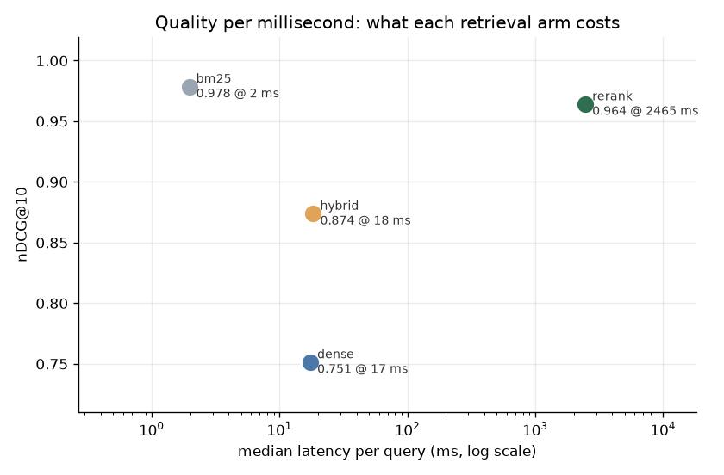
BM25 wins on quality and costs 1,200x less than the reranker
BM25 nDCG@10 0.978 [0.962, 0.992] 2.0 ms
rerank nDCG@10 0.964 [0.942, 0.982] 2,465 ms
hybrid nDCG@10 0.874 [0.835, 0.911] 18.3 ms
dense nDCG@10 0.751 [0.691, 0.811] 17.4 ms
BM25 is the top-left point. Nothing else buys quality it
does not already have, and everything else costs more.
Notes:
Reporting the intervals is the point - a benchmark without them is four bars and a story. But do not let me get away with reading them against each other, and that is exactly the next slide. The reranker line is the one I would dwell on: an earlier version of this project's README recommended a cross-encoder as the obvious next iteration that would lift MRR. I built it, and building the thing is what refuted my own recommendation - which is the argument for benchmarking rather than reasoning about it.

Slide 5
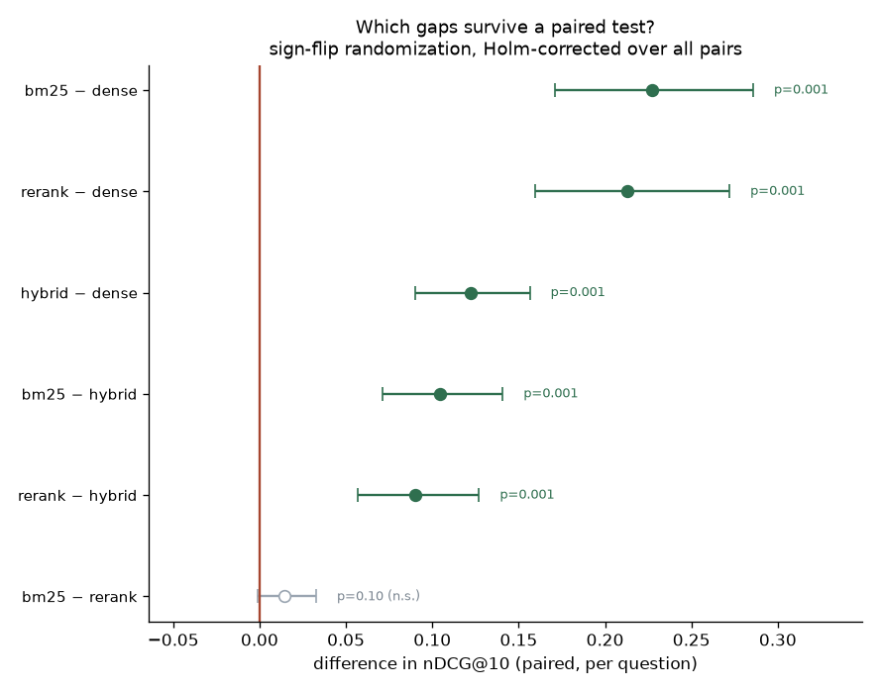
Two overlapping intervals are not a comparison - so I paired them
Every arm answered the same 180 questions, so the
per-question difference exists. Question difficulty is
shared between arms, so it cancels.
Sign-flip randomization test, Holm-corrected over all
six pairs:
bm25 - dense +0.227 52W / 1L p = 0.0006
hybrid - dense +0.122 46W / 0L p = 0.0006
bm25 - rerank +0.014 8W / 6L p = 0.101
The cross-encoder buys nothing measurable, at 1,200x
the latency.
Notes:
This is the slide I would want a retrieval team to ask about. Comparing two marginal confidence intervals and checking whether they overlap is the standard mistake, and I nearly published it: overlapping intervals do not imply no difference, the implication only runs the other way. The intervals are wide because questions differ in difficulty, and that variance is shared by both arms, so it cancels in the per-question difference. Paired, the dense gap is fifty-two wins to one loss. The reranker gap is eight wins to six losses over a hundred and sixty-six ties, and it does not survive correction. So my claim is a null, correctly stated - and it is stronger than what I had before. Slightly better invites an argument about whether it is worth paying for. No measurable difference at a thousand times the price ends the argument.

Slide 6
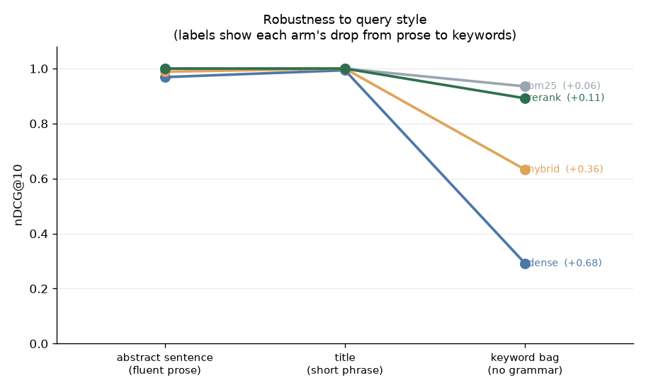
Why: the dense arm needs the query to be well-formed prose
Every paper produced a query in three styles - a fluent
abstract sentence, a title, and a shuffled bag of five
keywords.
BM25 never reads word order, so it barely moves: -0.065
The dense arm loses two-thirds of its quality:
0.969 → 0.291
Real users type keywords, not sentences.
Notes:
This is the slide that shows I understood the result rather than just measured it. A bi-encoder is trained on natural sentences, so it has no particular reason to handle a keyword bag well - and it doesn't. The slope is the measurement here, not any single point, which is why the eval set was generated three ways instead of the one that would have looked tidiest. My first version used only abstract sentences and every arm scored 1.00 - a saturated benchmark measures nothing, and noticing that was most of the work. The cutoff sweep adds the mechanism: the dense arm's recall is still only 0.856 at k of fifty, so it is not mis-ranking documents, it is never retrieving them - which is also why no reranker can rescue it.

Slide 7
The average hides the row that decides the architecture
s5 asks what word2vec learns.
The right paper is ‘Efficient Estimation of Word
Representations in Vector Space’ - and the string
‘word2vec’ appears zero times in all 4,298 chunks.
BM25 scores 0.00. The dense arm finds it, around rank 6.
Hybrid RRF fails it too - fusion is not free insurance.
So: BM25 as the default, dense as a fallback.
Not ‘BM25 wins’.
Notes:
This is the most useful thing in the whole benchmark and it is invisible in the average. It is the canonical vocabulary-mismatch case - the exact problem dense retrieval was invented to solve - turning up live in an evaluation whose headline says dense retrieval lost. Rare here, catastrophic when it happens, which argues for a fallback rather than a replacement. Note hybrid loses it as well: fusing a confident-but-wrong ranking with a correct one pushed the right document out of the top ten. And this one replicated exactly when I rebuilt the corpus from scratch with zero paper overlap. If someone asks me one question about this project, I want it to be this slide.

Slide 8
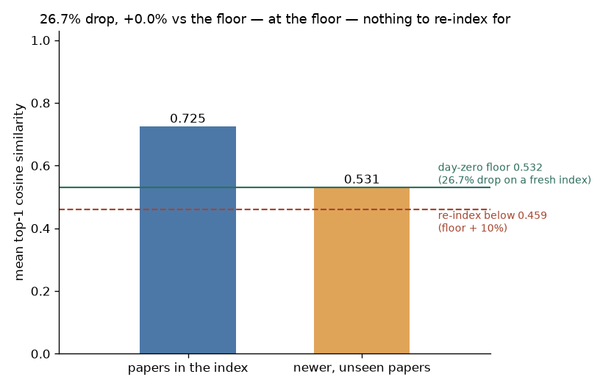
My drift monitor was broken, and acting on it is what proved it
The probe read a 27.2% similarity drop against a 15%
re-index trigger. So I re-indexed.
On an index one hour old, it read 26.7%.
The drop has a structural floor: a baseline query is a
sentence lifted out of an indexed document, so it
near-self-matches. That gap is there on day one.
Now: trigger on excess over a measured floor.
Current reading: +0.05pp. Nothing to do.
Notes:
I would rather present this than hide it. I had a monitoring metric with a threshold, it fired, I acted on it, and the largest possible intervention - replacing every paper in the corpus - moved the number by half a percentage point. That is the metric failing, not the index. The general lesson is the transferable part: a monitoring metric you have never evaluated in the healthy state is not calibrated, it just has a threshold on it. And the bug was findable from the start - the module's own docstring always said the gap widening was the signal, and the code thresholded the level anyway. The prose was right and unread, the code was wrong and trusted. The fix costs something too: the floor is a measured number that expires whenever the embedder or the corpus size changes, which is written down next to it in config.

Slide 9
What I'd do about it
1. Switch the first stage to BM25. 8x the latency for
0.227 less nDCG, 52 wins to 1 - a default nobody
tested.
2. Do not buy the cross-encoder. If you keep it anyway,
cut its shortlist from 50 to 20 - recall saturates
there.
3. Keep dense as a fallback for vocabulary mismatch -
and not via naive RRF, which loses that case too.
4. Do not re-index. The probe is at its floor.
5. The residual multi-hop gap is still the agent's case.
Notes:
The point of measuring is that the next step is not a guess - including when the number contradicts what the project was built to believe, and including when the number itself turns out to be the thing that was wrong. Item two comes straight from the cutoff sweep: hybrid recall hits one point zero by rank twenty, so candidates twenty-one to fifty are pure cost. Item four is the reversal of what this slide said a fortnight ago, and I would rather show you a recommendation I withdrew on evidence than a list that never changed.

Slide 10
Limitations I would raise before you do
· Generated queries are built from their target
document's own words - that favours BM25. Mitigated by
the slope across three query styles, by the
hand-written set agreeing, and by replicating on a
corpus with zero paper overlap.
· Known-item retrieval is the easy end of the problem.
· The curated set is 11 questions - intervals overlap
completely, and it is too small for a paired test.
· The drift trigger has two readings. Two is not a trend.
· One corpus, one embedder, one CPU.
pytest → 98 passed, 1 skipped · runs with no API key
Notes:
Say these before being asked. The first one is the real attack surface and I would raise it myself: if you manufacture queries out of a document's own words, you have built something that flatters keyword matching. Three things make it survivable - the styles measure a slope rather than a point, the hand-written questions do not share the bias and agree, and the whole result replicated on a completely different corpus. If those had disagreed I would be presenting a different conclusion. Everything here reproduces offline with no key and no account, which is what makes the headline checkable rather than claimed.

