Slide 1
Same churn model, better rule:
+43% retention profit
A Kaggle churn notebook reproduced, audited, and taken from a prediction to a decision
10,000 bank customers · LightGBM + SHAP · value-aware targeting
Notes:
I took a public Kaggle notebook that predicts bank churn with LightGBM and explains it with SHAP. I reproduced it on the same split, checked it, and then asked the question it stops short of: if a retention team acts on these scores, whom should they call? The headline is that tuning the model, where most churn notebooks spend their effort, is worth about zero euros here, while changing the decision rule on the very same model raises campaign profit by 43 percent on the held-out customers.

Slide 2
The question is whom to call, not how well we can predict
• A retail bank loses ~1 in 5 customers (20.4%)
• The retention team can call customers and offer a €100 fee waiver
• Decision: for each customer, is the call worth its cost?
Data: 10,000 real customers (FR / DE / ES), public CC0. The parent of the Kaggle competition file
Source notebook: 80/20 split, LR / RF / LightGBM, SHAP. It stops at probabilities
Notes:
The source notebook answers 'how well can churn be predicted'. A client asks a different question: who do we call, and is it worth it. I used the public original dataset, ten thousand customers of a European bank, because the competition file is a noise-added derivative behind a rules gate. That means absolute AUCs differ from the source's 0.93, so every comparison I show is like for like: the source pipeline re-run on this data, same split, same folds.

Slide 3
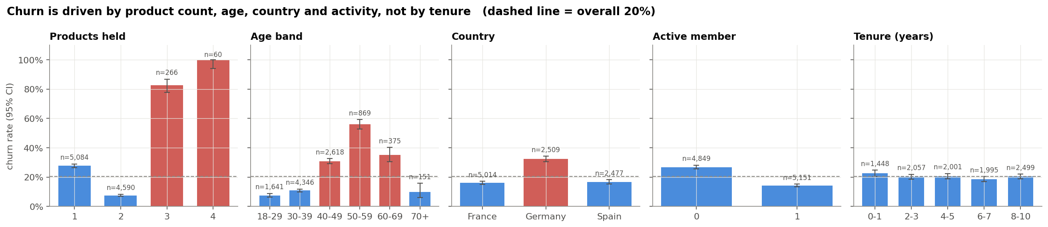
Churn follows products, age, country and activity, and two of those are not straight lines
Products U-shaped (1 → 28%, 2 → 8%, 3–4 → 83–100%) · age peaks at 56% in the 50s
Germany 32% vs 16–17% · inactive 27% vs 14% · tenure, salary, card: no signal
Notes:
Before any model, the EDA shows the shapes. Product count is U-shaped: two products is the safest state, three or four is almost certain churn. Age is a hump peaking in the fifties. Those two shapes matter because a plain logistic regression treats them as straight lines, which is exactly why the source's logistic regression scores so badly. The bars carry Wilson intervals, so the 60 customers with four products are shown with the uncertainty they deserve. And there is a confound: every German customer holds a balance, so balance and country effects are tangled.

Slide 4
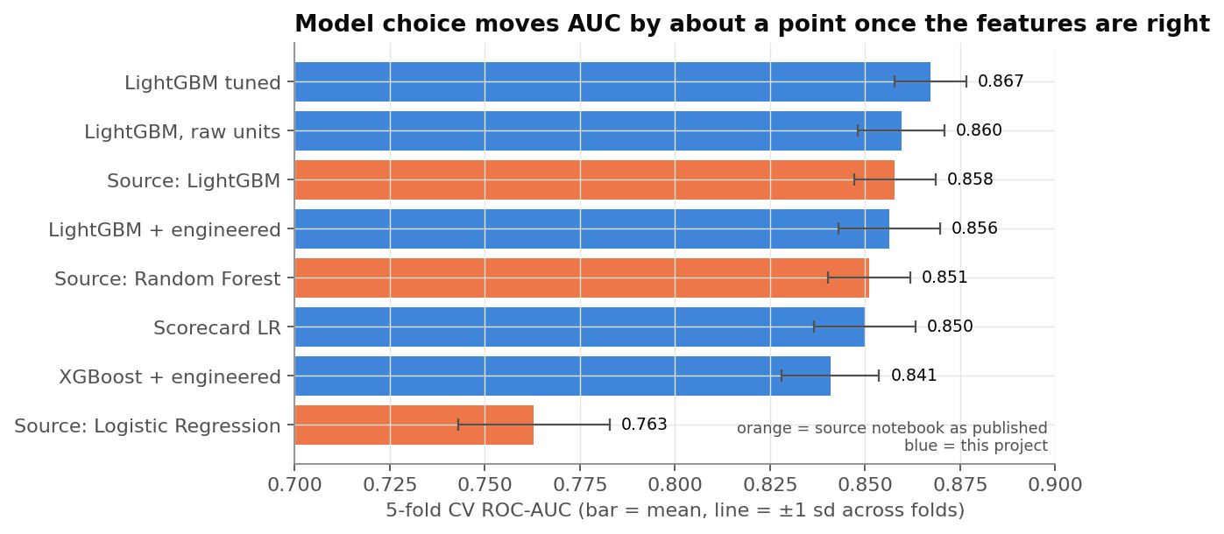
Tuning buys one point of AUC; respecting the data's shapes buys nine
• Source LightGBM: 0.858 CV AUC → tuned: 0.867
• Holdout: 0.860 → 0.868, Δ +0.008 (95% CI +0.001 to +0.015)
• Logistic regression 0.76 → 0.85 with a spline on age + products as categories
• Fixed a search-space bug: subsample without subsample_freq is a no-op in LightGBM
• Calibrated (ECE ≈ 2 pts); equal AUC for women and men
Notes:
Every candidate changes one thing so its effect is readable. Optuna tuning, which the source wrote but never ran, adds under a point of AUC: real, the paired bootstrap interval excludes zero, but small. The biggest jump in the table is the interpretable scorecard: the same logistic regression goes from 0.76 to 0.85 just by being told that age bends and that product count is a category. That came from the EDA, not from compute. I also checked calibration, because the next step multiplies probabilities by euros, and fairness by country and gender.

Slide 5
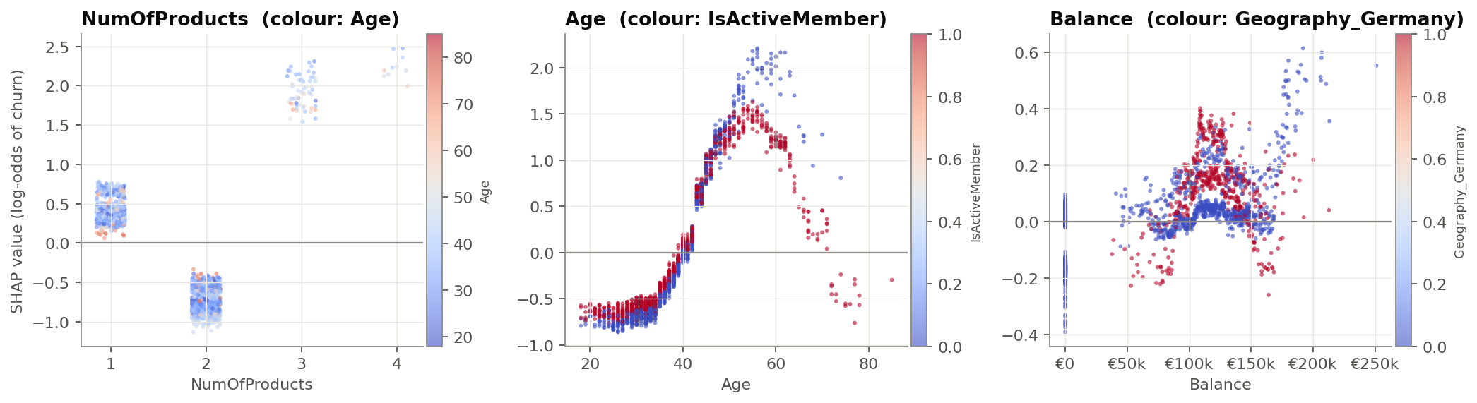
The second product is the most protective thing a customer holds
1 product raises risk, 2 lowers it, 3–4 raise it sharply: 'more products → more churn' is wrong for 97%
From ~45, inactive customers (blue) sit well above active ones of the same age
Notes:
These are SHAP dependence plots in real units, which is why I trained the trees on unscaled features. The source notebook concluded that more products increase churn. The plot shows that is only true past two; for the 97 percent of customers holding one or two products it is the opposite. The age panel shows an interaction: from about 45, inactive customers sit well above active ones of the same age. One caution I always add: SHAP explains the model, not the world. These are associations until tested.

Slide 6
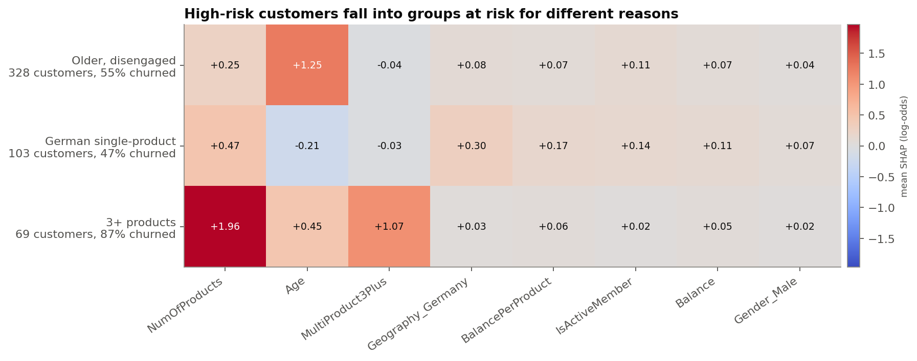
High-risk customers are at risk for different reasons, so they need different actions
Older, disengaged → re-engage · German single-product → second-product offer
3+ products (87% churned) → not a call list, an investigation (k-means on SHAP, k by silhouette)
Notes:
I clustered the explanations of the 500 riskiest holdout customers rather than their raw features, so the groups are defined by why the model flags them. Three personas came out. The third one is the slide I would bring to a client: customers who bought three or more products and then almost all left. A model-driven campaign would call them first because they score highest, but a fee waiver will not fix whatever drove them out. That is a product or mis-selling question for the business, not for the call centre.

Slide 7
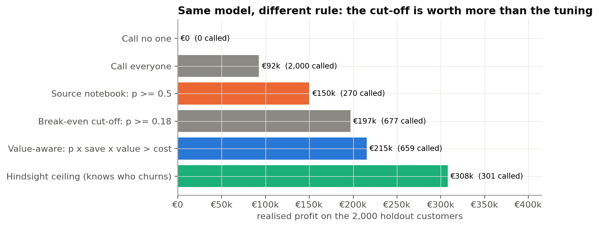
Same model, different rule: +€65k on 2,000 customers
Call customer i if p × save rate × value > cost
• 0.5 cut-off (source): €150k, misses half the churners
• Break-even cut-off p ≥ 0.18: €197k
• Value-aware rule: €215k, +43% (95% CI +€44k to +€89k)
• Tuned model under the same rule: −€2k (noise)
• 70% of the hindsight ceiling, up from 49%
Notes:
Here is the core result. Value is three years of deposit margin plus product fees; a call costs 130 euros including the waiver, which goes to everyone called; and the offer saves 20 percent of would-be churners. The source model at 0.5 earns 150 thousand on the 2,000 holdout customers. The same model with the value-aware rule earns 215. The bootstrap interval on that gain is 44 to 89 thousand. Swapping in my tuned model under the same rule changes nothing. So the value is in the decision, not the model.

Slide 8
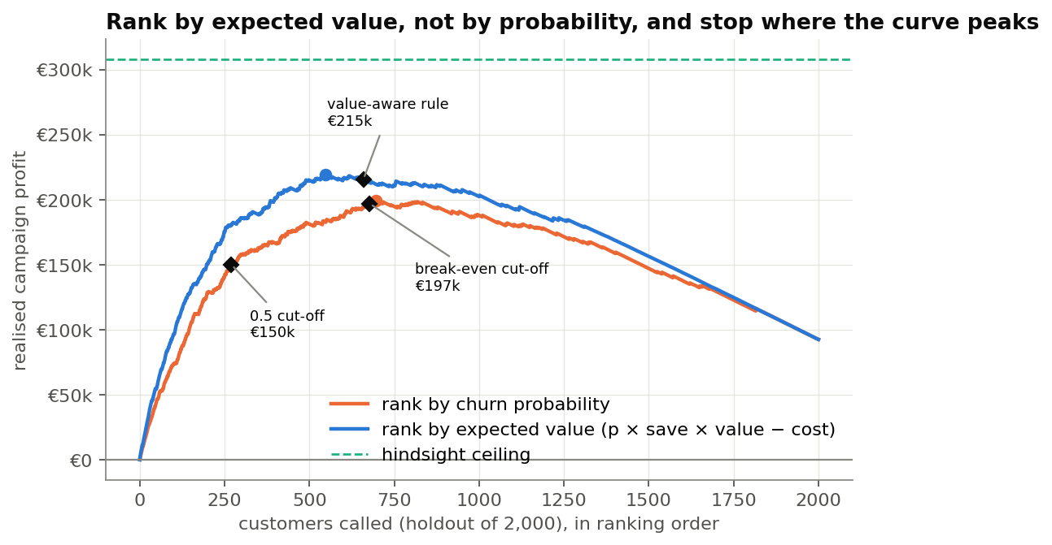
Rank by expected value, not by probability, and stop where the curve peaks
• Ranking by expected value peaks at €219k after 546 calls
• Ranking by probability peaks at €199k after 695 calls
• The rule stops near the peak without seeing outcomes
• Top 20% of customers hold 67% of expected value lost
Notes:
If you call customers in order and track realised profit, ranking by expected value beats ranking by probability everywhere, and peaks higher with fewer calls. The value-aware rule lands near that peak without having seen who churned, because it stops exactly where the next call's expected gain turns negative. Value at risk is concentrated: a fifth of customers hold two thirds of it.

Slide 9
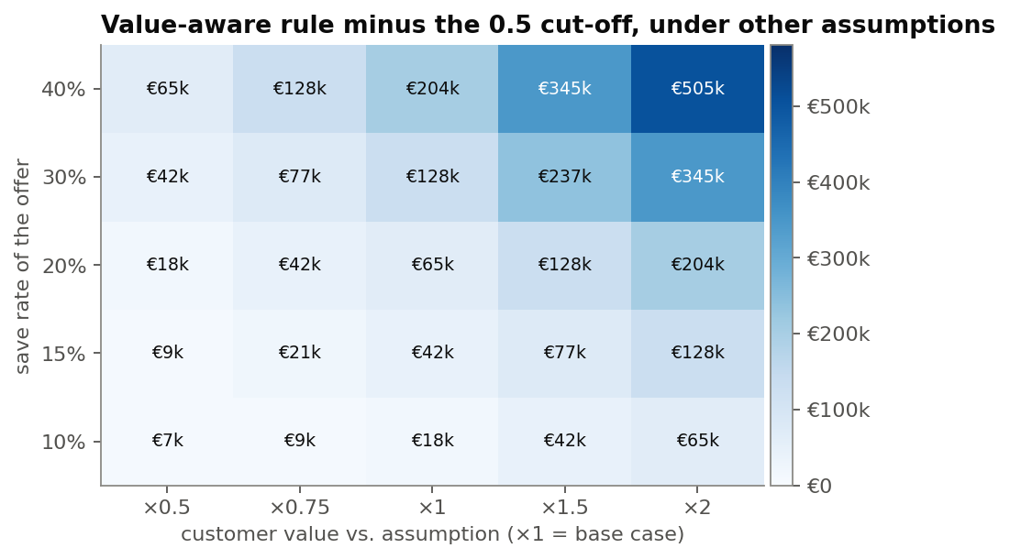
The rule wins under every assumption tested; only the size of the win moves
• 25 scenarios: save rate 10–40% × customer value ×0.5–×2
• Gain over the 0.5 cut-off: €7k to €505k, never negative
• Only save rate × value matters, so a client estimates one number
• Lead with the direction, give the size as a range
Notes:
The money rests on assumptions, so I swept the two most uncertain. The value-aware rule beats the 0.5 cut-off in all 25 scenarios. The size of the gain depends on the assumptions; the direction does not. The grid repeats along its diagonals because the rule only uses save rate times value, which simplifies the conversation with a client: they only need to estimate one number.

Slide 10
What I'd do: change the rule now, prove the save rate with a test
1. Switch to the value-aware rule: +43% campaign profit, no new model
2. Split the call list by persona: different scripts, different offers
3. Send 3+ product customers to the product team
4. Randomised test: ~580 customers per arm to detect a 20% cut in churn
5. If model-risk sign-off binds, ship the scorecard (−0.015 AUC)
Notes:
The recommendation is in that order on purpose. The rule change is free and is worth the most. Personas turn one call list into three playbooks. The 3+ product group is a root-cause question. The test matters because everything rests on the assumed 20 percent save rate, and because it is the only way to learn whether the call causes retention, which SHAP cannot tell us. With roughly 39 percent churn among targeted customers, about 580 per arm detects a 20 percent relative reduction.

Slide 11
Limitations: the money is modelled, the data is a snapshot
• Value, cost and save rate are assumptions; direction robust, size not
• No dates: cannot rule out timing leakage or model when customers leave
• SHAP and personas are associations, not causes
• 3–4 product group is 326 customers; cause unknown from this data
• Not the competition file: absolute AUCs differ from the source's 0.93
Notes:
The honest limits. The euro figures are a model of the economics, which is why I lead with the sensitivity analysis. The data has no timestamps, so a production version would need point-in-time features. The personas describe the model, not causes. And because I used the clean public parent rather than the competition file, the AUCs are not comparable to the source's leaderboard number. Every comparison inside the project is like for like.

Slide 12
Appendix: what reproducing the source notebook turned up
• Evaluates at 0.5 only; no decision layer
• SHAP on standardised features; 'more products → more churn' misread
• Optuna commented out, ROC still labelled 'Optimized'; subsample no-op
• Dependence-plot text describes Age, code plots EstimatedSalary
• No intervals, paired tests or calibration; gender unexamined
Reproduce: python run_analysis.py · github.com/Cena-S/bank-churn-retention-targeting
Notes:
If asked what I thought of the source: it is a clean, standard pipeline, and none of these issues is unusual for a competition notebook. But most of them would matter in front of a client, and the first one, stopping at a 0.5 cut-off, is worth 65 thousand euros per two thousand customers here. Everything regenerates from one command, and the notebook asserts every number quoted in its prose.

