Slide 1

Lost Souls:
Mapping the Haunted Connections
Jared Pavlik
Peiwen Chiu
Richard Wallace

Slide 2

Motivation
Halloween heightens interest in haunted locations, as the thrill of the supernatural draws in those eager for paranormal experiences. To tap into this excitement, we’re combining data on haunted sites with geographic information, identifying nearby landmarks such as hospitals, cemeteries, and historic sites. This approach offers an immersive, location-based guide for those seeking eerie, mysterious spot close to home.

Slide 3

Objective
Develop a user-friendly webpage where individuals can explore potential haunted sites and discover connections between them. The core feature is an interactive map showcasing reported haunted locations across Kansas, along with their proximity to notable landmarks. This map enables users to visualize potential correlations between haunted locations and sites often linked to paranormal activity, offering an immersive experience for those seeking eerie encounters.

Slide 4

Data Gathering
Data Cleaning
Data Storage
JavaScript coding
HTML Coding
Data Conversion
Methodology
Kaggle
Google Places API
GIS shapefiles

Slide 5


Google Places API
Generate a grid of latitude and longitude points across Kansas, spaced every 50,000 meters.
Use these points to make API requests within a 50,000-meter search radius.
Collect and merge the results into a single CSV file.
GIS Shapefiles
Extracted tabular data from GIS shapefiles, data sources includes:
Kansas GIS Data Access & Support Center (DASC)
USGS – The National Map (TNM)
U.S. Census Data
Images: https://www.certa.ai/partners/google-places-api & https://www.iconfinder.com/icons/4577754/shp_file_format_icon

Slide 6
Data Gathering
Data Cleaning
Data Conversion
JavaScript coding
HTML Coding
Data Storage
Methodology
Kaggle
Google Places API
GIS shapefiles
Jupyter Notebook
ArcGIS Pro to isolate data specifically to KS
Encoding format
Removed duplicate records
Removed rows with blank data
Removed special characters
Data is stored in SQL database using PgAdmin
Jupyter Notebook was used to convert SQL tables to GeoJSON and JSON formats
Leaflet
Leaflet Heatmap Layer Plug in
D3.js
Turf.js

Slide 7
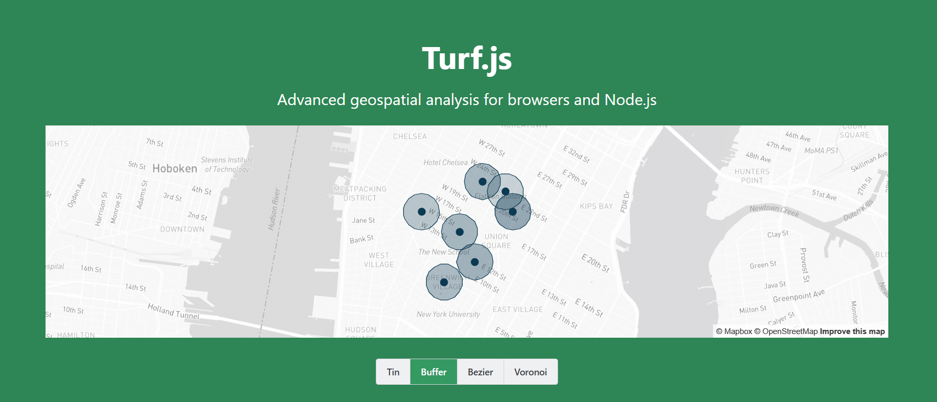

Slide 8
Data Gathering
Data Cleaning
Data Conversion
JavaScript coding
HTML Coding
Data Storage
Methodology
Kaggle
Google Places API
GIS shapefiles
Jupyter Notebook
ArcGIS Pro to isolate data specifically to KS
Encoding format
Removed duplicate records
Removed rows with blank data
Removed special characters
Data is stored in SQL database using PgAdmin
Jupyter Notebook was used to convert SQL tables to GeoJSON and JSON formats
Leaflet
Leaflet Heatmap Layer Plug in
D3.js
Turf.js

Slide 9
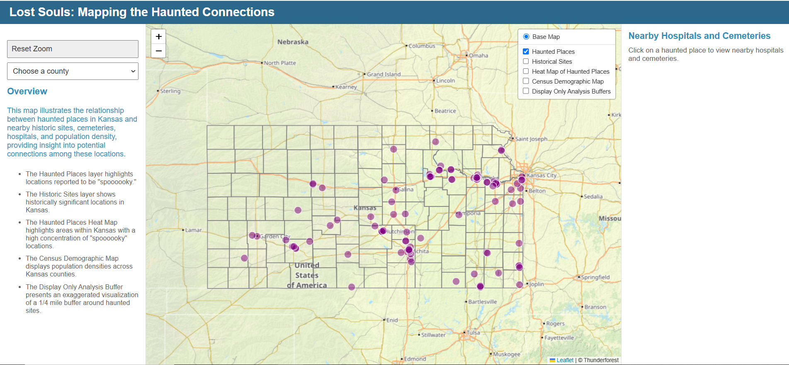
Website

