Slide 1
Data Science Persistency of a Drug Project
Exploratory Data Analysis

Slide 2
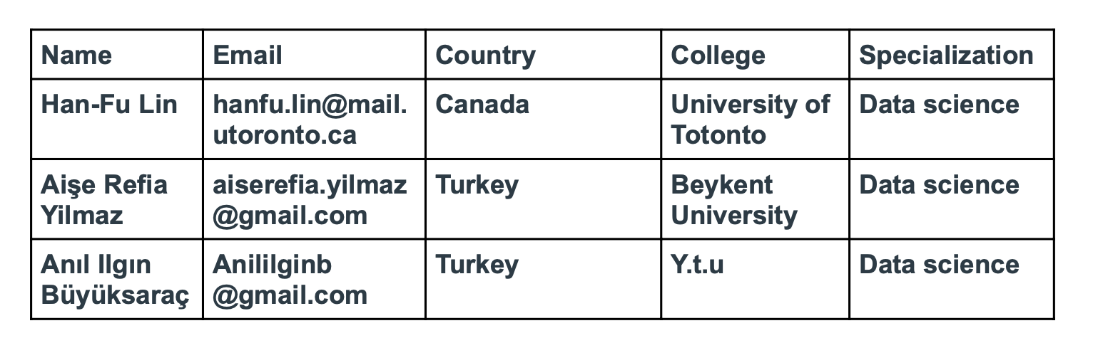

Slide 3
Includes
Data Analysis Approach
Problem Understanding
Data Preparation
Exploratory Data Analysis
EDA Summary
Model Building
Final Recommendation
Conclusion

Slide 4
Data Analysis Approach
One of the challenge for all Pharmaceutical companies is to understand the persistency of drug as per the physician prescription. To solve this problem ABC pharma company approached an analytics company to automate this process of identification.
Explore and Understand the data
Prepare and clean the data
Analyze the data
Find the features of drug persistency
Give recommendations

Slide 5
Problem Understanding
Since the data is very large, we know that ABC pharmaceutical company wants to run the whole process faster and to get precise results.
We have considered and measured many factors that do or do not affect permanence.

Slide 6

DATA PREPARATION
We used pandas library and Google Colab Notebook
Data was cleaned and prepared for analyzation.
Approaches:
From null and missing values.
Virtualization of data.

Slide 7
EXPLORATORY DATA ANALYSIS
The demographic data characteristics, gender, race, ethnicity, age, region etc are analyzed.
Many graphics used for visualization.
Some analyzes achieved very high accuracy rates.
As a result of the analyzes made, we got different outputs every week and saved them.

Slide 8
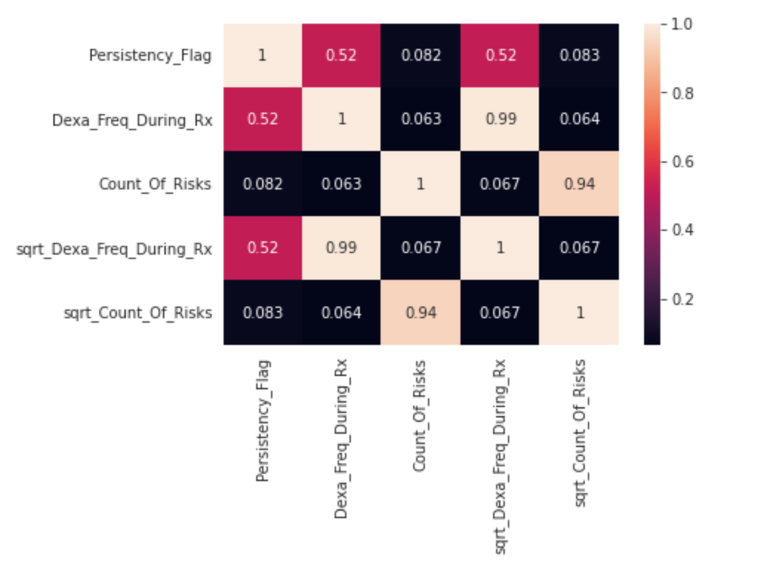
Heatmap

Slide 9
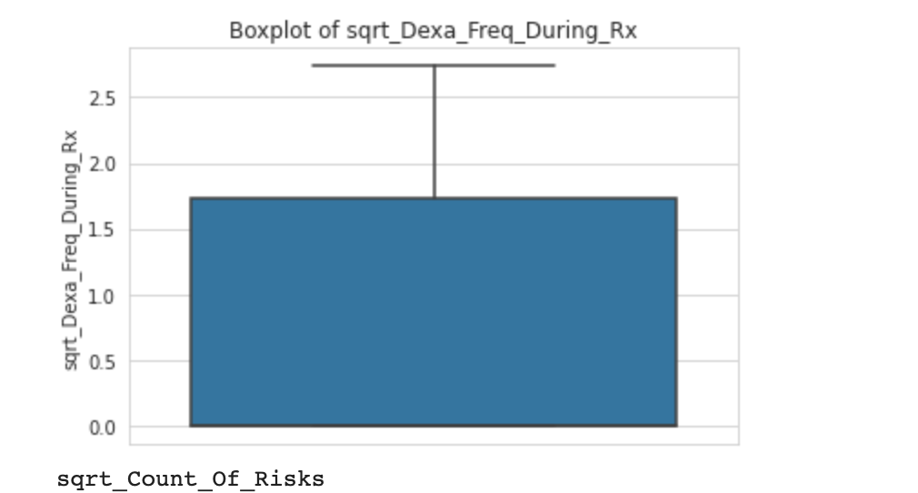
Outlier Test

Slide 10
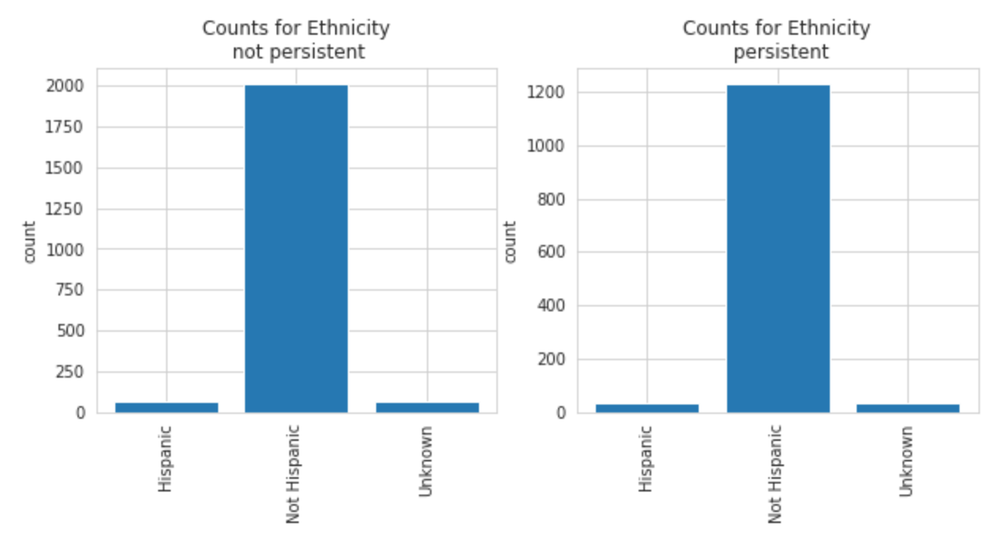

Slide 11
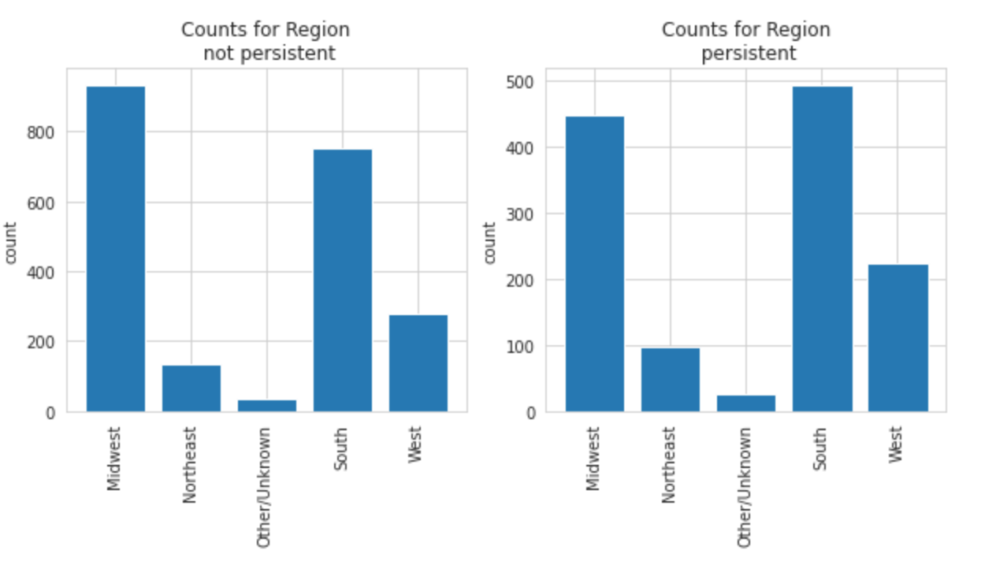
Persistency and Non-Persistent

Slide 12
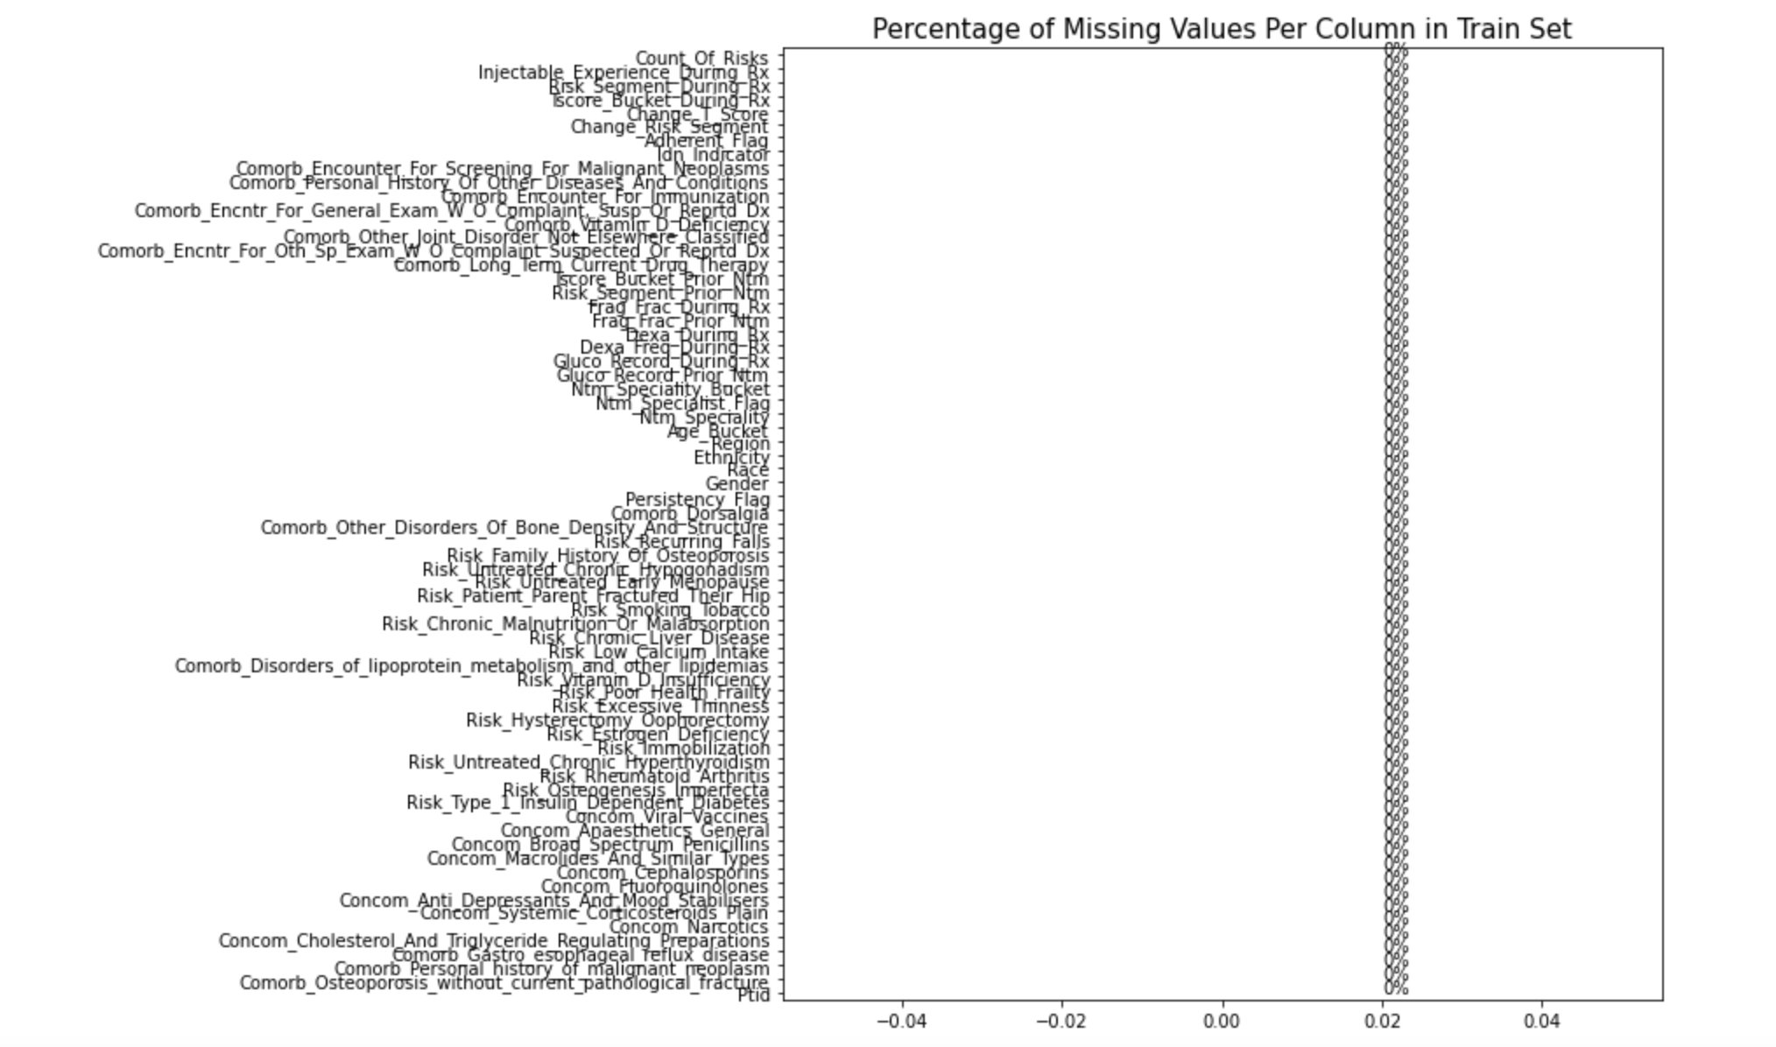

Slide 13
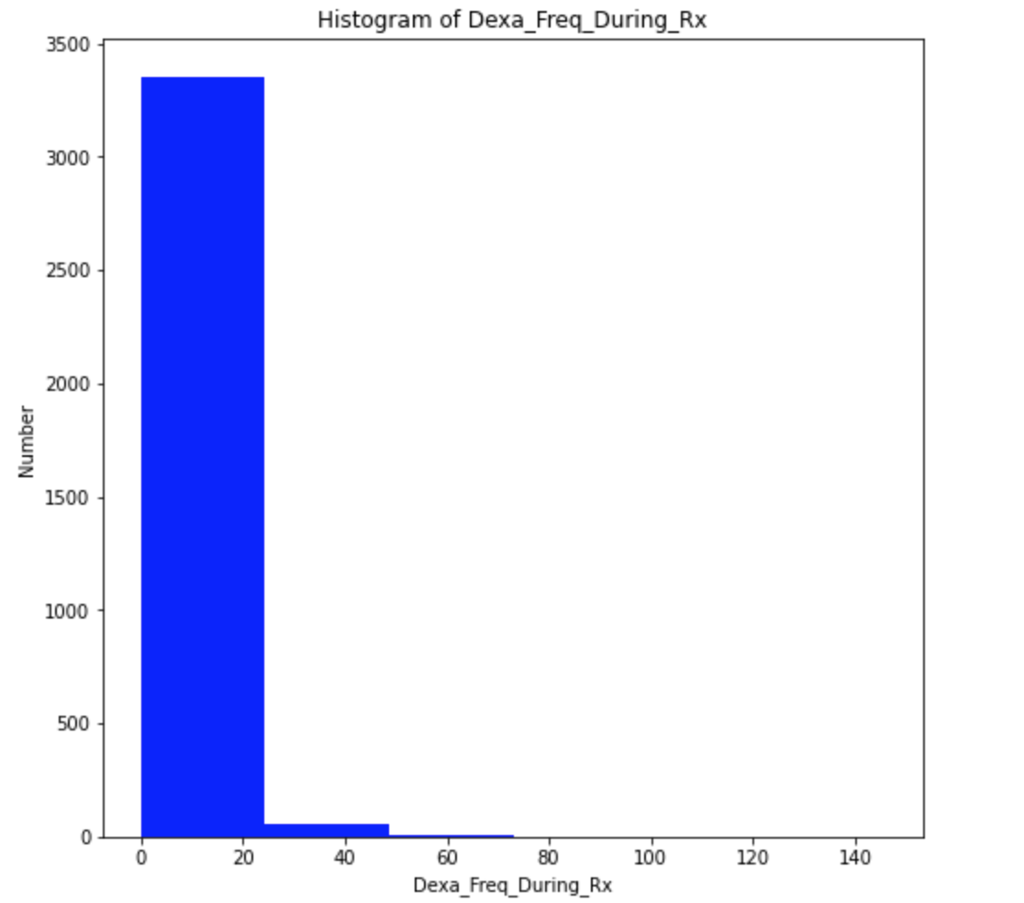
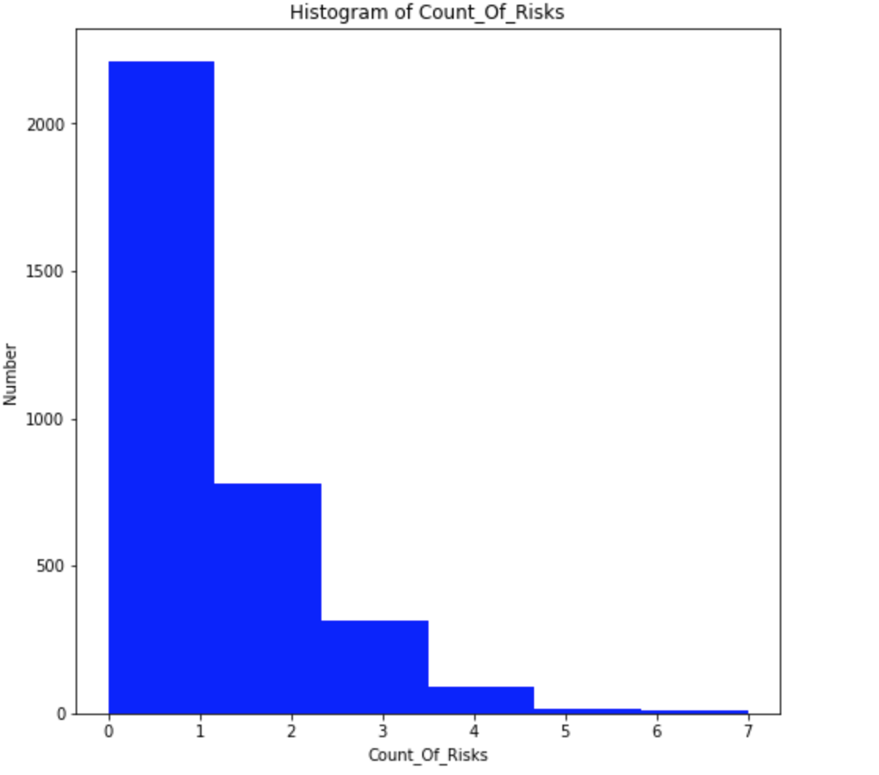
Skrewed Histogram

Slide 14
EDA Summary
We tried many ways to learn the permanence of the drugs on the patient, and as a result of the necessary analyzes, the effect of factors such as race, gender, origin was better understood. Apart from these, although there are many different factors, we achieved good results with a very good margin of precision as a result of the data we have.

Slide 15
Model Building
Categorical data were converted into numerical data.
Tree Classifier, Random Forest Classifier and LightGBM Classifier regression techniques were used.

Slide 16
Final Recommendation
The Random Forest Classifier model is the most suitable model because it has the highest accuracy rate.
It will give the best results in persistent and non-persistent drug effects compared to other models.

