Slide 1

Exploratory Data Analysis
<Data Science Persistency of a Drug Project>
<December 2022>

Slide 2
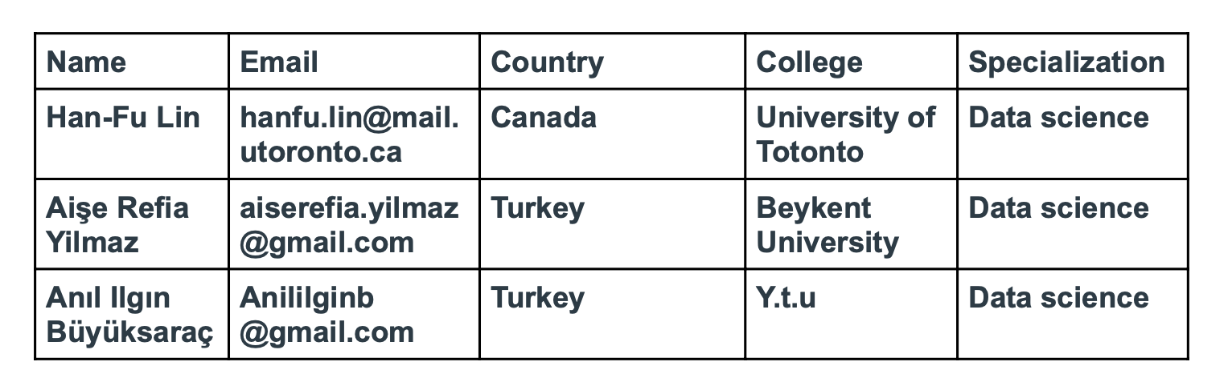
Group Details

Slide 3
Agenda
Data Analysis Approach
Problem Understanding
Business Understanding
Data Preparation and Understanding
Exploratory Data Analysis
EDA Summary
Model Selection and Development
Model Building
Final Recommendation
Conclusion

Slide 4
Data Analysis Approach
One of the challenge for all Pharmaceutical companies is to understand the persistency of drug as per the physician prescription.
To solve this problem ABC pharma company approached an analytics company to automate this process of identification.
Explore and Understand the data
Prepare and clean the data
Analyze the data
Find the features of drug persistency
Give recommendations

Slide 5
Problem Understanding
Since the data is very large, we know that ABC pharmaceutical company wants to run the whole process faster and to get precise results.
We have considered and measured many factors that do or do not affect permanence.
ML Problem:
With an objective to gather insights on the factors that are impacting the persistency, build a classification for the given dataset.

Slide 6
Business Understanding
All process algorithms based on:
Problem Model Solution

Slide 7
Task
Problem understanding
Data Understanding
Data Cleaning and Feature engineering
Model Development
Model Selection
Model Evaluation
Report the accuracy, precision and recall of both the class of target variable
Report ROC-AUC as well
Deploy the model
Explain the challenges and model selection

Slide 8
DATA PREPARATION and UNDERSTANDING
We used pandas library and Google Colab Notebook
Data was cleaned and prepared for analyzation.
Approaches:
Number of NA values and missing values.
Outliers and Skewed.
Virtualization of data

Slide 9
EXPLORATORY DATA ANALYSIS
We analyzed gender, race, ethnicity, age, region, IDN Indicator values because demographic characteristics are personal and do not change.
We produced 'persistent and non-persistent of drug' histogram graphs of these properties.
Data variables are presented in Heatmap.
According to bar graph, the highest values are seen in the midwest and south parts of the region permanent and non-permanent drug.
On the ethnicity persistent and non-persistent bar graph, not hispanic is clearly ahead of unknown and hispanic.
As a result of the analyzes made, we got different outputs every week and saved them.

Slide 10
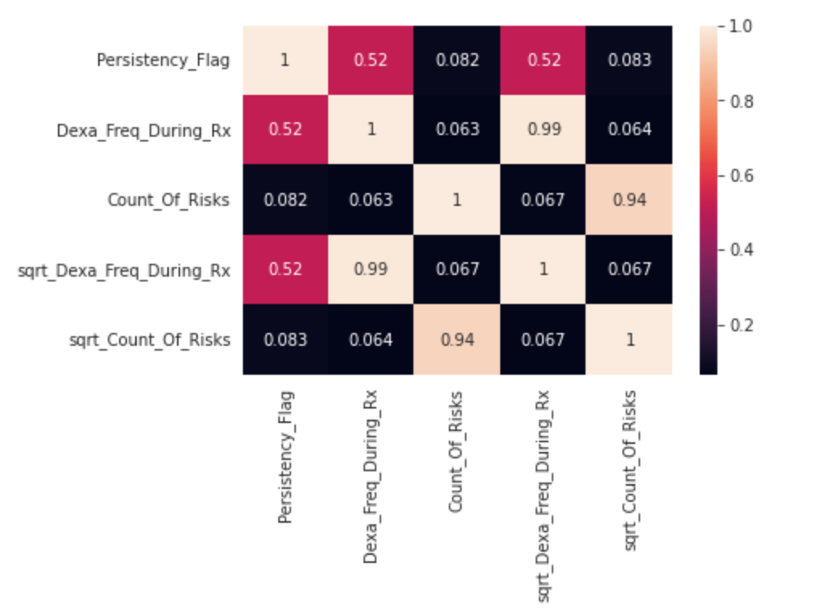
Heatmap

Slide 11
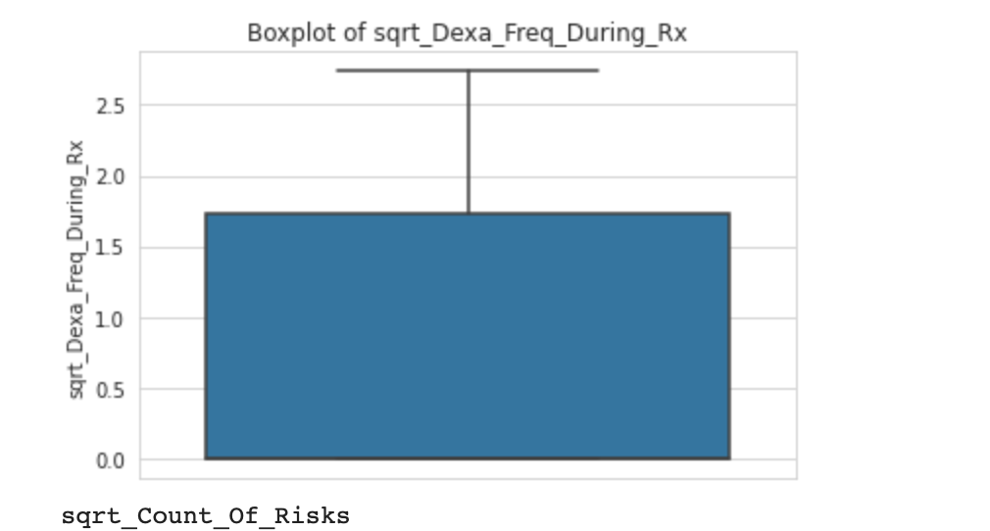
Outlier Test

Slide 12
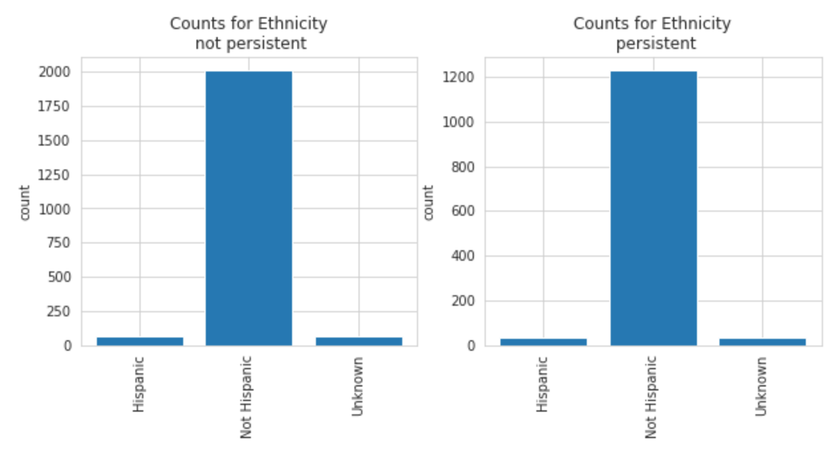
Although the values of the two graphs are different, they are quite similar in shape.

Slide 13
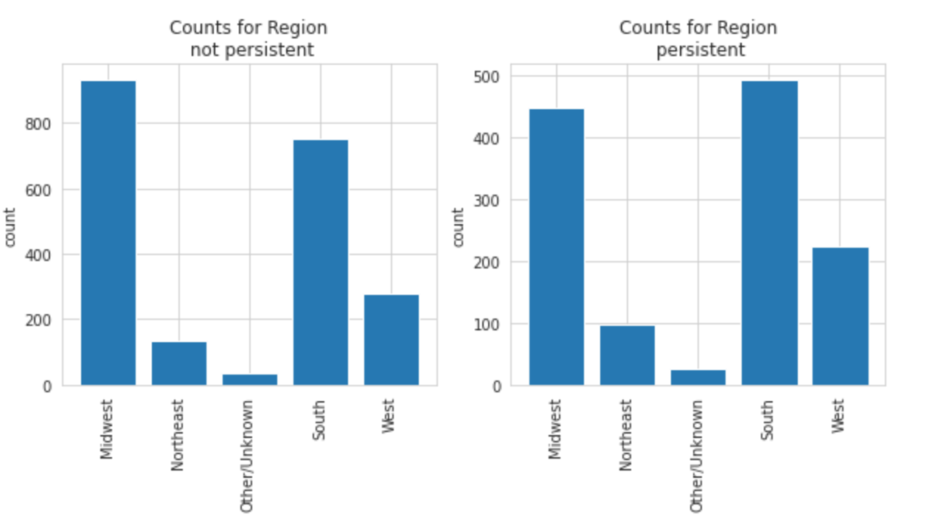
Persistency and Non-Persistent
There are not very big difference between each graph.

Slide 14
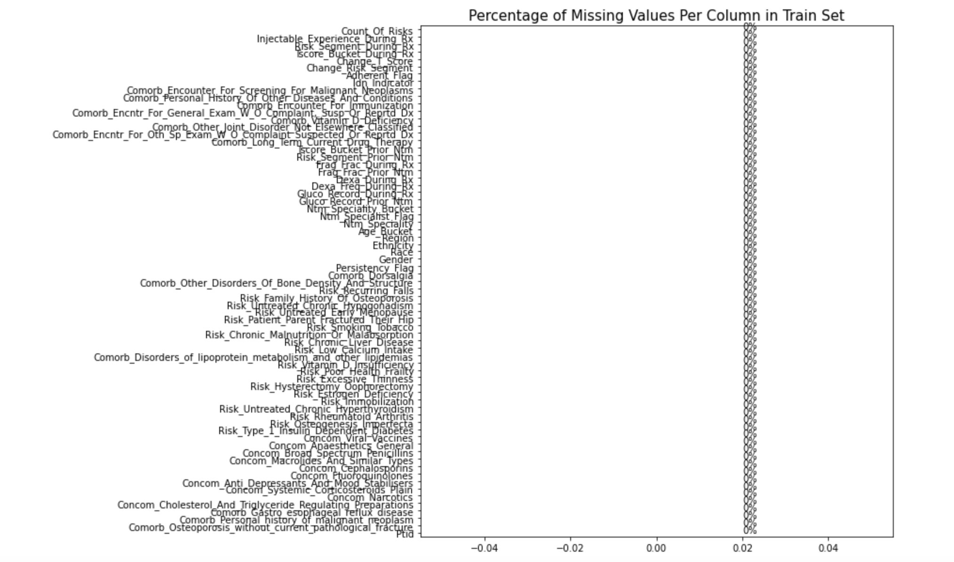

Slide 15
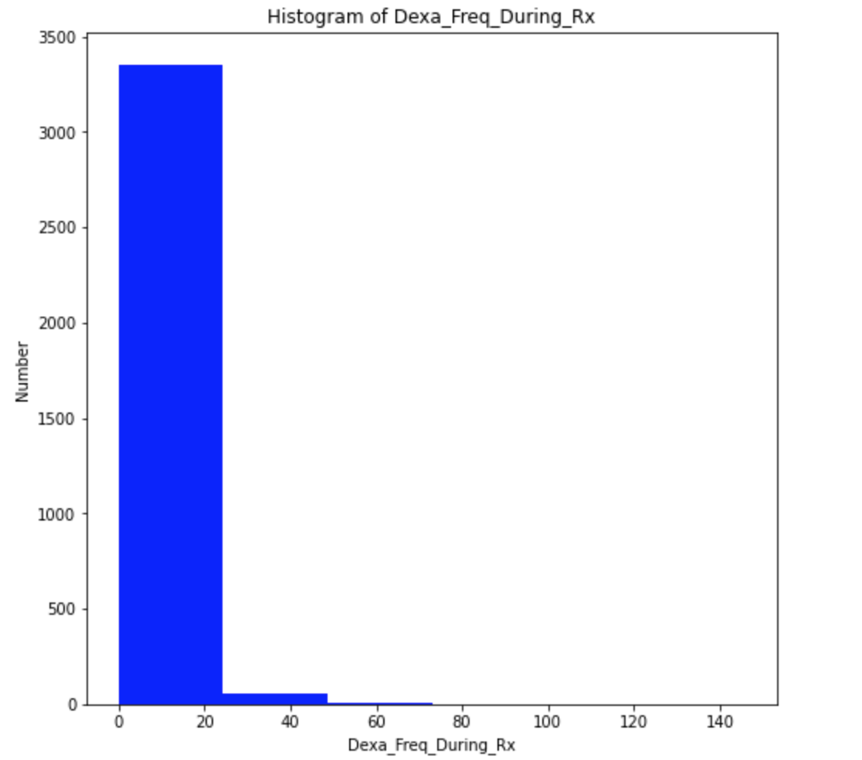
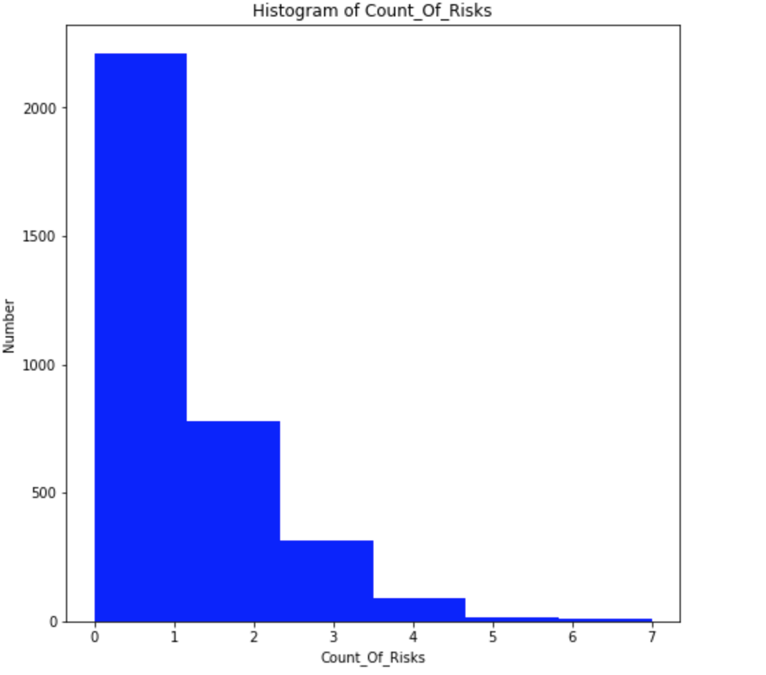
Persistency and Non-Persistent
Histogram of Dexa_Freq_During_Rx and Count_of_Risks are positively skewed distribution.

Slide 16
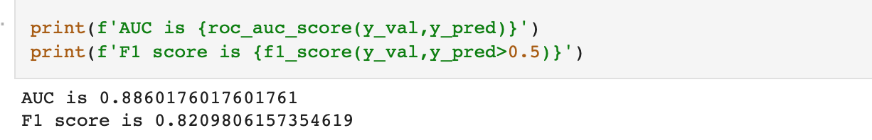
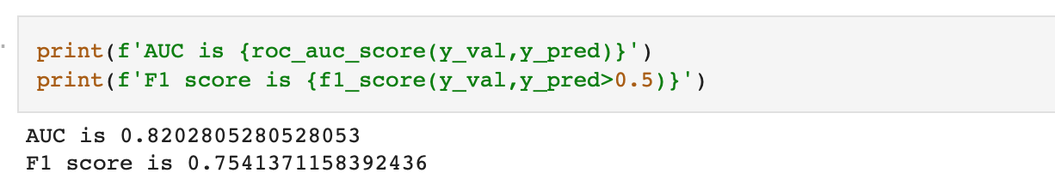
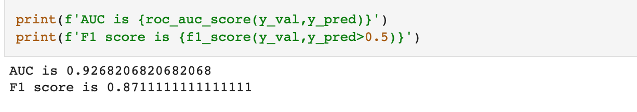
Model Selection and Development
Logistic Regression result
Decision Tree result
LightGBM result

Slide 17
Model Building
Categorical data were converted into numerical data.
Tree Classifier, Random Forest Classifier and LightGBM Classifier regression techniques were used.

Slide 18
EDA Summary
Although there are many different factors apart from the analyzes we have made with the data we have, the result we have obtained regarding drug permanence is very high.
There are two situations here. Firstly, this rate may decrease or increase with the data we do not have. Secondly, we can consider the 92 accuracy rate and values close to it.

Slide 19
Final Recommendation
The LightGBM model is the most suitable model because it has the highest AUC and F1 score.
It will give the best results in persistent and non-persistent drug effects compared to other models.

Slide 20
Thank You

