Slide 1
Photos Light
Hands-on

Slide 2
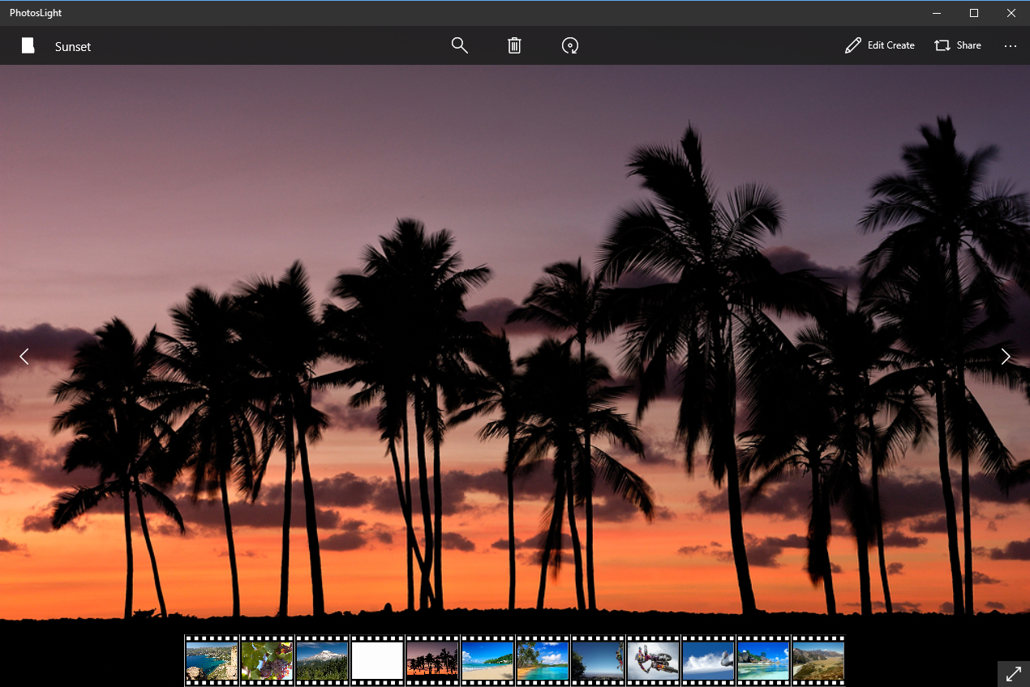
Notes:
This is what we’re creating – a photo viewer.

Slide 3
PhotosLight-Labb\PhotosLight-labb.sln Your starting point
PhotosLight.sln The goal

Slide 4
Display images and title Binding and DataTemplate
Add a FlipView to MainView
Create a binding between FlipView ItemSource and Thumbnails property
Create a DataTemplate to display an ImageViewerItem
Create a viewmodel property SelectedItem and bind it to the FlipView
Add CommandBar and add a TextBlock to commandBar content.
Add a binding to SelectedItem Title property
Notes:
<DataTemplate x:Key="ImageItemDataTemplate">
<Grid>
<Image Source="{Binding Source}" Stretch="UniformToFill"/>
</Grid>
</DataTemplate>

Slide 5
Display video content DataTemplateSelector
Create a DataTemplate to display a video
Create a ViewerDataTemplateSelector that inherit from DataTemplateSelector override SelectTemplateCore
Add the ViewerDataTemplateSelector to the page
Set the ItemTemplateSelector of the FlipView
public class ViewerDataTemplateSelector : DataTemplateSelector { public DataTemplate ImageTemplate{ get; set; } public DataTemplate VideoTemplate { get; set; } protected override DataTemplate SelectTemplateCore(object item, DependencyObject container) { var image = item as ImageViewerItem;
if (image != null)
return ImageTemplate;
else
return VideoTemplate;
}
}
Notes:
<DataTemplate x:Key="VideoItemDataTemplate">
<Grid>
<MediaElement AreTransportControlsEnabled="True" Source="{Binding Source}" Stretch="UniformToFill"/>
</Grid>
</DataTemplate>
<Page.Resources>
< ViewerTemplateSelector x:Name=”ViewerTemplateSelector"
ImageTemplate="{StaticResource ImageViewerDataTemplate}"
VideoTemplate="{StaticResource VideoDataTemplate}" />
</Page.Resources>
<FlipView ItemsSource="{x:Bind ViewModel.Thumbnails}" ItemTemplateSelector="{StaticResource ViewerTemplateSelector}" />

Slide 6
Add a Filmstrip to bottom of the page
Add a ListView to bottom of the page
Bind ItemSource to Thumbnail and bind SelectedItem
Create a dataTemplate to display a image
Change ItemTemplate on ListView so content is displayed horizontally.
Notes:
<ListView x:Name="listView" HorizontalAlignment="Center" ScrollViewer.HorizontalScrollMode="Enabled" ScrollViewer.HorizontalScrollBarVisibility="Visible" ScrollViewer.IsHorizontalRailEnabled="True" ItemTemplate="{StaticResource ImageFilmStripItemDataTemplate}" SelectedItem="{x:Bind ViewModel.SelectedObject, Mode=TwoWay}" ItemsSource="{x:Bind ViewModel.Thumbnails}" Grid.Row="1" VerticalAlignment="Bottom" ItemsPanel="{StaticResource ItemsPanelTemplate}" ItemContainerStyle="{StaticResource ListViewItemStyle1}" Margin="50,0" />
<ItemsPanelTemplate x:Key="ItemsPanelTemplate">
<ItemsStackPanel Orientation="Horizontal" />
</ItemsPanelTemplate>

Slide 7
Add a Button to toggle fullscreen mode
Add a FullScreenCommand property to ViewModel
Add and bind a Button to the command
Add a VisualState to change icon. Use a VisualStateTrigger
private void ToggleFullScreenMode()
{
var view = ApplicationView.GetForCurrentView();
if (view.IsFullScreenMode)
{
view.ExitFullScreenMode();
ApplicationView.PreferredLaunchWindowingMode = ApplicationViewWindowingMode.Auto;
}
else
{
if (view.TryEnterFullScreenMode())
{
ApplicationView.PreferredLaunchWindowingMode = ApplicationViewWindowingMode.FullScreen;
}
}
}
Notes:
<Button x:Name="FullScreenButton" HorizontalAlignment="Right" Command="{x:Bind ViewModel.FullscreenCommnad}" VerticalAlignment="Bottom" Grid.Row="1">
<FontIcon x:Name="FullScreenFontIcon" Foreground="White" FontSize="20" FontFamily="{ThemeResource SymbolThemeFontFamily}" Glyph="&#xE1D9;" HorizontalAlignment="Center" MirroredWhenRightToLeft="True" UseLayoutRounding="False" VerticalAlignment="Center"/>
</Button>
<VisualStateGroup x:Name="FullScreenVisualStateGroup">
<VisualState x:Name="FullScreenState">
<VisualState.StateTriggers>
<StateTrigger IsActive="{x:Bind ViewModel.IsFullScreen,Mode=OneWay}"/>
</VisualState.StateTriggers>
<VisualState.Setters>
<Setter Target="FullScreenFontIcon.(FontIcon.Glyph)" Value="&#xE1D8;"/>
</VisualState.Setters>
</VisualState>
</VisualStateGroup>
public bool IsFullScreen { get { return ApplicationView.GetForCurrentView().IsFullScreenMode; } }
FullscreenCommnad = new DelegateCommand(() =>
{
ToggleFullScreenMode();
OnPropertyChanged(() => IsFullScreen);
});

Slide 8
Toggle Chrome On/Off
Bind Tapped event on FlipView
Add a property IsCromeOff
Toggle property
Add a VisualState with a VisualStateTrigger that binds to IsChromeOff
In the state change visibillity on Toolbar and Filmstrip
Notes:
FlipView Tapped="{x:Bind ViewModel.OnViewTapped}"
public void OnViewTapped(object sender, RoutedEventArgs e)
{
if (e.OriginalSource.GetType() == typeof(Image))
{
ToogleChrome();
}
}
<VisualStateGroup x:Name="ChromeStateGroup">
<VisualState x:Name="ChromeOn">
<VisualState.StateTriggers>
<StateTrigger IsActive="{x:Bind ViewModel.IsChromeOn,Mode=OneWay}"/>
</VisualState.StateTriggers>
<VisualState.Setters>
<Setter Target="listView.(UIElement.Visibility)" Value="Visible"/>
<Setter Target="commandBar.(UIElement.Visibility)" Value="Visible"/>
</VisualState.Setters>
<Storyboard>
<DoubleAnimation Storyboard.TargetProperty="Opacity" Storyboard.TargetName="commandBar" From="0" To="1.0" Duration="0:0:0.2"/>
<DoubleAnimation Storyboard.TargetProperty="Opacity" Storyboard.TargetName="listView" From="0" To="1.0" Duration="0:0:0.2"/>
</Storyboard>
</VisualState>
<VisualState x:Name="ChromeOff">
<VisualState.StateTriggers>
<StateTrigger IsActive="{x:Bind ViewModel.IsChromeOff, Mode=OneWay}"/>
</VisualState.StateTriggers>
<Storyboard>
<DoubleAnimation Storyboard.TargetProperty="Opacity" Storyboard.TargetName="commandBar" To="0" Duration="0:0:0.2"/>
<DoubleAnimation Storyboard.TargetProperty="Opacity" Storyboard.TargetName="listView" To="0" Duration="0:0:0.2"/>
<ObjectAnimationUsingKeyFrames Storyboard.TargetProperty="Visibility" Storyboard.TargetName="commandBar">
<DiscreteObjectKeyFrame KeyTime="0:0:0.2" Value="Collapsed"/>
</ObjectAnimationUsingKeyFrames>
<ObjectAnimationUsingKeyFrames Storyboard.TargetProperty="Visibility" Storyboard.TargetName="listView">
<DiscreteObjectKeyFrame KeyTime="0:0:0.2" Value="Collapsed"/>
</ObjectAnimationUsingKeyFrames>
</Storyboard>
</VisualState>
</VisualStateGroup>

