Slide 1
Steps to Enroll a New Blacklisted Person

Slide 2
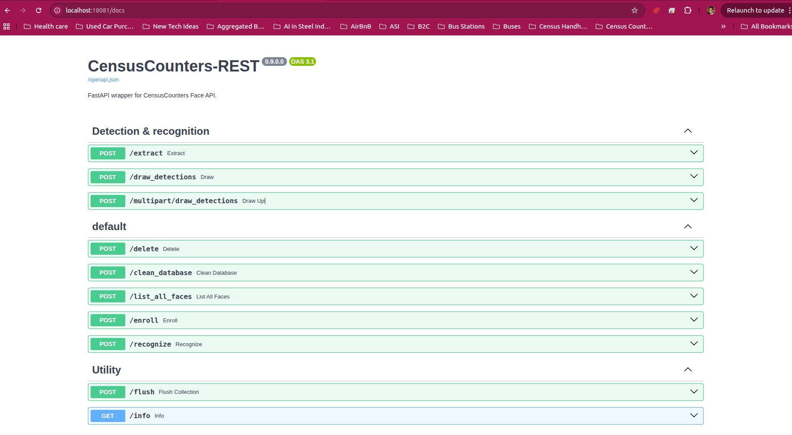
Go to http://localhost:18081

Slide 3
Click on /enroll

Slide 4
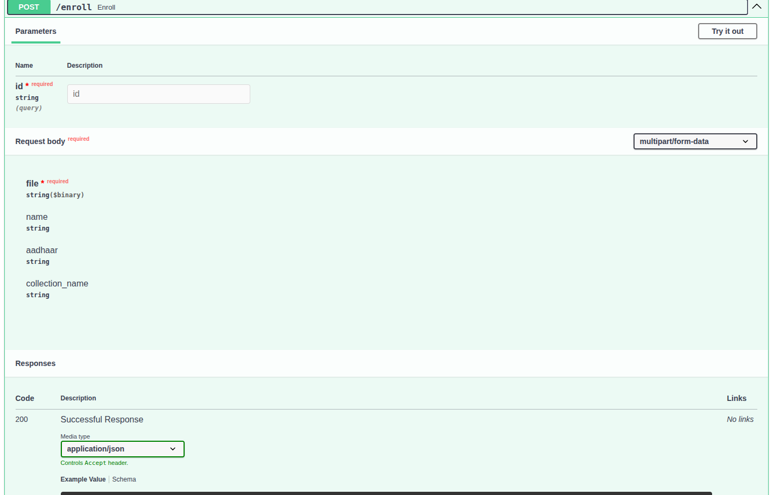
Click on Try it Out

Slide 5
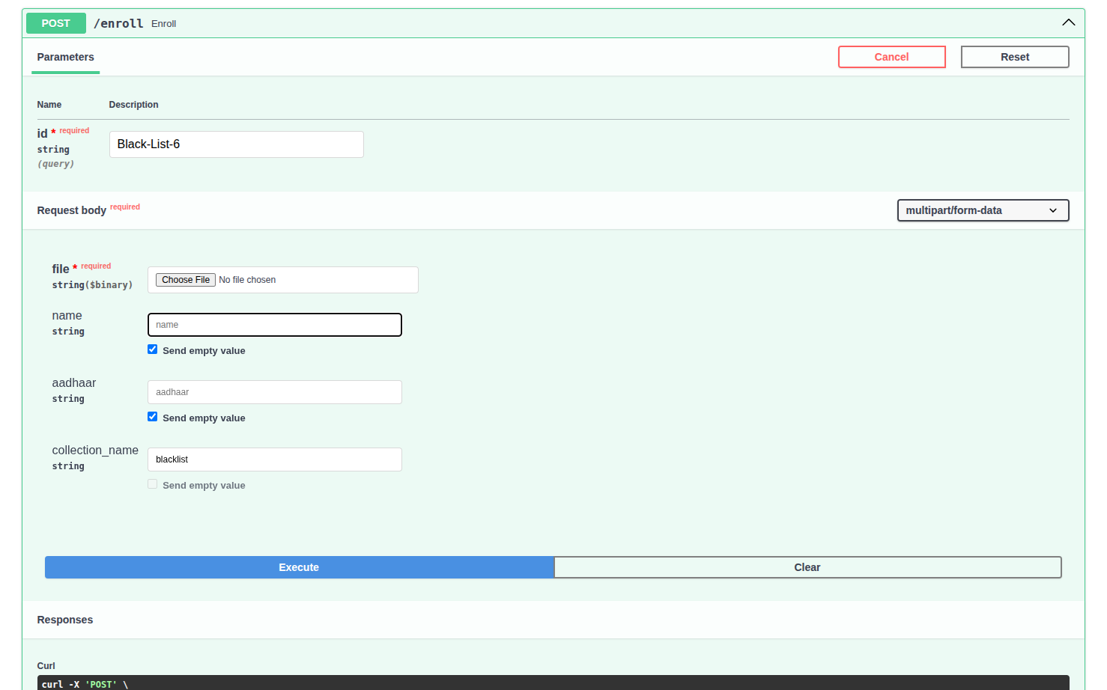
Fill the Person Details, Upload Image file, and Click Execute. The collection name should be blacklist in lower case. Rest all should be unique values

Slide 6
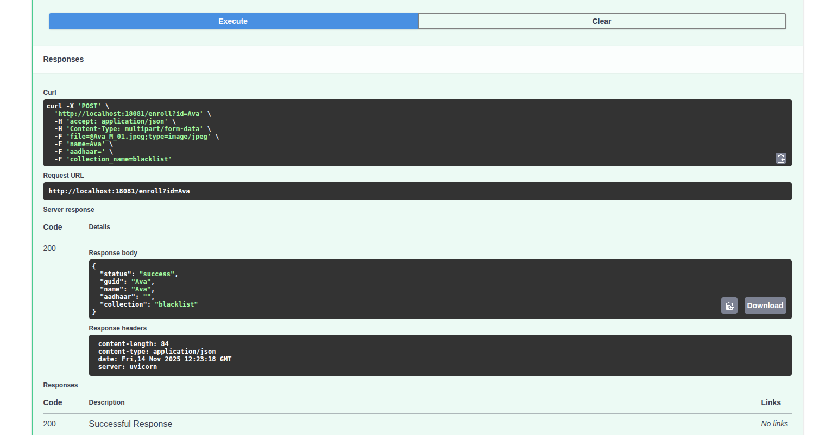
Scroll Down to check the response. It should show status:success and the rest of the fields you have added.

Slide 7
Repeat Steps in Slides 5 and 6 for any new person to be enrolled as a blacklisted

Slide 8
Click on /flush to finish enrollment

Slide 9
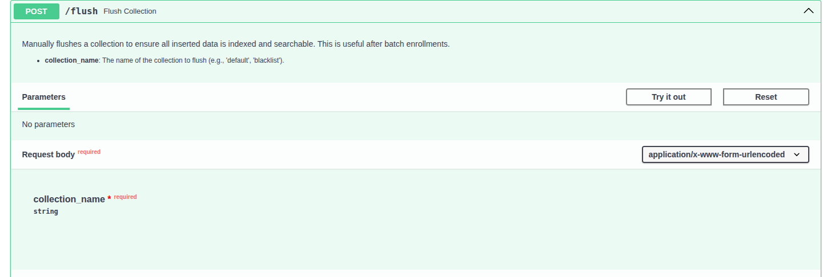
Click on Try it Out

Slide 10
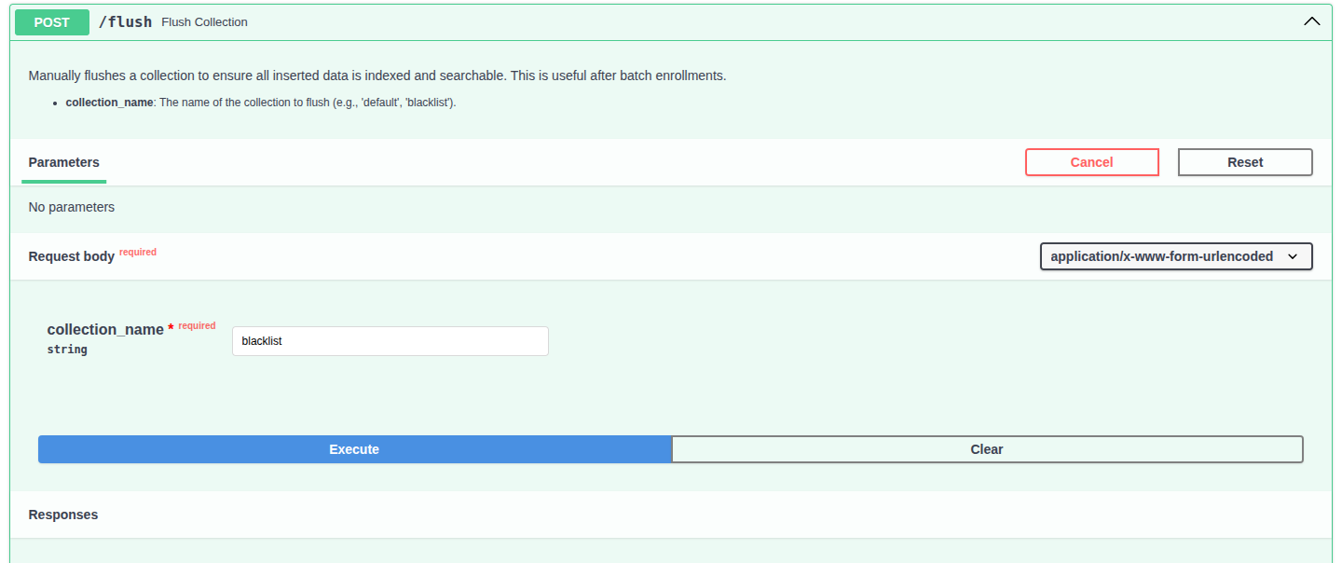
Add blacklist to the collection_name and Click Execute

Slide 11
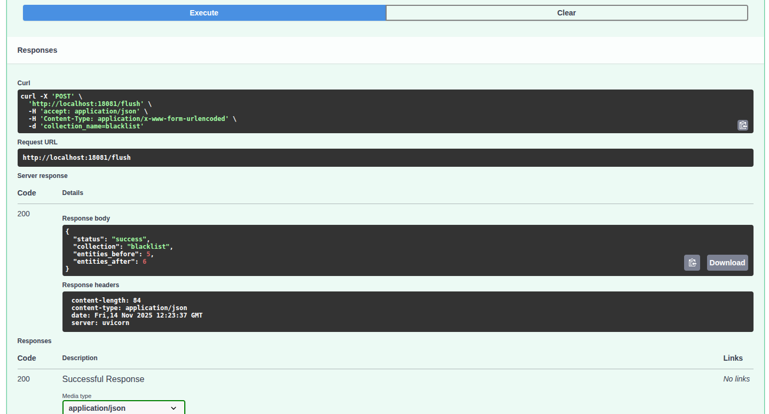
Check Responses to ensure status:success. entities_before and entities_after should match the number enrolled.

Slide 12
End
For questions, call Manish at 9078877329

