Slide 1
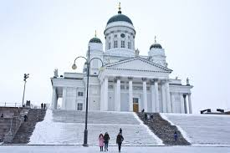
Hello
This is a sample
This is a sub text
Capital of Finland is Helsinki
Helsinki has population of 1 million
This is a new text

