Slide 1
CUDA Interception - Alnair vGPU device plugin
Date: Nov 18, 2021
Centaurus AI SIG
Futurewei Technologies, Inc.

Slide 2
Motivations
Share a single GPU among multiple applications(Containers, VMs)
Particularly good for deep learning inference workload.
Need to enforce on GPU memory limit, otherwise processes that share the same GPU could randomly fail due to OOM.
Multiple approaches:
a) PCIe passthrough (for VM, no sharing)
b) SR-IOV (for VM, and AMD GPU)
c) Mediated passthrough (for VM and Intel GPU)
d) API interception: CUDA, OpenGL etc. (VM and container)

Slide 3
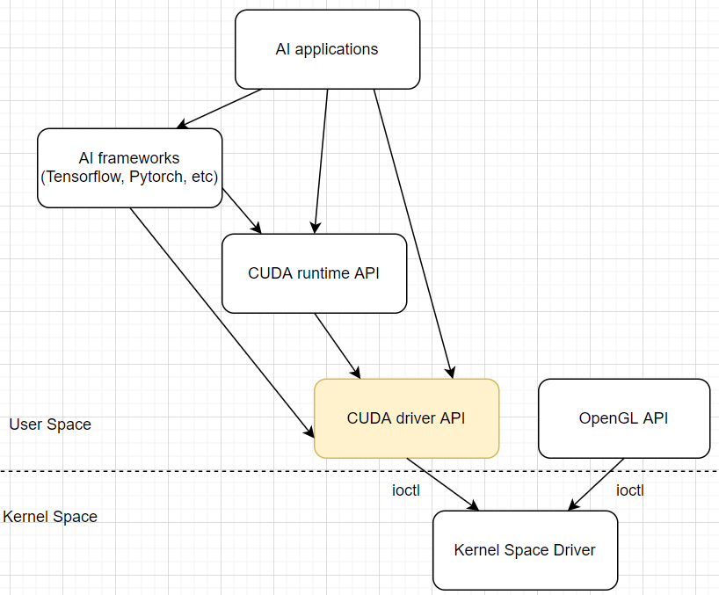
CUDA interception – where does it sit?

Slide 4
How to intercept – LD_LIBRARY_PATH ?
Straight forward, robust, but somewhat intrusive to user environment.
Create a shared library, overwrite all the relevant libcuda.so, libcudart.so, libnvidia-ml.so etc. Make LD_LIBRARY_PATH point to the intercept library instead of system libraries.
Incompatible with official Nvidia docker runtime, which also uses LD_LIBRARY_PATH. So has to use runc and reinvent the wheel.
All the symbols exported by these Nvidia user space libraries need to be intercepted. But only less than 20 API functions are necessary -- all others are just passthrough.

Slide 5
LD_PRELOAD trick
Less intrusive, a single intercept library, no need to overwrite Nvidia libraries in the system folder.
Compatible with Nvidia docker runtime.
However, challenging blockers encountered to make it work or robust (scratch my head!):
a) Two ways to make a library function call:
1) res = cuMemAlloc(ptr, size);
2) h = dlopen(“/lib/libcuda.so”, RTLD_LAZY);
cumemalloc = dlsym(h, “cuMemAlloc”);
res = (*cumemalloc)(ptr, size);
b) Segmentation faults!

Slide 6
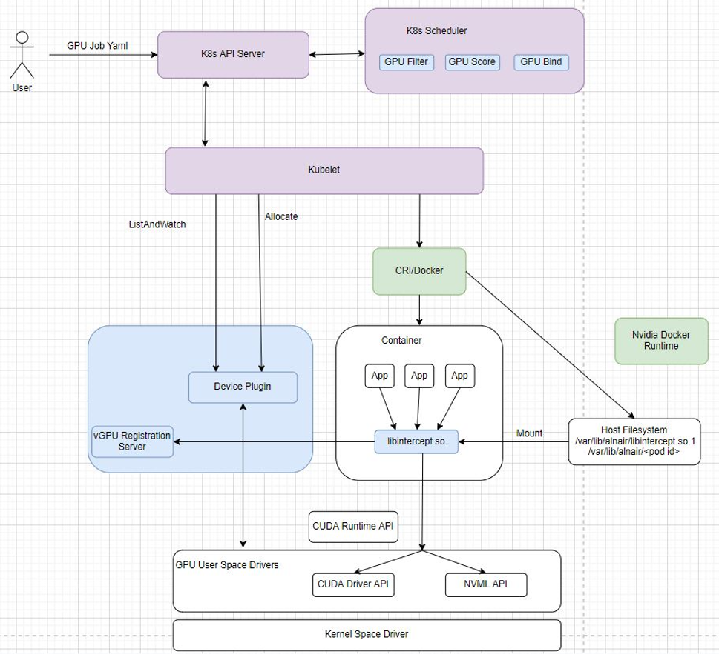
Alnair vGPU device plugin

