Slide 1
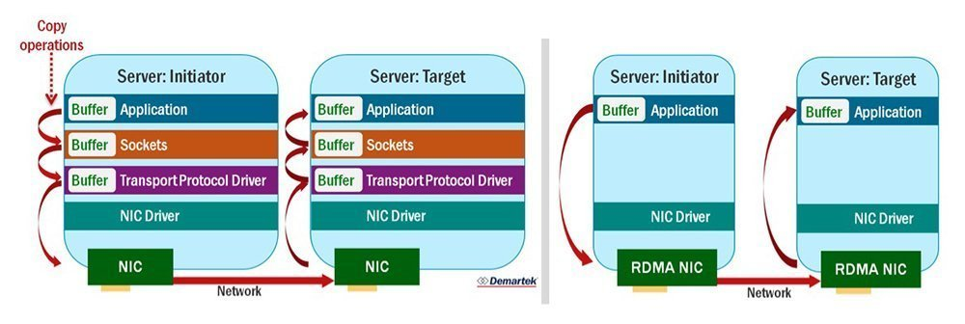
RDMA at a glance

Slide 2
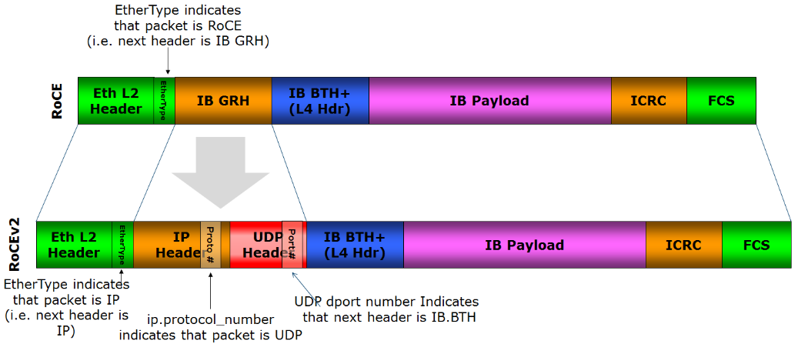
Technologies/Protocols that implements RDMA
Infiniband
RDMA over Converged Ethernet (RoCE) Also called InfiniBand over Ethernet (IBoE).
iWARP RDMA over TCP/IP networks

Slide 3
Infiniband
At the core is a messaging service
Specific network adapter called HCA (Host Channel Adapter).
A channel is created for each pair of communicating parties.
Each endpoint of a channel contains a Queue Pair (QP).
Software API is called OFED (Open Fabrics enterprise Distribution)

Slide 4
Infiniband relies on lossless flow control
TCP handles packet loss, congestion control for normal IP traffic.
For infiniband, lossless and congestion control happen at link layer. Therefore a special adapter (HCA) is needed.
Infiniband and RoCE uses different mechanisms for link layer flow control: https://en.wikipedia.org/wiki/RDMA_over_Converged_Ethernet

Slide 5
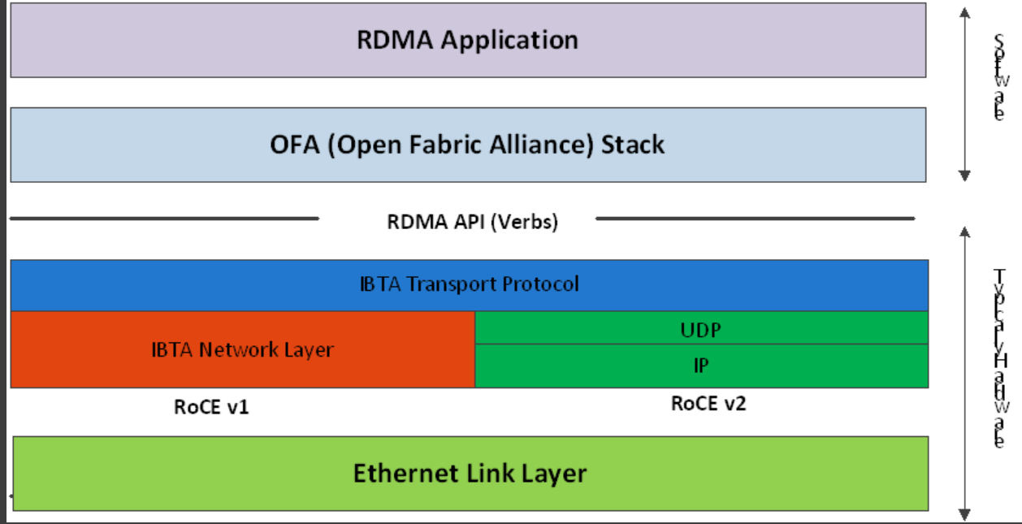
RoCE

Slide 6
Passive/Server Side program flow
Create an event channel
Bind to an address
Create a listener and return port/address
Wait for a connection request
Create a protection domain, completion queue, and send-receive QP.
Accept the connection request
Wait for the connection to be established
Post operations as appropriate

Slide 7
Active/Client Side program flow
Create an event channel
Create a connection id
Resolve the server address
Create a protection domain, completion queue and QP
Resolve the route to the peer
Connect
Wait for the connection to be established
Post operations as appropriate

Slide 8
Potential RDMA related acceleration in Alnair
Elastic training framework Alnair elastic training framework leverages MPI, which relies on efficient message passing between servers. MPI layer could use the infiniband RDMA messaging service instead of the sockets.
Deep learning training dataset storage RDMA’s zero copy feature and high throughput could make dataloader much faster. Nvidia GPUDirect even allows GPU memory to be accessed directly by NIC or storage drives.

Slide 9
References
https://www.techtarget.com/searchnetworking/definition/100-Gigabit-Ethernet-100GbE
https://en.wikipedia.org/wiki/RDMA_over_Converged_Ethernet
https://docs.nvidia.com/cuda/gpudirect-rdma/index.html
https://www.afs.enea.it/asantoro/V1r1_2_1.Release_12062007.pdf
https://network.nvidia.com/sites/default/files/related-docs/whitepapers/Intro_to_IB_for_End_Users.pdf
https://www.cs.mtsu.edu/~waderholdt/6430/papers/ibverbs.pdf
https://cw.infinibandta.org/document/dl/8566
https://www.mycloudwiki.com/san/converged-enhanced-etherne/
https://www.mycloudwiki.com/san/cee-functions/
https://community.fs.com/blog/fibre-channel-vs-ethernet-switch-what-are-the-differences.html
https://datacenteroverlords.com/2021/03/31/requiem-for-fcoe/
https://blog.ipspace.net/2022/05/fibre-channel-2022.html

Slide 10
More References
http://reports.ias.ac.in/report/12829/understanding-the-concepts-and-mechanisms-of-rdma
https://docs.nvidia.com/cuda/pdf/GPUDirect_RDMA.pdf
https://www.hpcwire.com/2021/09/27/enhancing-data-movement-for-gpus-with-nvidia-gpudirect-rdma-technology/
https://docs.nvidia.com/networking/pages/viewpage.action?pageId=19798092
https://support.mellanox.com/s/article/mellanox-linux-driver-modules-relationship--mlnx-ofed-x

