Slide 1
Elastic Training Framework

Slide 2
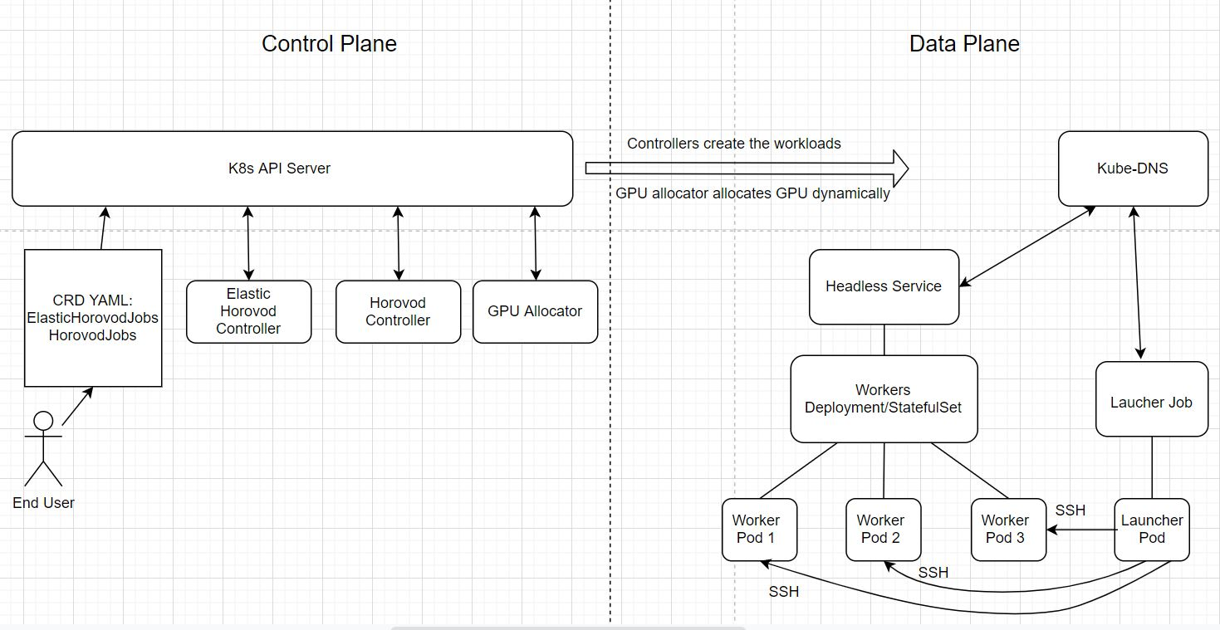
Overall Architecture

Slide 3
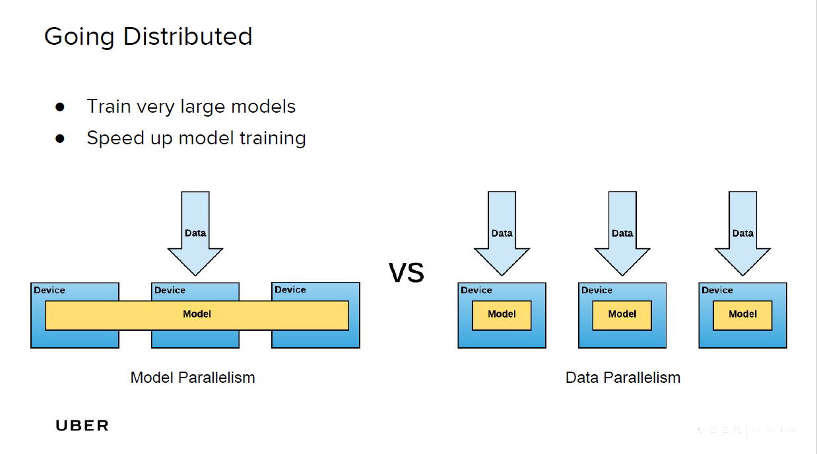

Slide 4
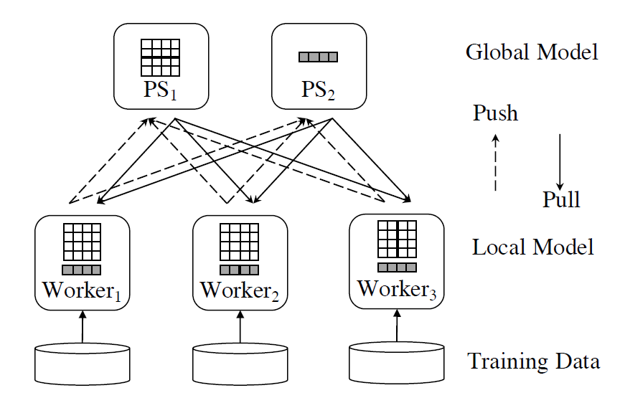
Parameter server (data parallelism)

Slide 5
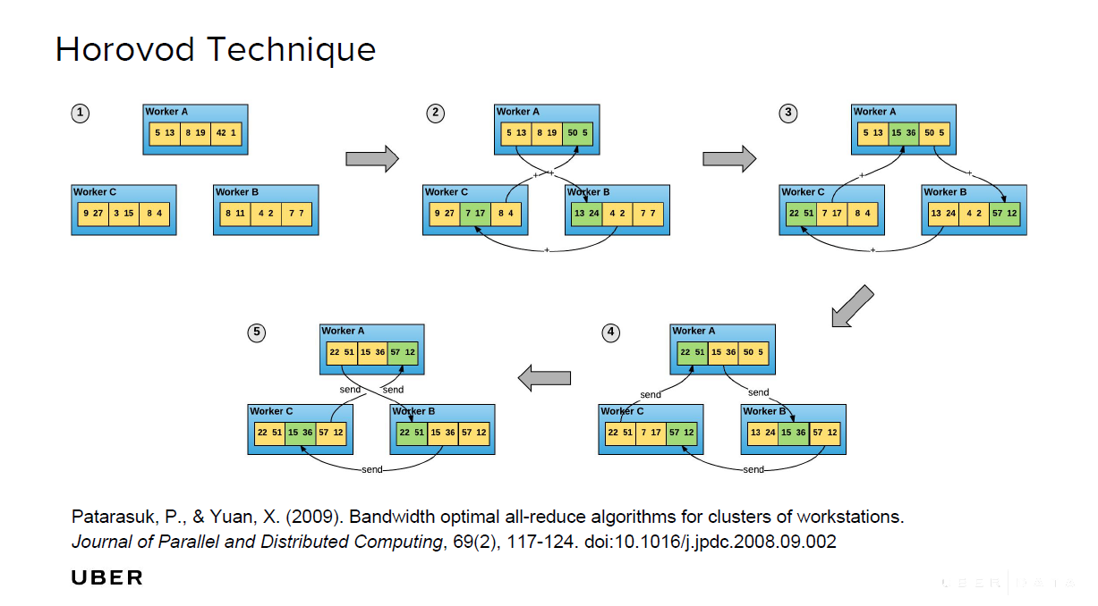

Slide 6
Elastic Horovod
https://horovod.readthedocs.io/en/stable/elastic_include.html
Scale up and down the number of workers dynamically at runtime, without requiring a restart or resuming from checkpoints saved to durable storage.
Fault tolerance.
Open up opportunities for dynamic scheduling of GPU to optimize GPU utilization and job completion time.

Slide 7
Elastic Training on Centaurus (Kubernetes)
Elastic training operator watches the CRUD of CRD (ElasticHorovodJob) objects.
GPU allocator (scheduler) allocates a number of GPUs for a specific job.
Once GPUs allocated, the elastic training operator creates a StatefulSet for the GPU workers and a Job to launch the training.

Slide 8
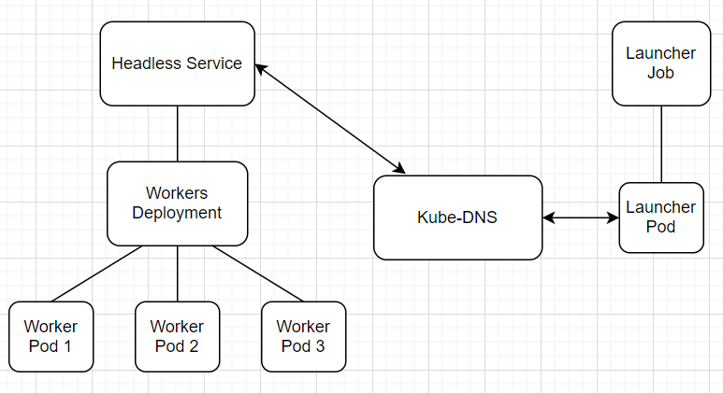
Host Discovery Mechanism

Slide 9
End user workflow
Write training scripts, build a docker image to encapsulate all the dependencies.
Write a <job name>.yaml file to create an ElasticHorovodJob CRD object, specifying the image created in step 1.
kubectl create -f <job name>.yaml

