Slide 1
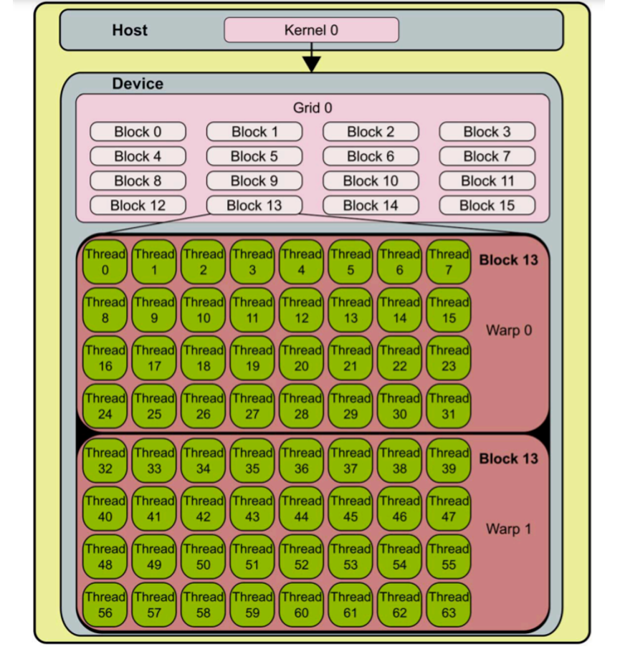

Slide 2
What is GPU utilization?
From Nvidia doc:
Percent of time over the past sample period during which one or more kernels was executing on the GPU.
https://stackoverflow.com/questions/40937894/nvidia-smi-volatile-gpu-utilization-explanation
https://stackoverflow.com/questions/5086814/how-is-gpu-and-memory-utilization-defined-in-nvidia-smi-results

Slide 3
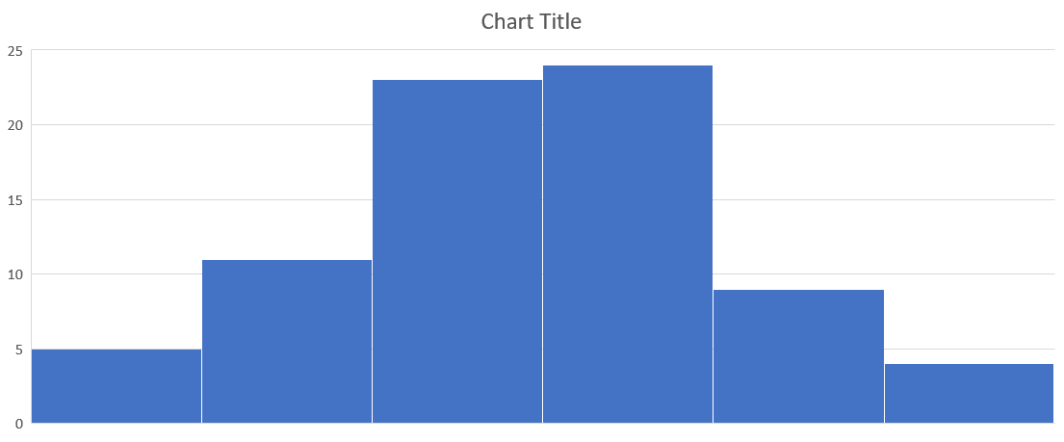
Ideal GPU compute metrics (in my mind)

Slide 4
GPU util is coarse
False positive: if the GPU util shows 100%, it might be just a single core is busy all the time – this will normally not happen because most GPU applications try to utilize as many cores in parallel as possible.
If the GPU util is low, then for sure the GPU is under utilized.
It’s a coarse metrics but still an okay indicator of how busy the GPU cores are.

Slide 5
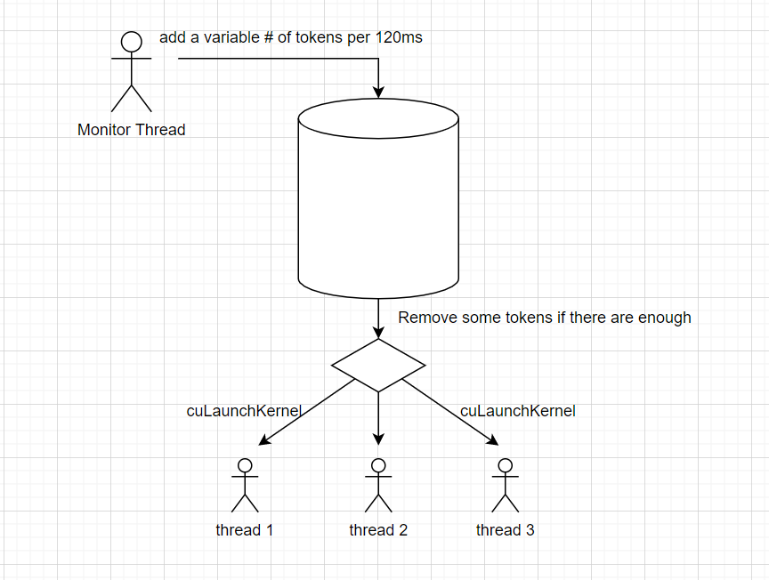
Gaia GPU compute algorithm

Slide 6
GaiaGPU compute algorithm
How many tokens to add per period?
How many tokens to remove for each cuLaunchKernel() call?
How large should the bucket size be?
How long the period should be?
How long should the thread wait if there are not enough tokens?

Slide 7
GaiaGPU compute continued
GPU utilization sort of acts as the “ground truth” that the algorithm is trying to track.
Grid size is the # of tokens to remove for each cuLaunchKernel()
But what about the block size, warp size?

