Slide 1
Arktos: Current Work and Next
Xiaoning Ding

Slide 2
Agenda
Background
Arktos
Features Overview
Current work
Next

Slide 3
CloudFabric Overview
Large-scale Cloud Platform: challenges and opportunities
Challenges : scalability; resource utilization, new workload types (containers & functions); new heterogenous hardware & high-speed network, etc.
Opportunities: new technologies in hardware and software, including hardware offloading, CPU QoS control, new networking capabilities in Linux kernel, etc.
CloudFabric: an open-source project group for large scale cloud platform
Arktos, computing platform, https://github.com/futurewei-cloud/arktos
Mizar, network data plane, https://github.com/futurewei-cloud/mizar
Alcor, network control plane, https://github.com/futurewei-cloud/alcor

Slide 4

Arktos: Overview
VM workloads
Container workloads
Serverless workloads
Unified Stack
Large Scalability
VM and containers share a same control plane.
VM and containers share a shared resource pool.
Built-in optimization for serverless functions.
Targeting at 100K nodes per cluster and 300K nodes per region
Make all components partitioned and replicated
Common Orchestration
Scheduling
Multi-tenancy
Resource Utilization
Network
Integration
Storage
Integration
Enable multi organizations and teams to share a same resource pool.
Provide strong isolation and quota mechanism for resources.
Vertical scaling and SLO-driven scaling.
intelligent distributed scheduling.
GPU scheduling.
Container Runtime
VM Runtime
Cluster Management
Virtualization
Edge Cloud
ARM virtualization & optimization.
lightweight virtualization.
Cloud/Edge Scheduling
Next version of KubeEdge

Slide 5
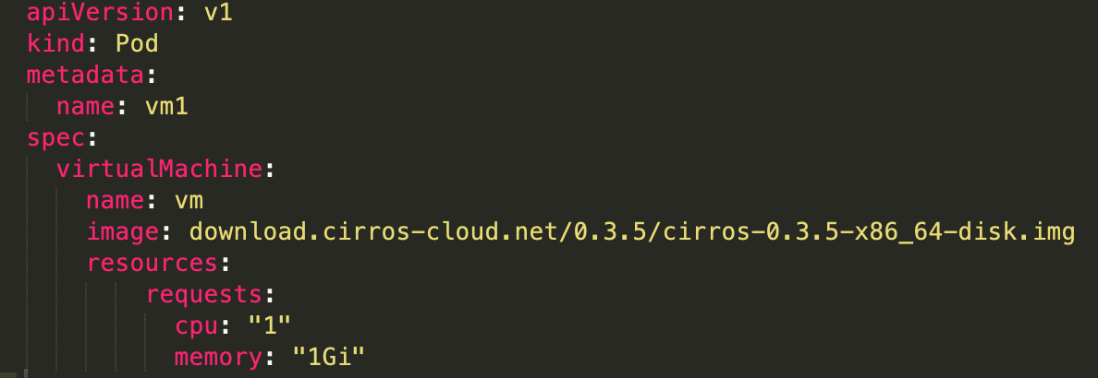
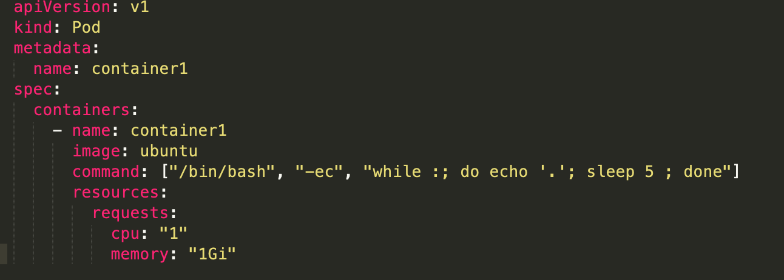
Arktos: Unified Stack
VM workloads
Container workloads
Arktos
Common Orchestration
Scheduling
Network
Integration
Storage
Integration
Container Runtime
VM Runtime
Cluster Management
POD
POD
POD
Node pool

Slide 6
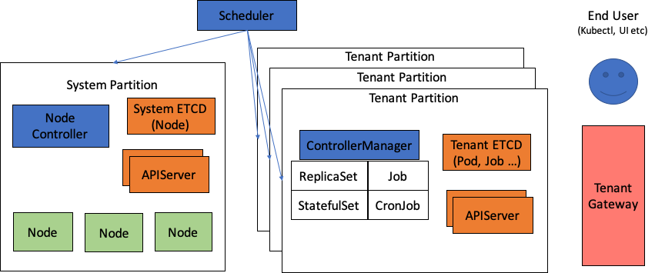
Arktos: Scalability
Shard tenant data
Scheduler has global view of all nodes in cluster

Slide 7
Arktos: Scalability
Controller n
Controller 1
ETCD
Partition
N1+1
Controller 2
N1+1
N1+1
Api Server
N1+1
List/watch by range of field value
Multiple controller instances
Multiple controller managers works in active-active mode

Slide 8


Arktos: Multi-Tenancy
Hard Multi-Tenancy
Enable organizations/departments to safely share one infrastructure, without deploying/operating multiple clusters.
Support per-tenant resource view, access control, quota, etc.
Assume no trust among tenants; ready for strict scenarios like public cloud.
Org 1
Org 2
Arktos
Key Changes:
A new API object: tenant
All API objects have a new field Tenant in its ObjectMeta section
A new resource URL scheme: tenants/{tenant}/namespaces/{namespace}/{objectTypes}/{objectName}
Tenant-aware Client-Go library, scheduler, controllers, agent and CLI tools.
Tenant 1
Tenant 2
Namespace 1
Namespace 1
Pod 1
Pod 2
Pod 1
Pod 2
Pod 3

Slide 9
Next: Scheduling, Resource Utilization & SLO
Intelligent Distributed Scheduling
A global entry to schedule workloads across cloud data centers and Edge sites.
Geo locality aware and application traffic-pattern aware.
Resource Utilization Improvements
In-place vertical scaling. Applications don’t need to reserve the peak resource requirement up front.
SLO-driven resource management, including SLO specification, monitoring and intelligent resource adjustment to enforce the SLO requirements.

Slide 10
Next: ARM Optimization & Virtualization
The eco system of ARM in data center is emerging. AWS released its Graviton cpu and Huawei released Kunpeng cpu.
ARM CPU is usually more energy efficient and cost efficient than x86, but per-core performance is less than x86.
Besides simply recompiling software for ARM platform, what software optimizations can we do? What new features can we build on ARM?
Some initial efforts
Work with university researchers to implement enclave in normal world of ARM TrustZone. This potentially can provide a large enclave for sensitive cloud applications.

Slide 11
Thank you.

