Slide 1
Introduction to Google Anthos

Slide 2
What is Anthos
Google’s new application management platform that has the following features:
An Integrated build and deployment platform
Integrated security from develop to build to run
Multi-cluster management that incorporated with serverless (via Cloud Run), container (via Kubernetes), VM and bare metal (via Anthos cluster)
Hybrid cloud across on-premise, edge, GKE, Vmware, AWS, Azure
Integrated monitoring and log via in Anthos dashboard

Slide 3
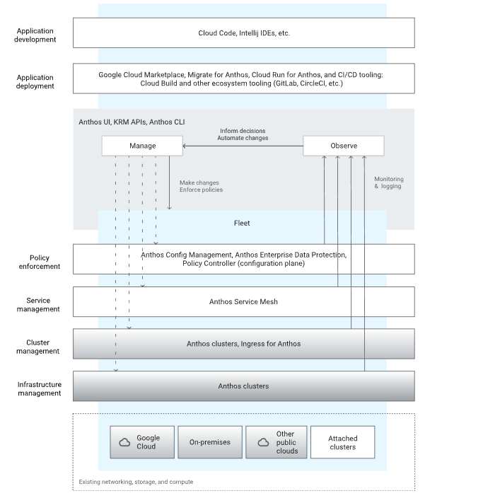
Anthos Architecture

Slide 4
Core Anthos Components
Container & cluster management: GKE, Anthos clusters on Vmware, AWS, Azure
Serverless: Cloud Run
Multicluster management: Connect
Config Management
Service Management: Anthos Service Mesh, dashboard, CA
Secure software supply chain: Binary Authorization
Logging and monitoring
Migration
Marketplace: kubernetes applications in cloud marketplace

Slide 5
References
https://cloud.google.com/anthos
https://cloud.google.com/anthos/docs/concepts/overview
https://cloud.google.com/anthos/service-mesh
https://cloud.google.com/anthos/multicluster-management/connect
https://github.com/cncf/k8s-conformance
https://cloud.google.com/run

