Slide 1
Community 2/7

Slide 2
Roadmap
Edge Workload scheduling
Edge Serverless Platform
Lightweight edge workload (container) runtime
Cross-cluster edge storage
Multi-tenant edge networking
Hierarchical edge cluster
Feb 2021
Aug
830
Sep
930
Jan 2022
130
April 2022
430
Time

Slide 3
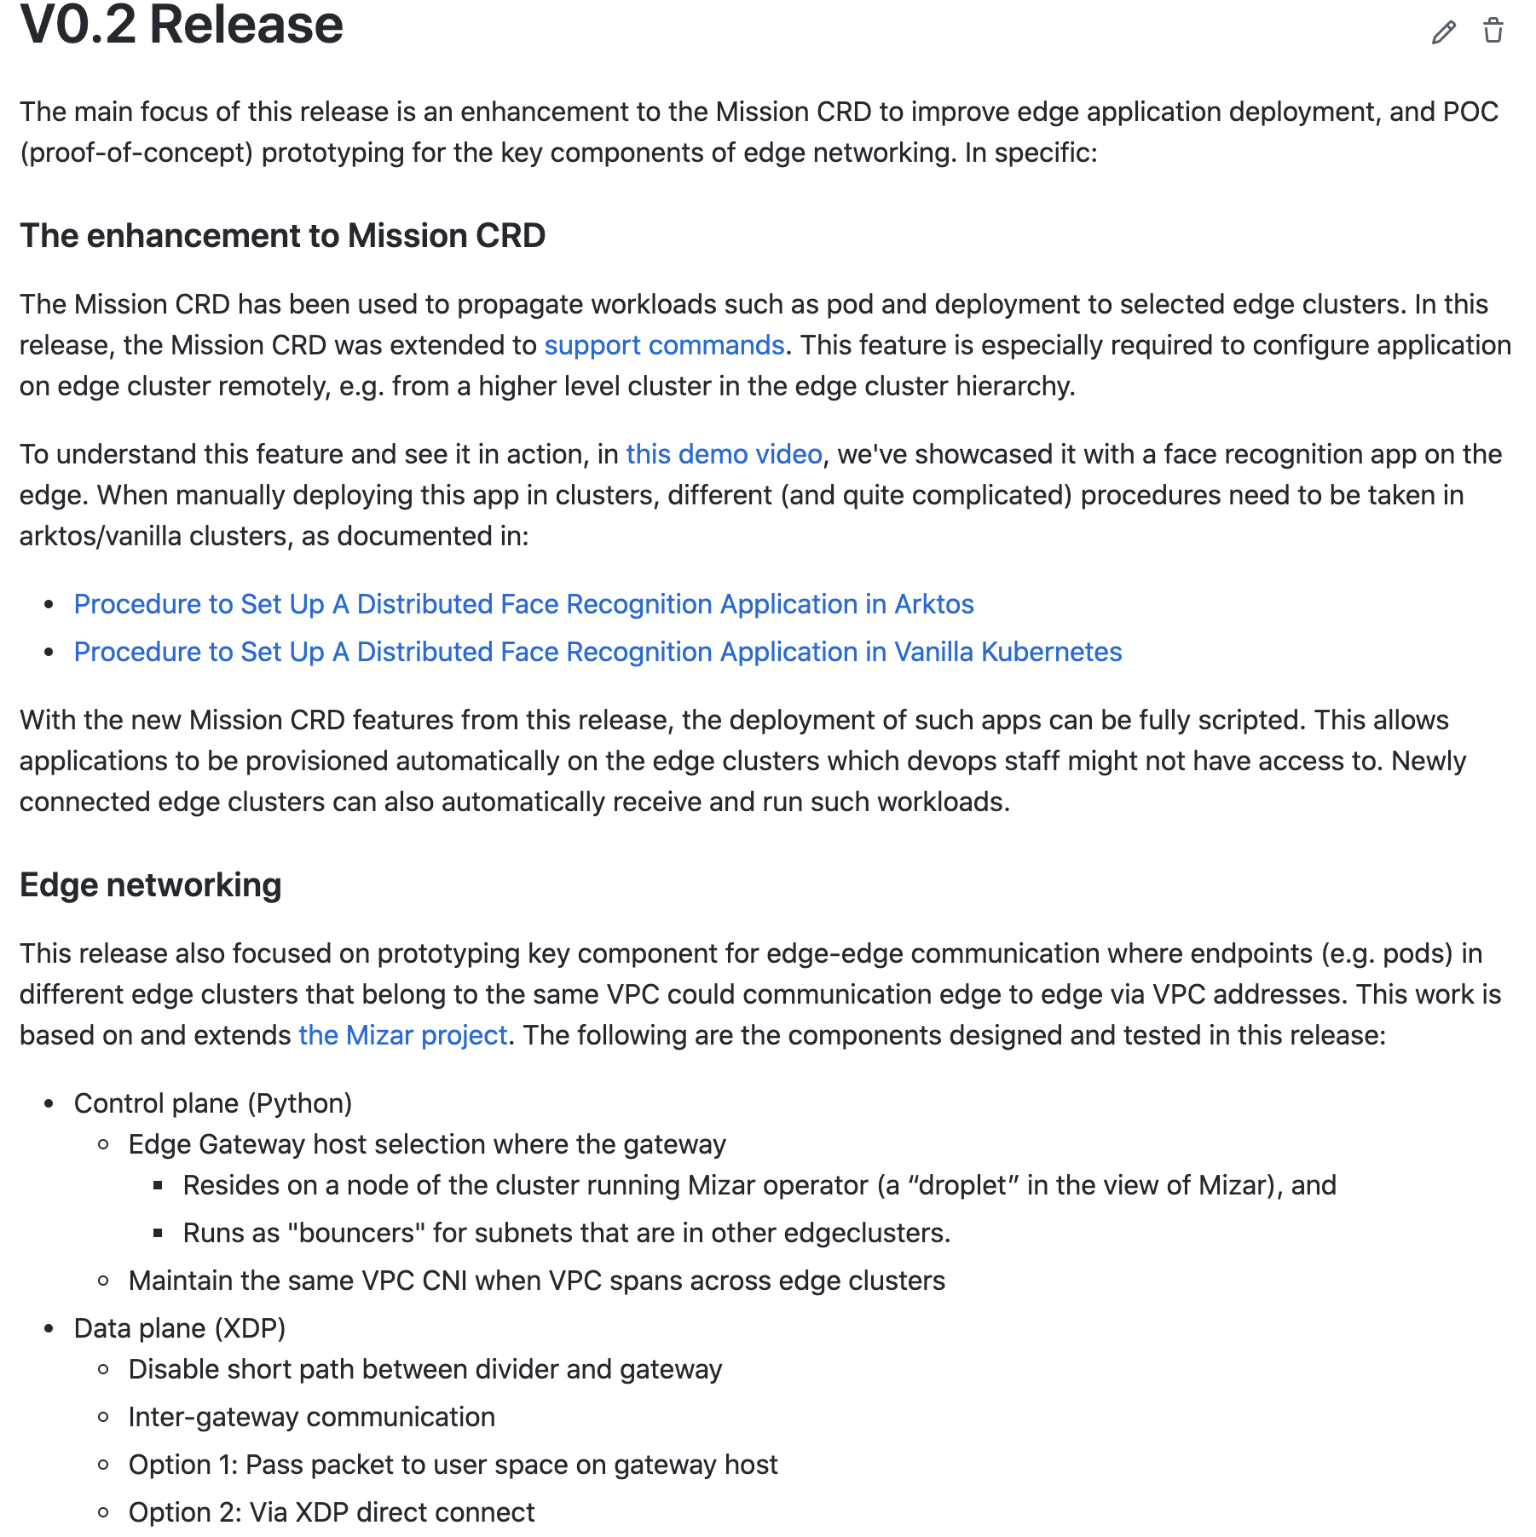
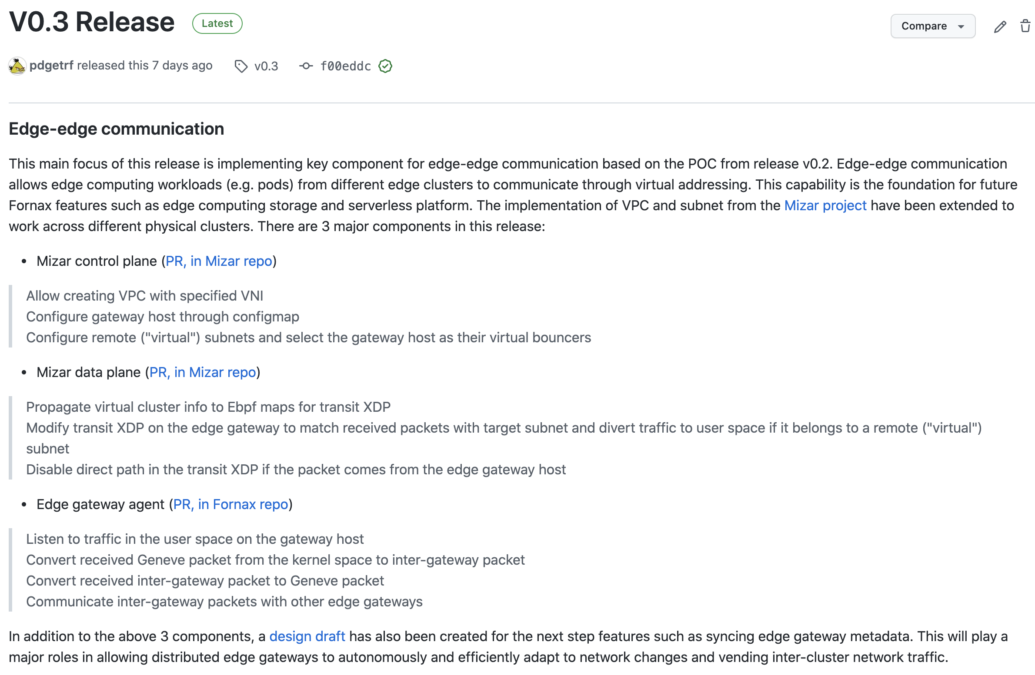
Release v 0.2 & 0.3
(1/30)
(9/30)
https://github.com/CentaurusInfra/fornax/releases

Slide 4
Edge Networking
VPC 192.168.0.0/16
Subnet 1
192.168.0.x
Subnet 2
192.168.122.x
pod1
pod2

Slide 5
Edge Networking
Cross-cluster edge communication
Virtual networking
VPC, subnet
Based on Mizar (https://github.com/CentaurusInfra/mizar)
Cross-cluster VPC
Edge gateway
Sky Computing (extended project)
gw2
gw1
Edge cluster

Slide 6

master
master
Slave host 1
Slave host 1
Slave host 2
Subnet 192.168.122.x
Subnet 192.168.0.x
Slave host 2
192.168.0.2
Pod 1
GW Agent
GW Agent
192.168.122.2
Pod 2
Ping 192.168.122.5
User Space
User Space
192.168.0.x bouncer
Kernel Space
Kernel Space
192.168.122.x bouncer
192.168.x.x divider
Subnet map on Divider
192.168.0.x -> bouncer 0
192.168.122.x -> gateway
192.168.x.x divider
Gateway host
Gateway host

Slide 7
Edge Networking
Cloud Cluster
Cross-cluster edge communication
Edge gateway networking
Auto-discovery and update
Foundation for
Edge storage (KV store across clusters)
Edge workload scheduling
gw1
gw2
gw4
gw5
gw3

Slide 8
Edge Networking
Cloud Cluster
gw0
{vpc 3 → gw2}
{vpc 3 → gw4}
VPC {}
gw1
{vpc 3→ gw2}
{vpc 3 → gw4}
gw2
{vpc 3 → gw4}
VPC {3}
New subnet 3.1 on cluster ”abc”
Update clusters who own VPC 3
Efficiency
VPC {3}
Subnet {3.1}
VPC {}
gw4
{vpc 3 → gw2}
gw3
{vpc 3 → gw2}
{vpc 3 → gw4}
Cluster: “abc”

Slide 9







Edge Storage
$$K1, V1$$
$$K2, V2$$
$$…$$
$$Kn, Vn$$
$$t1$$
CRDT-based edge storage (KV store)
Conflict-free Replicated Data Type
Strong eventual consistency
$$k,v$$
$$t2$$
$$K1, V1$$
$$K2, V2′$$
$$…$$
$$Kn, Vn$$
$$t3$$
$$K1, V1$$
$$K2, V2"$$
$$…$$
$$Kx, Vx$$

Slide 10
Edge Storage
CRDT-based edge storage (KV store)
Conflict-free Replicated Data Type
Strong eventual consistency
Cross-clusters
c1
c11
Edge Cluster

Slide 11
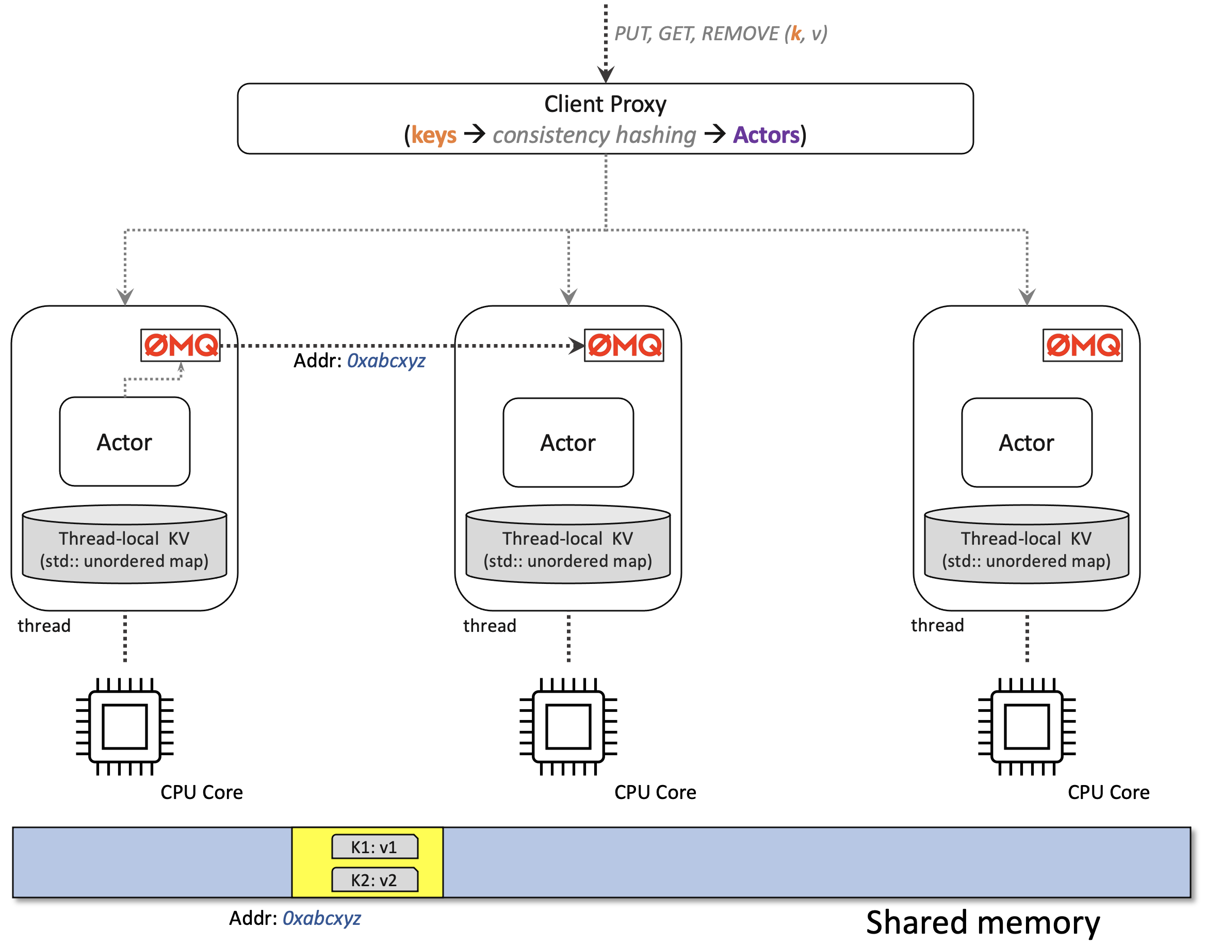
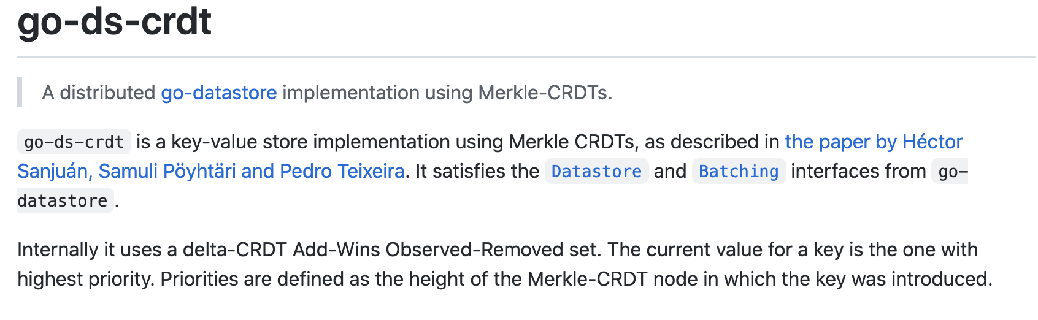
CRDT
State based
Merge data
Example solution:
Anna
Operation Based
Logical clock
Example solution:
Go-ds-crdt
https://github.com/hydro-project/anna
https://github.com/ipfs/go-ds-crdt

Slide 12
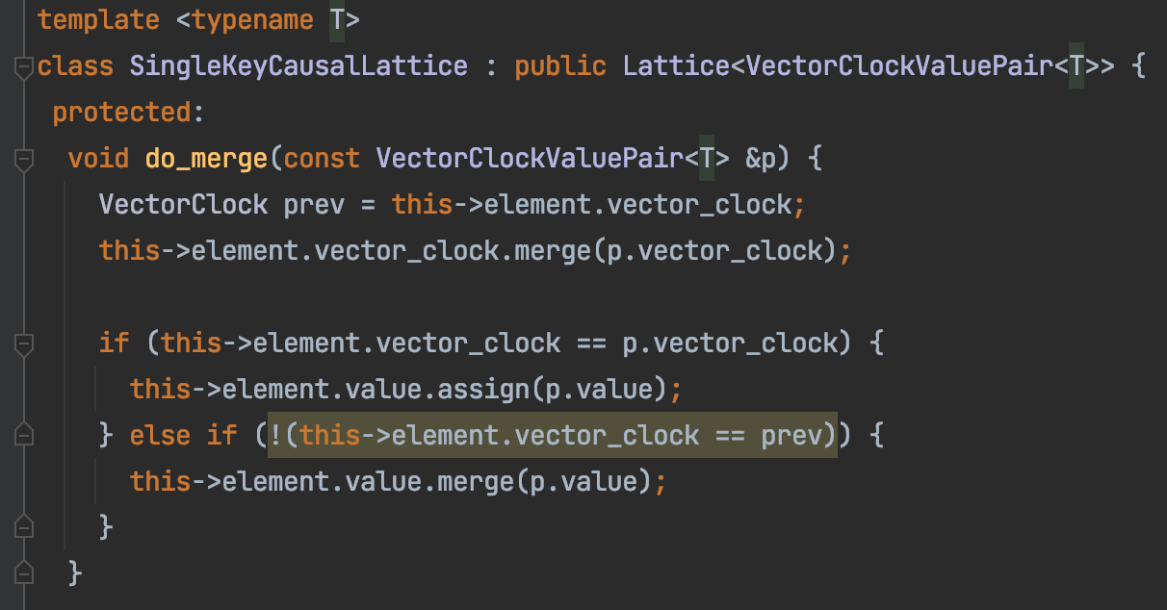
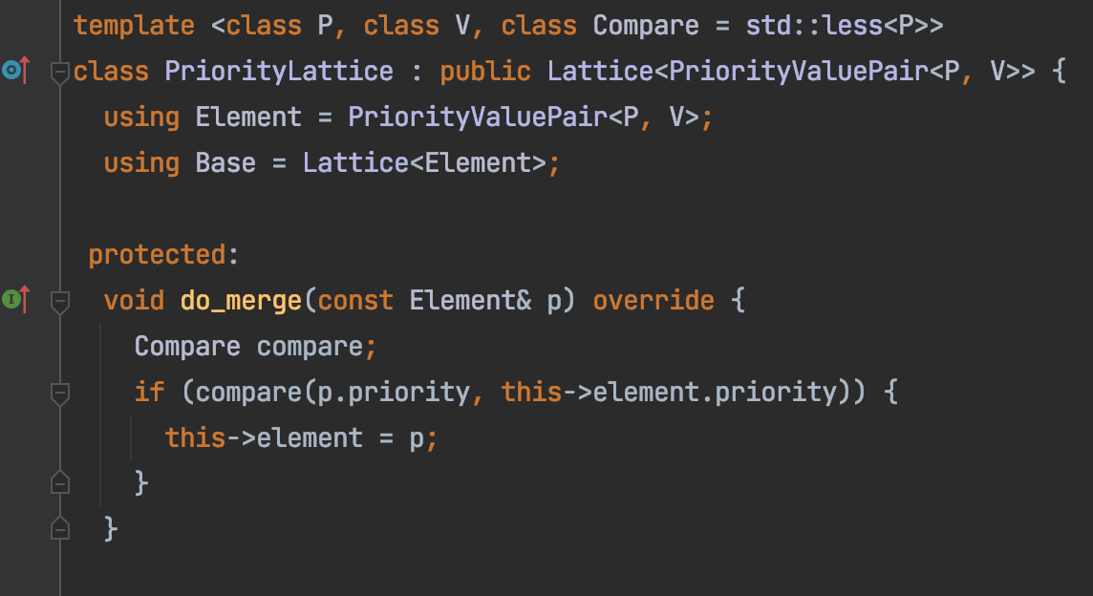
CRDT
Merge
Clock
https://github.com/hydro-project/anna

Slide 13
CRDT
h₅
Merge
Clock
Logic clock vs time clock
Merkle DAG
h₄
h₄
h₁
h₂
h₃
h₁
h₂
h₃
https://arxiv.org/abs/2004.00107
events

Slide 14
Application
Stateful serverless
Sharing state between clusters
Cross-cluster/region scheduling
Memory centric design
Mobile (MEC) edge application

