Slide 1
Global KV Service Architecture
Clients
Kubernetes
Applications
Services
Scheduler
API Server
(entry point, request mgmt)
Global KV Services
In-memory Store/Cache Management
Consistency Mgmt
Memory-store (strong)
Persistence-level
Partition Management
(hashing, partition with geo-optimization)
Memory Tier
Persistence Tier
(type TBD, write-oriented)

Slide 2
Key hashing and routing
K→ V
Storage instance
Partition Management
(hashing, partition with geo-optimization)
Put/Get
API Gateway
Hashing ring

Slide 3
Put (K, V)
Global Replication
write
Storage instance
Consistency Mgmt
Memory-store (strong)
Persistence-level
API Gateway
Global replication
Global replication
Primary
Regional Replicas

Slide 4
Global Replication
K→ V
Storage instance
Consistency Mgmt
Memory-store (Sequential Consistency)
Persistence-level
read
API Gateway
replica
replica
Hashing ring
primary

Slide 5
Caching in API gateway
Get (K, V)
Storage instance
Get (K, V)
In-memory Store/Cache Management
API Gateway
Cache

Slide 6
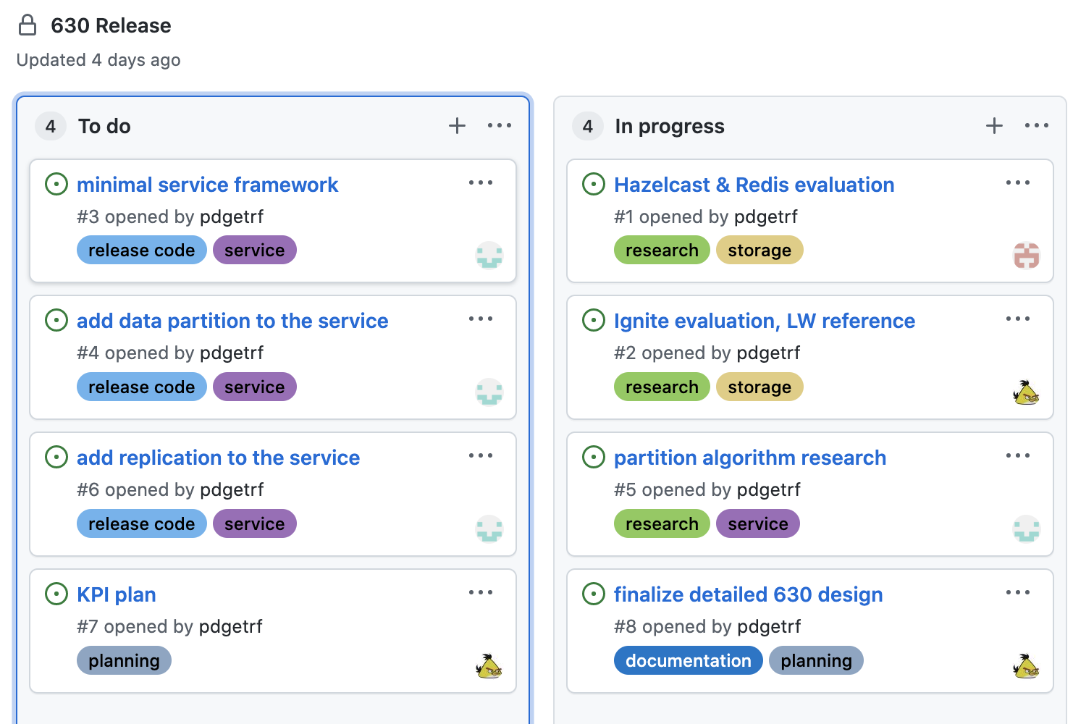
630 Task 1: Storage Solution Evaluation
Memory Store Options:
DB:
Redis & Redis-raft
Hazelcast (CP mode)
Ignite (shim)
Evaluation Target:
Storage Capacity: ~60m objects, ~1800G memory
Sequential Consistency
Performance: latency, throughput, scalability
Supported API: Put, Get, Range, Watch
1~2 weeks

Slide 7
630 Task 2: POC Setup
Storage Service
Hashing and key routing
Ref solutions:
https://github.com/lafikl/consistent
https://github.com/buraksezer/consistent
Query result aggregation (e.g. range)
E2E CRUD Validation
3-4 weeks

Slide 8
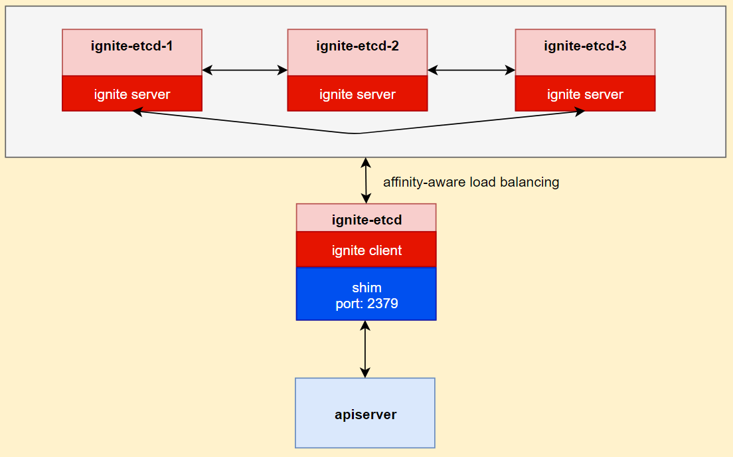
630 Task 3: Consistency Model Research
Strong (Sequential consistency) with sharded primaries
Ignite-shim (LW, RV)
2-3 weeks

