Slide 1
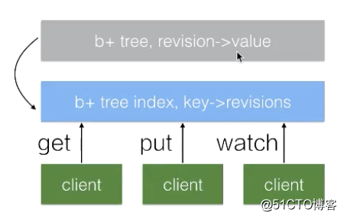
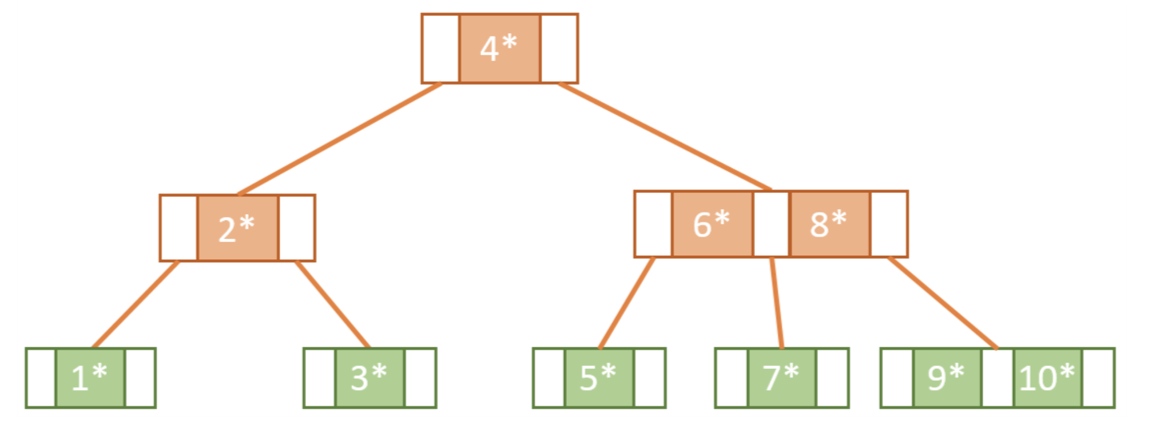
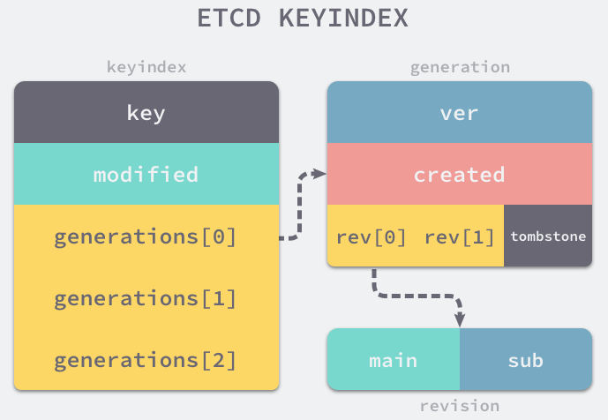

MVCC in ETCD
Each revision tick → set of {k, v} ops
BoltDB (B+ Tree) stores all versions of a key (MVCC)
BoltDB stores {k, v} using revision as the DB storage key.
Meaning BoltDB storage key (revision) maps to a set of atomic k-v changes
TreeIndex (B Tree) maps data key to storage key (revision)
TreeIndex uses data key as the tree key (for better range search)
Link 1
Link 2
Link 3
Data Key
Storage Key
/a/b/c
{created, modified, ver}
BoltDB
rev → val
Storage Key
{created, modified, ver}
Data Key
key → KeyIndex (versions)
/a/b/c
{/a/b/c, 3}
{/a/b/c, 5}
B Tree Index
ver

Slide 2
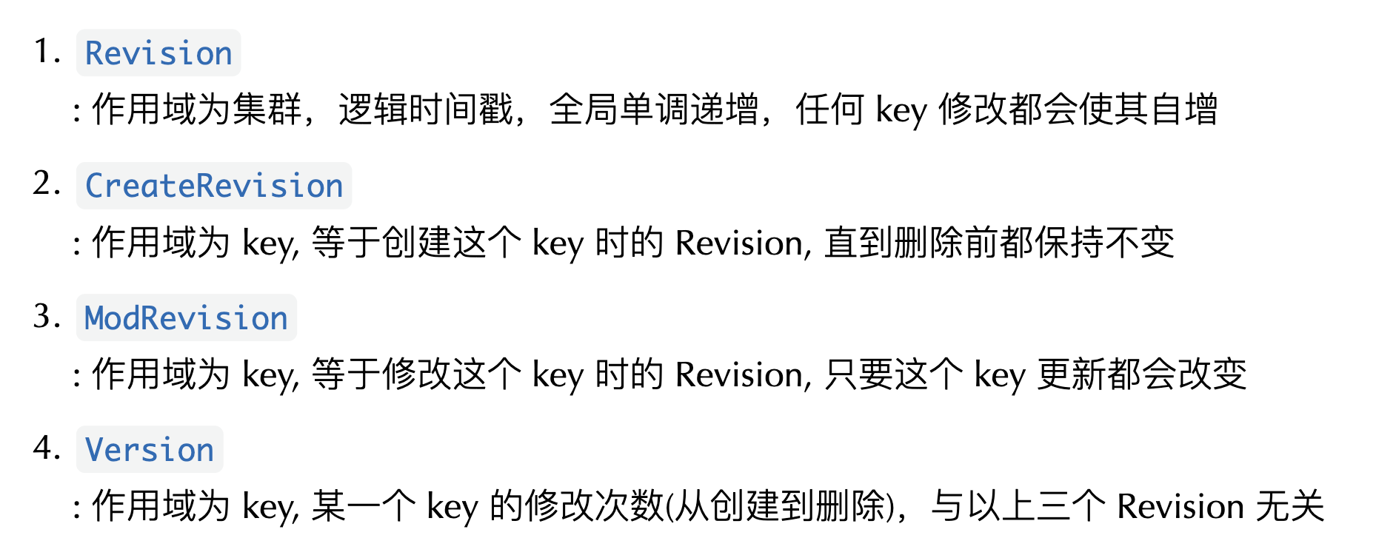
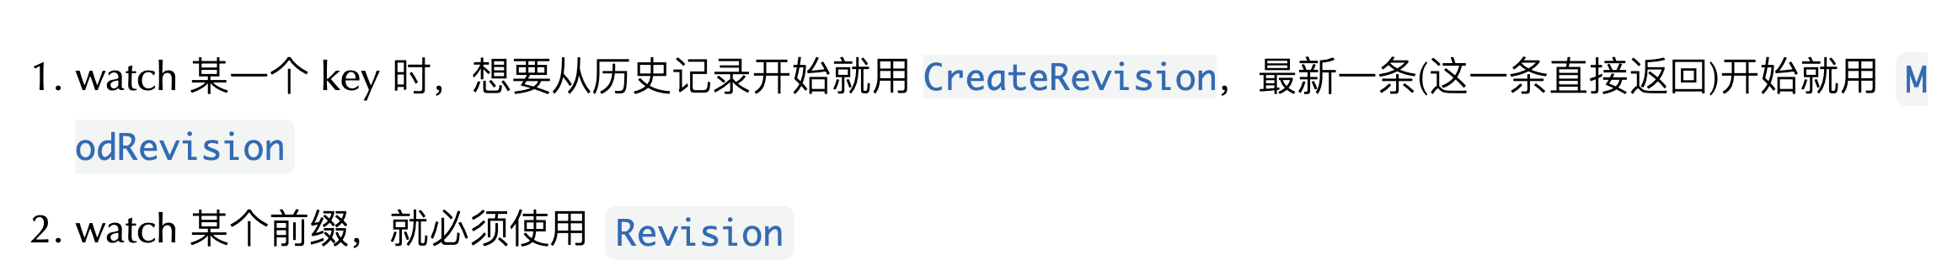
ETCD Revision
link
version tick
Revision (Store)
0
1
2
3
4
5
6
7
8
CreateRevision (key)
Key create
2
ModRevision (key)
Key update
2
5
Version (key)
1
2

