Slide 1
Strong Consistency Theoretical Study
Ke Xu

Slide 2
Sequential Consistency
Definition:
The result of any execution is the same as if the (read and write) operations by all processes on the data store were executed in some sequential order and the operations of each individual process appear in this sequence in the order specified by its program
Operations may arrive at different physical times on an instance
Operations must be executed in a same sequential order on each instance! (sequential guarantee)
Read from an instance may get stale state. (no time guarantee)
Reads from a same instance follow the sequential order.
Support overlapping read and write on any instance.

Slide 3
Linearizable Consistency
Definition:
The result of any execution is the same as if the operations by all processes on the data store were executed in some sequential order and the operations of each individual process appear in this sequence in the order specified by its program. In addition, if tsop1(x) < tsop2(y), then OP1(x) should precede OP2(y) in this sequence. [Herlihy & Wing, 1991]
Read from any instance gets a same state.
Weaker than strict consistency
Stronger than sequential consistency
Must consider overlapping read and write problem.

Slide 4
Strong Consistency Algorithms
Chain Replication
Chain Replication (CR)
Chain Replication Apportionable Queries (CRAQ)
Primary-Backup Replication
GFS (weak consistency though!)
Vmware FT
Leader-based Quorum-based Replication
RAFT
Zookeeper (Zab protocol)
All is leader-based system

Slide 5

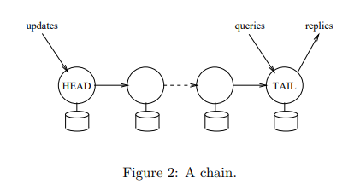
Algorithm #1: Chain Replication (CR)
R. Renesse, F. Schneider. Chain Replication for Supporting High Throughput and Availability. ISDI2004
http://nil.csail.mit.edu/6.824/2020/notes/l-craq.txt
Goal: Linearizable consistency; data safety
Writes:
Client sends to head -> forwarded down the chain in order and each server overwrites -> tail responds to client
Reads:
Client sends to tail -> always tail responds
Network partition: need a config manager
Drawbacks
Cannot handle read-heavy queries
Chained writes may take time

Slide 6
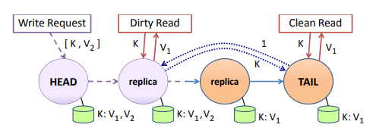
Algorithm #2: Chain Replication Apportioned Queries (CRAQ)
J. Terrace, M. Freedman. Object Storage on CRAQ. USEMOXATC 2009
http://nil.csail.mit.edu/6.824/2020/notes/l-craq.txt
Goal: Linearizable consistency; data safety
Versioning
Each replica stores a list of versions per object
One clean version + dirty version per recent write
Write:
Client sends write to head -> replicas create new dirty version as write passes through -> tail creates clean version, ACKs back along chain, replicas turn “dirty” to clean.
Read:
From tail: return latest clean version
From non-tail:
If latest version is clean, return
If latest version is dirty, query version state from tail, then return
Network partition: need a config manager

Slide 7
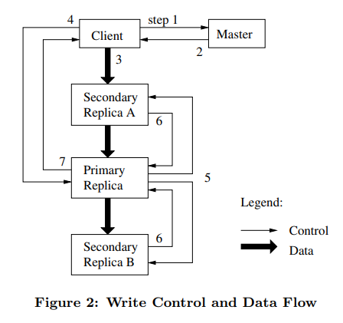
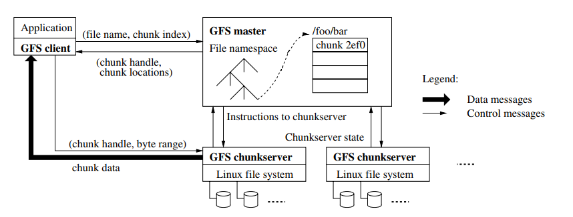
Algorithm #3: GFS (weak consistency though!)
S. Ghemawat, H. Gobioff, S. Leung, The Google File System, SOSP2003
https://timilearning.com/posts/mit-6.824/lecture-3-gfs/
http://nil.csail.mit.edu/6.824/2020/notes/l-gfs.txt
A single master: holds all metadata
Communication between master and chunkservers: heartbeat
Client <-> master: metadata operation
Client <-> chunkserver: data

Slide 8
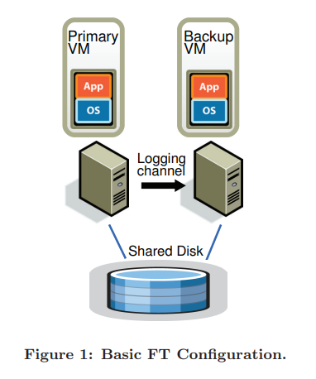
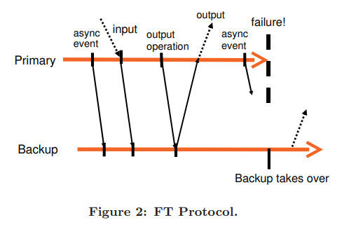
Algorithm #4: Vmware FT
D. Scales, M. Nelson, G. Venkitachalam. The Design of a Practical System for Fault-Tolerant Virtual Machines
http://nil.csail.mit.edu/6.824/2020/notes/l-vm-ft.txt
Goal: Linearizable consistency; data availability
State transfer vs. replicated state machine
Vmware FT uses replicated state machine
Transfers a sequence of operations
Split-brain problem
Test-and-set mechanism

Slide 9



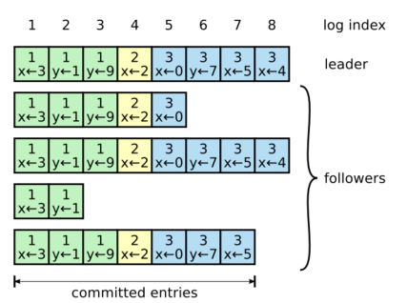
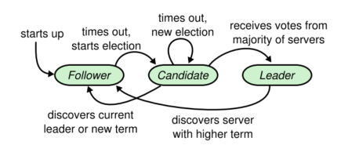
Algorithm #5: RAFT
D. Ongaro, J. Ousterhout. In Search of an Understandable Consensus Algorithm.
https://timilearning.com/posts/mit-6.824/lecture-6-7-fault-tolerance-raft/
Linearizable/sequential consistency (write through leader, read through leader optional)
Uses replicated state machine
Three parts
Leader election
Log replication
Safety (in-order log commit)

Slide 10
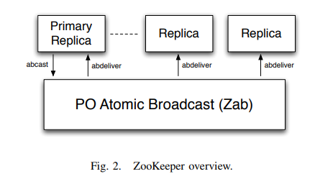
Algorithm #6: Zookeeper
P. Hunt, M. Konar, F. Junqueira, B. Reed. Zookeeper: Wait-free coordination for Internet-scale systems.
F. Junqueira, B. Reed, Marco Serafini. Zab: High-performance broadcast for primary-backup systems.
https://timilearning.com/posts/mit-6.824/lecture-8-zookeeper/
http://nil.csail.mit.edu/6.824/2020/notes/l-zookeeper.txt
Linearizable/sequential consistency (write through leader, read through leader optional)
Quorum-based Primary-Backup replication
Operations order can be specified by client
Used for
Config management
Rendezvous
Group membership
Zab protocol
Leader election
Atomic broadcast

Slide 11
Strong Consistency Algorithms
 | Chain Replication | Primary-Backup Replication | Quorum-based Replication
Leader assignment | Constant | Constant Need a config manager | Dynamic using quorum
Complexity | Small | Medium | Large
Write load | Balanced | Heavy on leader | Heavy on leader
Read load | Heavy on tail/leader (linearizable); Balanced (sequential)
Message Traffic | Light | Medium | Heavy
Latency (with few replicas) | Fast | Fast? | Slow
Fault tolerance | Need an external config manager |  | Recoverable
Split-brain problem | Need an external config manager |  | Recoverable
Object versioning | Yes | Yes | Yes

Slide 12
Existing Repo
CRAQ: despreston/go-craq
BoltDB for storage
RAFT:
etcd/raft at main · etcd-io/etcd
hashicorp/raft
Both are written in go. BoltDB for etcd, and optional for the latter.
Zookeeper: apache/zookeeper
Java; write to disk

Slide 13
Write Load Analysis
Define “write load”
Load of processing original write request from client and acknowledgment
Load of processing subsequent write requests and related message (e.g. commit) passed to other nodes and acknowledgment
Assume 1 write request, x replicas (including primary)

Slide 14
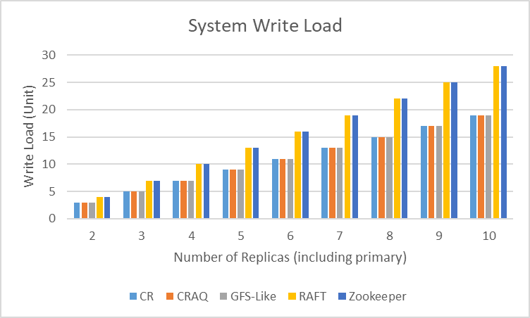
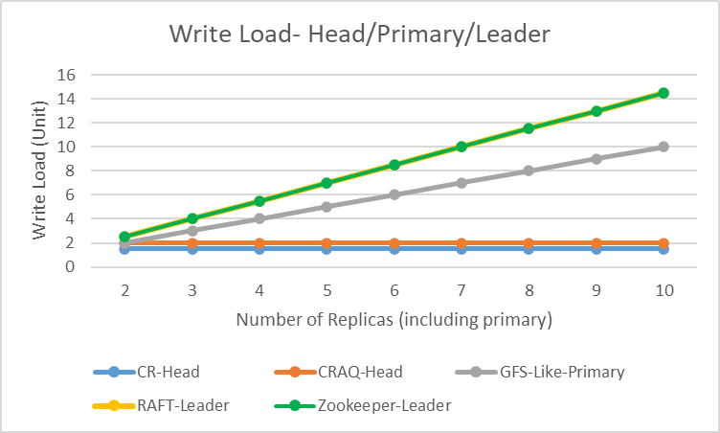
Write Load Analysis

Slide 15
Read Load Analysis
Define “read load”
Load of processing original read request from client and reply
Load of processing forwarded read requests reply
Assume a read requests, x replicas (including primary)
Assume read from all nodes

Slide 16
Read Load Analysis
Assume a read request, x replicas (including primary)
CR | CRAQ | GFS-Like | RAFT | Zookeeper
Head: 0 Mediate: 0 Tail: a | Head: a/x Mediate: a/x Tail: a/x | Primary: a/x Backup: a/x | Leader: a/x Follower: a/x | Leader: a/x Follower: a/x
Equivalent

Slide 17
Latency Analysis
Define “latency”
1 unit is the duration in terms of 1 hop between replicas
Assume x replicas (including primary)
Assume read from all nodes
Write latency
Read latency

Slide 18
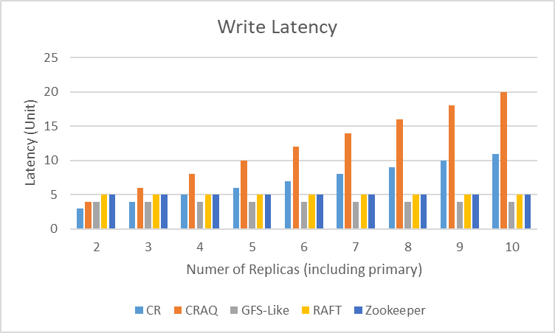
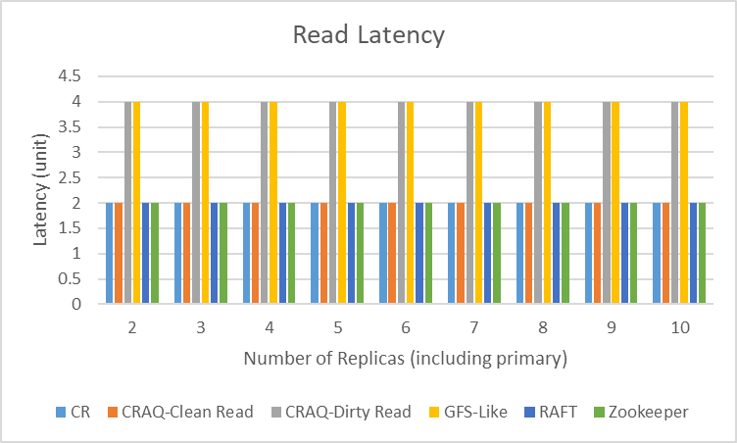
Latency Analysis

