Slide 1
Why MVCC?
Large Scale Distributed System
→
No Dirt Read
No overwriting writes (e.g. lost state)
Used for cluster synchronization
Strong Consistency
→
Avoid Locking (performance)
MVCC (timestamps, Versioning)
→
Do we have a better idea?
If no, live with watch
Client to receive new update efficiently
→
Most often, we also want to monitor those resources and track events as they happen. For instance, we might be interested in tracking pod life cycle events or deployment status changes. While we could use polling, this approach would suffer from a few limitations. Firstly, it would not scale well as the number of resources to monitor increases. Secondly, we risk losing events that happen to occur between polling cycles.
To address those issues, Kubernetes has the concept of Watches,
Push, push?
Scalability (client → pull, won’t scale)
Missing events between polling
Watch?
Watch
→
link

Slide 2
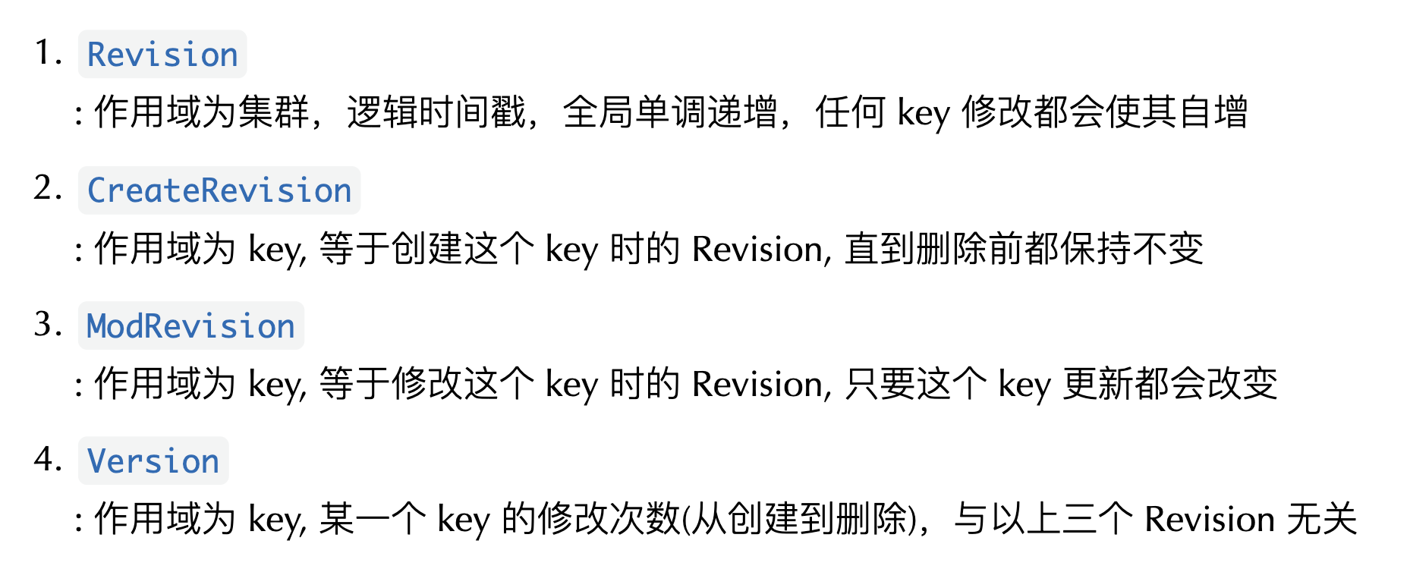
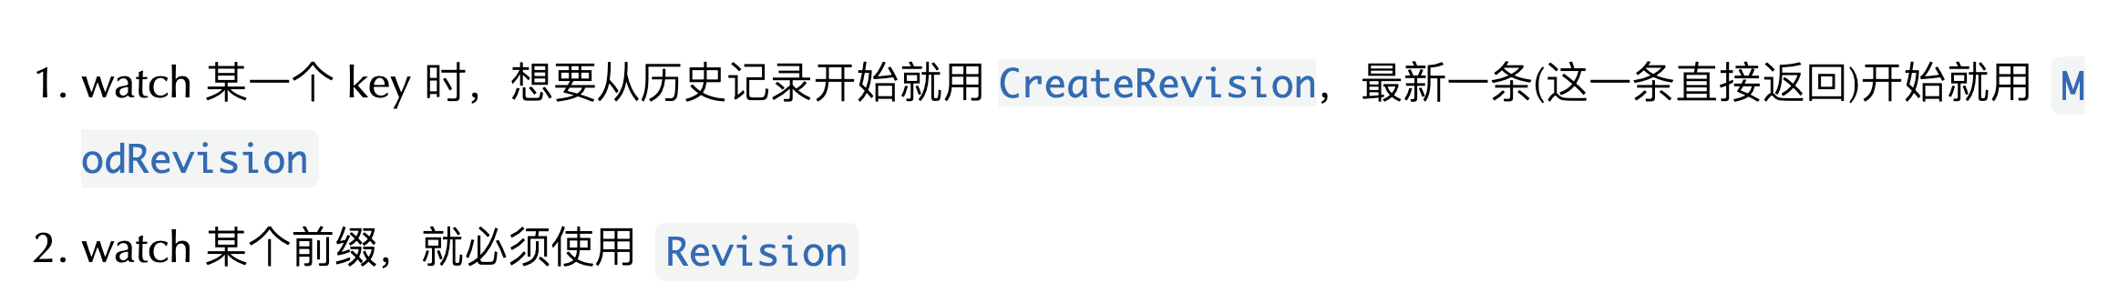
ETCD Revision
link
version tick
Revision (Store)
0
1
2
3
4
5
6
7
8
CreateRevision (key)
Key create
2
ModRevision (key)
Key update
2
5
Version (key)
1
2

Slide 3
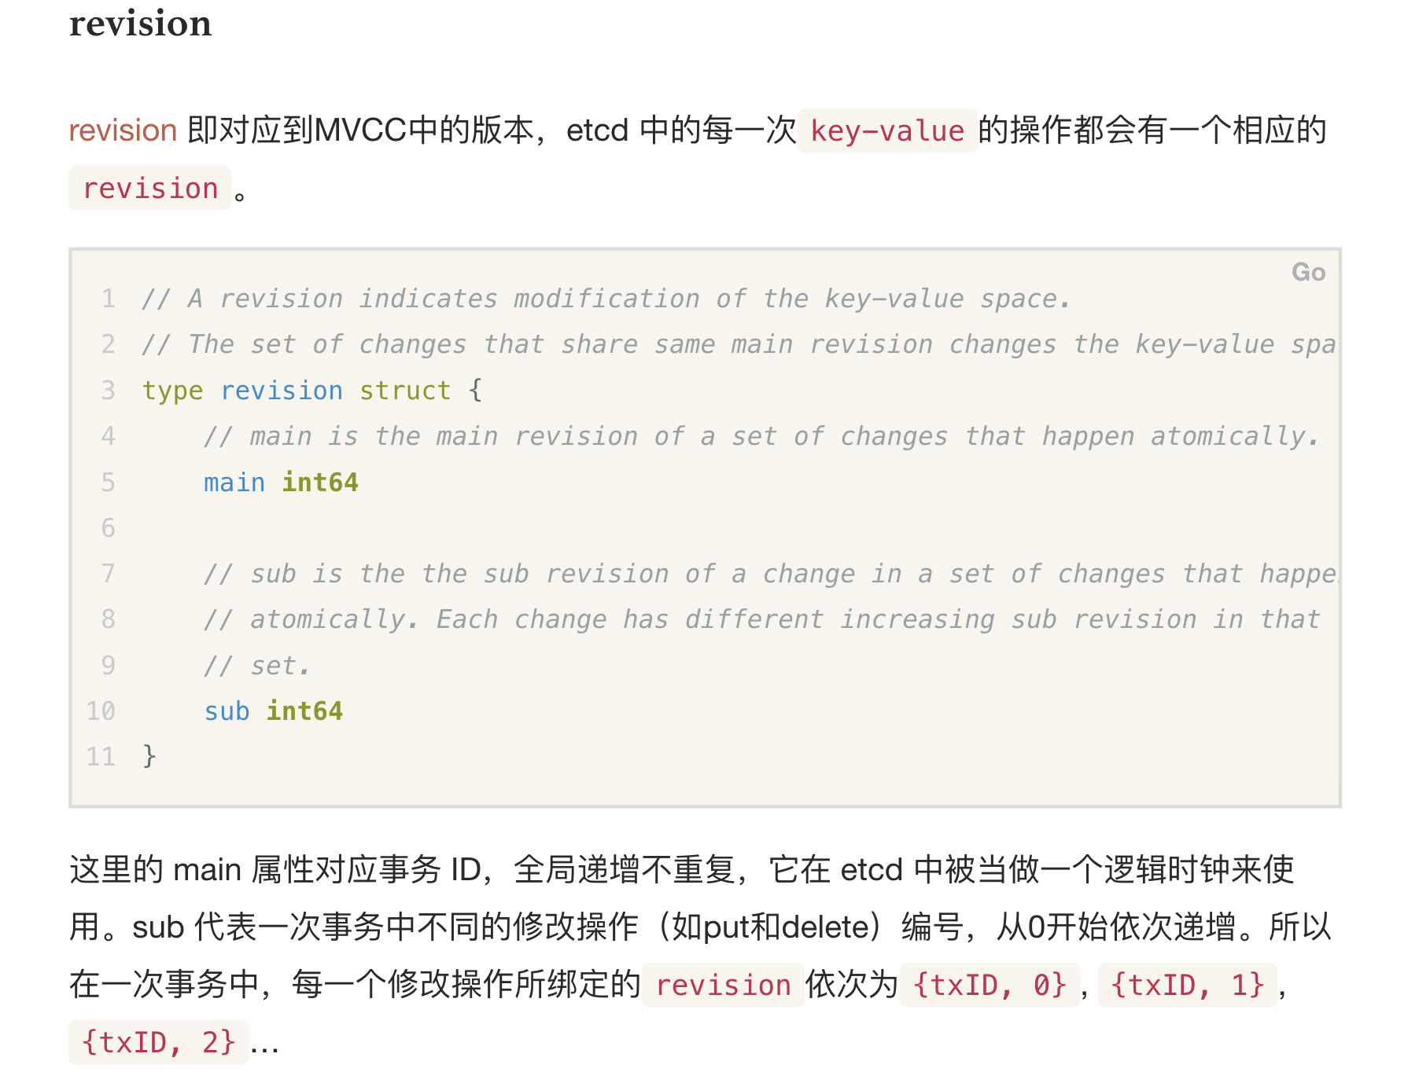
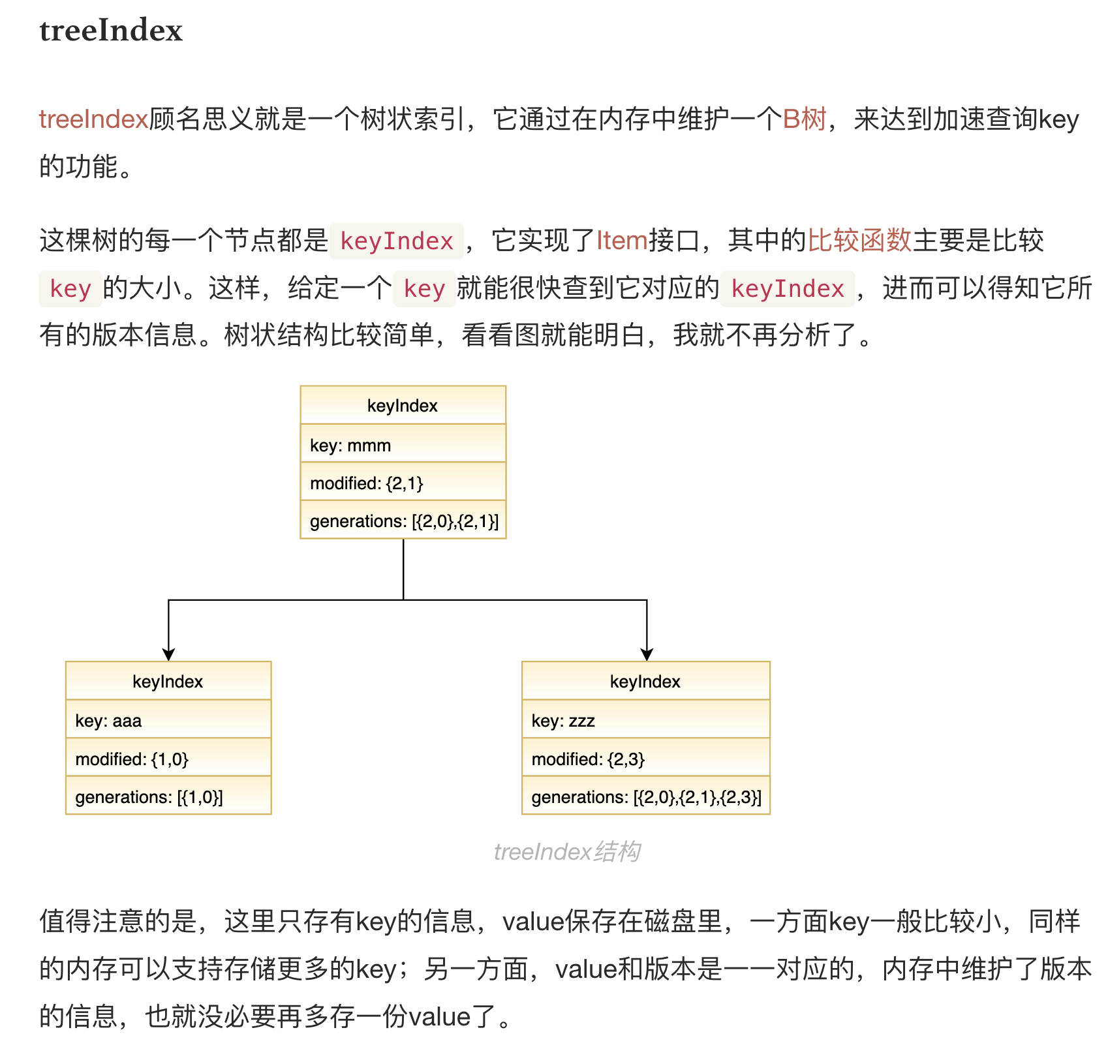
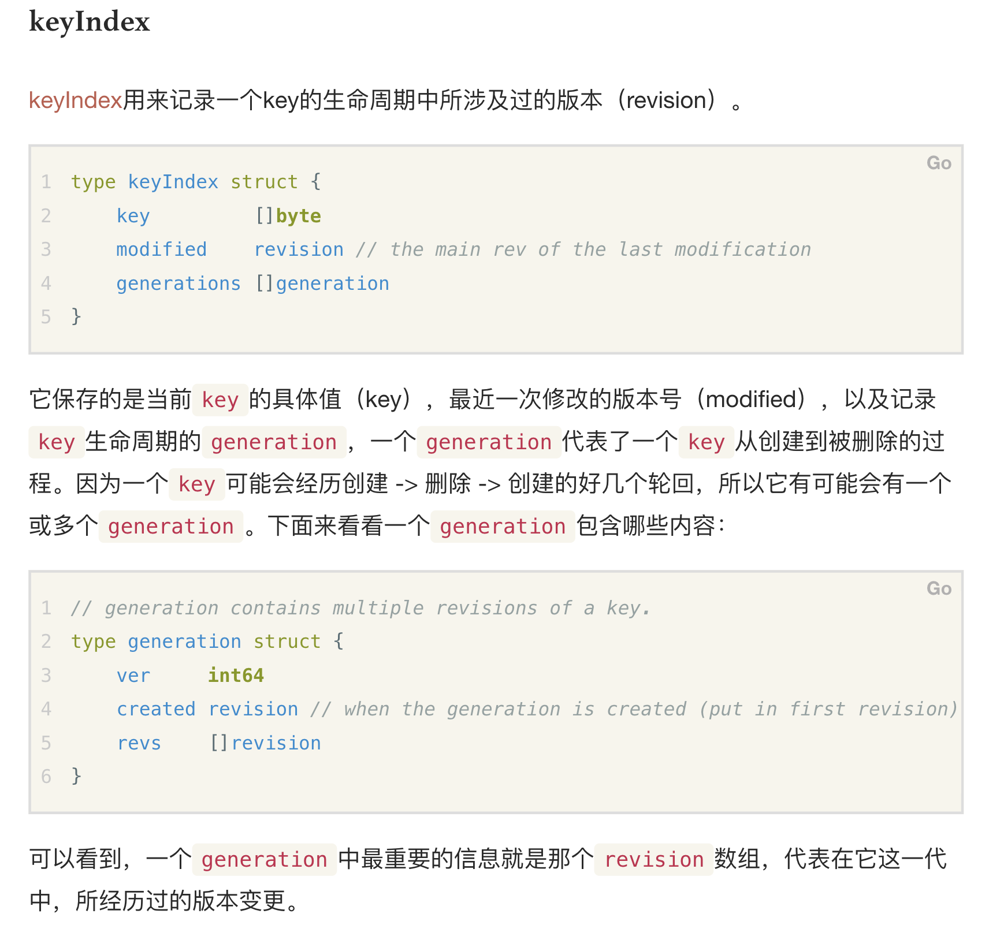
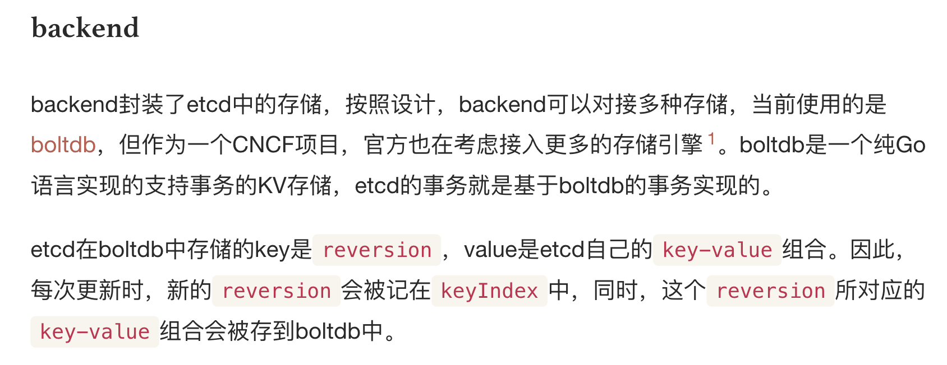
ETCD Concepts
LINK
Related post

Slide 4
ETCD Storage KV
BoltDB
Data Key
Storage Key
/a/b/c
{created, modified, ver}, VALUE
{created, modified, ver}
________________
BoltDB KEY

Slide 5
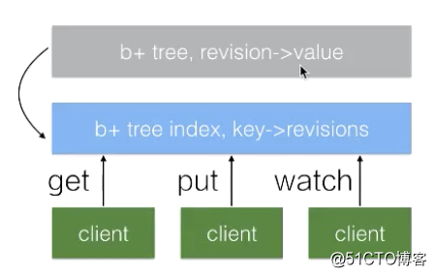
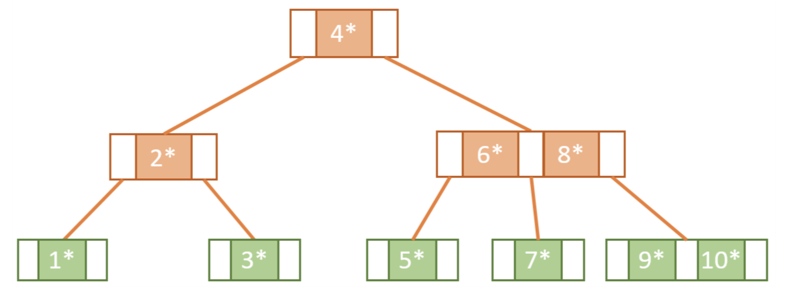
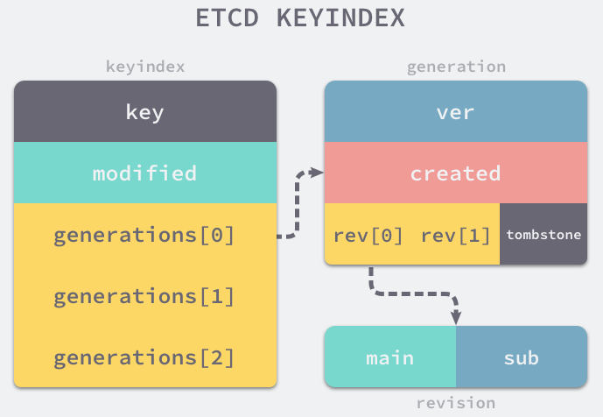

MVCC in ETCD
Each revision tick → set of {k, v} ops
BoltDB (B+ Tree) stores all versions of a key (MVCC)
BoltDB stores {k, v} using revision as the DB storage key.
Meaning BoltDB storage key (revision) maps to a set of atomic k-v changes
TreeIndex (B Tree) maps data key to storage key (revision)
TreeIndex uses data key as the tree key (for better range search)
Link 1
Link 2
Link 3
BoltDB
rev → val
Storage Key
{created, modified, ver}
Data Key
key → KeyIndex (versions)
/a/b/c
{/a/b/c, 3}
{/a/b/c, 5}
B Tree Index
ver

Slide 6
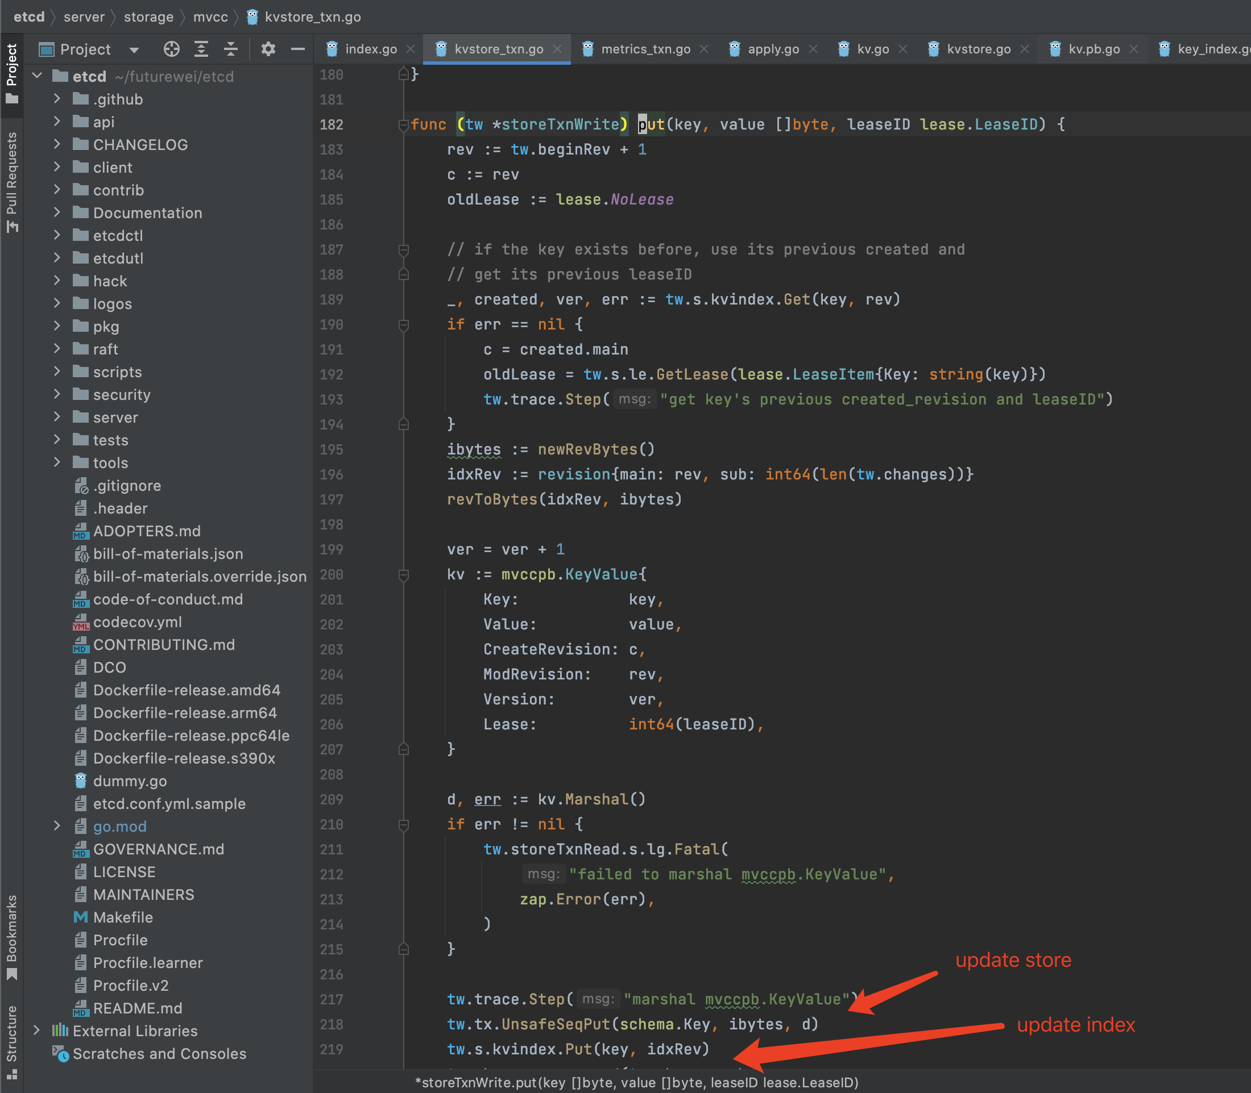
Revision Update In ETCD
Write request
MVCC
1
rev
KVIndex
3
2
BoltDB

