Slide 1
6/27

Slide 2
Research & Design
(functional validation)
Storage Capacity validation
Development
(perf & capacity validation)
6/27
(today)
6/30
7/22
(brown bag)
Timeline

Slide 3
Data Model
Storage Instance
?
/a/y
/b/m0
/c/s0
/c/t
/a/y
/c/t
/a/x/x0
/a/x/x1
/a/x/x0
/a/x/x1
/a/x/x1
/a/x/x1
Key path
object
Revisioned object

Slide 4
Data Model
MVCC
List-Watch
Txn (atomicity I/O)
Index
Storage
User [Key, Value] Pairs
Revision, [Key, Value] Pairs
Example:
{
123 →
{
{hello → world},
{Seattle → rain}
}
}
{
{hello → world},
{Seattle → rain}
}
Improve Reads
Range Query

Slide 5
Architecture (at interface level)
Storage Instance Interface
User request put/get
Cache Interface
Indexer Interface
Rev->[kvs]
Primary
Sharding Mgr Interface
Replication/Consistency Mgr Interface
Piping(I/O) Mgr Interface
Replica₀
Revision number Mgr Interface
Config Mgr
Replica_{n}

Slide 6
Index
Owner: Peng Du
Sharding
Owner: Ke Xu
Consistency
B-Tree
By Revision Group
Owner: Jun Shao
Linearizable
(Chain-Replication)
Segmented Tree
By Key Space
Owner: Hongwei Chen
Sequential
Skip-list
By Version Group
Owner: Peng Du
ROI (2- & 3-D)
Replication
Caching
Owner: Hongwei Chen
HA
Fault-tolerance
Owner: Hongwei Chen
Modding
Read Cache
Interface
Sync-Async
“Session”
Smart Global Cache
Implementation
Owner: Peng Du

Slide 7
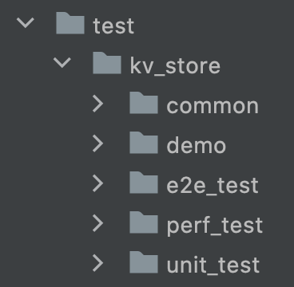
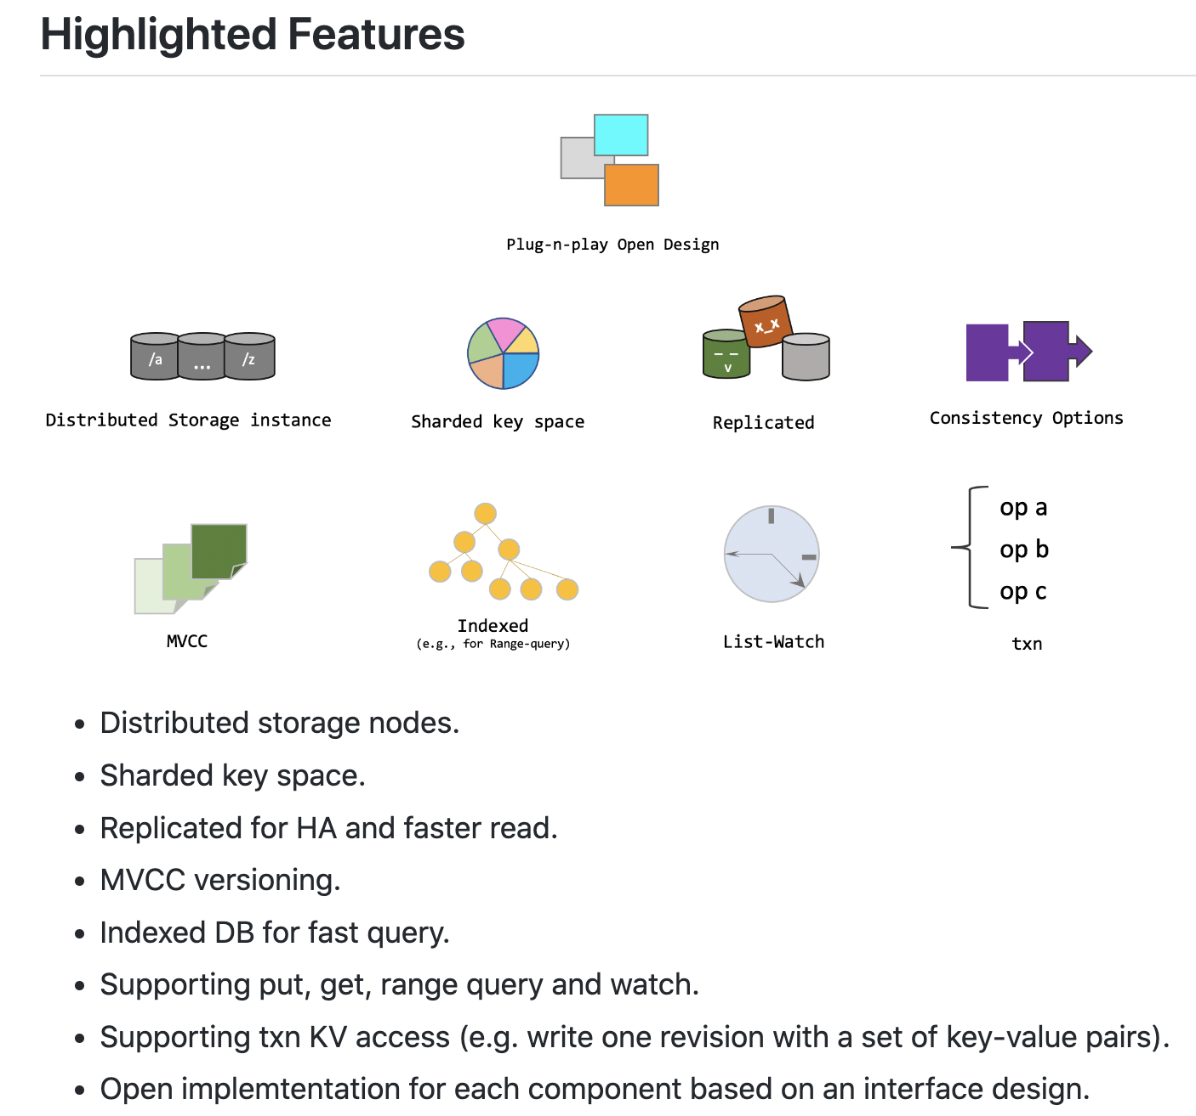
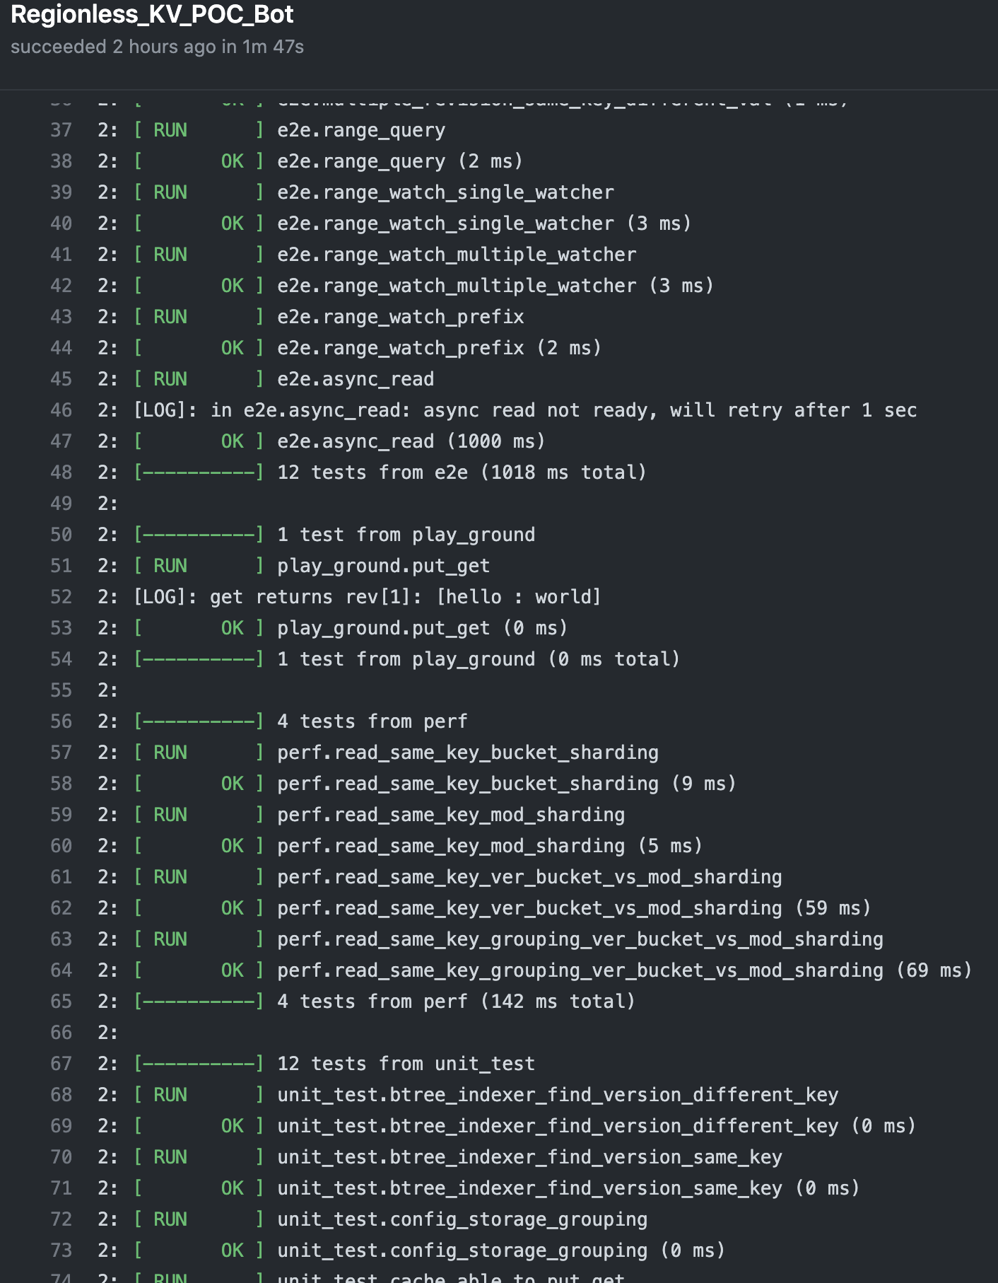
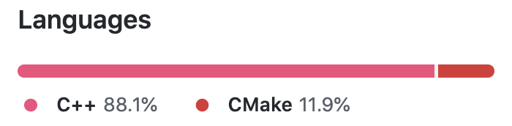
6/30 Item: Key Features POC
*This repo is private now but will be made public shortly

Slide 8
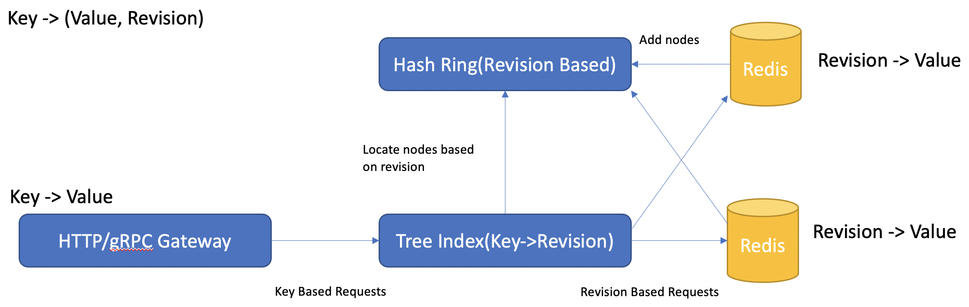
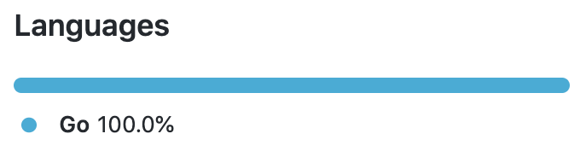
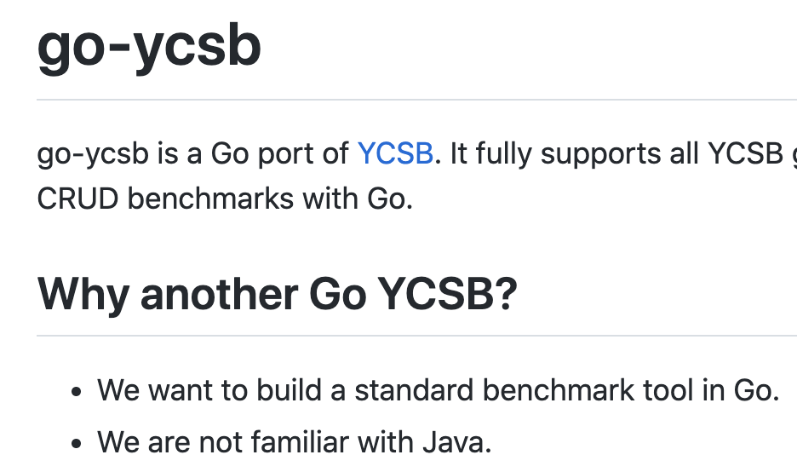
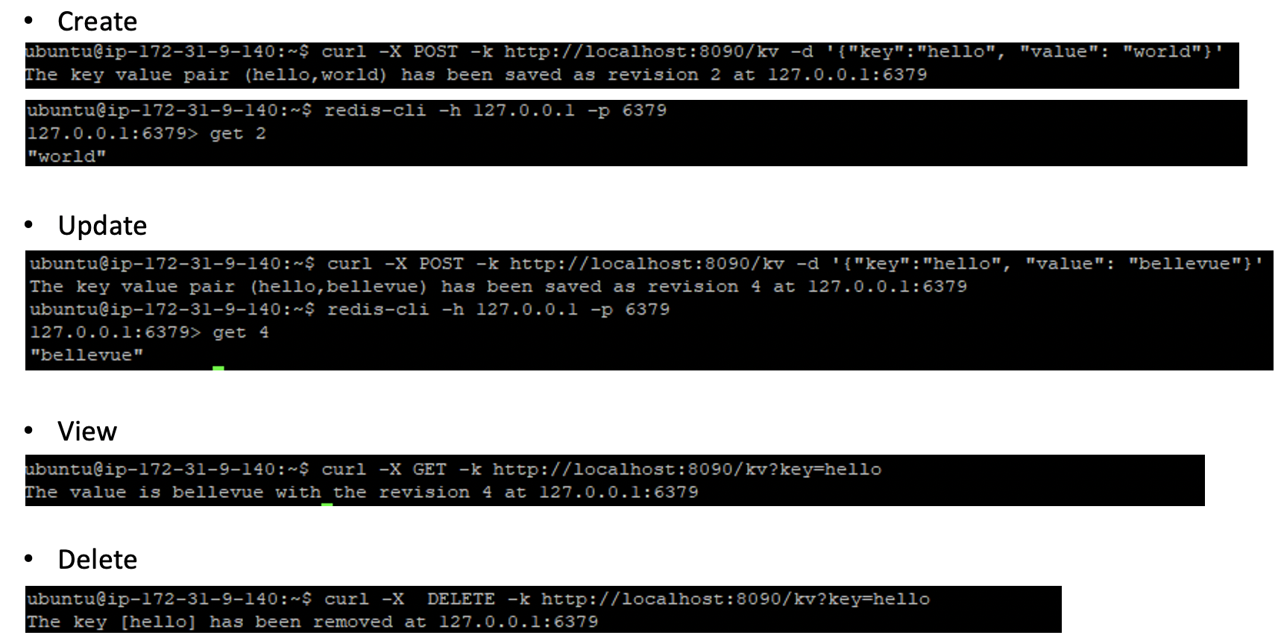
6/30 Item: Storage and Performance Validation
Owner: Jun Shao
I/O Perf Test
Owner: Hongwei Chen
Owner: Jun Shao

Slide 9
Rev Mod Sharding
Rev 0
Rev 1
Rev 2
Rev 3
Rev 4
Rev 5
Rev Bucket Sharding
Rev 0-5
Rev 6-10
Rev 11-15
Rev 16-20
Key Grouping + Rev Bucket Sharding
/
/t1
/t2
Node group for key prefix /t1
Rev 0-5
Rev 6-10
Rev 11-15
Rev 16-20

Slide 10
ROI Indexing/Sharding
Game Session Field (“game map”)
/a
Range Of Interest
/a/a₁
/a/a₂
/a/a₁/a₁₁
/a/a₂/a₂₁
/a/a₂/a₂₂
/a/a₁/a₁₁/a₁₂₁
/a/a₁/a₁₂/a₁₂₂

Slide 11
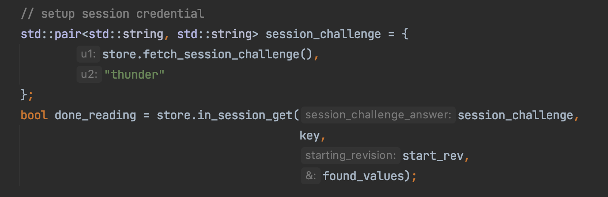
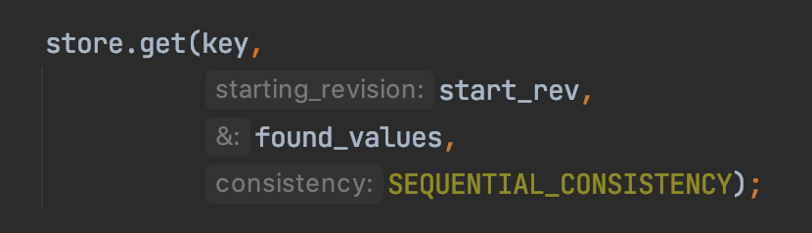
Session credential
In-session get()
(read from async replica)
Out-of-session get()
(read from sync replica)
*Read-uncommited Isolation for demo purpose

Slide 12



“Session"
KV Store
Game Session: RUNNING
writer
In-session readers
get()
rev 1: red
rev 2: green
rev 3: blue
Out-of-session readers
get()
rev 1: red
rev 2: green

Slide 13
Replication Consistency by Group
Linearizable Replica Group
Sequential Replica Group
Primary
Replica 1
Replica 2
Replica 3
Replica 4
C1
C2
C3
In-session Clients
Out-of-session Client

Slide 14


Time T 2:
2.1 {k, v3} → primary
2.2 Readers
In-session clients blocked on reading
Out-of-session can still read {k, v1}, {k, v2}
Primary
k, v1, v2
Primary
k, v3
Writer Client
Put
Sync Replica
In-session Reader Client
Get
out-of-session Reader Client
Get
Async Replica
k, v1, v2
*Read-uncommited Isolation for demo purpose

Slide 15
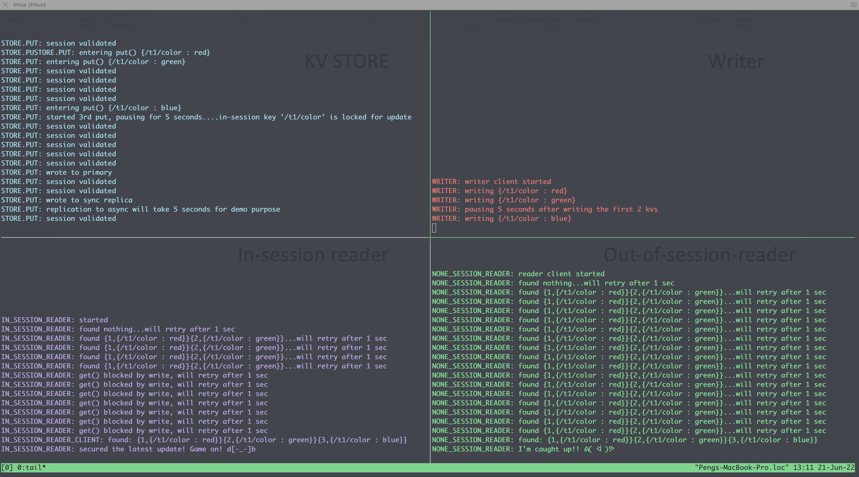
Demo
Writing to session
Non-session read continue without latest update
Session read blocked for latest update

Slide 16
7/11

Slide 17
730-Feature Research
Post-730 Feature Research
Sharding (CH + Rev Bucket + Path Group) - Peng
Distributed Indexing – Hongwei
Consistency (CR) - Ke
Feature Implementation
Perf Test
7/5
(today)
7/8
7/15
7/22
(brown bag)
7/29
Timeline

Slide 18
730 Solution Selection
Index
Sharding
Consistency
B-Tree
Revision Bucket + Consistency Hashing
Linearizable
(Chain-Replication)
Distributed Indexer
(Skip-list)
Sequential
(Chain-Replication)
Replication
Caching
Raft?
Read Cache
Chain-replication

Slide 19
“axx” → revs
indexer
rev → {key, value}
“bxx" → revs
storage
indexer
storage
txn {
axy,
bxy,
cxy,
}
storage
“cxx” → revs
storage
indexer

Slide 20
730 Storage Evaluation
Testing method
YCSB-go
Read latency
Replica (e.g. Locality)
Single Key, all revisions
Range key
Write latency
Replication (CR, sync-async)
Metrics Variables
Total data capacity (50 G, 100 G, 250 G, …)
Number of storage instance (also the data size per SI)
Read vs Write
Consistency, replication
Backend options, (Redis, BoltDB, RocksDB? …)
clients
Regionless KV

Slide 22
Later

Slide 23
Visions
Sharding algorithm
Key path group + rev bucketing + consistency hashing
Key groups
Path group
Txn group
Indexing:
B-tree
7/12 demo
ROI algorithm (7/12)
Smart indexer (access pattern aware)
Extension of the last face-color-changing demo
Txn, multiple values in the same transaction in the same session
Sharding, same txn to the same storage instance for atomicity
Replication protocol
7/30 release
KV store
Golang Code (Features see next slide)
Deployment scripts (download, deploy and test)
Performance test result

Slide 24
Owner: Peng Du
Owner: Ke Xu
Index
Sharding
Consistency
B-Tree
By Revision Group
Linearizable
(Chain-Replication)
Owner: Jun Shao
Segmented Tree
By Key Space
Sequential
(Chain-Replication)
Owner: Hongwei Chen
By Version Group
Distributed Indexer
(Skip-list)
Session
Owner: Peng Du
ROI (2- & 3-D)
Bounded Staleness
Owner: Peng Du
Owner: Hongwei Chen
Replication
Caching
HA
Fault-tolerance
Owner: Hongwei Chen
Modding
Read Cache
Interface
Plus-one
Smart Global Cache
Locality
Implementation

Slide 25
”The Demo” Project
Use cases:
Datacenter:
Regionless data store
Edge:
Stateful edge

Slide 26
Primary
replica
replica
Rev: 5
Value: k=a, v=b
Rev: 5
Value: k=a, v=b
Rev: 5
Value: k=a, v=b

Slide 27
Rev: 5
Value: k=a, v=b
Rev: 5
Value: k=a, v=b
Rev: 5
Value: k=a, v=b

