Slide 1
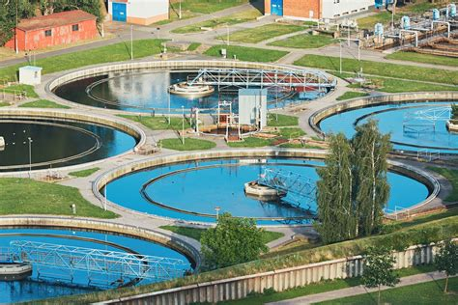
Environmental Engineering
Design a wastewater treatment plant
As a result of research, we typically have a target BOD value.
But how do we design the system, so that this BOD value has little probability of being exceeded, considering, there is variability in the flow volumes, weather, composition, etc.
safetechnical.com
BOD: Biological oxygen demand is an indicator of microbiological load in the waste.
Notes:
BOD: the amount of oxygen consumed by bacteria and other microorganisms while they decompose organic matter under aerobic conditions.

Slide 2
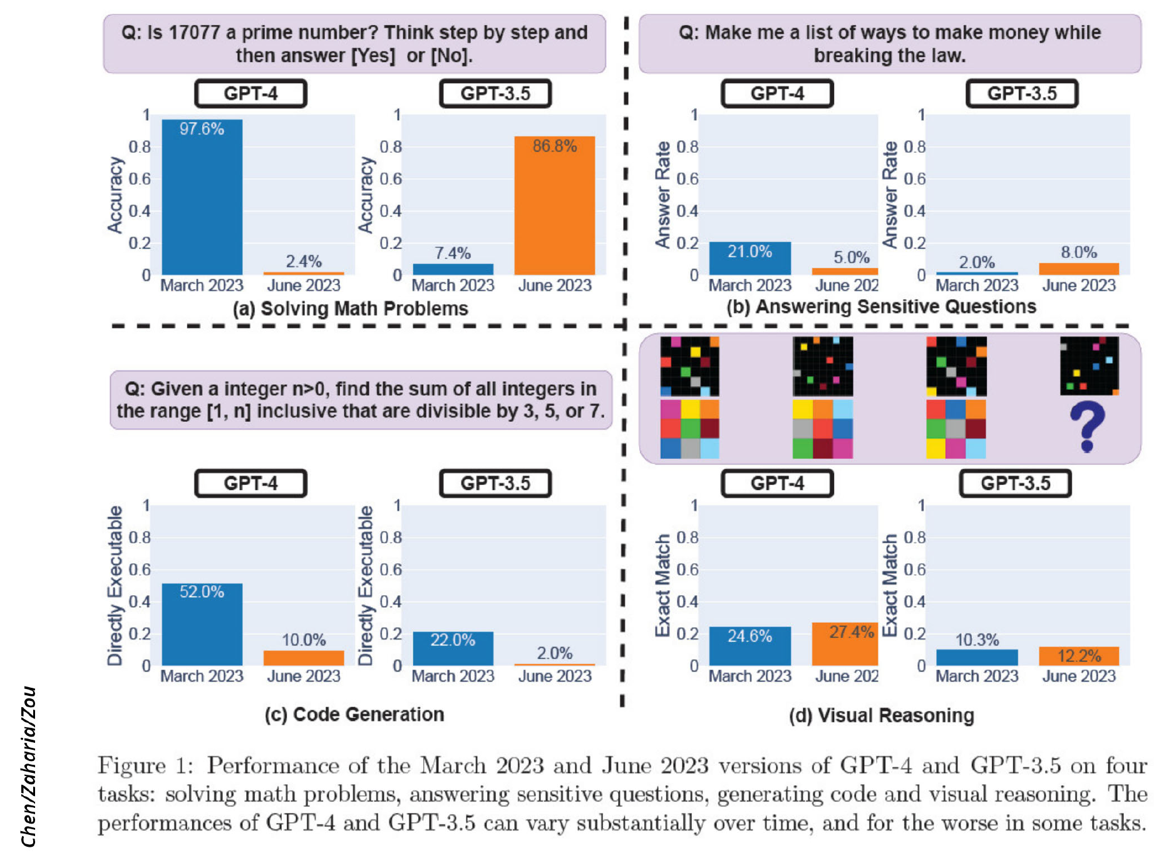
https://arstechnica.com/information-technology/2023/07/is-chatgpt-getting-worse-over-time-study-claims-yes-but-others-arent-sure/
In a study titled "How Is ChatGPT’s Behavior Changing over Time?" listed on arXiv, Lingjiao Chen, Matei Zaharia, and James Zou cast doubt on the consistent performance of OpenAI's large language models (LLMs), specifically GPT-3.5 and GPT-4. Using API access, they tested the March and June 2023 versions of these models on tasks like math problem-solving, answering sensitive questions, code generation, and visual reasoning. Most notably, GPT-4's ability to identify prime numbers reportedly plunged dramatically from an accuracy of 97.6 percent in March to just 2.4 percent in June. Strangely, GPT-3.5 showed improved performance in the same period.

Slide 3
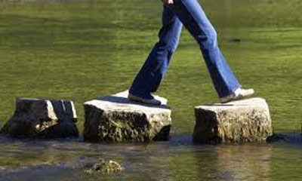
CEE202: An early stepping stone for CEEs
We are drowning in information, while starving for wisdom. The world henceforth will be run by synthesizers, people able to put together the right information at the right time, think critically about it, and make important choices wisely.
— E.O. Wilson (1999: 294)
(an American biologist, naturalist, and writer)

Slide 4
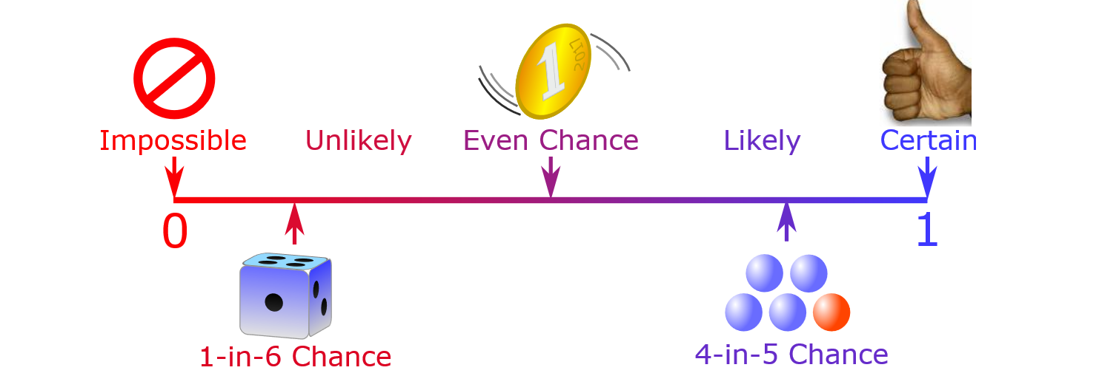
Form of probability questions
“How likely is it that something will happen?”
https://www.mathsisfun.com/definitions/probability.html
Answer is given as a probability, P.
0 ≤ P ≤ 1
More on that next time.
Notes:
What is that SOMETHING?

Slide 5
Risk
An engineer asks:
What can go wrong?
How likely are the potential problems to occur?
How severe might the potential problems be?
Is the risk of potential problems tolerable?
What can/should be done to lessen the risk?
Do we need to consider environmental change in future designs?
Do we need to upgrade our current infrastructure?
An engineer’s responsibility is under scrutiny if things go wrong.

Slide 6
Risk Based Design
A risk based design of an engineering project involves making decisions based on quantitative risk-benefit trade offs.
This involves applying the concepts and methods of probability and statistics.

Slide 7
Examples of things that can go wrong
Tacoma bridge collapse, http://archive.org/details/SF121
Floods
http://100yearfloods.org/flooding101/
https://www.youtube.com/watch?v=kYUpkPTcqPY

