Slide 1


Data Collection
Data Exploration
THE DATA'S
JOURNEY
Cleaning &
Normalization
Analysis
Hypothesis
Validation
Notes:
b

Slide 2



CONTINUING OUR JOURNEY
EXPLORATORY DATA ANALYSIS
DATA COLLECTION
DATA ANALYSIS
MODEL EVALUATION
PREPROCESSING

Slide 3
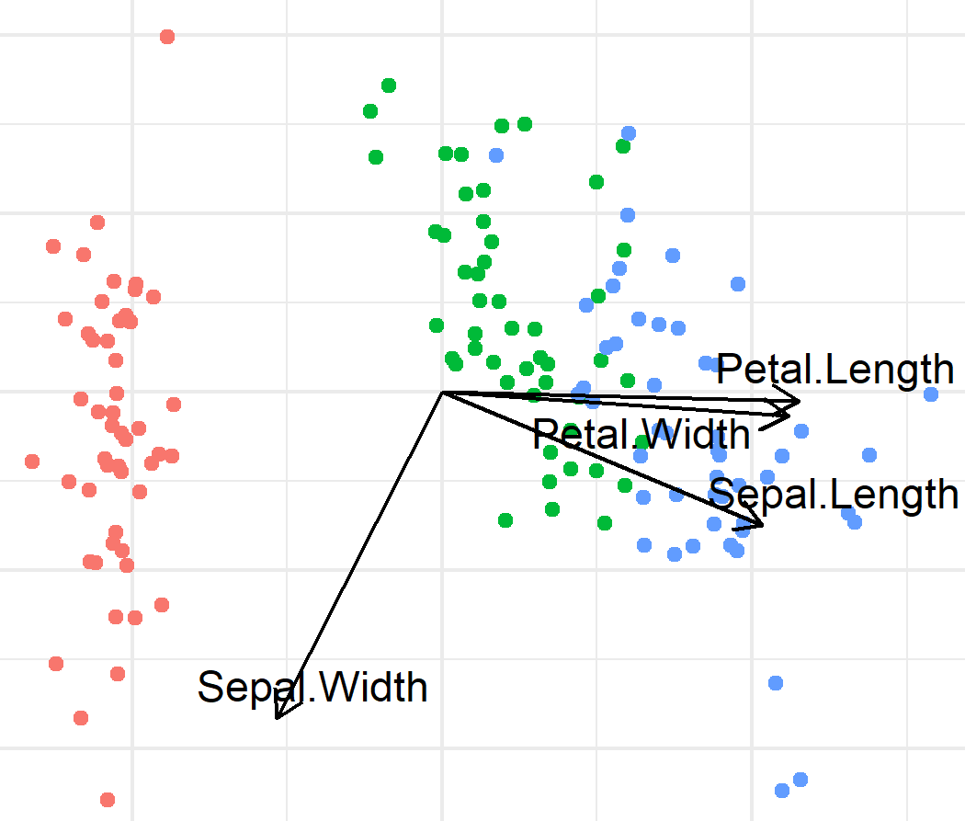
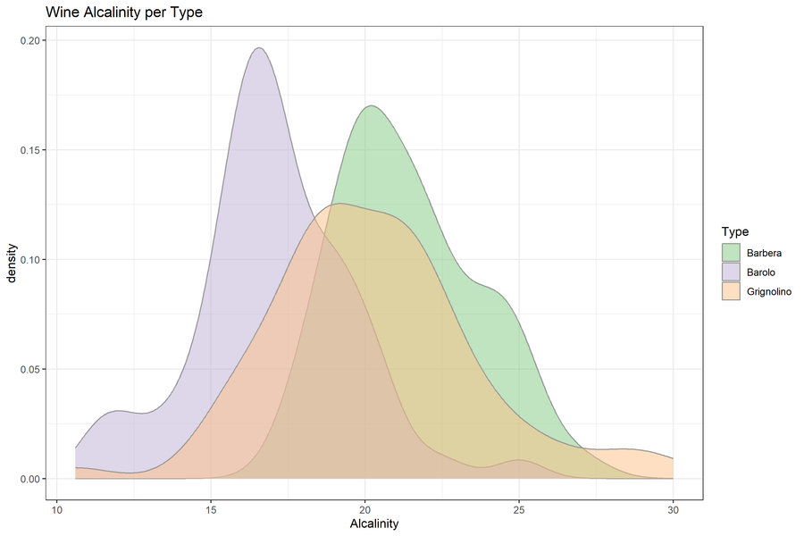
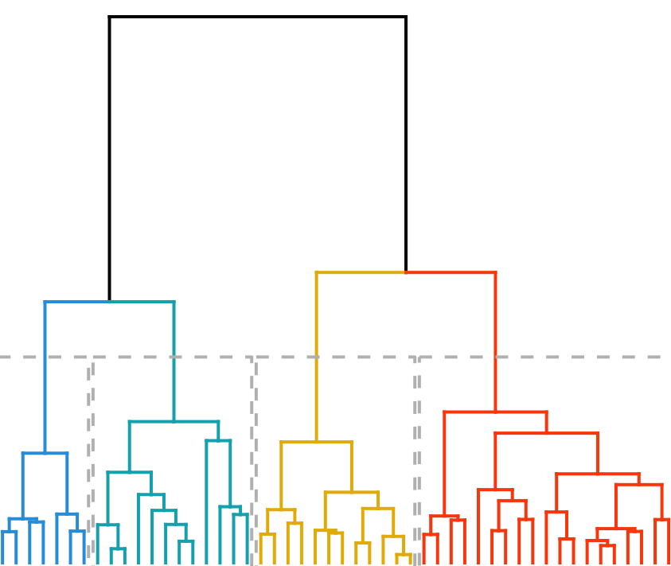
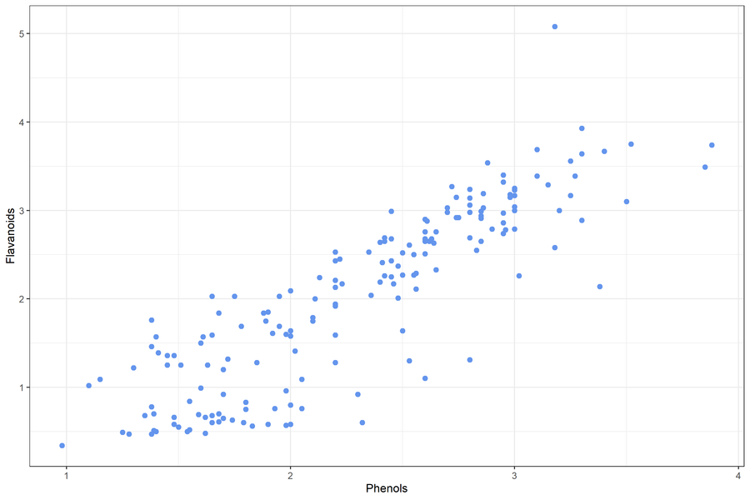
EXPLORATORY
DATA ANALYSIS
Biplot
Density Plot
Before we start our analysis we need to familiarize with the data.
What data do we have?
Does it look as you expected?
Is it suitable for the planned analysis?
How do we need to prepare the data for analysis?
Dendrogram
Scatter Plot
Notes:
Need to check both your own data and data you find somewhere else (repositories,ect)
It’s important to find good data
Examples of ‘bad’ stuff:
Linear regression on 3 data points
T-test on 5 data points
Confirm that data is suitable for planned analysis
Or
Help with idea generation(patterns, relationships between variables)
Establish whether:
Data looks as expected
identify obvious errors: outliers, label swaps
Something needs to be corrected
Preparation method
(normalization is needed?)
Are there patterns between variables?
What is the relationship between variables
How do we need to prepare the data for analysis?
What kind of analysis can we do?
https://www.ibm.com/topics/exploratory-data-analysis
Originally developed by American mathematician John Tukey in the 1970s, EDA techniques continue to be a widely used method in the data discovery process today.

Slide 4
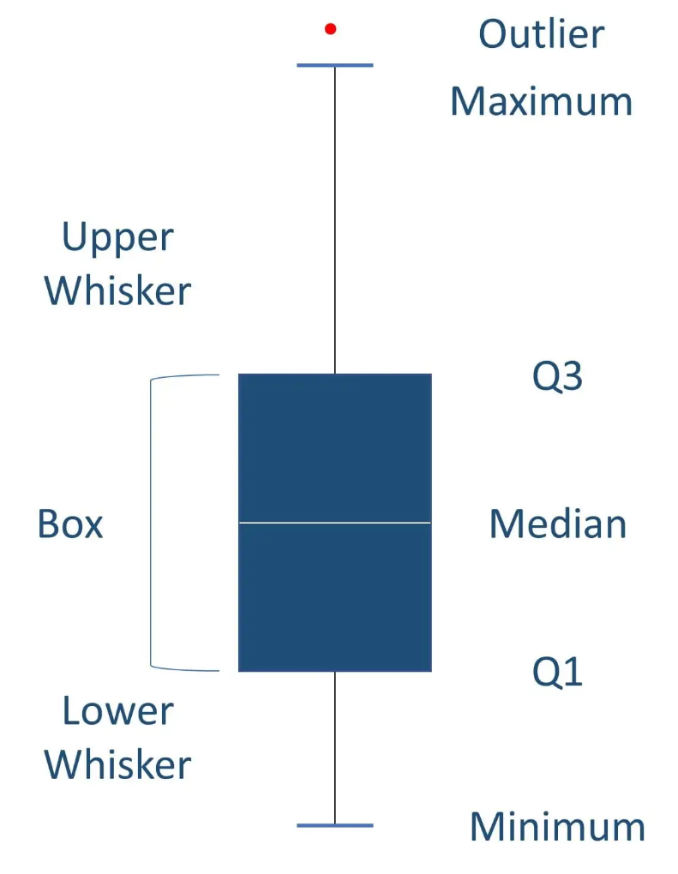
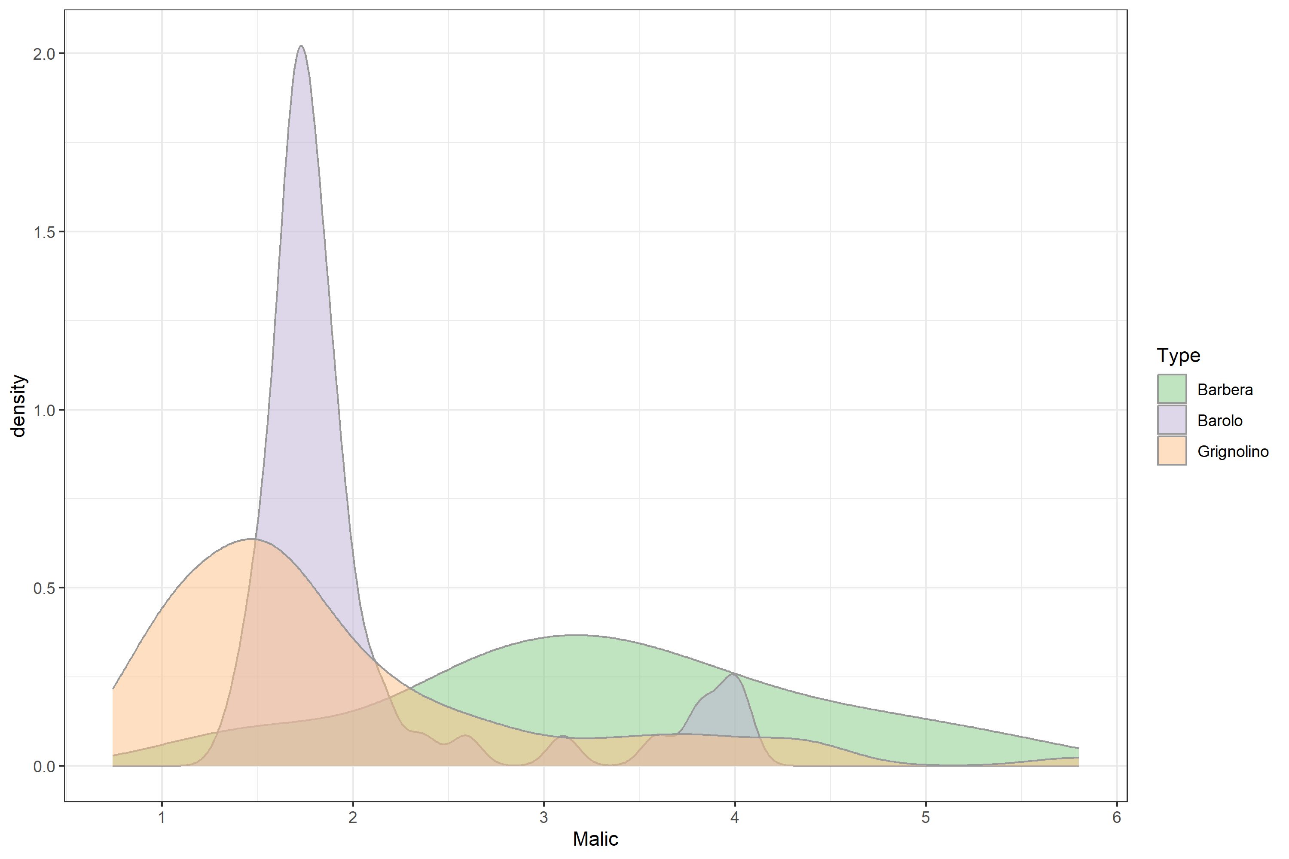
SUMMARY STATISTICS
Summary statistics are used to distill a dataset into some key characteristics.
They often include the following measures:
Central tendency (mean, median, mode)
Spread (standard deviation)
Minimum and Maximum
Quartiles
Shape of the distribution
Correlation between features

Slide 5
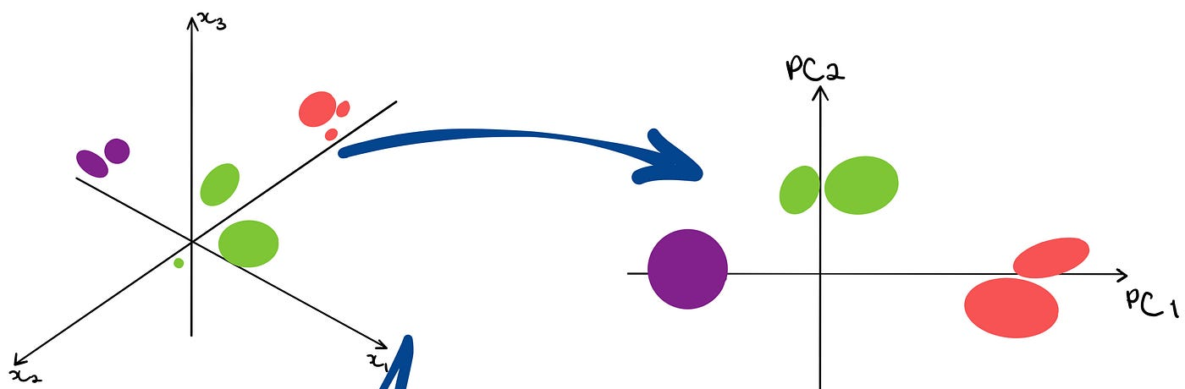
DOES THE DATA LOOK AS EXPECTED?
Single variables may be checked by their distribution, (density plot) but what about high-dimensional data?
One way to inspect the structure of your data is with a Principal Component Analysis (PCA) Plot
Image by Trist’n Joseph
PCA is a dimensionality reduction technique. It transforms data (linearly) from the original high dimensional space into a low (2 or 3) dimensional space, which the human eye can view and interpret.

Slide 6

PRINCIPAL COMPONENT ANALYSIS
Collection of wine bottles as an example. We have measured 13 different features such as alcohol content, color, alcalinity, and flavonoids.
PCA lets us derive a set of new dimensions that best describe all the original wine features while also being much lower dimensional.
These derived dimensions are the principal components and they will help us understand the structure of our data.
Notes:
PCs are linear combinations of all original features. Every original feature contributes to every PC (though some more than others)

Slide 7
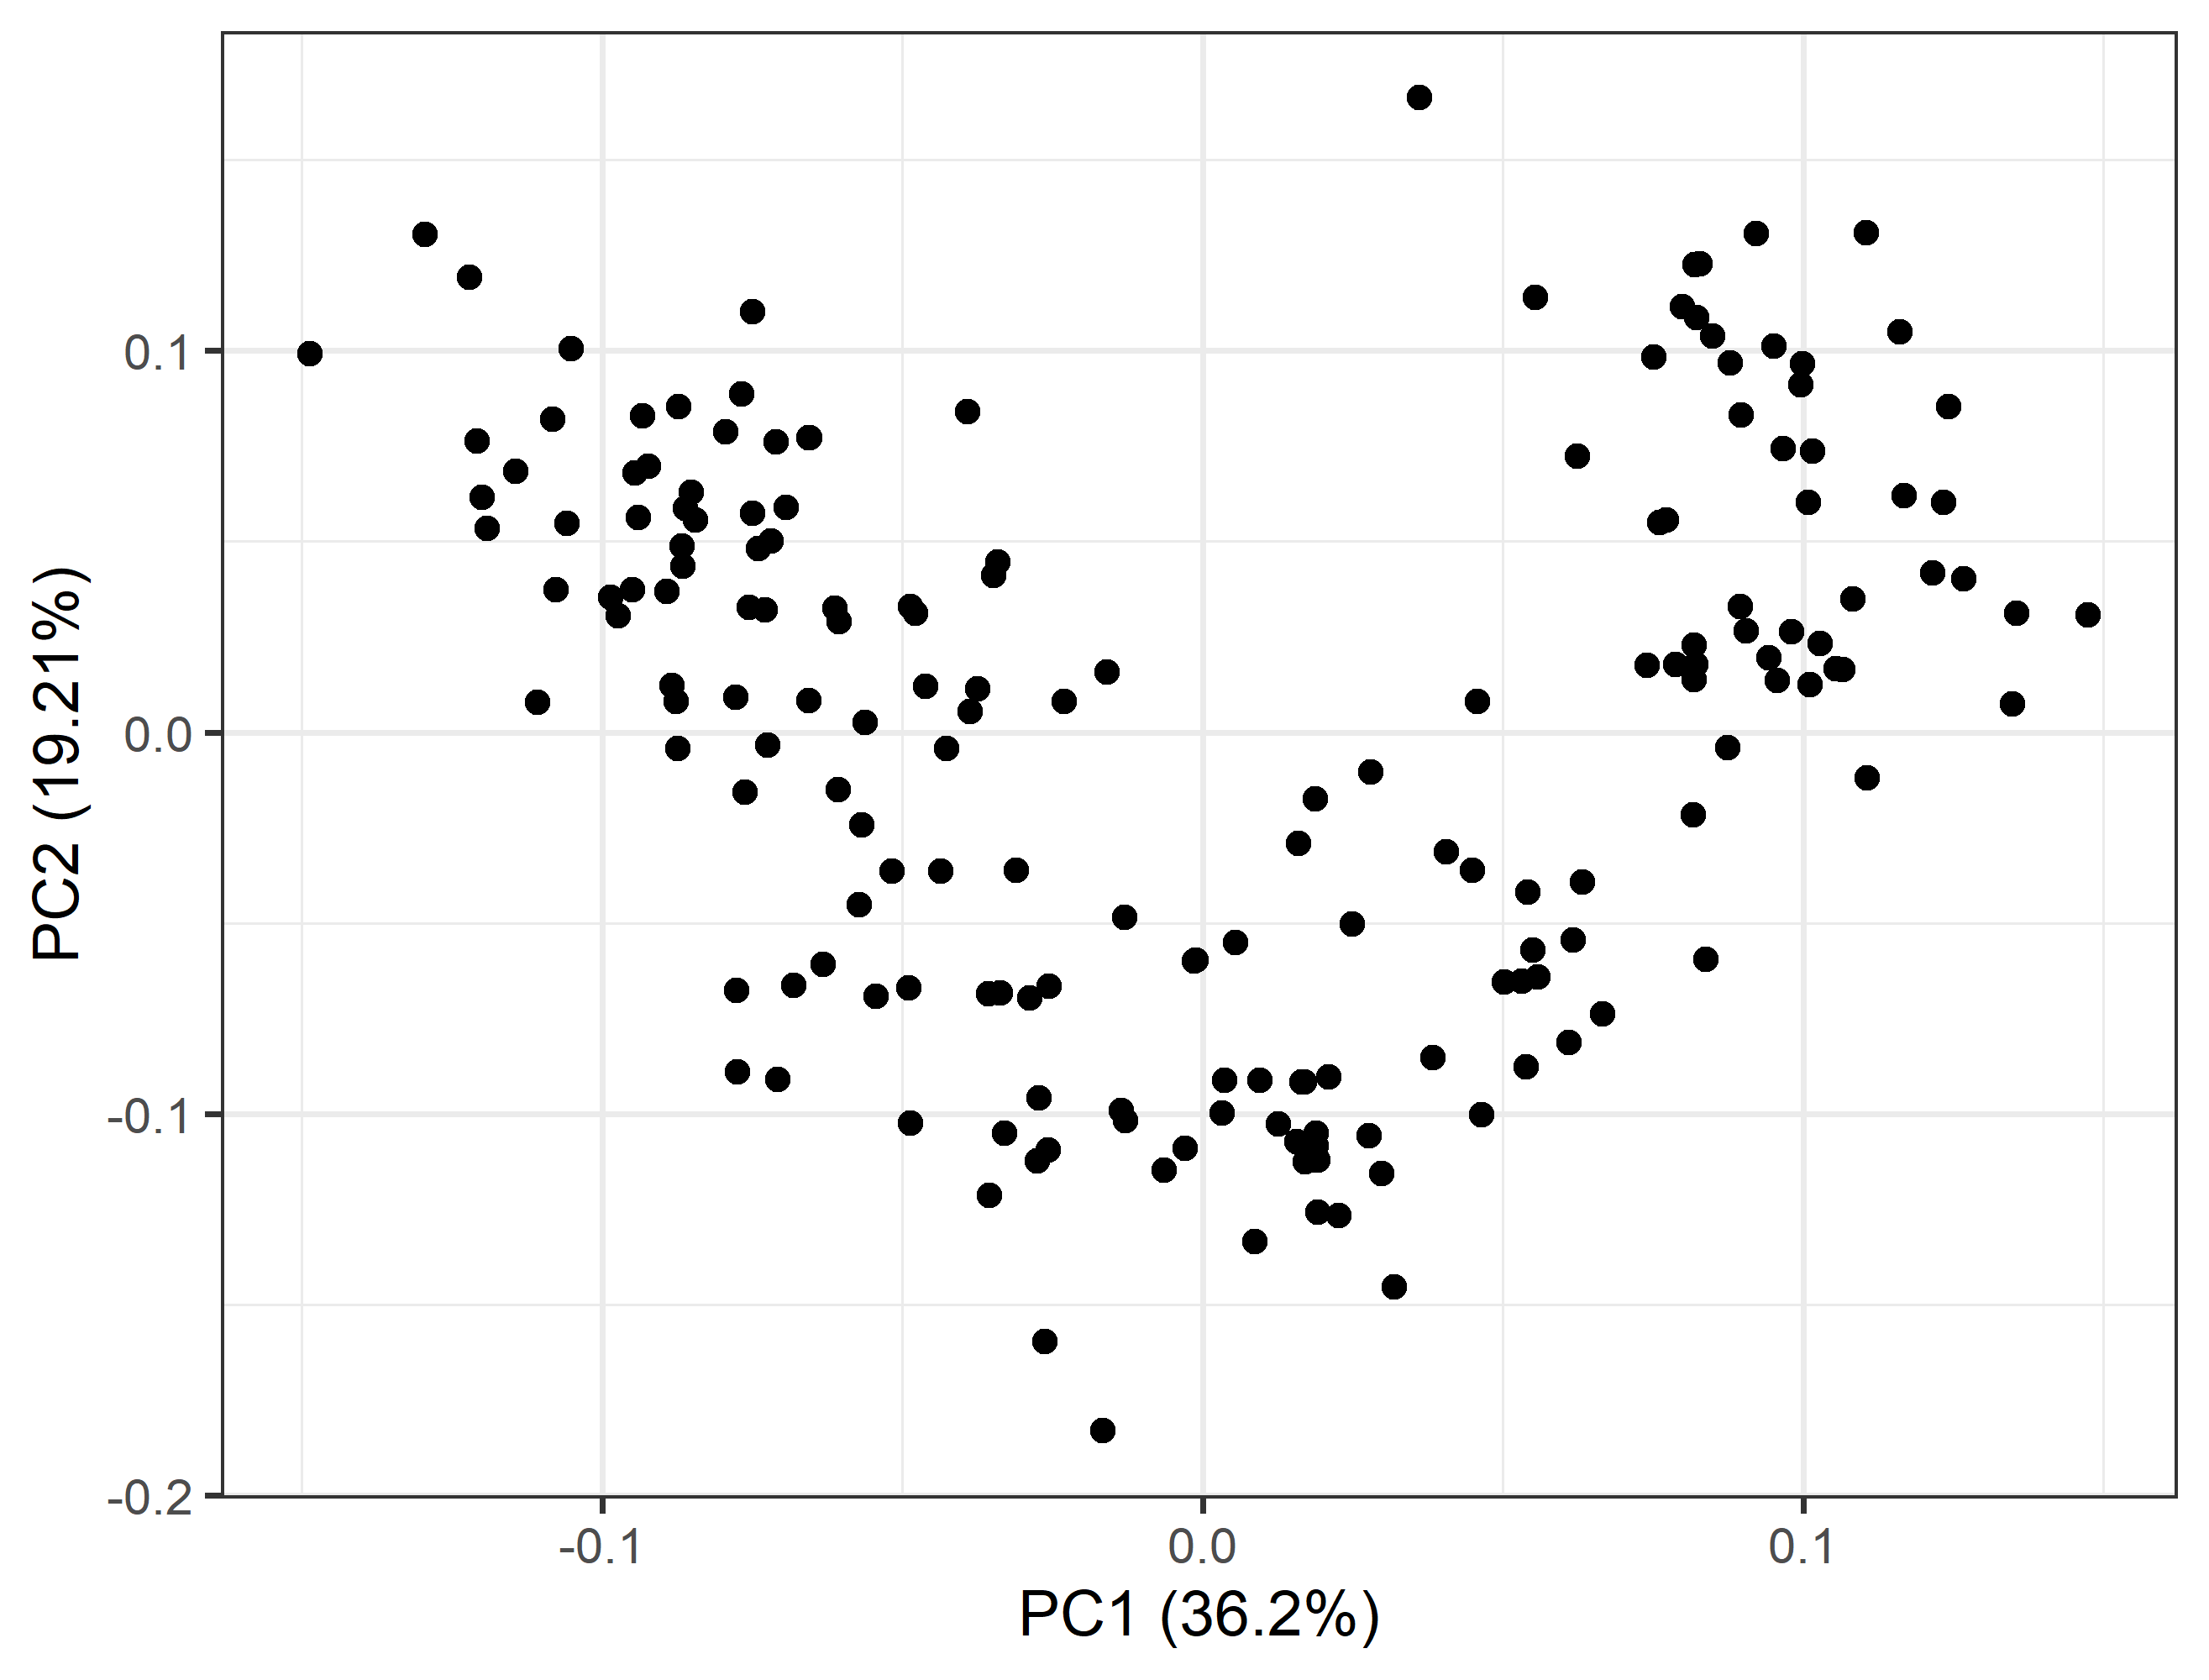
PRINCIPAL COMPONENT ANALYSIS
We can now plot all wine bottles in our data by the values of their first two PCs:
Each dot is one wine bottle.
If two wines are close in their PC1 and PC2, they are similar in the original feature space.
This helps us to visually understand the structure of our data (we cannot plot in 13 dimensions!).

Slide 8
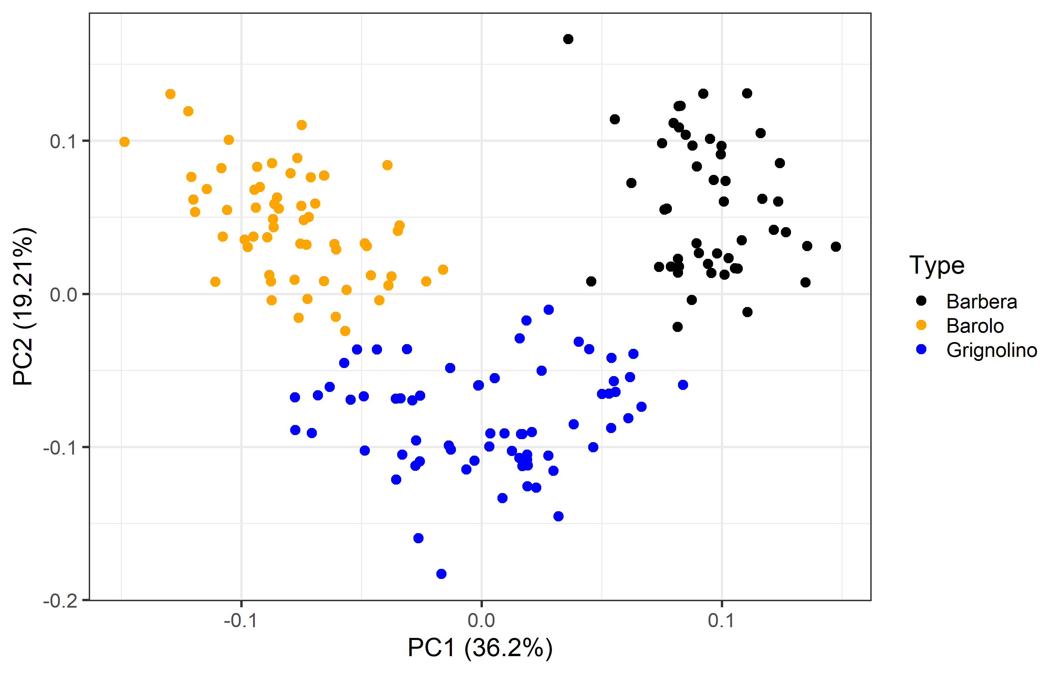
PRINCIPAL COMPONENT ANALYSIS
If two wines are close in PC1 and PC2 value they are similar also in their original features.
Color by wine type
Types of wine cluster together
Most Barbera wines are similar to other Barbera wines even in only 2 dimensions.
Notes:
Importantly, there are no 2 original dimensions (i.e. alcohol and color) we could have picked that would give us the same level of separation!
Now, what do you think would happen if we have an outlier data point with very strange values?
-> point somewhere by itself
What would happen if someone has swapped the labels of the type of wine?
-> you will see the dot in the cluster of another color

Slide 9
PRINCIPAL COMPONENT ANALYSIS
PC’s are linear combinations of the original features
If two clusters are well separated in the PCA that means there is a combination of original features that explains which cluster a data point belongs to.
We can use this to predict the cluster for new data points.
Notes:
This bodes well if wanted to predict the type of wine from the original features since the principal components are linear combinations of the original features.
Mention what the explained variance means (percentage on the axis)
Importantly, there are no 2 original dimensions (i.e. alcohol and color) we could have picked that would give us the same level of separation!
Now, what do you think would happen if we have an outlier data point with very strange values?
-> point somewhere by itself
What would happen if someone has swapped the labels of the type of wine?
-> you will see the dot in the cluster of another color

Slide 10

PRINCIPAL COMPONENT ANALYSIS
What do you think is going on in this PCA?
Notes:
Importantly, there are no 2 original dimensions (i.e. alcohol and color) we could have picked that would give us the same level of separation!
Now, what do you think would happen if we have an outlier data point with very strange values?
-> point somewhere by itself
What would happen if someone has swapped the labels of the type of wine?
-> you will see the dot in the cluster of another color

Slide 11
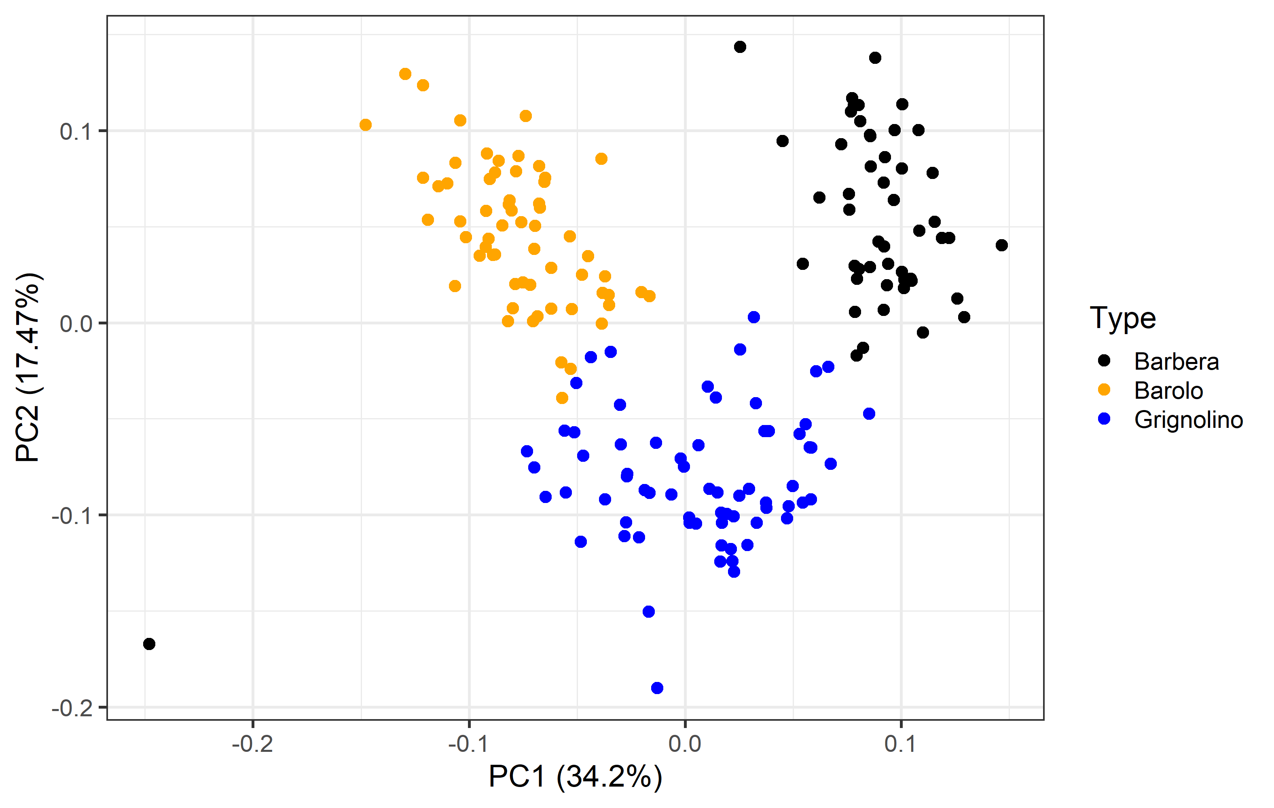
PRINCIPAL COMPONENT ANALYSIS
What do you think is going on in this PCA?
Notes:
Importantly, there are no 2 original dimensions (i.e. alcohol and color) we could have picked that would give us the same level of separation!
Now, what do you think would happen if we have an outlier data point with very strange values?
-> point somewhere by itself
What would happen if someone has swapped the labels of the type of wine?
-> you will see the dot in the cluster of another color

Slide 12
PRINCIPAL COMPONENT ANALYSIS
In summary:
PCA is a linear dimensionality reduction technique
We can see if there are clusters in the data
We can see whether these clusters correspond to a variable we are interested in
We can see if data points are outliers
We can see if data point behave strangely, i.e. if they are in the wrong cluster.
OBS: PCA works only on numeric data!
Notes:
There are also other dimensionality techniques, such as MDS (linear) and t-sne or UMAP (non-linear)

Slide 13



Slide 14


GROUP DISCUSSION
In your group discuss the printed PCA plots.
What can you see?
What do you think it means?
Notes:
10 mins

Slide 15

When things go wrong…
Help, please!

Slide 16






BATCH EFFECTS
Batch effect == unwanted variation introduced by technical procedures, i.e. collection, handling, storage, or experimental protocol.
Batch effects can be corrected during analysis, if they are not correlated with the outcome.
If the batch effect is correlated with the outcome you now have a confounded dataset (this can not be fixed!).
Notes:
It means there is an effect of which ‘batch’ a data point belongs to that is unrelated to the outcome and that we want to be as low as possible.
Confounded means we cannot distinguish between the effect of the condition (the outcome) and the effect of the batch.
Do more examples of batch effect: two different people doing the processing
Diana found the link between confounding and batch effect confusing
What you just discussed is called a batch effect. It means that either the main or at least a significant source of variation in your data comes from a variable which is not your outcome of interest.
I think batch effects can lead to confounding. I.e. if I have tissue samples from cancer patients and healthy people, and the cancer samples are all handled in one hospital and the healthy all in a different hospital. Then the hospital and group(cancer/healthy) variables are completely confounded. But this confounding has been introduced by the batching. They are not ‘inherently’ confounded.
Correcting batch effect is about trying to account for the batching by estimating how large the effect is
-> is this correct?
Sometimes batching is unavoidable, i.e. when samples are too many to be processed on the same day or by the same person. So the point is less to avoid batching and more to do it in a way that introduces the least amounts of confounding. We generally do this by trying to make the biological variables uncorrelated with the technical variables.
Batch effects can be accounted for in certain types of models by telling the model to discount the effect of a certain variable.
-> look up if this is correct, or how we conceptually correct batch effects
https://www.nature.com/articles/nrg2825/
Although batch effects are difficult or impossible to detect in low-dimensional assays, high-throughput technologies provide enough data to detect and even remove them.
But normalization does not remove batch effects, which affect specific subsets of genes and may affect different genes in different ways. In some cases, these normalization procedures may even exacerbate technical artefacts in high-throughput measurements, as batch and other technical effects violate the assumptions of normalization methods.
describe experimental and computational solutions to reduce their impact on high-throughput data
In gene expression studies, the greatest source of differential expression is nearly always across batches rather than across biological groups, which can lead to confusing or incorrect biological conclusions owing to the influence of technical artefacts.

Slide 17
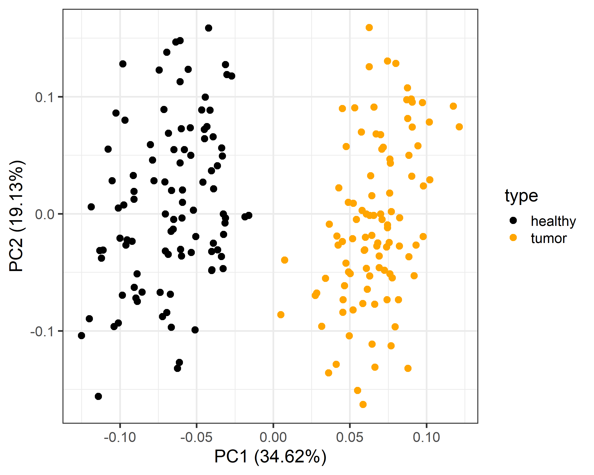
BATCH EFFECTS ON PCA PLOT
PCA plots can be used to investigate whether batch effects are present
PCA of gene expression data from healthy and tumor samples.
Separation of samples depending on the tissue type along PC1 (explains ~ 35% of the variation in our dataset).
Notes:
In fact, PCA plots are often the bearer of bad news before you have even started your analysis. Consider the following scenarios:

Slide 18
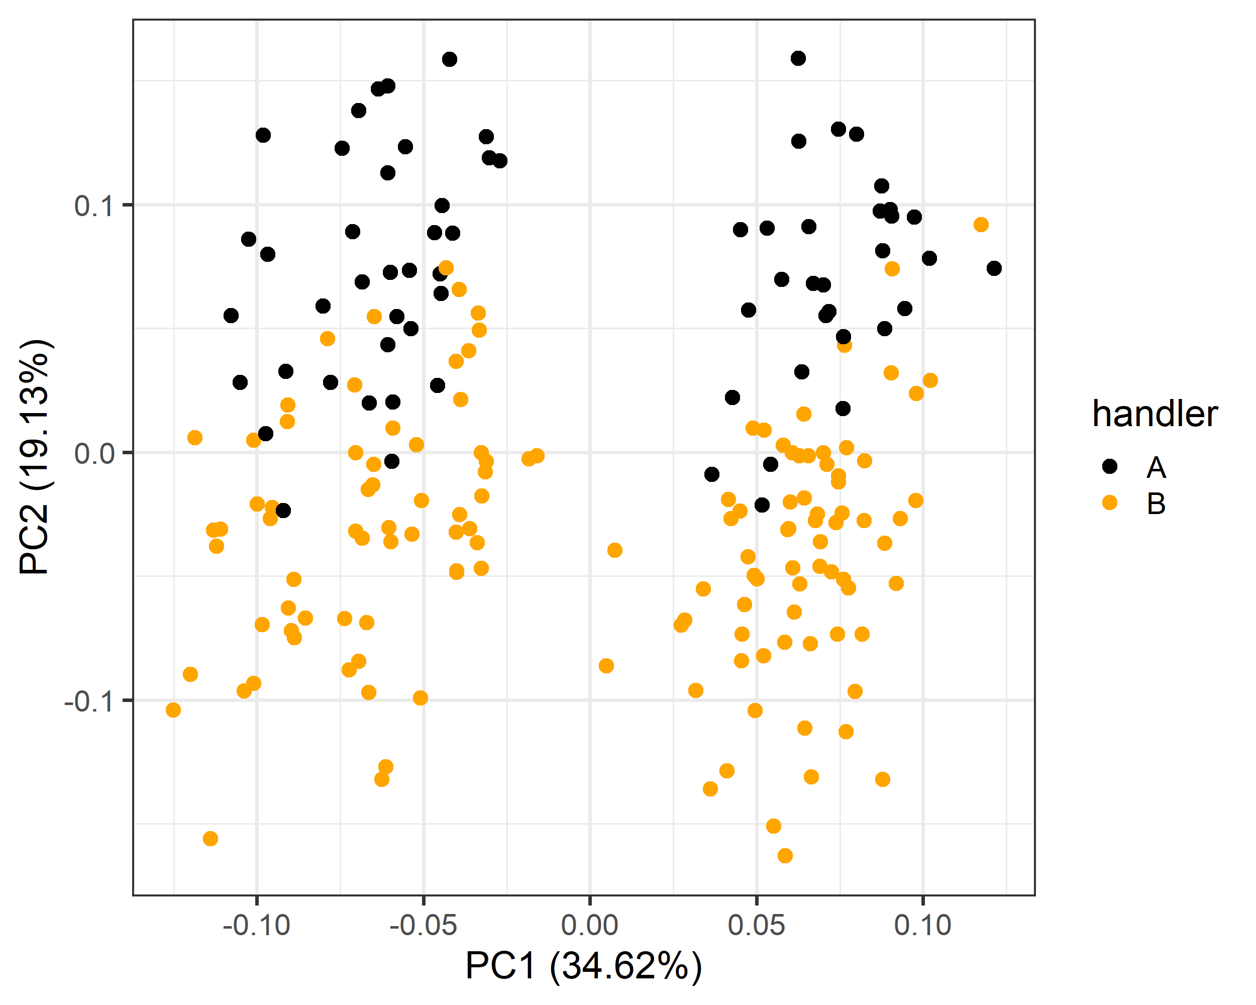
BATCH EFFECTS ON PCA PLOT
PC2, not related to the tissue type.
Color by who has processed the samples we can see this is a processing batch effect.
IF you had one person process all tumor samples and another person all the healthy samples, how would this plot look?
Notes:
In fact, PCA plots are often the bearer of bad news before you have even started your analysis. Consider the following scenarios:

Slide 19
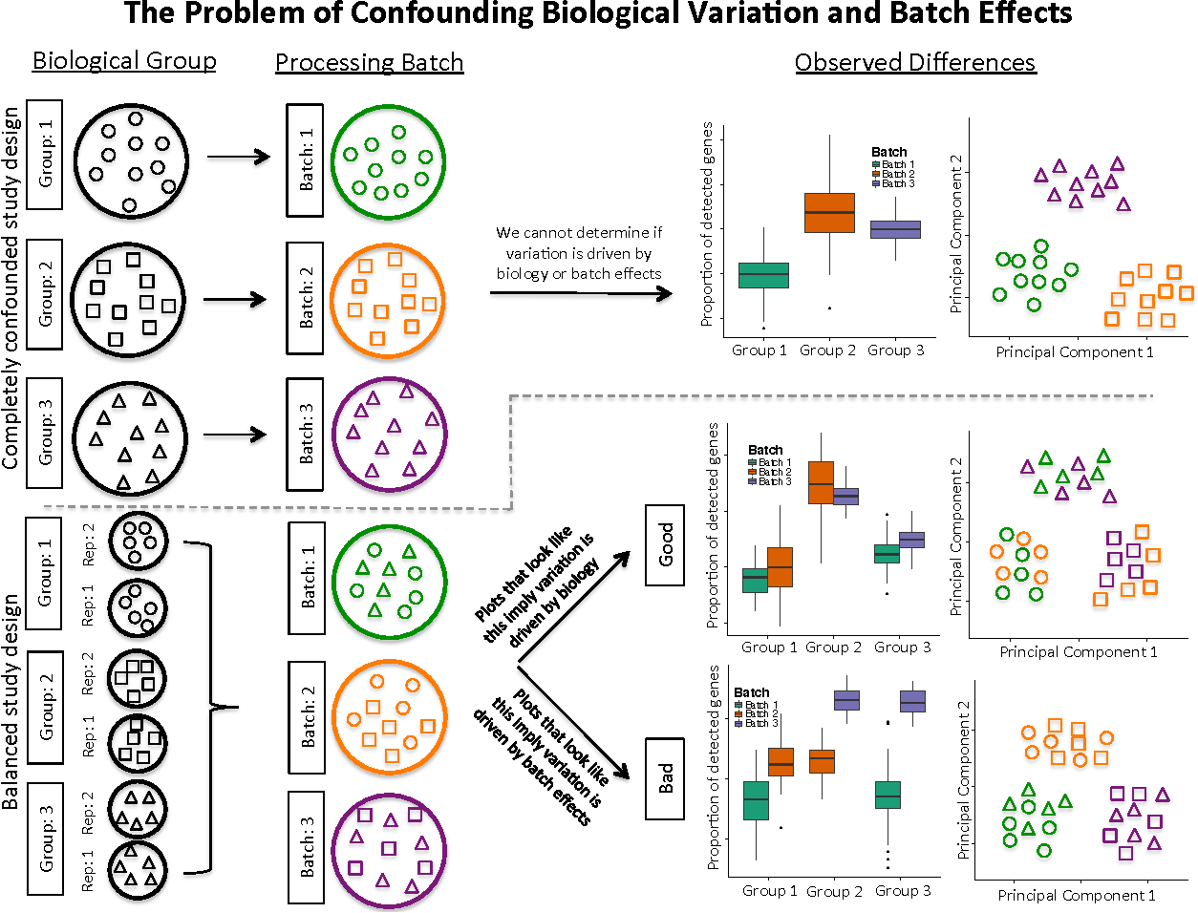
BACK TO EXPERIMENTAL DESIGN
Hicks, et al. BioRxiv 10 (2015): 025528.
Notes:
In fact, PCA plots are often the bearer of bad news before you have even started your analysis. Consider the following scenarios:

Slide 20
Remember our study of gene expression in tumor and healthy tissue from part 1. Since you have a lot of samples you ask two lab techs to each process half.
Which of the two workflows will lead to a confounded dataset?

Slide 21
OTHER CHECKS
There are many things one should check before DS analysis. Here we mention a just few:
Check the data:
Unreasonable values: If a data point is “out of scale” you should be able to see that in the PCA plot (if you have few features you could also check their range).
Unreasonable combinations: Sometimes each variable is fine by itself but they are combined in a way that strike you as odd, i.e. children who are also former smokers
Check model/test assumptions:
Most tests have assumptions, such as that data is normally distributed and that the variance is homogenous between groups - more on this later…
Notes:
Unreasonable values: Do you have i.e. patients with a negative age, an age over 100 or a pulse of 20?
Unreasonable combinations: children who are also former smokers (this is a real example from a heart disease dataset).

Slide 22
THE ROLE OF DOMAIN EXPERTS
Domain knowledge plays a big role in EDA
The person doing the data processing may not know what values are reasonable for a given variable or which combinations of variables look suspicious.
It is a good idea to have a person who understands the data check plots, ask questions and suggest things to test.

Slide 23
BACK TO THE ROLES
Principal Investigator
Idea generation:
Patterns
Relationship between variables
Confirm whether the data is suitable to analyze hypothesis
Perform data science analysis
Hypothesis
Domain expert
Statistician/
Mathematician
Data Scientist
Data
Data Collector
Notes:
Patterns are high dimensional, hierarchical, several variables

Slide 24
EXPLORATORY DATA ANALYSIS
Biplot
This was a quick intro to EDA.
In summary it helps us to:
Check if the data looks as expected
Identify obvious errors: outliers, label swaps
Establish what kind of analysis we can do
Find out how we need to prepare the data for analysis (more on this later)
Density Plot
Dendrogram
Scatter Plot
Notes:
Need to check both your own data and data you find somewhere else (repositories,ect)
It’s important to find good data
Examples of ‘bad’ stuff:
Linear regression on 3 data points
T-test on 5 data points
Confirm that data is suitable for planned analysis
Or
Help with idea generation(patterns, relationships between variables)
Establish whether:
Data looks as expected
identify obvious errors: outliers, label swaps
Something needs to be corrected
Preparation method
(normalization is needed?)
Are there patterns between variables?
What is the relationship between variables
How do we need to prepare the data for analysis?
What kind of analysis can we do?
https://www.ibm.com/topics/exploratory-data-analysis
Originally developed by American mathematician John Tukey in the 1970s, EDA techniques continue to be a widely used method in the data discovery process today.

Slide 25
EXPLORATORY DATA ANALYSIS
If you are unfamiliar with some data types and/or analysis we recommend you to:
Consult us in the Data Lab for a sparring/discussion session
Consult the literature, specifically review papers. Find out what is known to work and what other people do
Consult colleagues and collaborators
Take a course/send a group member to a course
Notes:
Need to check both your own data and data you find somewhere else (repositories,ect)
It’s important to find good data
Examples of ‘bad’ stuff:
Linear regression on 3 data points
T-test on 5 data points
Confirm that data is suitable for planned analysis
Or
Help with idea generation(patterns, relationships between variables)
Establish whether:
Data looks as expected
identify obvious errors: outliers, label swaps
Something needs to be corrected
Preparation method
(normalization is needed?)
Are there patterns between variables?
What is the relationship between variables
How do we need to prepare the data for analysis?
What kind of analysis can we do?
https://www.ibm.com/topics/exploratory-data-analysis
Originally developed by American mathematician John Tukey in the 1970s, EDA techniques continue to be a widely used method in the data discovery process today.

Slide 26
GROUP DISCUSSION
In your group discuss:
Boxplot:
Does the plot display a pattern worth noting. If so, what is the cause of it?
Are the data confounded?
Are there any outliers? If so, do you have any theory as to what gave rise to them (i.e. biological or technical reason?).

Slide 27

A BREAK IN OUR JOURNEY

Slide 28


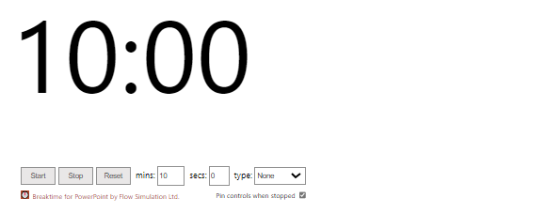
A BREAK IN OUR JOURNEY

Slide 29
DETOUR ON OUR JOURNEY
EXPLORATORY DATA ANALYSIS
DATA COLLECTION
DATA ANALYSIS
MODEL EVALUATION
CLEANING, SET-UP & NORMALIZATION
PREPROCESSING

Slide 30
DATA CLEANING AND SET-UP
Wide w. missing values
We want to clean up our data:
Remove data outliers or duplicates
Ensure categorical variables are spelled the same
Change one type of variable to another type
Merge, add or remove variables
Layout, long VS wide format
Treatment | Age | height | weight
A | 55.0 | NA | 65.7
B | 31.0 | 172.0 | 69.4
C | 39.0 | 161.0 | NA
Imputation
Treatment | Age | height | weight
A | 55.0 | 170.0 | 65.7
B | 31.0 | 172.0 | 69.4
C | 39.0 | 161.0 | 58.1
Wide to long
Treatment | variable | value
A | Age | 55.0
A | height | 170.0
A | weight | 65.7
B | Age | 31.0
B | height | 172.0
B | weight | 69.4
C | Age | 39.0
C | height | 161.0
C | weight | 58.1
Missing values:
Filter out some/all missing values
Impute missing values (Regression, Maximum Likelihood, ML)
Notes:
Types of variables: factors, binary, characters, numerical, integers

Slide 31
TYPES OF MISSING VALUES
MCAR:
Data points have the same probability of being missing
I.e. lab tool error
MAR:
Missing data point is not related to missing data itself, but to other variables.
I.e. Health records in lower median income countries
Missing Completely at Random
(MCAR)
MNAR:
Missing data points are related to the reason why data are missing.
I.e. Assessing depression through questionnaires
Missing at Random
(MAR)
Missing Not at Random
(MNAR)
Notes:
Types of variables: factors, binary, characters, numerical, integers

Slide 32
GROUP DISCUSSION
In your group discuss the data table we have handed out:
Identify the different data types it contains (categorical, numerical, integer, binary, factors).
Can you find any errors/problems within the data table which would have to be fixed before data analysis ?
Notes:
10 mins

Slide 33
DATA NORMALIZATION
In applied statistics the word 'normalization' can have a range of meanings.
Here we’re going to use the following definition:
Normalization is a process intended to reduce unwanted variation and make samples more easily comparable
Unwanted variation should be low between samples within a group (i.e. all the tumor samples) as we are interested in differences between groups (tumor VS healthy).
Notes:
Technical variation that affect different samples differently
This can obscure difference or create differences that are not real
We want to remove this variation as much as possible since we are interested in biological variation
Critically important for omics data analysis

Slide 34
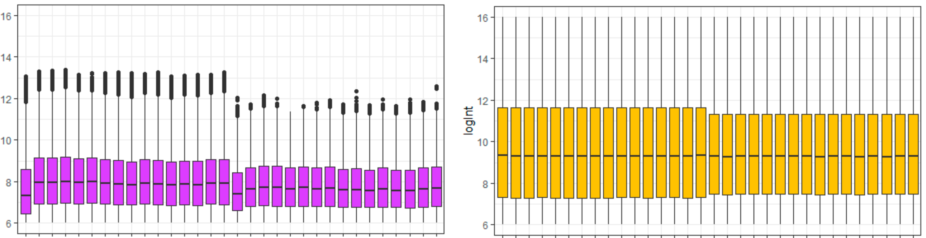
UNWANTED VARIATION
Technical variation:
Introduced by i.e. sample handling, data batches, device calibrations, ect.
Non-technical variation not related to the outcome:
i.e. gene length and library size (number of reads) in RNAseq
Notes:
Technical variation that affect different samples differently
This can obscure difference or create differences that are not real
We want to remove this variation as much as possible since we are interested in biological variation
There is of course background noise in our data, this can sometimes modelled and sometimes it is so little and random we do not expect it to affect our analysis, in that case we simply ignore it.

Slide 35
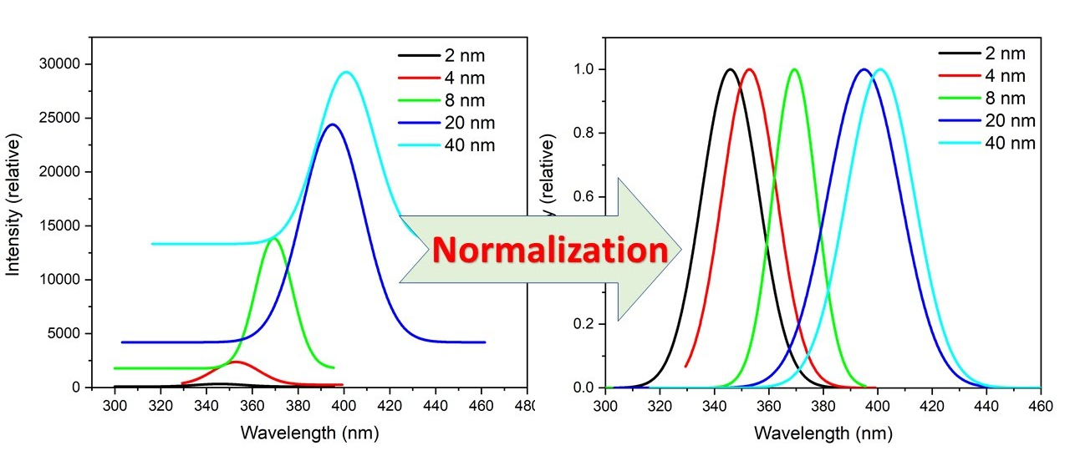
DATA NORMALIZATION
Normalization is not a trivial task!
Different data types have different suitable normalization procedures.
Sometimes one type of data/experiment can be normalized in multiple ways
New and improved normalization procedures are introduced regularly
Important that one uses the same normalization with same parameters for the entire dataset.
Often, we need to consult literature and/or an expert.
Notes:
Technical variation that affect different samples differently
This can obscure difference or create differences that are not real
We want to remove this variation as much as possible since we are interested in biological variation
Critically important for omics data analysis

Slide 36
GROUP DISCUSSION
Thinking of the data that you (or your students) work with, what are potential sources of unwanted variance, technical or non-technical?

Slide 37
STANDARDIZATION & TRANSFORMATION
NORMALIZATION
STANDARDIZATION
TRANSFORMATION
TRANSFORMATION
Can use for not normally distributed data.
Variables do not get zero centered.
Normalization within a range (max, min).
Affected by outliers.
For normally distributed data
Scaled to a mean of 0 and standard dev. of 1.
Scaling is not con-strained to a particular data range.
Not affected by outliers.
Attempt to make data normally distributed (required for some tasks)
Often logarithmic transformations
Squeezes outliers for less impact on model.
Notes:
We do not do standardization in the analysis of high throughput omics data, mainly because these data do not follow a normal distribution.

Slide 38
GROUP DISCUSSION
In your group discuss:
The density plot:
What does the plot tell you about the distribution of gene counts.
Are the data normally distributed? Why do we often like our data to be normally distributed?
If data are not normally distributed what could we do? There are two different strategies we could use...

Slide 39
DETOUR ON OUR JOURNEY
EXPLORATORY DATA ANALYSIS
DATA COLLECTION
DATA ANALYSIS
MODEL EVALUATION
CLEANING, SET-UP & NORMALIZATION
DATA
MANAGEMENT
PREPROCESSING
Notes:
Data management: file naming, version control, tracking of changes. What has been done to clean the data?

Slide 40

LUNCH BREAK
IN OUR JOURNEY

