Slide 1


Data Collection
Data Exploration
THE DATA'S
JOURNEY
Cleaning &
Normalization
Analysis
Hypothesis
Validation
Notes:
b

Slide 2


FINAL PART OF OUR JOURNEY
EXPLORATORY DATA ANALYSIS
DATA COLLECTION
DATA ANALYSIS
MODEL EVALUATION

Slide 3
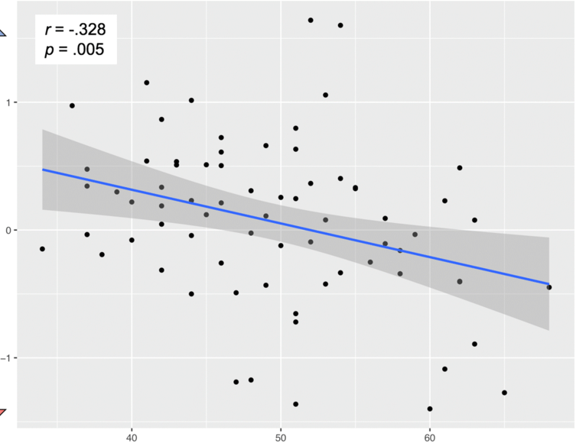
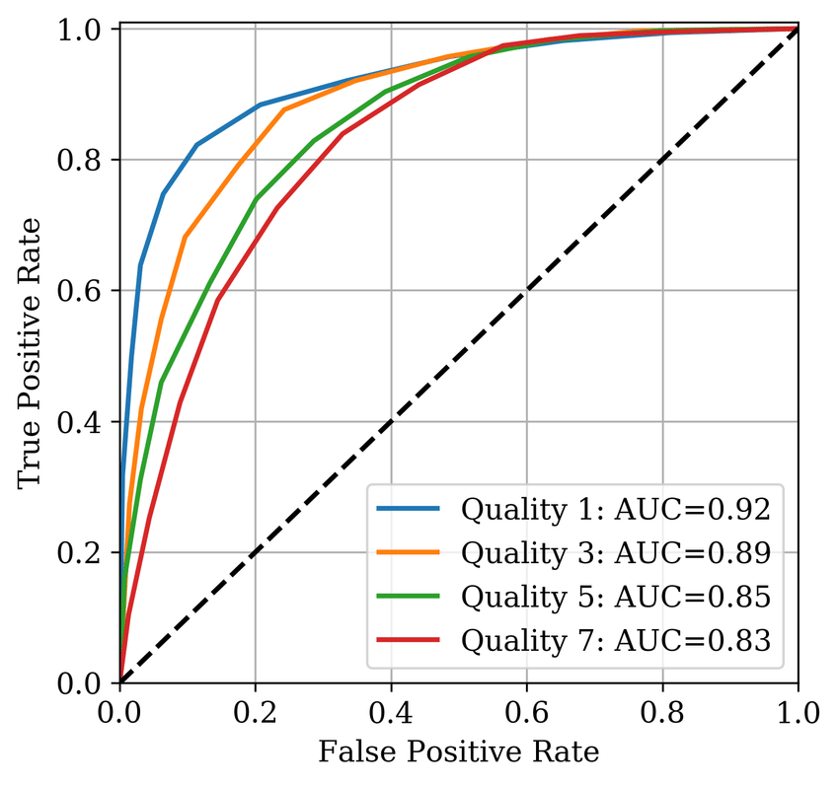
MODEL EVALUATION
How do we measure performance?
How far can we trust the results we have obtained?
What do the results mean?

Slide 4
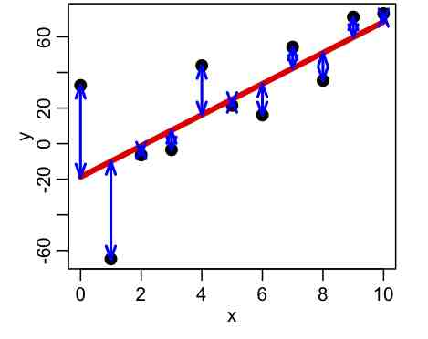
MODEL PERFORMANCE
What is a good model?
How well does the model fit the data?
Criteria depend on model type
Good models capture the underlying trends and characteristics
How well does the model perform the task?
Goodness of clustering (silhouette, BIC, ect)
Error terms
Accuracy, AUC, precision, recall
Notes:
Relevant for models that have parameters you can choose: regression, classification (not t-test).
The two questions are not the same.
How well does the model fit?
Every type of model has their own criteria by which we evaluate
For regression that could be least squares (distance of data points to fitted line)
Good model captures underlying trends and characteristics of the data
Can estimate deviations by goodness-of-fit
For clustering we can evaluate whether the number of clusters we have chosen is optimal
If we did kmeans we may discover the ideal number of clusters using the elbow method:
Different measures to describe “how much are the points in a certain cluster more similar between themself than with the points in different clusters?”
The measures, also called clustering evaluation techniques, are: silhouette score, calinski harabasz score, davies bouldin score. There may be others
We use this to score the goodness/usefulness of the clustering and pick the number of clusters with the highest measure
However, we do not want a perfect fit! Because data always has noise, if the model fits the data too well it will become very poor at doing the actual task (classification) and we get overfitting.
Therefore, we evaluate separately how well the model performs on the task.

Slide 5
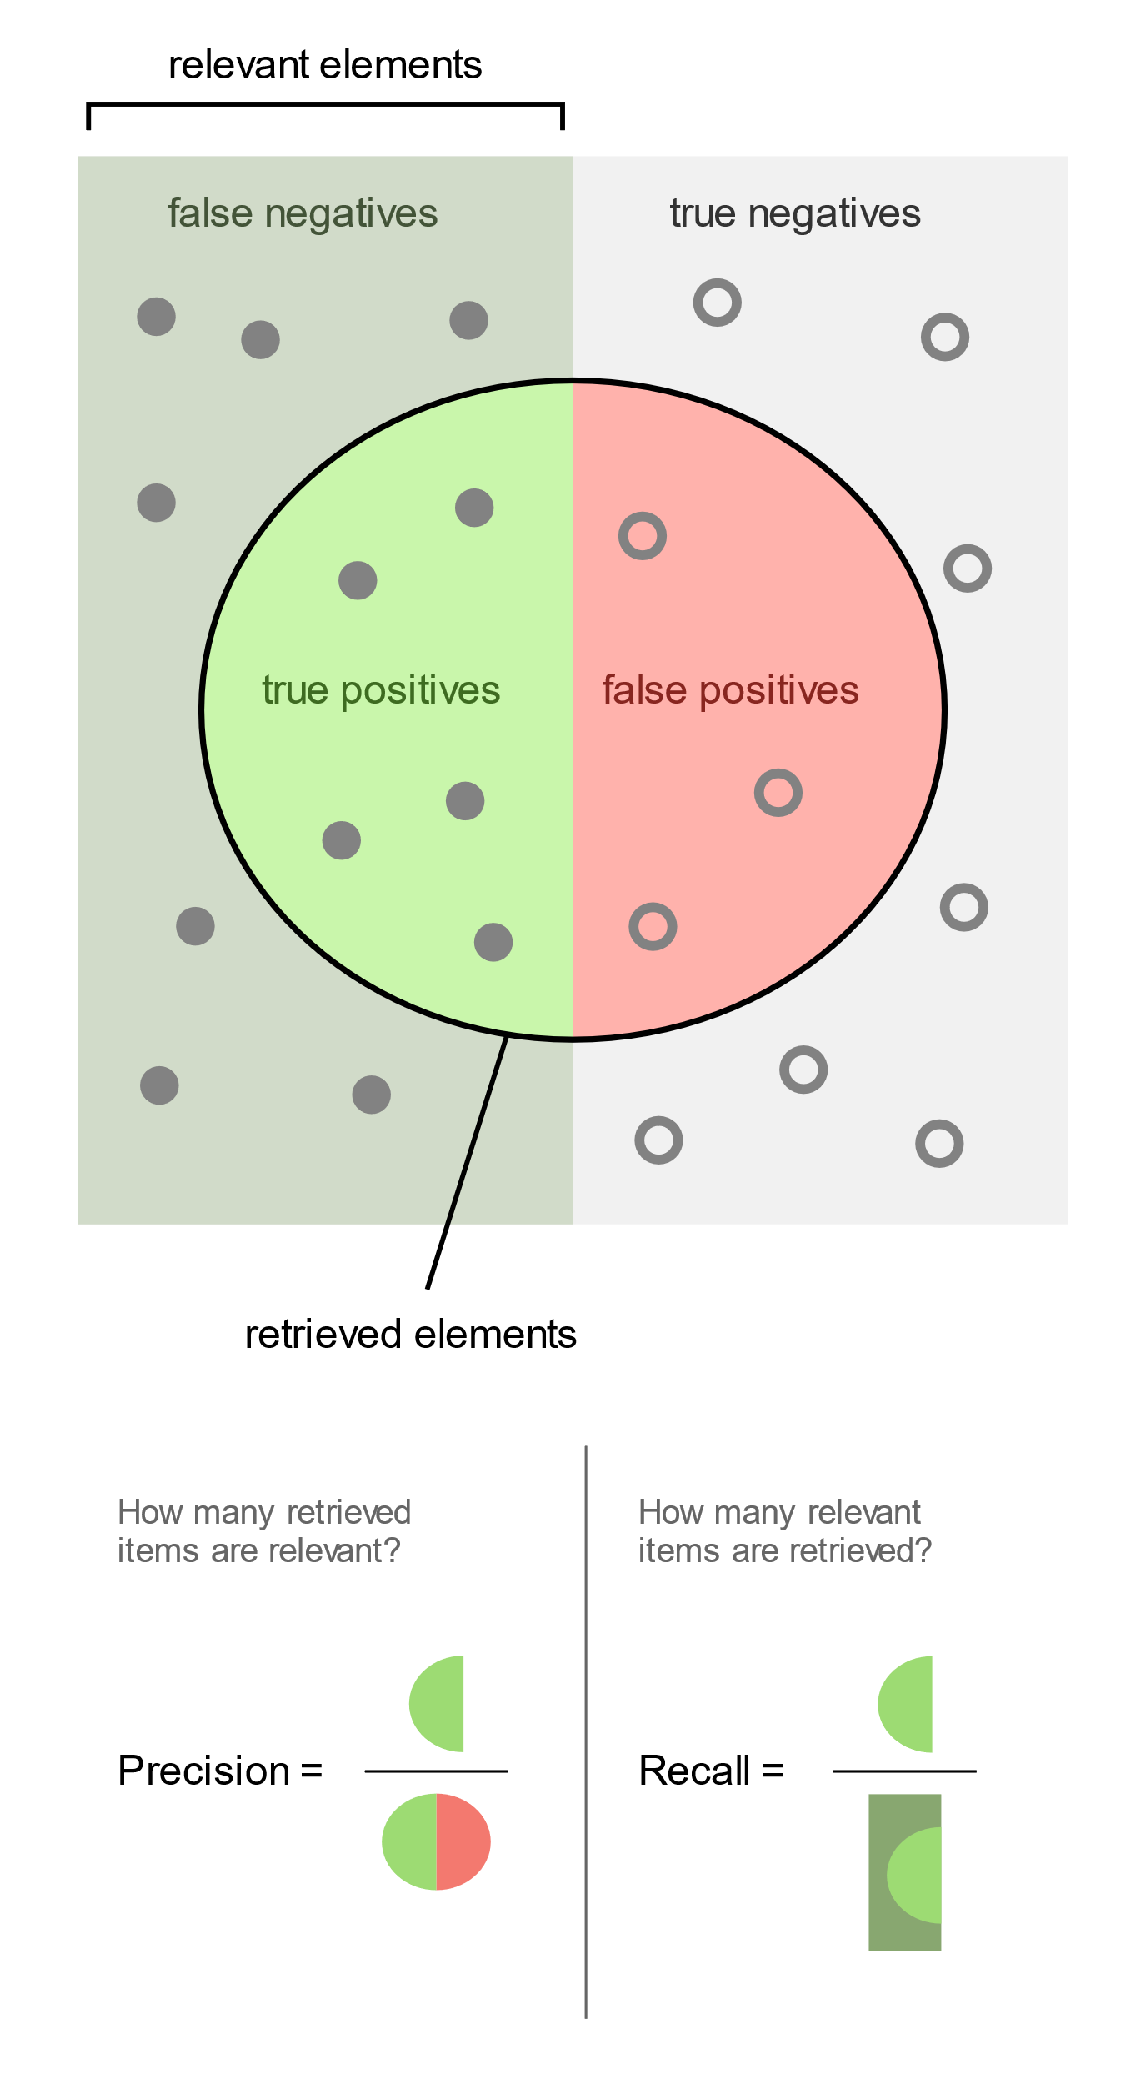
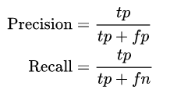
CLASSIFIER
PERFORMANCE
Classifiers performance is measured in several ways.
Performance measures like precision and recall depend on how many elements we choose to retrieve.

Slide 6
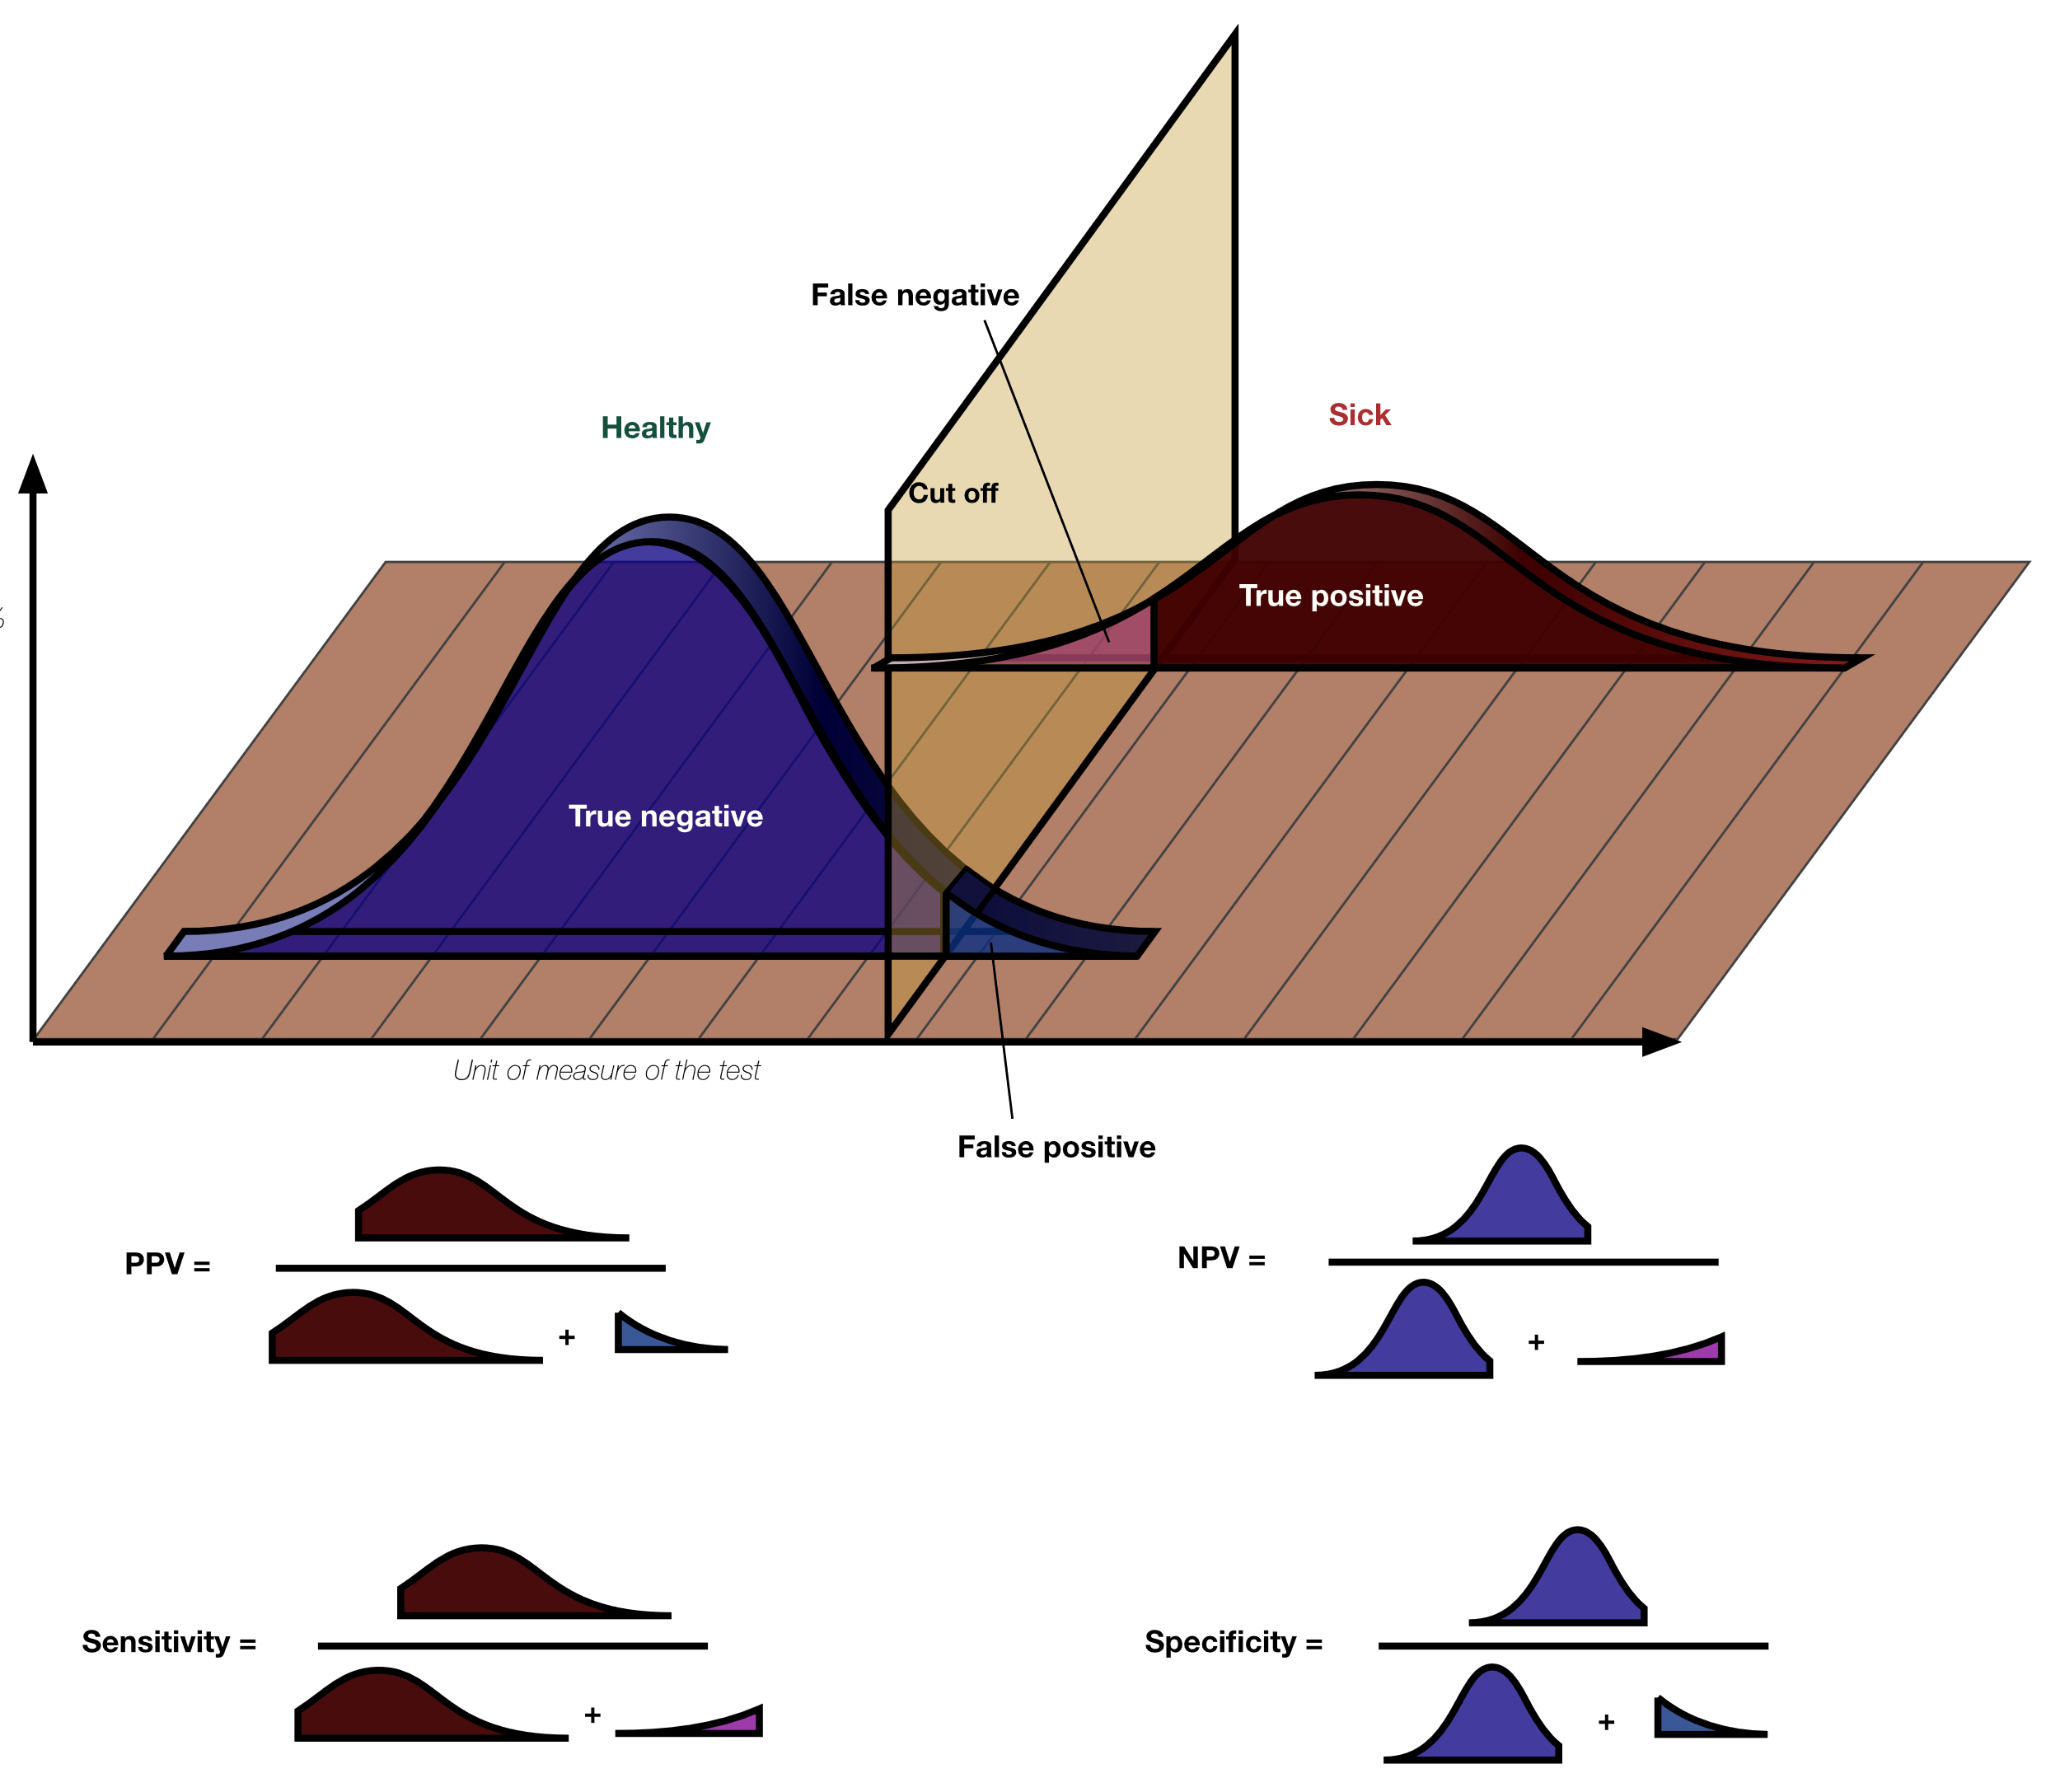
CLASSIFIER
PERFORMANCE
Performance measures of classifiers depend on the chosen cutoff.
One can easily optimize the number of false positives or false negatives, but not both at the same time.
Precision :
Recall/
True positive rate
Notes:
Relevant for models that have parameters you can choose: regression, classification (not t-test).
The two questions are not the same.
How well does the model fit?
Every type of model has their own criteria by which we evaluate
For regression that could be least squares (distance of data points to fitted line)
Good model captures underlying trends and characteristics of the data
Can estimate deviations by goodness-of-fit
For clustering we can evaluate whether the number of clusters we have chosen is optimal
If we did kmeans we may discover the ideal number of clusters using the elbow method:
Different measures to describe “how much are the points in a certain cluster more similar between themself than with the points in different clusters?”
The measures, also called clustering evaluation techniques, are: silhouette score, calinski harabasz score, davies bouldin score. There may be others
We use this to score the goodness/usefulness of the clustering and pick the number of clusters with the highest measure
However, we do not want a perfect fit! Because data always has noise, if the model fits the data too well it will become very poor at doing the actual task (classification) and we get overfitting.
Therefore, we evaluate separately how well the model performs on the task.

Slide 7
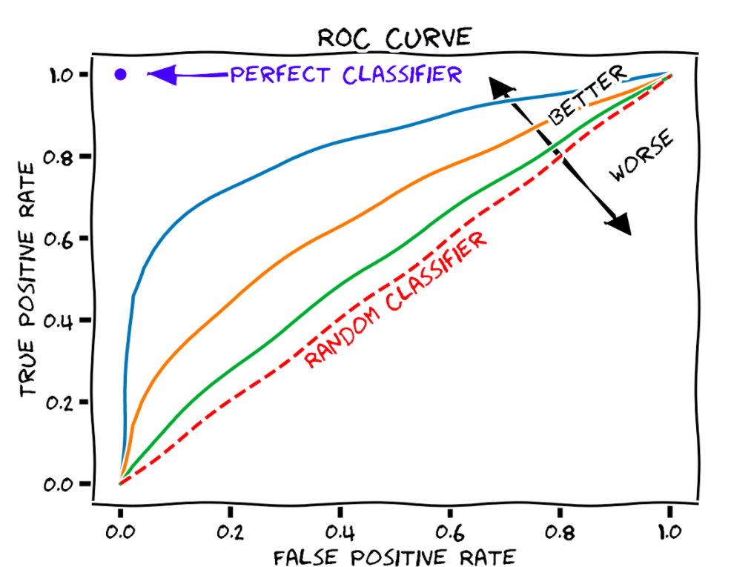
AREA UNDER THE CURVE (AUC)
This is why we use the AUC to report on the goodness of the classification.
Receiver Operator Curve (ROC)
Plotted by using every possible cutoff.
Each True Positive Rate has an associated False Positive rate.
How many of the true cases have we discovered?
Notes:
In terms of classifiers we always have the trade-off between true-positive and false-positive rates:
If we want few false positives (people predicted to have cancer though they are healthy), we will also have more false negatives (cancer people predicted to be healthy)
If we want to miss as few cases as possible, we will have a high amount of false-positives.

Slide 8


GROUP DISCUSSION
For a medical screening procedure to detect a disease, what does each of these terms correspond to:
True positive
False positive
True negative
False negative
On the right you have the formulas for precision and recall. Which one do you prefer to optimize for screening?

Slide 9
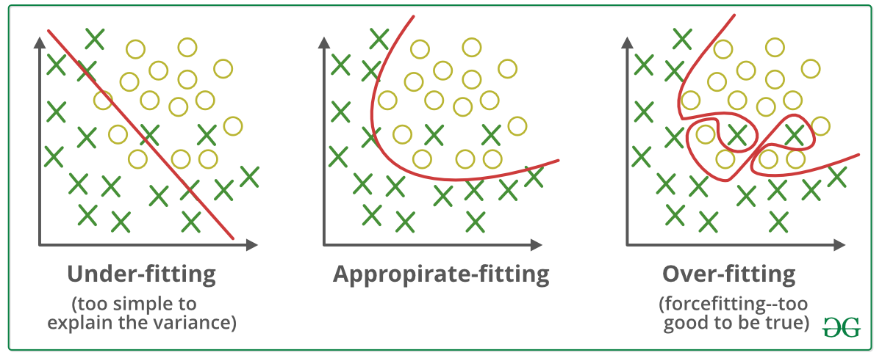
OVERFITTING
Data
Train
Eval
When a model follows the data too closely we get an effect known as overfitting.
We avoid this by splitting the data into training and evaluation sets.
Eval
Cross Validation
Eval
Eval
Notes:
Relevant for models that have parameters you can choose: regression, classification (not t-test).
The two questions are not the same.
How well does the model fit?
Every type of model has their own criteria by which we evaluate
For regression that could be least squares (distance of data points to fitted line)
For clustering we can evaluate whether the number of clusters we have chosen is optimal
However, we do not want a perfect fit! Because data always has noise, if the model fits the data too well it will become very poor at doing the actual task (classification) and we get overfitting.
Therefore, we evaluate separately how well the model performs on the task.

Slide 10
GROUP DISCUSSION
On your table you have a print-out in which the same data has been fitted with three different models (the red lines).
In your group, discuss which of these you think is the most suitable and why.
In general, what is the problem with high-dimensional model with many parameters?
Notes:
Overfitting linear regression picture
Why is the middle one better? Explain
What is the problem with having many parameters?
(What do the parameters mean? (reaction rate))
Discussion:
How would be your error term for regression with two data points, large or small?

Slide 11
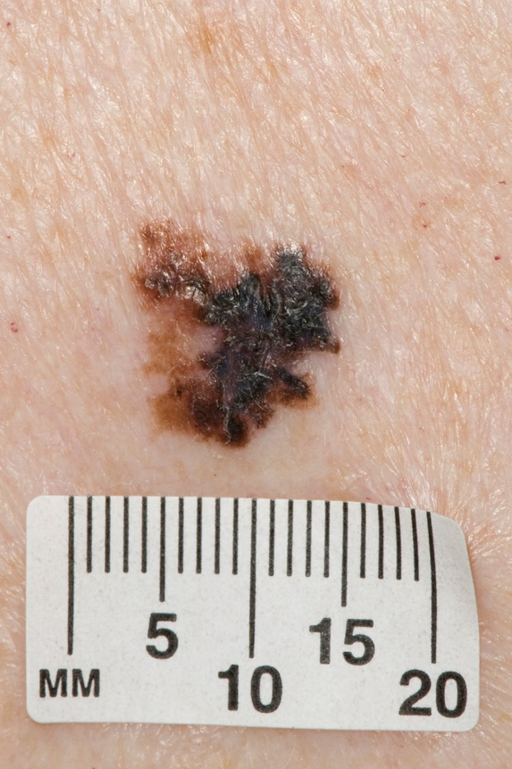



BIASES
What biases could have influenced the results?
Bias arises primarily from how the data was gathered and processed.
Bias can reduce model validity, i.e. a model trained in one population may not work in another.
?
Notes:
Output reflects input -> poor quality data results in poor performance
Rarely are both models and data free of biases.
Bias is different from accuracy. It is a skew in the data cause by collection or processing. Generally the term error refers to the outcome and the term bias refers to the process. (https://en.wikipedia.org/wiki/Bias_(statistics) )
Other examples:
If all photos of malignant melanoma have a ruler in them and the normal skin spot photos do not
Bias:
does data include elements that the model should be ignorant of?
The way training is set-up (objective function)
The way the model is set-up (parameters, design choices) -> algorithmic bias

Slide 12
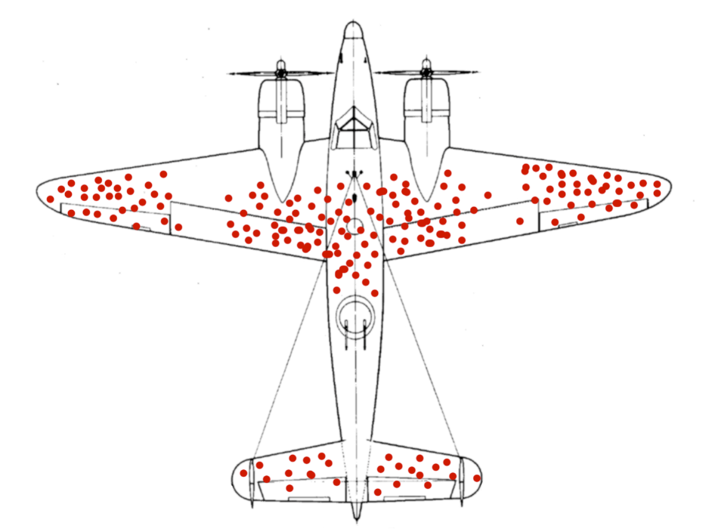
GROUP DISCUSSION
Consider the following schematic of bullet holes on returning WW2 planes.
It shows with red circles where each plane was struck.
Bases on this data, which part of the plane do you think should be reinforced to better protect the plane from being damaged?
Notes:
What kind of data types do you and your collaborators work with?
What would you like to work with?
Which of the roles we have introduced do you see yourself in?
Do you have people in your group or among your collaborators to fill the other roles? If not, what are alternatives?

Slide 13
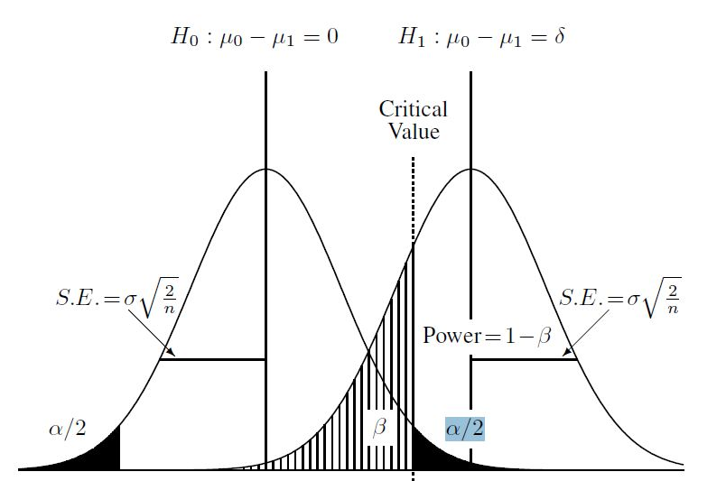
WHAT DO THE RESULTS MEAN?
Hypothesis testing
Predictive models
If p-value significant, the null hypothesis is rejected.
Poor model performance means it's not possible with this model + data
Interpretable parameters
Coefficients/feature importance tell which predictor variables have a large influence in outcome
Generalized linear model:
birth weight ~
mother’s weight + smoking +
mother’s age
Avg life exp.
Cigarettes smoked
Notes:
hypo test + pred -> can interpret results directly.
In hypothesis testing the meaning is mainly answering our question.
Is birthweight sig. different between mothers who smoke and non-smokers, yes or no?
Predictive modelling:
In pred modelling our question is often ‘Can this be done’ and the reply is the model performance: yes with this accuracy, or no probably not.
Parameters have a meaning, i.e. slope and intercept in a regression model.
If our model is average live expectancy (y) VS cigarettes smoked (x) then the intercept is the life expectancy at 0 cigarettes and the slope is how much life expectancy decreases for one unit of cigarette smoking.
Though the intercept sometimes doesn’t have real life meaning (if x cannot meaningfully be 0, the y-intercept has no useful interpretation).
Example: birth weight ~ mother’s weight + smoking + mother’s age
Coefficients tell us which of these have the largest influence and we can test whether we should drop (not consider) one or several
In a random forest the feature importance takes the roll of the coeff
If model performance is bad that means we cannot answer our question/build a good predictor with the data we have which is also an insight

Slide 14
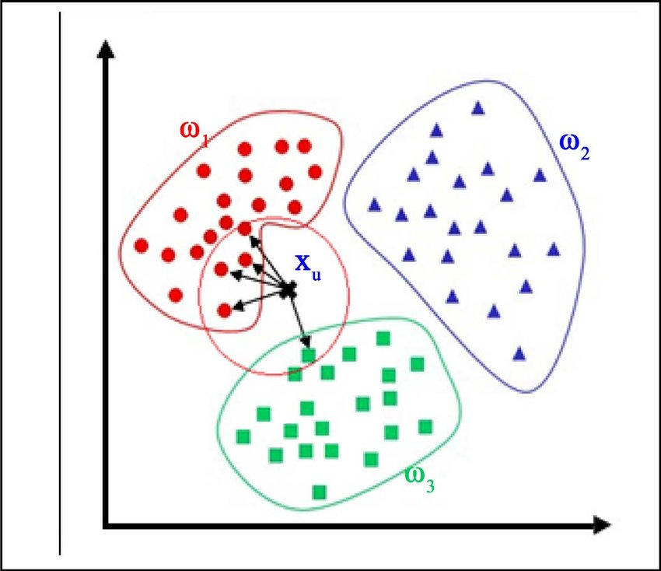
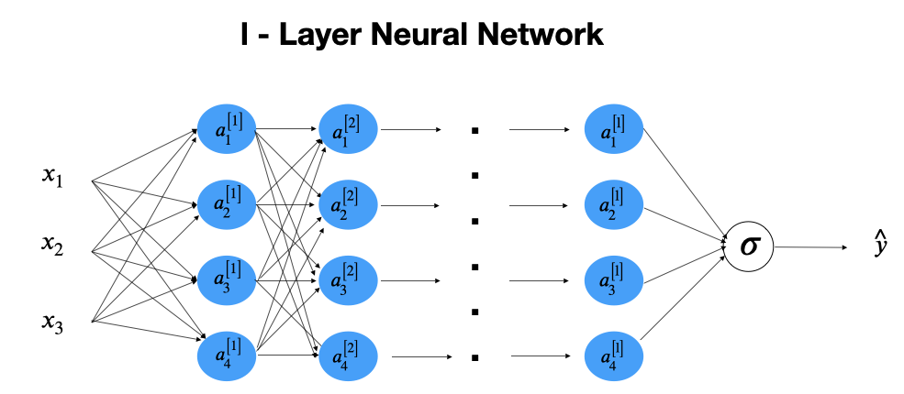
WHAT DO THE RESULTS MEAN?
Unsupervised Learning/Clustering
Black Box models
Insights about the structure of the data, esp. number of clusters
Further analyse properties of discovered clusters (biological meaning)
Highly non-linear models with many parameters are difficult to interpret
We mostly use the performance instead of trying to gain insights
Predict cluster membership of new data points
Notes:
Clustering:
- Cannot evaluate performance without ground truth
If it’s black box models: many parameters and non-linearity, for example neural network, tSNE, its more difficult
Cannot directly interpret results
Very difficult to know why the model gives a certain answer (why is this skin spot cancerous?) and therefore we do not understand what the model has learned
Performance is good, insights are few
What do results from clustering mean?
We don’t have ground truth so we can’t eval performance as in supervised learning.
I guess we have learned something about the structure of the data
If we did kmeans we may discover the ideal number of clusters using the elbow method:
Different measures to describe “how much are the points in a certain cluster more similar between themself than with the points in different clusters?”
The measures, also called clustering evaluation techniques, are: silhouette score, calinski harabasz score, davies bouldin score. There may be others
We use this to score the goodness/usefulness of the clustering and pick the number of clusters with the highest measure

Slide 15
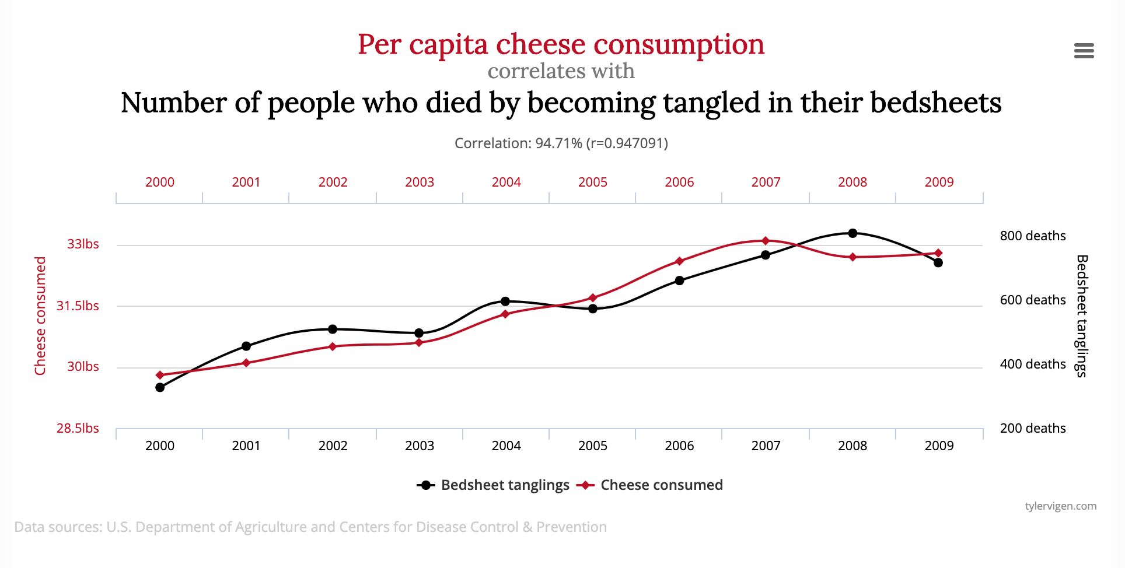
CORRELATION ≠ CAUSATION
One of the goals of modelling is to discover relationships between predictor and outcome variables.
However, modelling is not primarily concerned with causality.
In other words, if our model shows that a relationship exists, that does not mean the relationship is causal.
Notes:
Predictive power of A over/towards B does not mean that A causes B.
Add example
Example:
We know now that smoking increases risk of heart disease as well as cancer.
If we did not know, we might find an association between heart disease and cancer. However, treating heart disease does not reduce cancer rates because heart disease does not cause cancer. They are both caused by another, underlying problem/property.
Therefore, mode of action is important to causality. How does A cause B and does that makes sense in the framework of known biology?

Slide 16
THE QUESTION OF CAUSALITY
Where does this leave us?
Formally, causality can only be inferred in the statistical framework of causal inference (which we will not go into).
Mode of action is vital. If A causes B, how so? And does that make sense in the framework of existing domain knowledge? -> Domain experts
Causality can be shown by gathering convergent evidence from different lines of inquiry and direct cause-effect experiments (animal and cell culture studies).
Notes:
Domain expert -> do these results make sense?
Researchers are always interested in causality
However only recently have these kinds of questions even become available in a stats framework with the advent of causal inference
Must propose Mode of action for causality (how does A cause b), rooted in biology/domain knowledge -> domain expert
Gene expression -> interpretability?
From a practical point of view, mode of action is vital. If A causes B, how so? And does that make sense in the framework of existing domain knowledge? -> Domain experts
Afterwards, new experiments must be devised to confirm or deny the hypothesis that A causes B. -> I thought you cannot prove that? Well, not without intervention data
How was it proven that smoking causes cancer? Is mode of action enough? Mouse model? Cell culture?
Well, this is a bit a special case since people haven’t always smoked so the rise of cigarettes and of lung cancer coincided suspiciously. In a way, cigs are an ‘intervention’ in statistical language that is like to produce the caner outcome. -> so whats the difference to the idea that cell phones cause cancer? Those two rates also increased at the same time!
The population study was the indication which was later confirmed in animal experiments and by histology (looking at cells from smokers), though this is again not direct evidence
There was also a convergence from different lines of inquiry
Though if people with damage in the pulmonary cilia are more likely to smoke and also more likely to get cancer you would get the same result.
Afterwards, new experiments must be devised to confirm or deny the hypothesis that A causes B. -> convergent evidence from different lines of inquiry, trying to eliminate spurious correlations.

Slide 17
GROUP DISCUSSION
In large population study you find a subpopulation of people who complain of fatigue and joint aches. The same people later develop oral problems such as bleeding gums and loosing teeth.
Do you expect that treatment of the joint pain will lead to less oral symptoms later?
Does joint pain cause oral problems?
Hint: Your population data is from 13th century sailors.

Slide 18
OVERVIEW OF OUR JOURNEY
EXPLORATORY DATA ANALYSIS
DATA COLLECTION
DATA ANALYSIS
MODEL EVALUATION

Slide 19
GROUP DISCUSSION
What is your main take away from today?
How does it change your perspective on Data Science?
How do you think your future relationship to Data Science will be?
In what ways can you incorporate Data Science thinking into your teaching?
Notes:
Closing thoughts/ discussion:
What do you take away
What is your most important take away from today?
How does it change your view on DS?
How does it change your teaching
How could you incorporate this in your teaching?
Is there anything in this workshop that opened your eyes?

Slide 20
Nice slides with resources from Thilde
Links to awesome resources
Also check the absalon course room

Slide 21
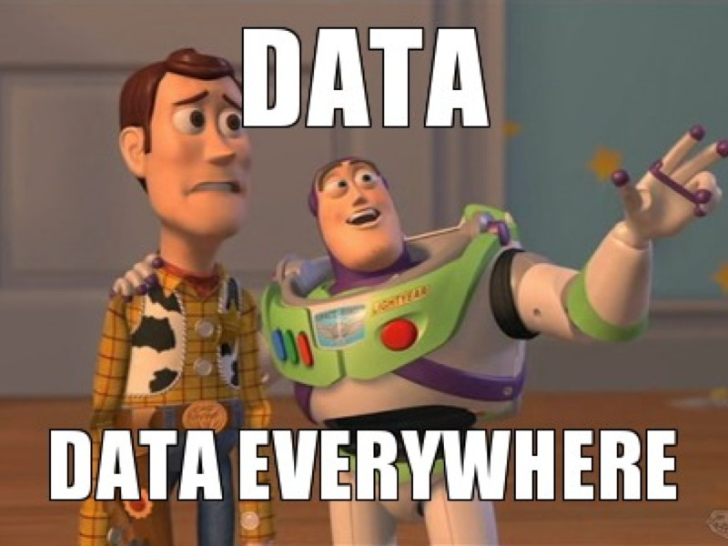
THANK YOU

