Slide 1


Data Collection
Data Exploration
THE DATA'S
JOURNEY
Cleaning &
Normalization
Analysis
Hypothesis
Validation
Notes:
b

Slide 2


BEGINNING OUR JOURNEY
EXPLORATORY DATA ANALYSIS
DATA COLLECTION
DATA ANALYSIS
MODEL EVALUATION

Slide 3


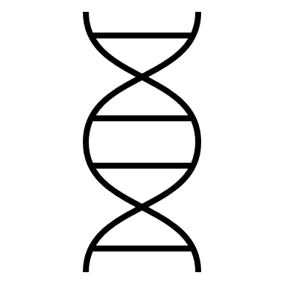

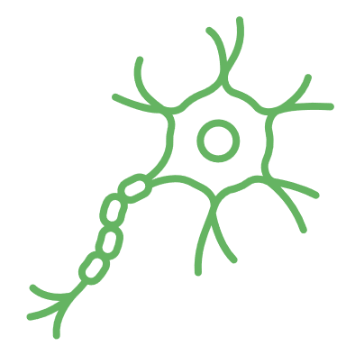


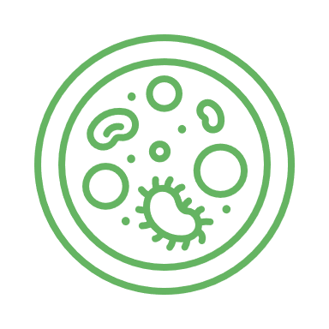
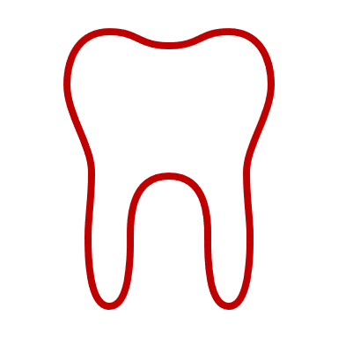

DATA COLLECTION
Data points are observations of reality, often made with the help of measuring devices or techniques.
All data has an inherent measurement uncertainty, the size of this uncertainty may be unknown.
Data may have introduced biases. If we know what they are we can avoid them or correct for them.
Notes:
Bias is a systematic tendency in which the methods used to gather data present an inaccurate or skewed view of reality
Understanding the source of statistical bias

Slide 4
DATA TYPES
Measurements
i.e. height, weight, heart rate
Can usually be represented as a number or a category
Typically low dimensional, but wearables are changing that
Survey Data
Can be descriptive, numeric or categorical
Relies on reporting, i.e. very prone to bias
MEASUREMENT
SURVEY
DATA
Omics Data
i.e. genomics, proteomics
(Ultra) high-dimensional
Needs a lot of preprocessing
OMICS
DATA
Descriptive Data
i.e. patient journals, registry data
Highly person-sensitive
Not easily standardized
DESCRIPTIVE
DATA

Slide 5
A LITTLE TERMINOLOGY
How many observations?
Observation is the entity whose properties were collected, i.e. a patient, a cell, a tissue sample
Which properties were measured?
i.e. blood pressure, smoker/non-smoker, gene expression. Also called: Features or Variables.
What is the outcome variable(s) (dependent) and which are explanatory variables (independent)?
Obs.
Var X1
Vector
Obs.
Vars X1-Xn
Dataframe
Obs.
Vars X1-Xn
Matrix
Notes:
If this is data you have yourself collected many of these are design choices.
Need to check both your own data and data you find somewhere else (repositories,ect)
It’s important to find good data
Examples of ‘bad’ stuff:
Linear regression on 3 data points
T-test on 5 data points
Establish whether:
Data looks as expected
identify obvious errors: outliers, label swaps
Something needs to be corrected
Preparation method
(normalization is needed?)
Are there patterns between variables?
What is the relationship between variables
How do we need to prepare the data for analysis?
What kind of analysis can we do?
https://www.ibm.com/topics/exploratory-data-analysis
Originally developed by American mathematician John Tukey in the 1970s, EDA techniques continue to be a widely used method in the data discovery process today.

Slide 6
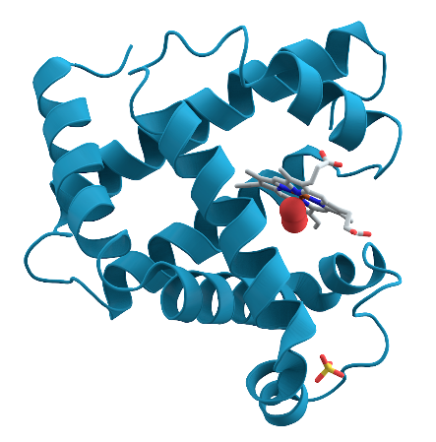
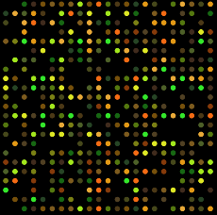
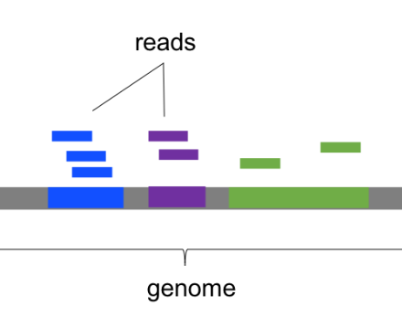
OMICS DATA
Omics approaches aim to study the entirety of an ‘ome’ (proteome, transcriptome, genome). Here we name the most commonly used types.
Proteomics
Whole genome seq
SNP calling
Transcriptomics
RNAseq
Notes:
There are many specialized lab protocols for things you can measure with next generation sequencing. Here we name the most standard types. of omics data which you may encounter or already have colleagues/ group members working with.
Proteomics:
Attempts to measure all proteins expressed
Notoriously high variability and high amount of missing values
Directly addresses the proteome, usually with tandem mass spec
Often correlates poorly with RNAseq
RNAseq/transcriptomics:
Attempts to capture all mRNA expressed as a proxy of protein expression
Very established technique
Indirect measure, often correlates poorly with proteomics
Specialized subtypes: Single cell, spatial
Whole genome/exome sequencing or SNP array to determine genetic variants:
Well established technique, many databases
Often in the context of personalized medicine and GWAS
You typically want to combine this information with phenotype or other metadata

Slide 7
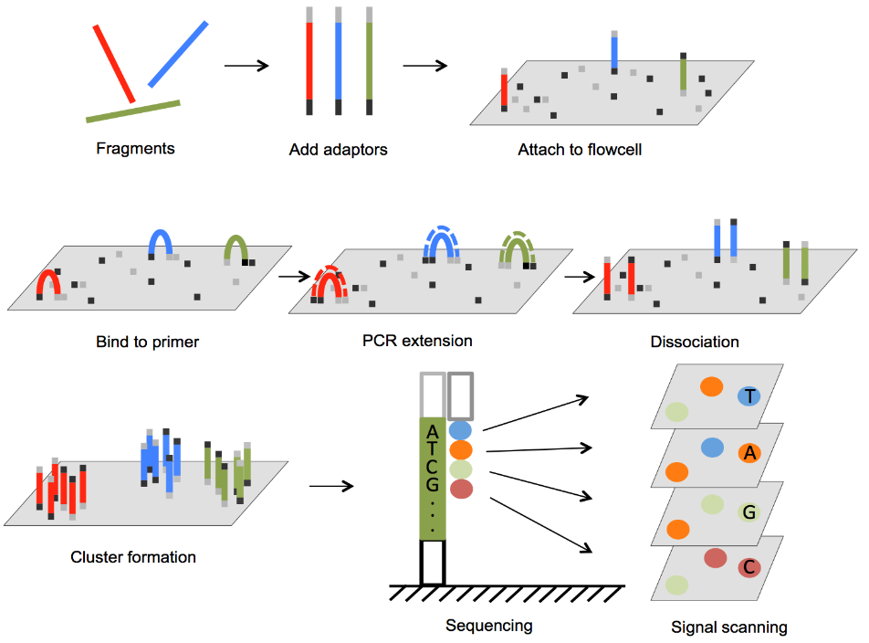
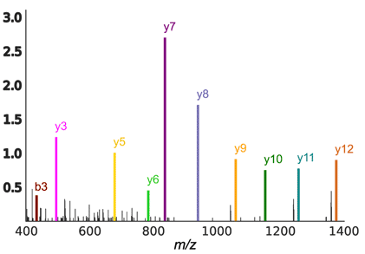
OMICS DATA
Omics data are produced with specialized lab protocols followed by:
Next generation sequencing (DNA, RNA)
Mass spectrometry technologies (proteins, lipids, sugars, metabolites)
Data characteristics:
Extremely high-dimensional
Expensive to generate
Measurement is indirect
Need for pre-processing
Can be prone to high variability (therefore replicates)
Illumina NGS
LC-MS/MS Spectrum
Notes:
Omics data are a specialized data type that has different assessment criteria than classical measurement data.
which is usually done by applying specialized lab protocols followed by next generation sequencing.
This type of data is becoming very important in health data science research so we wanted to give it its own section.
In general omics data is:
extremely high-dimensional
expensive to generate (some more than others)
in need of pre-processing
can be prone to high variability that you can not always control
therefore we use replicates

Slide 8
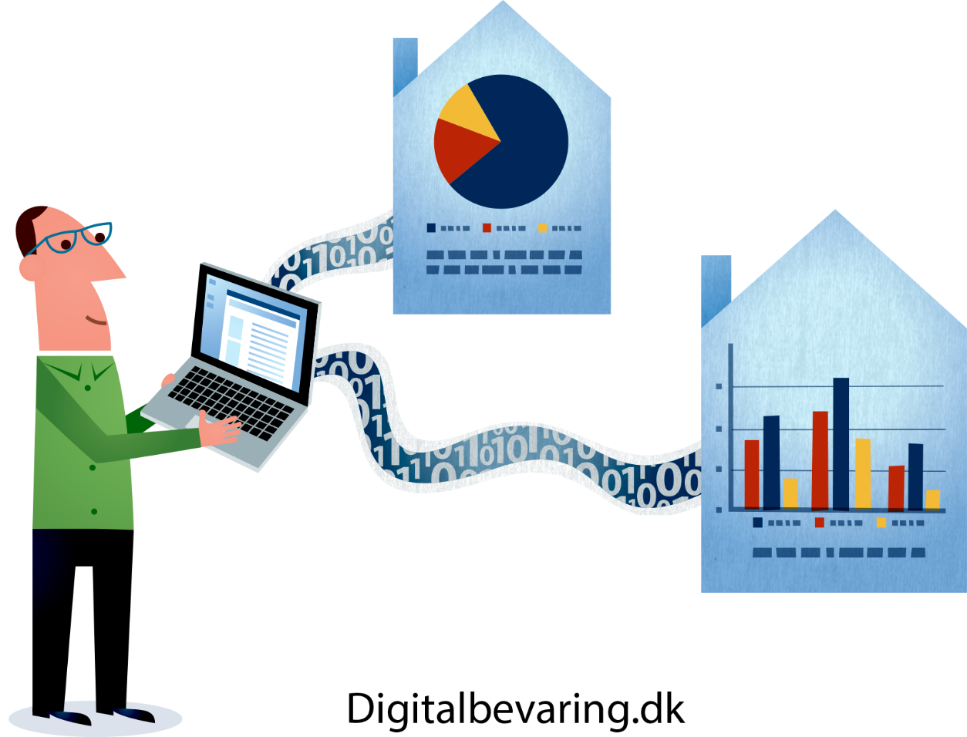
BIOBANKS & REPOSITORIES
Biobanks and repositories are great sources of both bio data and patient metadata
We have many such resources in Denmark but getting access can be a cumbersome process, since this is (highly!) person-sensitive data
Access has to be applied through the proper channels and compliance has to be ensured while working with them.
You can hear more about this in our GDPR course for biomedical researchers!

Slide 9
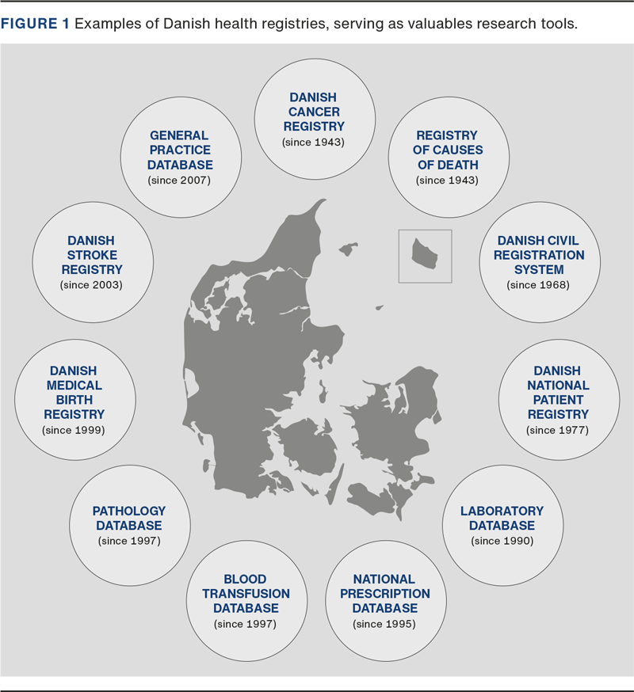
REGISTRY DATA
Most doctors, epidemiologists, …, and statisticians work with registry data (birth, death, diseases, medications, biometrics)
Data characteristics:
Data are sensitive & hard to access
There are many inconsistencies and errors
Missing data are very common
Needs a lot of clean-up and restructuring
The registries are governed by Sundhedsdatastyrelsen (The Danish Health Data Authority).
Dan Med J 2023;70(4):A12220796
Notes:
You apply to SDS for access to the registries. For some of them, special conditions
and/or procedures apply.
• Patient records etc. are governed by the Danish Health Act.
• Other registers are governed by Data Protection Regulation.

Slide 10
A QUICK GDPR RECAP
1.
Lawfulness
Fairness
Transparency
2.
Purpose Limitation
3.
Data Minimization
4.
Accuracy
The 7 principles of personal data processing
6.
Integrity and confidentiality
5.
Storage Limitation
7.
Accountability
“Health data are personal data concerning the physical or mental health of a person, including the provision of health care services, which reveal information about a person’s health status in the past, present or future.”
The GDPR Handbook (www.gdprhandbook.eu)
Notes:
General Data Protection regulation
Governs how personal data of EU citizens can be gathered, stored and processed.
Ensure protection of sensitive data
Compliance
www.gdprhandbook.eu
Health data is always sensitive, not merely personal
Health data is subject to a stricter data processing regimen than ‘merely’ personal data
Health data can only be processed under a lawful basis
These 7 principles you always have to comply with when processing personal data. Sensitive data has extra requirements on top.

Slide 11



EXPERIMENTAL DESIGN
You have heard it before and you will hear it again, experimental design is important.
WHAT IS GOOD EXPERIMENTAL DESIGN?
WHY IS IT SO IMPORTANT?
True normal controls
Power calculations
Randomization (data collection & laboratory)
Bias prediction
Documentation
You will be able to correctly answer your scientific question
Saves you time/work
Saves you money
Notes:
Experimental design:
- how you collect your data and set up your experiment and processing
- involves some design choices like how many groups are there, how are groups defined, what is the hypothesis

Slide 12


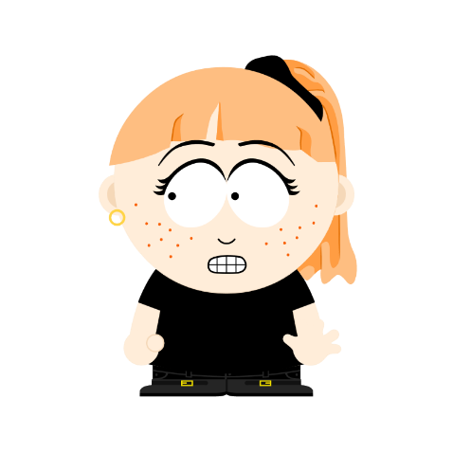
CONFOUNDING
Hi I am Jake.
I have proteomics samples from people with diabetes and healthy controls. Can you help me analyze these data?
They cost us 250.000 DKK to produce.
We often see non-randomized design, and sometimes total confounding.
Confounding: We cannot distinguish the separate effects of two different sources of variation.
There is no way to correct confounding when it is complete (this means the two variables 100% co-occur).
Hi, I am Thilde. I would love to! Where were the samples collected & stored?
The healthy samples are all from Rigshospitalet and the diabetes samples are from Århus University hospital.
Jake my friend, I have some bad news….
Notes:
On source of information is one we are interested in (the main effect) while the other could stem from a bias, a contaminant, or, it is simply an effect not relevant for our research question.

Slide 13


GROUP DISCUSSION
Consider the following scenario (1):
You would like to study whether smokers have an increased risk of heart disease.
For this, you have collected some data from both men and women on whether they smoke and have heart disease.
When you examine the data you see that all of your smokers are men.
Can you answer your research question with this dataset?
Notes:
5 mins

Slide 14
GROUP DISCUSSION
Consider the following scenario (2):
You would like to study differences in gene expression between tumor and healthy tissue. Since you have a lot of samples you ask two lab techs to each process half.
What are potential biases and confounders in this set-up?
Notes:
5 mins

Slide 15
BEFORE THE ANALYSIS COMES…
File formats in data science usually need to be a table (csv, xlsx, tab delimited, …)
Omics platforms return:
Fasta, fastq, SAM, GFF, MzML, … huge files do not fit in DS analysis
Registries are:
In formats more easily legible by humans, but still poorly structured for DS
At the point where we do what is typically regarded as DS, the raw data has been translated into the quantities we want to measure and/or restructure.
The steps we take before Data Science may be called: data management, set-up or wrangling
Notes:
Bioinformatics deals with many different file formats. You will likely never see those.
In general, omics techniques do not allow us to directly measure the object of our interest. Therefore, pre-processing is needed to get to these data points.
We try to measure different things such as numbers of transcripts/proteins, presence/absence SNPs, ect, and depending on that the results that the data science analysis is done on come in many different file formats.
What they are depends on the specific omics technique (i.e. numbers of transcripts/proteins, presence/absence SNPs), and depending on that the results that the data science analysis is done on come in many different file formats.
Different omics techniques measure different things such as the numbers of transcripts per gene, number of protein copies present, presence/absence SNPs, ect.
These results come in many different, specialized file formats that bioinformaticians deal with: Fasta, fastq, SAM, …

Slide 16
DATA MANAGEMENT
Don’t store BIG DATA in your computer
No embedded XLSX sheets
No color coding
No spaces nor special characters in naming
Do not do things ‘manually’ if avoidable
DOs
Write down steps (protocol & comments)
Record date of downloads
Consistency of file naming and folder structure
The raw data is untouched!
Consistency of data management
DON’Ts

Slide 17
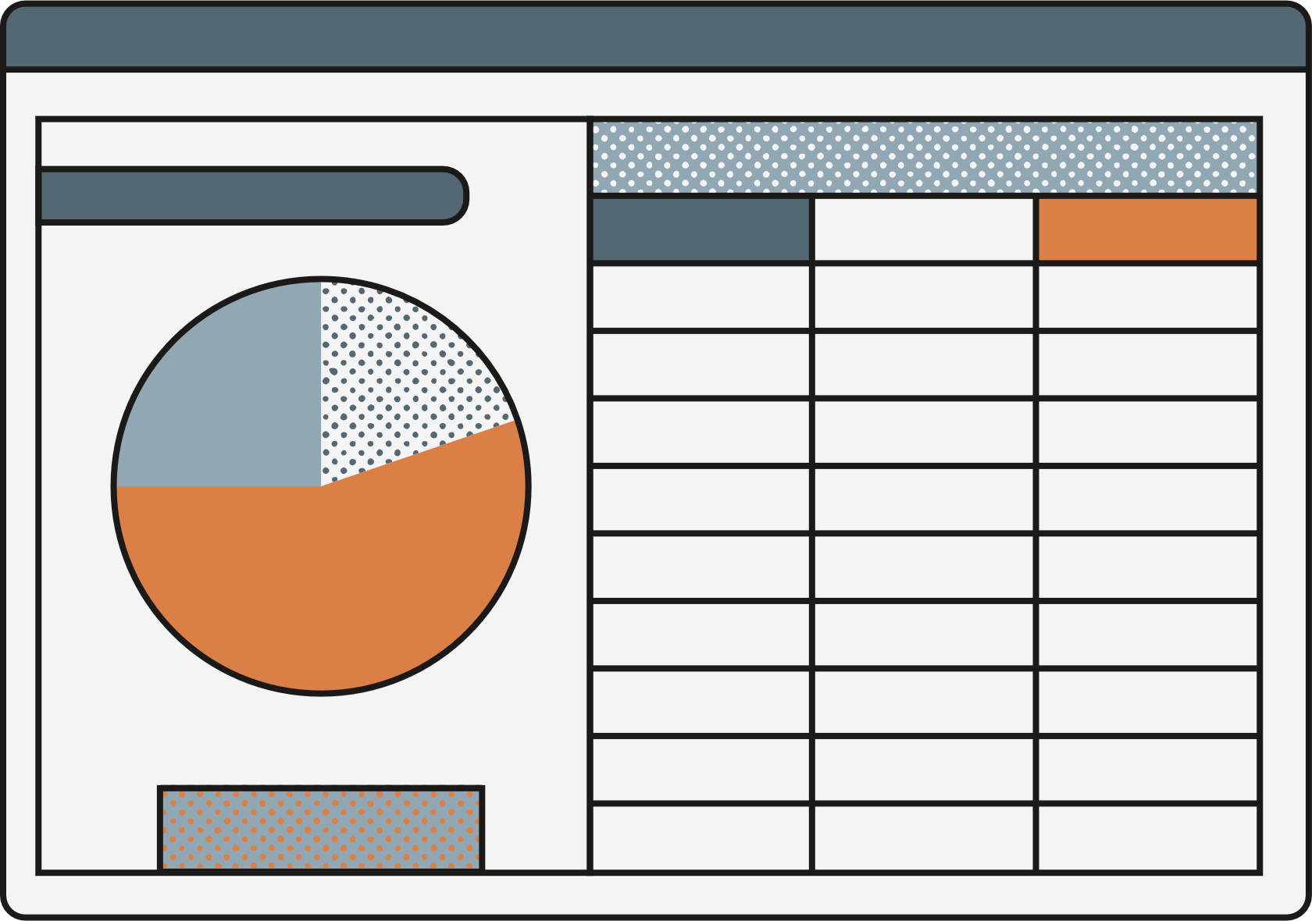
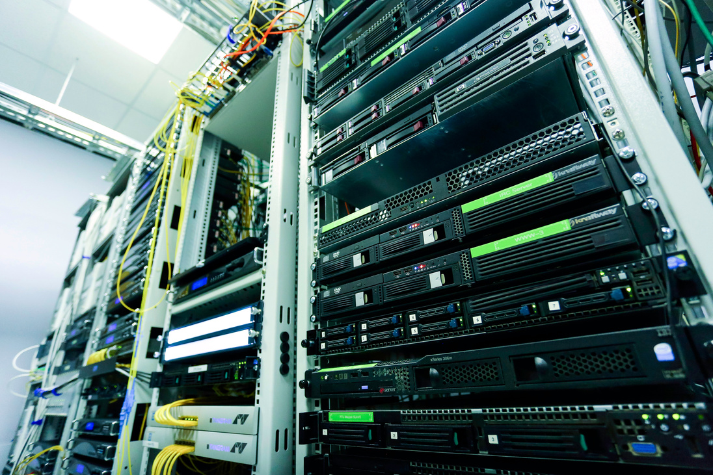


WHAT HAS CHANGED?
Absolutely massive amount of data! Both in terms of number of observations as well as number of measured variables
New types of data (i.e. omics, geolocation, wearables, ect)
change of tools
new analysis techniques
Notes:
So we understood that a lot has changed and now we work with tons of data and we need analysis, langauge

Slide 18


Programming languages
Part of the new tools is the use of formal programming languages to analyze data instead of tools like Excel. This has a couple of advantages:
Automation of tasks
Workflow is explicit and visible
Separate raw data and data processing. The raw data is never touched
Working code can be reused (perhaps with some tweaks) to analyze other similar datasets
The most popular languages are python and R

Slide 19
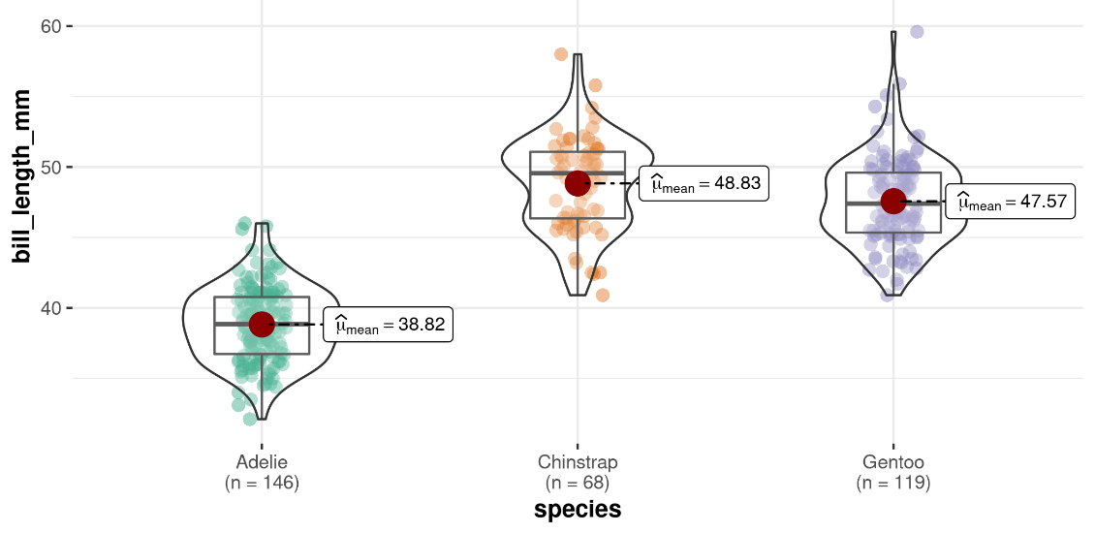
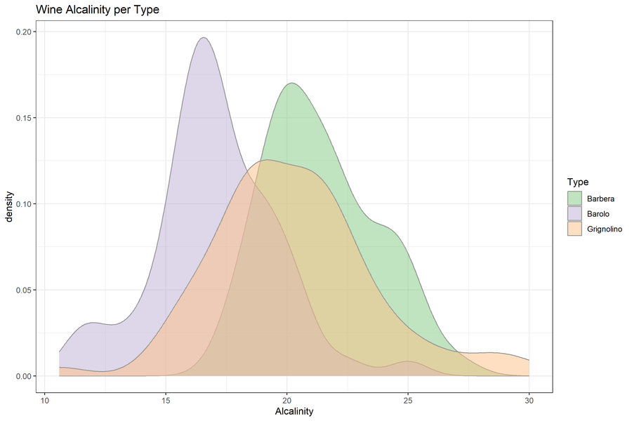


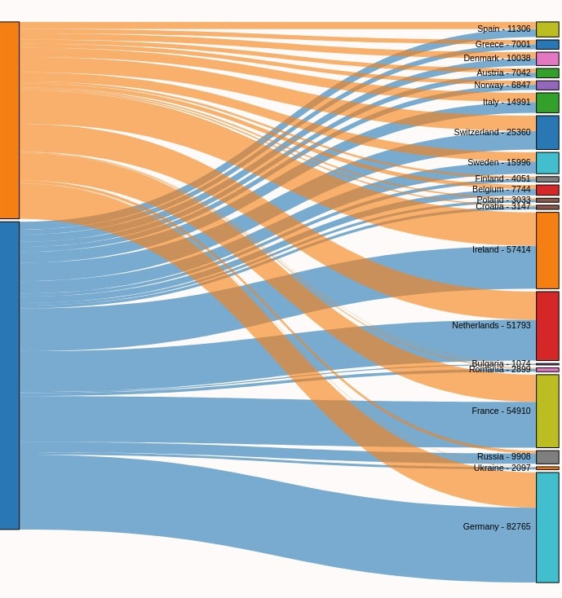
Programming languages
/
Quick overview
Processing power
Easy starting
Data Wrangling
Reproducibility
Raw data exposed
Complex analyses
Manual analysis
Programming language
Beginner’s Courses

Slide 20
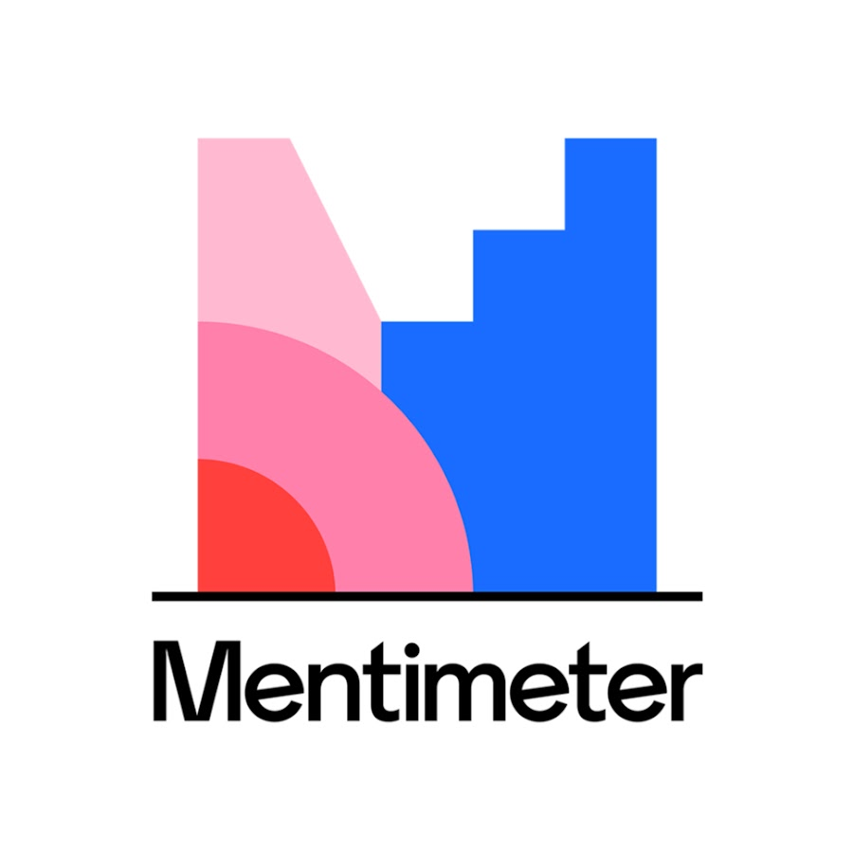

Which programming languages have you had contact with?

Slide 21

THE DATA-HYPOTHESIS CYCLE
Hypothesis-driven:
'traditional' way of research
formulate hypothesis
design experiment to challenge
hypothesis supported or rejected
Data-driven:
Discover properties of data set
Identify patterns and relationships
Mostly possible with BIG datasets
data-driven ≠ fishing!

Slide 22


THE DATA-HYPOTHESIS CYCLE
High-dimensional data with many observations
Discover complex patterns that humans cannot identify without algorithms & computer power
Find new patterns from re-analysis with new (multiple) methods or combination of datasets
Hypothesis
Gather new data to confirm or deny new hypothesis
Data
We do both alternatingly
Notes:
Patterns are high dimensional, hierarchical, several variables

Slide 23
GROUP DISCUSSION
In your groups discuss:
What data types do you and your collaborators currently work with and/or what are you interested in working with in the future?
What considerations are there in terms of experimental design, data collection and/or data management/set-up?
Notes:
What kind of data types do you and your collaborators work with?
What would you like to work with?
Which of the roles we have introduced do you see yourself in?
Do you have people in your group or among your collaborators to fill the other roles? If not, what are alternatives?

Slide 24
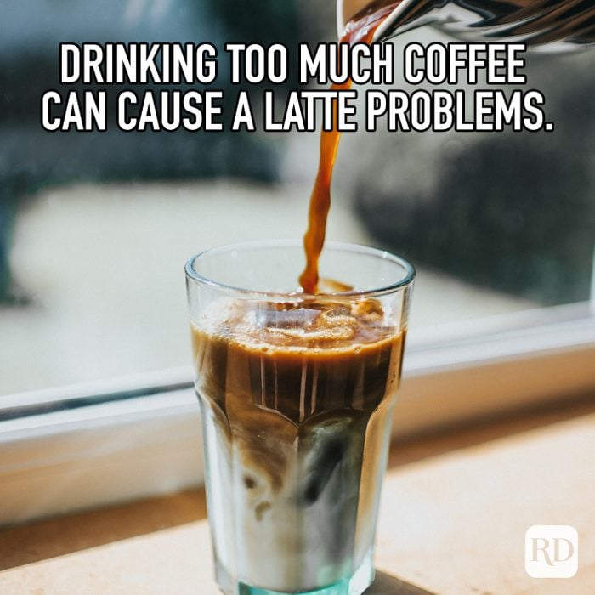
BREAK

