Slide 2


FromExceltoR
Data
Scripts
Presentations
[…].xlsx
climate.xlsx
…
presentation1.qmd

Slide 3
read_excel("../Data/climate.xlsx")
/Data
FromExceltoR
..
Go one folder back/up with ”..”
Data
Scripts
Presentations
Current location
/climate.xlsx
[…].xlsx
climate.xlsx
…
presentation1A.qmd

Slide 4
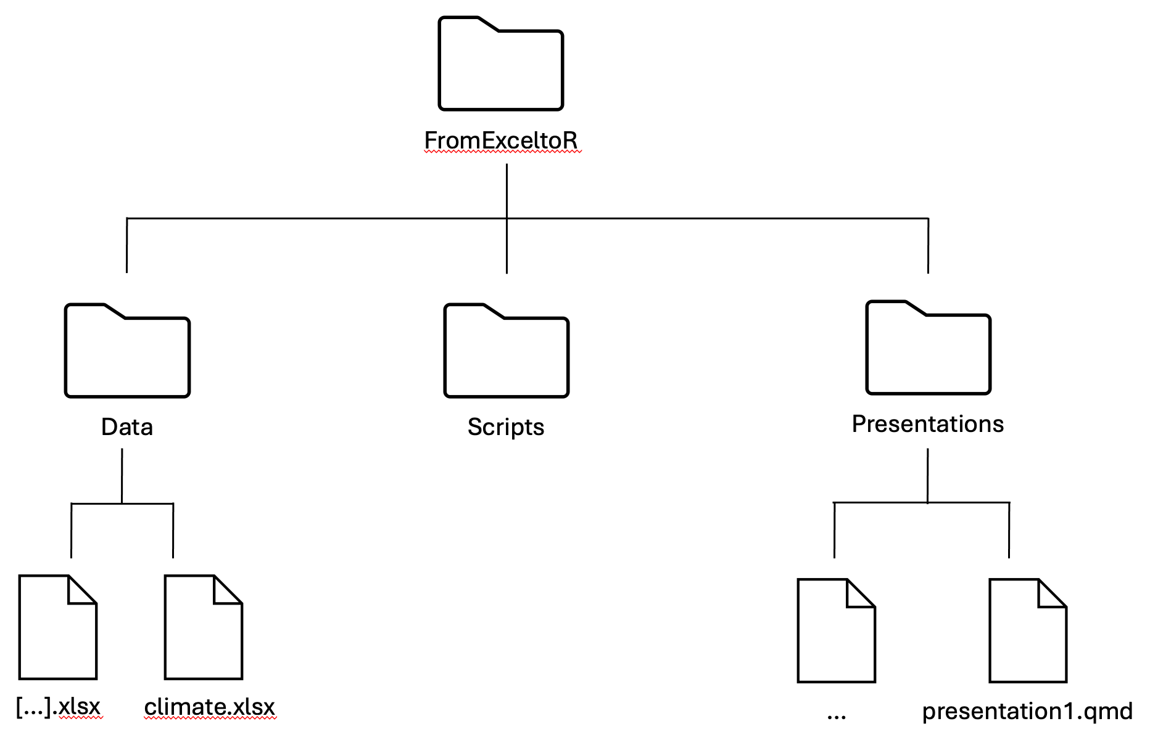
Desktop
Work
Courses

