Slide 1


FROM EXCEL TO
R

Slide 2






SUND DATA LAB
WHO ARE WE?
Center for Health Data Science (HeaDS):
Read more on HeaDS Website!
https://heads.ku.dk
Chelsea
Diana
Follow HeaDS on LinkedIn!
https://www.linkedin.com/company/ucph-heads/
Suze
Data Science Laboratory (DSL) - https://datalab.science.ku.dk/
Notes:
First time running this course. There will be an evaluation, please be patient with us, we are not quite sure how this will go :-)

Slide 3
SUND DATA LAB
WHAT WE DO?
CONSULTATIONS
Need guidance? Drop by for a consultation on your DS analysis
COMMISSIONED RESEARCH
Commissioned DS Analysis
Commissioned Supervision
OUTREACH
?
Conference, seminars and networking events - Join us!
COURSES & WORKSHOPS
Data Science skills, Tools and HDS Topics
Notes:
First time running this course. There will be an evaluation, please be patient with us, we are not quite sure how this will go :-)

Slide 4
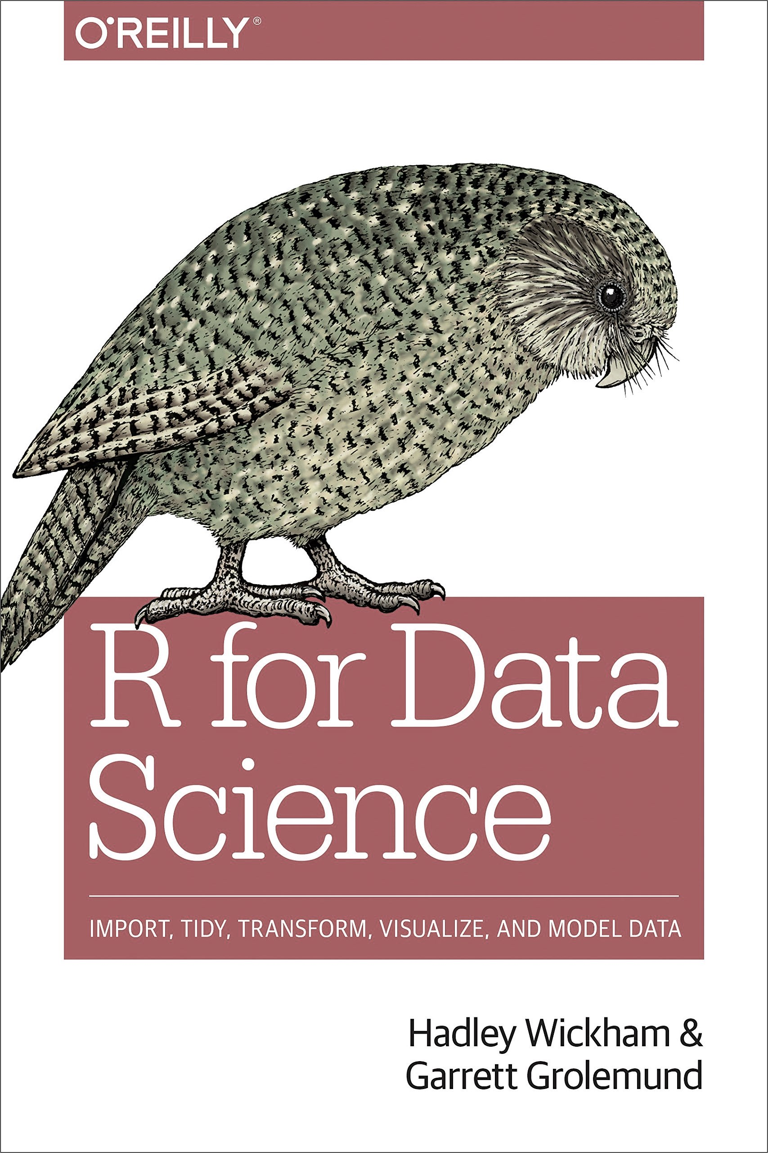
FROM EXCEL TO R
THE PRACTICALS
Two days: 9.00-16.00. There will be coffee breaks, we promise
“R for Data Science” - a generally useful book on R, also for this course
The course is build on hands-on presentations & exercises
Download and install the newest version of R (https://cran.r-project.org/)
Download and install the newest version of R-studio (https://posit.co/download/rstudio-desktop/)
Go to course website: https://center-for-health-data-science.github.io/FromExceltoR/
3

Slide 5

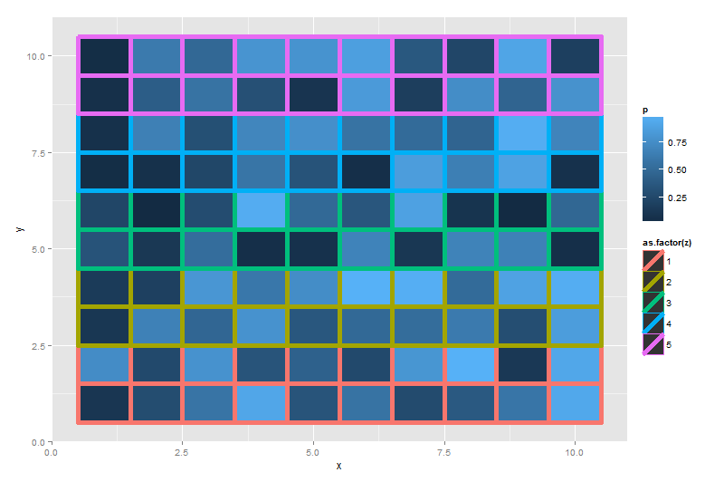
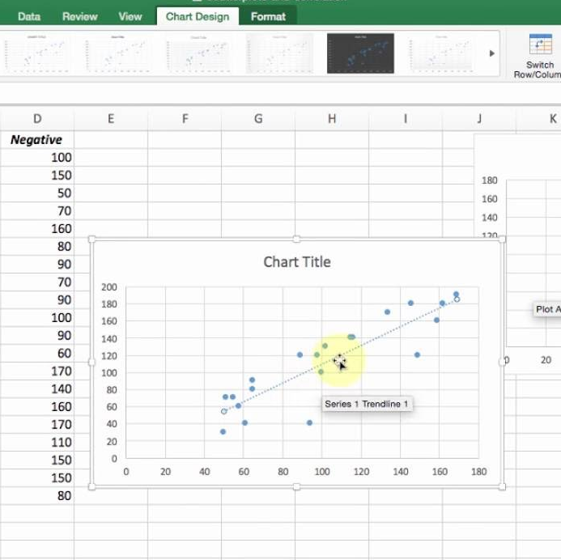
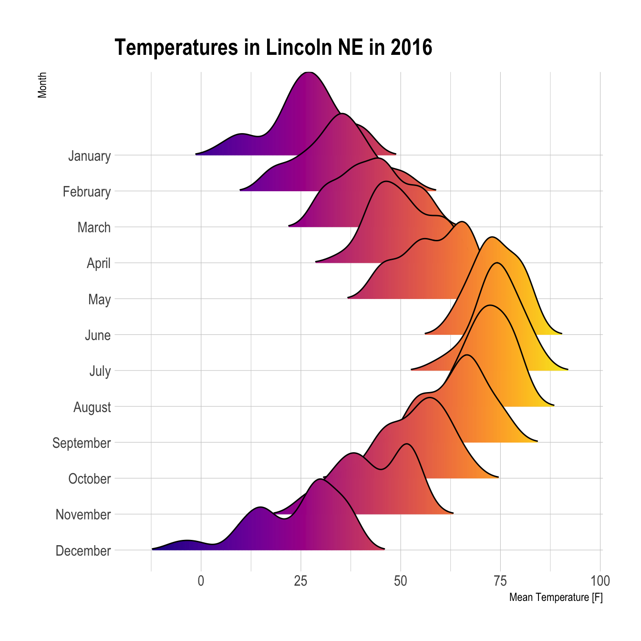
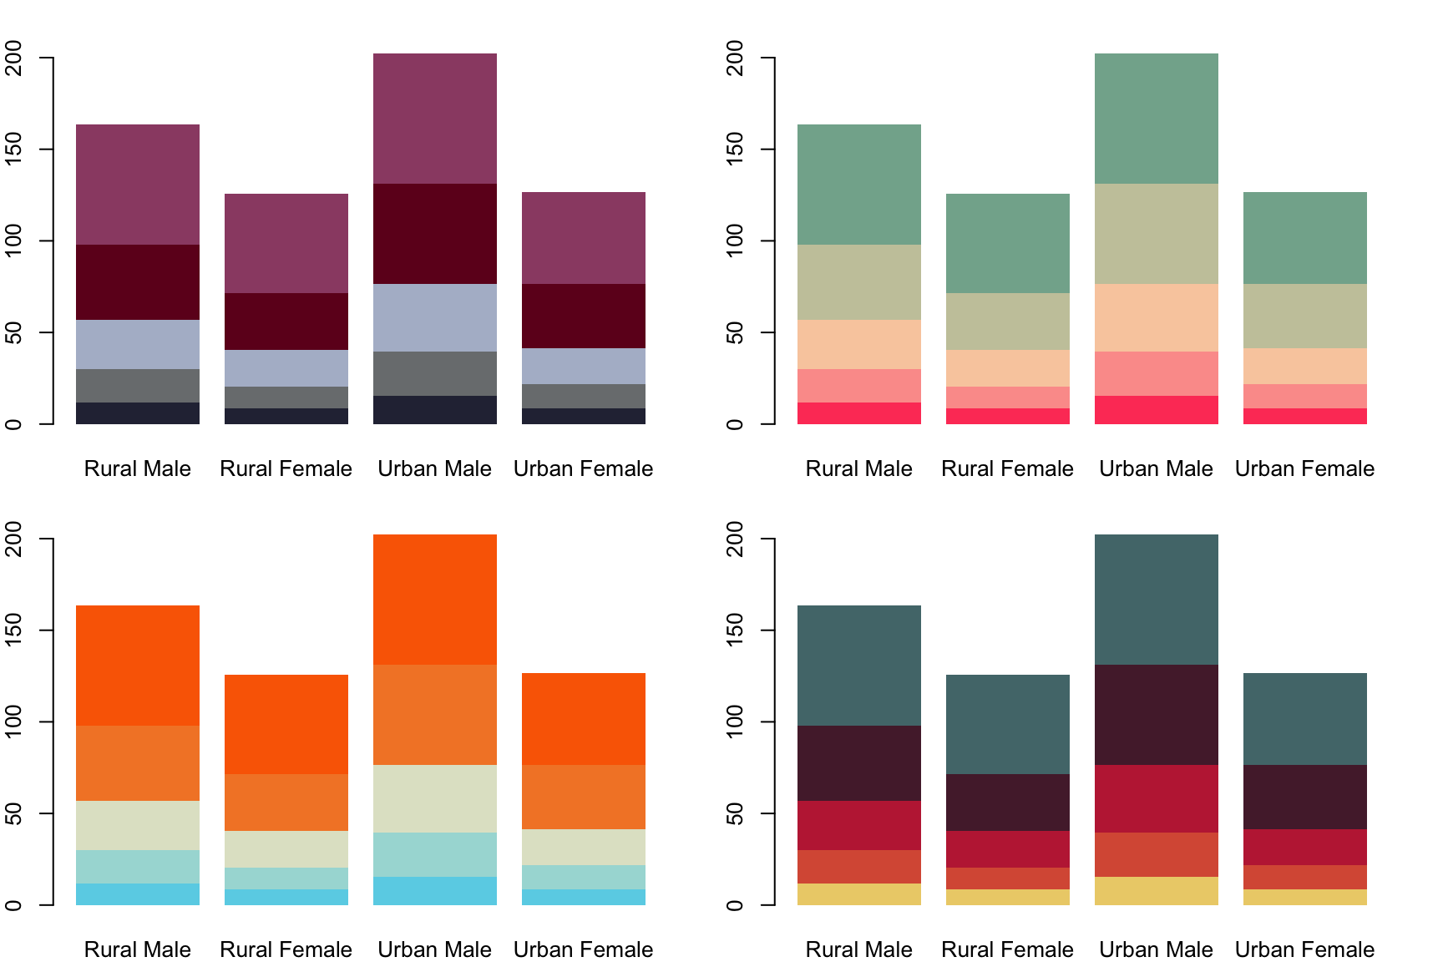
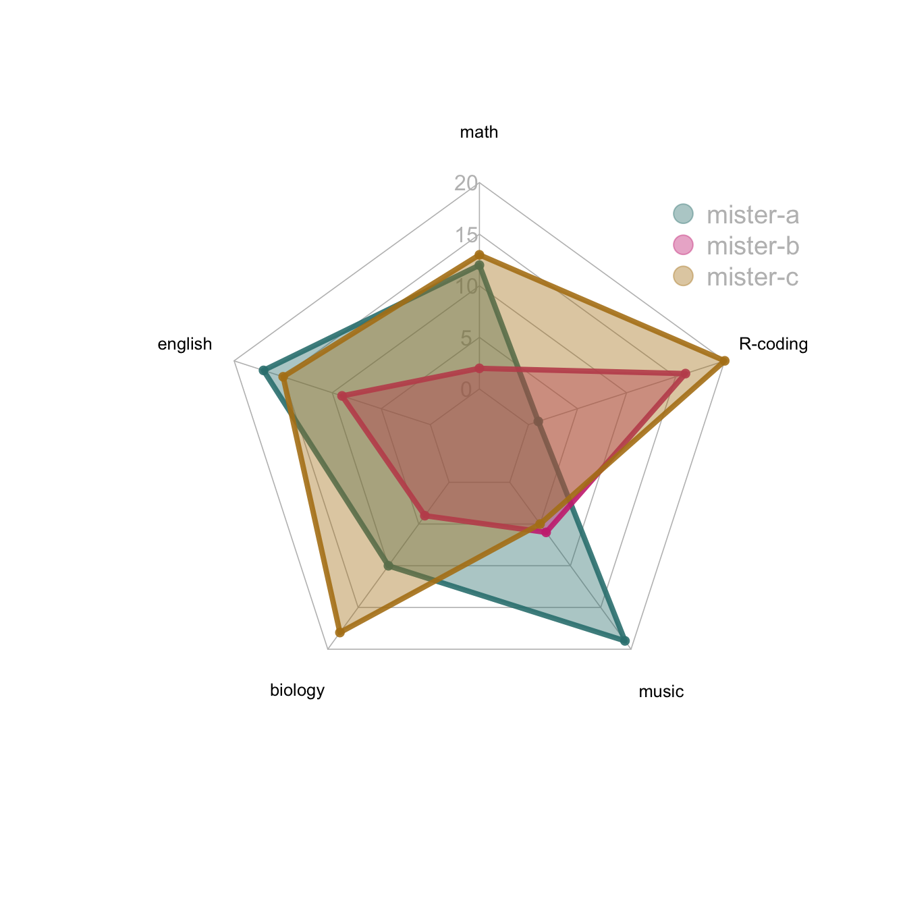
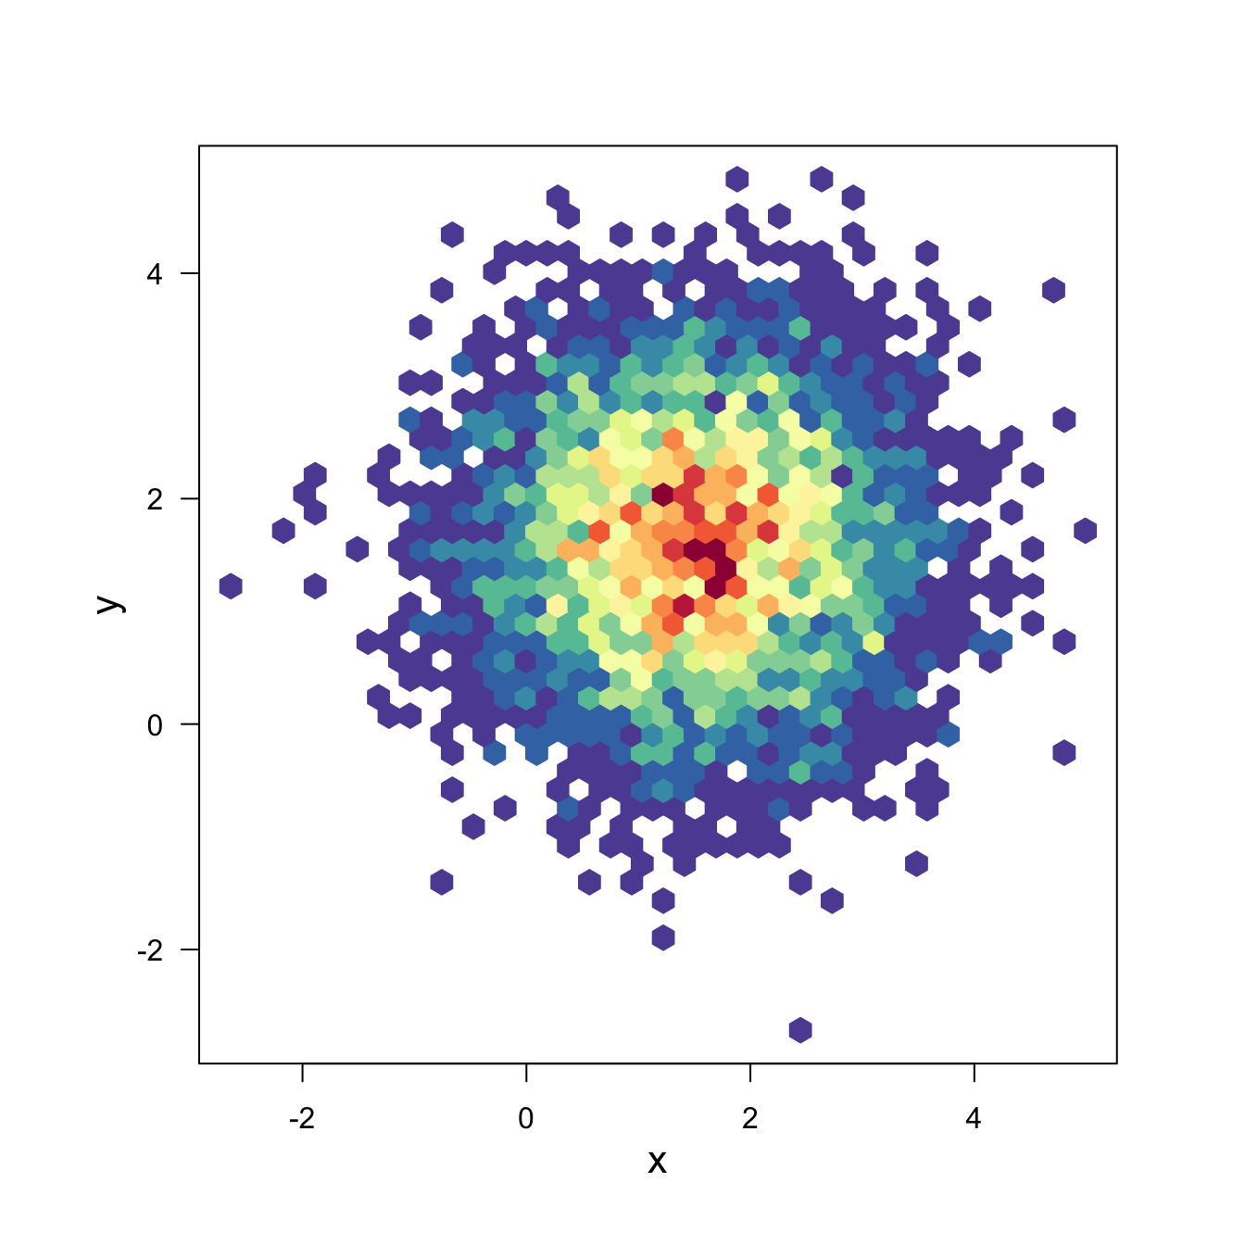
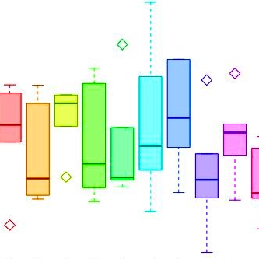
WELCOME TO
FROM EXCEL TO R
R
4
Notes:
[Talk shortly about why here. Open source, easy and intuative for data wrangling and plotting which are the first steps you will need to do to your data]

Slide 6


FROM EXCEL TO R
WHAT WILL I LEARN?
DATA WRANGLING
PLOTTING
tidyverse
Data Structures
Useful Functions
Pipe (“clean” code)
ggplot2
Code structure
ggplot2 + tidy data
THE BASICS
STATISTICS
R
RStudio
Scripts, paths, files
R project
Help recourses
Linear models
ANOVA
Post Hoc Tests
5
Notes:
[Copy of previous slide but with potential update]

Slide 7
FROM EXCEL TO R
PROGRAM
DAY 1
DAY 2
08:45 - Installation Issues + Coffee
09:00 - Introduction to R
09:45 - Exercise 0
10:15 - Break
10:30 - Introduction to Quarto
11:10 - Exercise 1
12:00 - Lunch
13:00 – Tidyverse
14:00 - Break
14:15 - Tidyverse Exercise 2
16:00 - See you tomorrow
08:45 - Coffee + Optional Q&A
09:00 - ggplot2 + Exercise 3
10:30 - Break
10:45 - ggplot2 Exercise 3
12:00 - Lunch
13:00 - Applied Statistics
14:00 - Break
14:15 - Statistics Exercise
15:00 - Cool things in R + Course Evaluation
15:15 - DataLabs Services / Where to get Help
16:00 - Bye Bye Bye!
6
Notes:
Possibility to bring your own data.

Slide 8
FROM EXCEL TO R
LET’S GET STARTED
R

Slide 9
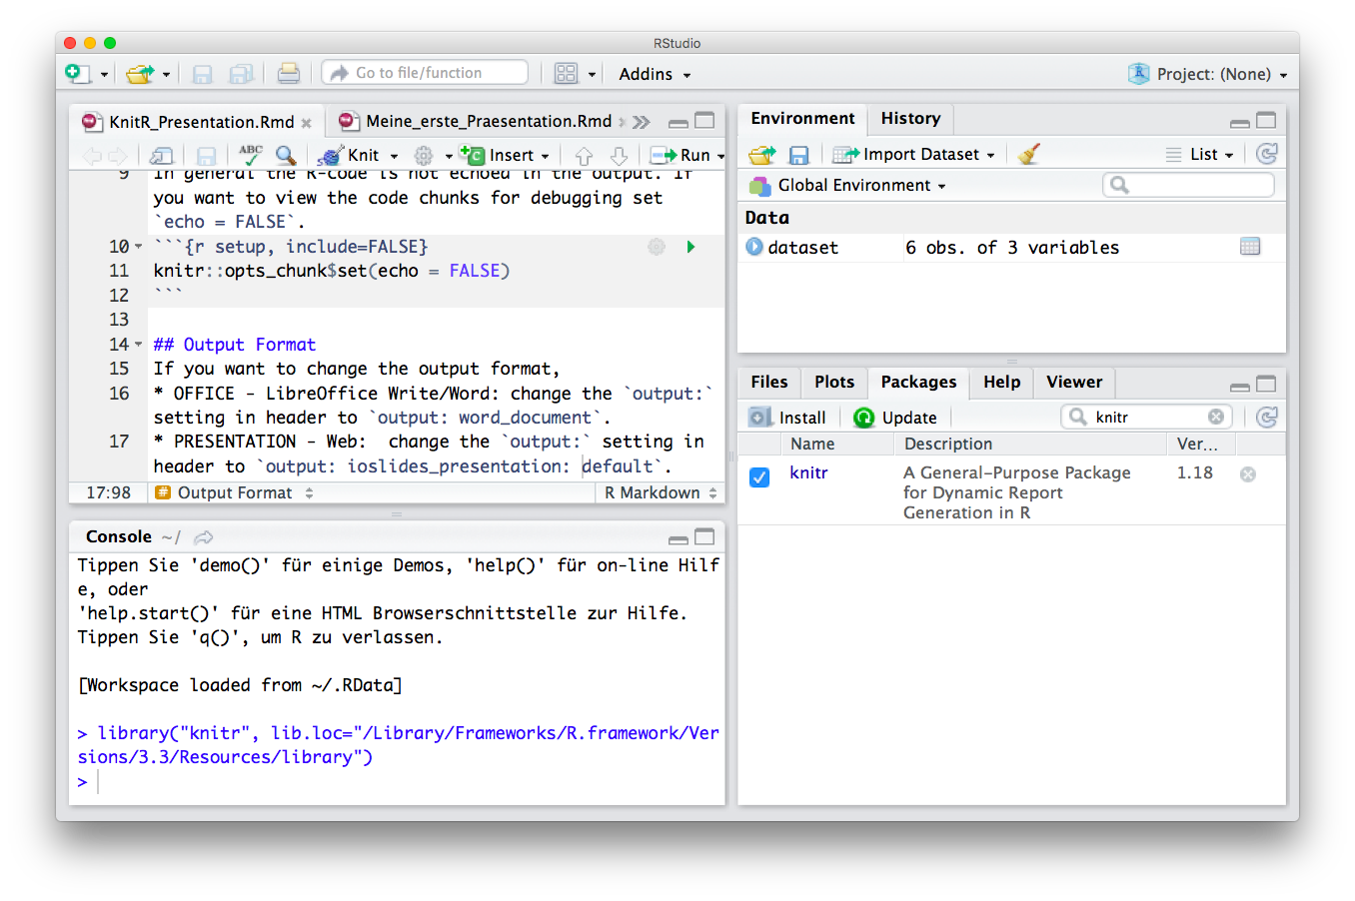


FROM EXCEL TO R
R & FRIENDS
R
R
Studio
Scripting / Programming Language
Objects in Environment
R-scripts (Save Your Code)
Console (Run and Test Code)
Overview by Type, Help and R-packages
Reports (html, pdf, word)
R Code Interpreter and Editor
8
Notes:
Markdown is a plain text language with formatting syntax designed so that it can be converted to HTML and many other formats.
They are written using an extension of markdown syntax that enables R code to be embedded in them in a way which can later be executed.
Knitr takes a plain text document with embedded code, executes the code and 'knits' the results back into the document.

Slide 10





FROM EXCEL TO R
THE ANATOMY OF R
R
R
Studio
The programming language may be used from within in the Code Editor
.R
.Rmd
.qmd
The R code you write may be saved in scripts with extensions:
select()
mutate()
mean(x)
sd(x)
Functions perform actions based on input arguments and return an output:
Packages are bundles/libraries of functions.
tibble()
9
Notes:
A double is a double-precision, 64-bit floating-point data type. It accommodates 15 to 16 digits, with a range of approximately 5.0 × 10−345 to 1.7 × 10308

Slide 11
https://www.quarto.org/
PATHS – LOCATION, LOCATION, LOCATION
The directories on your computer are organized in a File Tree
Move between directories or point to a place in the tree with a specific file
abc123
We do this by specifying a path:
  Move to: /abc123/Documents/Research
Point to: /abc123/Documents/Research/myData.csv
Data
Documents
Desktop
Exp1.csv
Teaching
Research
Go through Exercise 0 in plenum!
myData.csv
11
Notes:
First we need to make sure that our files are in order. It is very important to have a good structure when coding.
Go through exercise 0.

Slide 12
R project & R Script
Read & Write
Basic calculus
R help
Save & Shutdown
0
1
2
3
FUNDAMENTALS
R
Studio
EXERCISE 0
4
5
16

Slide 13
FROM EXCEL TO R
LIVE CODING 0 – INTRO TO R
Notes:
Now that we have our file tree in order – let’s go through presentation 0

Slide 14
FROM EXCEL TO R
ONLINE RESOURCES FOR R
https://www.r-project.org/
GET STARTED
GRAPHICS
BOOKS & COURSES
OTHER RESOURCES
https://www.r-bloggers.com/best-books-to-learn-r-programming/
https://www.datacamp.com/
https://www.codecademy.com/
https://www.coursera.org/
https://github.com/trending/r
https://blog.revolutionanalytics.com/
https://stackoverflow.com/questions/tagged/r
https://rseek.org/
https://rstudio.com/resources/cheatsheets/
http://www.cookbook-r.com/
https://www.statmethods.net/r-tutorial/index.html
https://www.r-graph-gallery.com/
http://r-statistics.co/Top50-Ggplot2-Visualizations-MasterList-R-Code.html
15

Slide 15
https://www.rstudio.com/wp-content/uploads/2016/10/r-cheat-sheet-3.pdf
INTRO CHEAT SHEET
Basics:
Read in Data:
getwd() # location
install.packages("package_name") # install packages
library(package_name) # load packages
read.xlsx("name.xlsx”) # library(readxl)
read.delim("name.txt", sep ="\t") read.csv("name.csv", sep=";")
GETTING
STARTED
Overview:
view() # view data as table
df$col1 # extract column from dataframe
nrow(df), ncol(df) # number of rows/columns
head(df, n=10), tail(df, n=10) # first or last 10 rows
unique(), table(), count() # unique vals, count vals
OVERVIEW
CHUNK OPTIONS
Type/Class:
Conditions:
class() # get data type/class
is.numeric(x), is.character(), is.factor() # is data type
as.numeric(x), as.character(), as.factor() # change data type
a > b a < b
DATA TYPES & CONDITIONS
a == b a != b
a >= b a <= b
is.na() is.null()
Summary Stats:
Plots:
summary() # summary statistics
mean(), median(), sd(), sum(), log(), max(), min(), quantile(), var()
plot(x)
plot(x, y) or plot(col1, col2, df) # scatter
hist(x) # histogram
STATISTICS &
BASE PLOTS
14
Notes:
Second slide intermezzo

Slide 16

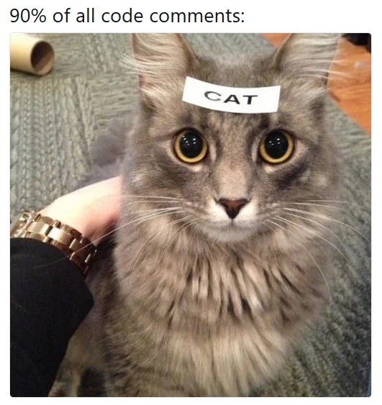
https://www.quarto.org/
QUARTO DOCUMENTS
Tool which supports reproducible coding/publication (reports)
Quarto works with a markup language
A markup language is text-coding system which specifies structure & format of a document and the text within it
We render (compile) a Quarto → html, pdf, word, website
Pointers for quarto:
Separate sections with headers
Do not overfill code chunks
Write meaningful and precise comments
10
Notes:
First slide intermezzo

Slide 17
DATA STRUCTURES
DATA TYPES
Vector
Numeric
Age
-1.5, 2.7, 3.2
Data Frame
FROM EXCEL TO R
Age
Height
BMI
Integer
R DATA TYPES & STRUCTURES
-2, -1, 0, 3, 5
List
Character
“A”, “Bat”, “Tom”
VARIABLES
Array
Factor
G1, G1, G2, G3
OBSERVATIONS
Tibble
Logical
< >
< >
< >
< >
< >
TRUE, FALSE
12
Notes:
Second slide intermezzo
A double is a double-precision, 64-bit floating-point data type. It accommodates 15 to 16 digits, with a range of approximately 5.0 × 10−345 to 1.7 × 10308

Slide 18
FROM EXCEL TO R
LIVE CODING 1 – QUARTO

Slide 19


https://quarto.org
QUARTO CHEAT SHEET
YAML parameter:
Code Chunk:
---
title: My Project Name
output:
  html_document (pdf_document, …)
---
Source mode:
```{r}
# some R code
```
Visual mode:
GETTING
STARTED
Code Options:
Figure Options:
{r echo = FALSE} # don’t print code (default is TRUE)
{r eval = FALSE} # don’t run code (default is TRUE)
{r error = FALSE} # don’t display error message (default is TRUE)
(Can also be set for warning and message)
fig.align (='left', 'right', 'center')
fig.cap (= 'my figure cation’)
fig.height (= n), fig.width (= n)
CHUNK OPTIONS
Source mode:
Header
Text
Lists
*italics*
**bold**
`highlighted`
List item1 (filled dot)
    + sub-item1 (open dot)
List item1 (numbered)
  i) sub-item1 (roman)
Header size ranging from largest (one #) to smallest (six #):
# my.text, ## my.text, ### my.text, etc.
TEXT
13
Notes:
First slide intermezzo

Slide 20
0
1
2
Quarto
Data Structure
Data type
3
QUARTO
R
Studio
EXERCISE 1
4
5
16

Slide 21
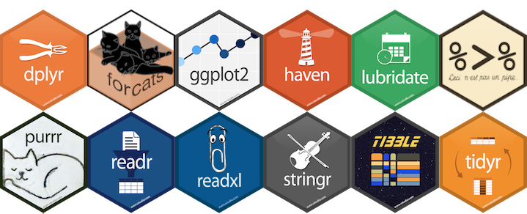
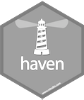

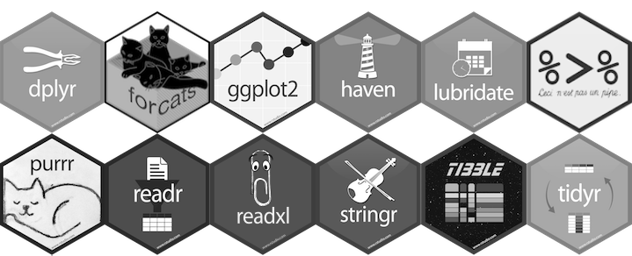
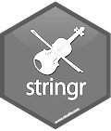
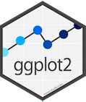
tidyverse is a collection of R packages for data science
READING DATA
“The packages share an underlying design philosophy, grammar, and data structures.” Wickham and Grolemund
TIDYING
https://www.tidyverse.org/
TIDYVERSE
MANIPULATION
tidyverse is used to “tidy up” your datasets, so they are easy to work with
PROGRAMMING
VISUALIZATION
17

Slide 22
https://www.tidyverse.org/
CECI N'EST PAS UNE PIPE
%>%
tidyverse
You do NOT have to “chose” between
tidyverse and base R
base R
base R
# think from the inside out
g(f(x,y),z)
BENEFITS
?
CONSIDERATIONS
tidyverse
Short & well-organised code
Can be less stable
# no brain acrobatics
x %>% f(y) %>% g(z)
Tidy datasets, easy to work with
“Different syntax”
Great documentation
pipe symbol
Functions with logical names & inputs
Can be computationally slow
18
Notes:
dpyr functions are like lego. You can add them however you want (in theory).

Slide 23
FROM EXCEL TO R
LIVE CODING 2 – TIDYVERSE

Slide 24
https://www.tidyverse.org/
TIDYVERSE CHEAT SHEET
readr, tidyr, dplyr, …
Read Data (readr)
Workflow
Data Manipulation (dplyr)
Reading tabular data
There are solutions for multiple data types
read_excel() # using readxl package
read_table()
read_csv()
Useful arguments
Skip lines: read_csv(file, skip=1)
Read subset: read_csv(file, n_max=1)
Data types
readr guesses the types of each column and tells you about it
(“Parsed with column specifications: …”)
Tidyverse workflow
df %>%
select(col1)
df %>%
filter(col1 < x)
df %>%
summarize(n_1 = n(),
avg_1 = mean(co1),
sd_1 = sd(col1))
Select column
df$col1
Summary
summarize()
count()
Group
group_by()
Functions will manipulate each group separately and combine results.
Extract and sort observations (rows)
filter() # subset rows by condition
distinct() # subset to unique values
top_n() # subset by position
arrange() # sort low->high, other way with desc()
Manipulate variables (columns)
select() # subset rows by condition
mutate(new_name = f(column))
mutate(new_name = ifelse(col1 < x, ”Yes”, ”No”))
mutate(new_name = col1 + col2)
HELP
R Documentation (e.g. enter ?dplyr::filter and see examples)
Much more info and detailed cheat sheets:
  https://brianward1428.medium.com/introduction-to-tidyverse-7b3dbf2337d5
It also helps to google “tidyverse + whatever_you_want_to_do”
20

Slide 25
0
1
2
TIDYVERSE
R
Studio
3
EXERCISE 2
4
Tidyverse:
  Filtering
  Selecting
  Mutating
  Arranging
  Summarizing
5
21

Slide 26
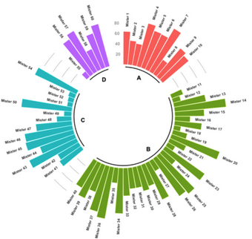
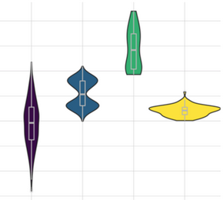
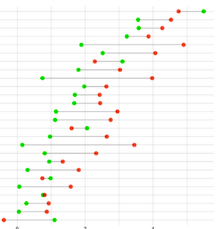
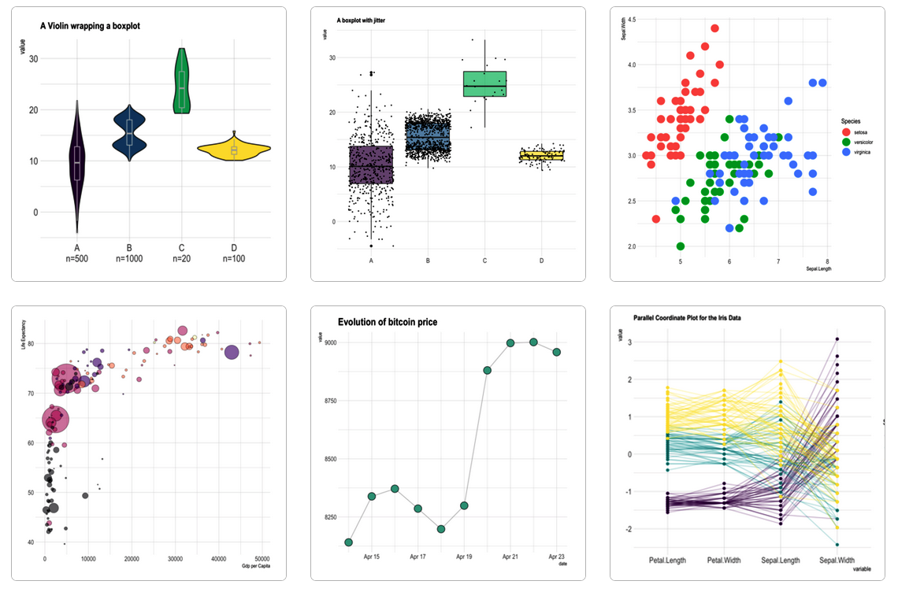

https://www.r-graph-gallery.com/
GGPLOT2 - EASY GRAPHICS
Aesthetically pleasing graphics
Well-defined “additive” (+) structure
Integrates perfectly with tidy data
Great documentation & community
22
Notes:
Plots to visualize data
Additive structure: Build a plot layer by layer where each layer enhances the plot. This makes plots easily customizable.
Tidydata: One row per observation, one variable per feature.
ChatGPT

Slide 27
http://tutorials.iq.harvard.edu/R/Rgraphics/Rgraphics.html
GGPLOT2
ADDITIVE STRUCTURE
DATASET
ggplot(data,
aes(X, Y,
color, fill, size, group, alpha..)) +
AESTHETICS
GEOMETRIES
geom_line()
FACETS
Aesthetics
Mapping variables to groups or magnitudes - color, fill, group (all grouping variable), size, shape, etc.
SCALES
Aesthetics
Geoms
Mapping variables to groups or magnitudes - color, fill, group (all grouping variable), size, shape, etc.
geom_point()
geom_boxplot()
geom_histogram()
Inherit global aesthetics, Overlay
STATISTICS
THEME+LABS

Slide 28
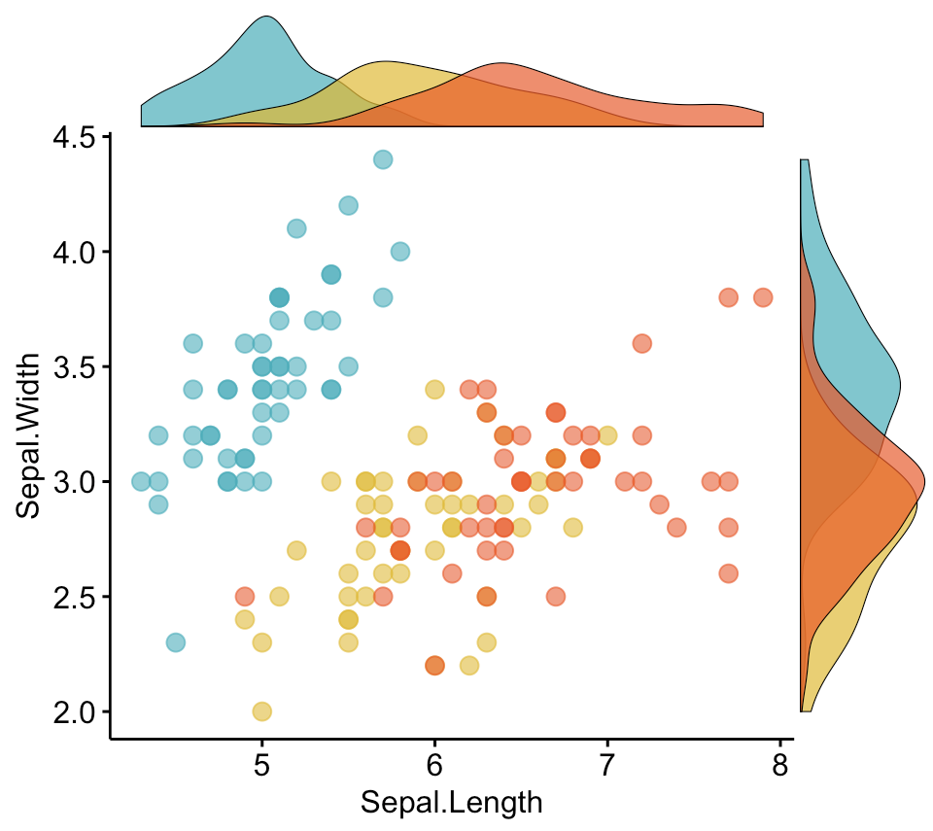
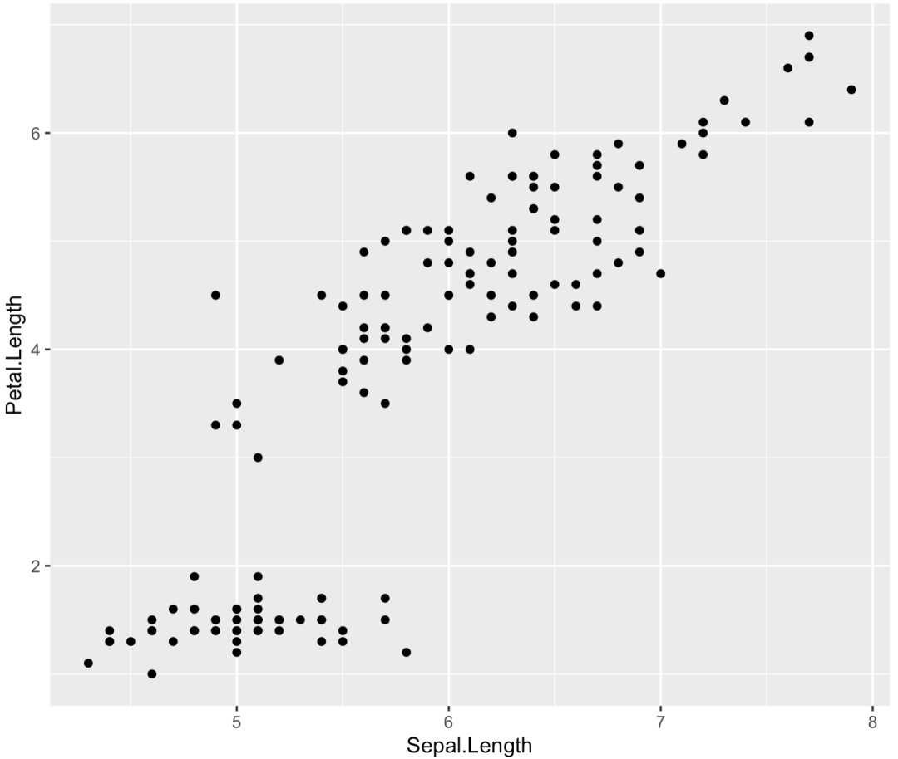
http://tutorials.iq.harvard.edu/R/Rgraphics/Rgraphics.html
GGPLOT2
ADDITIVE STRUCTURE
DATASET
ggplot(data,
aes(X, Y,
color, fill, size, group, alpha..)) +
AESTHETICS
GEOMETRIES
geom_line()
FACETS
SCALES
STATISTICS
THEME+LABS

Slide 29
FROM EXCEL TO R
LIVE CODING 3 – GGPLOT 2

Slide 30
https://rstudio.com/wp-content/uploads/2016/11/ggplot2-cheatsheet-2.1.pdf
GGPLOT CHEAT SHEET
Define Plot:
Add Plot Type:
GET STARTED
ggplot(data = my.data,
aes(x = x.var,
y = y.var))
… + geom_point() # scatter plot
… + geom_line()
… + geom_boxplot()
… + geom_col()
… + geom_density()
… + geom_histogram()
One Color:
Color Fill by Group:
Custom Colors:
ggplot(…, aes(…), color = "green")
ggplot(…, aes(…, fill = z.var))
… + scale_*_manual(values = c())
ex: scale_color_manual(values = c("blue", "pink"))
COLORS
More Colors:
Labels:
… + labs(title = ”Title”,
x = ”X label”,
y = ”Y label”)
COLOR SCALES & THEMES
… + scale_fill_grey(start = 0.2, end = 0.8)
… + scale_fill_gradient(low="white", high="red")
Theme:
… + theme_bw()
… + theme_minimal()
… + theme_dark()
… + theme_classic()
Text:
… + theme(legend.position = *)
* = ”none”, ”top”, ”bottom”, ”left”, ”rigth”
TEXT
25

Slide 31
0
1
2
GGPLOT2
R
Studio
3
EXERCISE 3
4
ggplot2
  Bar plot
  Scatter plot
  Boxplot
  …
Syntax
Aesthetics
5
27

Slide 32
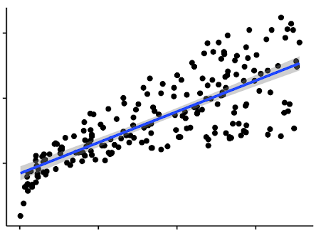
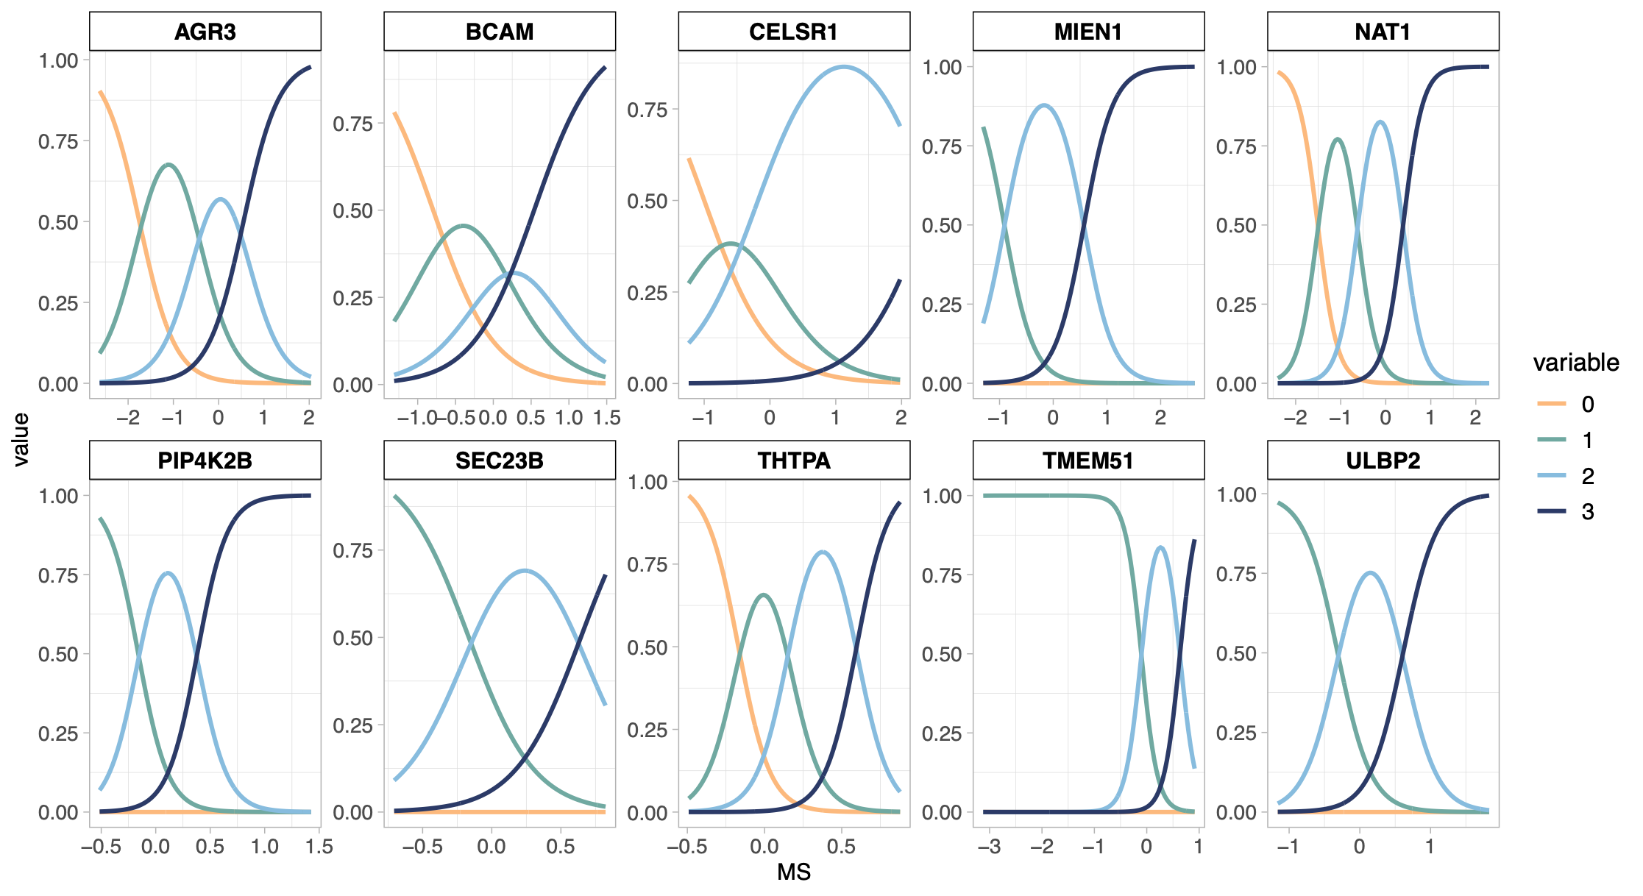
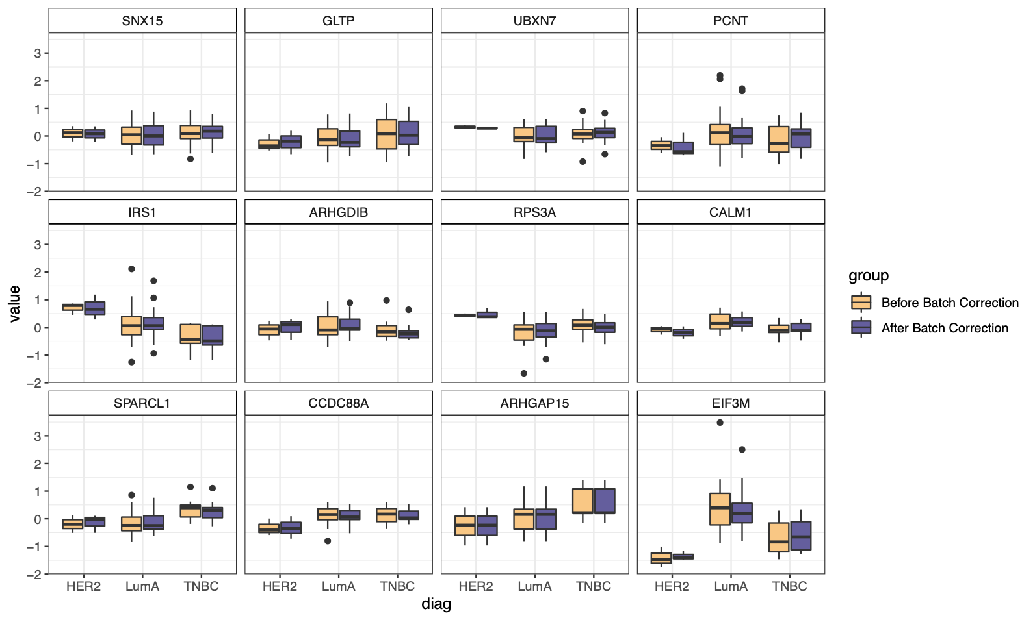
http://www.sthda.com/english/
R - A STATISTICAL
SCRIPTING LANGUAGE
  Y
MODEL FUNCTIONS
EMMEANS PACKAGE
lm(), glm()
lmer(), glmer(),
nls(), …
emmeans(), pairs(), cld()
  X
  Variable 1
  Variable 2
  A
  B
APPLY TO MODEL
MORE FUNCTIONS
summary(), anova(), confint(), predict(), drop1(), update(), step(), …
t.test(), cor(), cor.test(), aov(), quantile(), p.adjust(),
rank(), …
  C
  D
28

Slide 33

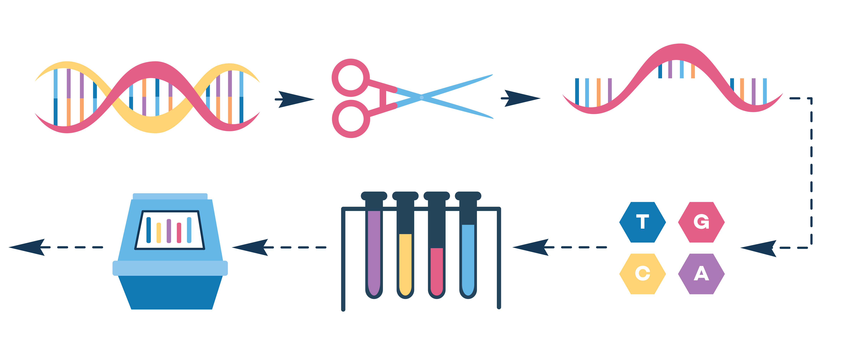

YOU
The researcher with R skills!
YOUR DATA
Gene expression data, i.e. how much a gene is used to produce a protein. Multiple genes measured in one experiment.
Let’s use R in a statistical analysis
YOUR DISEASE OF INTEREST
Psoriasis, an immune-mediated skin disorder.
29

Slide 34
http://www.sthda.com/english/
R - A STATISTICAL
SCRIPTING LANGUAGE
  Y
During this session:
Cooperatively discuss and share ideas about the data
Apply steps of basic statistical analysis for hypothesis testing consistent with the given data
Suggest conclusions based on your analysis, regarding the association between psoriasis and gene expression levels
  X
  Variable 1
  Variable 2
  A
  B
  C
  D
30

Slide 35
FROM EXCEL TO R
LIVE CODING 4 – APPLIED STATS

Slide 36
https://rstudio.com/resources/cheatsheets/ for various relevant cheat sheets.
Other example: https://www.dummies.com/programming/r/statistical-analysis-with-r-for-dummies-cheat-sheet/
STATS CHEAT SHEET
Import Data:
Overview of Data:
read_excel(“my.data.xlsx”)
summary(my.data)
nrow(my.data)
length(my.data)
names(my.data)
GET STARTED
Linear:
Logistic:
Linear Mixed:
Check Model:
summary(model) par(mfrow=c(2,2))
plot(model)
REGRESSION MODELS
lm(y~x, data=my.data)
confint(model)
glm(y~x,
data=my.data)
lmer(y~x + (1|z), data=my.data)
ANOVA:
F-Test:
Emmeans:
emmeans(model,~x)
pairs(emmeans(model,~x))
predict(model, newdata)
TESTS/
COMPARISONS
anova(model2, model1)
drop1(model, test="F")
Check Type:
Change Type:
table(my.data$x)
is.numeric(my.data$x)
is.factor(my.data$x)
mutate(my.data, x = factor(x))
fct_collapse(x)
VARIABLES
31

Slide 37
0
1
2
Statistics in R
R
Studio
3
EXERCISE 4
Linear regression
Summary Statistics
ANOVA
Logistic regression
Clustering
Correlation
4
5
21

Slide 38

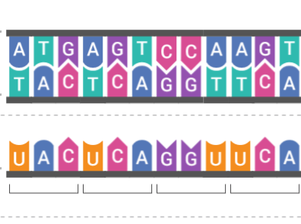
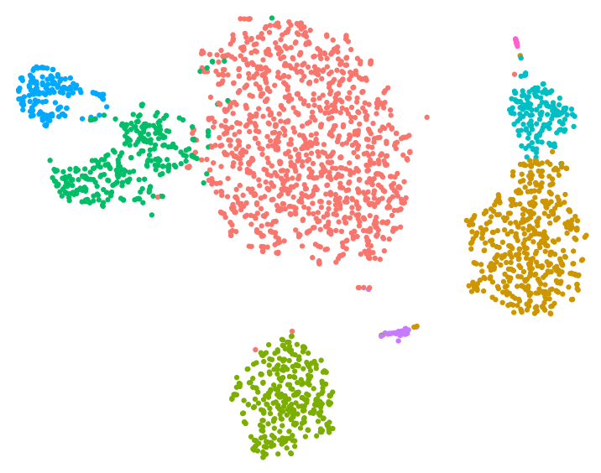
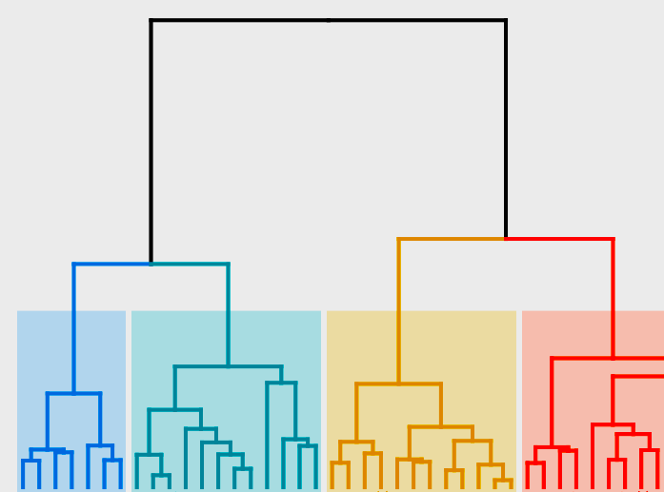
https://www.r-graph-gallery.com/
BIOINFORMATICS IN R
HIGH THROUGHPUT DATA
BIOINFORMATIC ANALYSIS
DIMENSIONALITY REDUCTION
CLUSTERING
DNA
RNA
PROTEIN
MACHINE LEARNING
NETWORK ANALYSIS
RNA SEQ DATA
PROTEOMICS DATA
33

Slide 39
1
2
R
Studio
3
Statistics in R
EXERCISE 5
4
5
Tidyverse
ggplot
Stats
Quarto
34

Slide 40
FROM EXCEL TO R
THE TOP OF THE R ICEBERG
STATISTICAL ANALYSIS
DATA MANGEMENT
Statistical models (linear, generalized, mixed, …)
EASY PLOTTING
Statistical tests (t-test, chisq, anova, …)
Survival analysis (Cox, Kaplan meier)
BIOINFORMATIC ANALYSIS
R
35

Slide 41
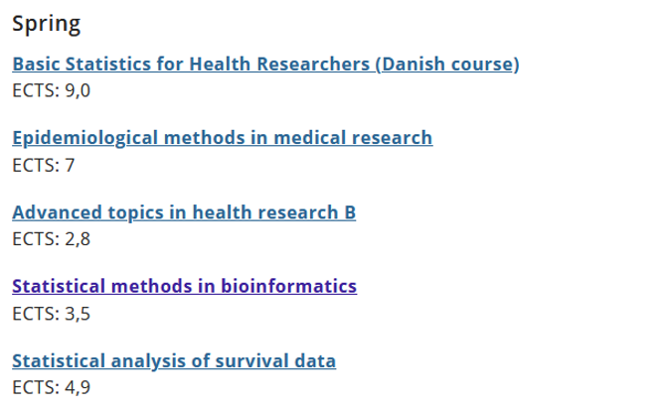
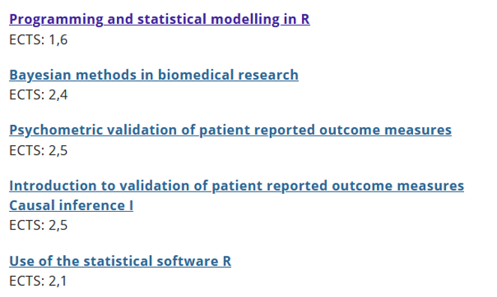
FROM EXCEL TO R
WANT MO-R-E?
The Section for Biostatistics offers a number statistics-oriented R courses:
https://publichealth.ku.dk/about-the-department/biostat/
* These are screenshots. Go to the website and scroll down to ‘Teaching’
36

Slide 42
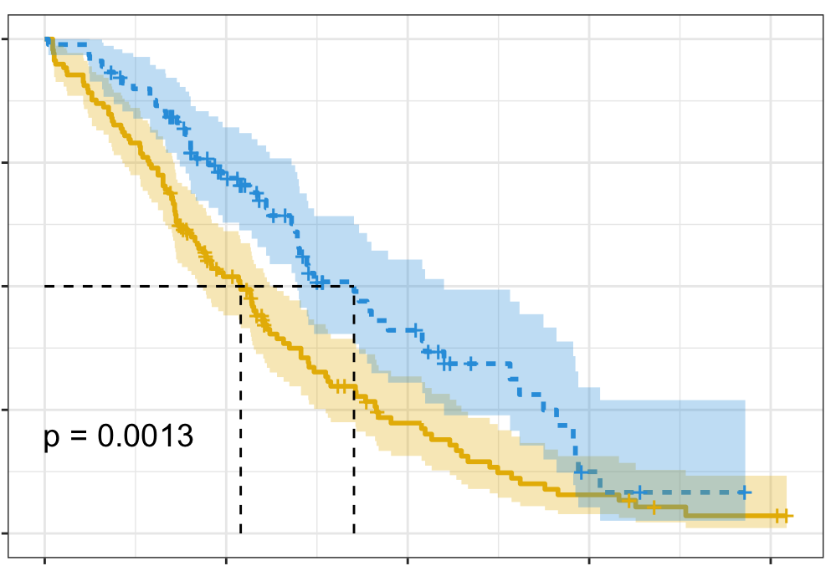
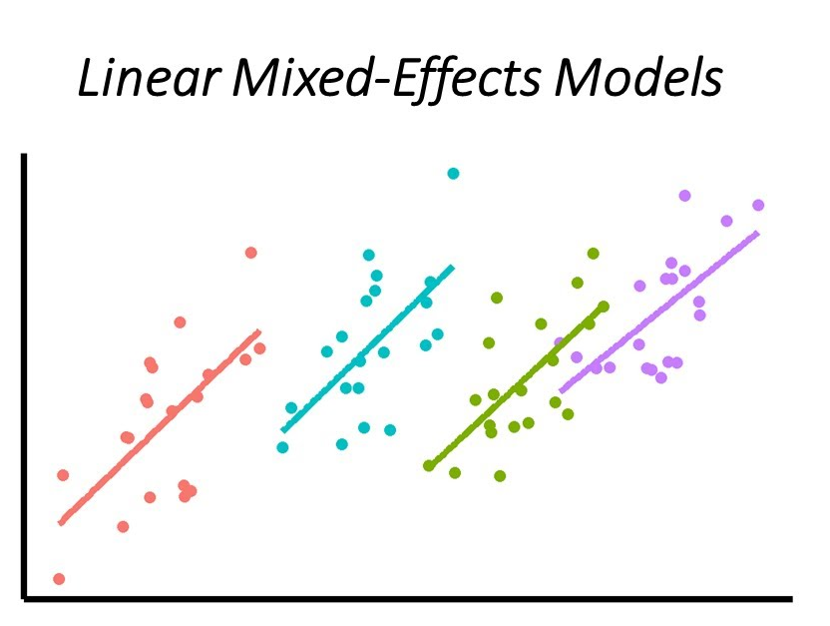
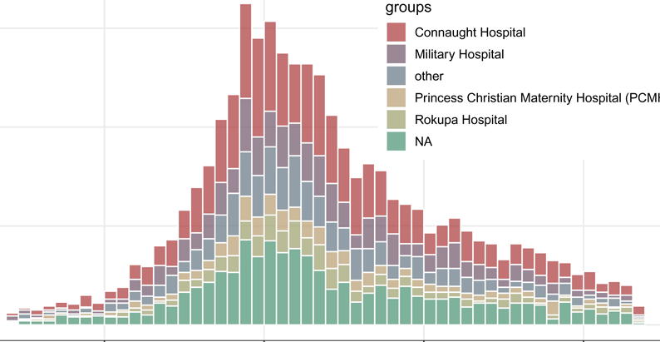
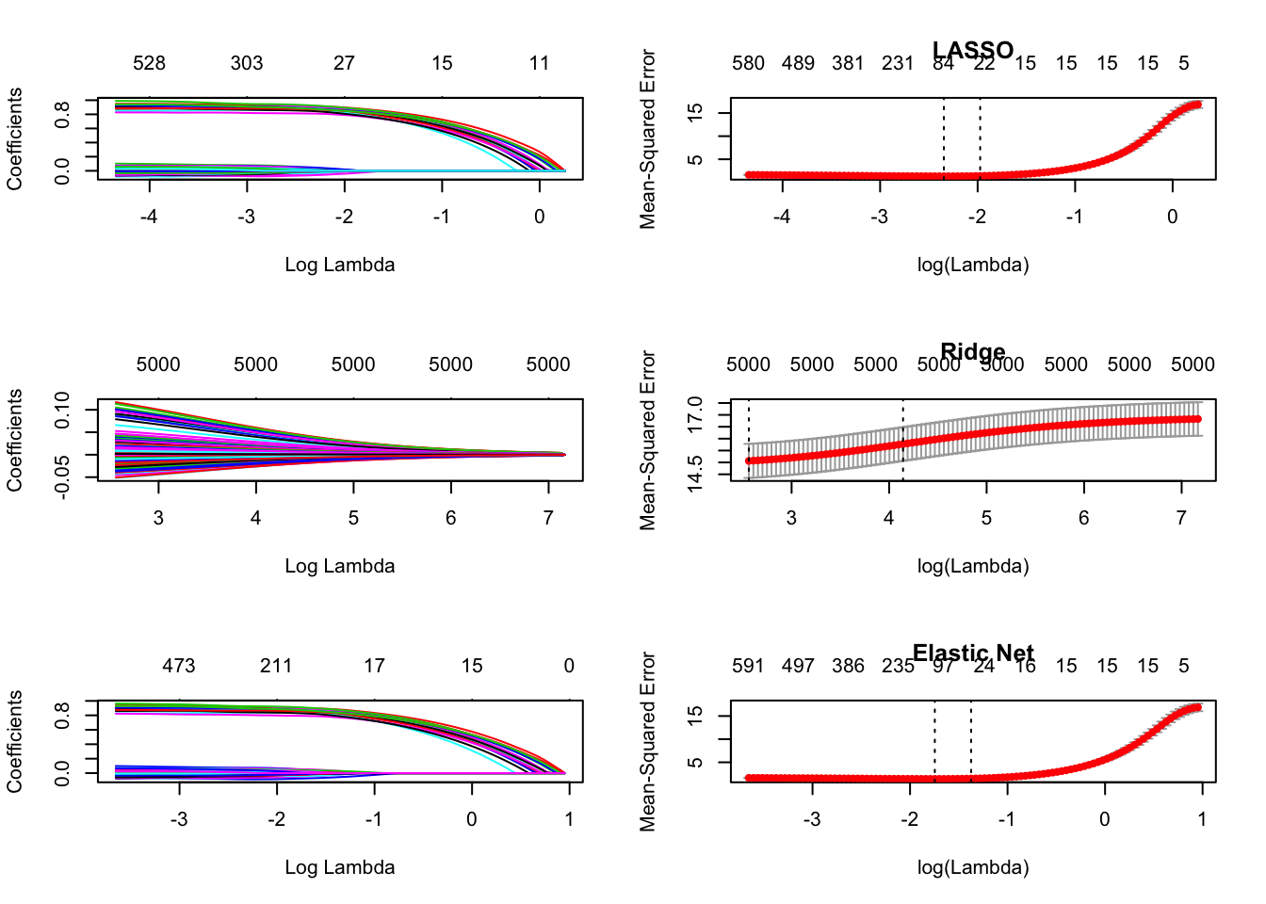
Survival Analysis
survival: https://rviews.rstudio.com/2017/09/25/survival-analysis-with-r/
survminer: https://cran.r-project.org/web/packages/survminer/survminer.pdf
(https://rpkgs.datanovia.com/survminer/ )
Mixed-Effects Models
lme4: https://cran.r-project.org/web/packages/lme4/vignettes/lmer.pdf
https://cran.microsoft.com/snapshot/2017-08-01/web/packages/sjPlot/vignettes/sjplmer.html
glmmTMB: https://cran.r-project.org/web/packages/glmmTMB/index.html
TEASER
STATISTICS in R
Epidemiological Analysis
Epi: https://cran.r-project.org/web/packages/Epi/index.html
pubh: https://rviews.rstudio.com/2020/03/05/covid-19-epidemiology-with-r/
https://cran.r-project.org/web/packages/incidence/vignettes/customize_plot.html
https://rviews.rstudio.com/2020/03/05/covid-19-epidemiology-with-r/
Elastic-Net Regression (R
glmnet: https://cran.r-project.org/web/packages/glmnet/glmnet.pdf
elasticnet: https://cran.r-project.org/web/packages/elasticnet/elasticnet.pdf
https://www.datacamp.com/community/tutorials/tutorial-ridge-lasso-elastic-net
21
37

Slide 43


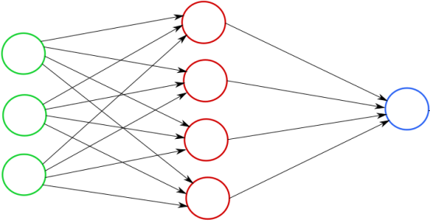
Clustering
Feature Selection: PCA
Missing Data
TEASER
Machine Learning
https://lgatto.github.io/IntroMachineLearningWithR/an-introduction-to-machine-learning-with-r.html
https://statsandr.com/blog/clustering-analysis-k-means-and-hierarchical-clustering-by-hand-and-in-r/
https://bioconductor.org/packages/release/bioc/vignettes/PCAtools/inst/doc/PCAtools.html
https://amices.org/mice/
https://datascienceplus.com/imputing-missing-data-with-r-mice-package/
Random Forest
kNN
SVM
Neural Networks
https://www.blopig.com/blog/2017/04/a-very-basic-introduction-to-random-forests-using-r/
https://www.edureka.co/blog/knn-algorithm-in-r/
https://cran.r-project.org/web/packages/e1071/vignettes/svmdoc.pdf
https://keras.rstudio.com/
https://tensorflow.rstudio.com/
38

Slide 44
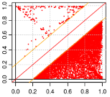
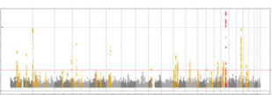
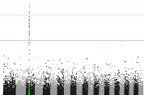
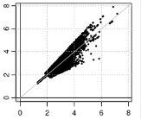
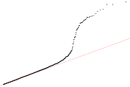
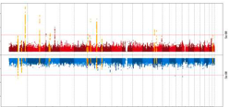
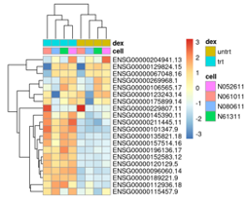
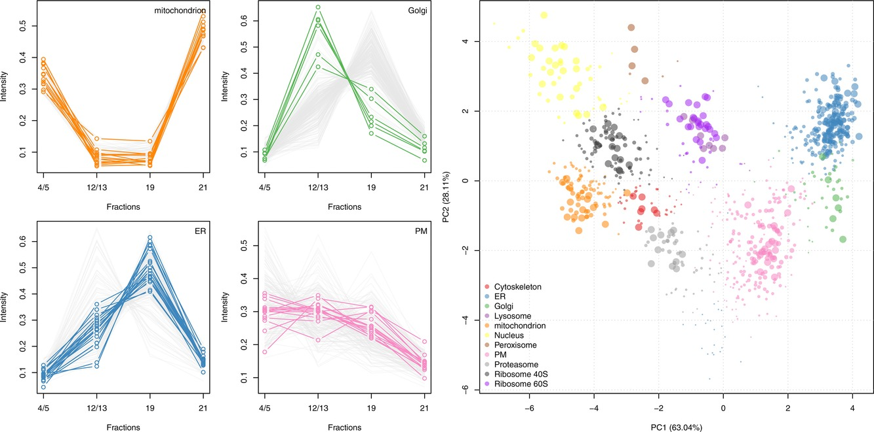
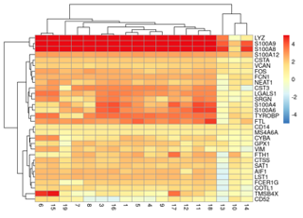
GWAS - QC &
Data Harmonization
GWAS Data Management & Plots
More Plotting…
EasyQC: https://www.uni-regensburg.de/medizin/epidemiologie-praeventivmedizin/genetische-epidemiologie/software/
EasyStrata: https://www.uni-regensburg.de/medizin/epidemiologie-praeventivmedizin/genetische-epidemiologie/software/
Manhattan and QQ plots: https://cran.r-project.org/web/packages/qqman/vignettes/qqman.htm l
TEASER
Omics Data
Gene Expression Analysis
Proteomics Analysis
Single-Cell RNASeq
http://www.bioconductor.org/packages/release/BiocViews.html
DESeq2, limma, EdgeR, etc.: http://www.bioconductor.org/packages/release/BiocViews.html#___RNASeq
RforProteomics: https://www.bioconductor.org/packages/release/BiocViews.html#___Proteomics
https://cran.r-project.org/web/packages/e1071/vignettes/svmdoc.pdf
39

Slide 45
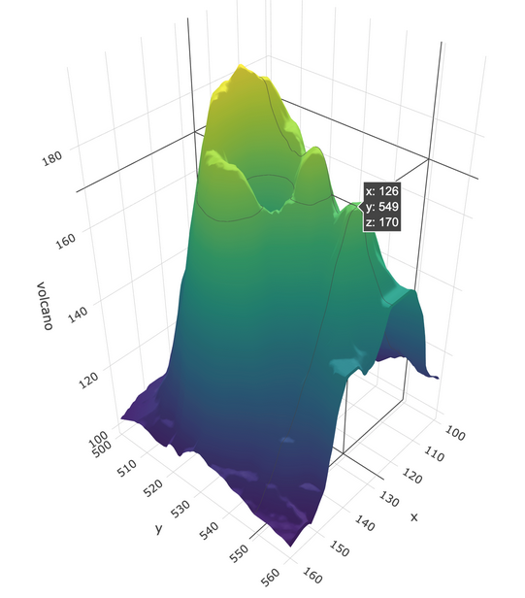

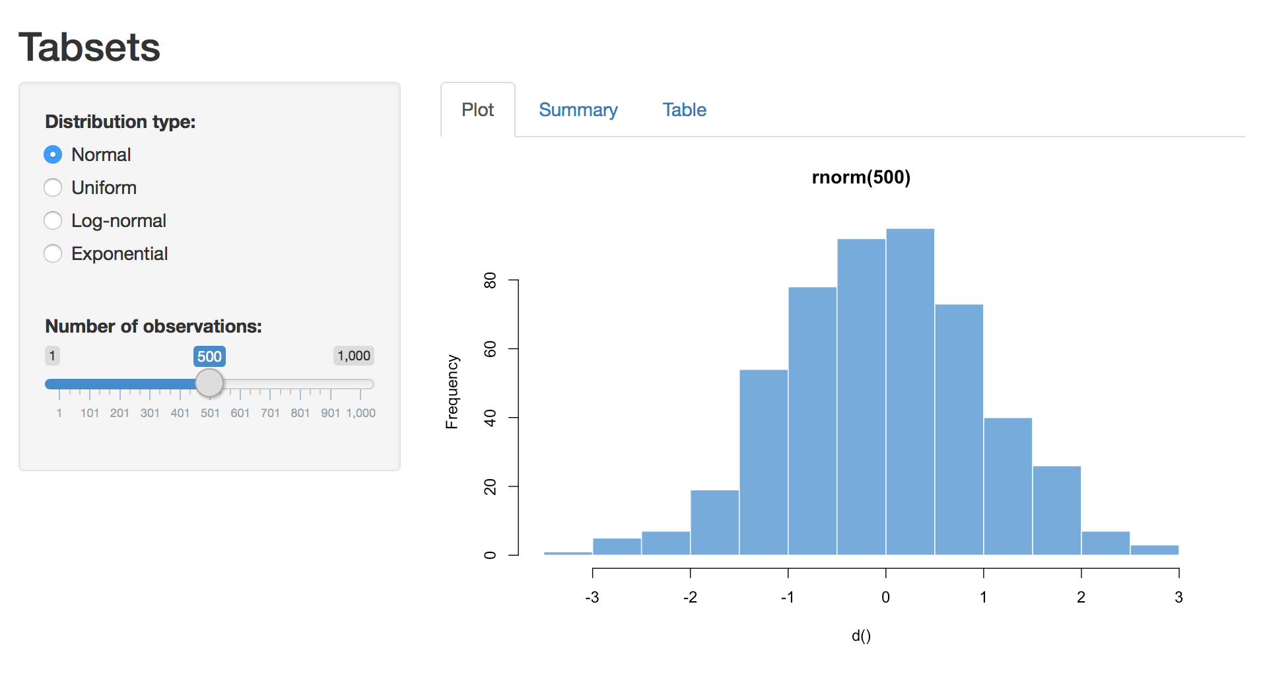
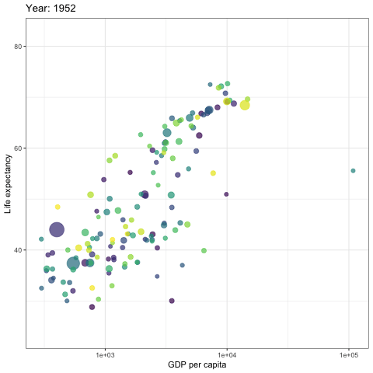


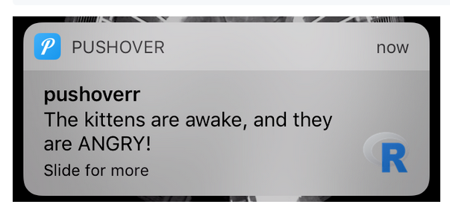
PLOTTING IN 3D
DEEP LEARNING
BAYESIAN STATISTICS
FROM EXCEL TO R
https://plotly-r.com/d-charts.html
https://keras.rstudio.com/
https://tensorflow.rstudio.com/
https://mc-stan.org/users/interfaces/rstan
COOL STUFF IN R
WEBPAGE WITH R SHINY
INTERACTIVE PLOTS
MAIL AND MESSAGES
https://shiny.rstudio.com/
https://gganimate.com/articles/gganimate.html
https://github.com/briandconnelly/pushoverr
40

Slide 46

FROM EXCEL TO R
FREE CONSULTATIONS - Drop by!!!​
Experimental Design
Randomization, confounders, power estimates
Data, workflows, and infrastructure
Compliance (GDPR, Projects Like Mine);
HPC & Storage,
Reproducibility (Git, Dockers, FAIR, Pipelines)
Data analysis & bioinformatics
R analysis, omics, single-cell, clinical & registry data Batch effects, normalization, missing data
Research outputs
Visualizations, Reproducible reports, dashboards and apps, Data sharing /Hosting

Slide 47


FROM EXCEL TO R
EVENTS and CONFERENCES
REPRODUCIBLE ANALYSIS
Follow HeaDS on LinkedIn!
https://www.linkedin.com/company/ucph-heads/
Read more on HeaDS Website!
https://heads.ku.dk
41
Notes:
Always free to book a meeting with us to dicuss your project and how we can help.
Decide on a working model that works for the project.
PhD students gets 10 hrs of supervision for free.

Slide 48

THANK YOU FOR LISTENING
  This presentation was created by Center for Health Data
  Science, SUND, KU.
  For internal use at KU only, do not distribute commercially.

Slide 49

FEEDBACK FORM
  This presentation was created by Center for Health Data
  Science, SUND, KU.
  For internal use at KU only, do not distribute commercially.

