Slide 1
xCell

Slide 2
What is xCell?
R package
Enrichment method
Compare across samples and not cell types.
Performs cell type enrichment analysis from gene expression data.
Trained on pure cell types from various sources.
Output: enrichment scores, not percentages.
does an attempt to make the scores resemble percentages.

Slide 3
Methods
Gene enrichment
Deconvolving cellular composition
”integrate the advantages of gene set enrichemnt with deconvolution approaches.”

Slide 4
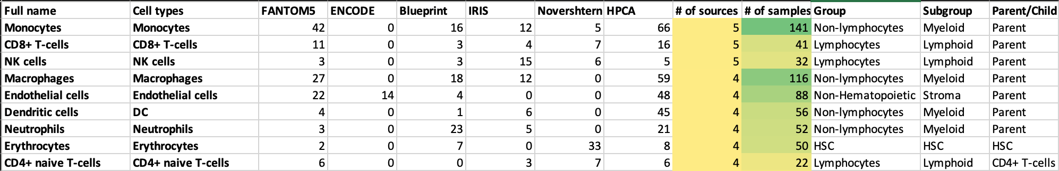
Sample collection
1822 samples of pure cell types from 6 sources
Pure cell type samples = consiting of only one type of cell, I guess
64 distinct cell types/subsets
54 cell types were found in at least two of the sources
Traning set: 1725 samples
Test set: 97 samples
97 cell types were found in five or samples in a data source.
Notes:
Projects: FANTOM5, ENCODE, Blueprint, IRIS, Human Primary Cell Atlas (HPCA)

Slide 5
Gene enrichment
Identified genes that are overexpressed in one cell type compared to all other cell types (done per source).
Multiple gene signatures per cell type within source.
Result: 6574 gene signatures to 64 cell types.
Filter out genes that tend to be overexpressed in cancers.
ssGSEA to score each sample based on all gene signatures.
Narrow down to 489 gene signatures after cross-testing.
3 signatures per cell type per source where available
Notes:
ss = single-sample.
cross-testing: signatures defined from one source was test on samples from another source.

Slide 6
Transforming enrichment scores
Forcing scores on a linear scale

Slide 7
Spillover effect: similar cell types have overlapping gene expression patterns
Spillover correction
”Correcting for correlations between cell types”.
” However, the spillover cor- rection adjustment removes this strict independence be- tween cell type inferences, as in deconvolution methods.”

Slide 8
Validation
Test on 97-sample test set.
”Simulations of gene expression combinations for different cell types”.
”from the data source”?
Maybe testing on traning data…

Slide 9
What did they not do
Batch correct across sources and define signatures on whole dataset.
Rank transformation, combat…

Slide 10
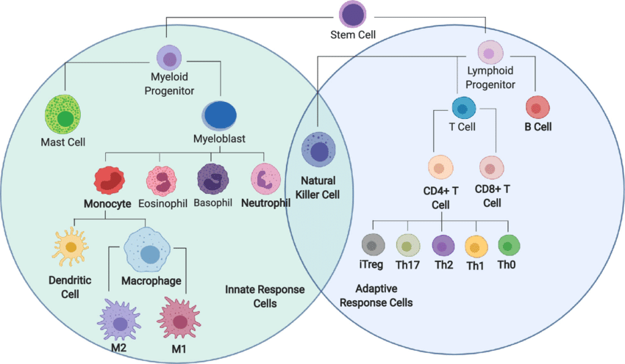
Lineage tree of immune cells
How are cell types defined?
Are the boundaries between cell types so rigid?
Torang, Arezo & Gupta, Paraag & Klinke, David. (2019). An elastic-net logistic regression approach to generate classifiers and gene signatures for types of immune cells and T helper cell subsets. BMC Bioinformatics. 20. 10.1186/s12859-019-2994-z.

