Slide 1
Neural Networks 3
Anders Krogh
Center for Health Data Science
and Department of Computer Science
University of Copenhagen

Slide 2
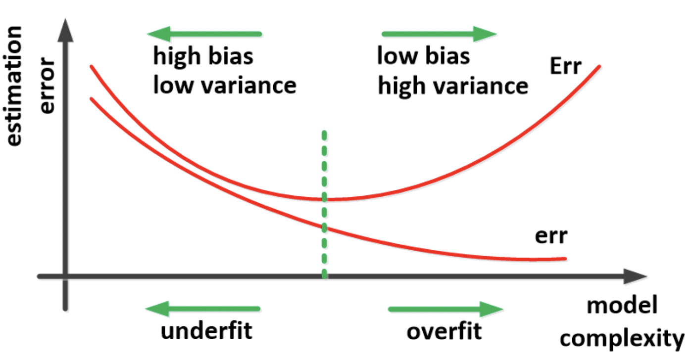
Performance evaluation
Neural networks should be evaluated like other machine learning methods on independent test data
Additional danger with neural networks: Selection of network type/architecture using test set leads to biassed test results
Optimal model
Use validation set for model selection and “early stopping”
Use test set once in the very end of the project
Test error
Train error

Slide 3
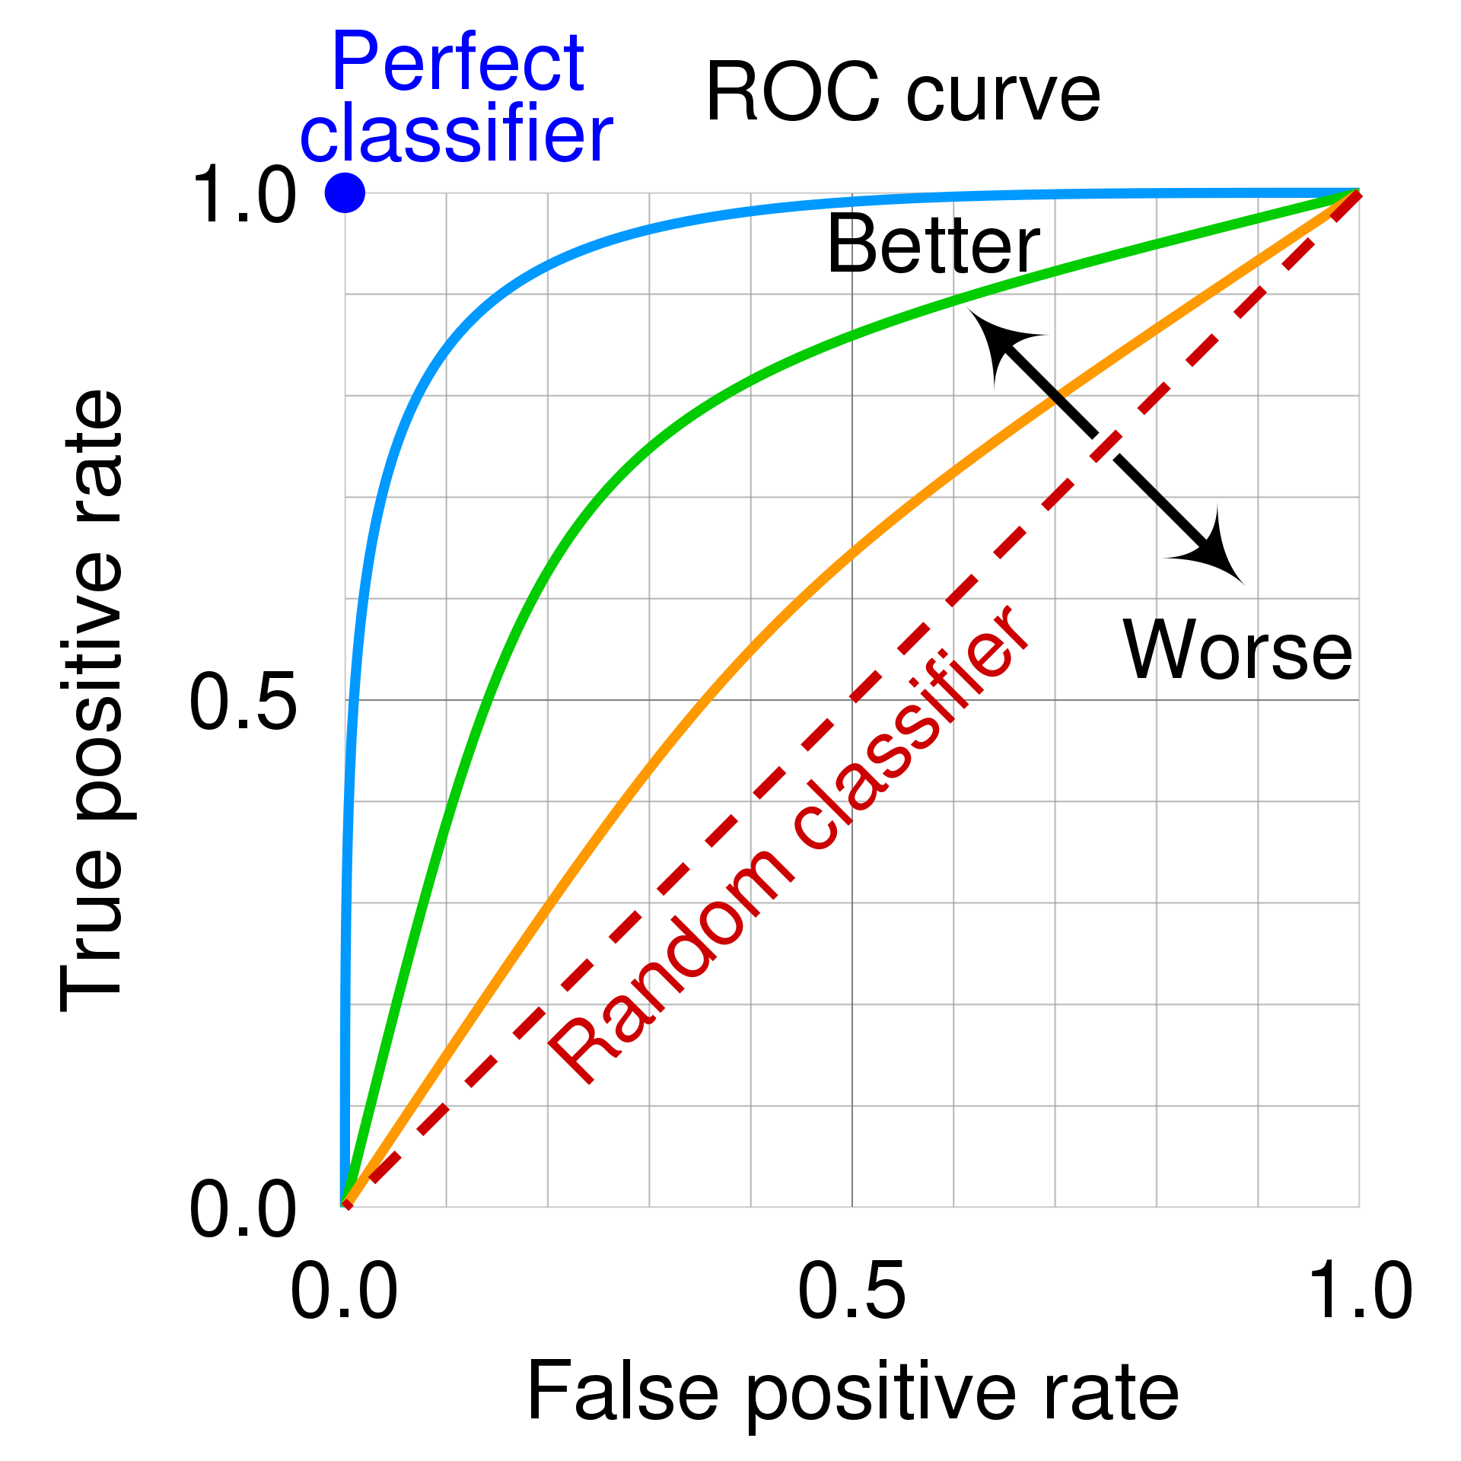
ROC curves for evaluation of classification
To classify you select a cut-off on the output (e.g. 0.5)
You can then calculate accuracy
ROC curves give a performance overview independent of cut-off
AUC: area under the curve is an overall measure of performance that should be >0.5 and <1.
TP = correctly predicted positives (cats)
TP rate = TP/real_positives (fraction correctly predicted cats)
FP = incorrectly predicted as positives
FP rate = FP/real_negatives
Figure from Wikipedia that has a detailed discussion of ROC curves: https://en.wikipedia.org/wiki/Receiver_operating_characteristic

Slide 4
Letters/sequences as input
What if the input DNA or protein sequences – how are they coded?
Use one-hot encoding
AGTCACCACCGCTGGCAAGCCACATGTA
DNA sequence
BAD IDEA!
AGTCACCACCGCTGGCAAGCCACATGTA
1000100100000000110001010001
0001011011010001000110100000
0100000000100110001000000100
0010000000001000000000001010
Just number letters
1342122122324332113221214341
2D tensor
Make 1D tensor (flatten)
10000010100001001000010001001000010001000010010000010010…
A G T C A C C A C C G C T G …

Slide 5
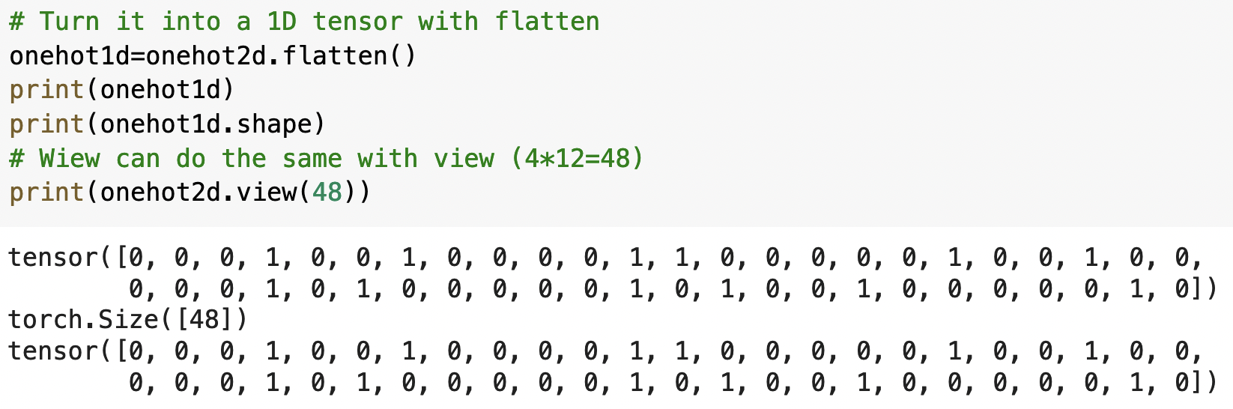
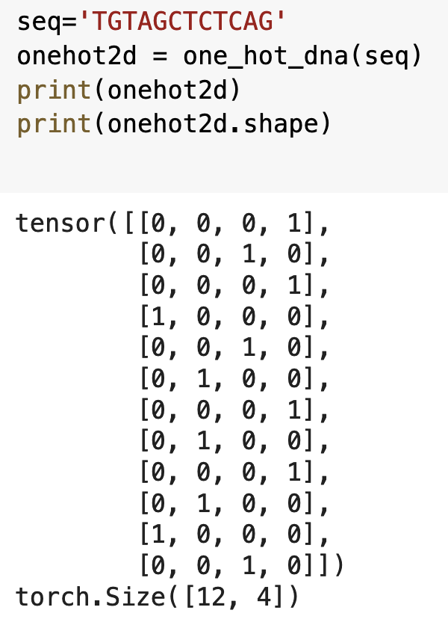
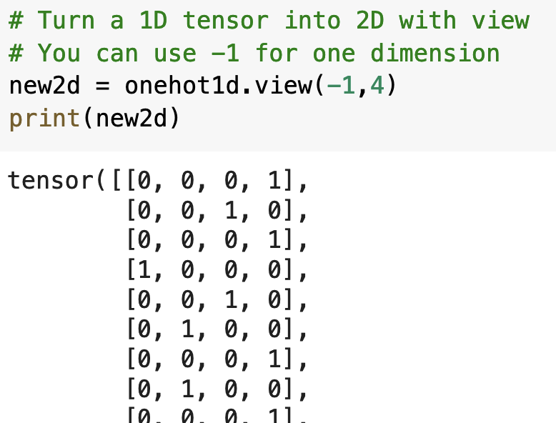
One-hot tensor magic
The method view() can change the shape of a tensor.
A dimension with -1 will be filled to fit the remaining dimensions

Slide 6
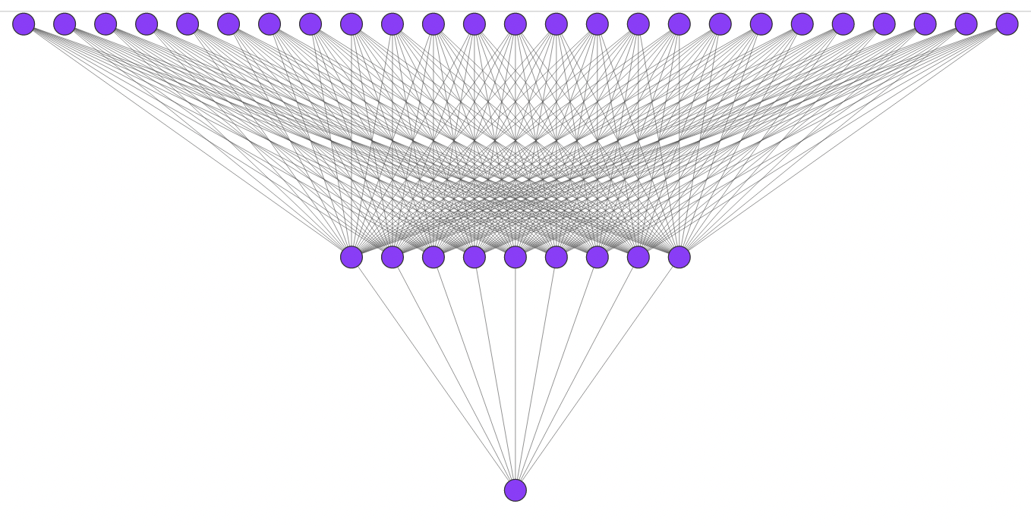
Convolution
AGTCACCACCGCTGGCAAGCCACATGTA
1000100100000000110001010001
0001011011010001000110100000
0100000000100110001000000100
0010000000001000000000001010
Convolution is used when data are ordered like
Letters in a sequence
Words in a sentence
Pixels in an image
Cannot be used for gene expression values
Weights are the same in all copies
This illustrates one channel
You can have many channels
The kernel size is the input geometry for the convolution.
In the illustration the kerne size is (5,4)
Stride is the number of inputs you skip. stride=1 here.
Padding can be used to add zeros to each side of the sequence. padding=0 here.

Slide 7
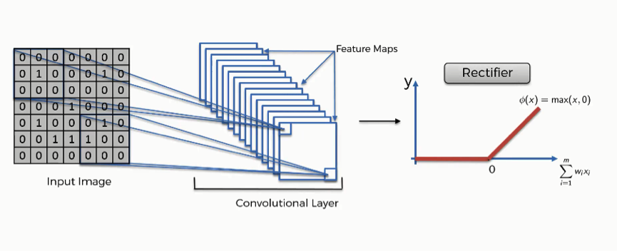
Convolution for images
Follow the same recipe
Image from
https://www.superdatascience.com/blogs/the-ultimate-guide-to-convolutional-neural-networks-cnn

Slide 8
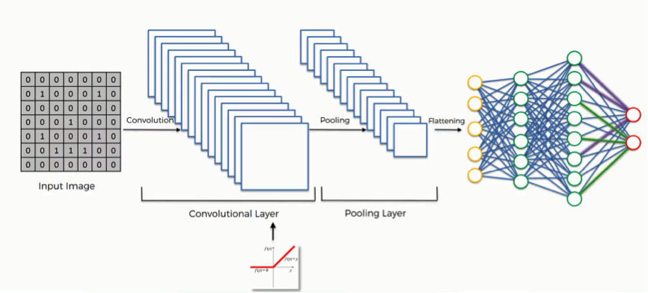
Convolution for images
Image from
https://www.superdatascience.com/blogs/the-ultimate-guide-to-convolutional-neural-networks-cnn

Slide 9
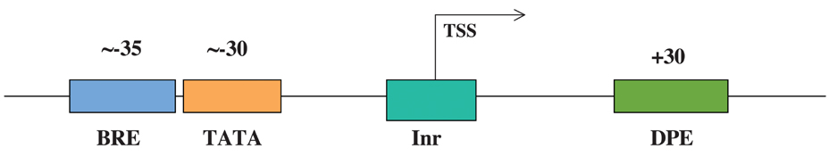
Exercise with human core promoters
The core promoter is the region around the transcription start site (TSS)
BRE: “B recognition element”
GGGGCGCC
CCAGCGCC
TATA box
TATAA
Initiation signal
Downstream promoter elements
In the exercise we will try to predict the TSS from the DNA sequence around it
figure from Roy A.L. (2005) Core Promoters. In: Encyclopedic Reference of Genomics and Proteomics in Molecular Medicine. Springer, Berlin, Heidelberg . https://doi.org/10.1007/3-540-29623-9_2210

Slide 10
Predict TSS from DNA
Select a window around TSS to use for prediction
TSS
20 bp before
10 bp after
AACCGATTACGTGCTTAAGCTTCTGAACCTAAGAGGATGCTATGGGAAACACATCGATACAAACGCAGAGTTACCG
0
1
We use one-hot encoding
Negative examples are randomly sampled from +/- 1000 bases around TSS
You can compare convolution and fully connected networks

