Slide 1
Neural Networks 2
Anders Krogh
Center for Health Data Science
University of Copenhagen

Slide 2
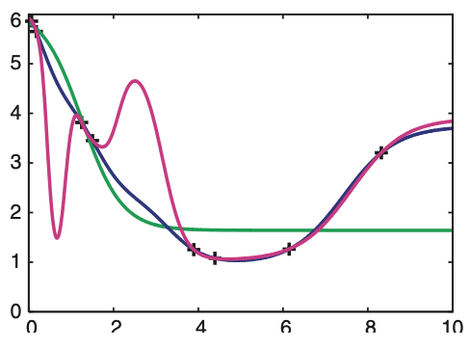
Over-fitting and generalization
Many parameters and few training data leads to over-fitting
If it over-fits, the network cannot generalize
To generalize means to be able to predict on unseen (test) data
+
training set
1 hidden unit
10 hidden
20 hidden
over-fitting
“under-fitting”
From A Krogh (2008) Nat. Biotech. 26, p. 195

Slide 3
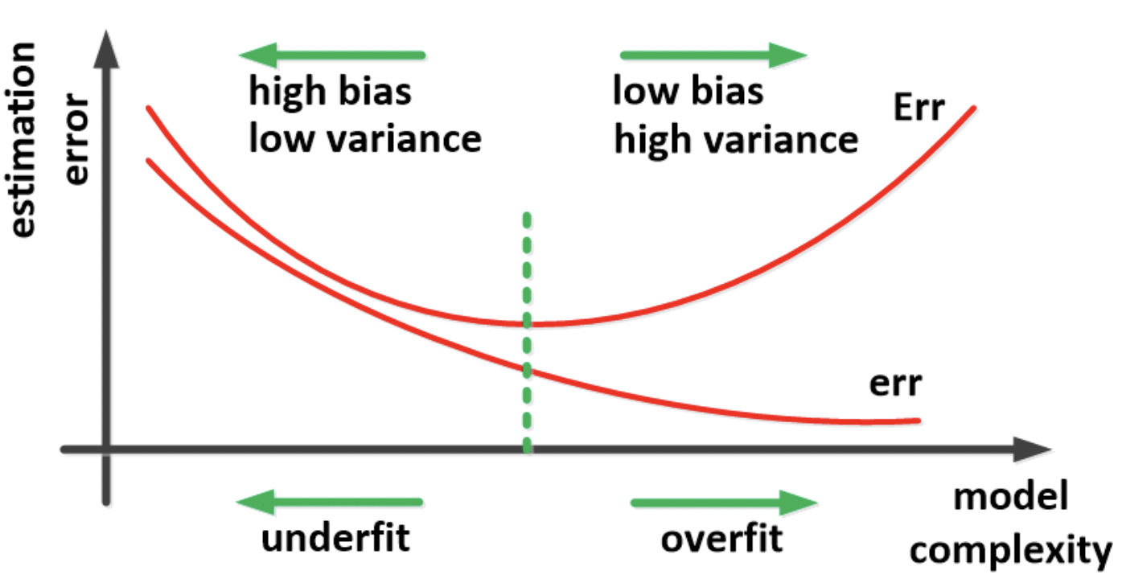
Over-fitting and generalization
Optimal model
Test error
Train error
Figure adapted from Ghojogh & Crowley (2019). https://arxiv.org/abs/1905.12787

Slide 4
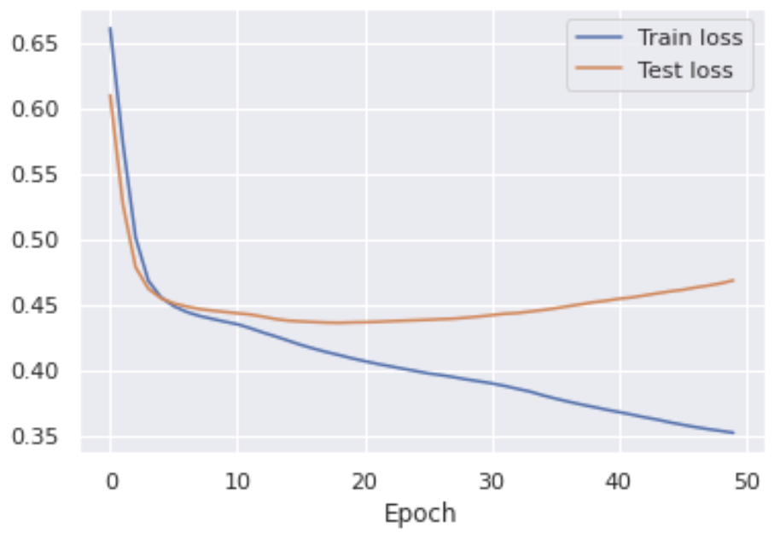
Over-fitting
Sign of over-fitting:
Test error starts to grow while training error decreases
The network size can be decreased if it over-fits (e.g. fewer hidden units)
Alternatively, a weight decay can mitigate over-fitting
Weight decay: a term $λw$ is subtracted from a weight $w$ in each iteration. $λ$ is normally small, 10⁻² to 10⁻⁶

Slide 5
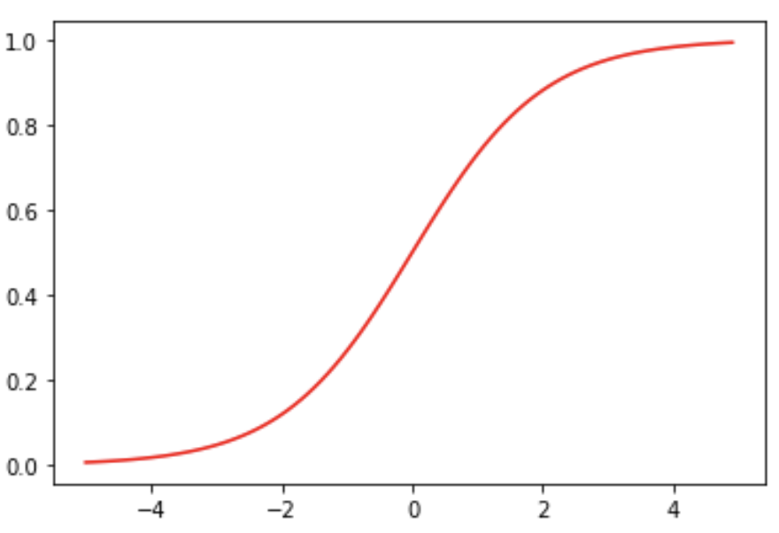
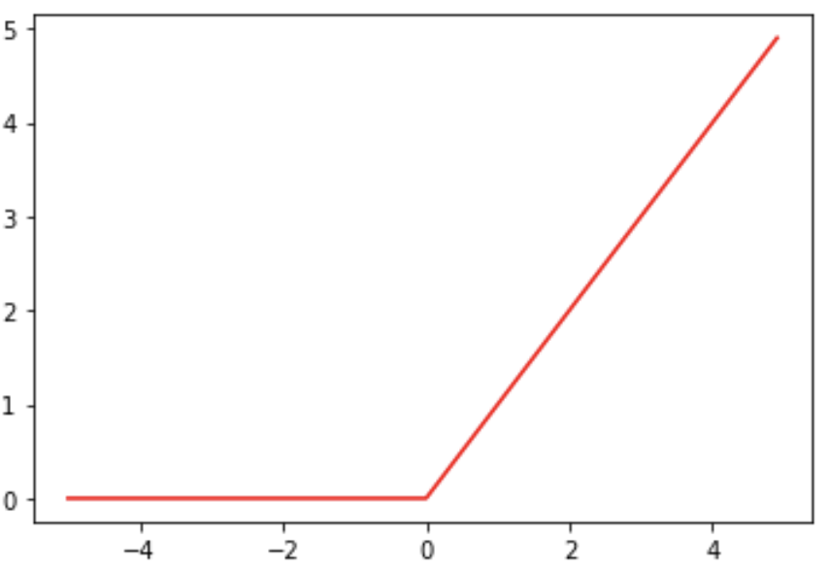
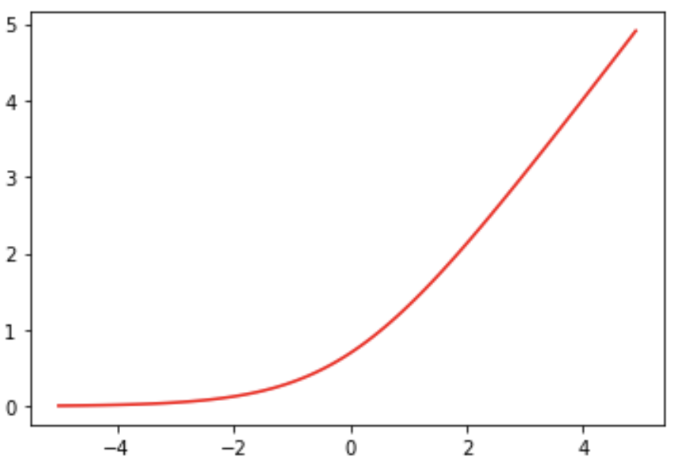

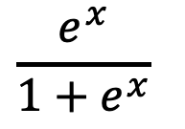
Activation functions
Sigmoid is mostly
used to output probabilities
ReLU: Rectified Linear Unit
Often used for hidden
units
$$\frac{e^{x}}{1+e^{x}}$$
Softplus
is a smooth replacement for ReLU
$$\frac{1}{β}log{(1+e^{βx})}$$

Slide 6
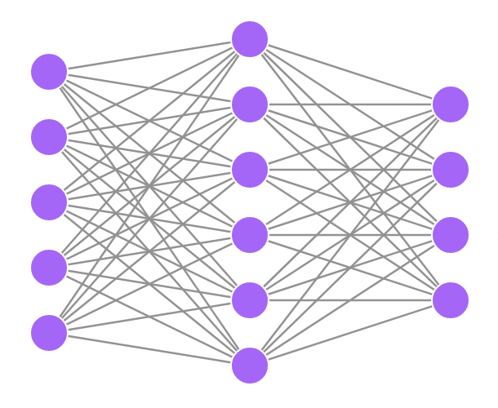
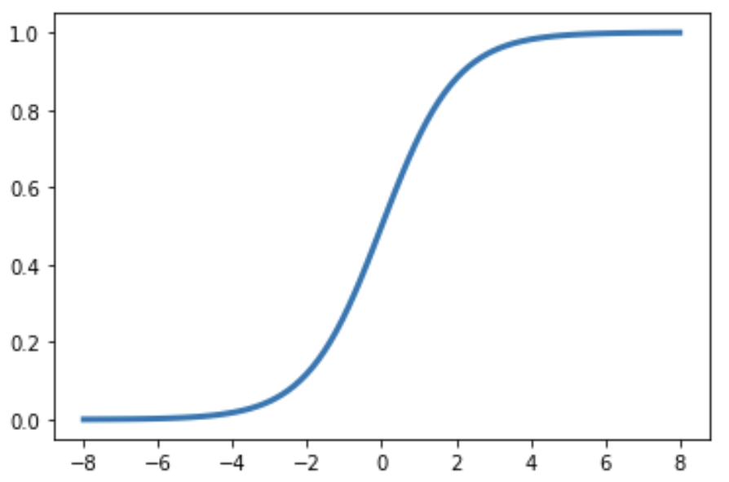




What if we have multiple classes?
Sigmoid for two classes
Output
class
1
P(class 1)
2
Input
3
P(class 0) = 1–P(class 1)
4
We would like the network to output the probability of each class
Neural net drawing made at http://alexlenail.me/NN-SVG/index.html

Slide 7

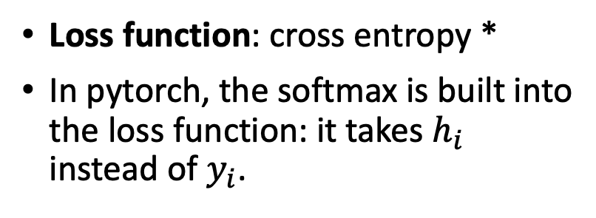
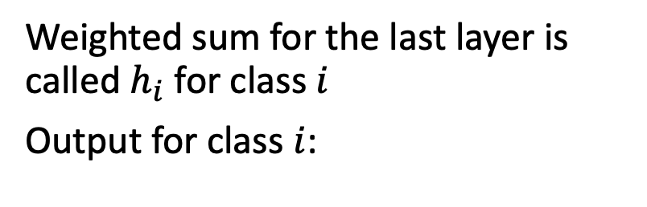


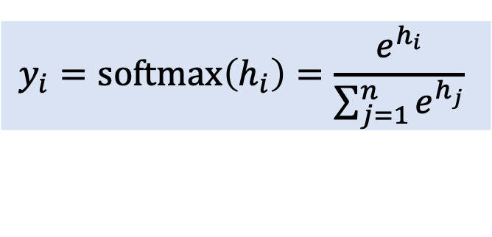





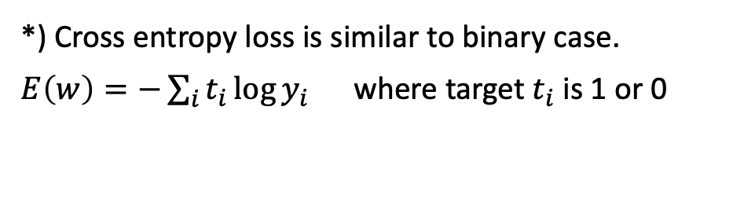
Multiple classes: Softmax
Use the softmax function to ensure probabilities sum to one
Weighted sum for the last layer is called $h_{i}$ for class $i$
Output for class $i$:
Output
class
$$y_{i}=softmax\left(h_{i}\right)=\frac{e^{h_{i}}}{\sum_{j=1}^{n}{e^{h_{j}}}}$$
$h_{1}$
1
$$y_{1}$$
$h_{2}$
2
$$y_{2}$$
Loss function: cross entropy *
In pytorch, the softmax is built into the loss function: it takes $h_{i}$ instead of $y_{i}$.
Input
$h_{3}$
3
$$y_{3}$$
$h_{4}$
4
$$y_{4}$$
*) Cross entropy loss is similar to binary case.
$E\left(w\right)=−\sum_{i}{t_{i}\log{y_{i}}}$ where target $t_{i}$ is 1 or 0

Slide 8
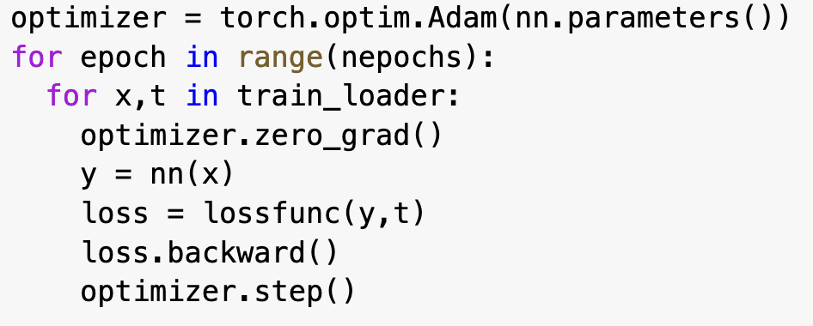
The optimizer
Example of code using the Adam optimizer:
In plain stochastic gradient descent (torch.optim.SGD) you need to set parameters (learning rate and momentum)
The Adam optimizer is usually a better choice
It automatically adapts the learning rate and momentum in clever ways
It is based on SGD and uses mini-batches
you can set a weight decay
You can set parameters in Adam, such as
learning rate (e.g. “lr=1.e-4”)
“weight_decay=1.e-5”

Slide 9
All the choices you have to make …
There are many parameters you can vary in a Neural Network.
It is a good idea to make an initial “grid search” where you systematically test performance by varying
the number of hidden layers and their size
other parameters one by one
This is sometimes done on a reduced data set and or with quite few iterations

Slide 10
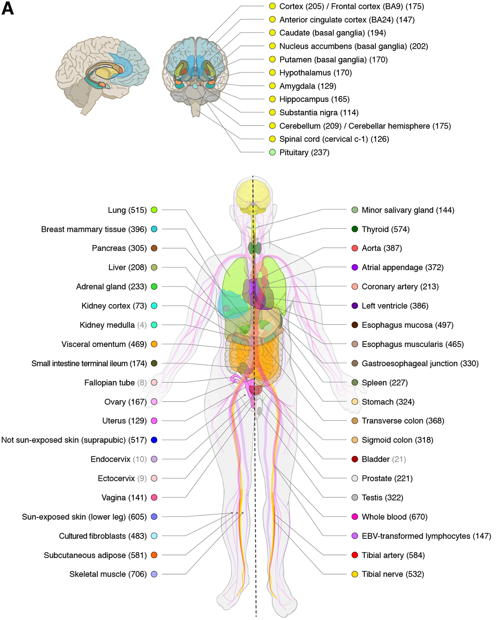
Exercise with gene expression data
RNA-seq is a great use-case for Machine Learning algorithms:
High dimensional data
Many cellular pathways are highly correlated
Tissue specific
Big datasets available (GTex)
The exercise:
Can a neural network capture the information encoded on gene expression and detect tissues?
In the exercise we will build a neural network that learns the gene expression profile and is able to guess the tissue of origin
Figure adapted from the Gtex Consortium (2020). https://pubmed.ncbi.nlm.nih.gov/32913098/

