Slide 1
Introduction to machine learning in biomedical research - Part A*
*) There is no part B this year

Slide 2
Course on Github
https://github.com/Center-for-Health-Data-Science/IntroToML
Note that it will change during the course

Slide 3
Machine learning is a very broad topic
We will cover the basics
PCA, logistic regression, and other standard methods
Basics of neural networks (feed-forward)
The course is very practical:
Many exercises/practicals
The last two days consists of project work
After the course you can do basic machine learning in python

Slide 4
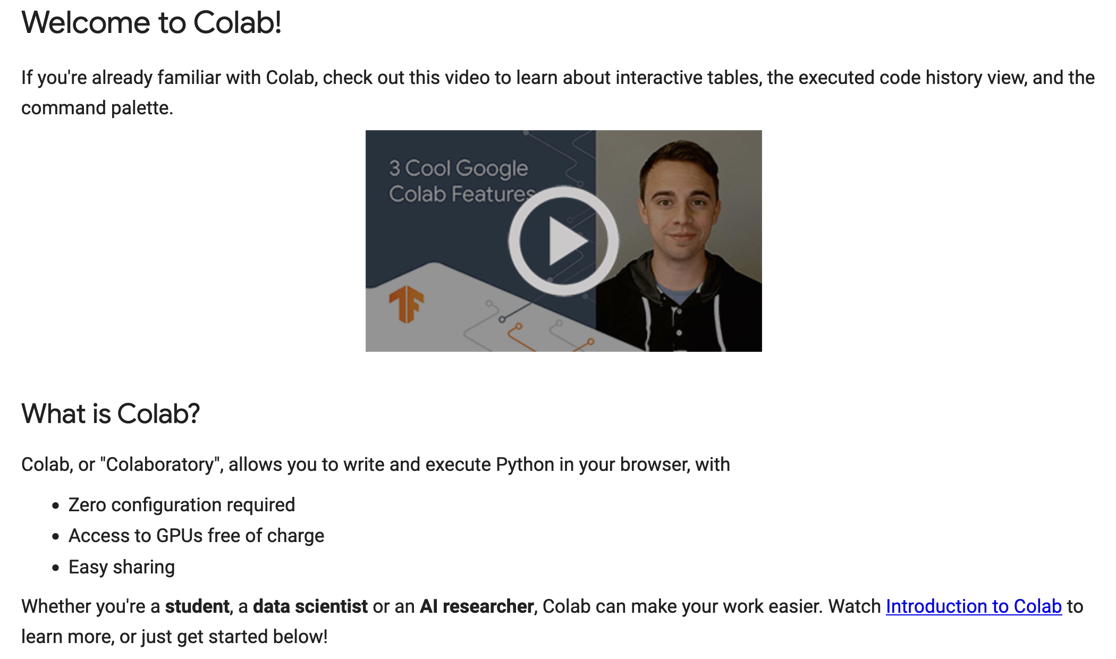
We are using Google Colaboratory: colab.research.google.com
You can also run on your own computer (jupyter notebooks)

Slide 5
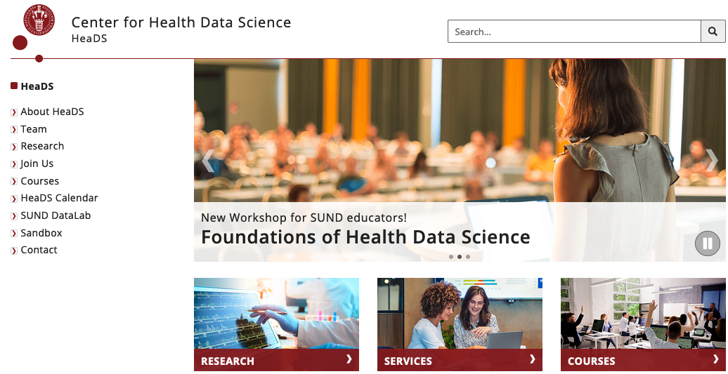
heads.ku.dk

Slide 6
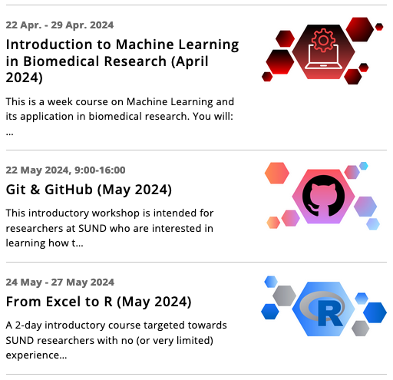
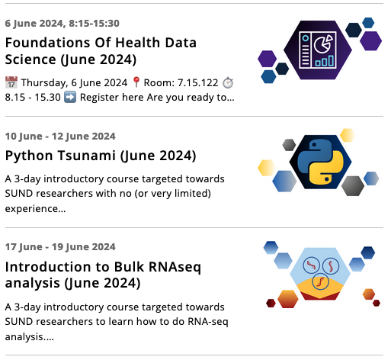
Courses

Slide 7
Enjoy the course!

